Slide 1
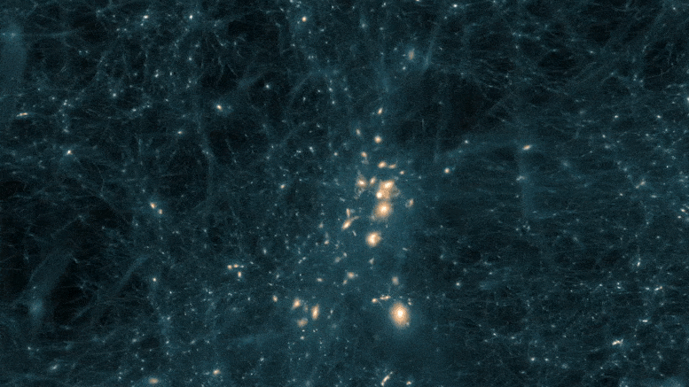
The Cosmological Lithium Problem
Young Researchers and Engineers days 2025
Direct measurement and study of the ⁶Li(p,α)³He reaction
Scientific Advisers: CS II Catalin MATEI, PhD Teodora (Petruse) Madgearu, PhD
Speaker: Ana LUPOAE

Slide 2

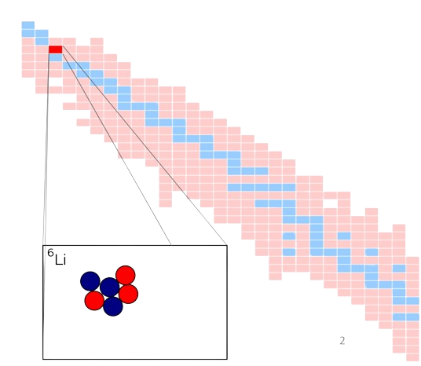
Overview
Measurement motivation: The Cosmological Lithium Problem
Detection set-up
The experiment
Results and conclusion

Slide 3
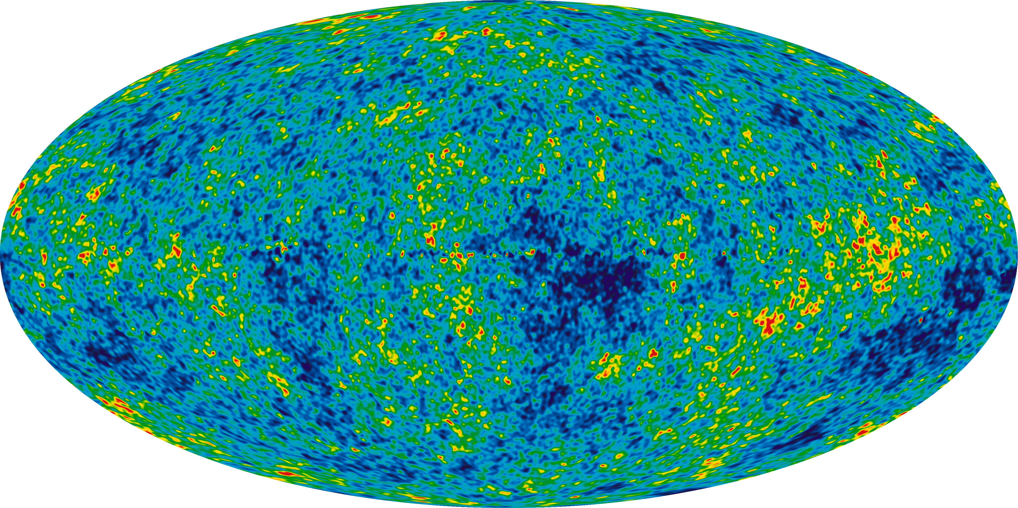
⁶Li(p,α)³He

Slide 4
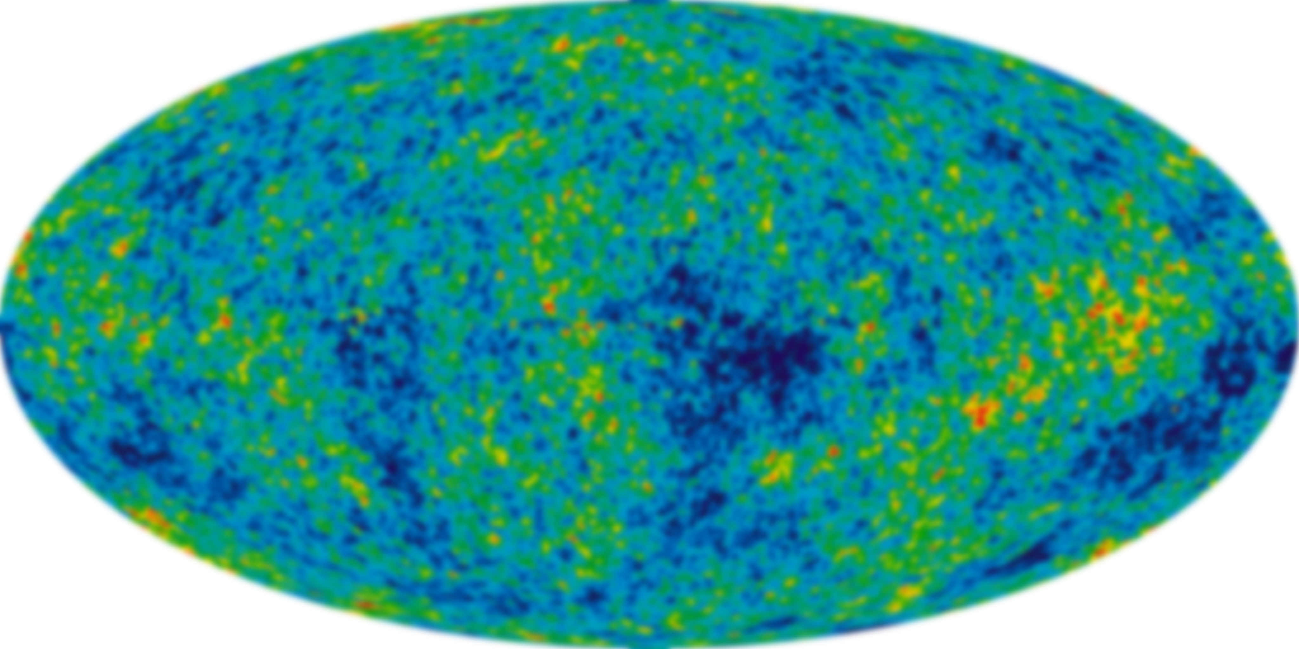
⁶Li(p,α)³He
Measurement motivation: The Cosmological Lithium Problem
Measurement motivation: The Cosmological Lithium Problem

Slide 5
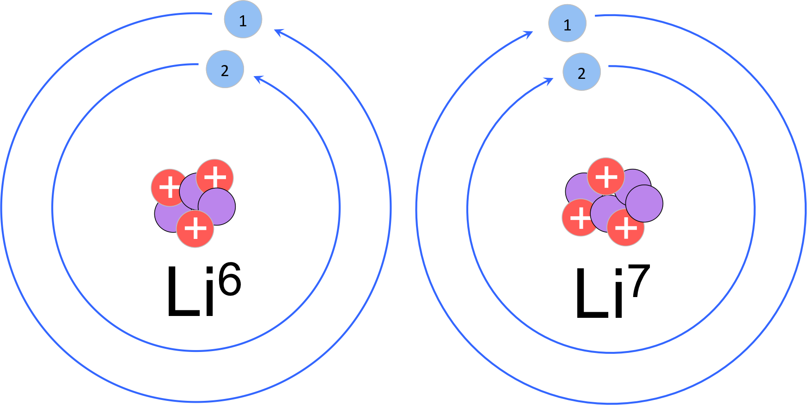
Which Li problem?
⁶Li(p,α)³He
More light lithium in old stars than predicted by BBN?
Less lithium-7 in old stars than predicted?

Slide 6
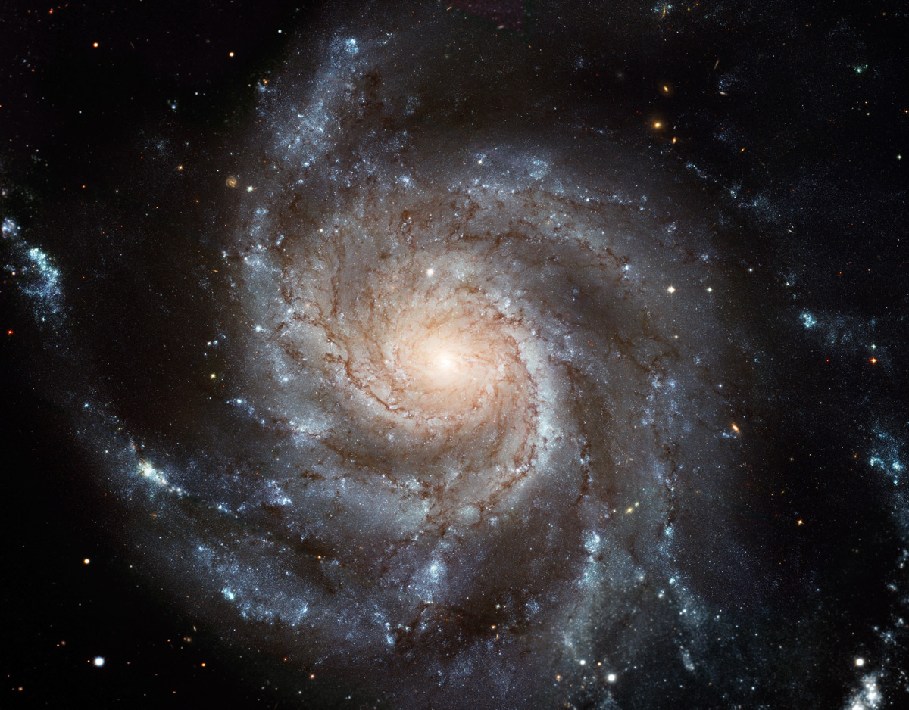
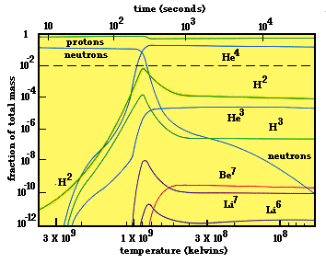
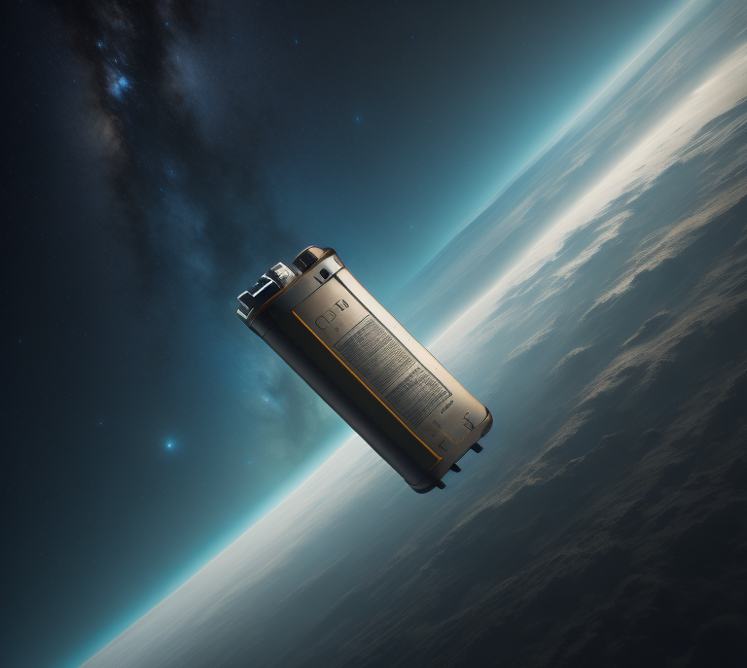

⁶Li(p,α)³He
galaxy formation
Big Bang
.
9 Gyr
380 000 yr
0
3 min
200 Myr
13.7 Gyr
Cosmic Microwave Background

Slide 7
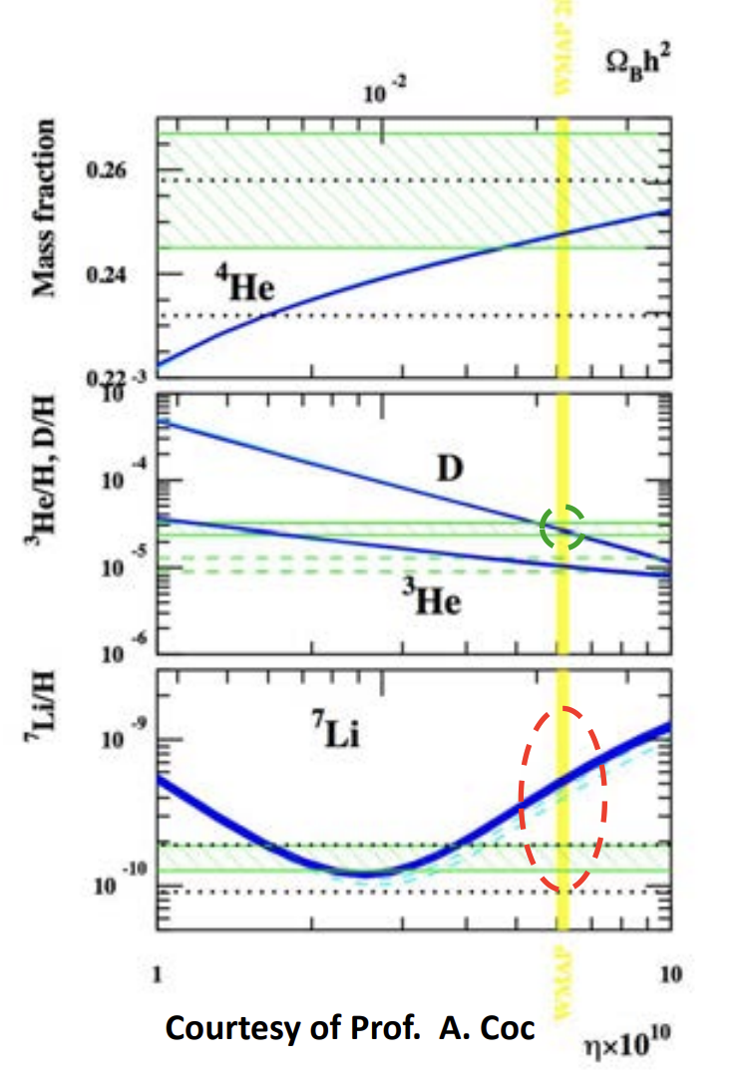
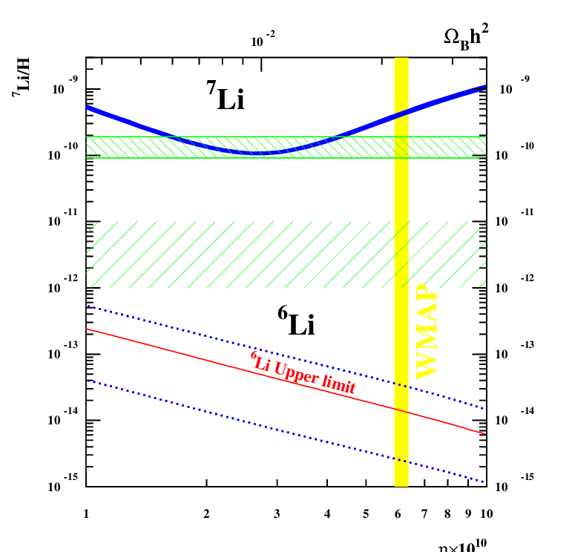

⁶Li(p,α)³He
How do we approach this problem?
Astrophysical solutions
Nuclear physics
Solutions beyond the Standard Model
^{6,7}Li abundance as a function of the baryonic density of the Universe.
F. Hammache et al.

Slide 8
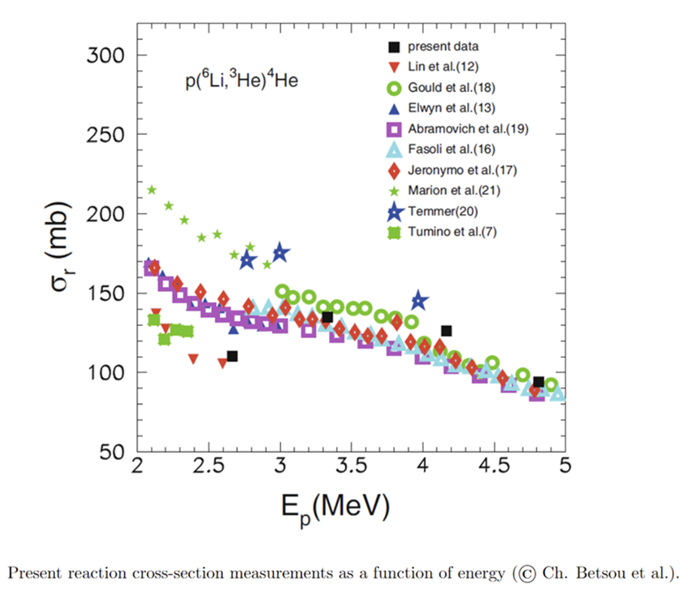
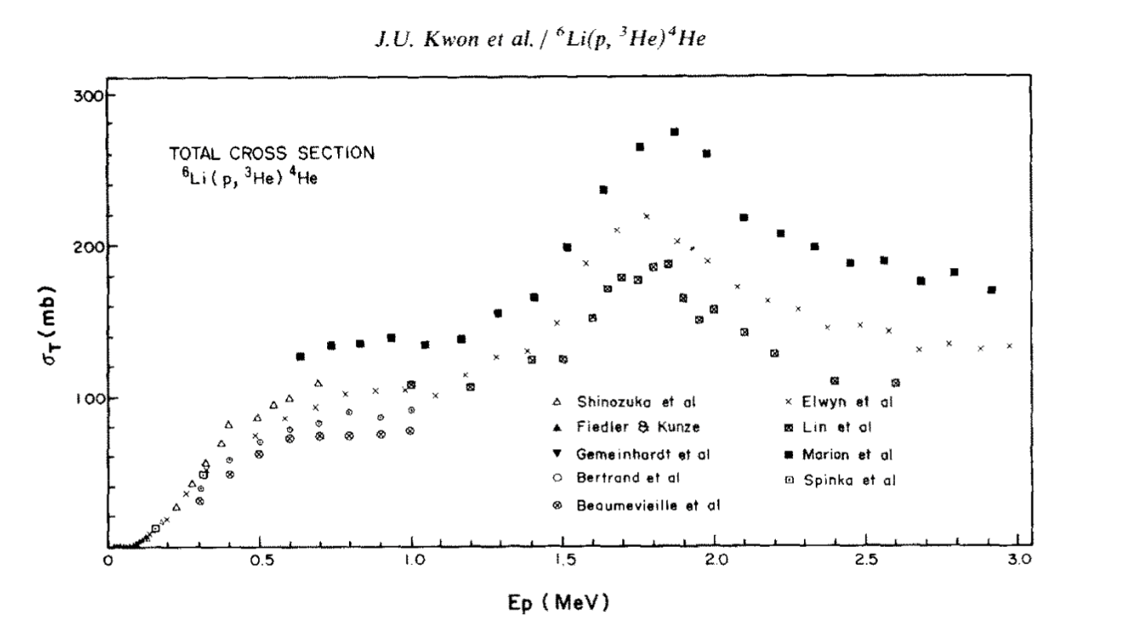
⁶Li(p,α)³He
Discrepancies arise below Ep = 3MeV

Slide 9
⁶Li(p,α)³He

Slide 10
⁶Li(p,α)³He
Measurement motivation: The Cosmological Lithium Problem
Detection set-up

Slide 11
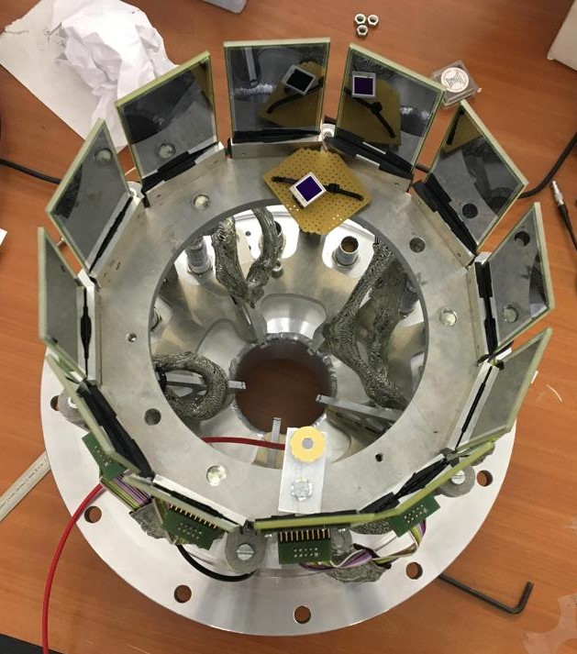
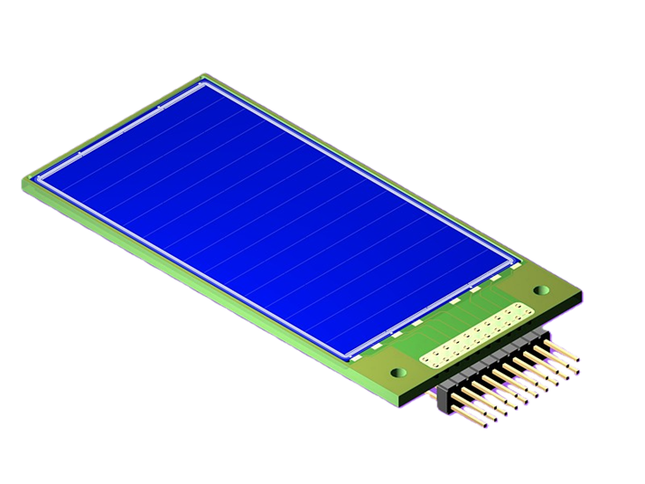
⁶Li(p,α)³He
Position sensitive silicon strip X3 detector

Slide 12
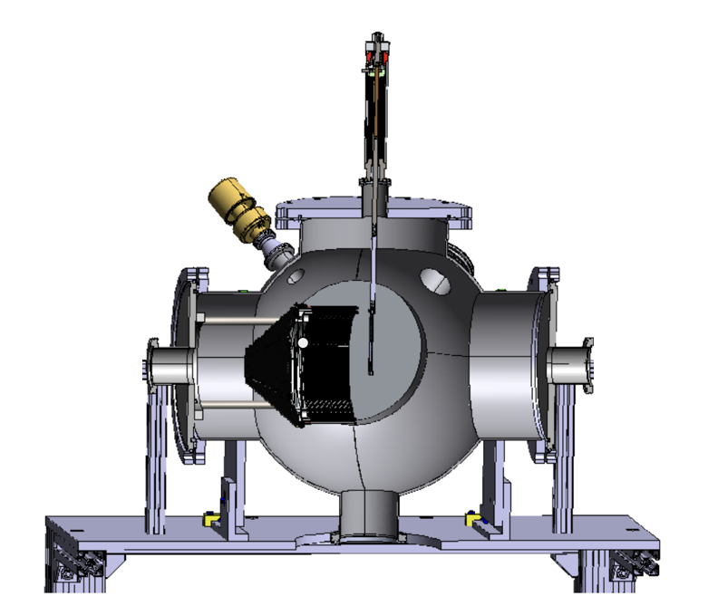
⁶Li(p,α)³He
ELISSA Chamber
Extreme Light Infrastructure Silicon Strip Array

Slide 13
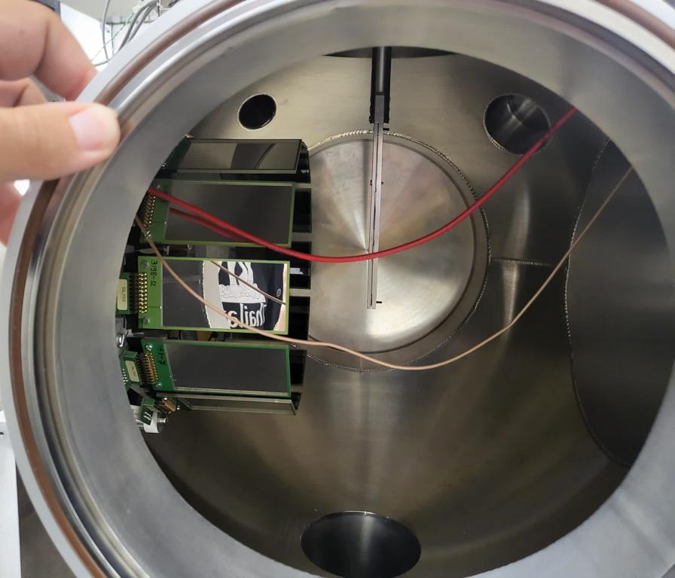
⁶Li(p,α)³He
12 X3 silicon detectors ring

Slide 14
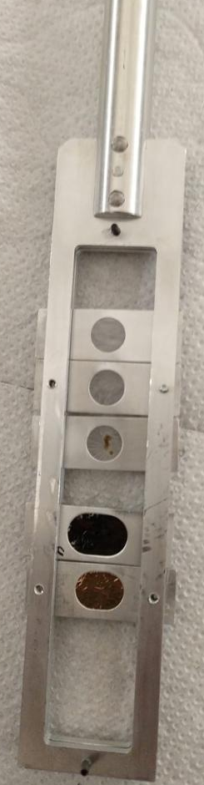
⁶Li(p,α)³He
Target ladder
12 X3 silicon detectors ring
CH₂ 50-70 ug/cm²

Slide 15
⁶Li(p,α)³He
Target ladder
12 X3 silicon detectors ring
Photodiode
Used to monitor the number of particles in the target

Slide 16
⁶Li(p,α)³He
Target ladder
12 X3 silicon detectors ring
⁶Li beam
Photodiode
1 - 9 MeV

Slide 17
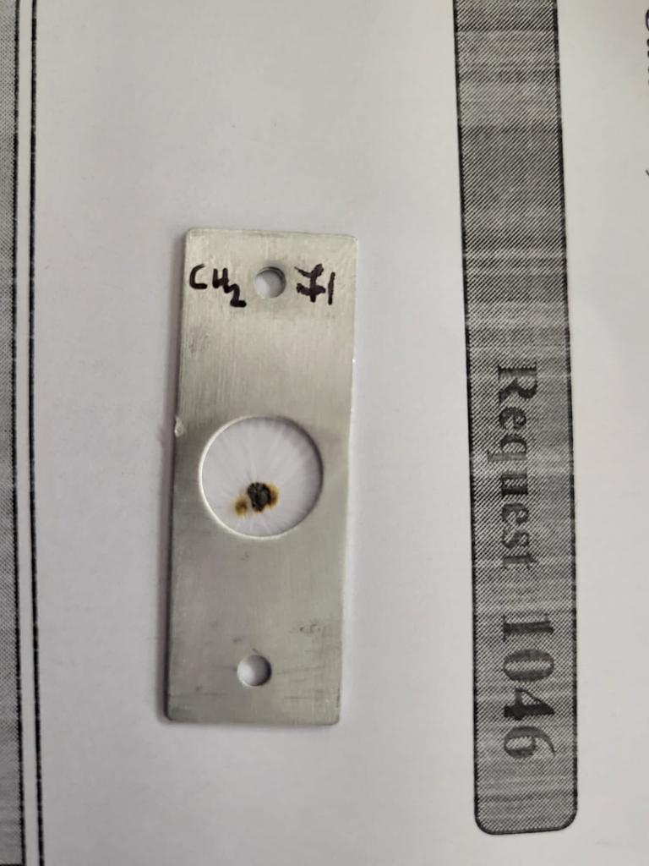
⁶Li(p,α)³He
Target ladder
12 X3 silicon detectors ring
⁶Li beam
Photodiode
1 - 9 MeV

Slide 18
⁶Li(p,α)³He

Slide 19
⁶Li(p,α)³He
Measurement motivation: The Cosmological Lithium Problem
The experiment – IFIN-HH 3MV Tandetron

Slide 20
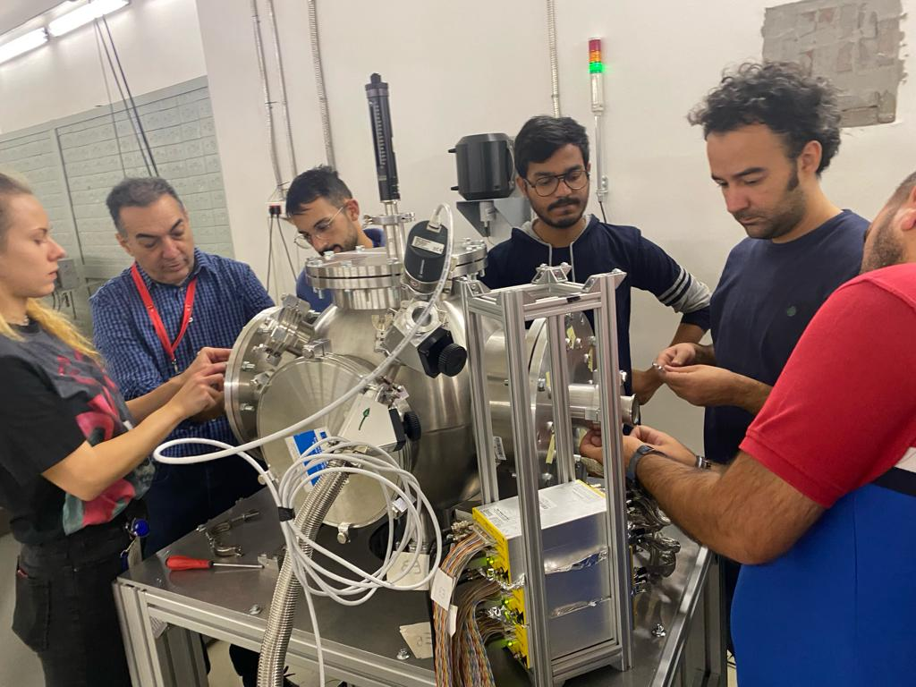
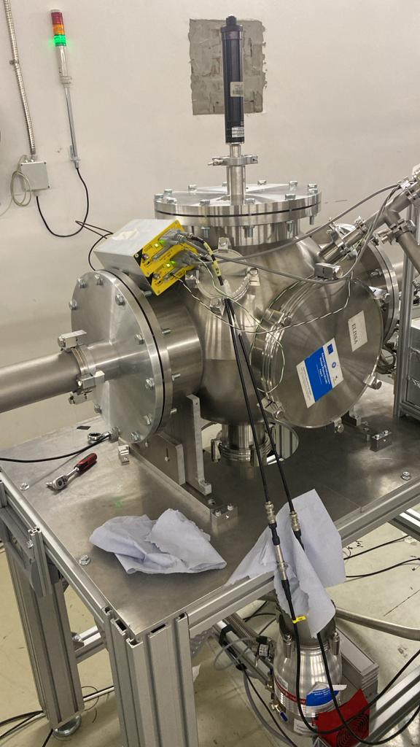
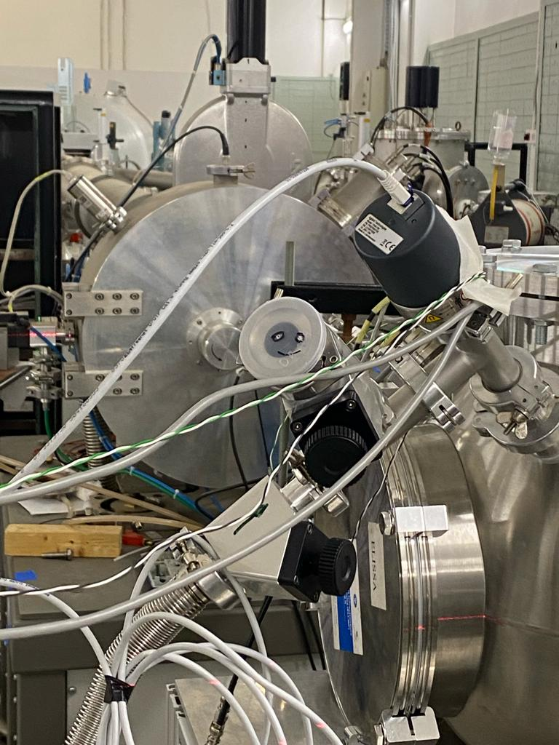
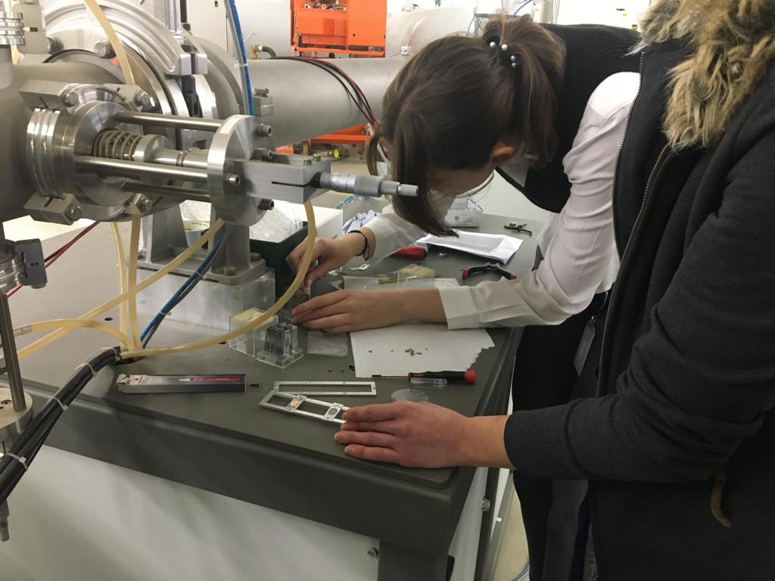
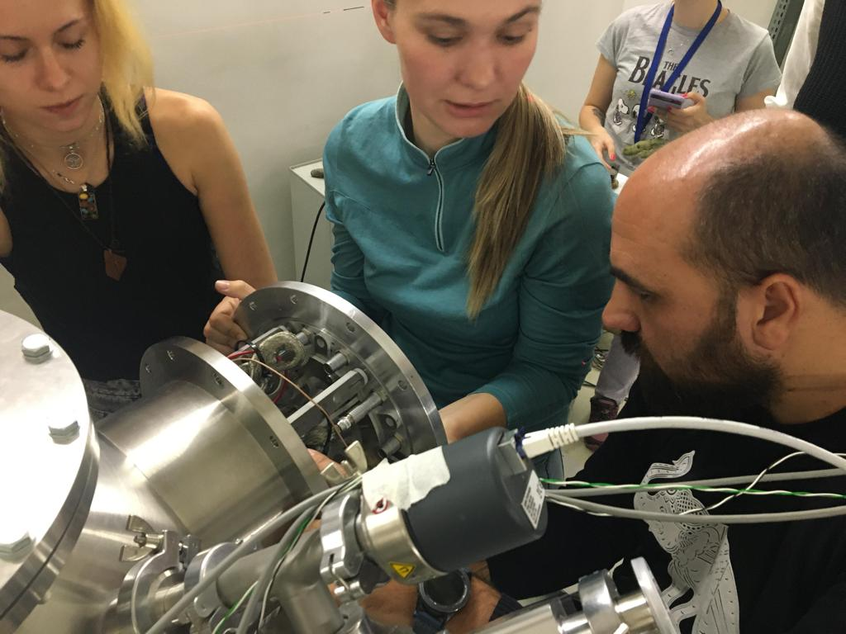
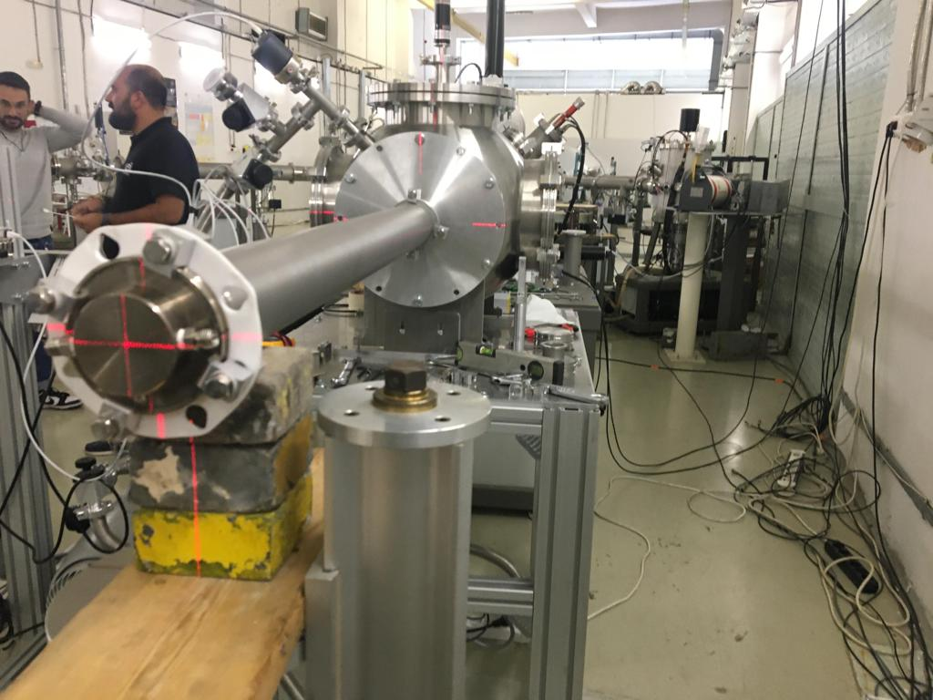
⁶Li(p,α)³He
me !!

Slide 21
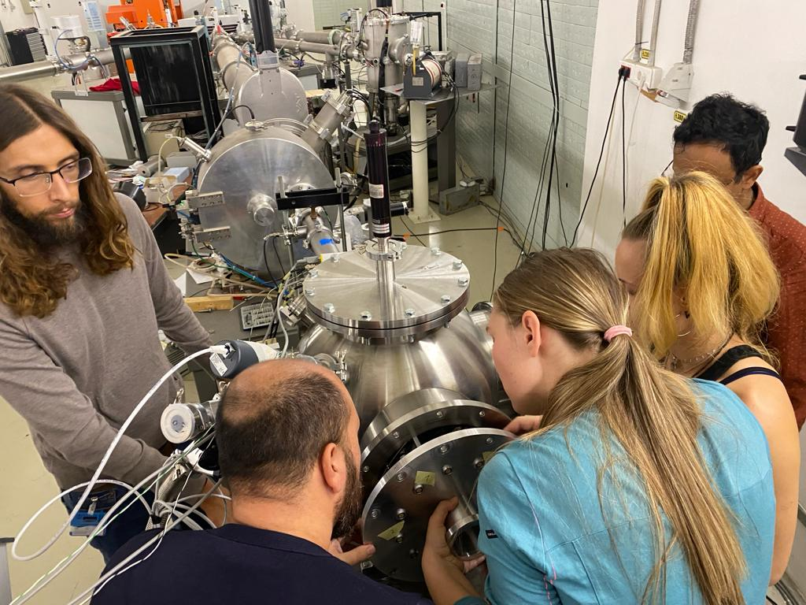
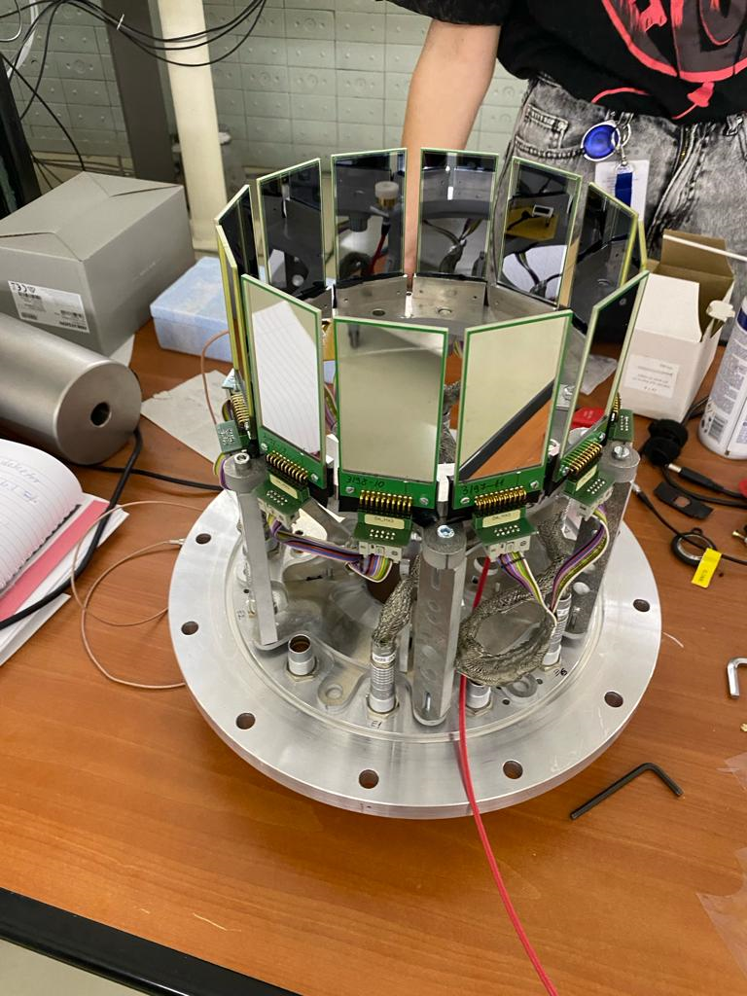
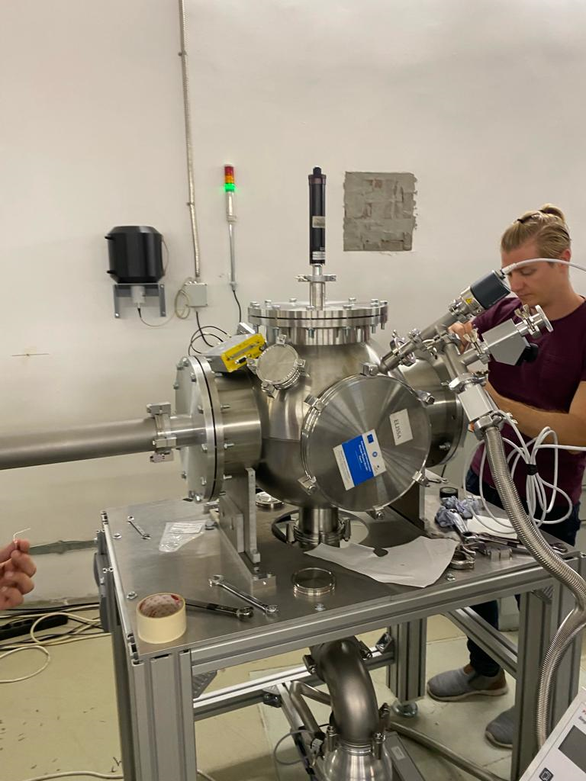
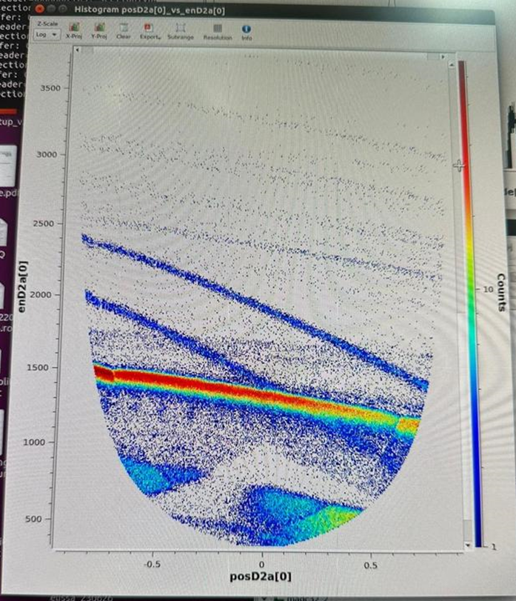
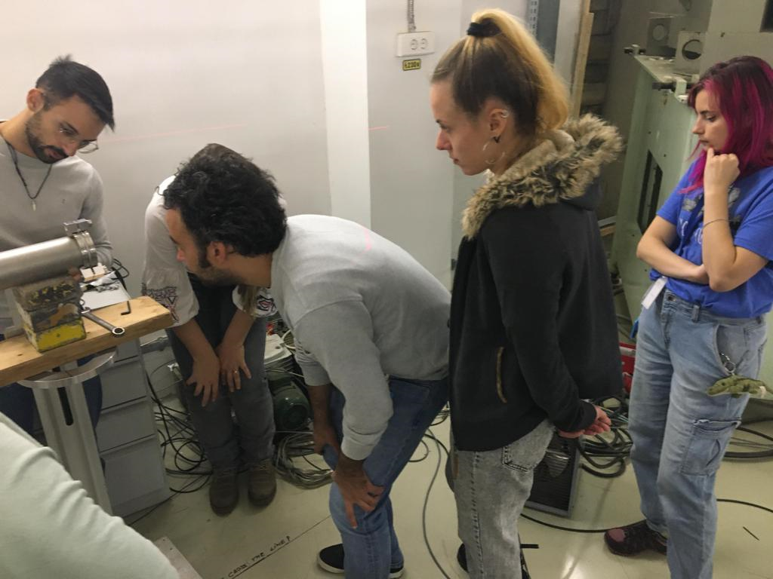
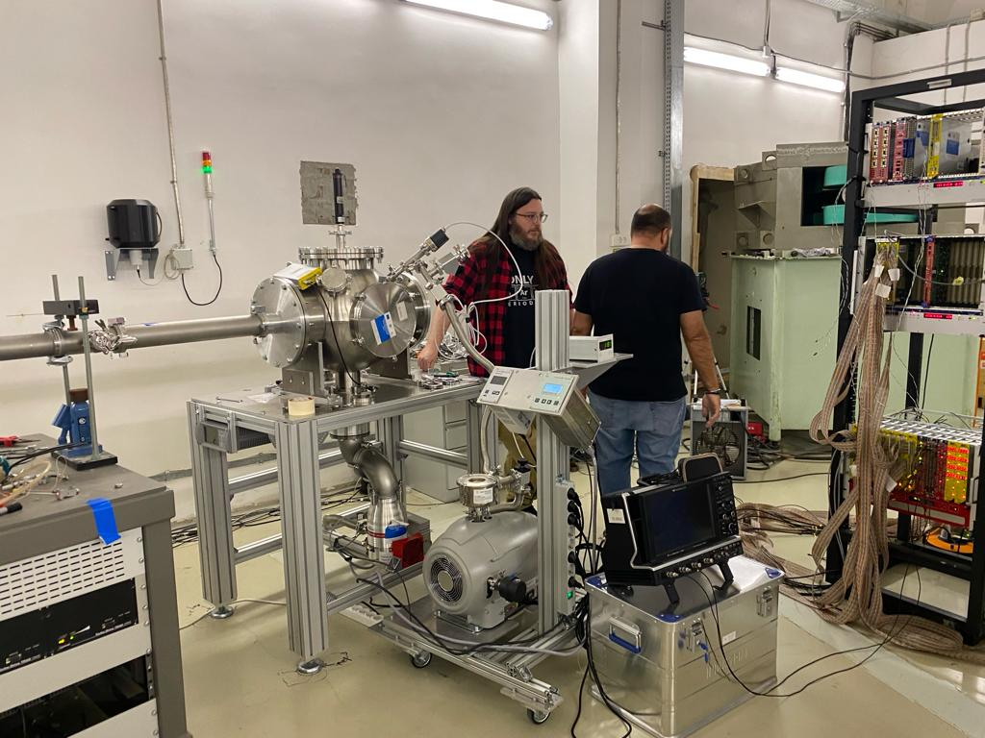

Slide 22
⁶Li(p,α)³He

Slide 23
⁶Li(p,α)³He
Measurement motivation: The Cosmological Lithium Problem
Results and conclusion

Slide 24
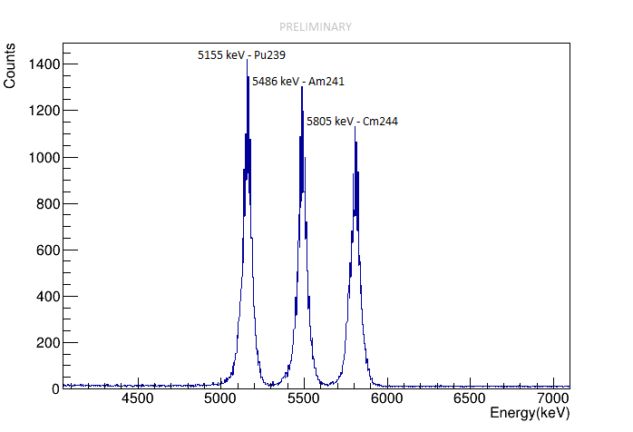
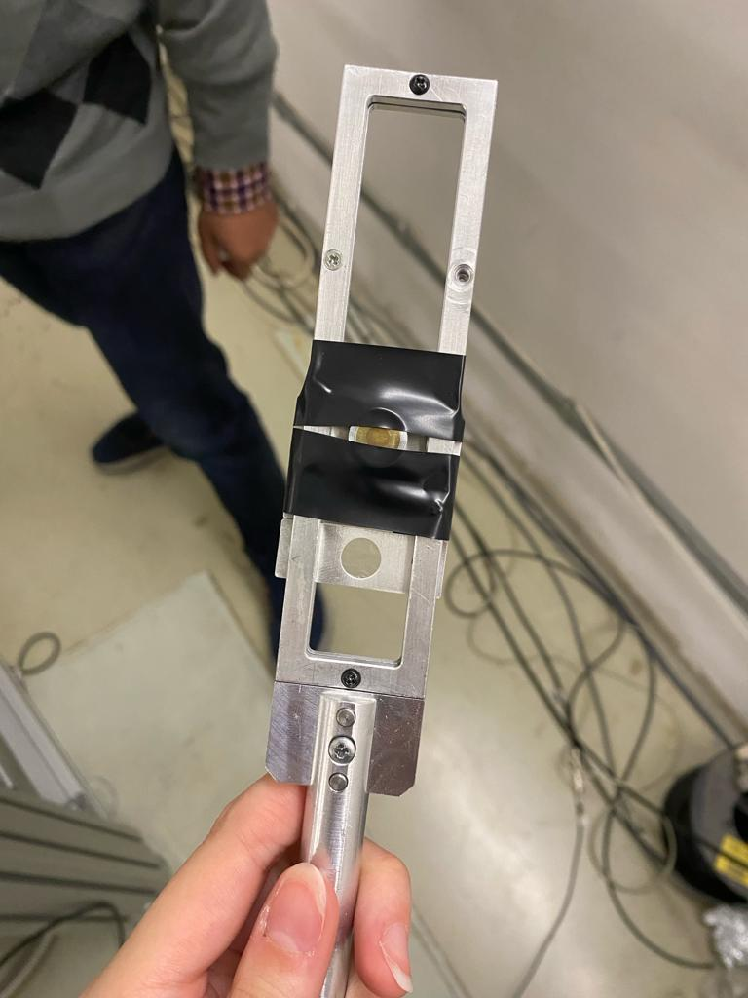
⁶Li(p,α)³He
CALIBRATION PROCEDURE
₊
Magic wand
(triple alpha source)

Slide 25
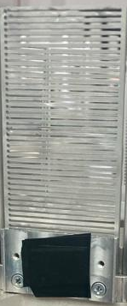
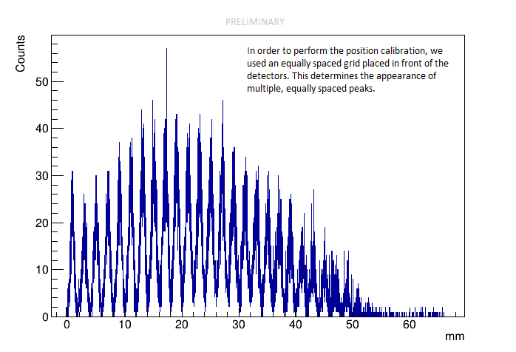
⁶Li(p,α)³He
CALIBRATION PROCEDURE
equally spaced grid
₊
Magic wand
(triple alpha source)

Slide 26
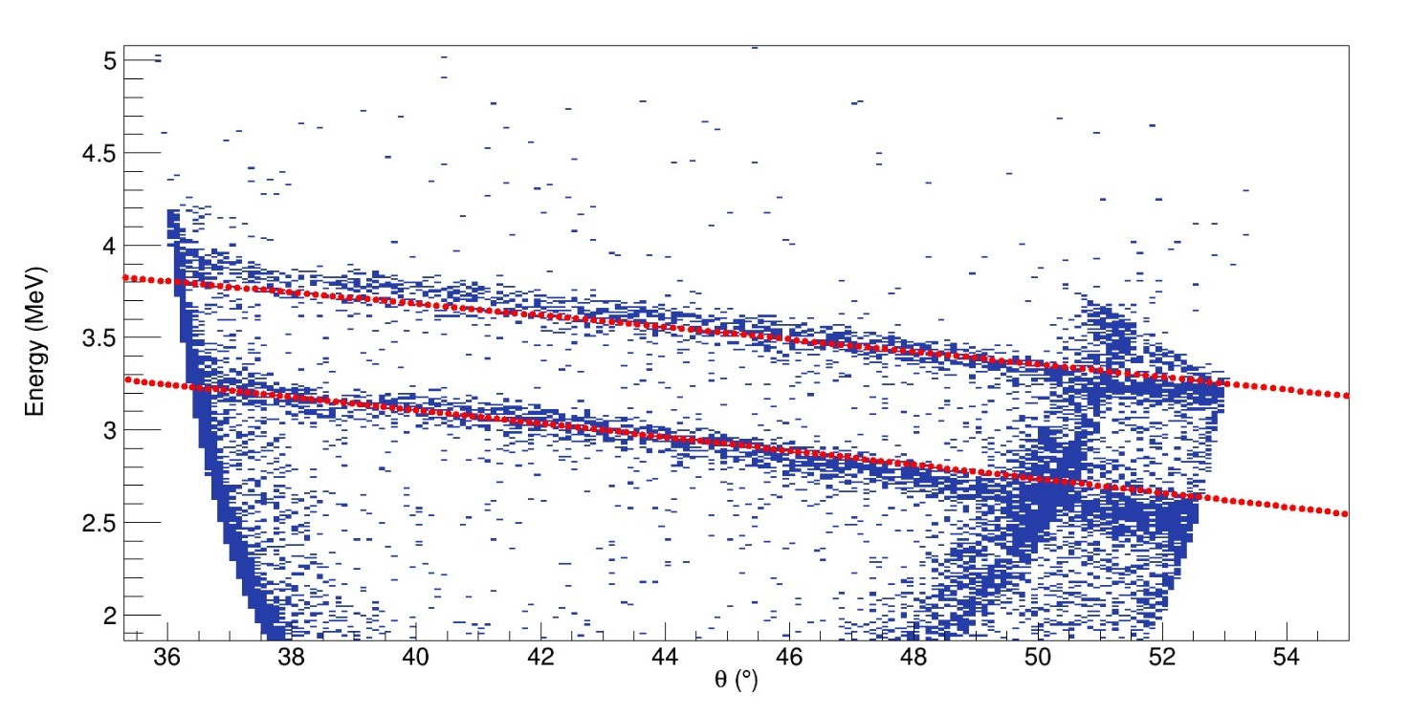
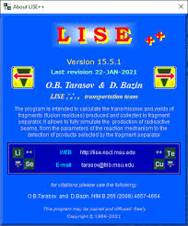
Results
Energy vs. position histogram displaying the reaction products, ³He and ⁴He, at a 1 MeV beam energy (150 kev in the center of mass system)
³He
⁴He
LISE++

Slide 27
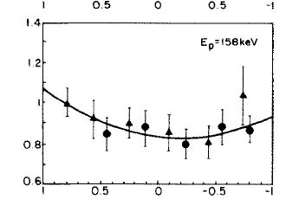
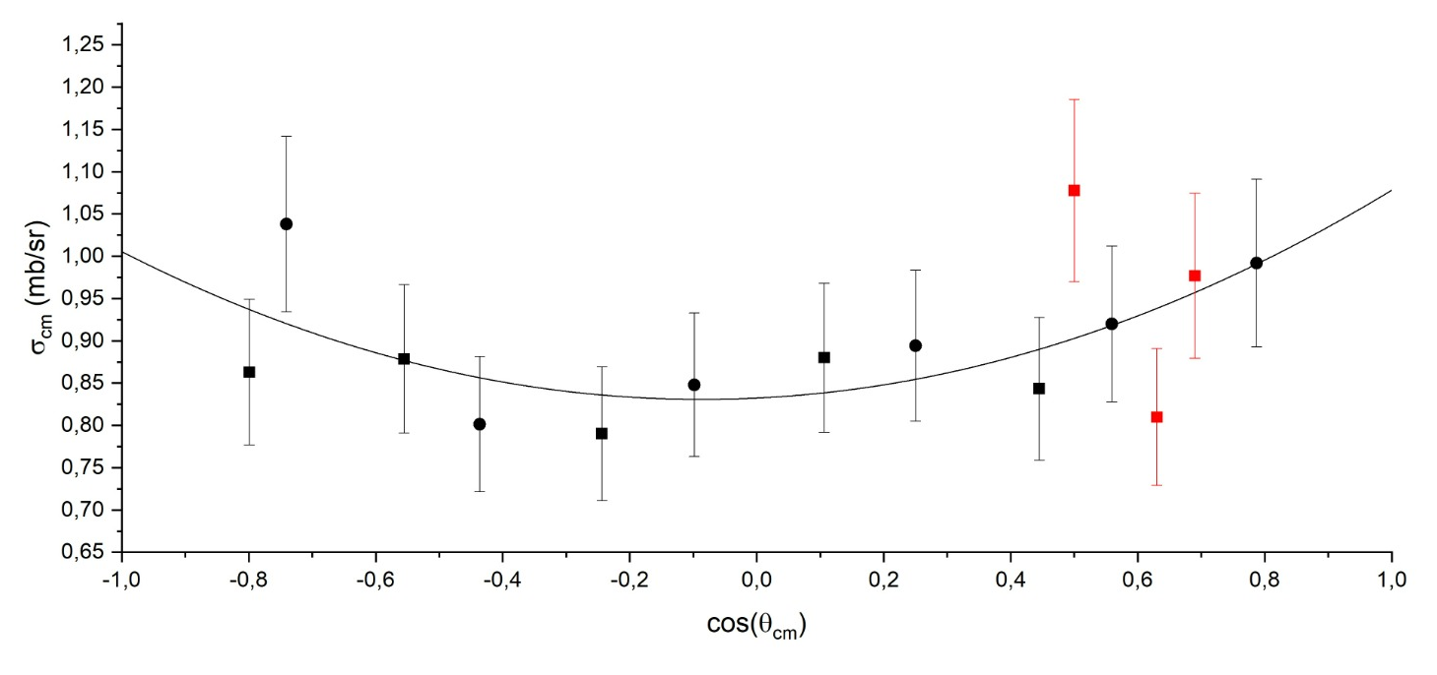

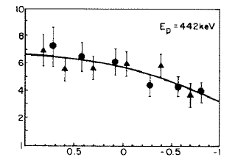
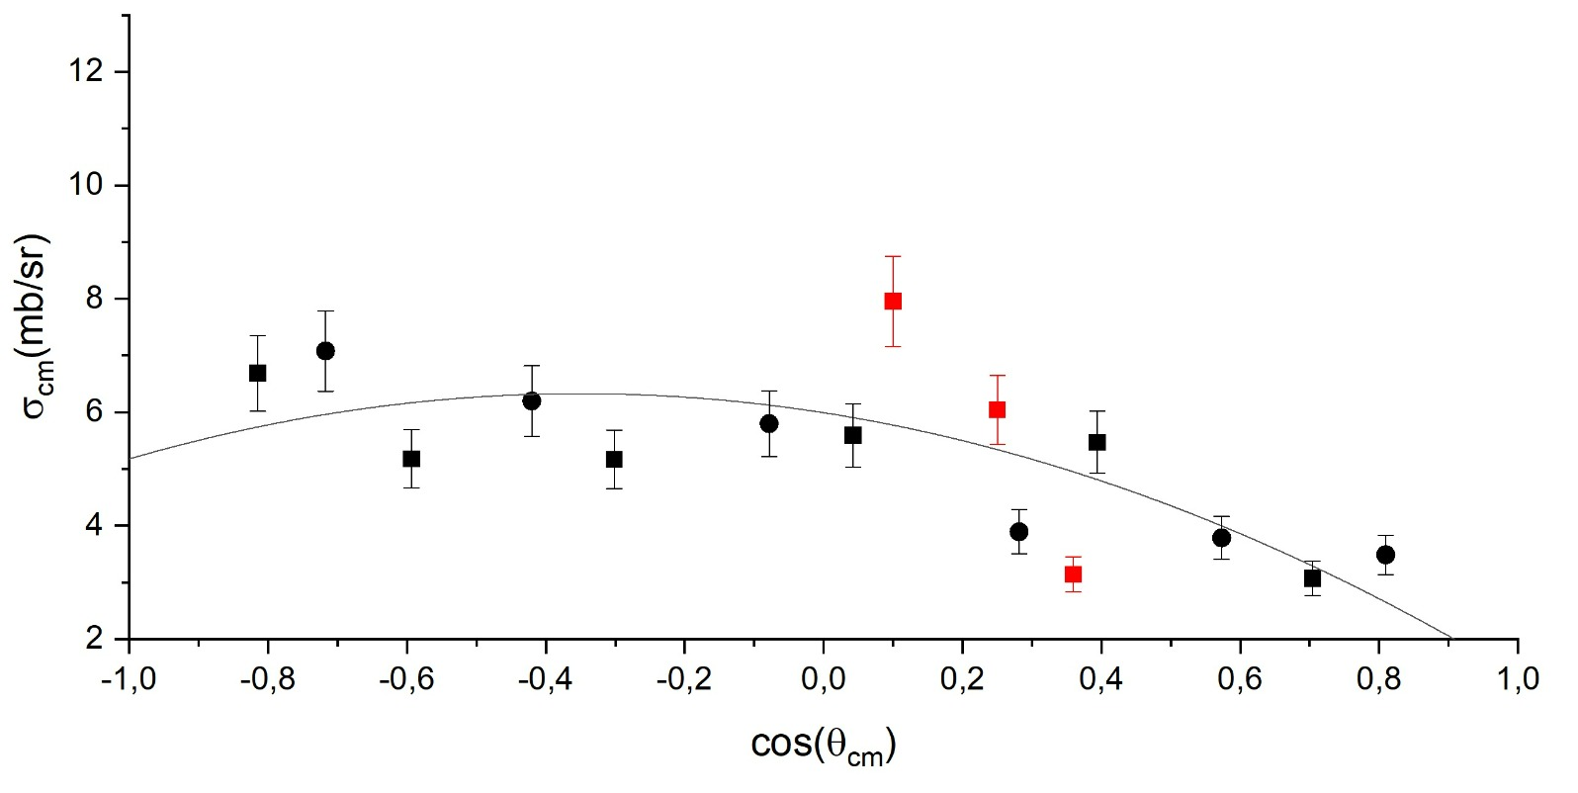
Results
Angular distribution of ³He for the ⁶Li(p,α)³He reaction
- my contribution
E_{CM}=
150 keV
Legendre polynomial fit
E_{CM}=
430 keV
J.C. KIM J.U. KWON and B.N. SUNG. Low-energy cross sections for the ⁶Li(p,α)³He reaction. Nuclear Physics A493, 1989.

Slide 28
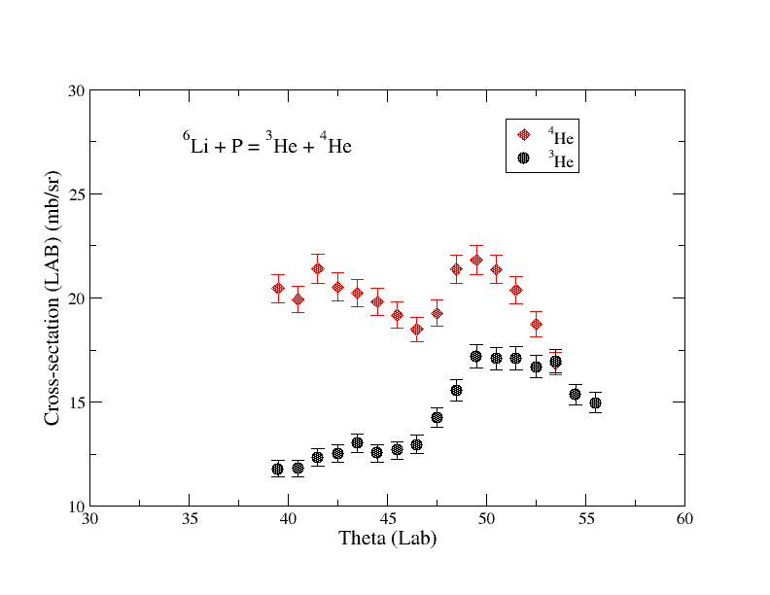

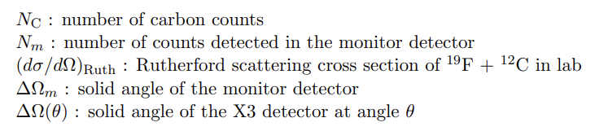
Results
Laboratory differential cross section for the ⁶Li(p,α)³He reaction:
PRELIMINARY
3 MeV
³He, ⁴He
Differential cross section

Slide 29
Conclusions
The ⁶Li(p,α)³He reaction measurement could contribute to solving the discrepancies in previous measurements.
The ⁶Li(p,α)³He reaction is deeply connected with the Cosmological Lithium Problem.
The experiment was successful: we managed to get good data for multiple beam energies.
The angular distribution has been determined for energies ranging from 150 keV to 430 keV in the center of mass system. The distributions are in agreement with previous measurements.
The differential cross section has also been determined.
This is subject to ongoing analysis.

Slide 30
Thank you for your attention !

