Slide 1
Hardware trigger system for nuclear physics experiments using digital data acquisition
Corbu Radu-Vasile
Engineer, GDED
Coordinator:
Mihai Cuciuc

Slide 2
Overview
Motivation
HW Trigger System Architecture
Implemented Trigger Logic
Testing Platform
Preliminary Results
Conclusions

Slide 3
Motivation
Custom Hardware Trigger System:
  Easy to integrate specific experimental requirements
  Better control over multiple DAQ modules
  Allow on-line data filtering
  Overcome bandwidth limitations
  Improve storage efficiency

Slide 4
Hardware
Input signals
CH pair 0
VX1730:
  Used in most GDED experiments
  Limited programmability for complex trigger pattern detection
Take trigger decision externally
  16 Analog Input Channels grouped in pairs:
    8 channel pairs output the triggers on LVDS pins
  8 Self-triggers to be sent to the configurable logic via LVDS pins (DT 5495)
  External trigger saves data on all the 16 Analog Input Channels
CH pair 1
External trigger
CH pair 2
CH pair 3
CH pair 4
CH pair 5
CH pair 6
LVDS pins
(to configurable logic)
CH pair 7

Slide 5
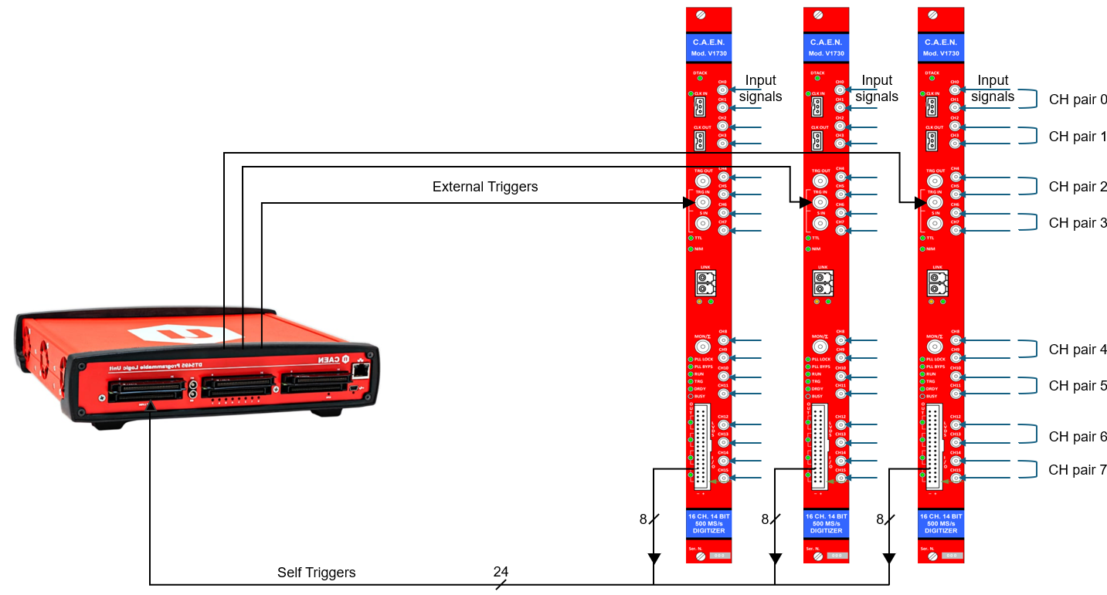
Architecture
CAEN V1730 digitizers
Custom trigger logic for different physics cases (CAEN DT5495 Programmable Logic Unit)

Slide 6
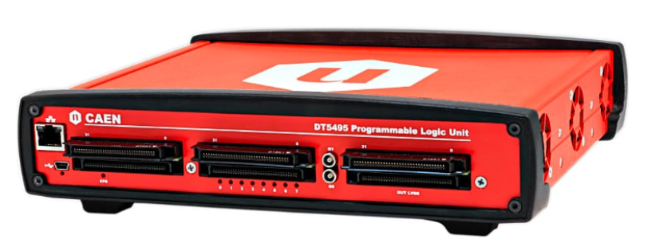
Architecture
Input signals
Input signals
Input signals
CH pair 0
External Triggers
CH pair 1
CH pair 2
CH pair 3
CH pair 4
CH pair 5
CH pair 6
CH pair 7
8
8
8
Self Triggers
24

Slide 7
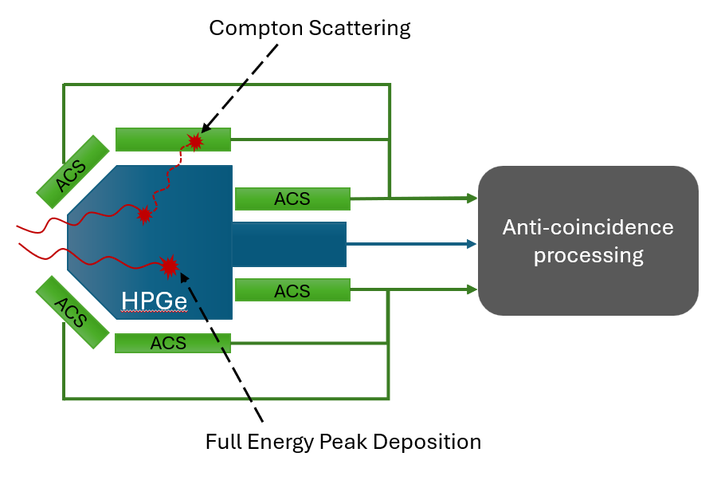
Physics cases / Trigger logic modes
Compton Rejection:
  Suppress unwanted background in gamma spectrometry
  Anti-coincidence logic implemented in DT5495 Programmable Logic Unit
16
HPGe
DAQ
16
ACS

Slide 8

Physics cases / Trigger logic modes
Single High Energy Gamma:
High Thr
High Thr
DAQ
High Thr
Pattern matching:
Multiplicity trigger:
16
Pattern 0
≥ N
16
Pattern 1
DAQ
DAQ
16
Pattern 2
16
Pattern 3

Slide 9
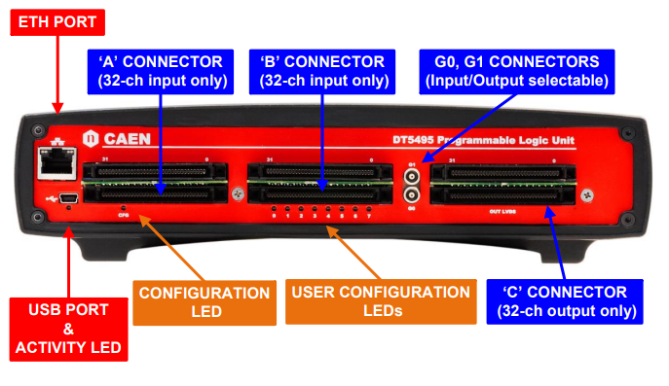
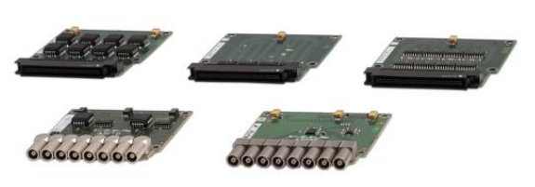
Hardware Implementation
CAEN DT5495 Programmable Logic Unit:
  User accessible FPGA
  Multiple supported standards (LVDS/ECL/PECL/NIM/TTL)
  Up to 162 inputs
  Piggyback board expansion slots:
      32 LVDS/ECL/PECL input ch.
      32 LVDS output ch.
      32 ECL output ch.
      8 NIM/TTL input/output ch.
      8 Analog output 16bit ch.

Slide 10
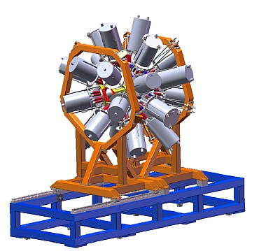
HW Trigger System Testing
On-site troubleshooting:
    Unexpected issues
    Live debugging (hard to diagnose in real-time)
    Time wasting (limited beam-time usage)
HW Trigger System

Slide 11
HW Trigger System Testing
Off-site troubleshooting:
    In-house testing tool
    Faster debugging (known inputs)
    Increased test coverage
Pulse Emulator
HW Trigger System

Slide 12
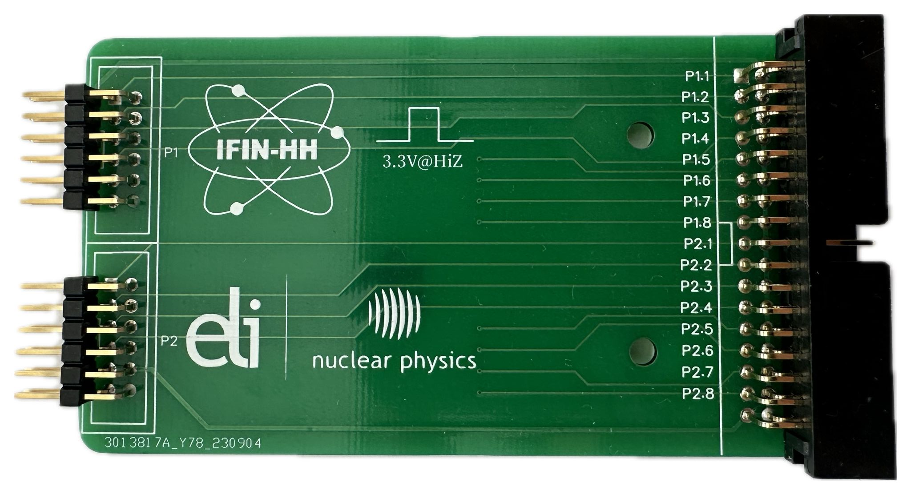
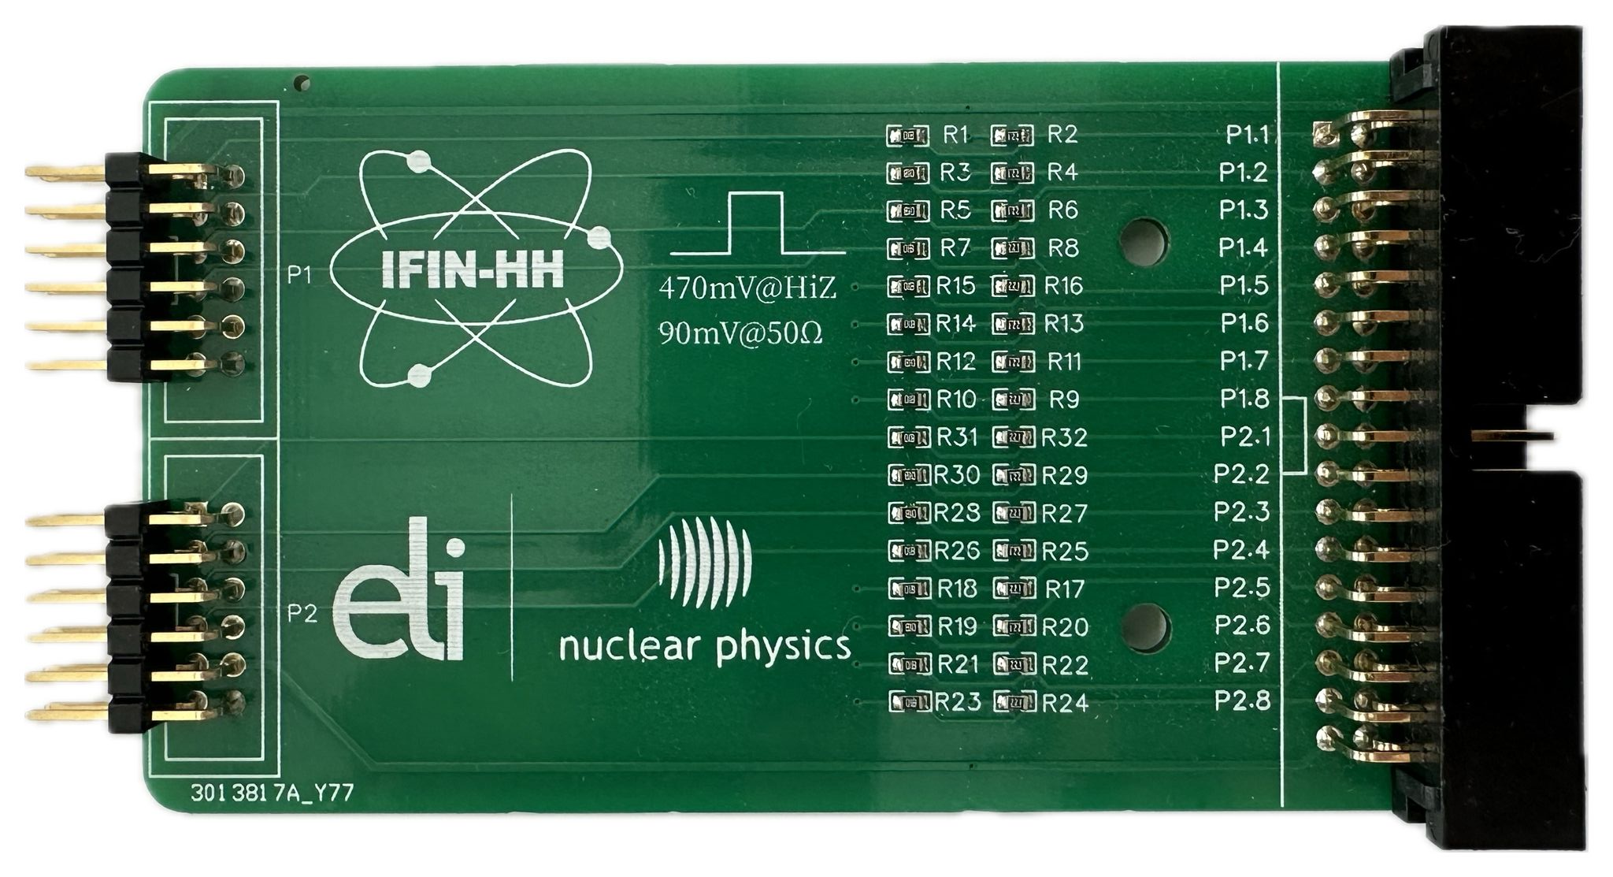
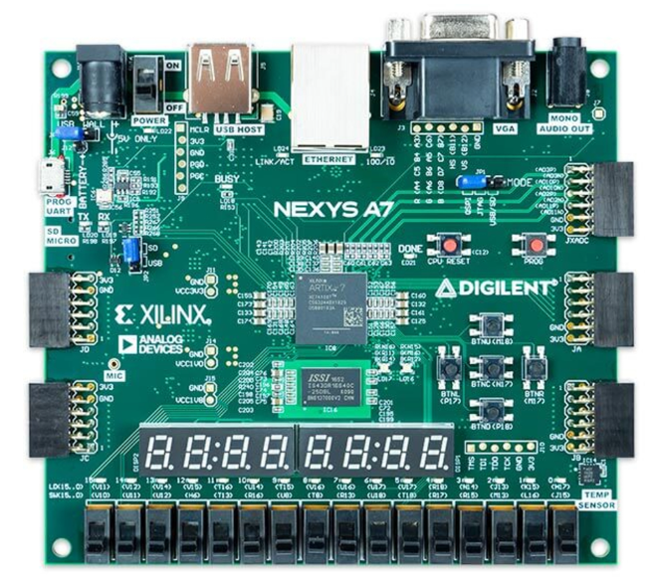
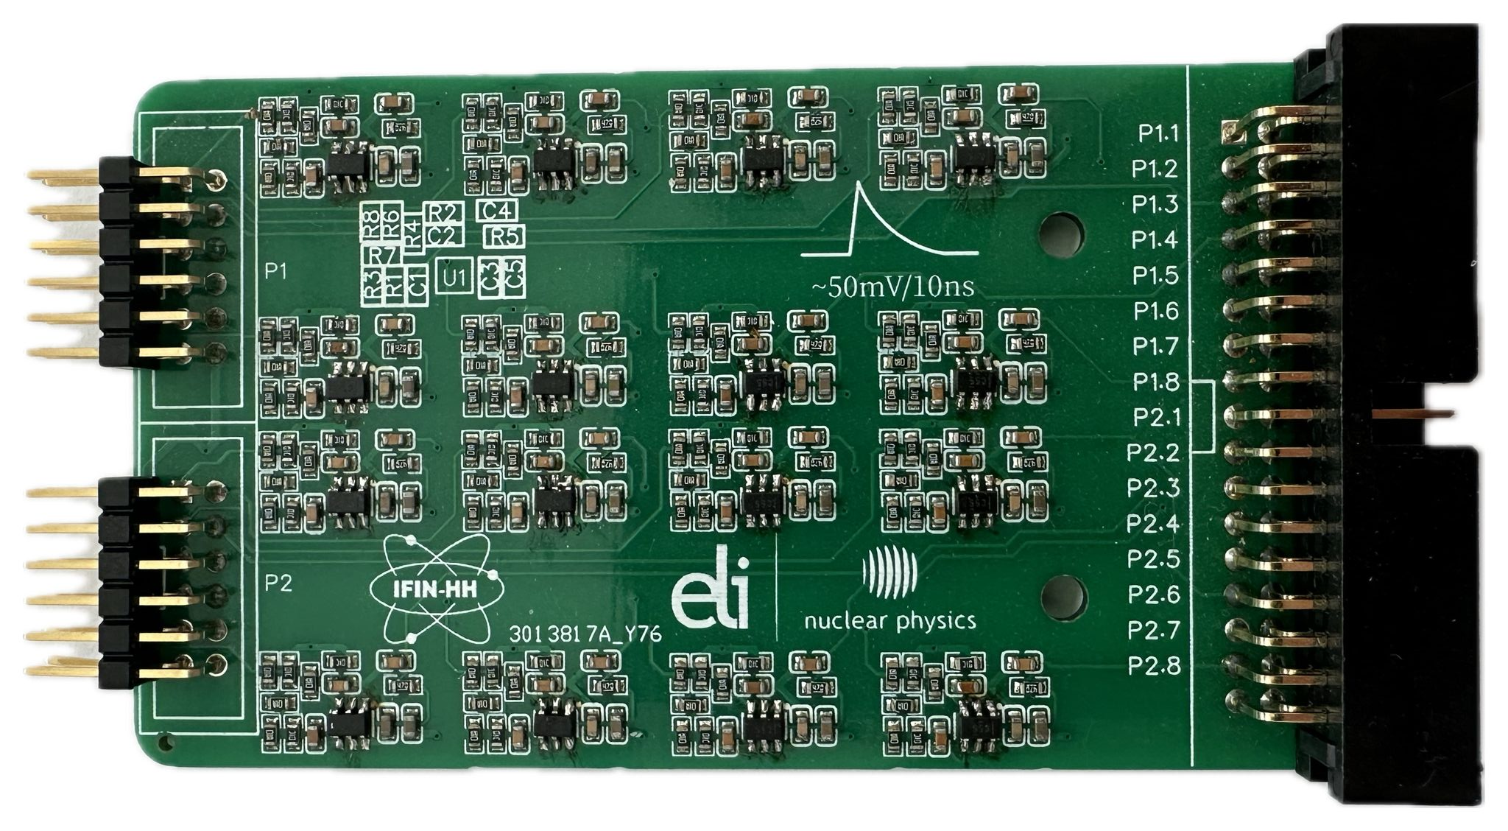
Testing Platform
Nexys A7 Development Board
  32 output channels
  Xilinx Artix-7 FPGA
Pulse shaping interface boards for DUT connection.
16
3.3V
16
470mV
8
16
8
50mV/10ns

Slide 13
Testing Platform
Nexys A7 Development Board Firmware:
  Storing channel Values and Timestamps in internal BRAM (.coe file generated by custom software);
  Generate Pulse Streams with programmable data rates and distributions.
DT5495
PLU
Digitizer
LVDS self-triggers
Interface Board
8
Trigger
Digitizer
LVDS self-triggers
Interface Board
8
Trigger
Coefficient file

Slide 14
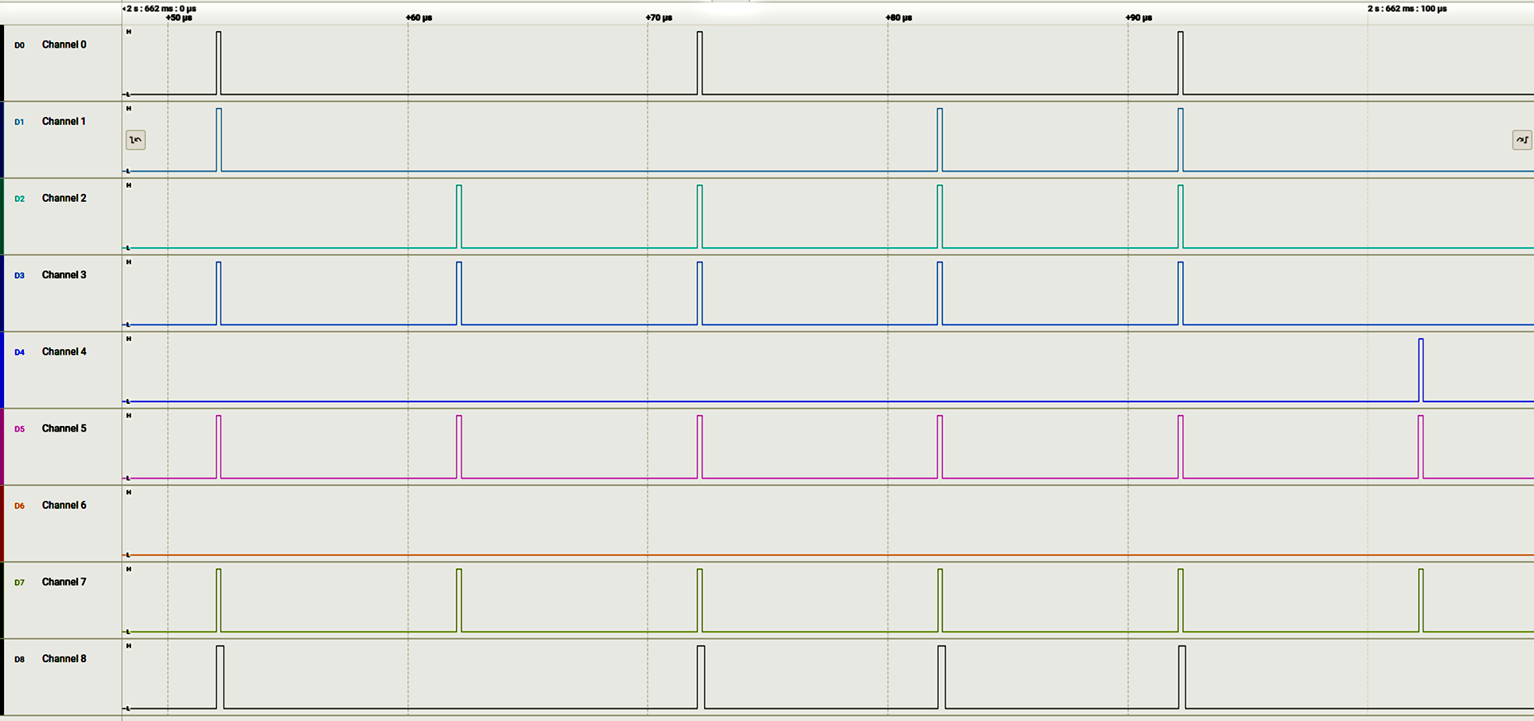
Test Results: Multiplicity (N = 5)
IN 0
IN 1
IN 2
IN 3
IN 4
IN 5
IN 6
IN 7
TRG_OUT

Slide 15
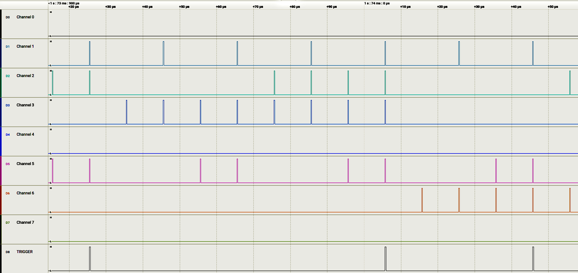
Test Results: Pattern matching
IN 0
Pattern 1
Pattern 1
Pattern 2
IN 1
IN 2
IN 3
IN 4
IN 5
IN 6
IN 7
TRG_OUT

Slide 16
Conclusions and outlook
Draft implementation of custom trigger system
Available tools for trigger system testing
TO DO:
  Increase test coverage on different physics case scenarios;
  Validate the trigger system in experiments (ELIADE Compton Rejection).
  User Interface

Slide 17
Thank You!

