Slide 1
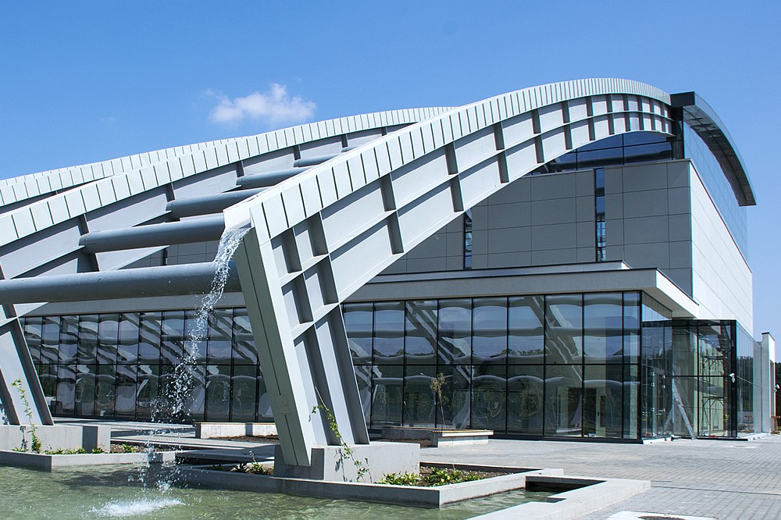

Fine tuning of the positron beam line
Andrei covali
ENGINEER at GDED, ELI-NP
Coordinator:
CSII Dr.Habil. Nikolay Djourelov
Young Researchers and Young Engineers Days, February 2025

Slide 2
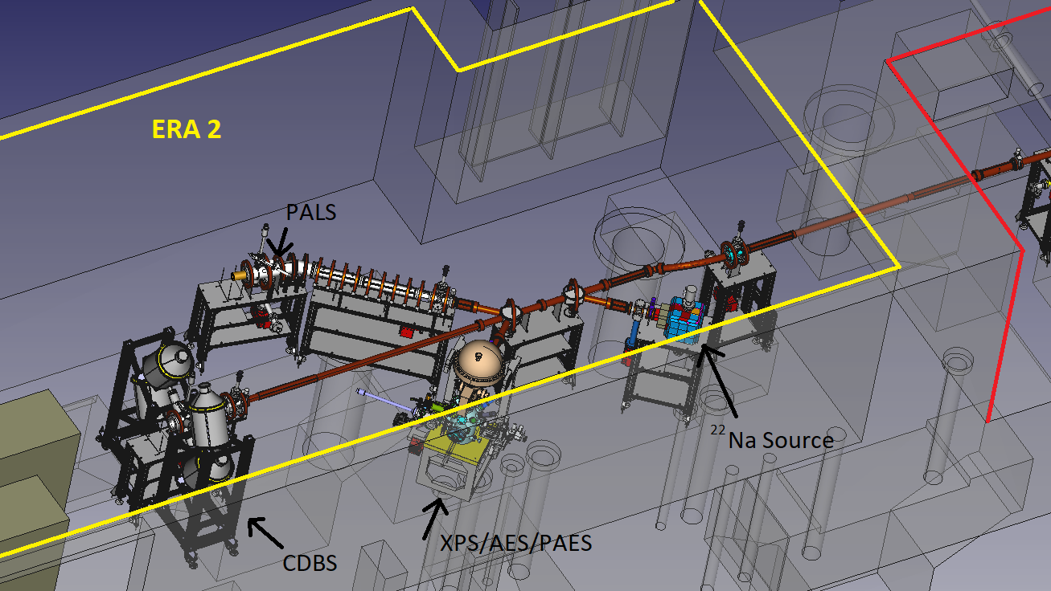
Summary
Laboratory’s placement and layout
Positron beam purpose and motivation
Tuning and characterization of the beam
Results
Conclusion/Future work

Slide 3
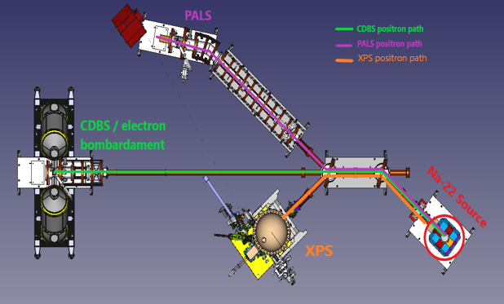
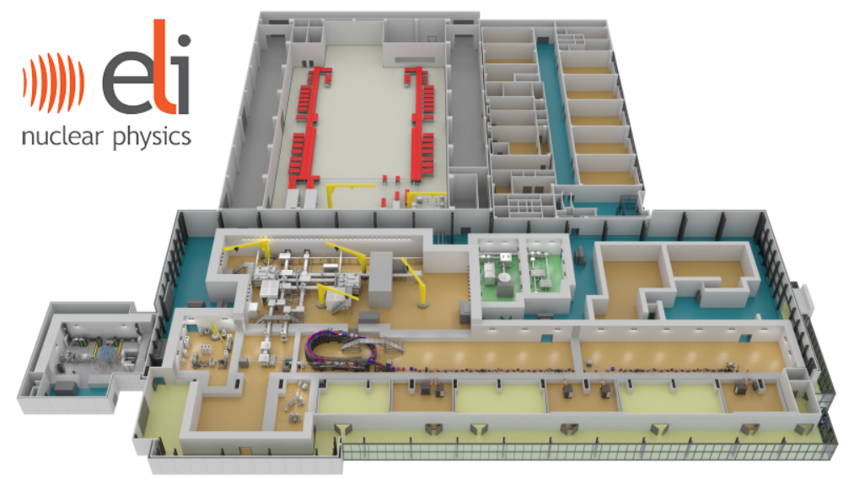
Laboratory’s placement and layout
Positron Laboratory

Slide 4
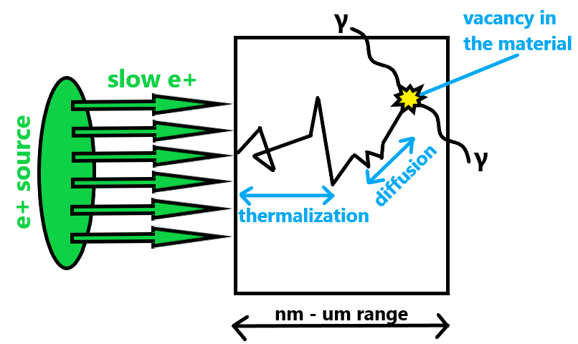
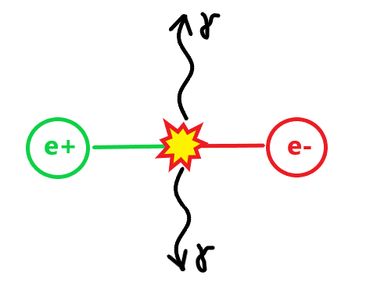
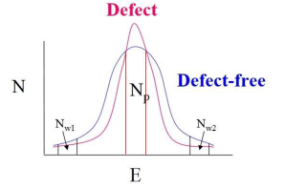


Positron beam purpose
Interaction between positron beam with a material
Annihilation process
$ⅇ^{−}$/ $ⅇ^{+}$ pair annihilate (usually)
Two 180°-angle gamma rays are emitted
Gamma rays provide information (among other things) on material’s defects
Thermalization = loss of energy
$ⅇ^{+}$ energy < $ⅇ^{−}$ energy
Variance in the annihilation radiation = info on the $ⅇ^{−}$
All this leads to broadening of the 511keV gamma quanta
Thus, Coincidence Doppler Broadening Spectroscopy was developed

Slide 5
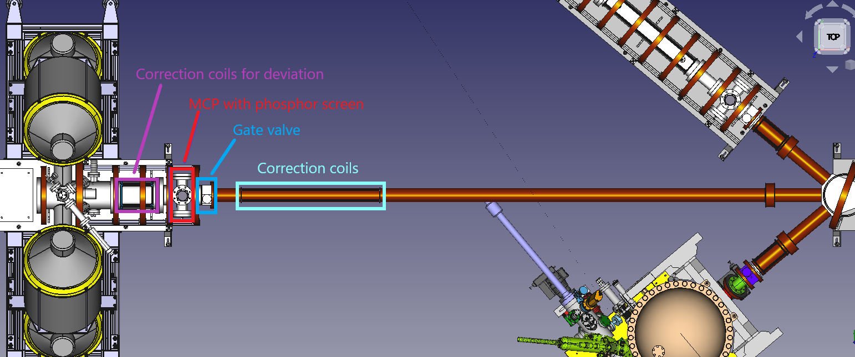

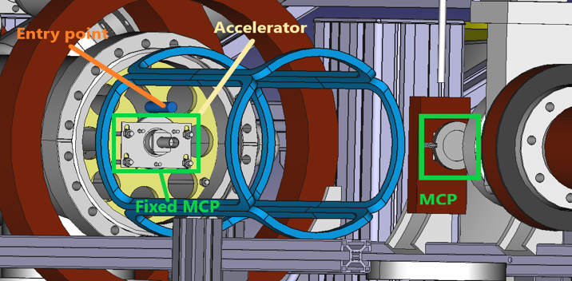
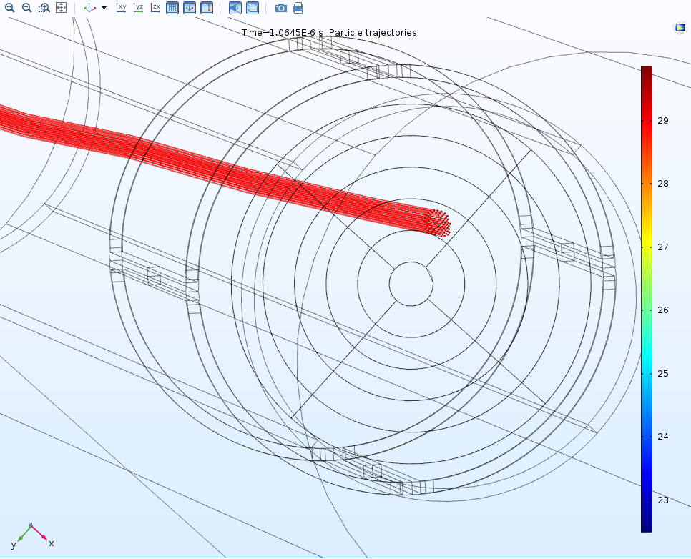
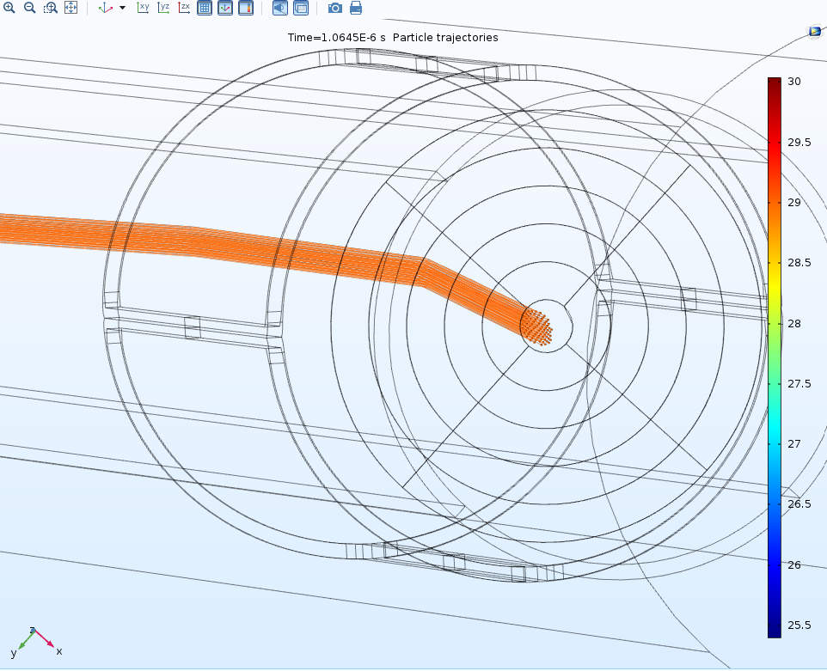
Motivation for fine tuning process of the beam line
Gate valves – used to maintain optimal vacuum level
MCP(micro channel plate) with phosphor screen – used to generate a light spot representing the beam spot
CCD camera – used together with a 45°-angle mirror to see the MCP’s output image
How the current through the coils affects the beam
Fixed MCP is used for Positron Annihilation Lifetime Spectroscopy (PALS)
Start signal: Fixed MCP
Stop signal: Scintillator

Slide 6
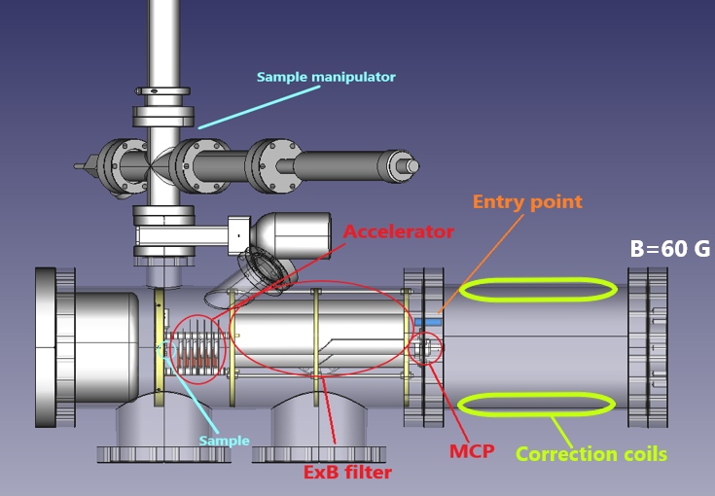
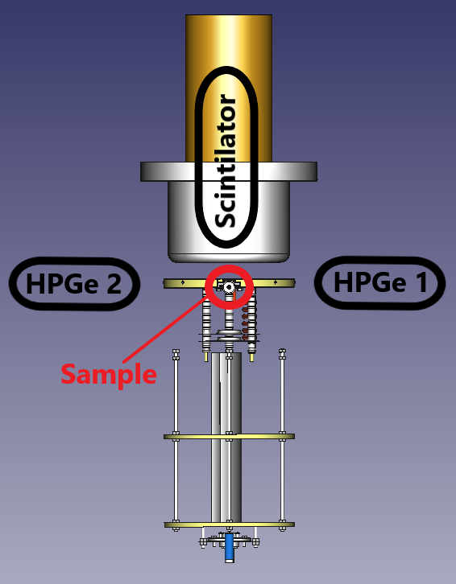
Motivation for fine tuning process of the beam line
Problem arises
How can we know precisely where the beam will be
Deviation to the entry point is precise: 2.5mm/A
Beam spot at the end is a black box (complex behavior after ExB filter)
What is the correlation between CorrCoill Current [A] and the deviation of the beam at the sample [mm]
No MCP or other means to center the beam on the sample, except using detectors
ExB filter – used for deviating the beam back to the middle
Accelerator – used because our beam is moderated (slow positrons at 29eV)

Slide 7
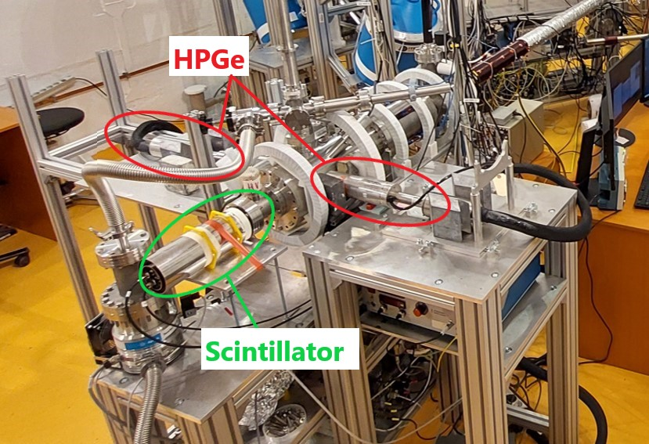
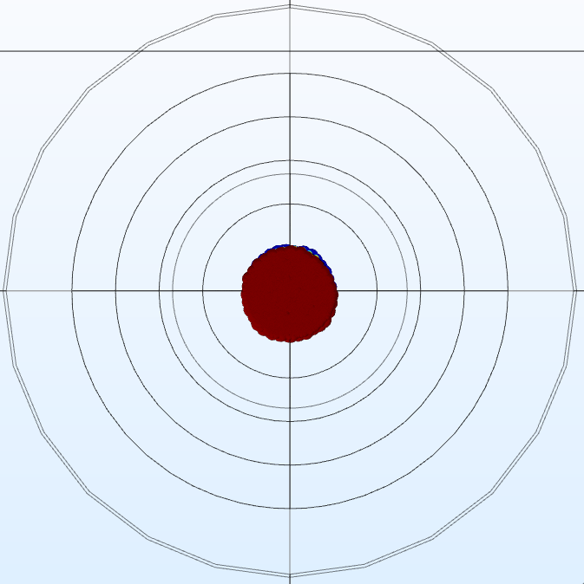
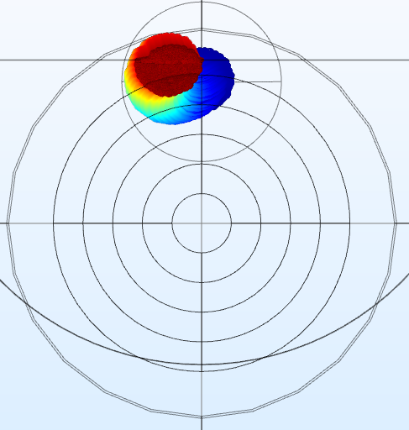
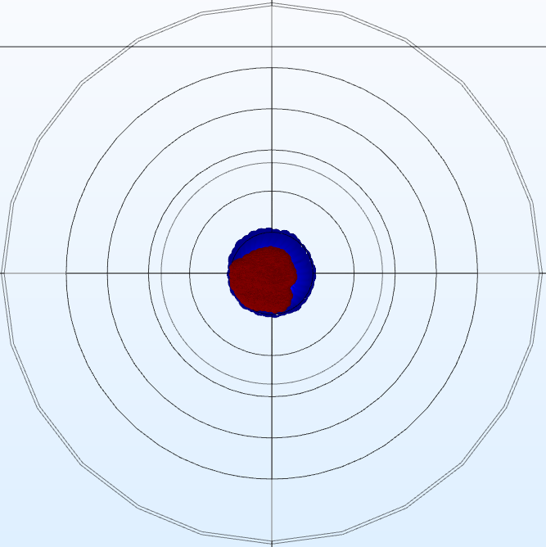
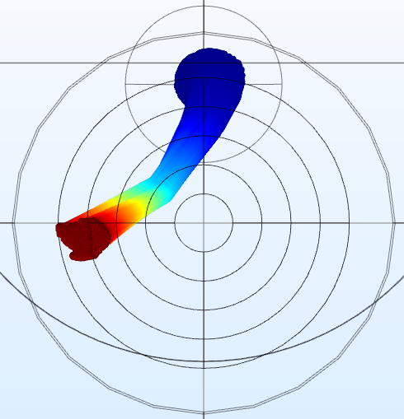

Fine tuning process of the beam line
For beam centering we used 2 HPGe detectors and 1 Scintillator
Vert_displ = 0 mm
Vert_displ = 5 mm
V_acc = 1 kV
Vert_displ = 0 mm
Vert_displ = 5 mm
Combination of parameters for centering:
Voltage on accelerator’s electrodes (V_acc)
Beam spot size: $∅=$3,5,8 mm (adjustable)
Vertical displacement (Vert_displ)
Horizontal displacement (Hor_displ)
V_acc = 24 kV

Slide 8
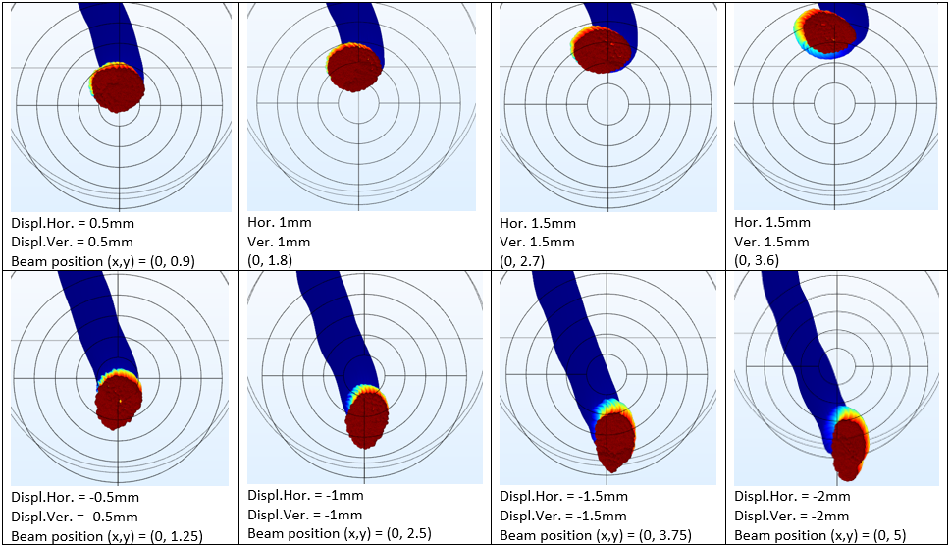
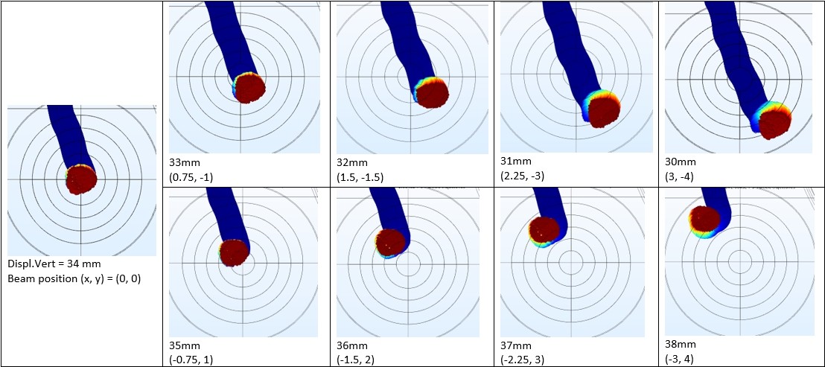
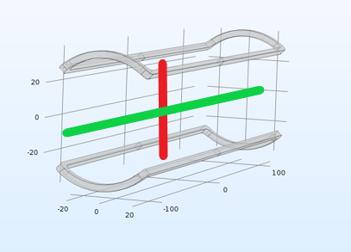
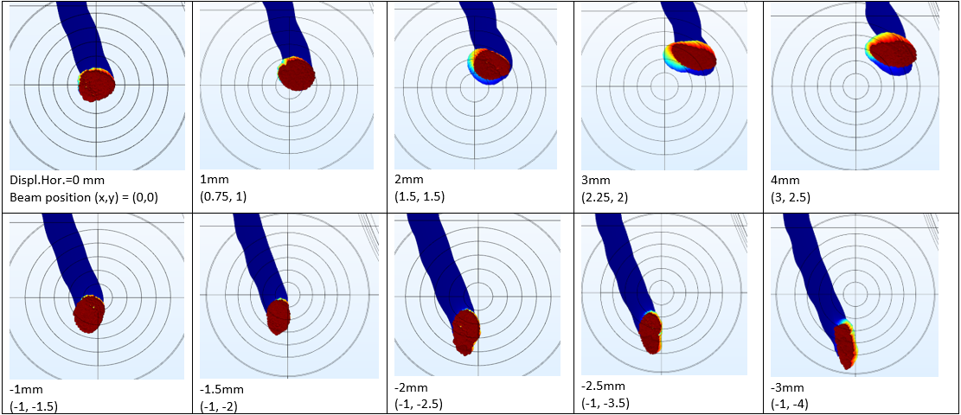
COMSOL Simulations
Using COMSOL we predict the behavior of the beam with respect to shifting the center at the beginning on X,Y and X+Y axis, respectively.
Vertical + Horizontal displacement
Vertical displacement behavior
Horizontal displacement behavior
The beam does not move intuitively:
At the beginning, moving on X => at the end, diagonal shift on primary diagonal
At the beginning, moving on Y => at the end, diagonal shit on the secondary diagonal
At the beginning, moving on both => at the end, straight beam shifting

Slide 9
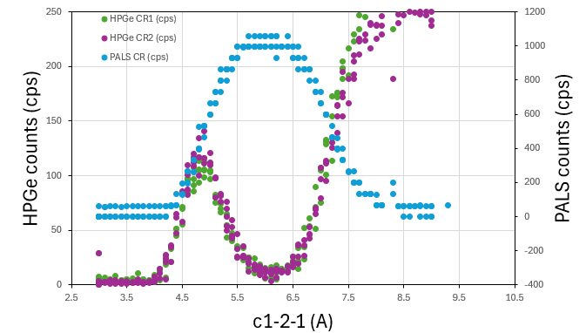
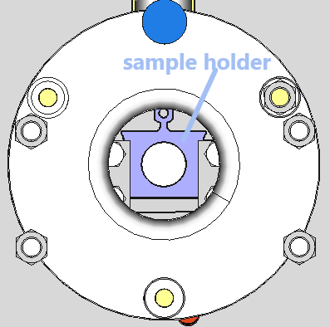
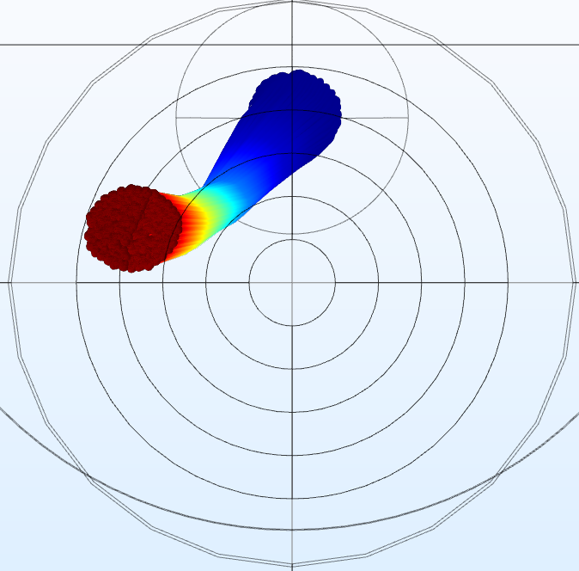
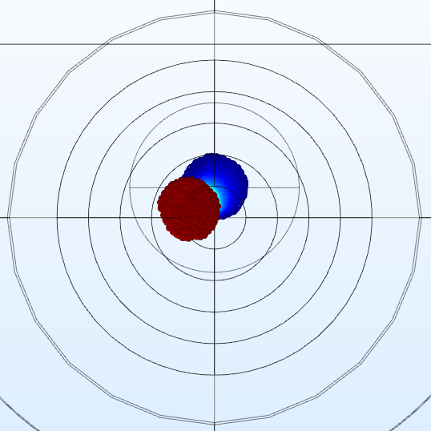
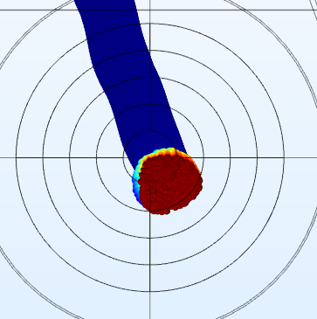
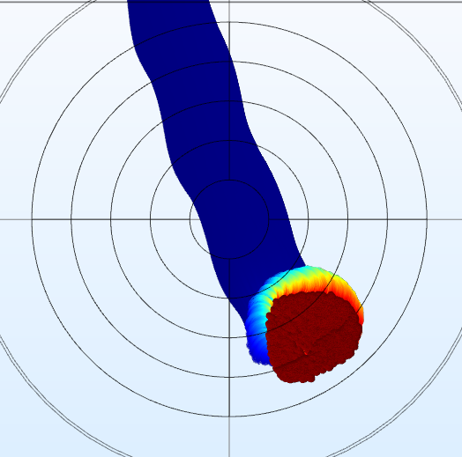
Results of the measurements
Behavior of the beam line (cps) with respect to the current in the correction coils (A)
Difficulty of the task is amplified by the fact that the beam is not a perfect circle

Slide 10
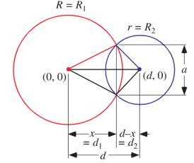
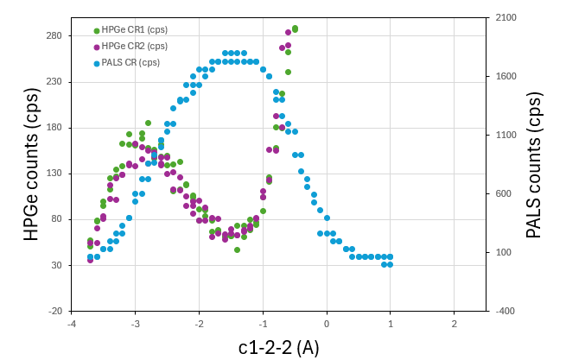
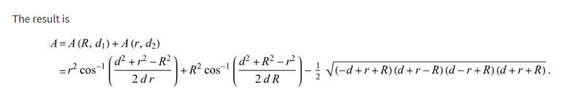

Results of the measurements
We know the number of counts from the detector
We know what % of the beam is passing throw the hole
Direct correlation to the beam spot position
For example, let’s analyze and compare 5 mm and 8 mm aperture beam:
5 mm case:
Plateau for approximate current of 1 A
Results:
2.5 mm = 0.25 A
The result varies from the previous correlation between beam displacement and coil’s current (2.5 mm = 1 A)
5mm
Beam sample: $∅$ = 10 mm
Beam spot: $∅=$3,5,8 mm (adjustable)
Direct relation between the number of counts and the current through the correction coils
8mm

Slide 11
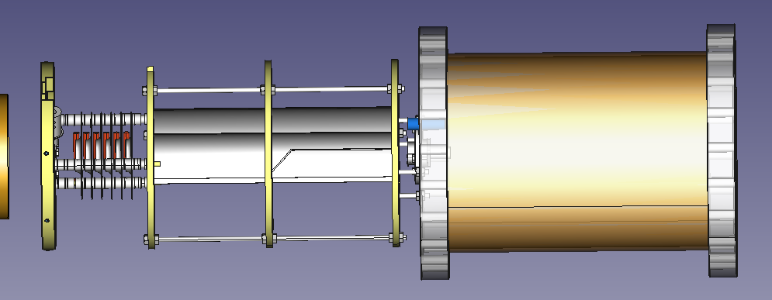
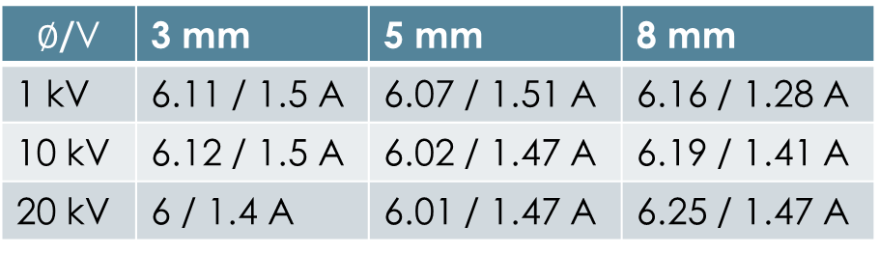
Conclusion
Values for the required current though the coils
We found a direct relation between the correction coil’s current and beam spot at the sample!
Combining COMSOL simulations and the experimental results we can confidently conclude that we can manipulate the beam with great precision through the correction coils’ current.
$∅$/V | 3 mm | 5 mm | 8 mm
1 kV | 6.11 / 1.5 A | 6.07 / 1.51 A | 6.16 / 1.28 A
10 kV | 6.12 / 1.5 A | 6.02 / 1.47 A | 6.19 / 1.41 A
20 kV | 6 / 1.4 A | 6.01 / 1.47 A | 6.25 / 1.47 A
Future work
Upgrading the LabVIEW software for the DAQ to change the proper parameters when the aperture (3,5,8 mm) in changed

Slide 12
Thank you for your attention!
Questions?
Young Researchers and Young Engineers Days, February 2025
Notes:
12

