Slide 1
Recent measurements of reaction cross-sections at astrophysical energies using the ELISSA array
Haridas Pai
On behalf of ELISSA collaboration
haridas.pai@eli-np.ro
Extreme Light Infrastructure – Nuclear Physics,
IFIN-HH, 30 Reactorului Street, 077125,
Măgurele Romania
Notes:
I wish to thank the organizers for giving me the opportunity. I am going to talk about .

Slide 2


One of the proposed research topics at ELI-NP is nuclear astrophysics through the detection of charged particles from the photodissociation reactions using the gamma beam.
2
NPA-XII, Cluj-Napoca, Romania.

Slide 3
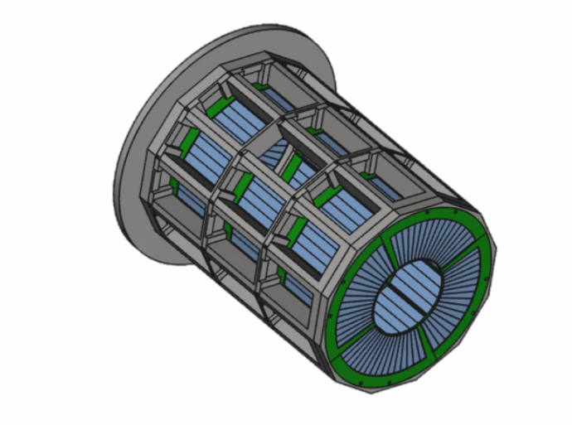
ELI-NP Silicon Strip Detectors Array (ELISSA)
ELISSA is a 4π silicon-strip detector array.
The array is expected to consist of three rings of 35 single-sided X3 detectors and two end-caps made up of eight double-sided QQQ3 detectors manufactured by Micron Semiconductor Ltd.
It has been designed in collaboration with INFN-LNS, Catania.
EPJ Web of Conferences 165, 01026 (2017)
Multiple configurations are possible with the YY1, MMM, and QQQ3 detectors as end-caps detectors.
3
NPA-XII, Cluj-Napoca, Romania.

Slide 4
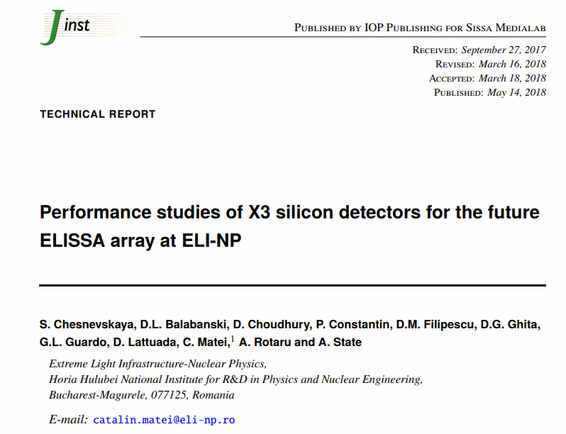
X3 detector
S. Chesnevskaya et al 2018 JINST 13 T05006
The X3 position-sensitive detectors (1000 μm thick) have four resistive strips, 1 cm wide and 7.5-cm long, on the front side. The rear side is non-resistive.
4
NPA-XII, Cluj-Napoca, Romania.

Slide 5
Several reactions important for the astrophysical p-process, Big Bang Nucleosynthesis, and supernova explosion have been selected for measurement with ELISSA with gamma beams and also with locally available beams.
5
NPA-XII, Cluj-Napoca, Romania.

Slide 6
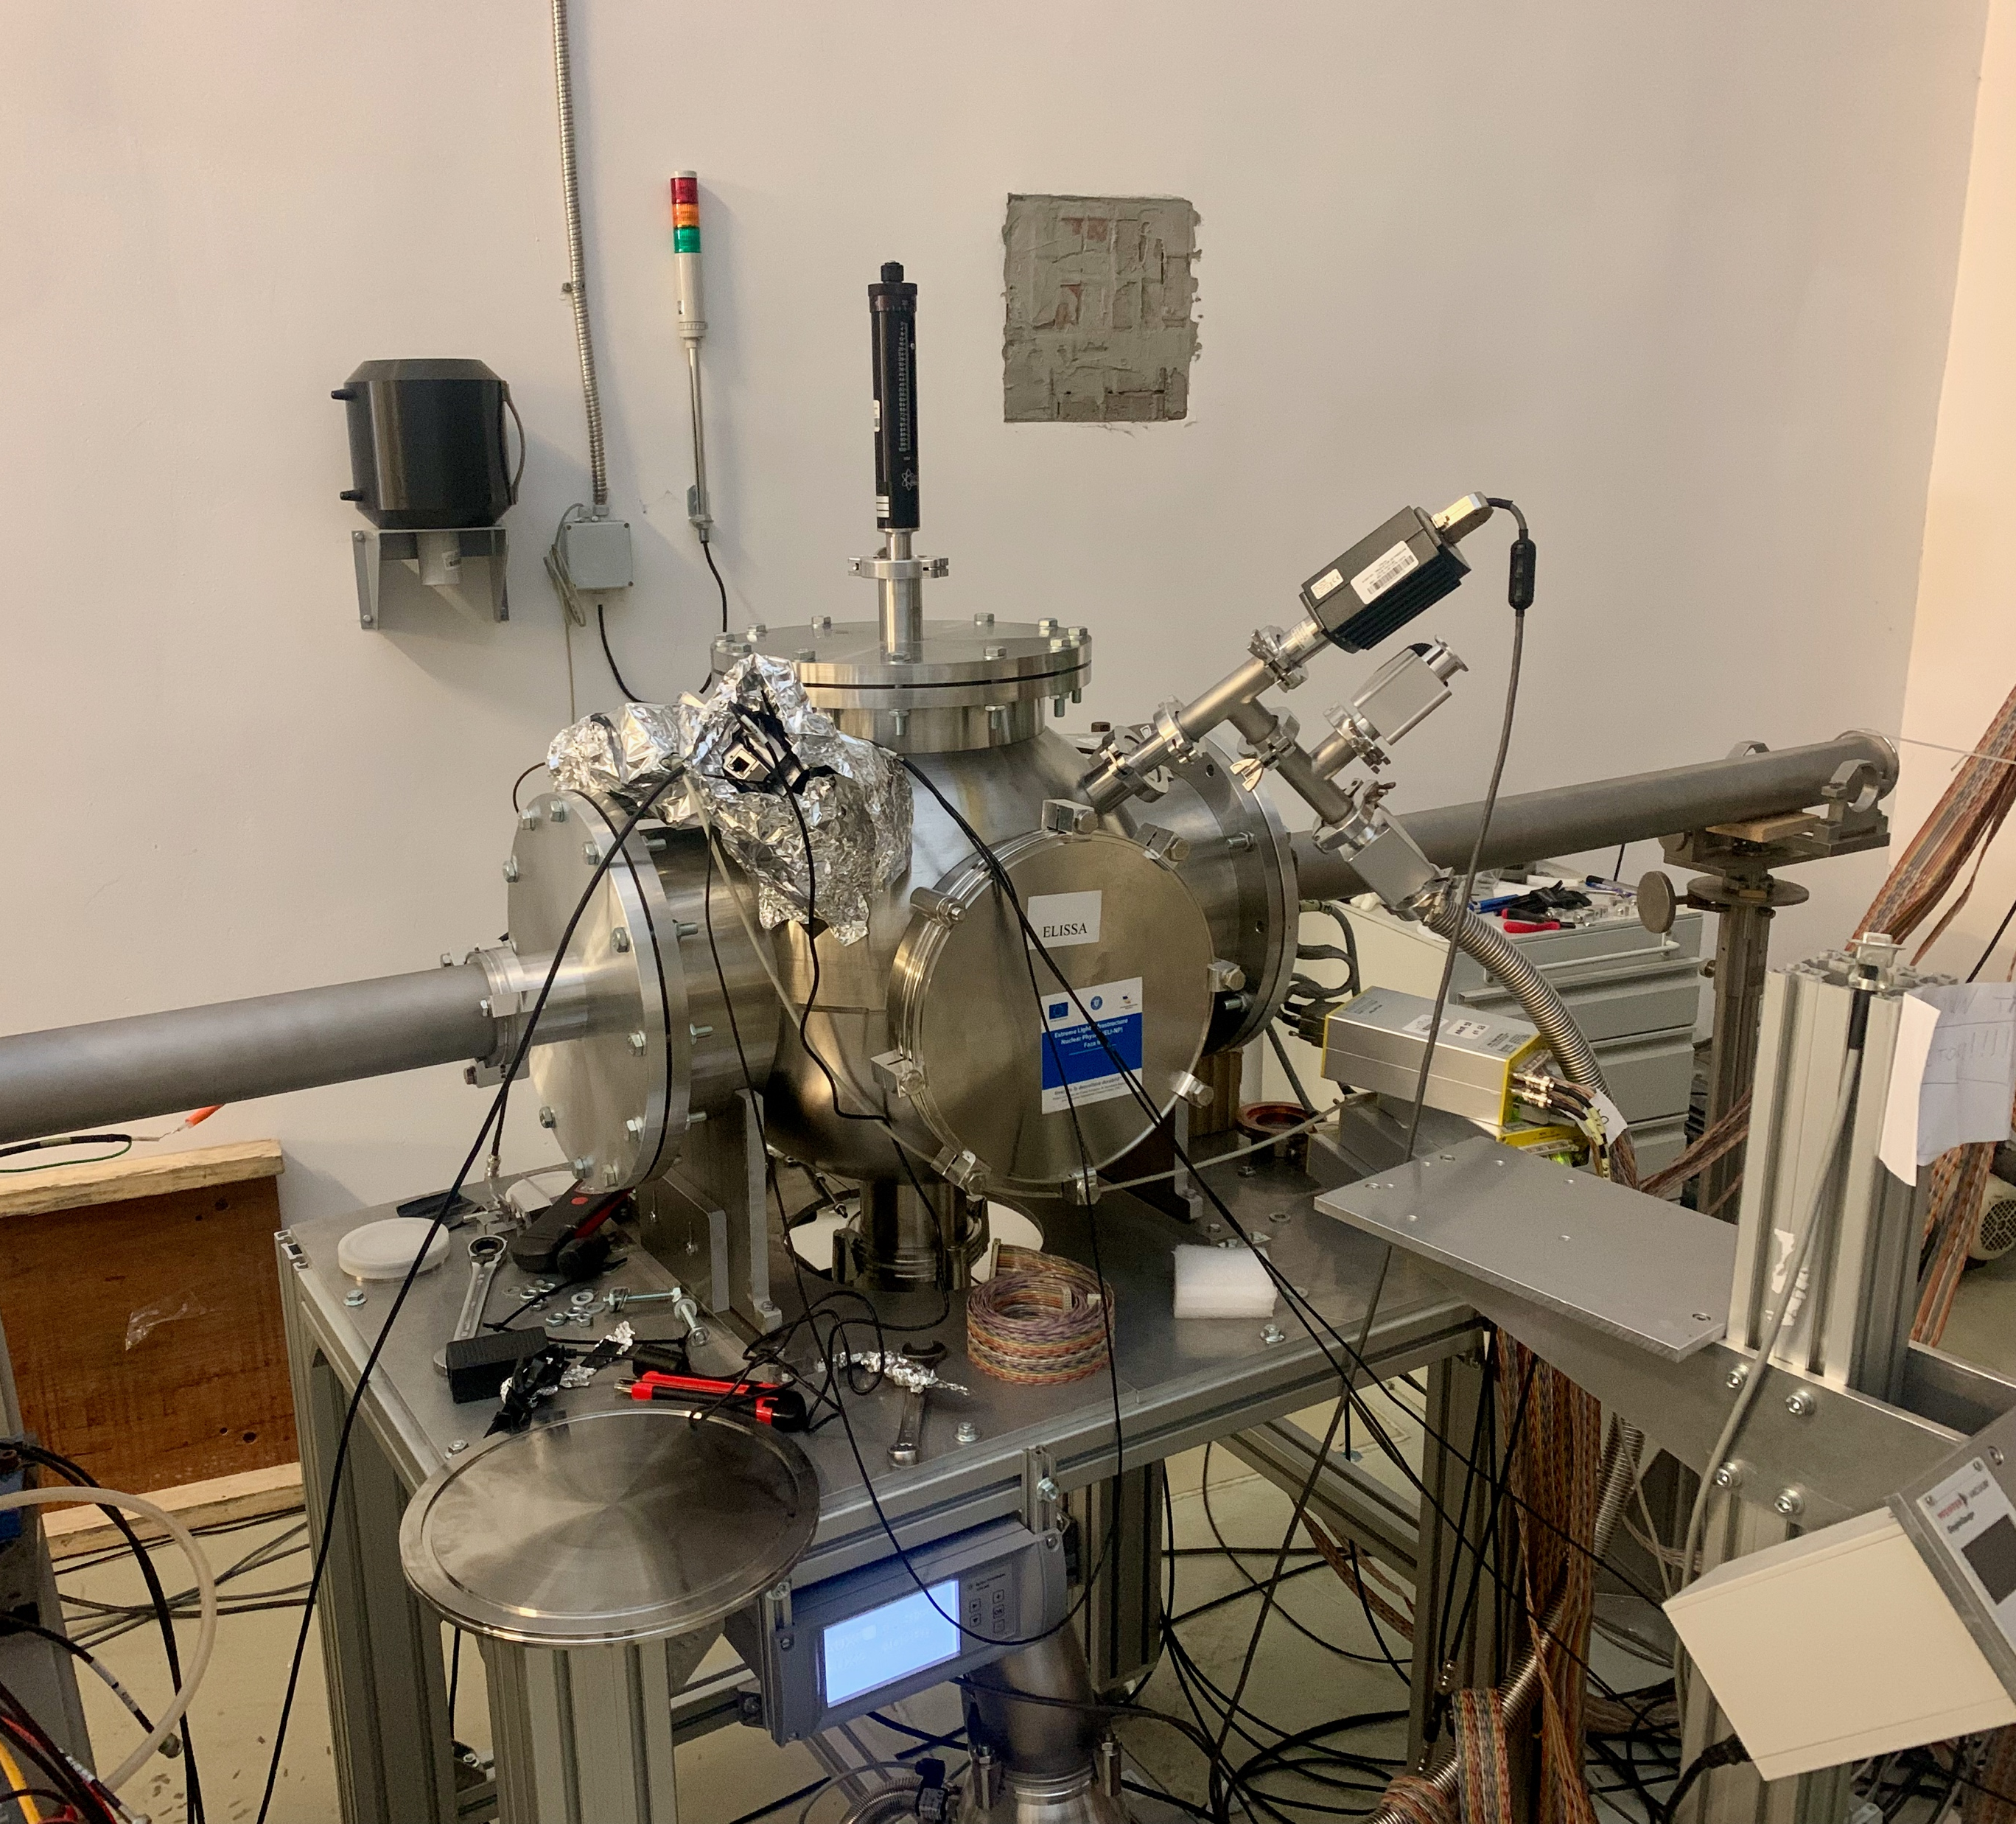
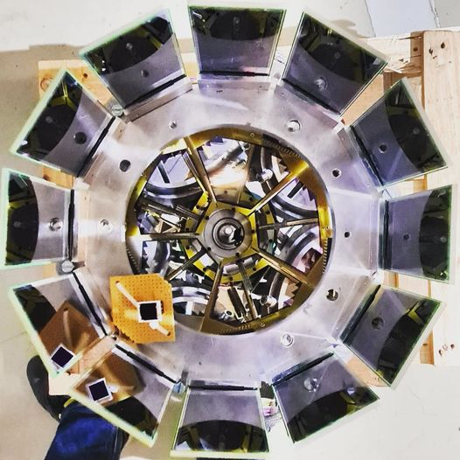
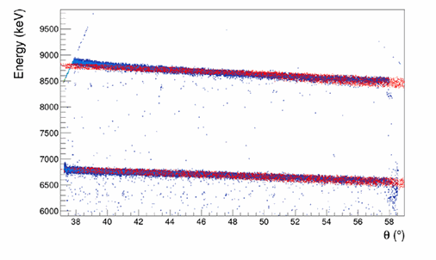
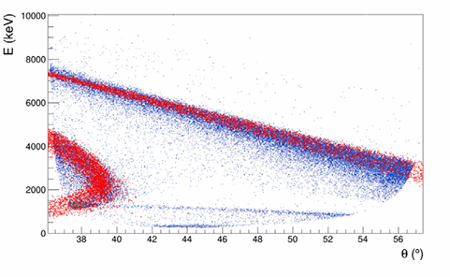
In-beam characterization of ELISSA at the IFIN-HH 3 MV Tandem
The X3 detectors are placed at a distance of ~ 6 cm from the target center. The diameter of the barrel is ∼ 19.54 cm.
Beam: ¹⁹F (7 to 15 MeV); Target: CH_{2,} Au, C
Beam: ⁷Li (7 and 9 MeV); Target: Au
12 X3 detectors from ELISSA
5 YY1 detectors from LHASA
Mini-ELISA chamber
The first in-beam characterization of the ELISSA silicon strip array has demonstrated that the detector system achieves excellent energy resolution (≅ 0.5% at 5.8 MeV for 𝛼 particles), excellent position resolution (𝜎 < 40 μm), and an energy threshold of approximately 700 keV, confirming its suitability for high-precision charged-particle spectroscopy in nuclear astrophysics.
¹²C
¹⁹F
Elastic scattering of 7 and 9 MeV ⁷Li beam on ¹⁹⁷Au target
13 MeV ¹⁹F beam on ¹²C target
6
NPA-XII, Cluj-Napoca, Romania.
Notes:
ELISSA X3 setup shows a FWHM energy resolution of approximately 40 keV for a 5.5 MeV alpha particle. The position resolution of ELISSA X3 ring is below 40 μm.
X3 detector threshold is around 700 –keV.

Slide 7
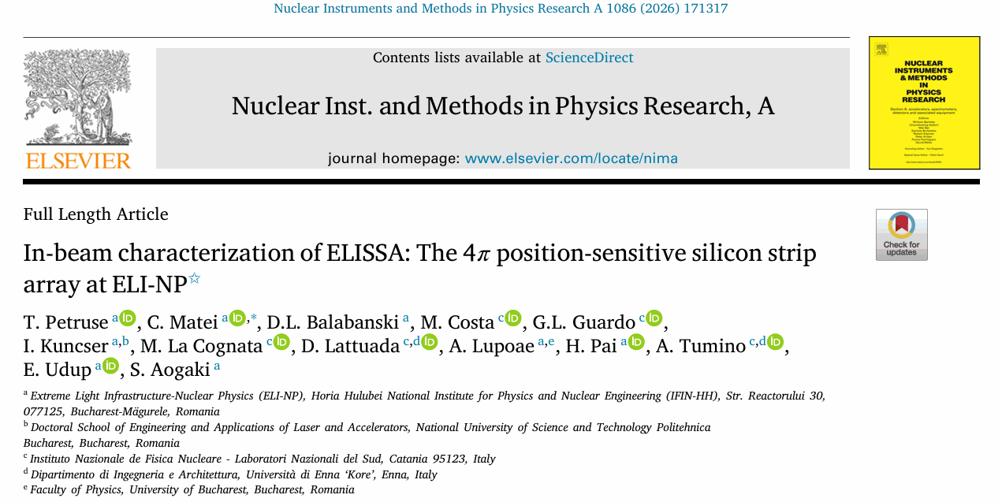
NPA-XII, Cluj-Napoca, Romania.

Slide 8
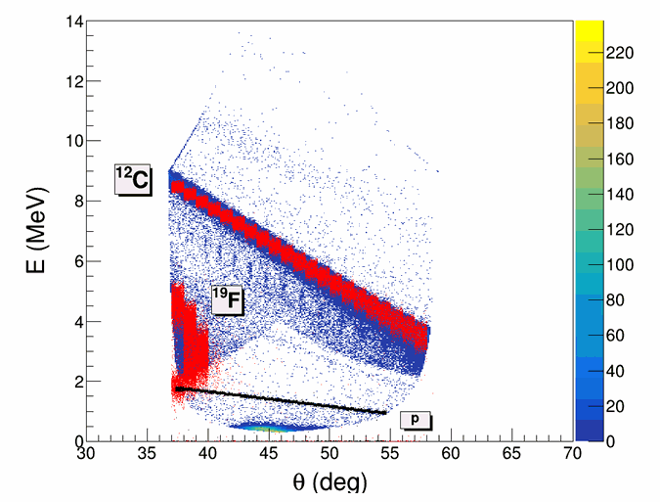
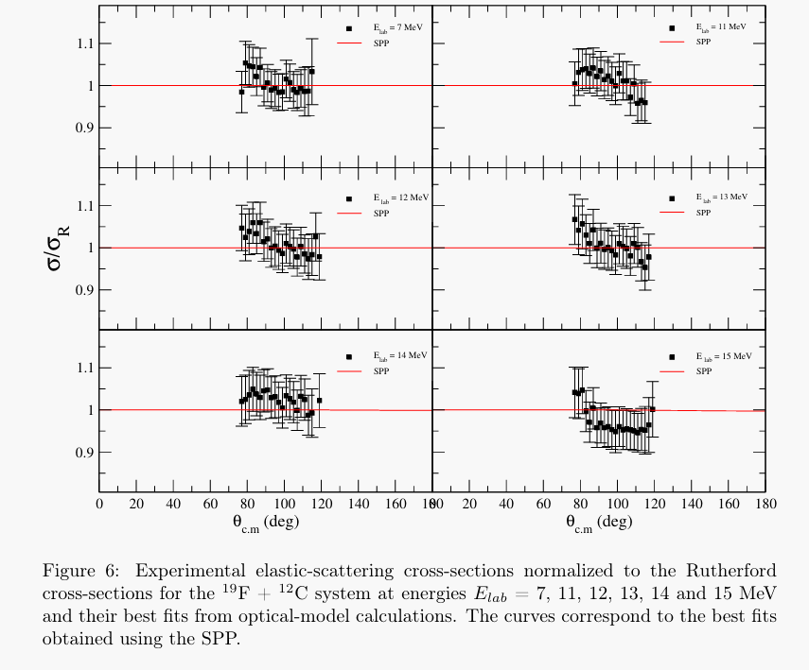
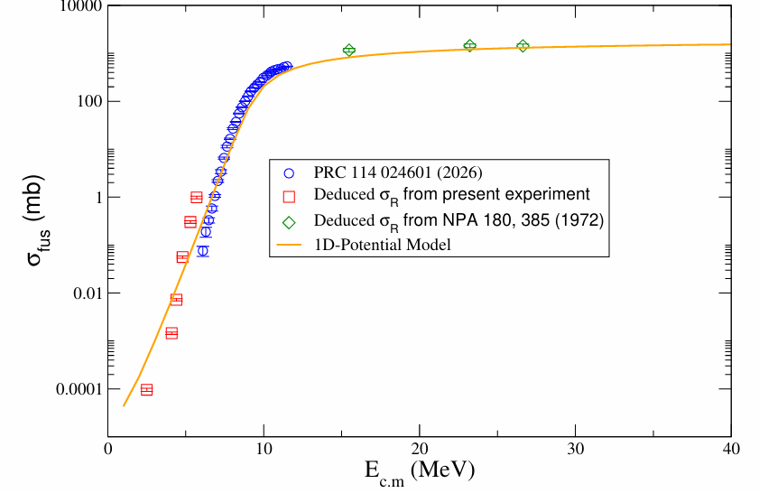
Measurement of elastic scattering cross sections for the ¹⁹F + ¹²C system
The manuscript is under preparation by H. Pai et al.
NPA-XII, Cluj-Napoca, Romania.

Slide 9
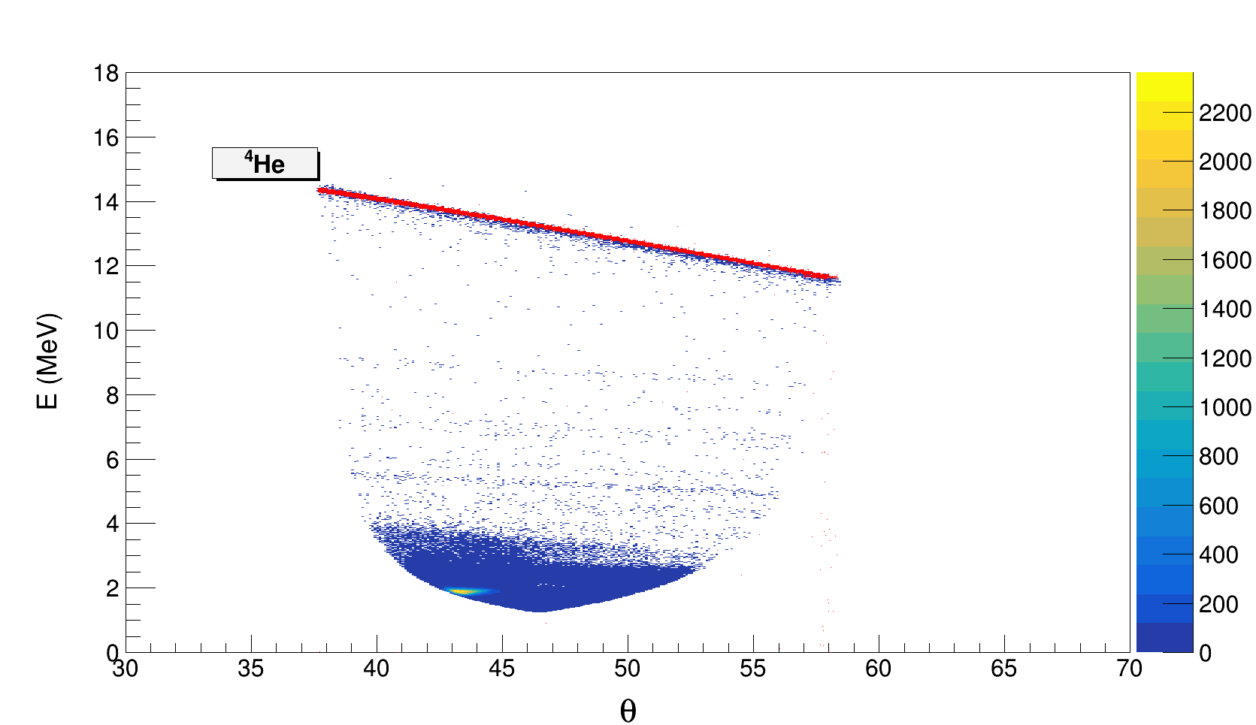
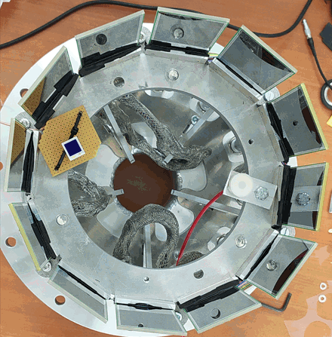
⁷Li(p, α)⁴He experiment at the IFIN-HH 3 MV Tandem
We have successfully measured the ⁷Li(p, α)⁴He reactions at 8, 7, 6, 5, 4, 3, 2, 0.9, 0.75, and 0.6 MeV (E_{lab}) energies.
12 X3 detectors from ELISSA
The X3 detectors are placed at a distance of ~ 6.0 cm from the target center. The diameter of the barrel is ∼ 19.54 cm.
Target: CH₂
Beam: ⁷Li
Beam Energy: 0.6 to 8 MeV
Comparison of E vs θ plot (Kinematic plot) of ⁷Li(p, α)⁴He reaction from Monte Carlo simulation code NPTool (red ) and experimental data (blue) for 3 MeV beam energy.
9
NPA-XII, Cluj-Napoca, Romania.

Slide 10
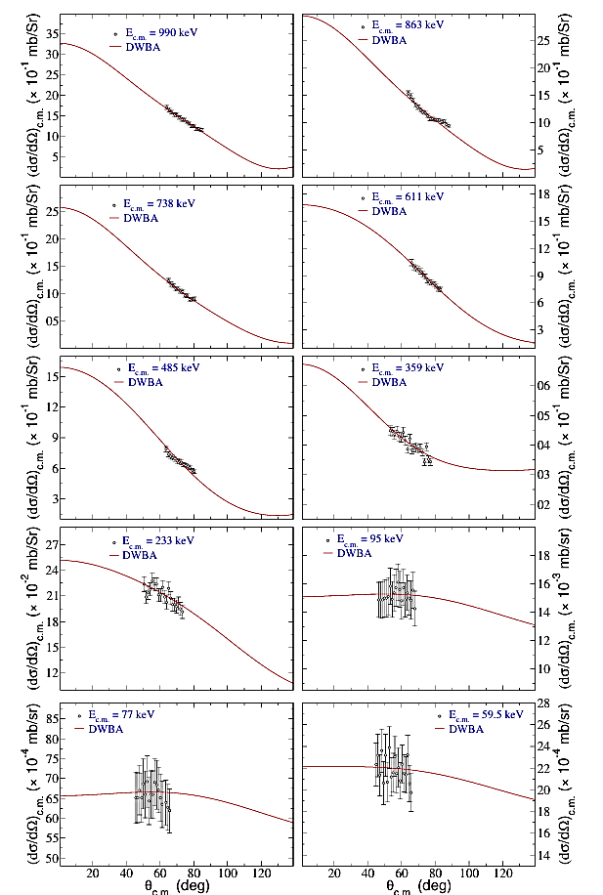
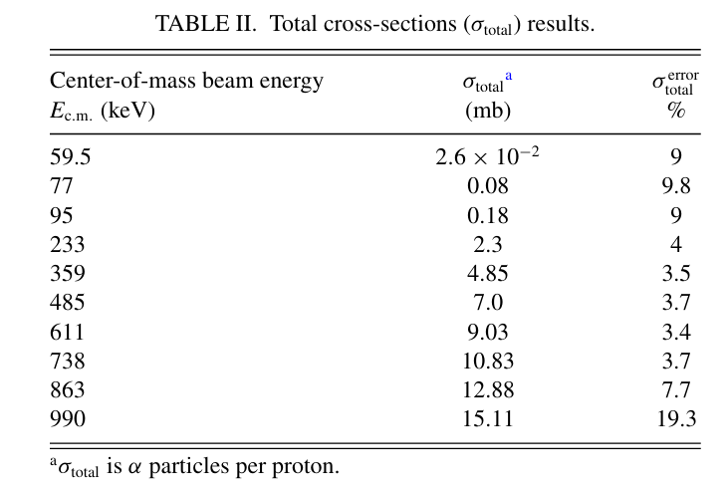
Differential cross sections for ⁷Li(p, α)⁴He and DWBA Calculations
Angular distributions for ⁷Li(p, α)⁴He at 990, 863, 738, 611, 485, 359, 233, 95, 77, and 59.5-keV energies (E_{c.m.}).
The solid curves are the DWBA results, and the black circles are the experimental data points from the present work.
10
NPA-XII, Cluj-Napoca, Romania.

Slide 11
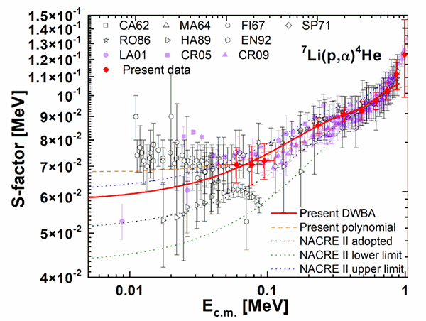
S-factor
In DWBA calculations, the zero-range approximation has been adopted (the interaction between the transferred particle and the core of the ejectile).
From the present DWBA and polynomial fits, S(0)= 59.8 keVb and 68.4 ± 4.9 keVb are obtained, respectively. The present DWBA value lies within the uncertainty bounds of the NACRE-II compilation.
A red diamond symbol shows the present data points. Horizontal errors originate from the uncertainty in energy loss at the target.
11
NPA-XII, Cluj-Napoca, Romania.
Notes:
In DWBA calculations, a further DWBA fit on the total cross-sections (σtotal)
at nine energy points (59.5-keV t o863-keV) is performed.

Slide 12
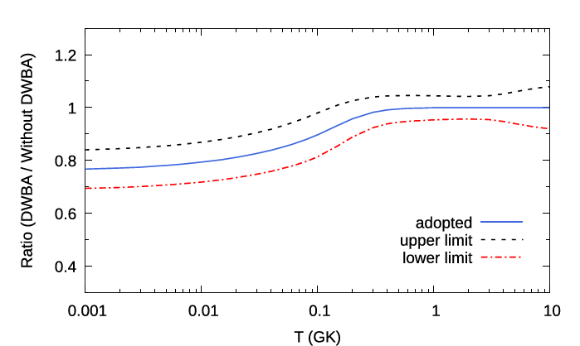
Reaction rates
The ⁷Li(p,α)⁴He reaction rates at 0.001≤T9≤10 are calculated using the present DWBA-predicted cross-sections and available experimental data [Nucl. Phys. 33, 449 (1962), Nucl. Phys. 60, 588 (1964) and Nucl. Instrum. Methods Phys. Res. Sect. B 267, 478 (2009).] below and above Ecm ≃0.9 MeV, respectively.
It was found that the present DWBA prediction results in 5%–25% difference in reaction rate below T9 = 0.2.
The ratio of the ⁷Li(p,α)⁴He reaction rates calculated from DWBA fitting plus experimental data [Nucl. Phys. 33, 449 (1962), Nucl. Phys. 60, 588 (1964) and Nucl. Instrum. Methods Phys. Res. Sect. B 267, 478 (2009).] to those calculated without DWBA results.
12
NPA-XII, Cluj-Napoca, Romania.

Slide 13
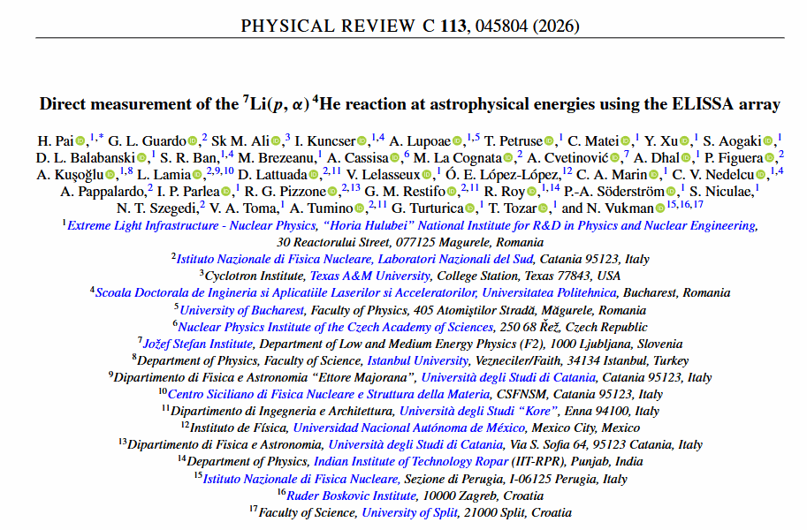
NPA-XII, Cluj-Napoca, Romania.

Slide 14
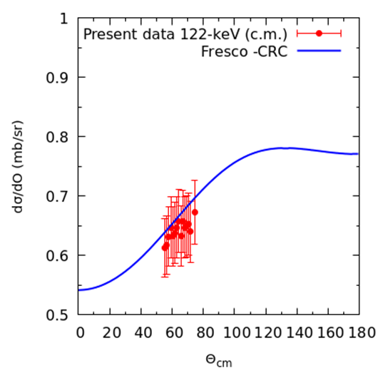
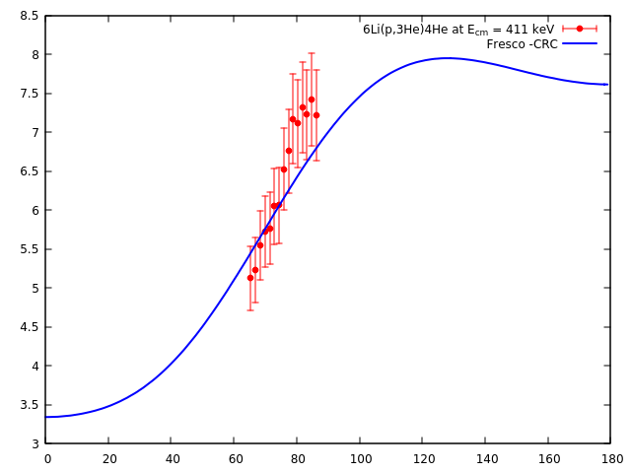
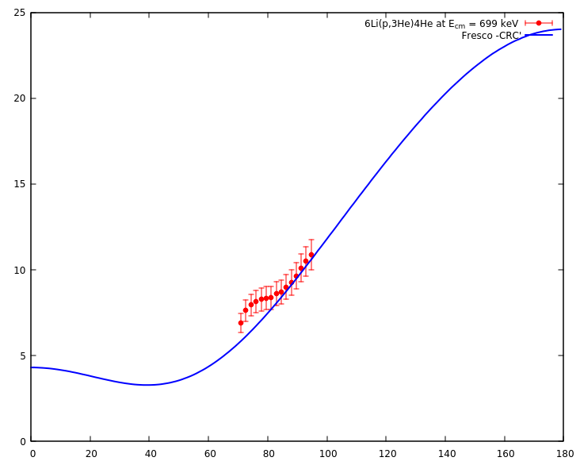
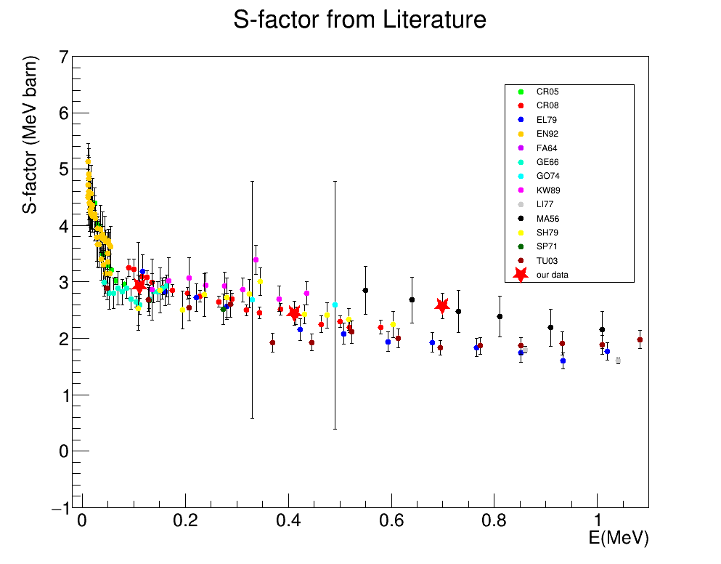
⁶Li(p,α)³He reaction measurement using the ELISSA array
We have also successfully measured the ⁶Li(p, α)³He reactions at 9, 5, 3, and 1 MeV (E_{lab}) energies with a CH₂ target.
The total cross-sections (σ_{total}) were obtained using CRC (coupled-reaction channel) calculations with the fresco code.
Please see the poster presentation by Ms. Ana Lupoae on 08/09/206.
NPA-XII, Cluj-Napoca, Romania.

Slide 15
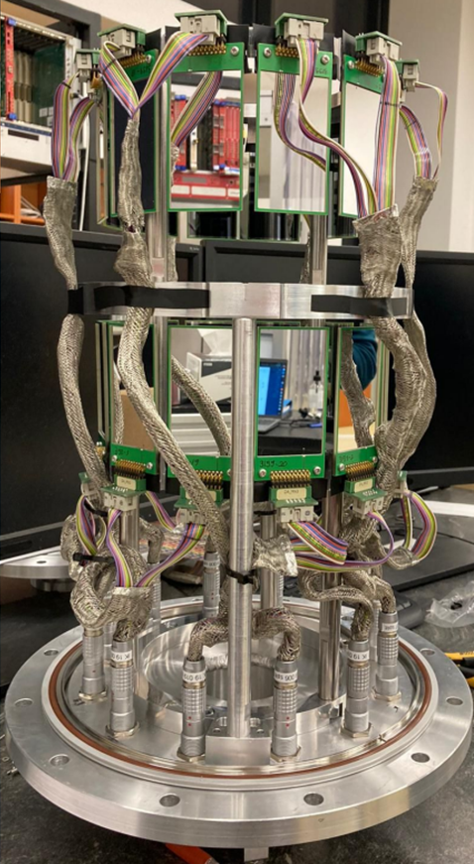
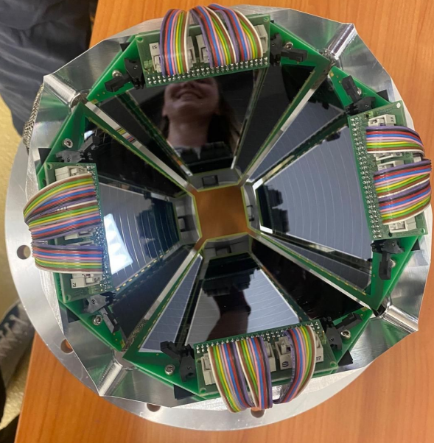
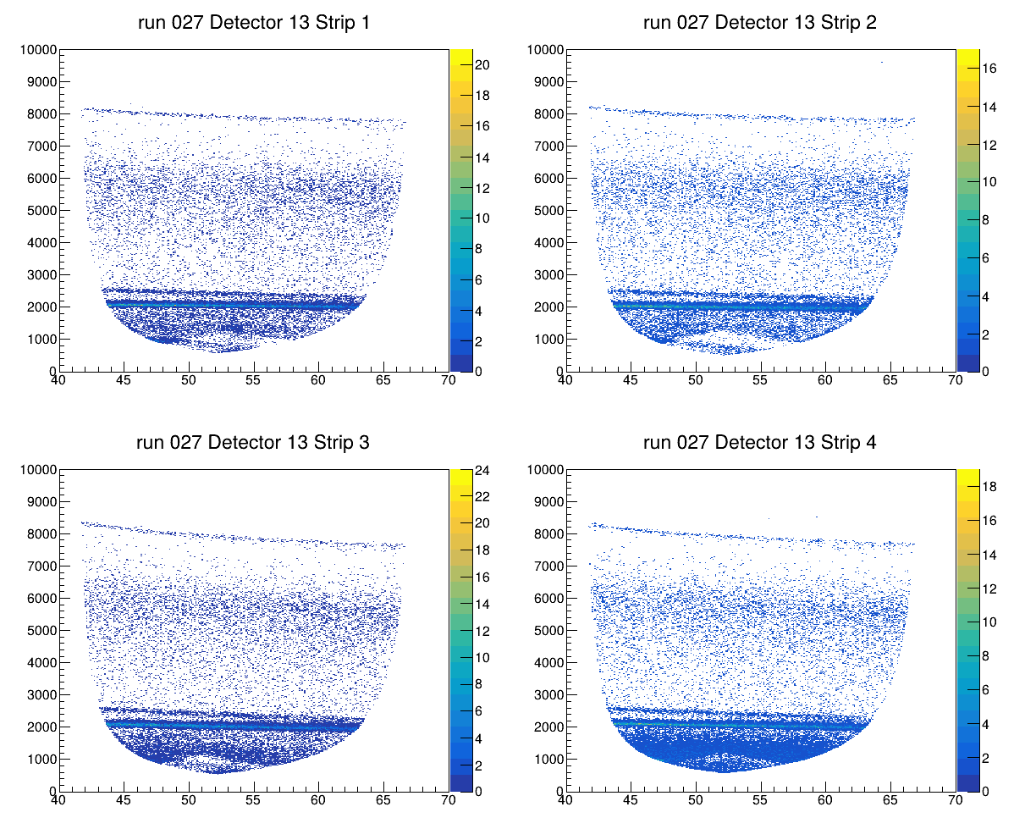
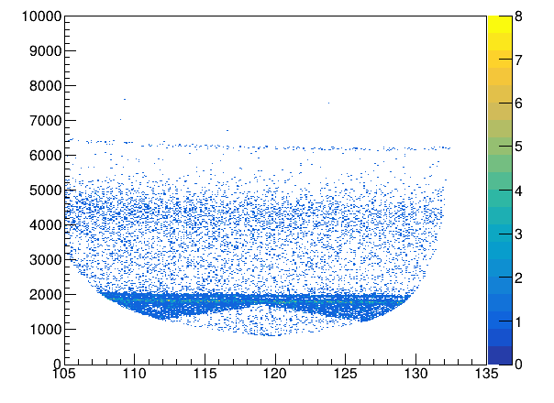

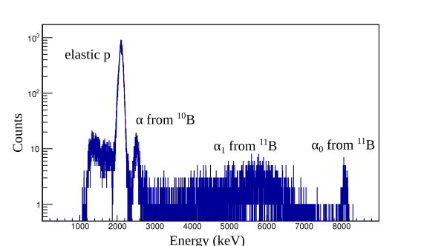
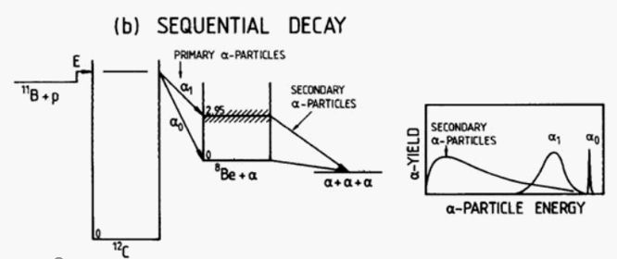
Recent measurements with ELISSA: ¹¹B(p,α)αα
α₀
α₀
E vs 𝜃 correlation for p+¹¹B at 2.2 MeV
Please see the oral presentation by Dr. Kabita Kundalia on 08/09/206.
Target: ¹¹B ~ 50 - 150 𝜇g/cm²
Beam: Proton
(300 keV to 2600 keV)
Energy spectra in one strip of a detector in the forward ring.
15
NPA-XII, Cluj-Napoca, Romania.

Slide 16
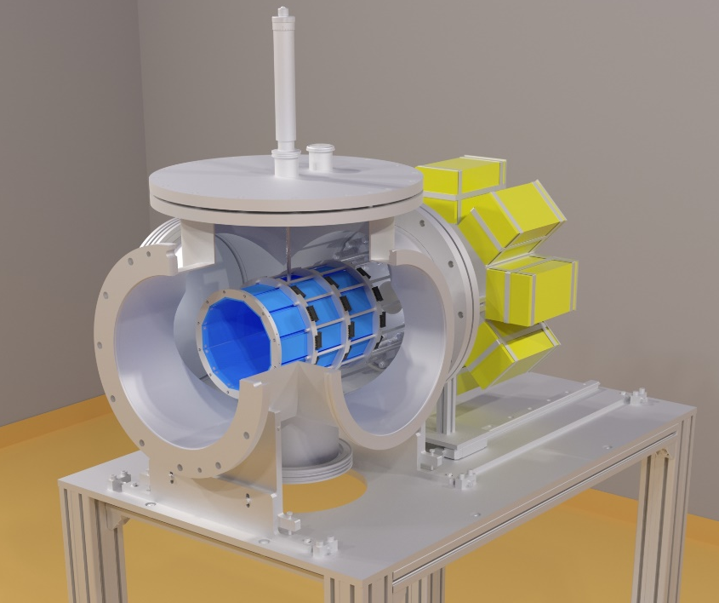
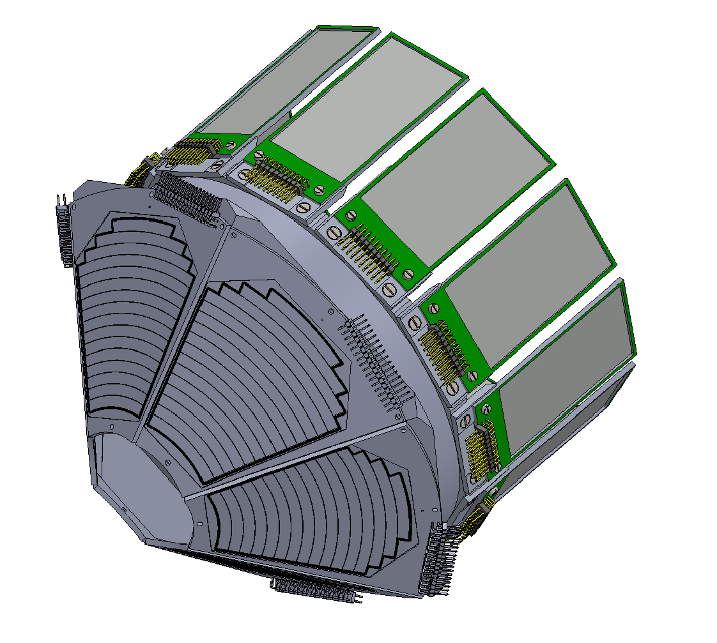
ELISSA – upgrade
ELISSA needs to upgrade to a DN320 chamber, as mini-ELISSA has limitations in detector configurations
Multiple configurations possible with the X3, YY1, MMM, and QQQ3 detectors
16
NPA-XII, Cluj-Napoca, Romania.

Slide 17
CONCLUSIONS…..
The first in-beam characterization of the ELISSA silicon strip array with one ring has been carried out.
The ⁷Li(p, α)⁴He, ⁶Li(p, α)³He, and ¹¹B(p,α)αα experiment was successfully carried out at the IFIN-HH 3 MV Tandem using the mini-ELISSA reaction chamber.
The ⁷Li(p,α)⁴He reaction rates at 0.001≤T9≤10 are calculated using the present DWBA-predicted cross-sections and available experimental data [literature] below and above Ecm ≃0.9 MeV, respectively.
It was found that the present DWBA prediction results in a 5%–25% difference in reaction rate below T9 = 0.2.
17
NPA-XII, Cluj-Napoca, Romania.

Slide 18
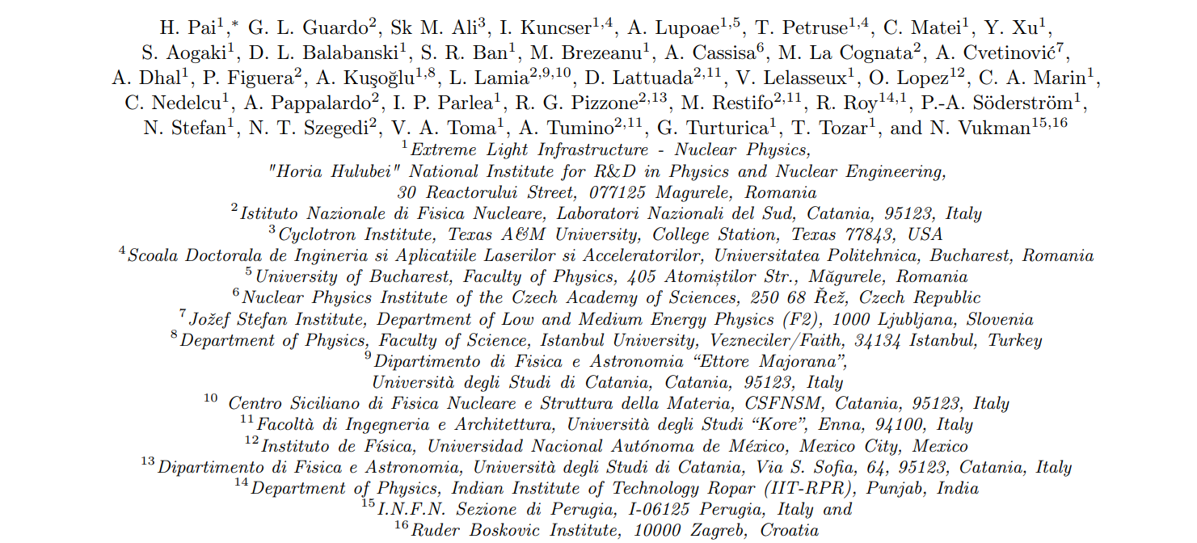
I would like to thank all the ELISSA collaborators
18
NPA-XII, Cluj-Napoca, Romania.

Slide 19

ELISSA TEAM
I. Kuncser, K. Kundalia, A. Lupoae, T. Petruse, C. Matei, H. Pai, Yi Xu, D. L. Balabanski
Acknowledgement : This work was supported by a grant of the Ministry of Research, Innovation and Digitization, CNCS - UEFISCDI, project number PN-IV-P2-2.1-TE-2023-0144, within PNCDI IV. Partial support was received under contract PN 23 21 01 06, also sponsored by the Romanian Ministry of Research, Innovation and Digitalization, as well as from the European Union's Horizon Europe Research and Innovation Programme under Grant Agreement No. 101057511 (EURO-LABS).
19
NPA-XII, Cluj-Napoca, Romania.

Slide 20
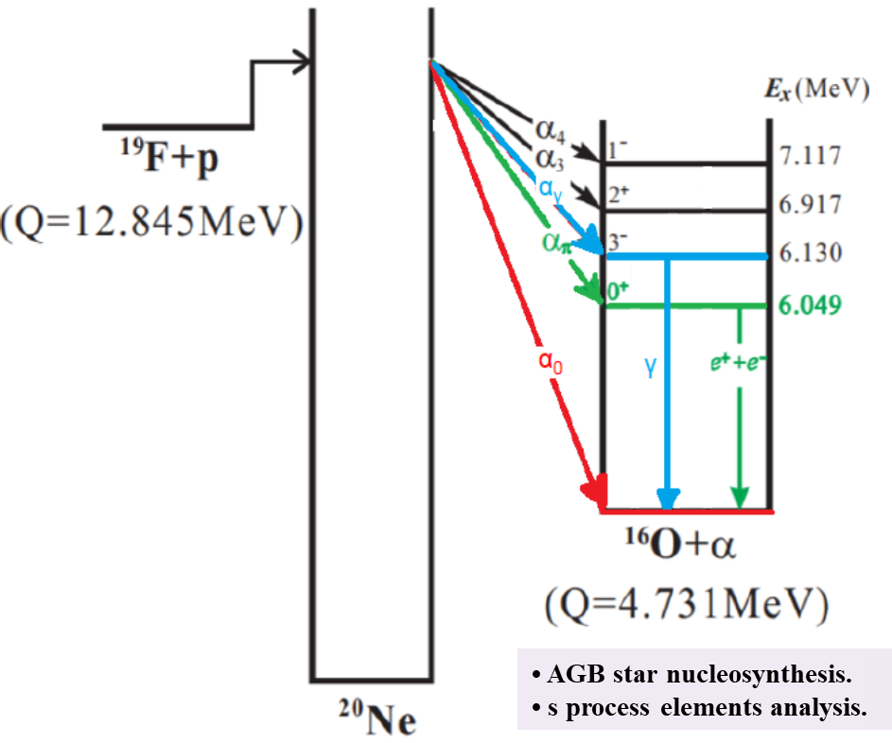
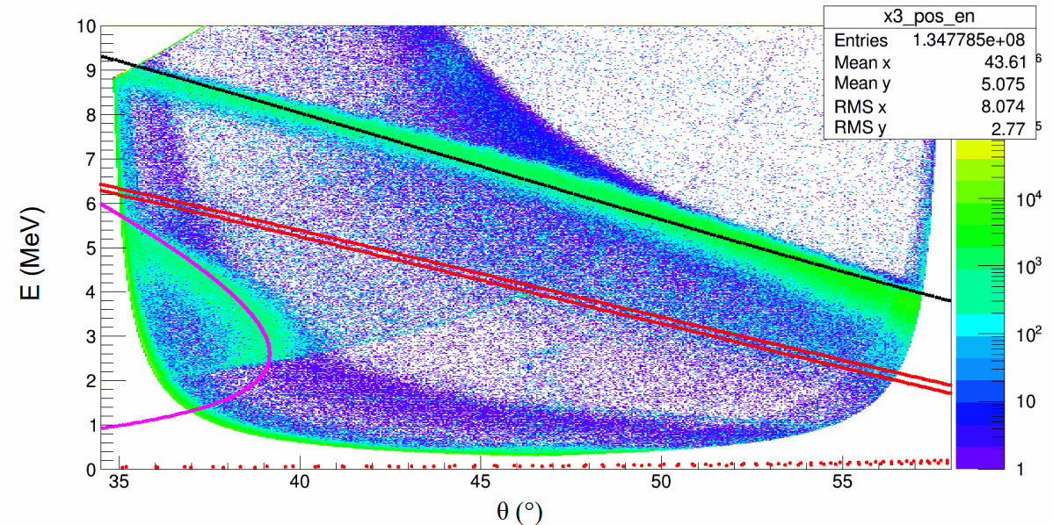
Recent ¹⁹F(p, α)¹⁶O experiment at the IFIN-HH 3 MV Tandem
A new direct measurement of α₀, α_{π}, and α_{γ} channels has been carried out.
12 X3 detectors from ELISSA
5 YY1 detectors from LHASA
¹²C
PRELIMINARY RESULTS
The X3 detectors are placed at a distance of ~ 6 cm from the target center. The diameter of the barrel is ∼ 19.54 cm.
Target: CH₂
Beam: ¹⁹F
Beam Energy: 7 to 15 MeV
α_{π}
¹⁹F
α_{γ}
Part of the Ph. D. Work of Ms. Teodora Petruse

Slide 21
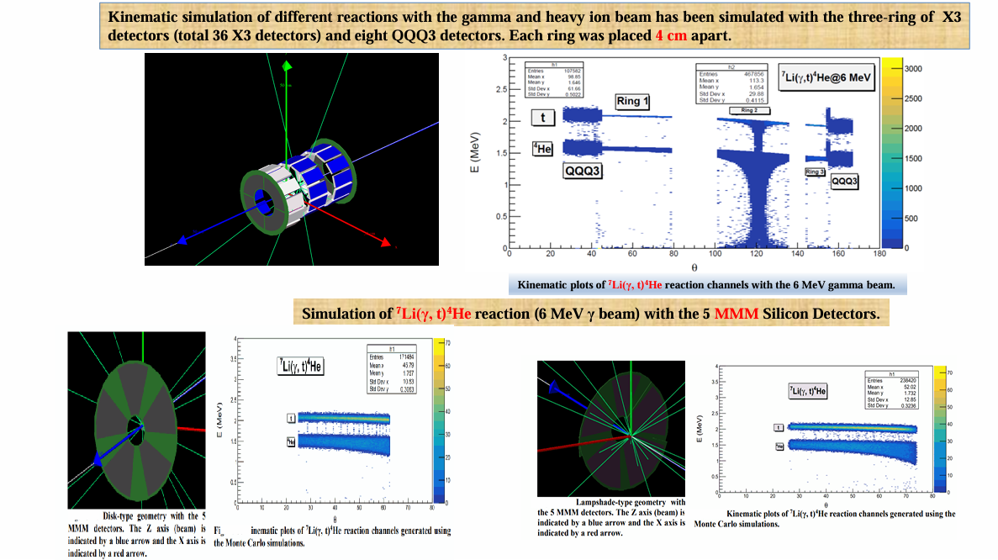
Simulation of ELISSA using the Monte Carlo simulation code NPTool
21
INP-NPG 2026

Slide 22
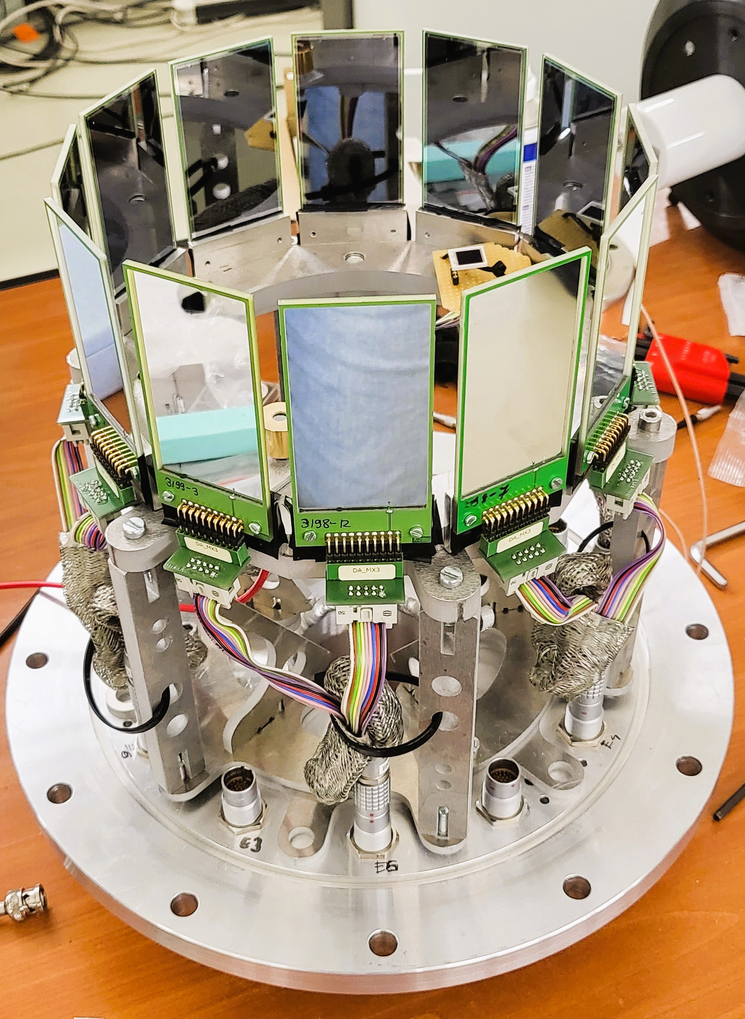
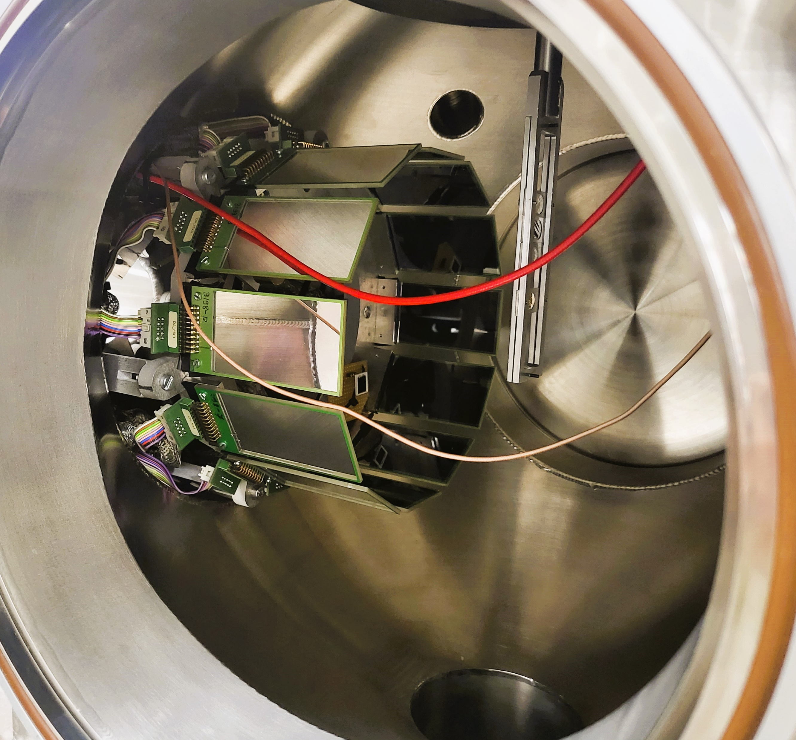
⁷Li(p, α)⁴He experiment at the IFIN-HH 3 MV Tandem
A scaled-down version of the ELISSA detector array in the mini-ELISSA chamber
A scaled-down version of the full ELISSA array (one ring).
mini-ELISSA chamber
22
INP-NPG 2026

