Slide 1
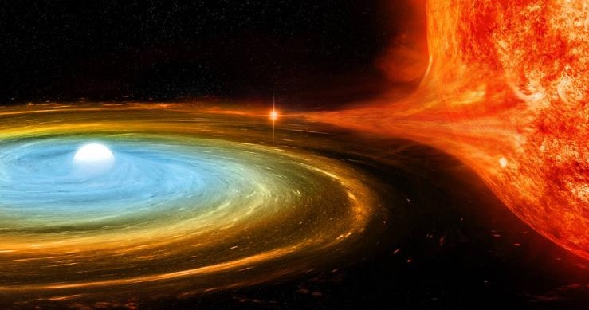
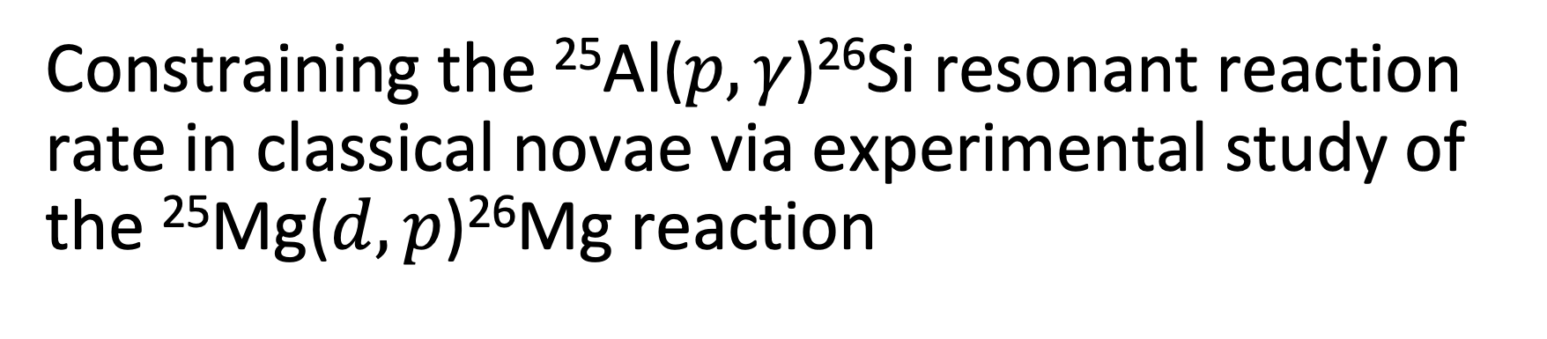
Constraining the ²⁵Al($p,γ$)²⁶Si resonant reaction rate in classical novae via experimental study of the ²⁵Mg($d,p$)²⁶Mg reaction
Nathan Giha
Postdoctoral Researcher at IJCLab
11 September 2026
²⁶Al nucleosynthesis
²⁶Si resonances
²⁵Mg(d,p)²⁶Mg@ALTO
Rate & perspectives

Slide 2
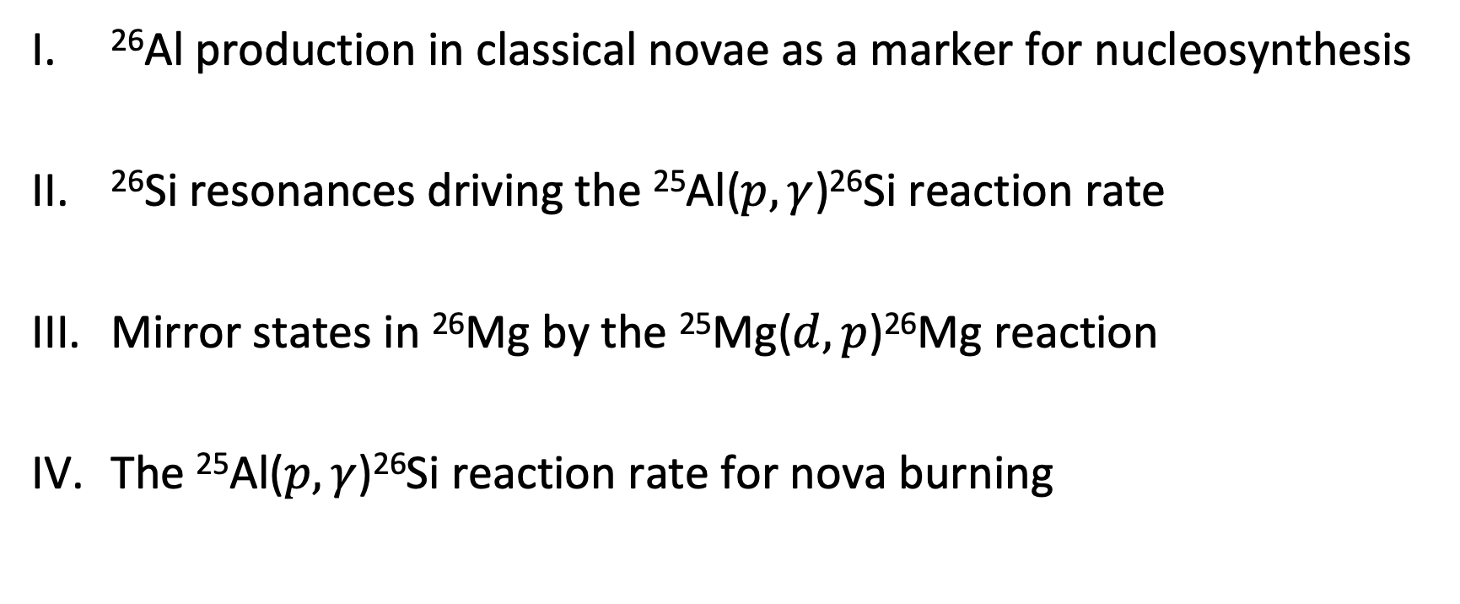
Outline
²⁶Al production in classical novae as a marker for nucleosynthesis
²⁶Si resonances driving the ²⁵Al($p,γ$)²⁶Si reaction rate
Mirror states in ²⁶Mg by the ²⁵Mg($d,p$)²⁶Mg reaction
The ²⁵Al($p,γ$)²⁶Si reaction rate for nova burning

Slide 3
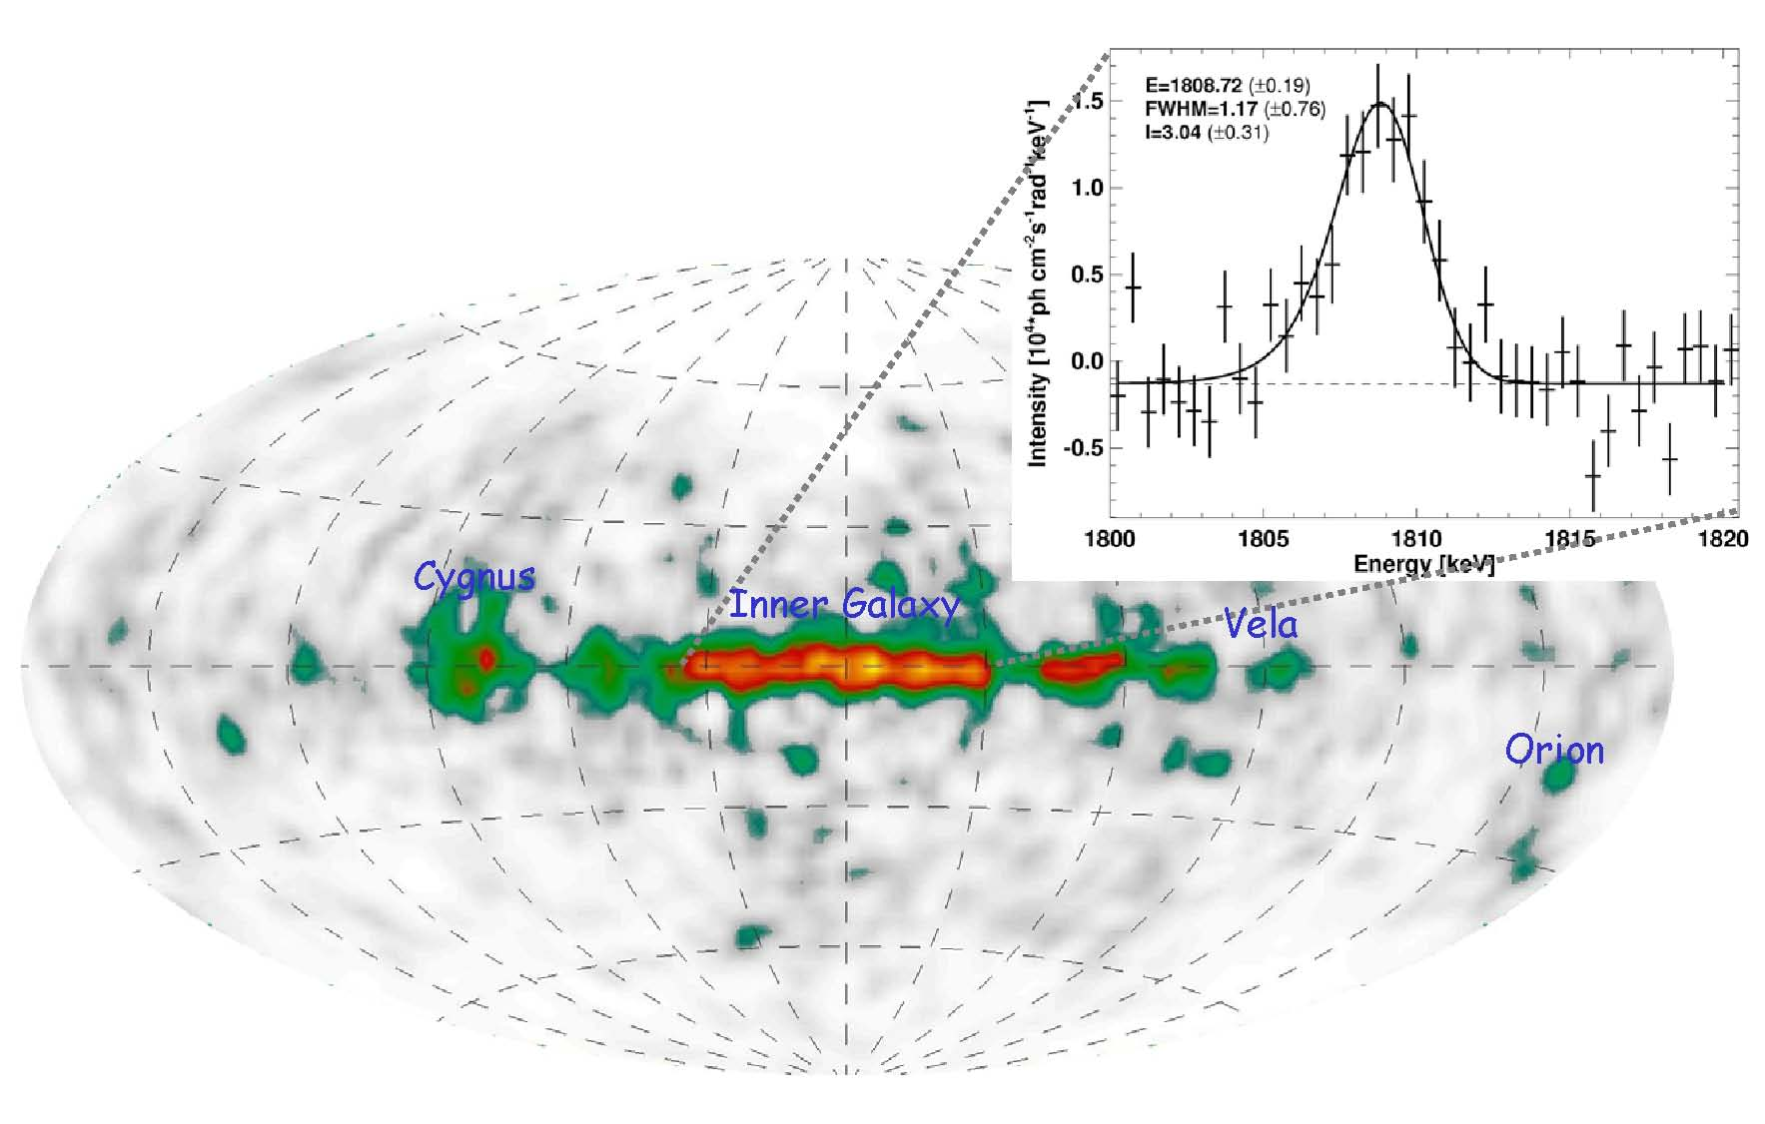
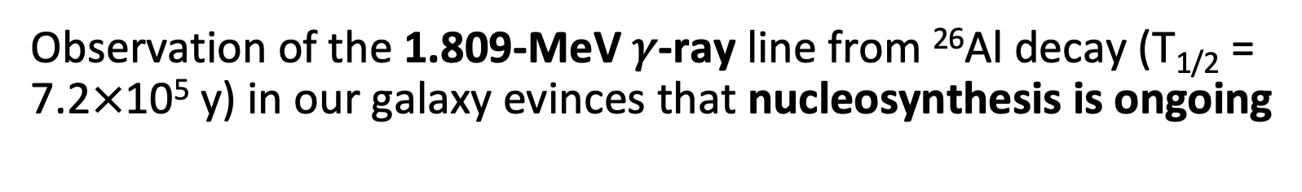
²⁶Al abundance and nucleosynthesis in novae
Observation of the 1.809-MeV 𝛾-ray line from ²⁶Al decay (T_{1/2} = 7.2$×$10⁵ y) in our galaxy evinces that nucleosynthesis is ongoing
Hotspots (Cygnus, Vela, Orion, galactic plane): Groups of massive stars–winds and core-collapse supernovae
Disperse contribution: Classical novae, up to 30% of ²⁶Al production
  COMPTEL Map of the 1.809-MeV ²⁶Al Sky,
  MPE Garching/Roland Diehl
²⁶Al nucleosynthesis
²⁶Si resonances
²⁵Mg(d,p)²⁶Mg@ALTO
Rate & perspectives
Notes:
Typical sites: Mostly massive stars (CCSN, winds), some novae and AGB contribution
T~few 10^5 K

Slide 4
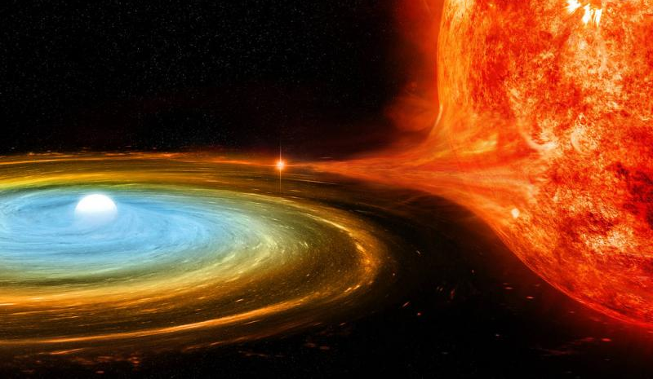
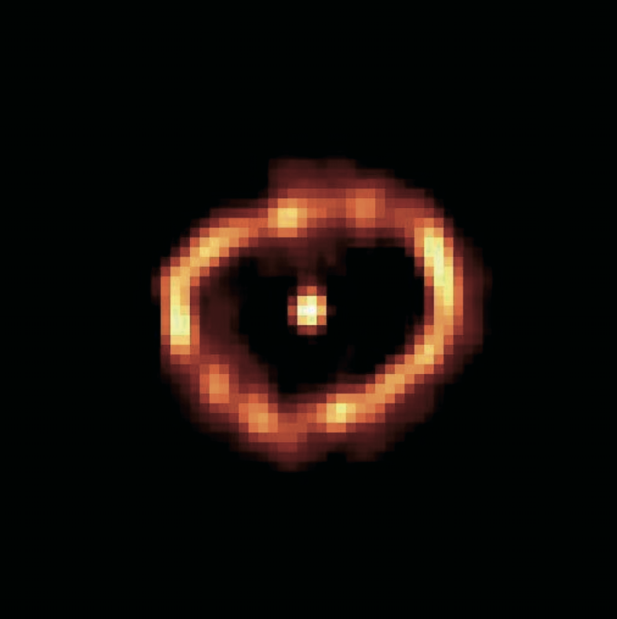
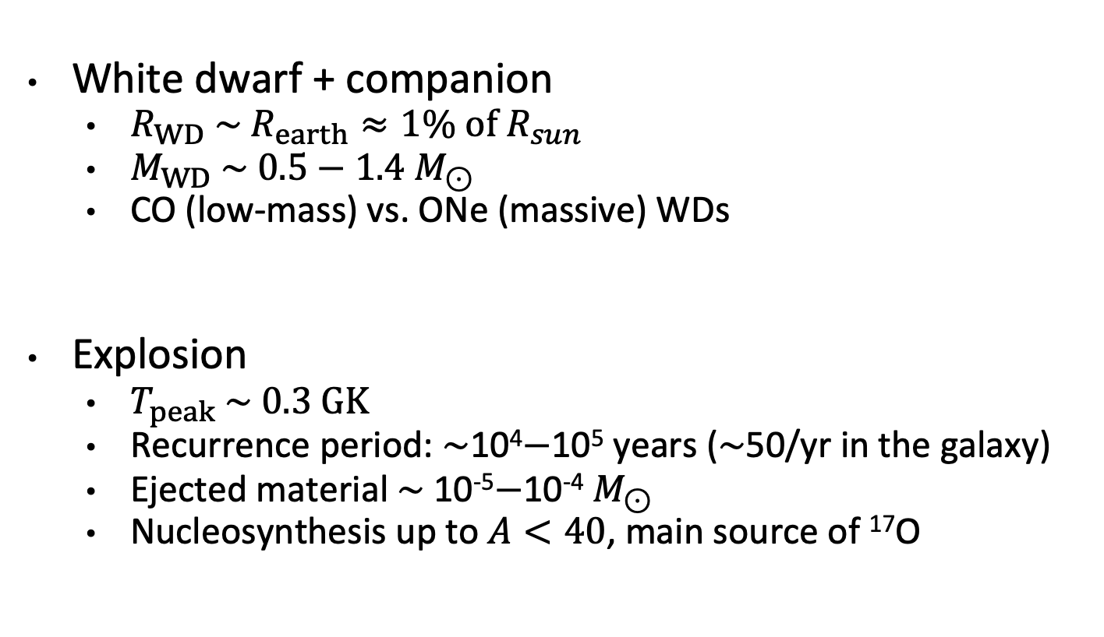
Classical novae: Accretion on a white dwarf
White dwarf + companion
  $R_{WD} \sim R_{earth}≈1\% of R_{sun}$
  $M_{WD} \sim 0.5−1.4 M_{⊙}$
  CO (low-mass) vs. ONe (massive) WDs
Explosion
  $T_{peak} \sim 0.3 GK$
  Recurrence period: $\sim$10⁴$−$10⁵ years ($\sim$50/yr in the galaxy)
  Ejected material $\sim$ 10⁻⁵$−$10⁻⁴ $M_{⊙}$
  Nucleosynthesis up to $A<40$, main source of ¹⁷O
  Artist’s rendition of a white dwarf accreting H-rich matter from a companion star
Nova V1974 Cygni 1992 (Hubble Space Telescope)
²⁶Al nucleosynthesis
Notes:
Solar mass ~ 2x10^30 kg
- 402 known galactic novae
WD mass range (Schaefer 2025 https://iopscience.iop.org/article/10.3847/1538-4357/ae0616/pdf)
Explosion time (Starrfield+ 2016 https://arxiv.org/pdf/1605.04294)
- TNR (explosive burning): ~10²–10³ s
- Rise to optical peak: ~10⁵–10⁶ s (1–2 days to weeks)
- Speed-class decline (t2): ~10⁶–10⁷ s (days to ~250 days)
- True return to quiescence: ~10⁸–10⁹ s (years to decades)Quiz?

Slide 5
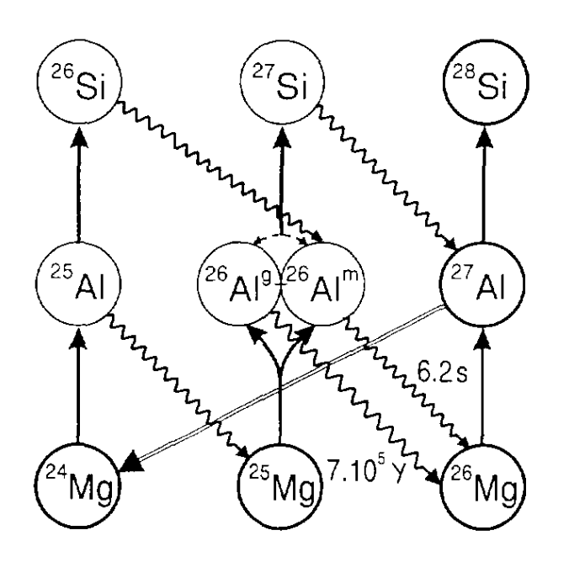
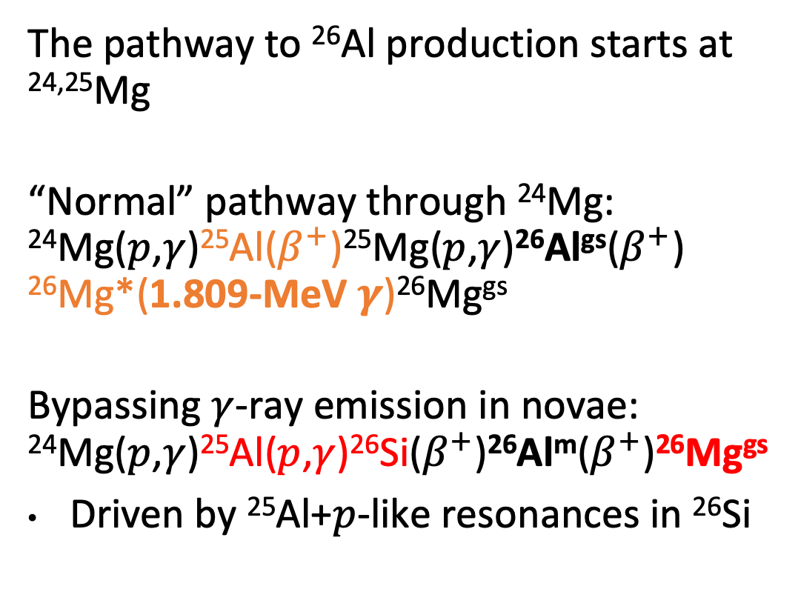
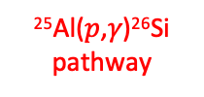


The impact of ²⁵Al($p$,𝛾)²⁶Si on $γ$-ray observations
The pathway to ²⁶Al production starts at ^{24,25}Mg
“Normal” pathway through ²⁴Mg: ²⁴Mg($p$,$γ$)²⁵Al($β^{+}$)²⁵Mg($p$,$γ$)²⁶Al^{gs}($β^{+}$)
²⁶Mg*(1.809-MeV $γ$)²⁶Mg^{gs}
Bypassing $γ$-ray emission in novae: ²⁴Mg($p$,$γ$)²⁵Al($p$,$γ$)²⁶Si($β^{+}$)²⁶Al^{m}($β^{+}$)²⁶Mg^{gs}
Driven by ²⁵Al+$p$-like resonances in ²⁶Si
²⁵Al($p$,𝛾)²⁶Si pathway
1.809-MeV 𝛾-ray pathway:
1.8-MeV $γ$ ray
  Pathways to ²⁶Al^{(m)} synthesis in classical novae,
  N. Prantzos and R. Diehl, Physics Reports 267, 1-69 (1996)
²⁶Al nucleosynthesis
Notes:
The 1.8 MeV gamma Ray Sky, shown on the left, is a map of currently ongoing nucleosynthesis in the galaxy, evidenced by the fact that the half-life of aluminum-26 (which produces this gamma ray) is about 10^6 years, several orders of magnitude shorter than the timescale of galactic evolution.
The typical reaction pathway starts at magnesium-24 and proceeds mostly through gamma-ray emission
One site of aluminum-26 production is Classical Novae, where the temperatures are high enough that a competing reaction pathway can obscure the amount of nucleosynthesis that's happening.
The aluminum-25 (p,gamma) reaction, highlighted in red here, ultimately bypasses the emission of this gamma ray, so its reaction rate must be constrained to use gamma-ray observations to determine the amount of nucleosynthesis happening in novae.
T~few 10^5 K

Slide 6
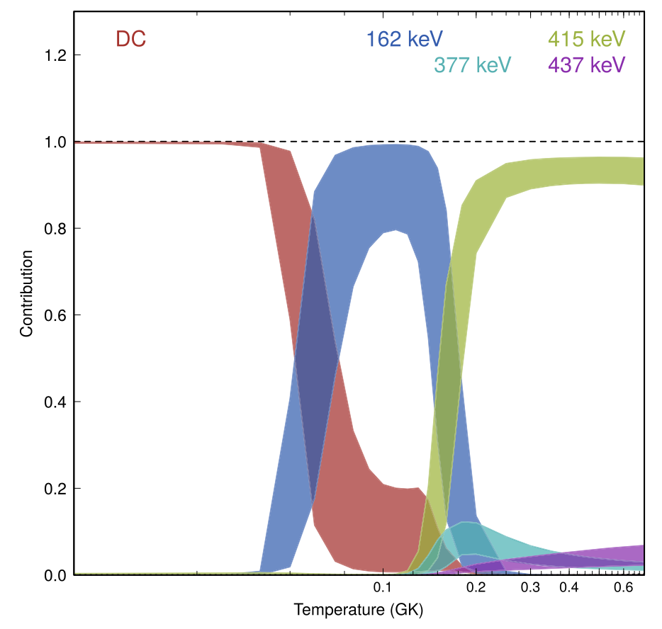
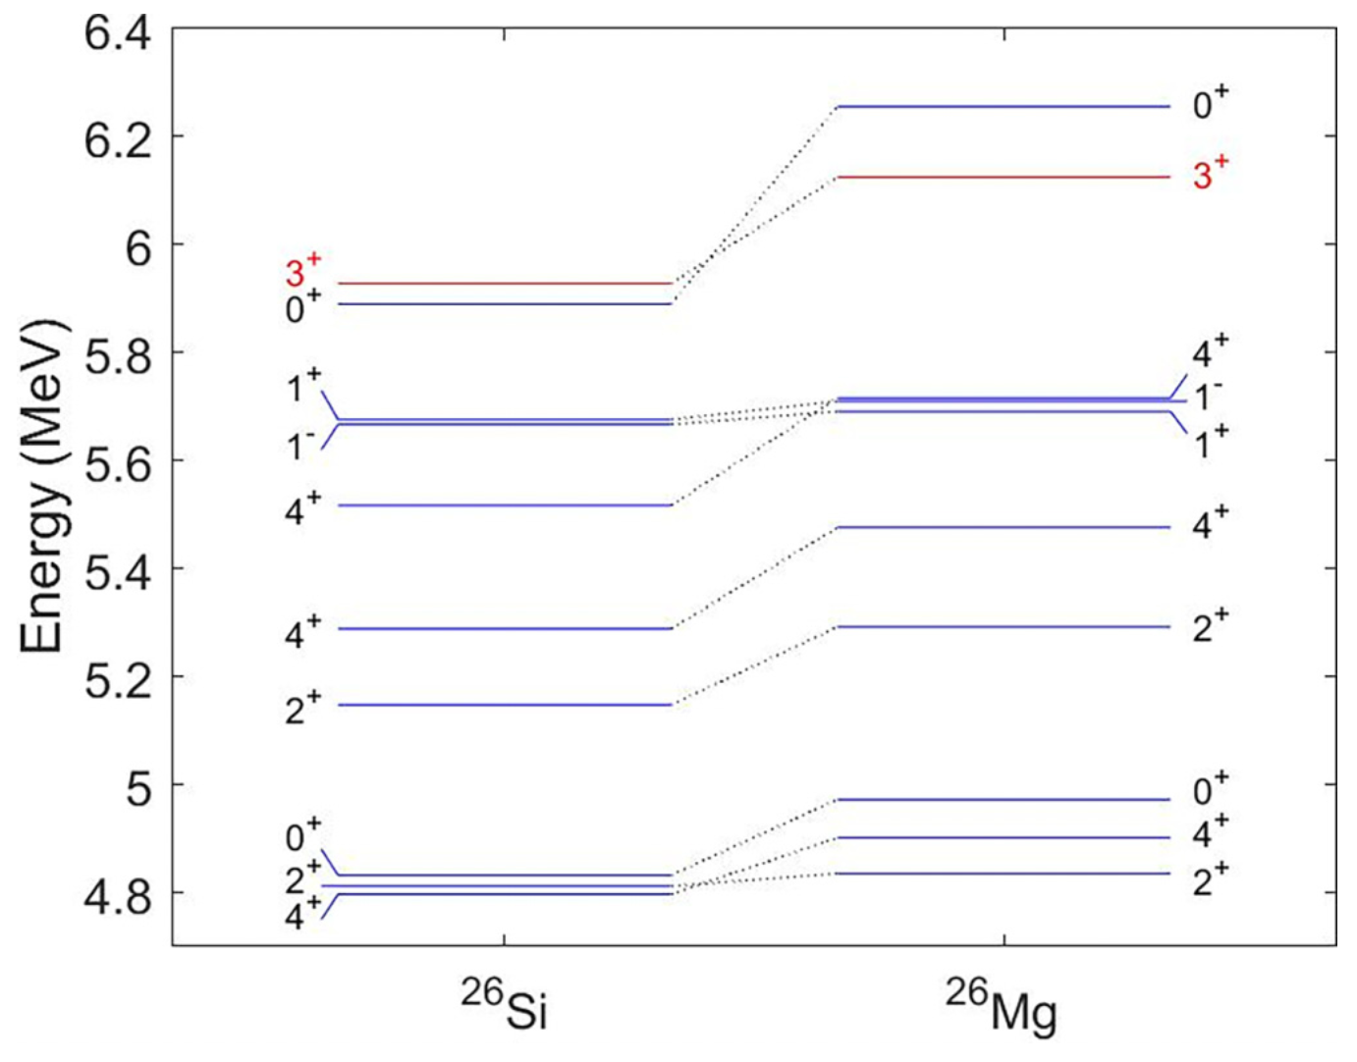
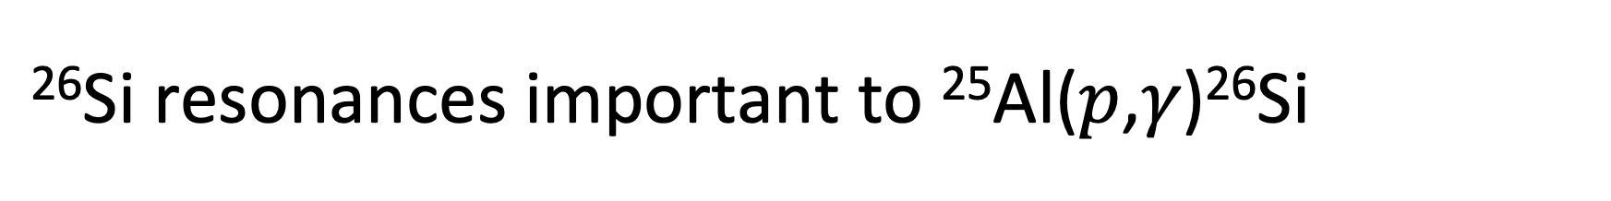


²⁶Si resonances important to ²⁵Al($p$,𝛾)²⁶Si
6256 keV
6125 keV
$$T_{9}\sim 0.2−0.4$$
1⁺
3⁺
5716 keV
(?) 5710 keV
(?)
5691 keV
$$S_{p}$$
Important: 3⁺,
Maybe: 1⁺ (, 1⁻ ?)
Not important: 0⁺, 4⁺
0⁺
  Relative contribution of ²⁶Si resonances to the reaction rate
  (Laird+ 2023)
  Experimental excitation energies in ²⁶Si and its mirror, ²⁶Mg (Cañete+ 2023)
²⁶Si resonances
Notes:
Sp=5514 keV

Slide 7
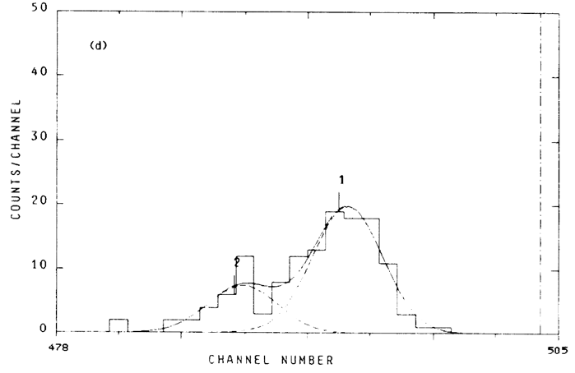
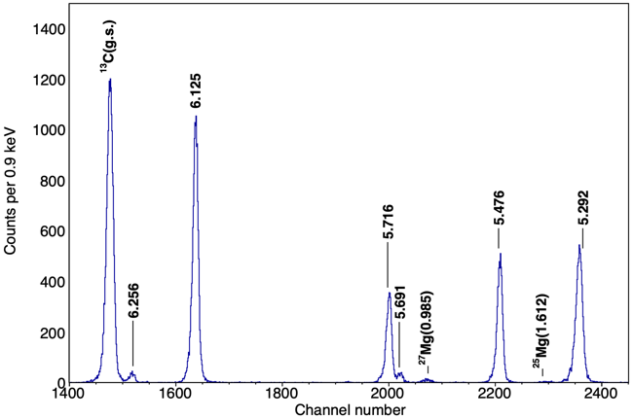
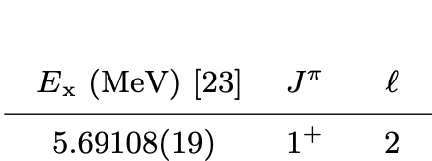
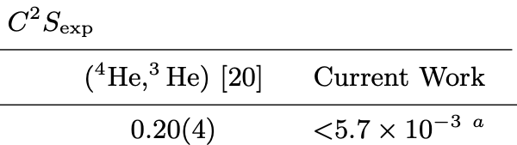


The 1⁺ resonance in the literature
4⁺ (& 1⁻ ?)
1⁺
1⁺
4⁺ (& 1⁻ ?)
  ²⁵Mg(⁴He,³He) ²⁶Mg at $E_{α}$=50 MeV (Yasue+ 1990)
  ²⁵Mg($d,p$)²⁶Mg at $E_{d}$= 8 MeV (Hamill+ 2020)
Yasue+ (⁴He,³He)
Hamill+ ($d,p$)
  2 orders of magnitude tension in literature for $C^{2}S$(5691 keV)
²⁶Si resonances

Slide 8
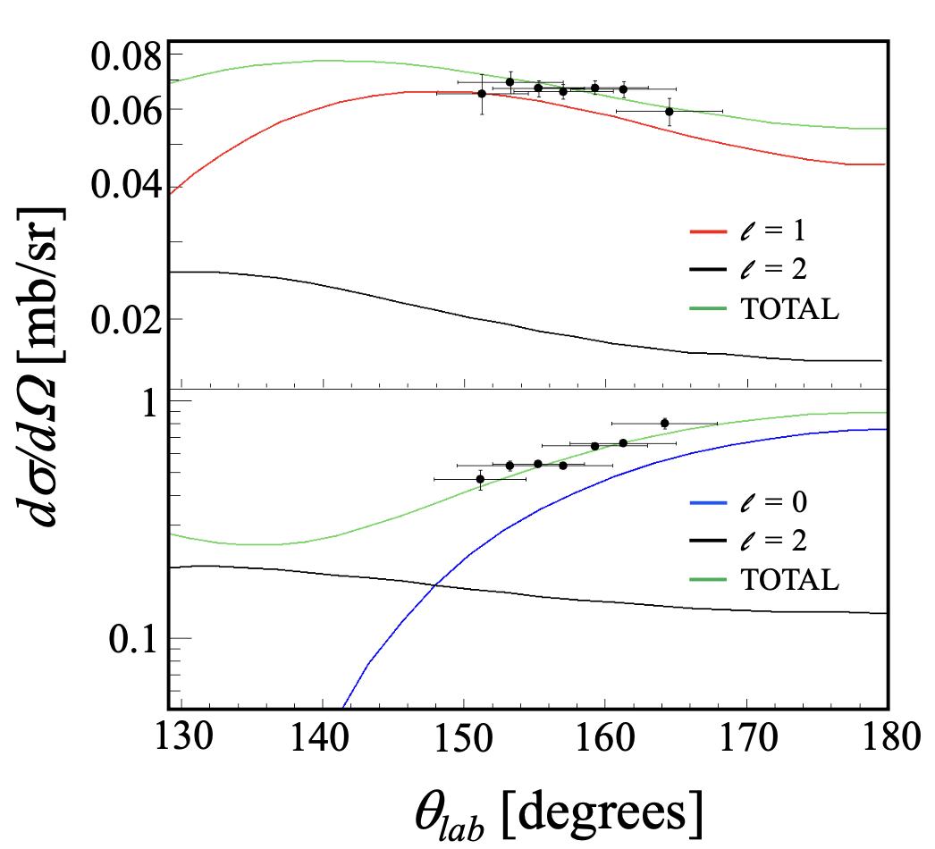
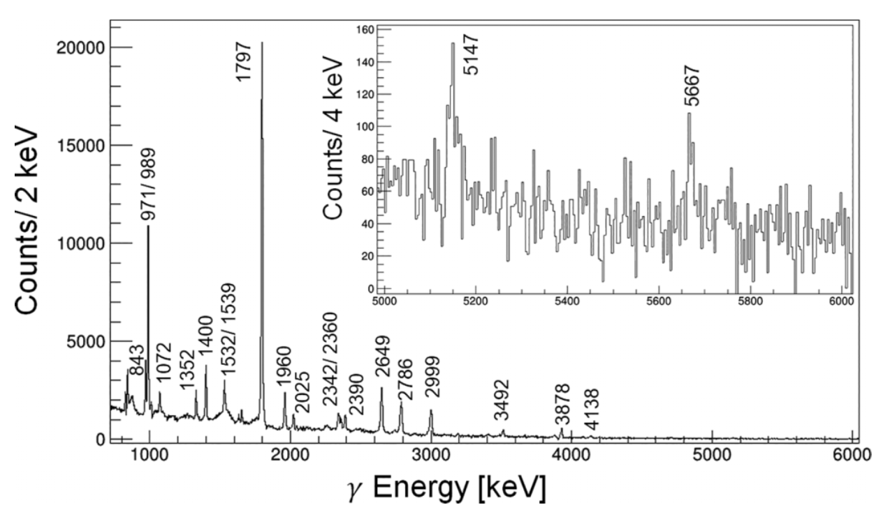
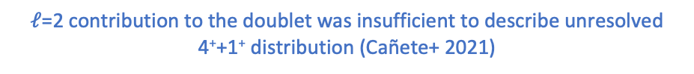
The 1⁻ resonance: our doublet becomes a triplet
Fusion-evap. To ²⁶Si with GRETINA
²⁵Mg(d,p) in inverse kinematics
Found ²⁶Si direct-to-ground state transition at 5667 keV, identifying with 1⁻ (Cañete+ 2023)
$ℓ$=2 contribution to the doublet was insufficient to describe unresolved 4⁺+1⁺ distribution (Cañete+ 2021)
²⁶Si resonances
Notes:
Cañete+ found:
evidence for odd-$ℓ$ contribution within the ²⁶Mg doublet and assigned 1⁻ (2021)
revised the energy of the corresponding ²⁶Si resonance to 5667 keV (2023)
Canete 2021: 25Mg(d,p) at 10 MeV/u (thCm~4-17 deg.) in inverse kinematics
Canete 2023: Transition direct to g.s.
- Mention burlein/arscheewkjisadjfiosaski l=3 component before lack of l=3 in Canete

Slide 9
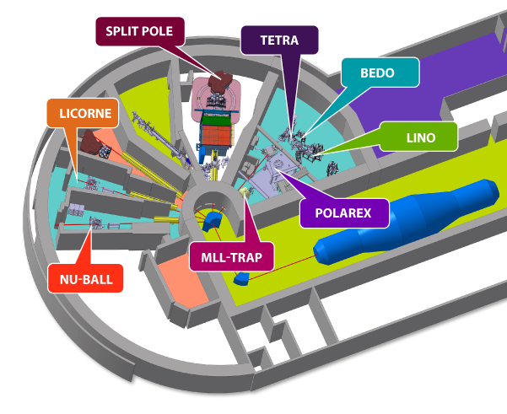

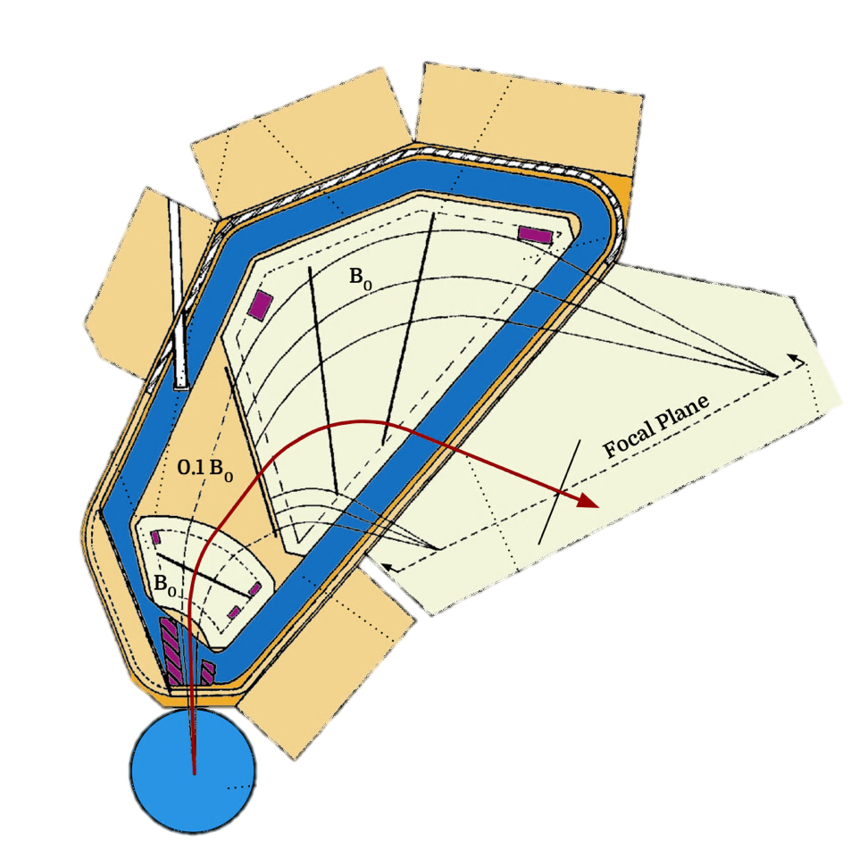
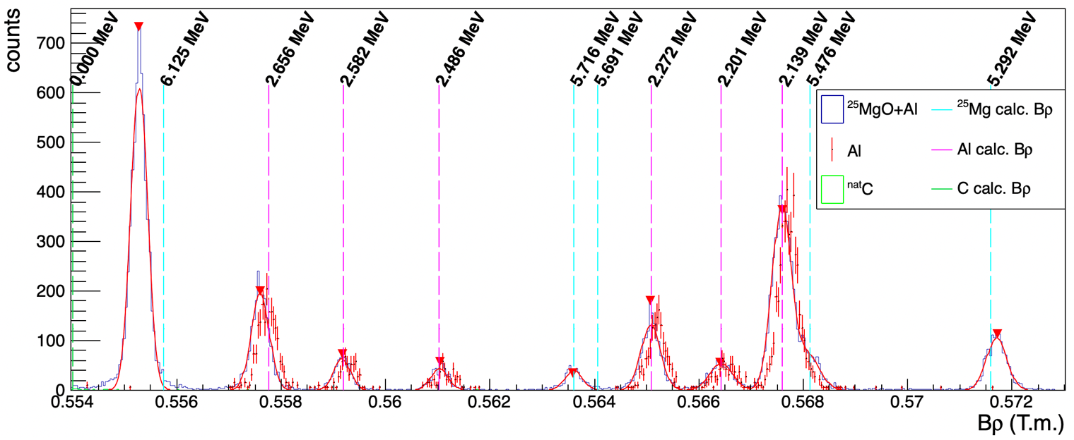







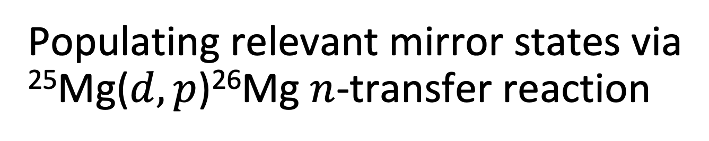
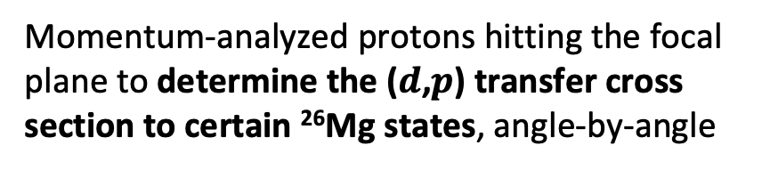

Populating relevant mirror states via ²⁵Mg($d,p$)²⁶Mg $n$-transfer reaction
$$p$$
$$t_{PBρ}$$
$$Bρ\sim a\left(t_{PBρ}−t_{GBρ}\right)+b$$
$$t_{GBρ}$$
Position-sensitive gas detector
$ΔE$ proportional gas counter
$$p$$
$E_{res}$ plastic scintillator
Focal plane detector gives magnetic rigidity and light ejectile PID
$$d$$
²⁵MgO + Al backing
($d$,$p$) on ²⁵Mg target in Split-Pole magnetic spectrometer
  Momentum-analyzed protons hitting the focal plane to determine the ($d$,$p$) transfer cross section to certain ²⁶Mg states, angle-by-angle
Focal-plane spectra for ²⁵MgO+Al, Al, and C targets with calculated Bρ
²⁶Al nucleosynthesis
²⁶Si resonances
²⁵Mg(d,p)²⁶Mg@ALTO
Rate & perspectives
Notes:
Target: 25MgO (75 iug/cm^2) + Al (50 ug/cm^2)
Beam: d @ 12 MeV, ~30 nA (2e11 pps)

Slide 10
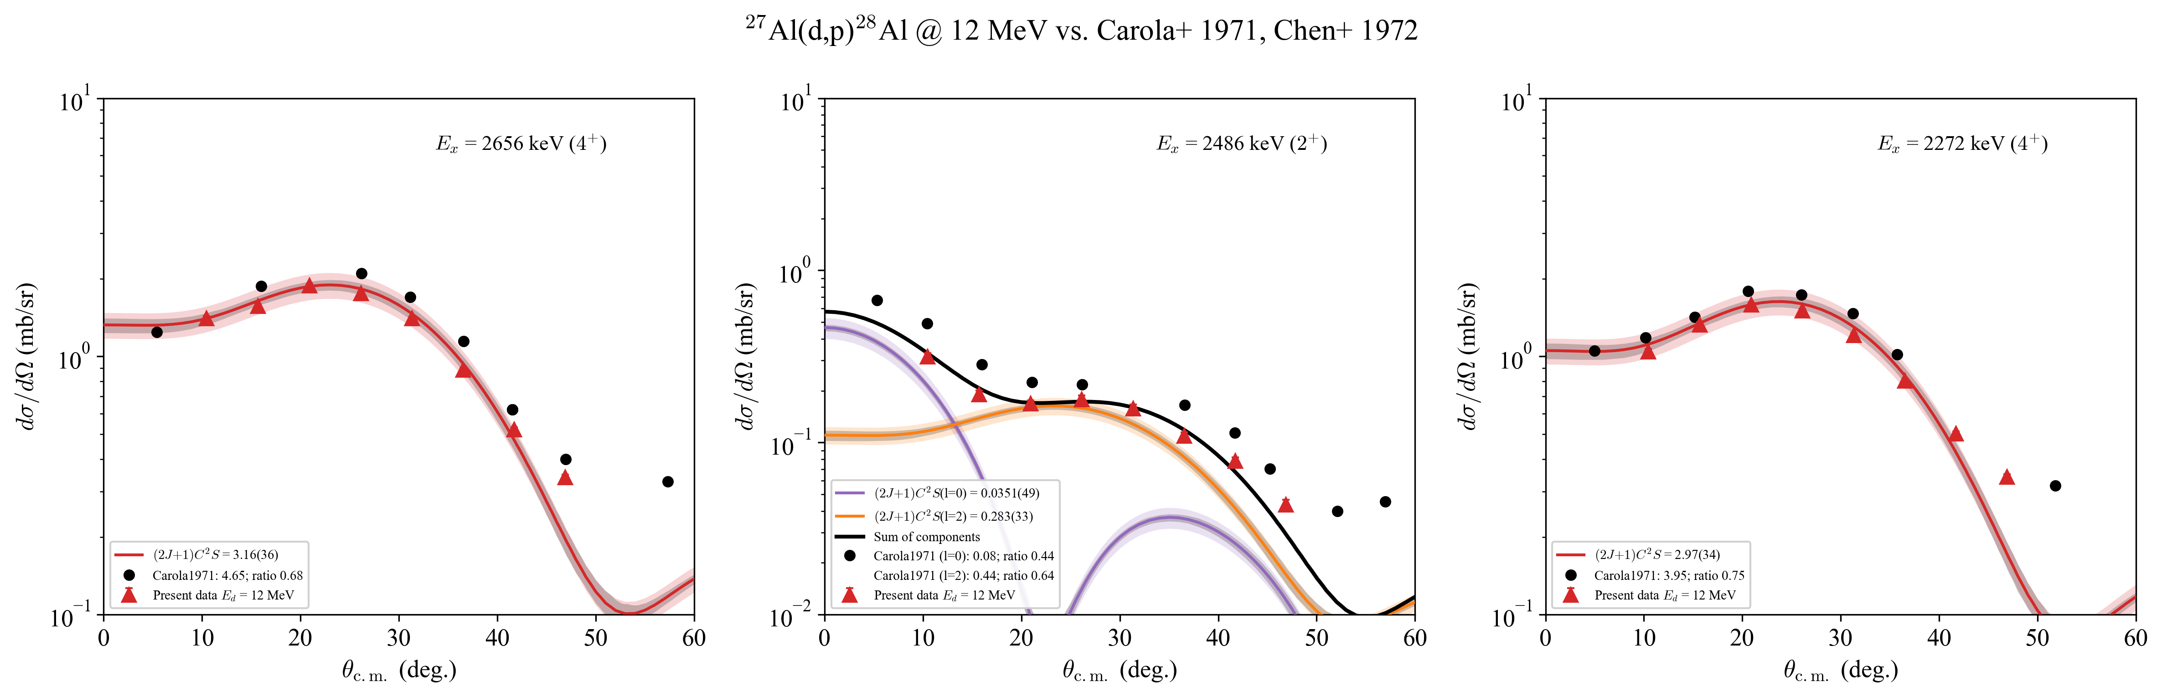
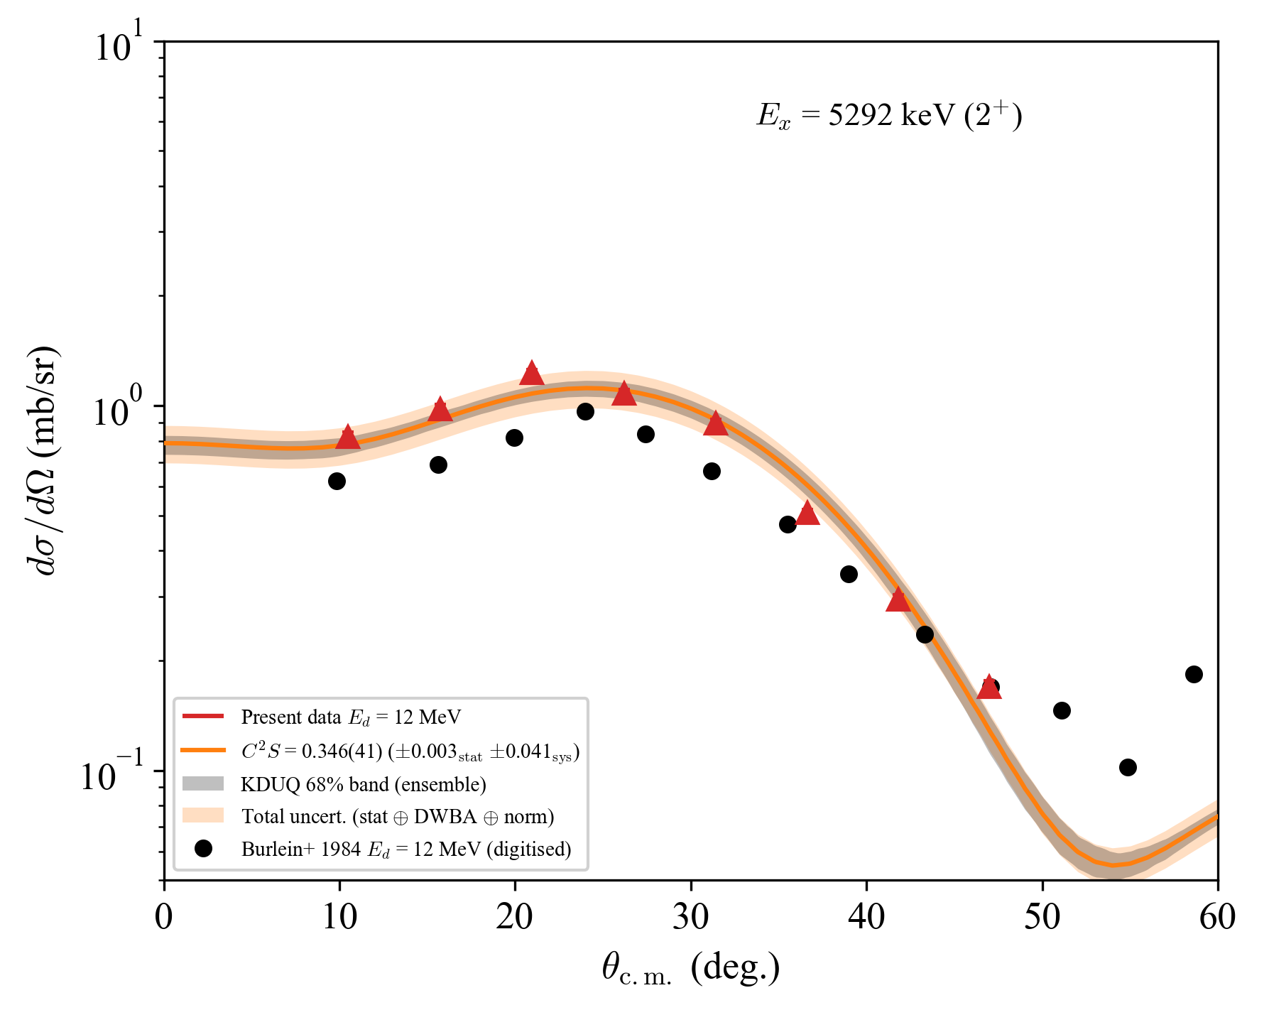
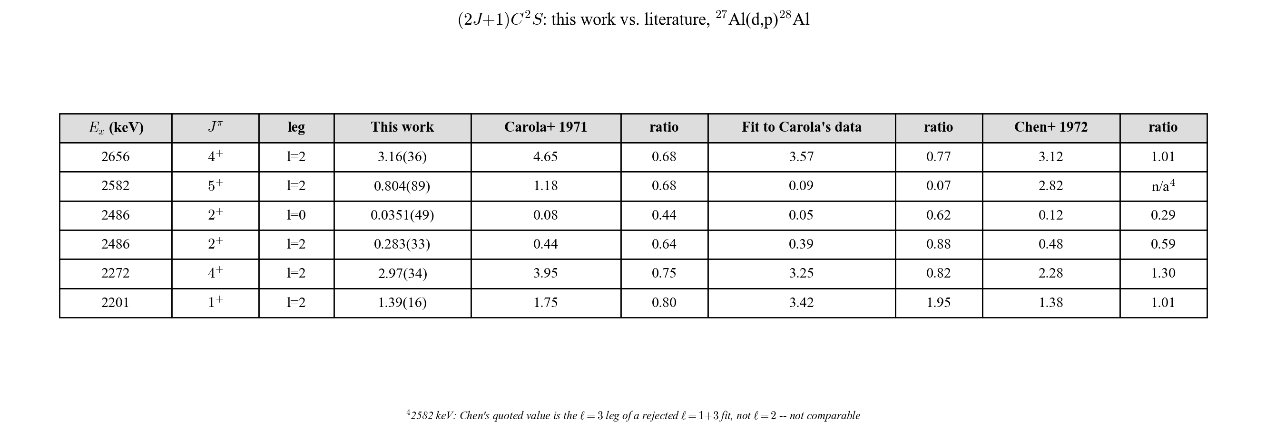
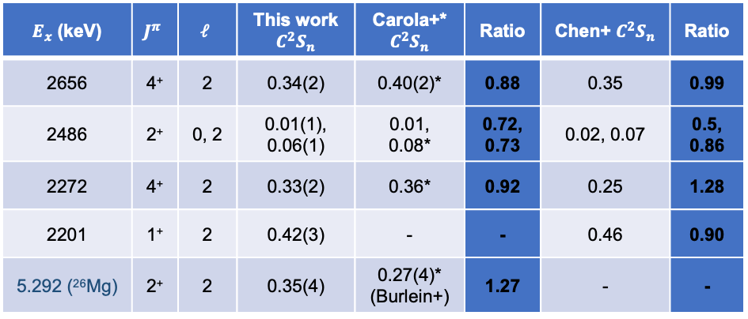
Verifying methodology with ²⁸Al and other ²⁶Mg states
Calculations: TWOFNR (ADWA) with KDUQ potentials, finite-range
Comparisons with Carola+ 1971 (²⁷Ap(d,p)) and Burlein+ 1984 (²⁵Mg(d,p))
²⁷Al(d,p)²⁸Al
²⁵Mg(d,p)²⁶Mg
$E_{x}$ (keV) | $$J^{π}$$ | $$ℓ$$ | This work $C^{2}S_{n}$ | Carola+* $C^{2}S_{n}$ | Ratio | Chen+ $C^{2}S_{n}$ | Ratio
2656 | 4⁺ | 2 | 0.34(2) | 0.40(2)* | 0.88 | 0.35 | 0.99
2486 | 2⁺ | 0, 2 | 0.01(1), 0.06(1) | 0.01, 0.08* | 0.72, 0.73 | 0.02, 0.07 | 0.5, 0.86
2272 | 4⁺ | 2 | 0.33(2) | 0.36* | 0.92 | 0.25 | 1.28
2201 | 1⁺ | 2 | 0.42(3) | - | - | 0.46 | 0.90
5.292 (²⁶Mg) | 2⁺ | 2 | 0.35(4) | 0.27(4)* (Burlein+) | 1.27 | - | -
Focal-plane spectra for ²⁵MgO+Al, Al, and C targets with calculated Bρ
*reanalyzed with our TWOFNR calculations
²⁶Al nucleosynthesis
²⁶Si resonances
²⁵Mg(d,p)²⁶Mg@ALTO
Rate & perspectives
Differential cross-section measurements for some ²⁸Al states with simi lar magnetic rigidity, comparison to Carola+ (1971) ²⁷Al($d,p$)²⁸Al at $E_{d}$=12 MeV
Notes:
Should also do other 26Mg states, 3+ would be nice
Big problems with some Al states in Carola, not an extremely trustworthy source but same incident energy
Put error bar

Slide 11
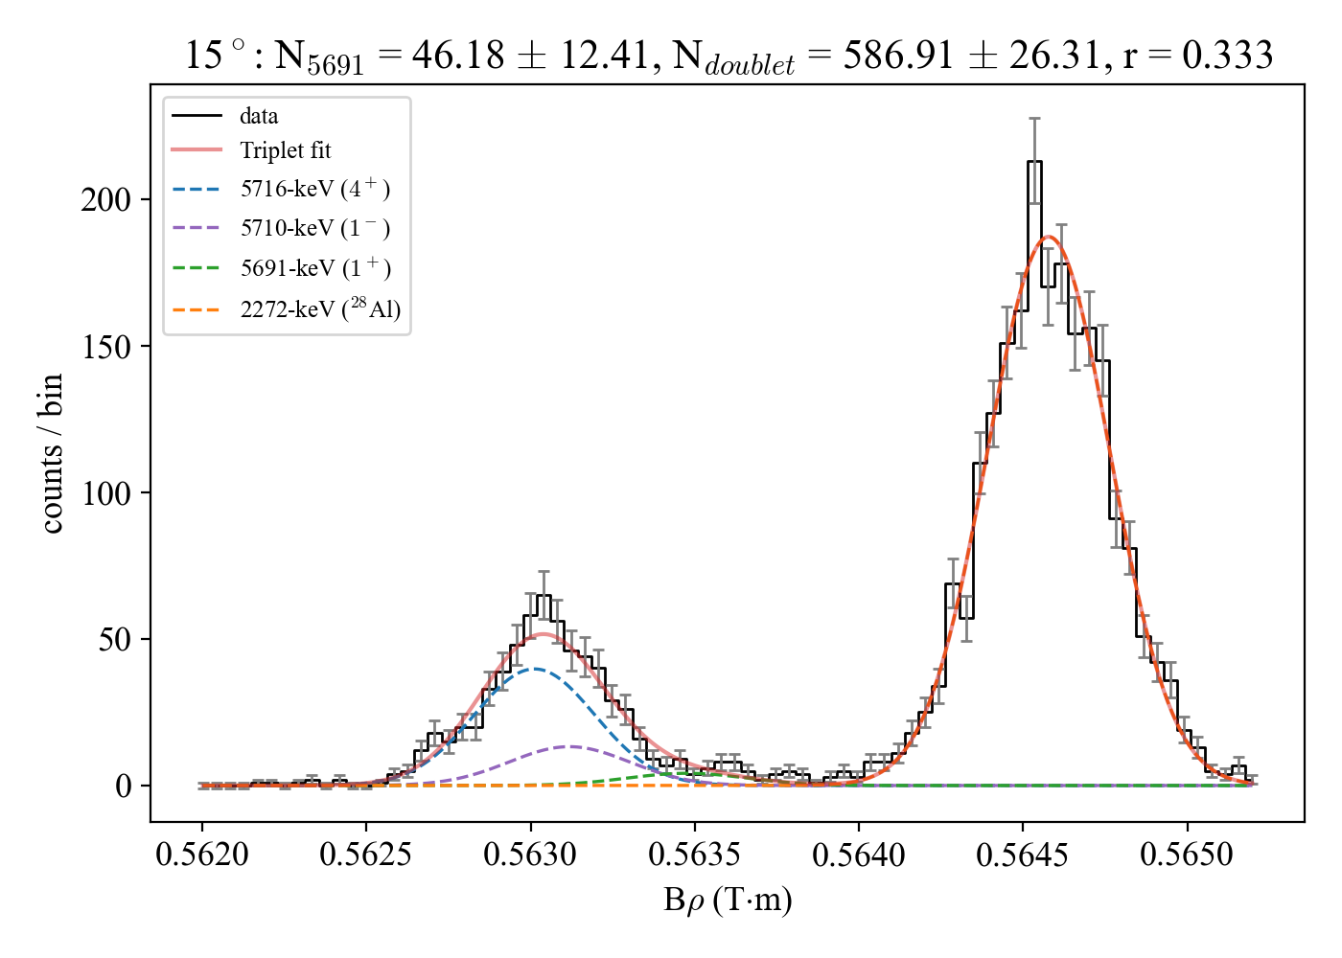
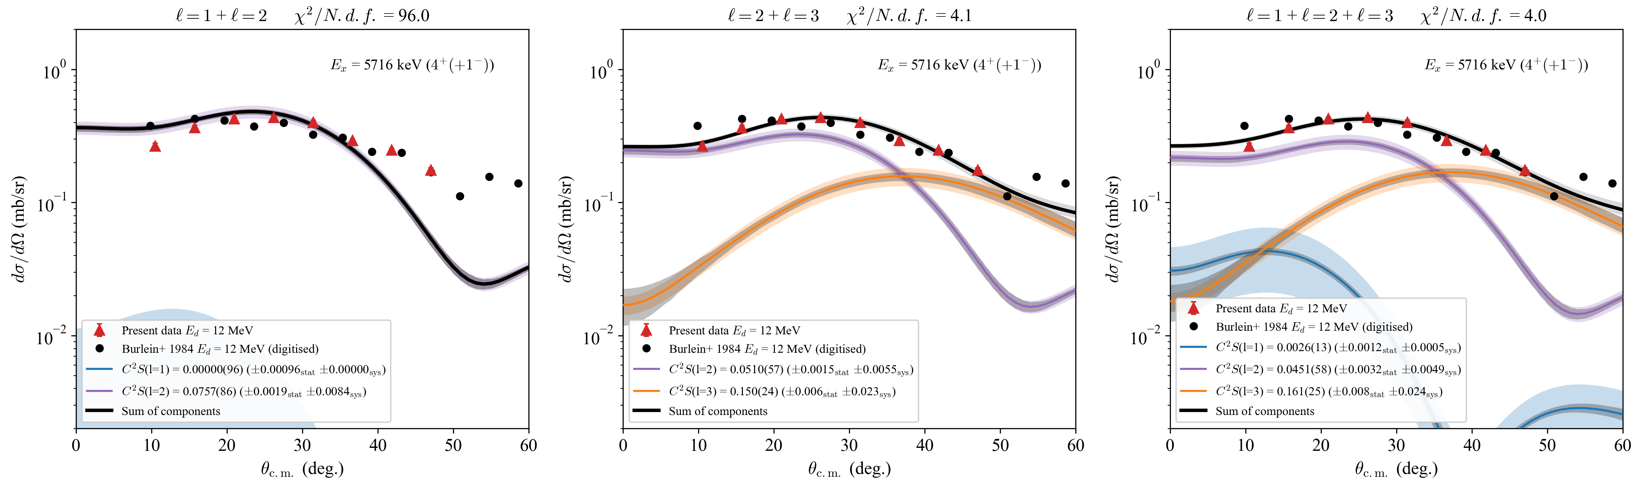
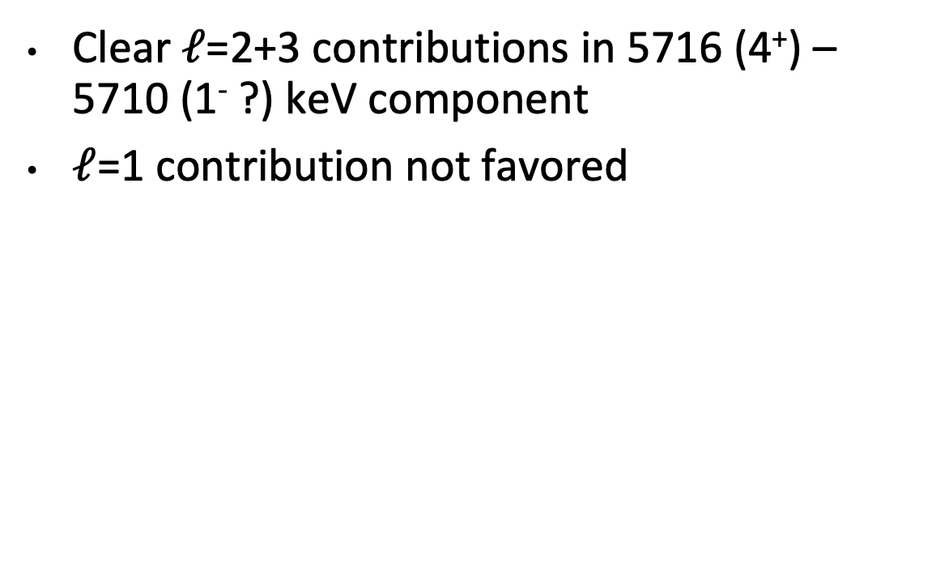
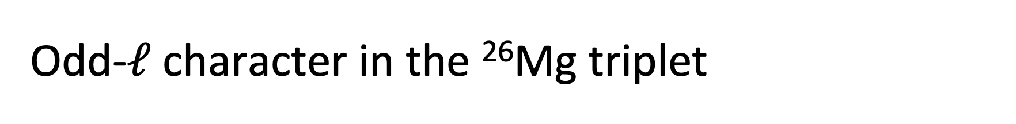
Odd-$ℓ$ character in the ²⁶Mg triplet
Clear $ℓ$=2+3 contributions in 5716 (4⁺) – 5710 (1⁻ ?) keV component
$ℓ$=1 contribution not favored
5710/5716-keV doublet fits to $ℓ$=1+2, $ℓ$=2+3, and $ℓ$=1+2+3
²⁶Al nucleosynthesis
²⁶Si resonances
²⁵Mg(d,p)²⁶Mg@ALTO
Rate & perspectives
Notes:
$ℓ$=1 contribution out of favor
$\sim 2σ$ consistent with zero as with Cañete, but different magnitude
$ℓ$=1+2+3: 0.0026 vs. Cañete’s reanalysis of Burlein: 0.018

Slide 12
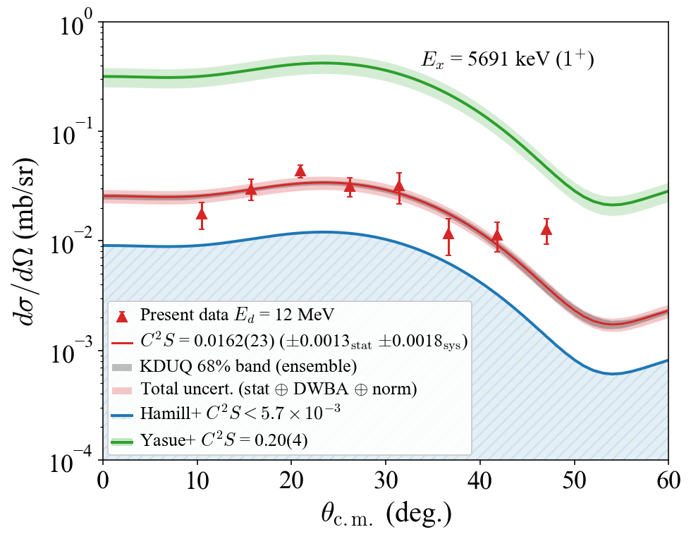
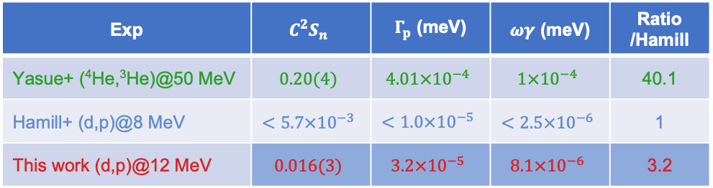
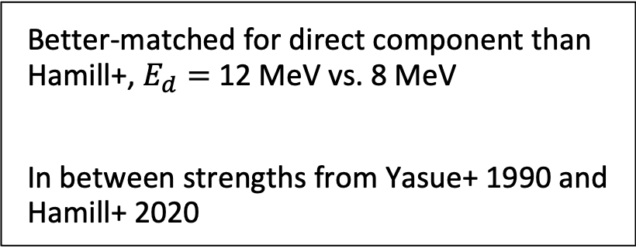

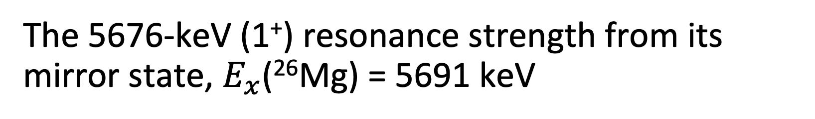
The 5676-keV (1⁺) resonance strength from its mirror state, $E_{x}$(²⁶Mg) = 5691 keV
$${\left(\frac{dσ}{dΩ}\right)}_{exp}=C^{2}S{\left(\frac{dσ}{dΩ}\right)}_{ADWA}$$
Exp | $$C^{2}S_{n}$$ | $Γ_{p}$ (meV) | $ωγ$ (meV) | Ratio /Hamill
Yasue+ (⁴He,³He)@50 MeV | $$0.20(4)$$ | $$4.01×{10}^{−4}$$ | $$1×{10}^{−4}$$ | 40.1
Hamill+ (d,p)@8 MeV | $$<5.7×{10}^{−3}$$ | $$<1.0×{10}^{−5}$$ | $$<2.5×{10}^{−6}$$ | 1
This work (d,p)@12 MeV | $$0.016(3)$$ | $$3.2×{10}^{−5}$$ | $$8.1×{10}^{−6}$$ | 3.2
PRELIMINARY
Better-matched for direct component than Hamill+, $E_{d}=$ 12 MeV vs. 8 MeV
In between strengths from Yasue+ 1990 and Hamill+ 2020
Differential cross-section measurement for 5691-keV (1⁺) state of ²⁶Mg, fit with ADWA calculations performed with TWOFNR
²⁵Mg(d,p)²⁶Mg@ALTO
²⁶Al nucleosynthesis
²⁶Si resonances
²⁵Mg(d,p)²⁶Mg@ALTO
Rate & perspectives
Notes:
Let’s move toward comparing \Gamma_p or, even better, \omega\gamma instead of spectroscopic factors
Hamill @ TUNL
Yasue @ U. Tokyo

Slide 13
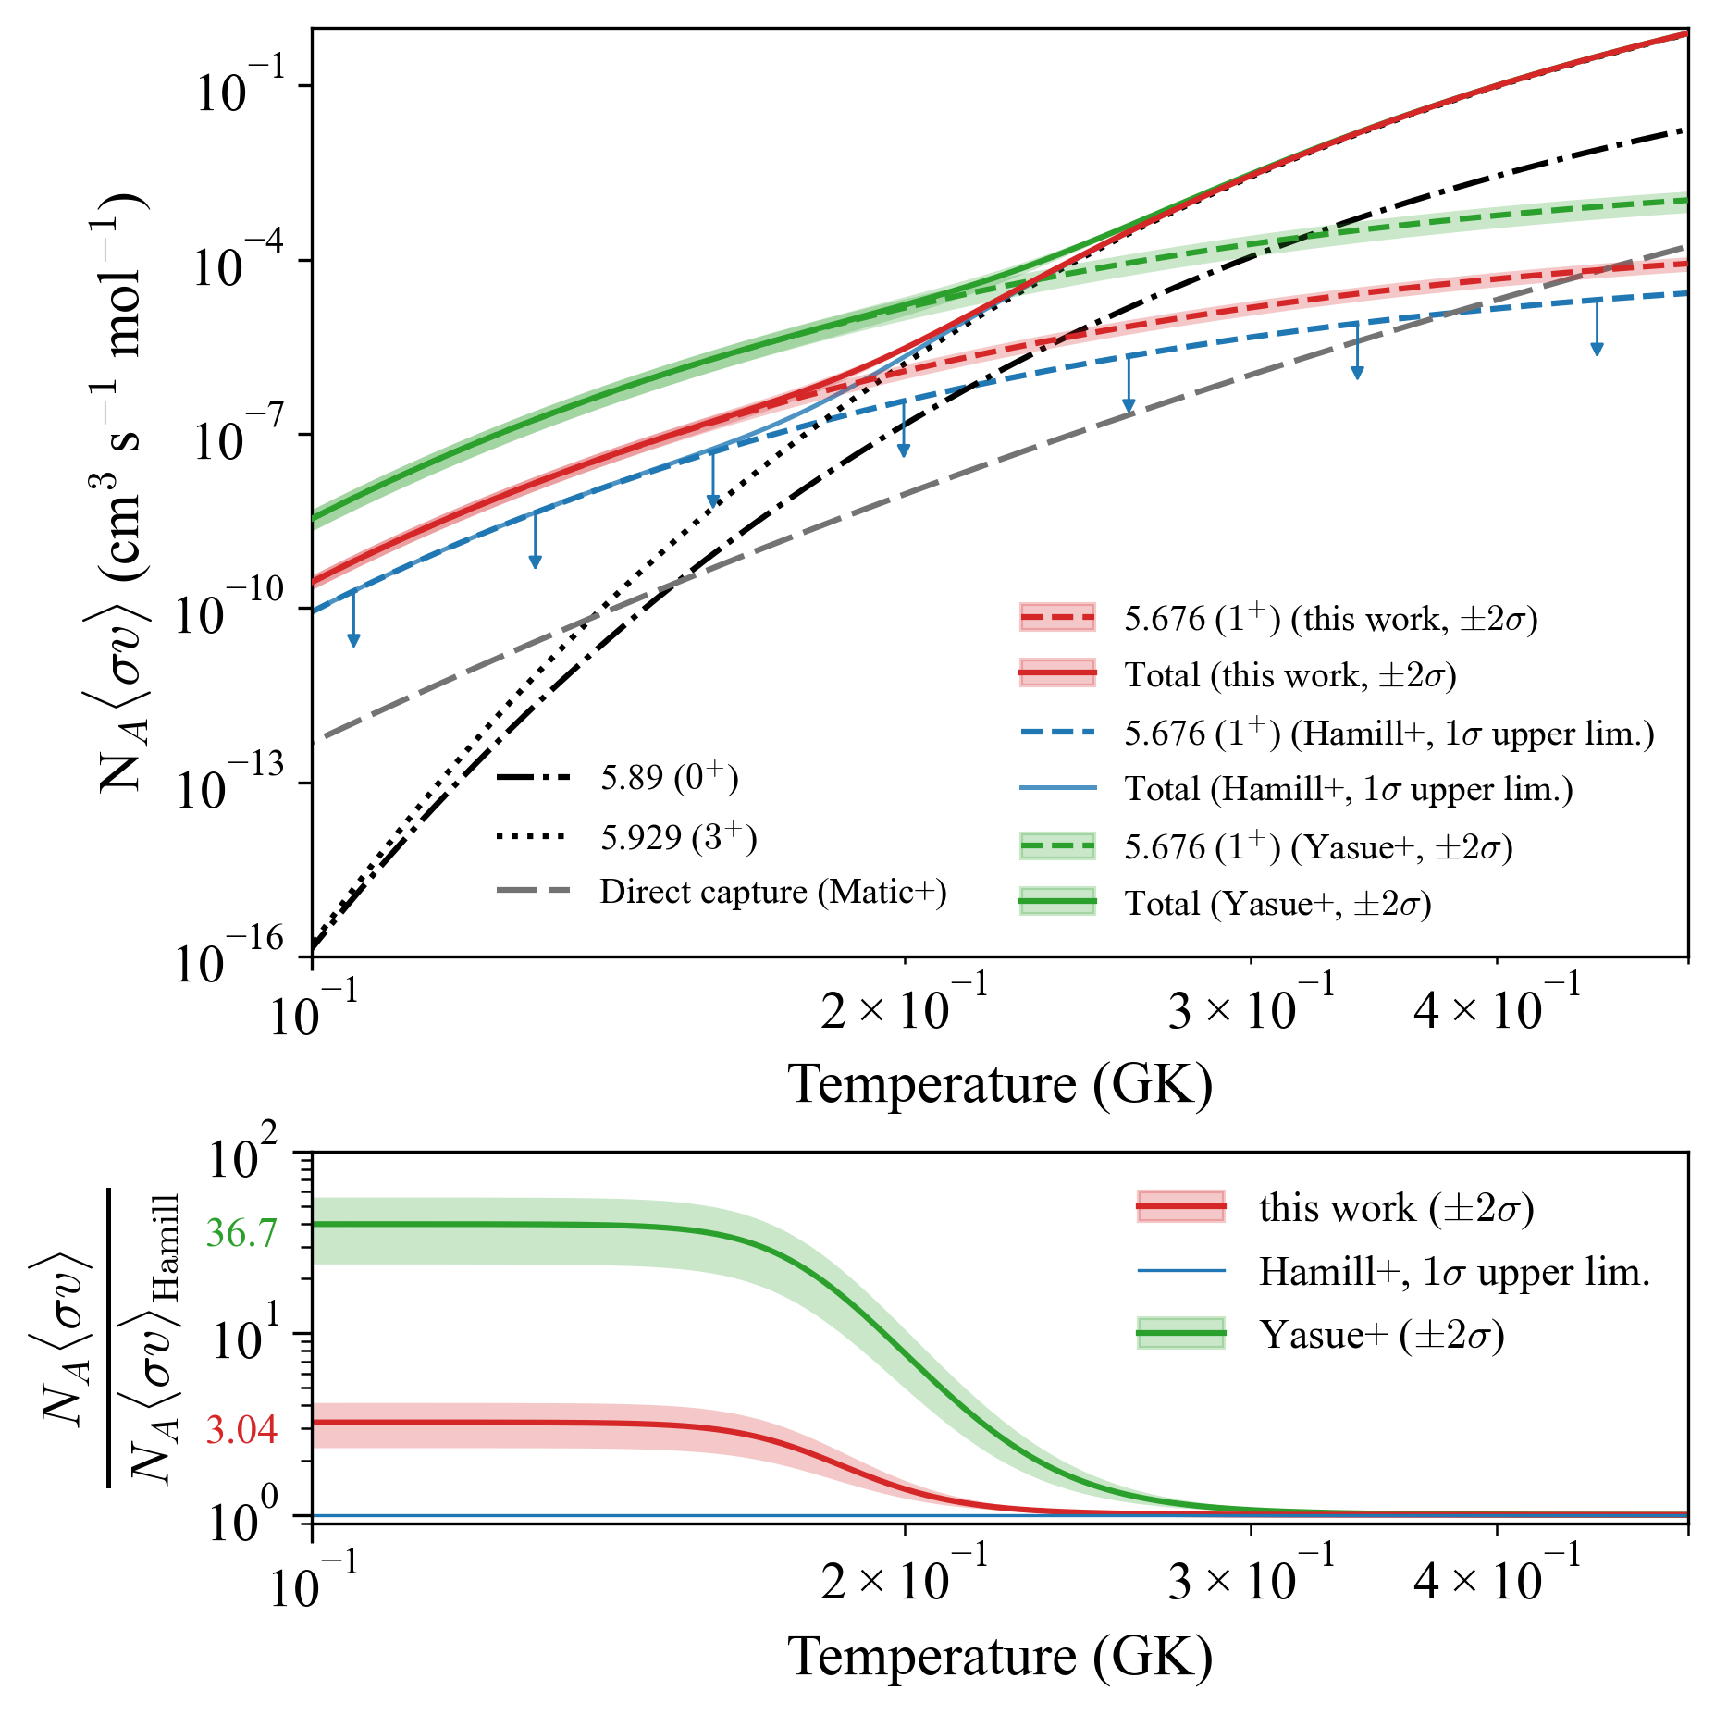
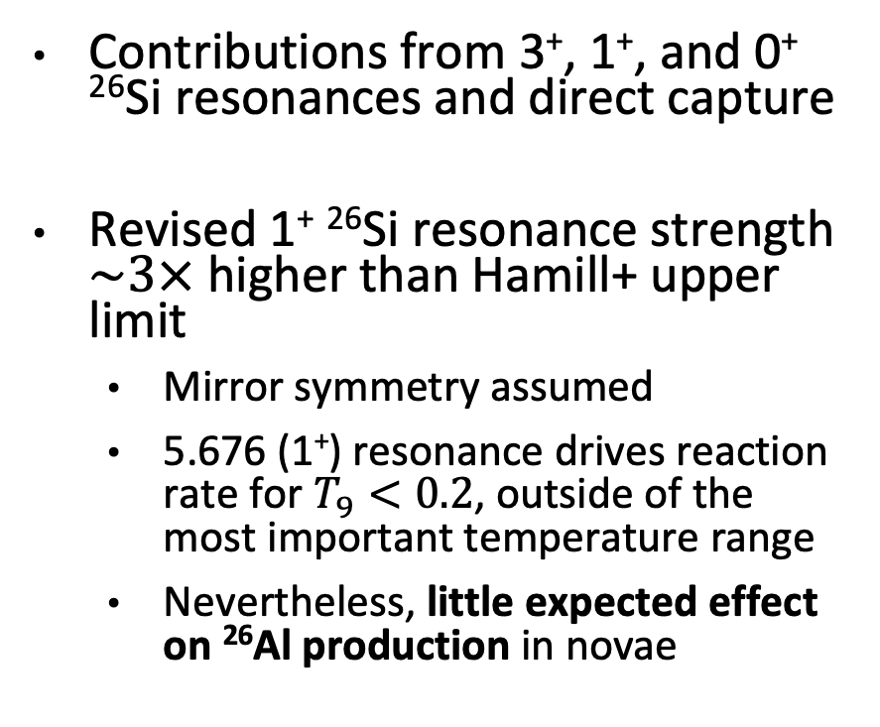
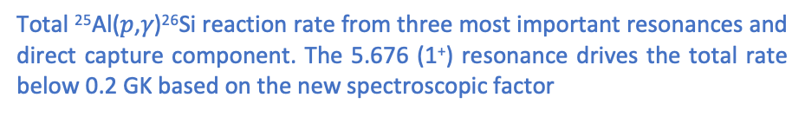
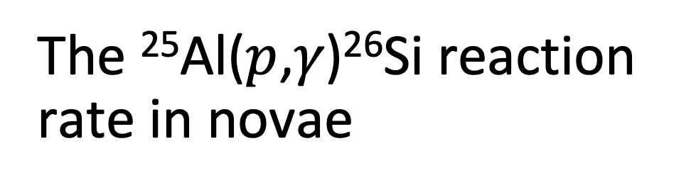
The ²⁵Al($p$,𝛾)²⁶Si reaction rate in novae
Contributions from 3⁺, 1⁺, and 0⁺ ²⁶Si resonances and direct capture
Revised 1⁺ ²⁶Si resonance strength $\sim 3×$ higher than Hamill+ upper limit
  Mirror symmetry assumed
  5.676 (1⁺) resonance drives reaction rate for $T_{9}<0.2$, outside of the most important temperature range
  Nevertheless, little expected effect on ²⁶Al production in novae
PRELIMINARY
Component sources:
0⁺ strength (Hamill+), 3⁺ strength (Temanson+), 1⁻ strength (Cañete+), direct capture (Matic+)
Total ²⁵Al($p$,𝛾)²⁶Si reaction rate from three most important resonances and direct capture component. The 5.676 (1⁺) resonance drives the total rate below 0.2 GK based on the new spectroscopic factor
Rate & perspectives
Notes:
Add table with resonances included and their energies/strengths
Ignoring 1⁻ for now

Slide 14
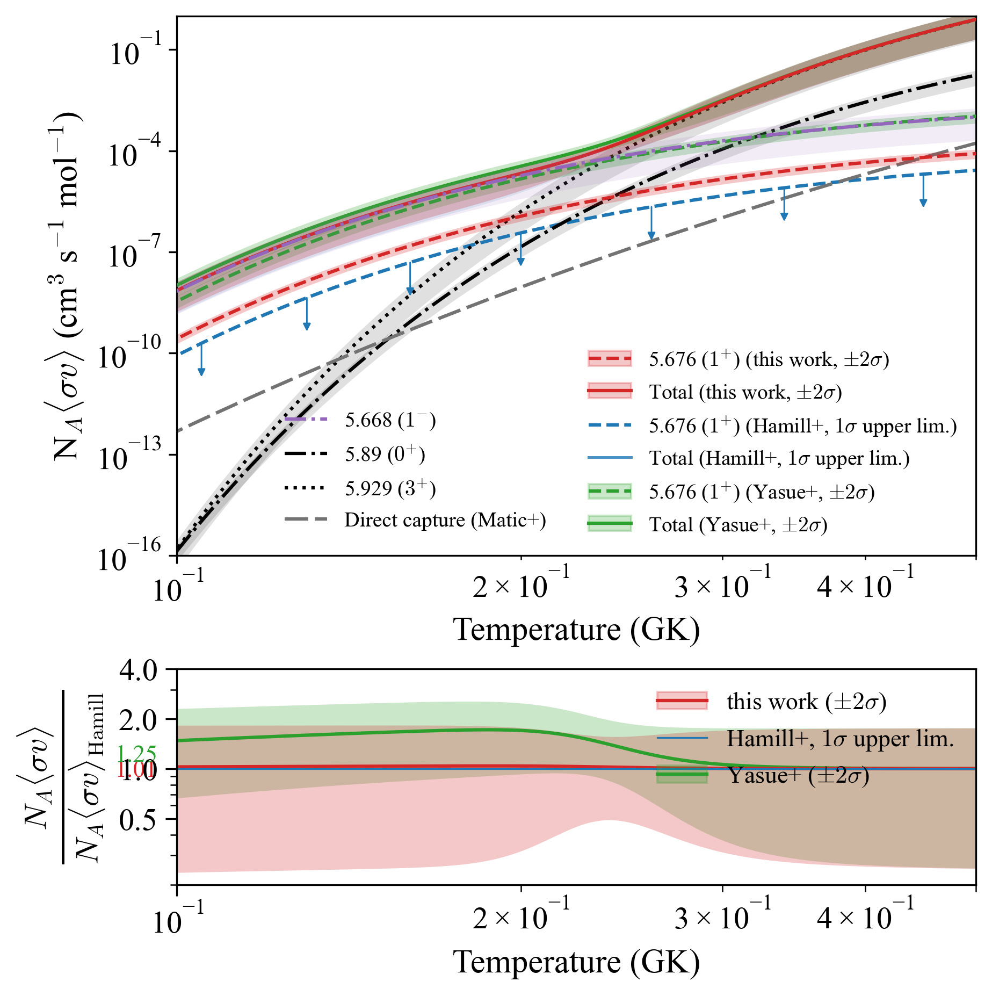
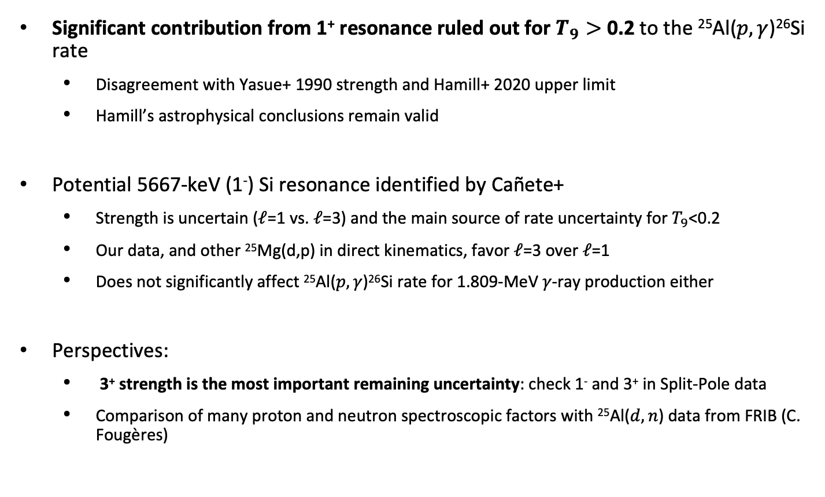
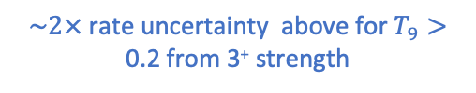
Conclusions
$$T_{9}\sim 0.2−0.4$$
Significant contribution from 1⁺ resonance ruled out for $T_{9}>$ 0.2 to the ²⁵Al($p,γ$)²⁶Si rate
  Disagreement with Yasue+ 1990 strength and Hamill+ 2020 upper limit
  Hamill’s astrophysical conclusions remain valid
Potential 5667-keV (1⁻) Si resonance identified by Cañete+
  Strength is uncertain ($ℓ$=1 vs. $ℓ$=3) and the main source of rate uncertainty for $T_{9}$<0.2
  Our data, and other ²⁵Mg(d,p) in direct kinematics, favor $ℓ$=3 over $ℓ$=1
  Does not significantly affect ²⁵Al($p,γ$)²⁶Si rate for 1.809-MeV 𝛾-ray production either
Perspectives:
  3⁺ strength is the most important remaining uncertainty: check 1⁻ and 3⁺ in Split-Pole data
  Comparison of many proton and neutron spectroscopic factors with ²⁵Al($d,n$) data from FRIB (C. Fougères)
1⁺
3⁺
✅
0⁺
  Relative contribution of ²⁶Si resonances to the reaction rate (Laird+ 2023)
  $\sim 2×$ rate uncertainty above for $T_{9}>$ 0.2 from 3⁺ strength
Rate & perspectives
Notes:
More work on 3+ and 1- in our data: 3+ is confirmed

Slide 15




Thank you!

Slide 16
Constraining the ²⁵Al($p,γ$)²⁶Si resonant reaction rate in classical novae via experimental study of the ²⁵Mg($d,p$)²⁶Mg reaction
Nathan Giha
Postdoctoral Researcher at IJCLab
11 September 2026
²⁶Al nucleosynthesis
²⁶Si resonances
²⁵Mg(d,p)²⁶Mg@ALTO
Rate & perspectives

Slide 17
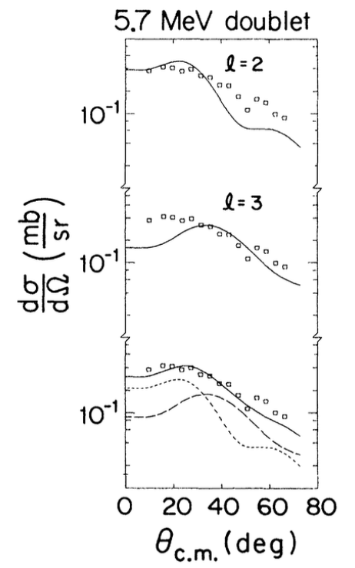
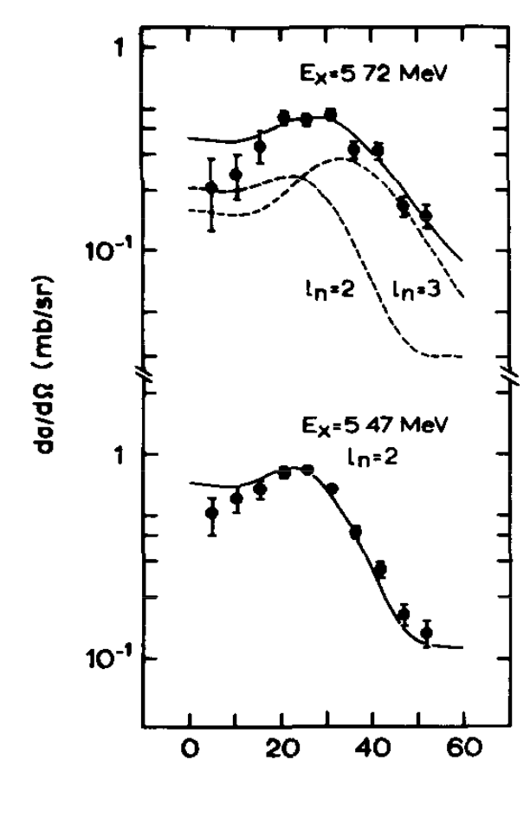
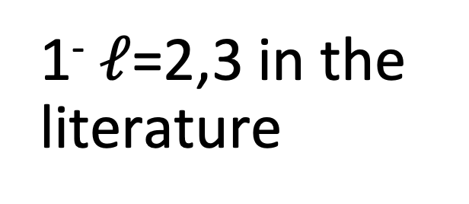
1⁻ $ℓ$=2,3 in the literature
Burlein+ 1984
Arciszewski+ 1984

Slide 18



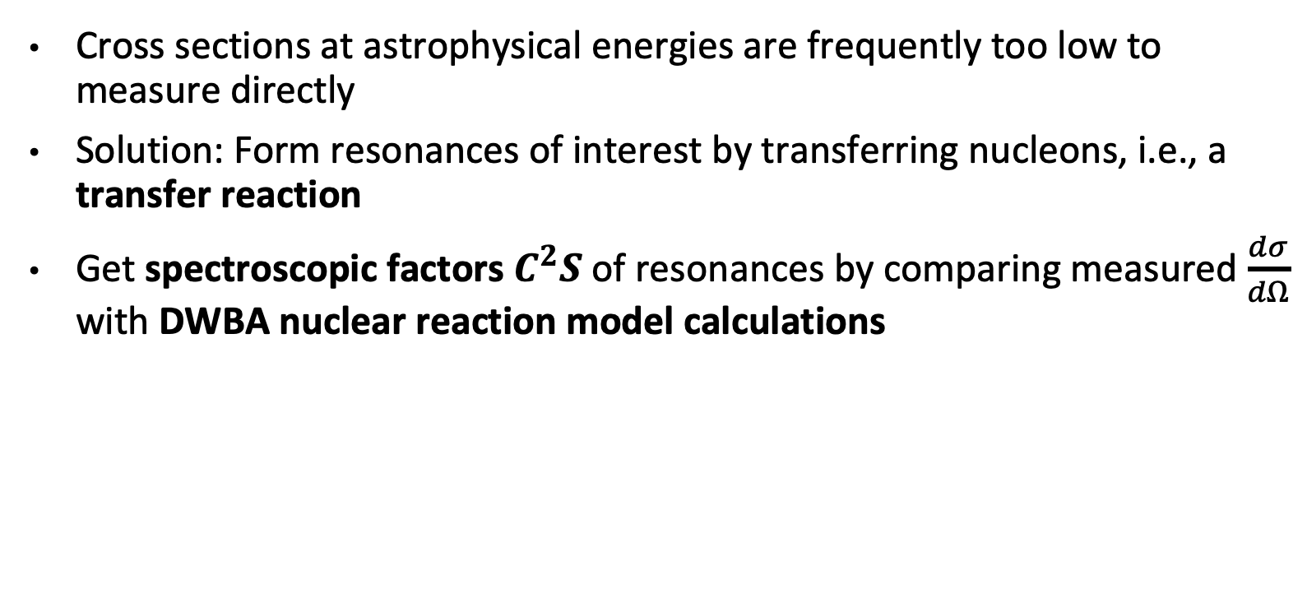

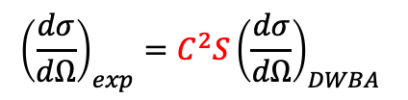



Transfer reactions for resonance strengths
Cross sections at astrophysical energies are frequently too low to measure directly
Solution: Form resonances of interest by transferring nucleons, i.e., a transfer reaction
Get spectroscopic factors $C^{2}S$ of resonances by comparing measured $\frac{dσ}{dΩ}$ with DWBA nuclear reaction model calculations
Measurement
DWBA calculation
$$E_{inc}$$
$$p$$
$${\left(\frac{dσ}{dΩ}\right)}_{exp}=C^{2}S{\left(\frac{dσ}{dΩ}\right)}_{DWBA}$$
$$d$$
X
$$Γ=C^{2}S⋅Γ_{s.p.}$$
calculation
$n$+X
Resonance strength $ωγ≈\left(2J+1\right)Γ$
Example: ^{A}X($d$,$p$)^{A+1}X as a surrogate for neutron capture on ^{A}X
Notes:
Typical energies of astrophysical relevance for these reactions are well below the Coulomb barrier, so the cross-sections are frequently too low to be measured directly. One way to overcome this challenge is by creating the states or resonances of interest via a transfer reaction.
With this method, I can get the spectroscopic factor of a given resonance or state, in red here, and proportional to its strength, by comparing a measured differential cross-section to DWBA reaction model calculations.
In this example, a neutron is transferred from a deuteron to X via a (d,p) reaction as a surrogate for neutron capture.
In the final state, we have the same configuration as neutron capture, as well as a proton whose momentum contains information about the state or resonance that was populated.

Slide 19

1⁻ strength from Cañete
With 1-, without uncerts
With 1-, with uncerts
Notes:
Can’t take strength from Canete if we think it’s l=3 instead of l=1

Slide 20

Calculations
[x] C.D. Pruitt et al. PRC 107, 014602 (2023)
[x] C. Hebborn, TWOFNR+KDUQ front-end
Uncertainty-quantified ADWA calculation with TWOFNR+KDUQ

Slide 21


Hamill ²⁵Mg(d,p)@8 MeV
Fit with two free parameters, normalizations of $ℓ$=2 and compound components

Slide 22







Reaction rates from transfer reactions
The resonant reaction rate for a single narrow resonance depends only on density, temperature, resonance energy, and resonance strength
Measurement
DWBA calculation
For broad resonances the picture is only slightly more complex—convolution of a Breit-Wigner distribution with velocity distribution
$${\left(\frac{dσ}{dΩ}\right)}_{exp}=C^{2}S{\left(\frac{dσ}{dΩ}\right)}_{DWBA}$$
$$Γ=C^{2}S⋅Γ_{s.p.}$$
calculation
Resonance strength $ωγ≈\left(2J+1\right)Γ$
$∴$ Reaction rate for a single narrow resonance
Notes:
DWBA
the entrance and exit channels processes are dominated by the elastic scattering
the transfer process is weak enough to be treated as a first order perturbation
• the nucleon(s) transfer occurs directly between the two active channels a + A and c + C
• the transferred nucleon(s) is directly deposited on the final state with no rearrangement of the core configuration

Slide 23

²⁶Si resonances important to ²⁵Al($p$,𝛾)²⁶Si
A: too low energy to be important
1⁻ : conflicting reports
B: our famed 1⁺
C: Small importance above 0.2 GK, in the same place where the 3+ is important
D: Dominant for classical novae 0.2-0.4 GK
E: Doesn’t exist, relocated to 1⁻ by Canete
To use:
3+ : Temanson G_p
0+: Hamill or Perello
1+: Hamill
1- (?): Canete—likely exists, but strength should have high uncertainty
  Stronger compared to 1+ unless the strength increases by many times
  In any case, neither resonance affects ²⁶Al production much in classical novae
²⁶Si resonances

Slide 24


Calculating partial width

Slide 25
Astro (²⁵Mg)

Slide 26


INTEGRAL ²⁶Al map
  INTEGRAL/SPI Map of the 1.809-MeV photon sky,
  T. Siegert et al. A&A 672, A54 (2023)

Slide 27


Width vs. angle
See two different groups
Changed after beam filament change during the night, maybe result of worse beam tune
Investigate discontinuity, especially in Al width
Notes:
Width vs. angle for individual peaks, both i) in region of interest and ii) outside

Slide 28



Finite- vs. zero-range DWBA
Log
Lin

