Slide 1



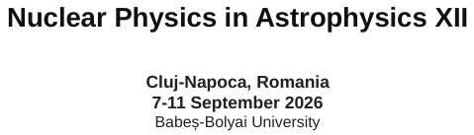
Heavy Elements as Clues to the Progenitors of Type Ia Supernovae
The Case of He-Accreting White Dwarfs
Umberto Battino
University of Naples “Federico II”
INAF – Osservatorio Astronomico d’Abruzzo
INFN – Naples
NuGrid Collaboration
Collaborators: J.D. Keegans, M. Allen, F. K. Röpke, F. Herwig, A. Best, L. Piersanti, O. Straniero, S. A. Sim, C. Travaglio, R. Hirschi, P. A. Denissenkov
Notes:
Open slowly. Establish the title and that this is a talk about a new chemical diagnostic of Type Ia supernova progenitors, focused on helium-accreting white dwarfs as the remaining channel to test.

Slide 2
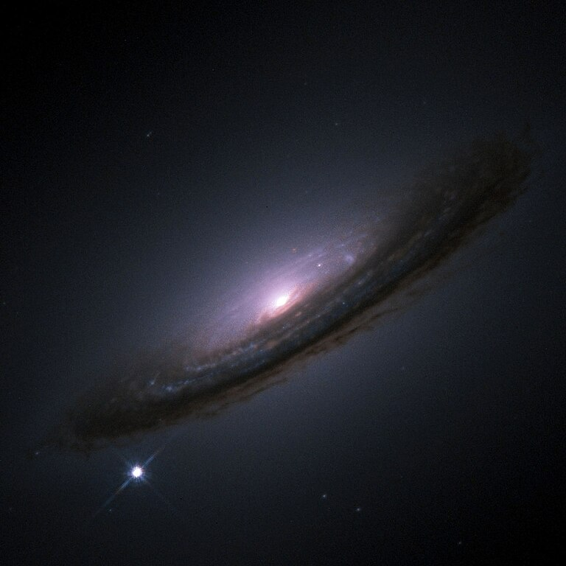
Why SNe Ia progenitors still matter
Type Ia supernovae are central to both:
Cosmology: standardisable candles for distance measurements
Galactic chemical evolution: major Fe-peak producers, possible p-process contribution
…yet the progenitor channels remain debated
Chemical elements give us an independent route:
they retain memory of the progenitor and explosion conditions
Battino et al. 2020; Battino et al. 2025
NASA/ESA, The Hubble Key Project Team The High-Z Supernova Search Team
Question for this talk:
Can trans-Fe elements shed light on SNe Ia progenitors?
1
Notes:
Keep this short: SNe Ia are important for cosmology and GCE, but progenitors are not settled. The chemical diagnostics angle is the motivation.

Slide 3
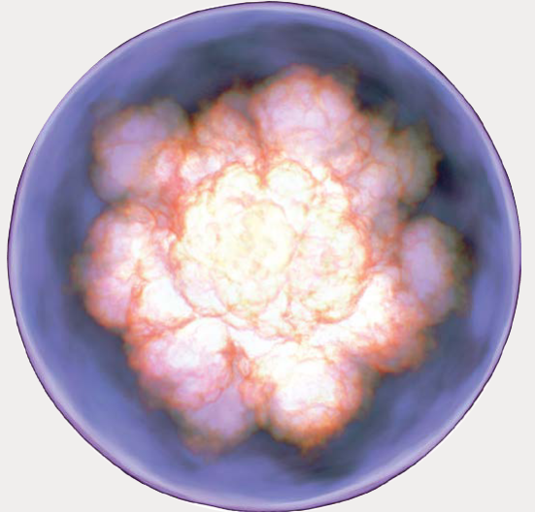
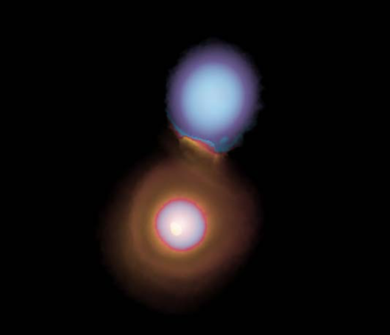
The progenitor landscape
Near-Chandrasekhar mass events
Deflagration or Deflagration+Detonation
Fast (~10⁻⁶ M_{sun}/yr) He-accretor → Needs significantly massive He-star companion (> 1 M_{sun})
(Piersanti+2014, Brooks+2016)
Slow CO WD merger → Accretion disk formation (Piersanti+2003, Battino+2025)
H-accretor → But only ~6% of SN Ia from there
(see e.g. Johansson et al. (2016))
Sub-Chandrasekhar mass events
Double or prompt Detonation
Slow (~10⁻⁸ M_{sun}/yr) He-accretor → Major channel (~70%), but we still need ~30% near-Ch
(Lach+2020, Collins+2022)
Violent CO WD merger → if mass ratio q > ~0.8
or > ~0.01 M_{sun} He present
(Pakmor et al. 2010 - 2013)
Working hypothesis from our models: high trans-Fe ejecta require a near-Chandrasekhar progenitor
2

Slide 4
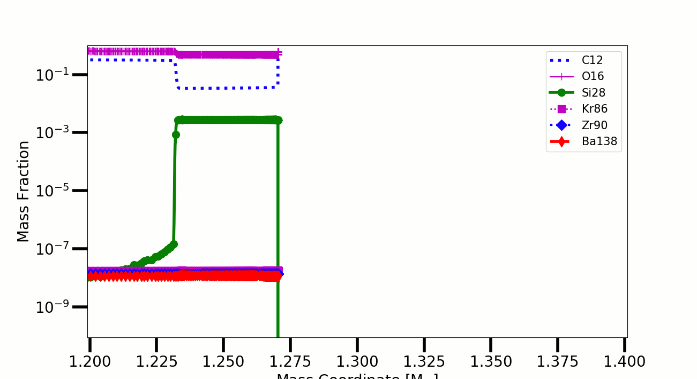
The common mechanism: neutron captures before the explosion
The progenitor does the heavy-element work; the supernova ejects the result.
Surface burning
α-particles
neutron source
trans-Fe layer
explosion
C/He flashes
α release
²²Ne(α,n)²⁵Mg
(sometimes ¹³C(α,n)¹⁶O)
Kr, Sr, Ba…
SNe Ia ejecta
¹²C+¹²C or 3α
→
(or already there)
→
neutron burst
→
surface enrichment
→
observable?
Mass Coordinate [M_{sun}]
3
Notes:
This slide is a bridge. Stress chronology: trans-Fe is made before the explosion in the surface layers; it is then ejected during the explosion.

Slide 5
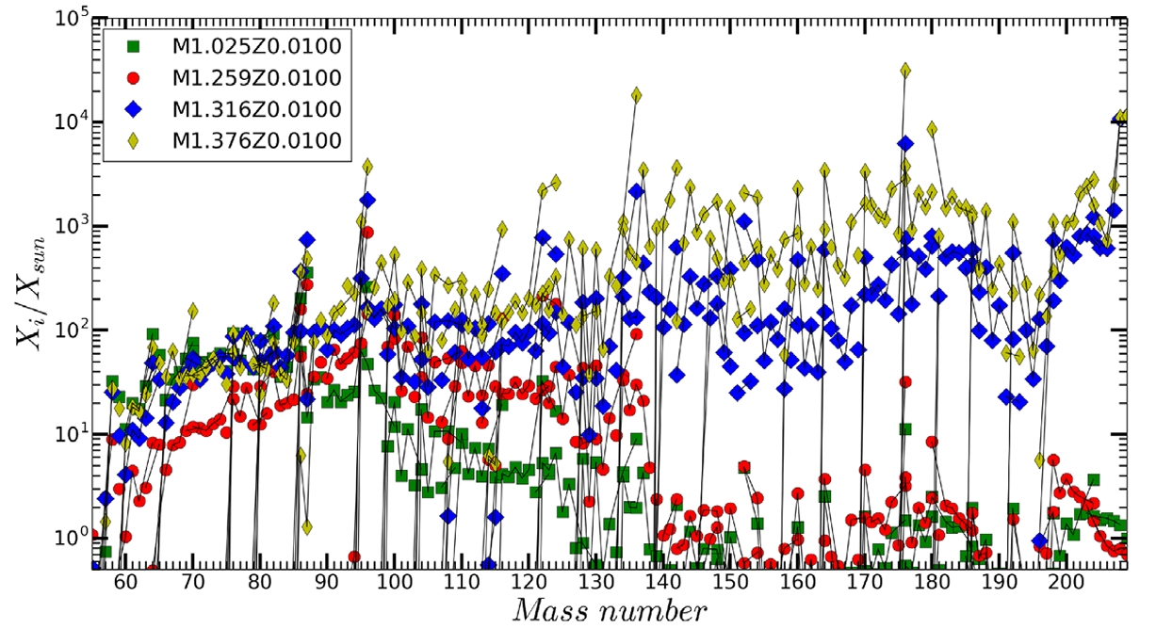
Case I: H-accreting near-Chandrasekhar WDs
Battino et al. 2020
Main result from the H-accretion case
recurrent H/He flashes on the WD surface
Occasional H-ingestion events → neutrons from both ²²Ne and ¹³C
high neutron densities, up to several 10¹⁵ cm⁻³
heavy-element distribution produced in the outer layers
strong production extending to Pb (ejected by the following explosion)
✓ near-Ch WDs formed via H-accretors get enriched in trans-Fe
4
Notes:
Present Battino et al. 2020 as the first benchmark: H-accreting WDs form heavy-element seed distributions in the external layers, through repeated flashes.

Slide 6
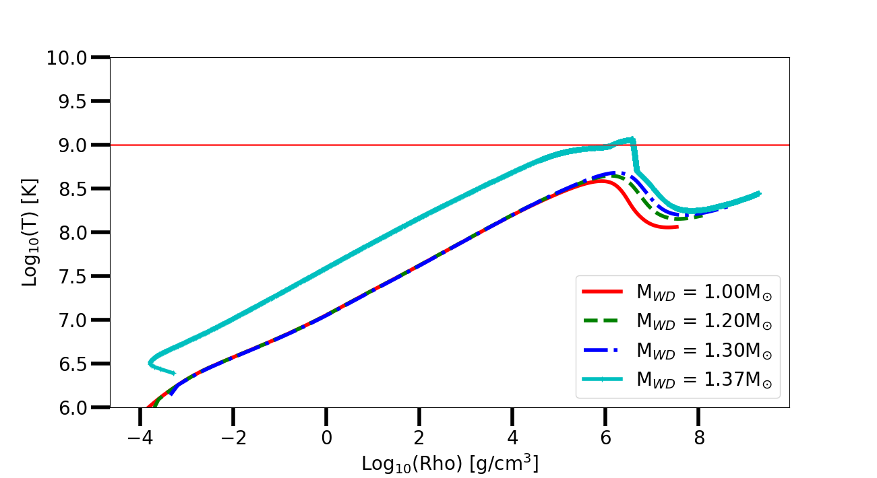
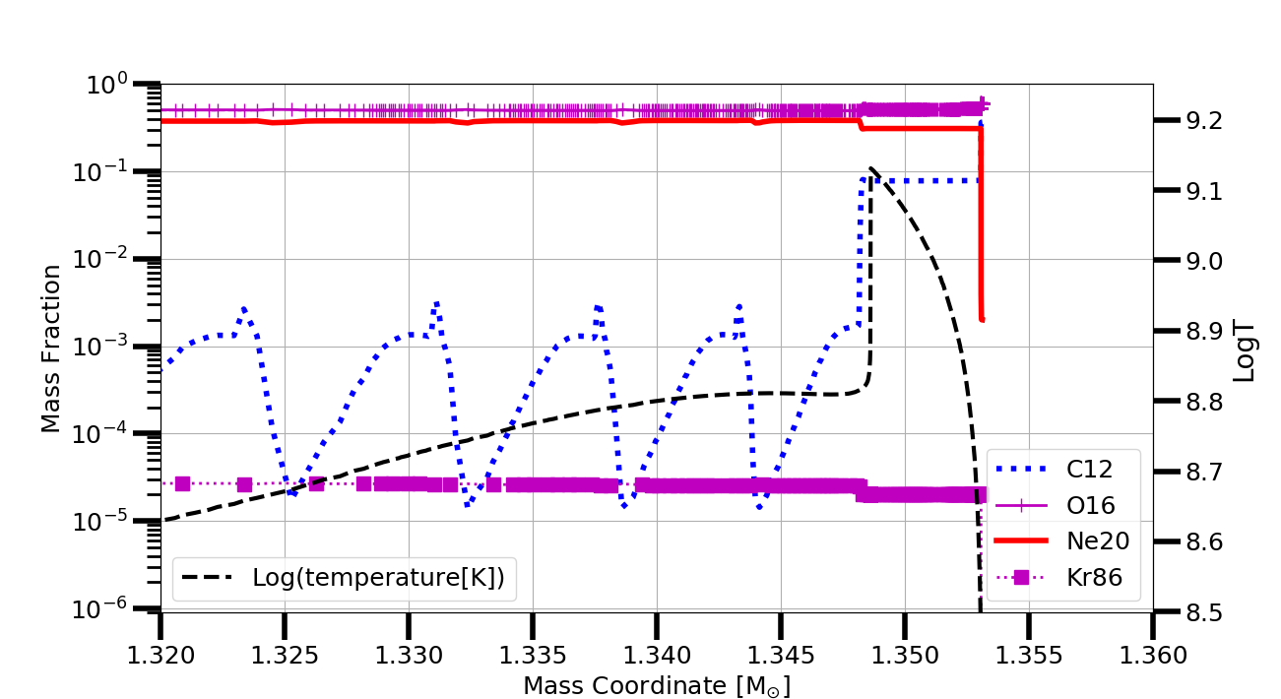
Case II: slow CO WD mergers
Battino et al. 2025
As the primary approaches M_{Ch}:
surface C flashes ignite before central explosive C ignition
¹²C(¹²C,α)²⁰Ne supplies α-particles
²²Ne(α,n)²⁵Mg releases neutrons in the outer layers
weak-s-like pattern, peaking at Kr
enriched layer: ∼0.1–0.2 M⊙ (or more, acc rate dependence)
Kr overproduced: ∼800 × solar
some isotopes (e.g. ⁸⁶Kr): >3000 × solar
Ga, Ge, Se, Kr, Rb, Sr ejected in high amounts (>10⁻⁶ M⊙)
✓ near-Ch WDs formed via CO WD slow mergers get enriched in trans-Fe
5
Notes:
This is the DD near-Ch case. Mention surface C burning only if needed; the key result is a thick outer layer enriched in first-peak elements, especially Kr, that is later ejected.

Slide 7
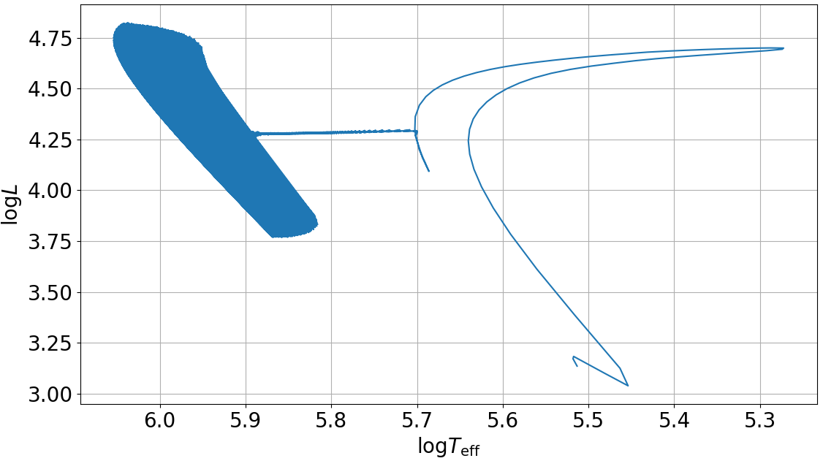
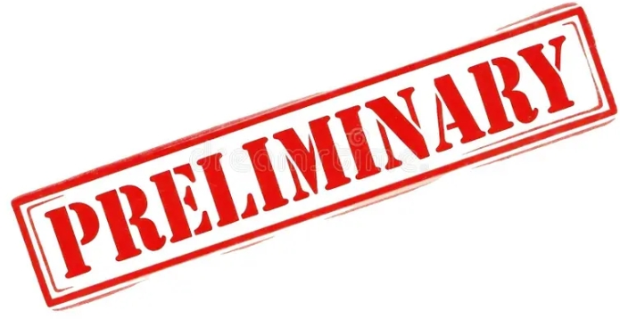
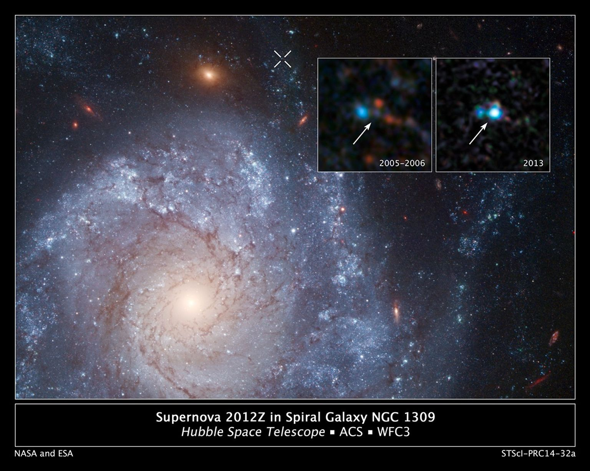
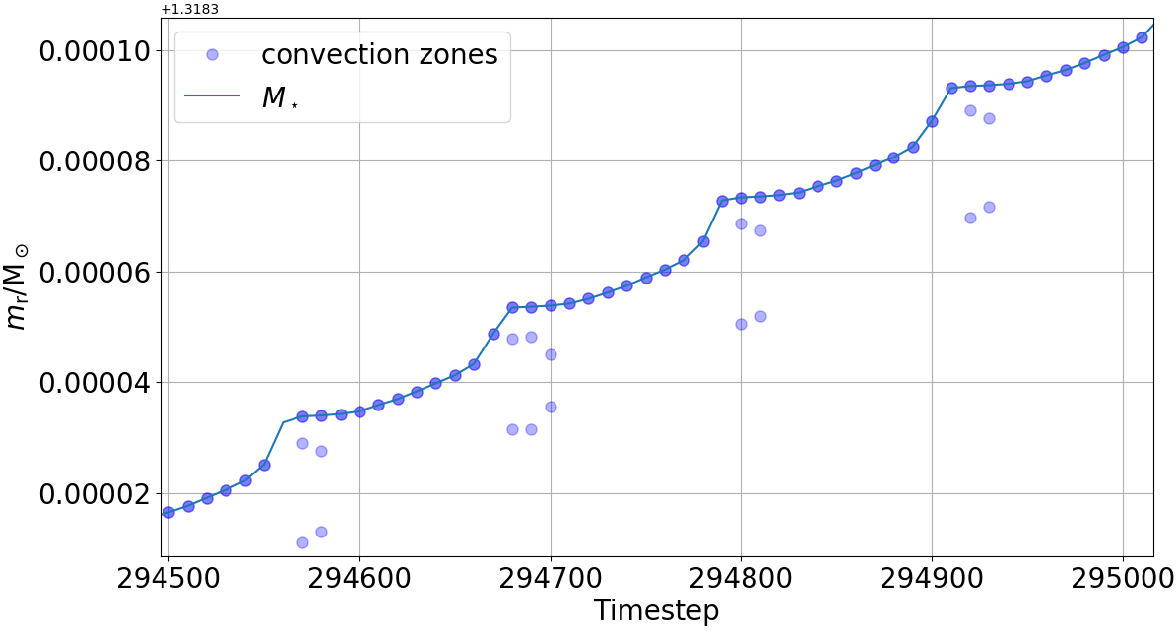
Case III: the He-accreting WD channel
In progress
rapid He accretion can grow the WD towards M_{ch}
slow He accretion more naturally leads to sub-Chandrasekhar double-detonation explosions
this is the remaining viable near-Ch channel to test for trans-Fe production
SN 2012Z (type Iax): the only SN Ia in history with a directly detected progenitor in pre-explosion images → helium star donor
Ejecta + remnant indicate Chandrasekhar mass (McCully+2022)
6
7
Notes:
Introduce the new part. Make clear this is preliminary. Rapid He-accretors are the last major near-Ch pathway; slow He-accretors are sub-Ch and not expected to eject significant trans-Fe material.

Slide 8
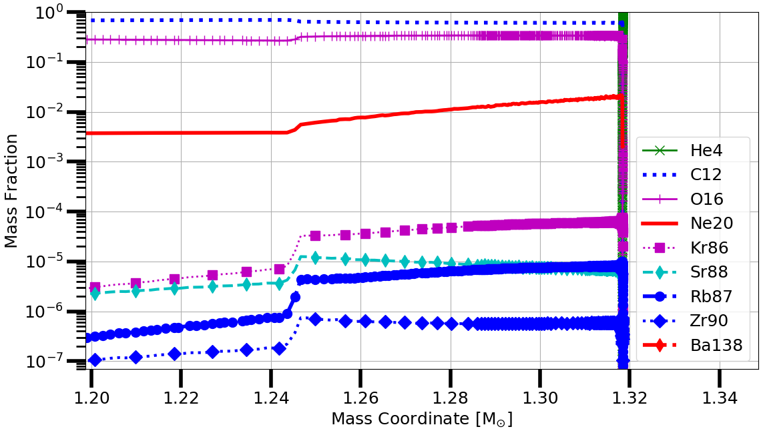
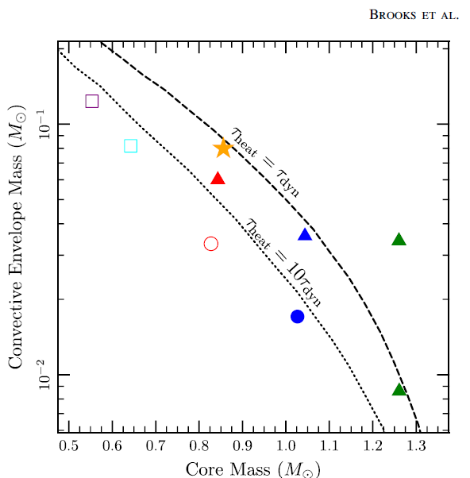
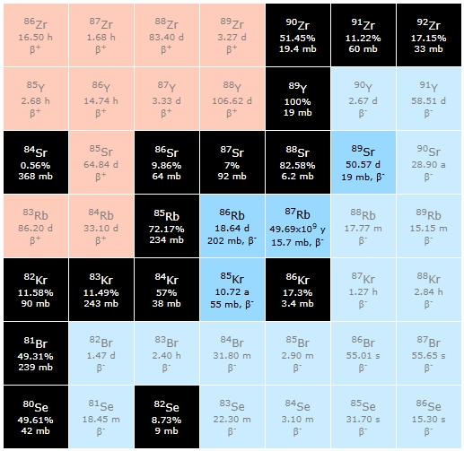
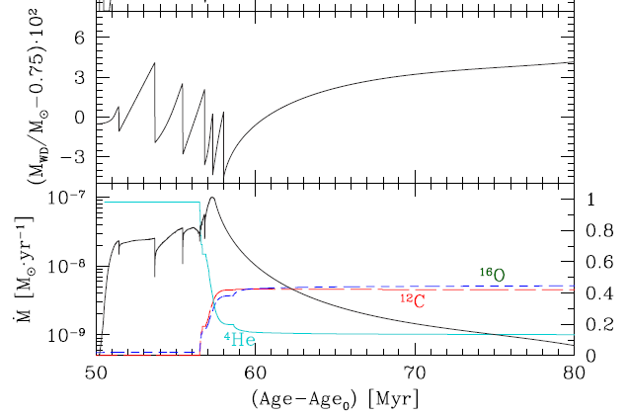
Case III: the He-accreting WD channel
In progress
rapid He accretion can grow the WD towards M_{ch}
slow He accretion more naturally leads to sub-Chandrasekhar double-detonation explosions
this is the remaining viable near-Ch channel to test for trans-Fe production
✓ near-Ch WDs formed via He-accretion get enriched in trans-Fe
X Sub-Ch prog: early detonation or strong mass-loss → no trans-Fe species
Brooks+2015
Piersanti+2024
6
Notes:
Introduce the new part. Make clear this is preliminary. Rapid He-accretors are the last major near-Ch pathway; slow He-accretors are sub-Ch and not expected to eject significant trans-Fe material.

Slide 9



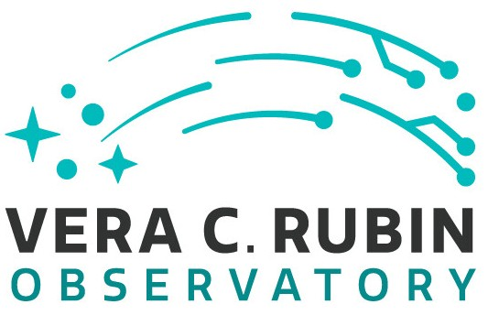
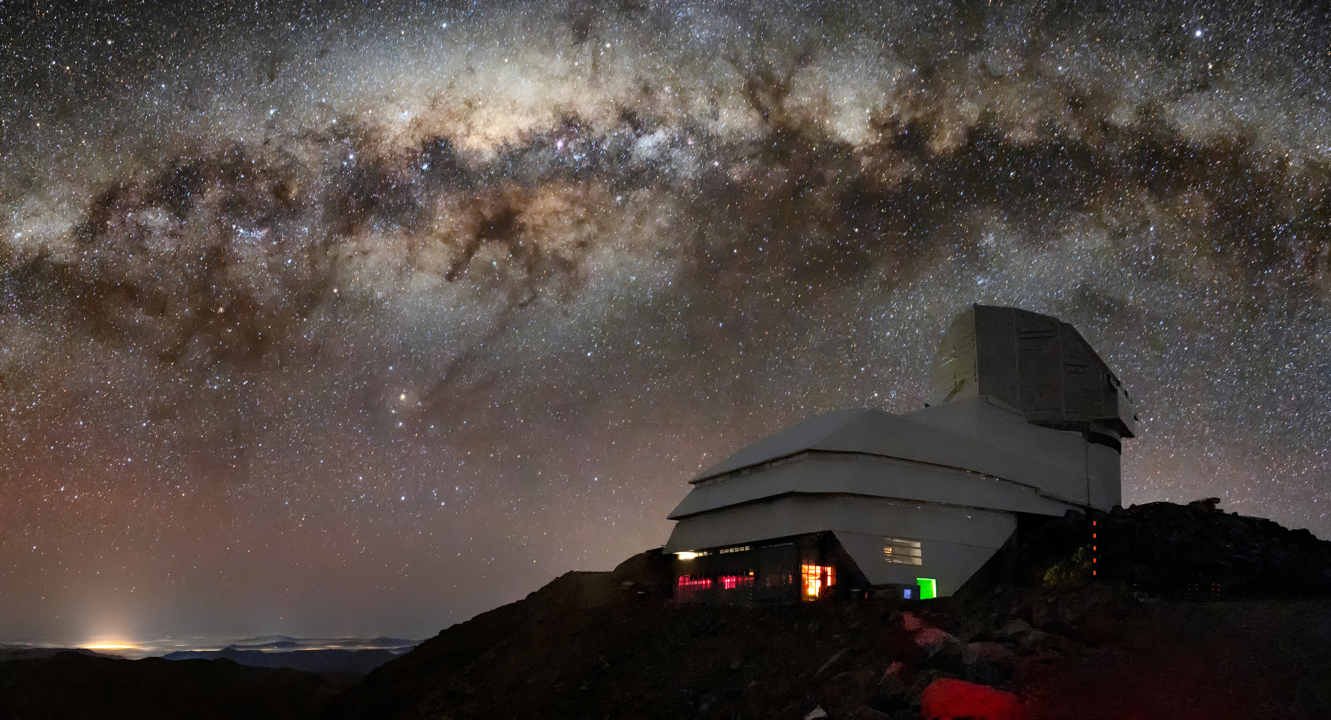
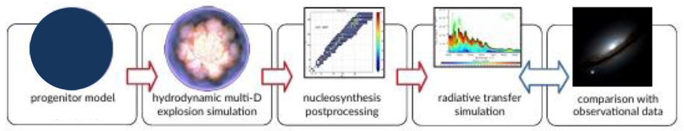

Summary and future work
Near-Chandrasekhar mass events
Deflagration or Deflagration+Detonation
Fast (~10⁻⁶ M_{sun}/yr) He-accretor
(Piersanti+2014, Battino+2027
in progress
Slow CO WD merger
(Piersanti+2003, Battino+2025)
H-accretor
Battino+2020
Sub-Chandrasekhar mass events
Double Detonation
Slow (~10⁻⁸ M_{sun}/yr) He-accretor
(Lach+2020, Collins+2022)
Violent CO WD merger
(Pakmor et al. 2010 - 2013)
Link to Battino+2020
(Near-Ch from H-accretors)
Link to Battino+2025
(Near-Ch from CO-WD mergers)
Trans-Fe elements from SNe Ia only produced and ejected in high amounts (>10⁻⁶ M⊙) by near-Ch explosions, and not by sub-Ch events → New way to constrain the progenitors? (Synthetic spectra needed)
Can we see this? A new observable ‘smoking gun’ of a Chandrasekhar explosion? Plenty of data from deep and all-sky surveys are coming! (LSST, 4MOST-TiDES).
Time-Domain Extragalactic Survey
(TiDES)
LSST Spectroscopic follow-up of ~25K SNe Ia (now starting, 2nd half 2026)

Slide 10
Near-Ch versus sub-Ch: what survives into the ejecta?
Near-Chandrasekhar progenitors
Sub-Chandrasekhar progenitors
✓
H-accretors
✕
violent CO WD mergers
Battino et al. 2020
timescale of minutes
✓
slow CO WD mergers
✕
slow He-accretors
Battino et al. 2025
thin enriched layer only
✓
rapid He-accretors
new preliminary results
Main message
Significant trans-Fe ejecta point to a near-Chandrasekhar progenitor.
Non-detections require care; detections are the clean observational opportunity.
Near-Ch: H-accretors, slow CO mergers, rapid He-accretors. Sub-Ch: violent CO mergers, slow He-accretors.
9
Notes:
This is the synthesis slide. You can mention that non-detection is not definitive, but do not dwell on it. Emphasise the detection opportunity.

Slide 11
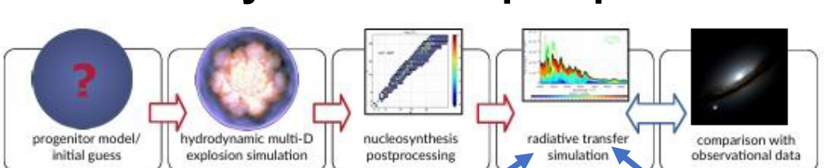
Can we see this?
If trans-Fe lines are detectable, they provide a new spectroscopic “smoking gun” of a near-Chandrasekhar explosion.
What is needed next?
synthetic spectra from high-resolution SNIa models with trans-Fe-rich outer layers
line identification and time-dependent radiative-transfer tests
comparison with the large datasets expected from LSST and 4MOST-TiDES
Poster/paper take-home: heavy elements can become progenitor diagnostics.
Observational path: progenitor model → hydrodynamics → post-processing → radiative transfer → survey comparison.
10
Notes:
Finish with the observational opportunity. Slow down on “Can we see this?” and the smoking-gun sentence.

