Slide 1


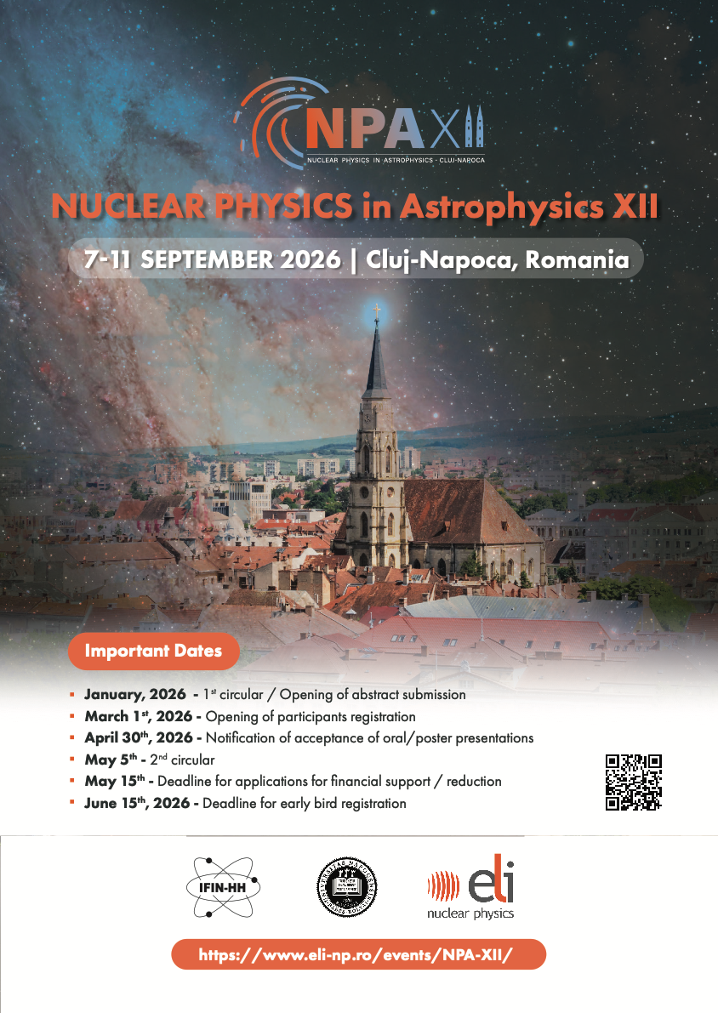

Big Bang Nucleosynthesis
and
the Li Problem
Ani Aprahamian
University of Notre Dame
September 8, 2026
Notes:
Hello…pleasure to be here….my first time in Romania..thehome of ELI-NP….
my talk today is about possibilities…using powerful lasers to carry out nuclear physics measurements…
possibilities with implications to the cosmological Li Problem…the cno abundances in old stars…and the origin of the neutrons that initiate the i-process.
Laser driven nuclear physics…

Slide 2
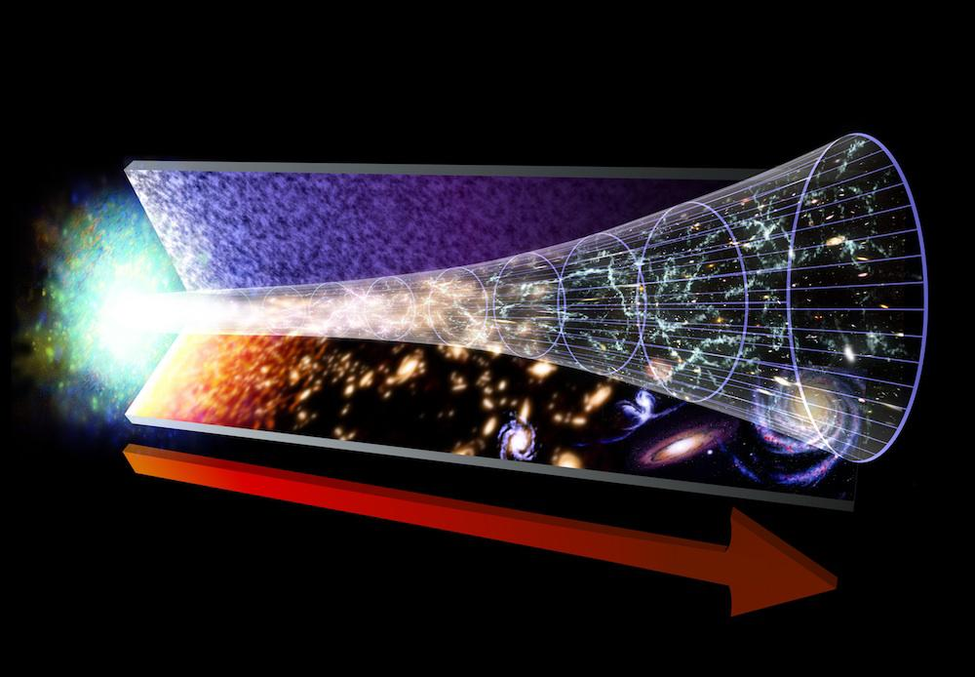
The cosmological Lithium problem? Primordial elements, CNO abundances in old stars
What are some potential solutions? Reactions with tritium
New experimental tools? Intense tritium and neutron beams, NSF OPAL project
Notes:
My talk today about possiblilties….specifically the role of tritium…in the cosmological lithium problem…the abundances of old stars…and new experimental capabilities…
Yesterday, we had a very nice description of BBN by Stefen Turkat and then by Eliana….

Slide 3
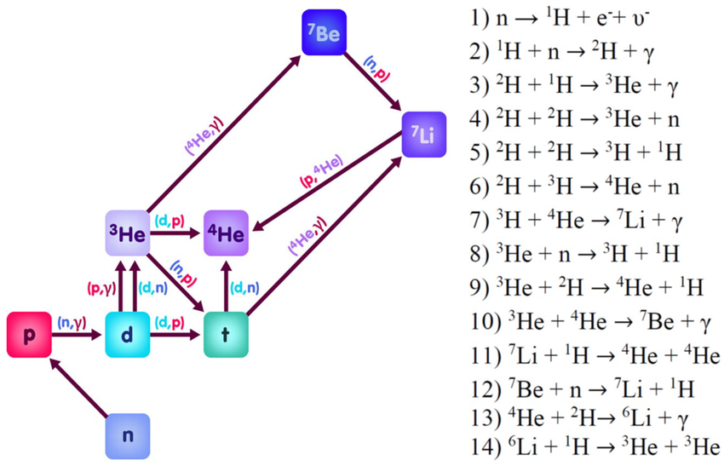
Nucleosynthesis: Cosmic creation of the primordial elements
H, ²H, ³H, ³He, ⁴He, ⁷Li
²H deuterium
⁴He
⁷Li

Slide 4
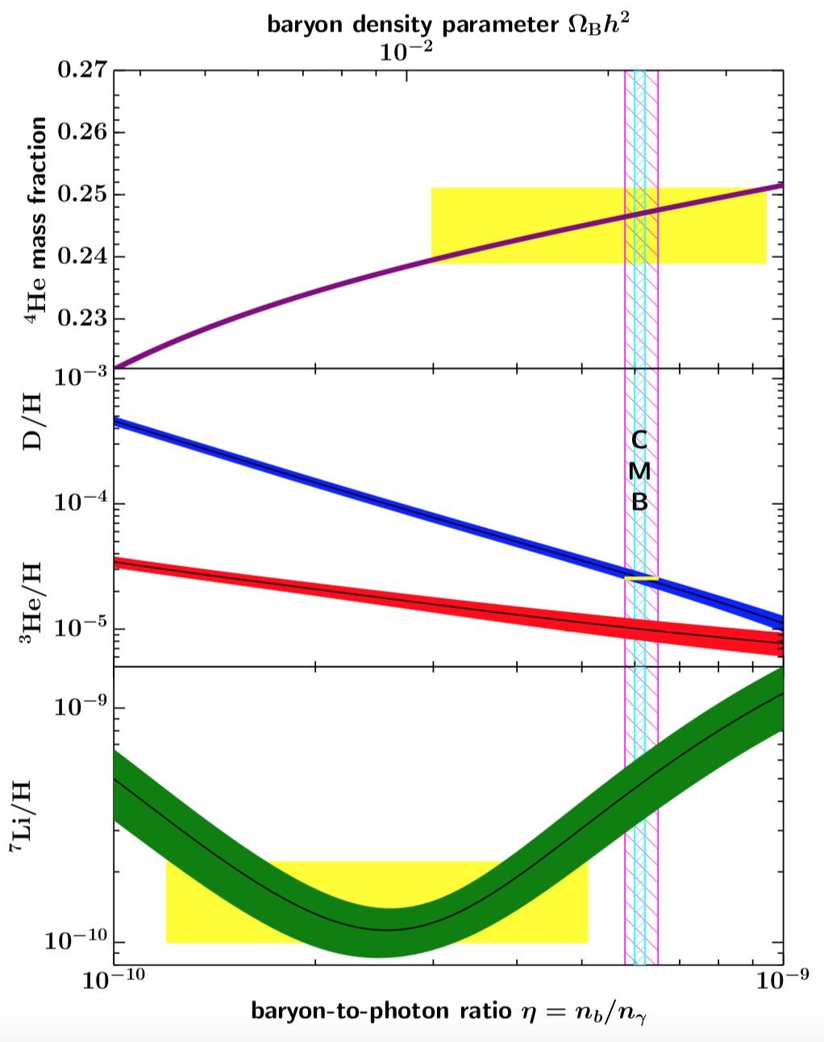
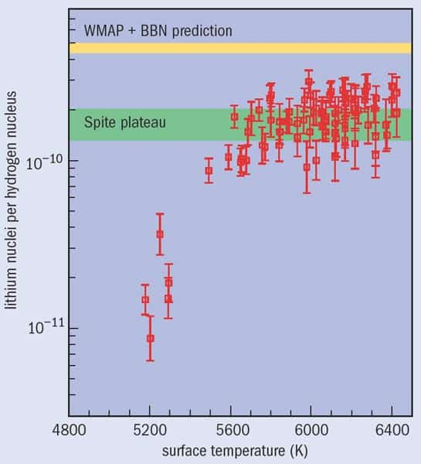
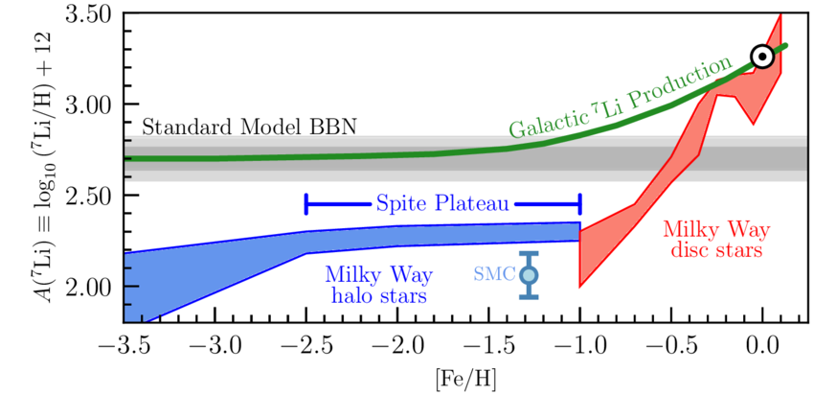
Cosmological Lithium Problem:
Disagreement with Cosmic Microwave Background
Cosmic baryon densities from CMB

Slide 5
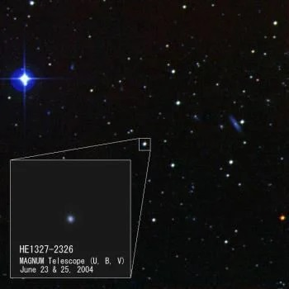
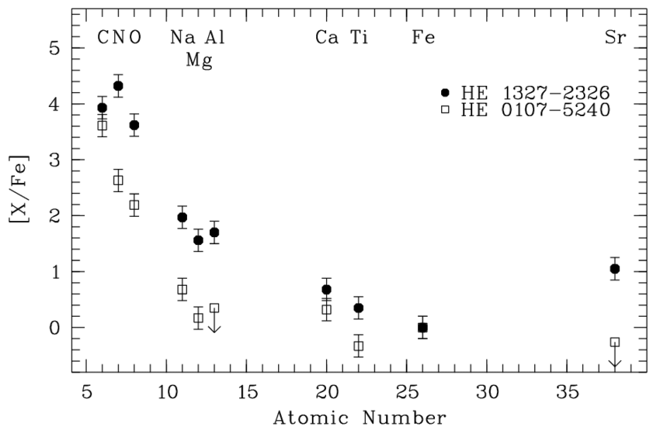
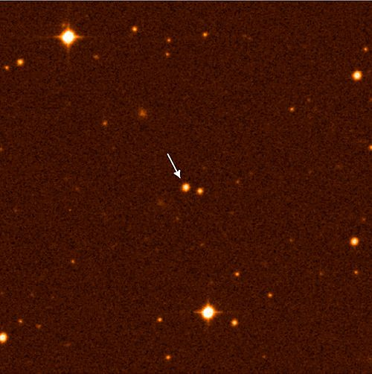
Element Distributions in very old Stars
Very old stars show abundances of C, N, O
He 1327-2326
CNO elements
What is the pathway
to produce them?
He 0107-5240

Slide 6
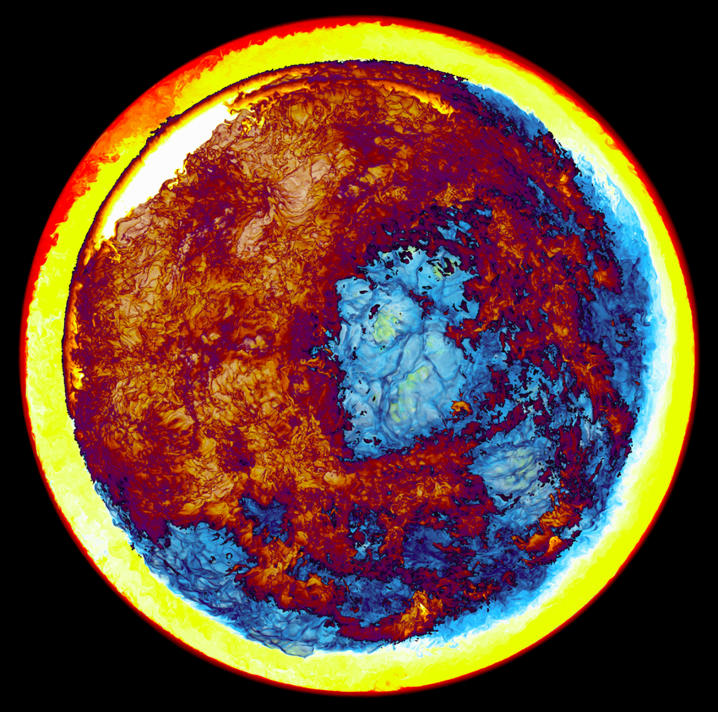
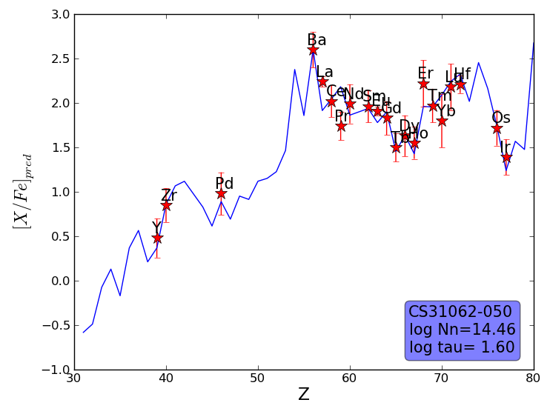
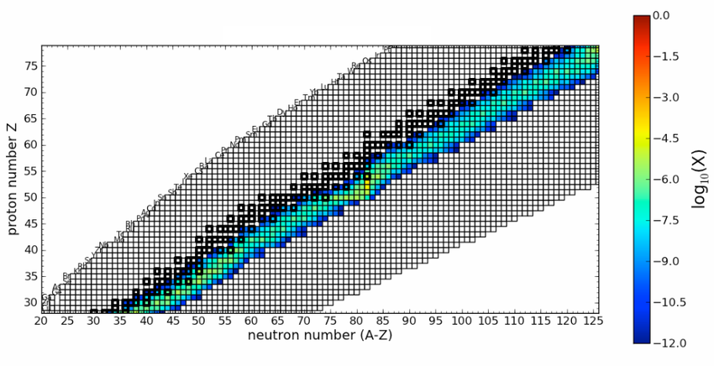
Neutron Sources in First Stars might be the Source for the i-Process
Peculiar neutron induced abundances observed in old Carbon Enhanced Metal-Poor stars requires neutron
capture off stability!
CEMP –
AGB star deep convective environments

Slide 7
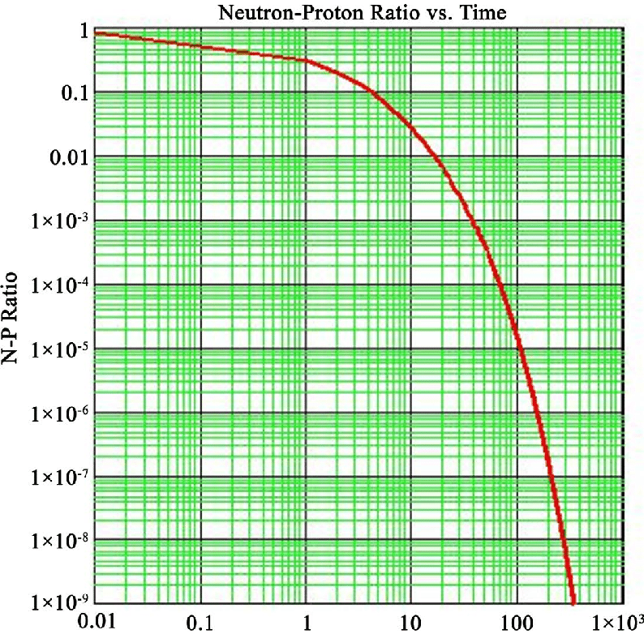
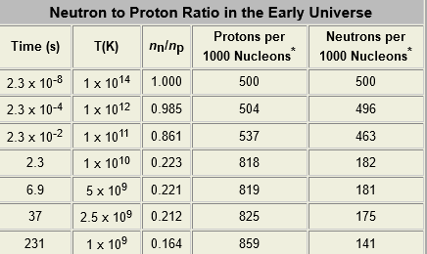
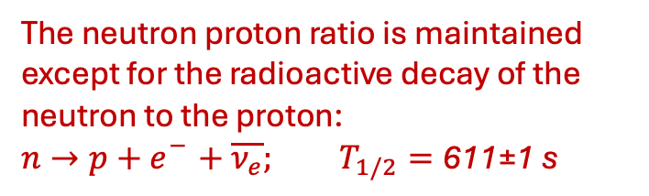
Neutron-proton ratio versus time:
Tritium as a neutron storage ?
Time in seconds
The actual half-life is a bit of a mystery. One method measures it as 615.3 seconds, plus or minus 2.2 seconds. Another method measures it as 608.9 seconds, plus or minus 0.8 second.

Slide 8
4 Reasons for this discrepancy between observation and theoretical prediction
1. Stellar Physics: Atomic diffusion of Li in stars
2. Nuclear Physics in Big Bang: neglect of these tritium reactions on
  Li and Be
3. Nuclear Physics in First Stars: neglect of alpha-capture reactions on
  Li and Be
4. Physics beyond the Standard Model
Notes:
Threshold states…alpha clusters….

Slide 9
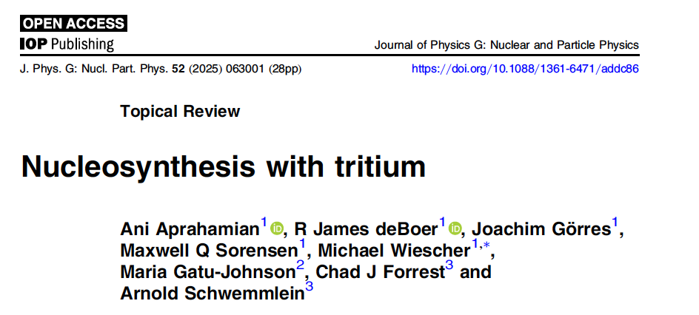

Slide 10

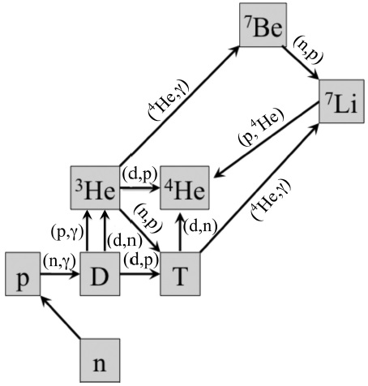
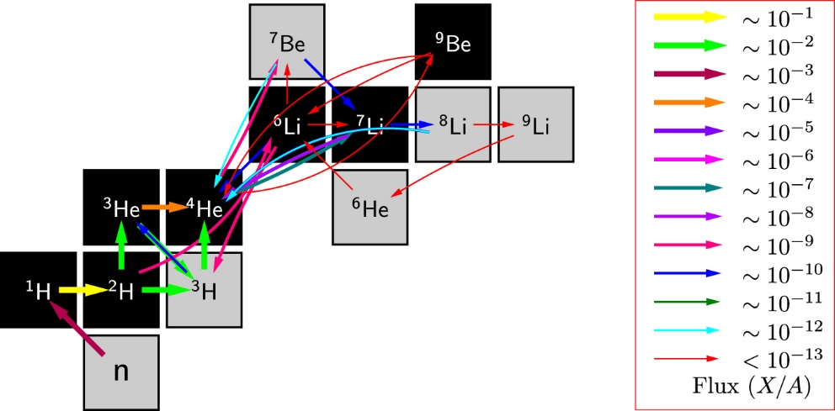
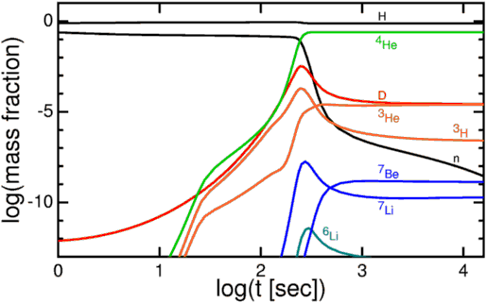
Big Bang Nucleosynthesis
The origin of the primordial elements: H, He, Li
The mass A=5 gap prohibits the production of substantial amounts of lithium and beryllium.
The mass A=8 gap prohibits the production of heavier elements such as boron, carbon, and beyond!
Notes:
Li…there is 3 times Less Li7 than predicted? How can we answer that?

Slide 11
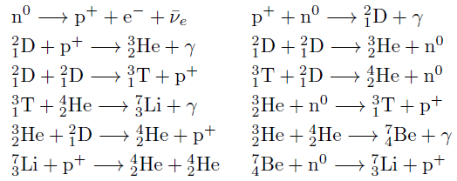
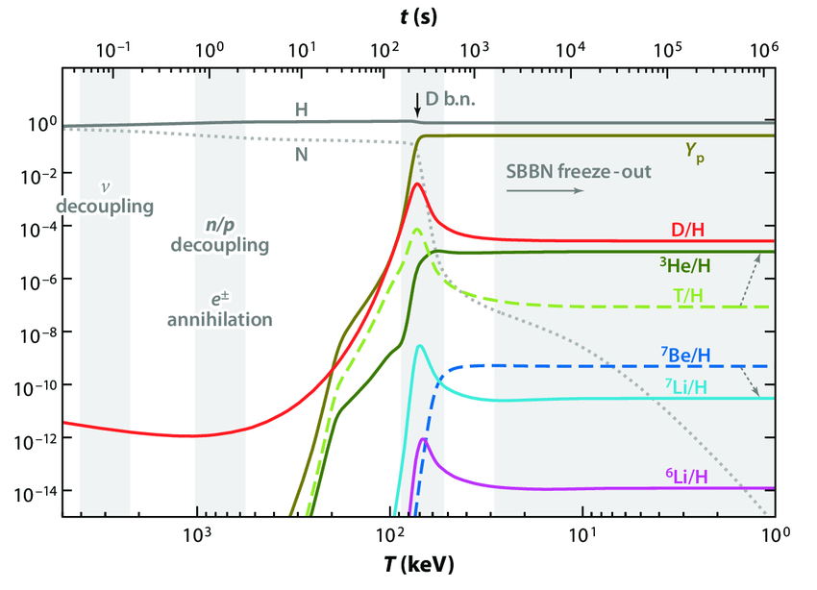
Subsequent reactions after deuterium formation
Tritium
Notes:
SBBN: Standard Big Bang Nucleosynthesis

Slide 12
Tritium reactions that use-up the Li
⁹Be
¹⁰Be
(t,n)
(t,γ)
Given the high abundances of tritium in BBN, ⁷Li(t,n)⁹Be and ⁷Li(t,α)⁶He reactions need to be further investigated
also, ⁹Be(t,n)¹¹B might be of interest for CNO synthesis

Slide 13
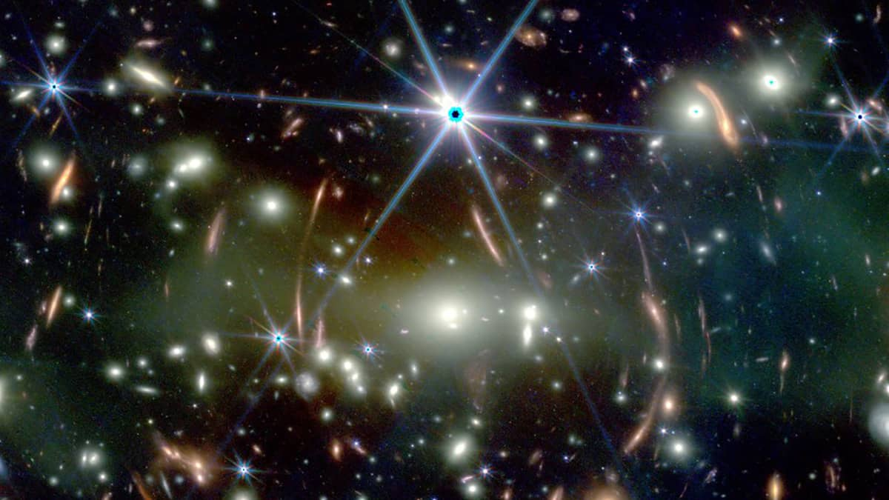
Bridging the mass 5 and 8 gap with tritium
Big Bang Nucleosynthesis or Chemical Evolution
Neutrino Driven Supernova Shock
Merging Neutron Stars

Slide 14
The Mass A=5 and A=8 Mass Gap
There are no stable nuclei with mass A=5 and mass A=8 in the universe!
The formation of heavier nuclei requires sufficient density to jump these two gaps by nuclear reaction processes!
This is a challenge in the rapidly expanding hydrogen and helium environments associated with the Big Bang, neutrino-driven shocks,
or merging neutron stars.
⁸B
⁹B
¹⁰B
⁷Be
⁸Be
⁹Be
⁵Li
⁶Li
⁷Li
⁸Li
²He
³He
⁴He
⁵He
A=8 mass gap
¹H
²H
³H
A=5 mass gap
¹n
²n

Slide 15
Tritium reactions
SI.a
The neglect of these tritium reactions may explain why the observed ⁷Li abundance is several orders of magnitude lower than predicted!
Subsequent ⁹Be(α,n)¹²C may generate neutrons and ¹²C.
⁹Be
¹⁰Be
(t,n)
(t,γ)
³H(t,2n) fusion and ³H(³He,pn) fusion require further studies at low energies.
The ³H(α,γ)⁷Li fusion studies show pronounced discrepancies.
Given the high abundances of tritium in the early Big Bang environment also the strength of the subsequent ⁷Li(t,γ)¹⁰Be and ⁷Li(t,n)⁹Be reactions need to be investigated as possible solution of Lithium problem.

Slide 16
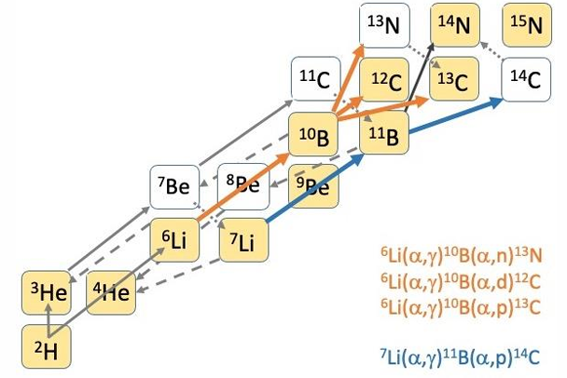
¹²C production paths
Are there alternatives?
¹²C
⁴He(2α,γ)¹²C
⁸Be
⁴He

Slide 17
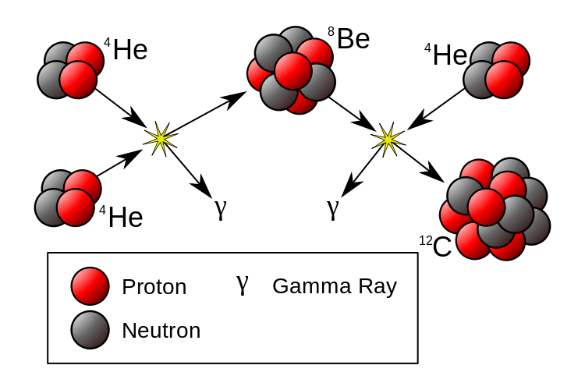
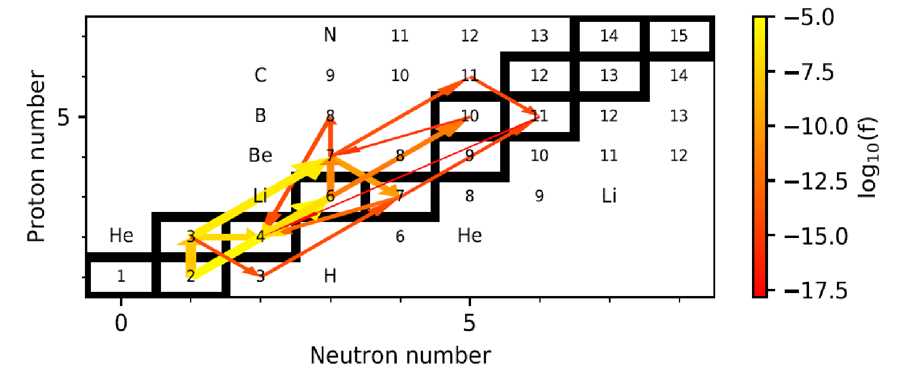
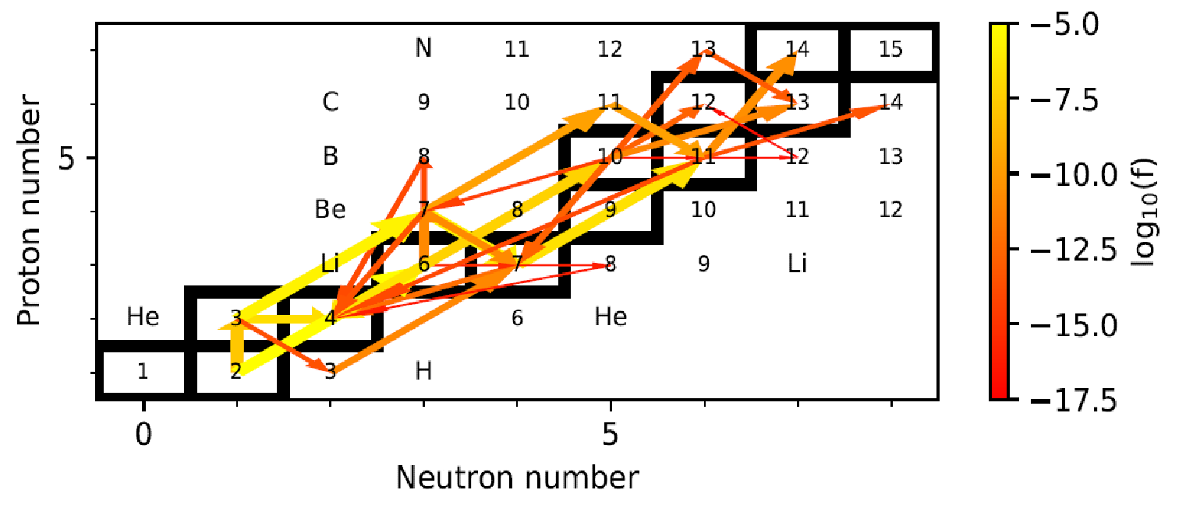
The onset of alternative paths: Clusters
Recent low energy studies at the CASPAR underground accelerator show pronounced cluster resonances near the alpha threshold, enhancing the reaction rates by several orders of magnitude!
⁶Li
¹⁰B
The ⁶Li(α,γ)¹⁰B(α,d)¹²C
¹⁰B(α,n)¹³N
¹⁰B(α,p)¹³C
²H
After 1 hour
After 10 months

Slide 18
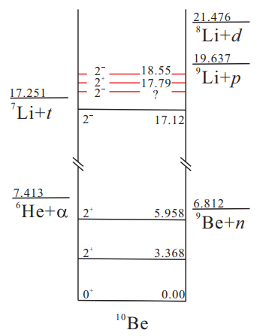
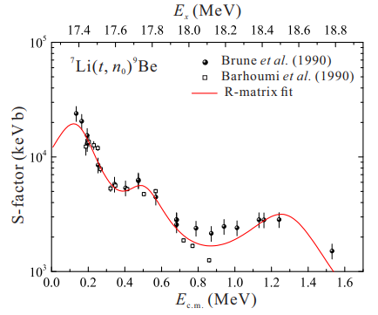
Impact of threshold states
SI.a
⁷Li(t,n)⁹Be
Impact of near threshold s-wave resonance states may cause order of magnitude increase in reaction rate!
Fictitious state?

Slide 19
Uncertainties in threshold states!
Impact of near threshold s-wave resonance states may cause order of magnitude increase in reaction rate!
Fictitious state?

Slide 20
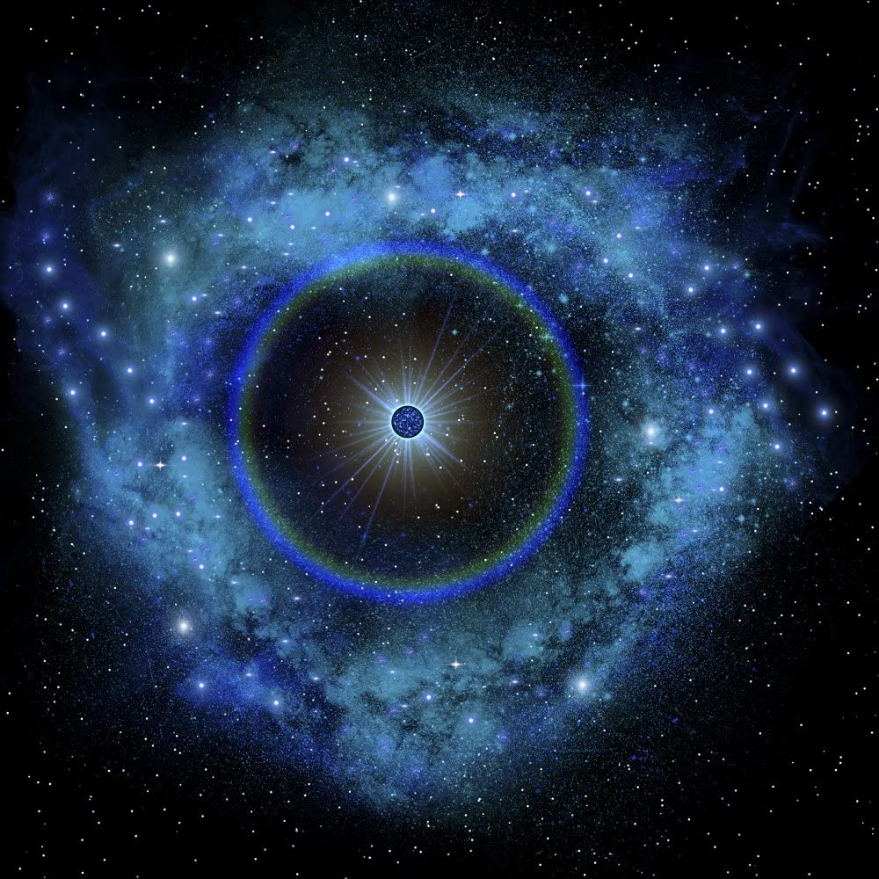
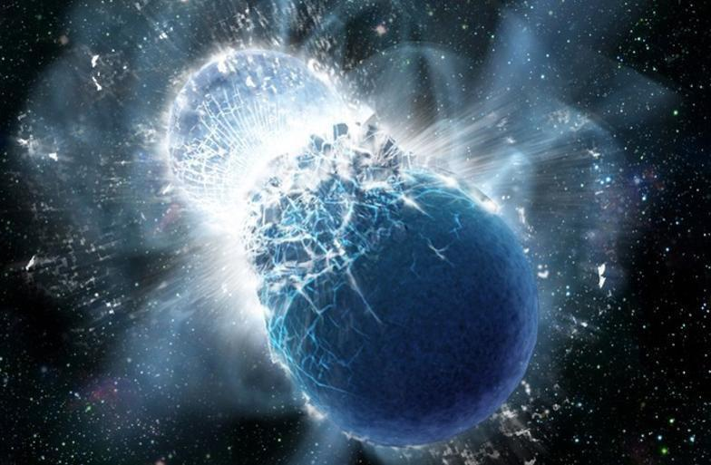
S
Is this important beyond Big Bang?
Dissociation of elements at high temperature and density conditions?
Neutrino driven wind
Merging neutron stars

Slide 21
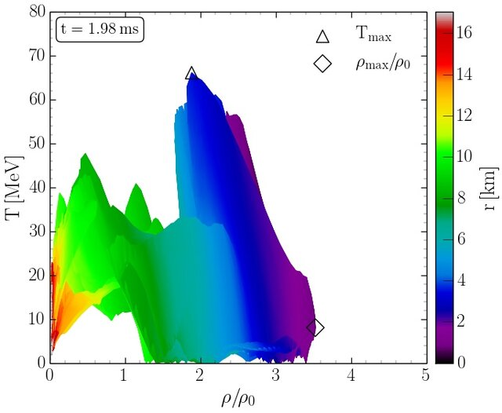
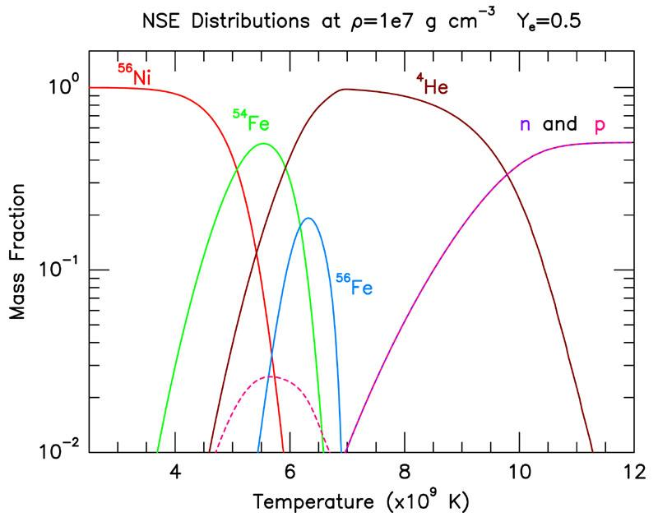
Rapidly expanding high density matter
Core Collapse Supernova or neutron star merger conditions rebuilding heavier elements in the neutrino driven expansion phase in statistical equilibrium. The onset is delayed by A=5 and A=8 mass gap, which needs to be bridged within milliseconds
Conversion from p, n, α to ³He, ⁷Li, ⁹Be, ¹⁰B, ¹⁴N with delayed release of neutrons to trigger light r-process!
Notes:
Convective environments of core collapse supernovae

Slide 22
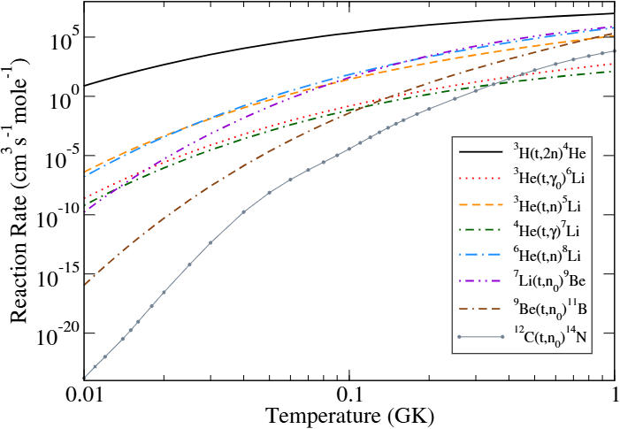
Additional neutron sources via (t,n) reactions
R-matrix Calculations
The tritium induced neutron sources are all considerably stronger than the strongest known alpha induced neutron source. The role of tritium depends on the tritium abundances generated in the first moments of the explosive event, BB or SN. It also depends on the reliability of the proposed reaction rates.
Experimental verification is necessary!
⁹Be(α.n)¹²C

Slide 23
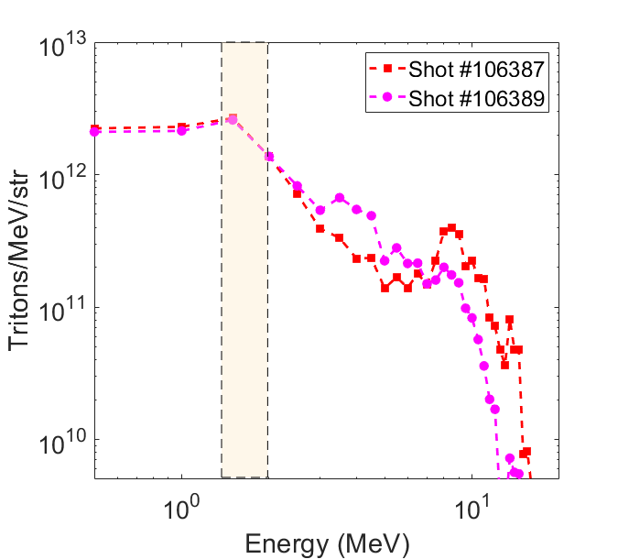
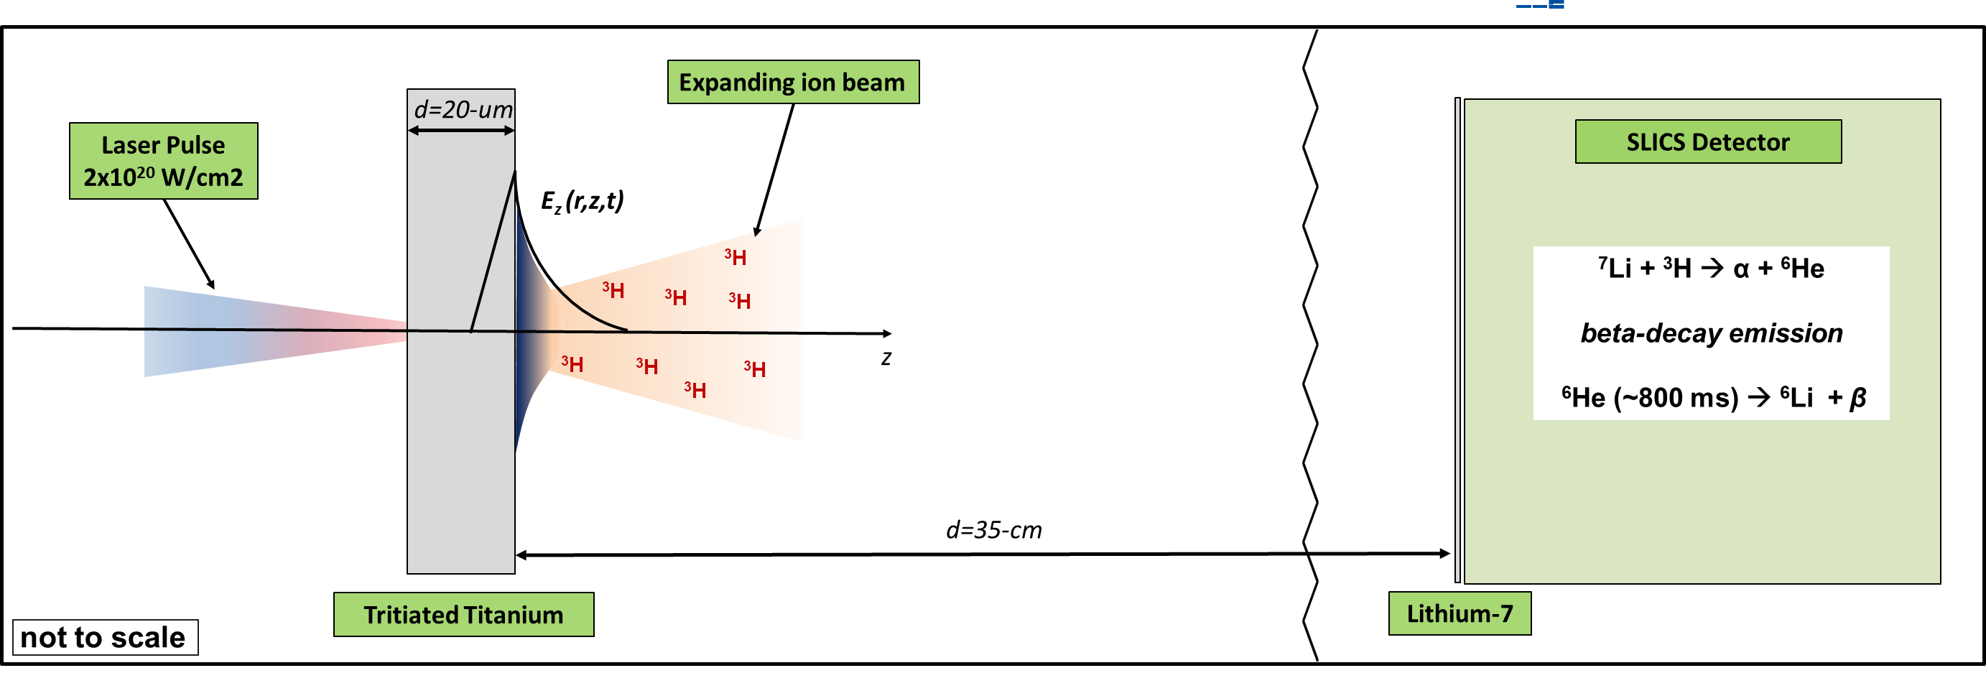
Experiments at OMEGA laser:
Recently deployed for the ⁷Li(t,α)⁶He reaction
1000 J laser pulse: TNSA (Target Normal Sheath Acceleration) Technique

Slide 24
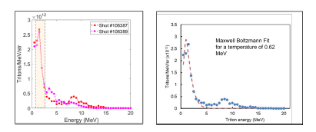
Tritons at the Omega Laser Facility

Slide 25
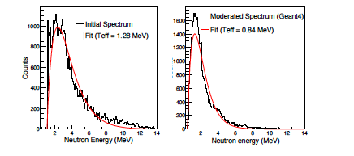
Neutron spectrum generated with a TNSA tritium pulse on a ⁷LiF layer:
10⁹ neutrons/cm² for a 10ps pulse (OPAL 5 orders of magnitude more)
⁷Li(t,n)⁹Be
s-process?

Slide 26

The NSF OPAL project proposes to build the world’s most powerful laser
enabling scientists to investigate the mysteries of the universe.

Slide 27
Laser-Driven Nuclear Physics: 2-25 Peta watt lasers

Slide 28
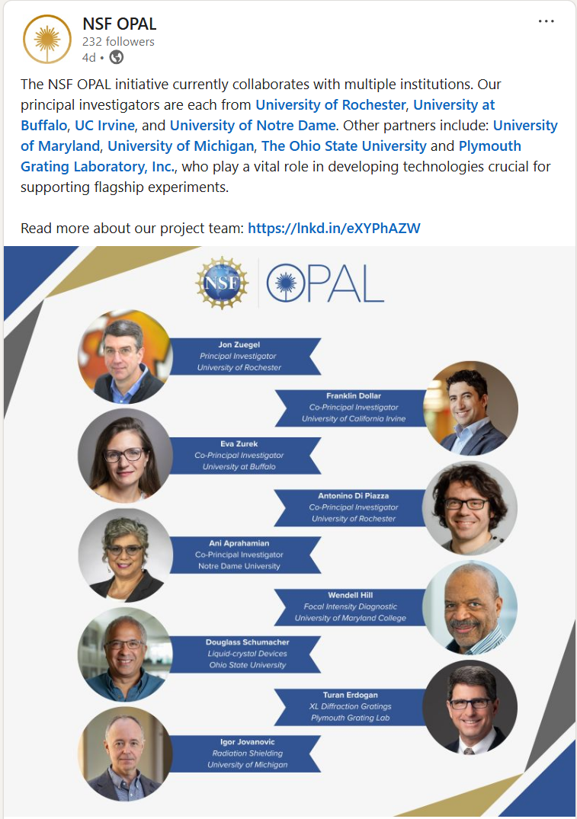

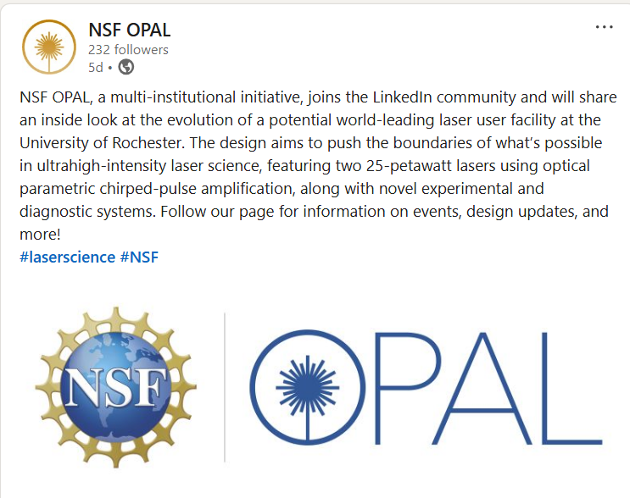

Follow on LinkedIn to stay up-to-date on all things NSF OPAL
https://linkedin.com/
company/nsf-opal

Slide 29
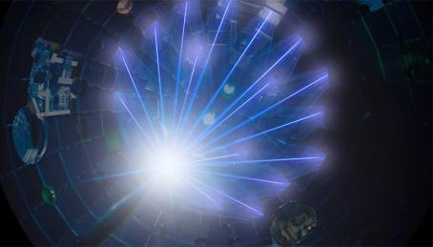
Conclusions
The Cosmological Li problem may be solved with the measurements of tritium induced nuclear reaction cross-sections.
Also, (alpha,n) reactions provide the neutron sources for r-process in much lighter nuclei.
Intense tritium beams and intense neutron beams
Other possibilities exist…
Thank you for your attention!

Slide 30
Experiments with tritons at accelerator or OMEGA
Plans and Projects
A(α,p)C tritium stripping experiments to populate tritium cluster states at tritium threshold. (Local exploration effort via A(α,p)C or A(⁷Li,α)C at the NSL Enge spectrograph)
C(t,t’) inelastic scattering experiments at FSU
Purchase of a tritium target through Air Force Academy grant for inverse kinematic experiments e.g. ³H(⁷Li,n), ³H(¹⁰B,n), ³H(¹²C,n) (Mike Febbraro)
⁹Be(n,t) and ¹¹B(n,t) experiments at LANSCE/LANL or n_ToF/CERN facilities (Hye Young Lee)
High flux tritium beam production at OMEGA and OMEGA-OPAL plasma facility (Ani Aprahamian, Chad Forrest)

Slide 31
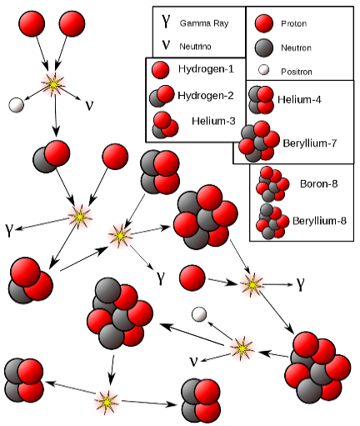


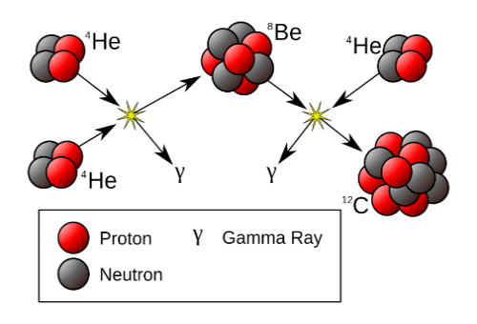






























The formation of ¹²C through alpha clusters
n
⁶Li
⁴He
n
⁴He
⁸Be
⁴He
¹³N
¹H
¹⁴N
⁴He
²H
⁶Li
⁴He
⁷Be
⁷Li
γ
¹²C
⁴He
γ
¹⁰B
²H
¹¹B
⁴He
γ
¹H
⁴He
¹²C
⁴He
¹H
⁴He
⁴He
³He
⁴He
¹³C
¹⁴C
α ⇨ ⁸Be ⇨ ¹²C
d ⇨ ⁶Li ⇨ ¹⁰B ⇨ ¹⁴N
d ⇨ d⊗α ⇨ d⊗⁸Be ⇨ d⊗¹²C
t ⇨ ⁷Li ⇨ ¹¹B ⇨ ¹⁵N
t ⇨ t⊗α ⇨ t⊗⁸Be ⇨ t⊗¹²C
2α⇨α⊗α ⇨α⊗⁸Be
Pronounced alpha cluster configurations at the threshold enhance the reaction rates of alpha induced processes versus proton induced reactions by orders of magnitude and facilitate a speedy formation of CNO nuclei!

Slide 32
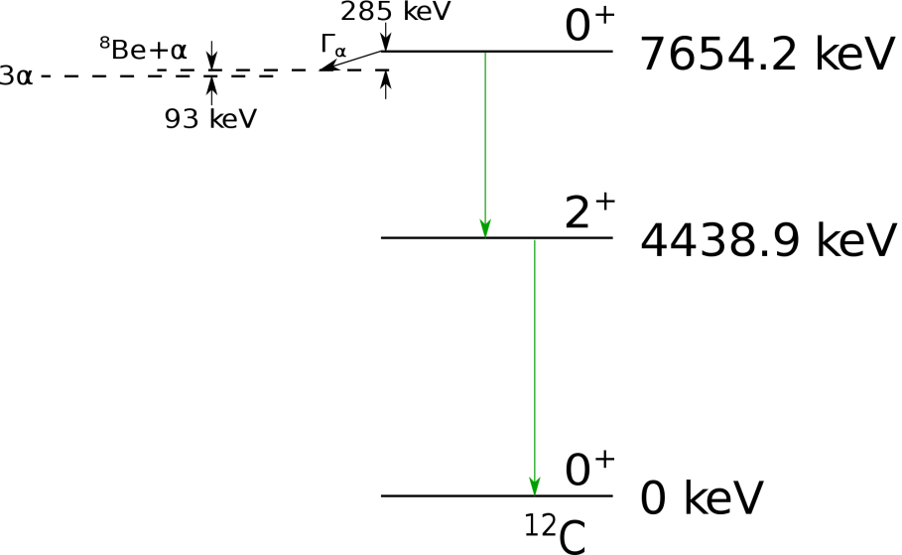
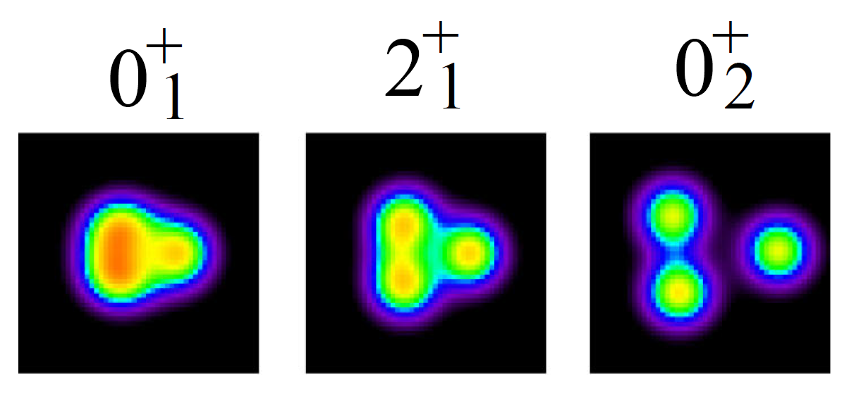
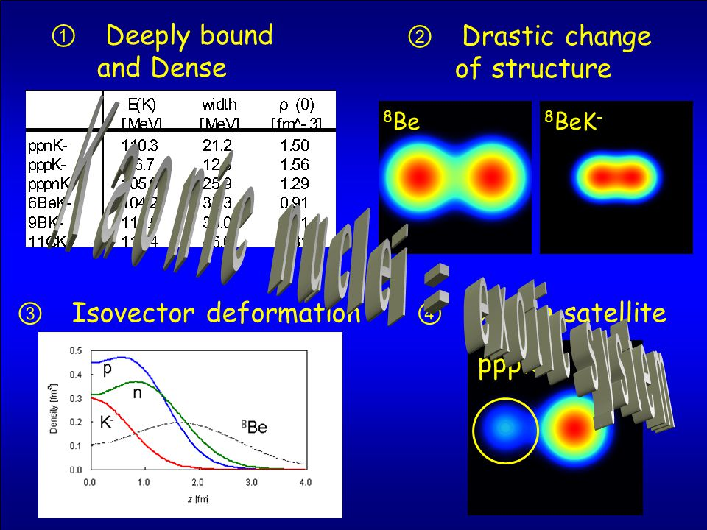
The triple-alpha-process
Three particle fusion that may occur by different reaction pathways:
Single step process (more likely for high density environments
Two step sequence (handicap is short-lived ⁸Be in equilibrium abundance)
Unbound 0⁺ alpha-cluster state in ¹²C (Hoyle state) saves the day since it adds a resonant component.
¹²C
Structure simulations by Kanada En’yo and co-workers

Slide 33
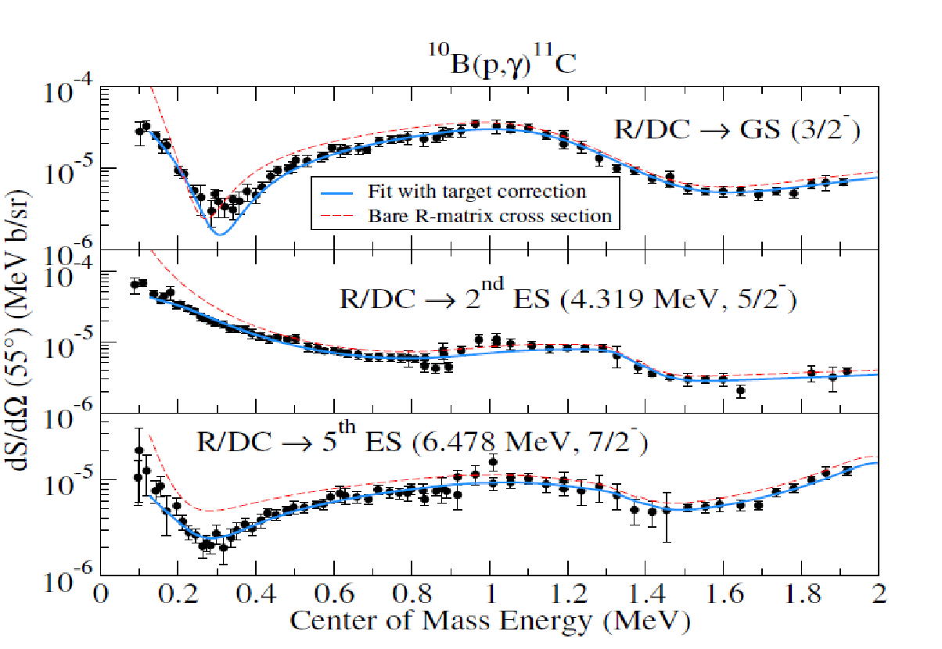
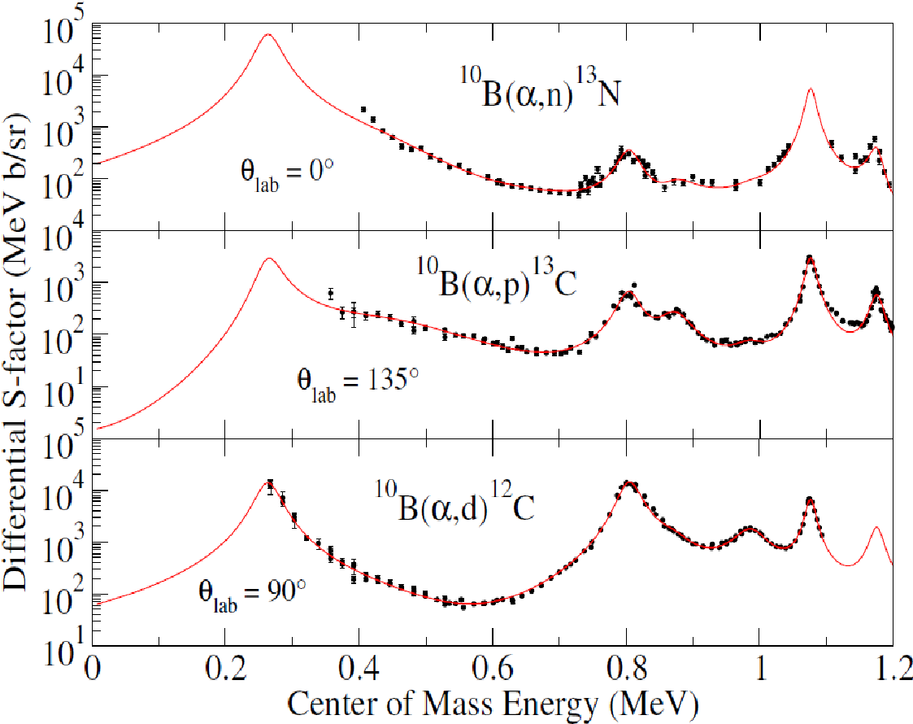
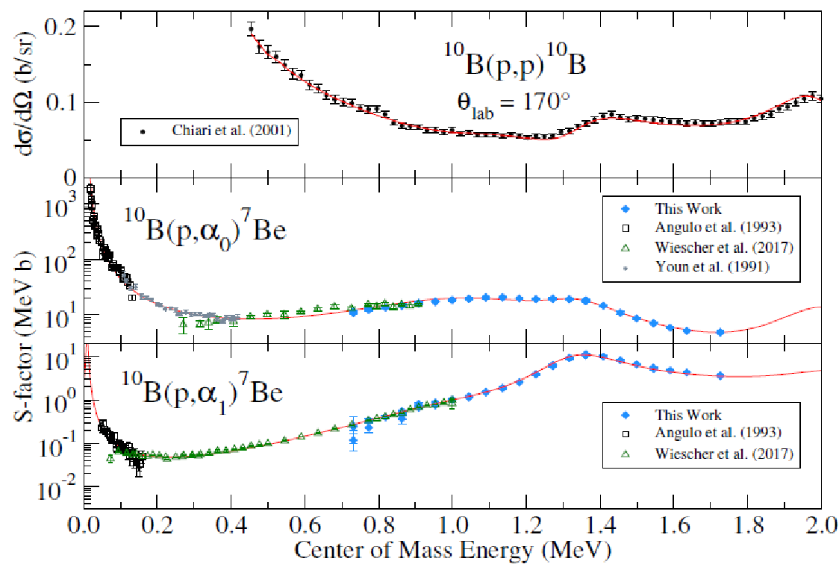
¹⁰B(α,γ)CNO over ¹⁰B(p,α): ?
Broad threshold resonances in both cases! The impact is not clear yet! New measurements are planned for LUNA and CASPAR to map the ¹⁰B+α resonance. We don’t know the outcome yet!

Slide 34
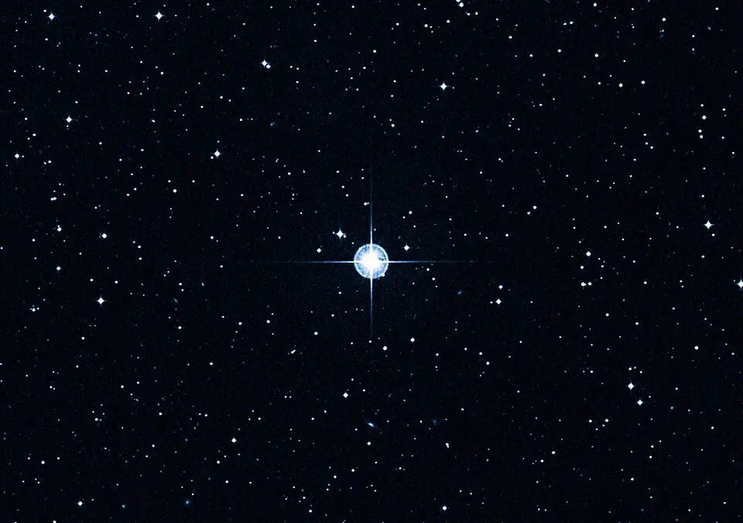
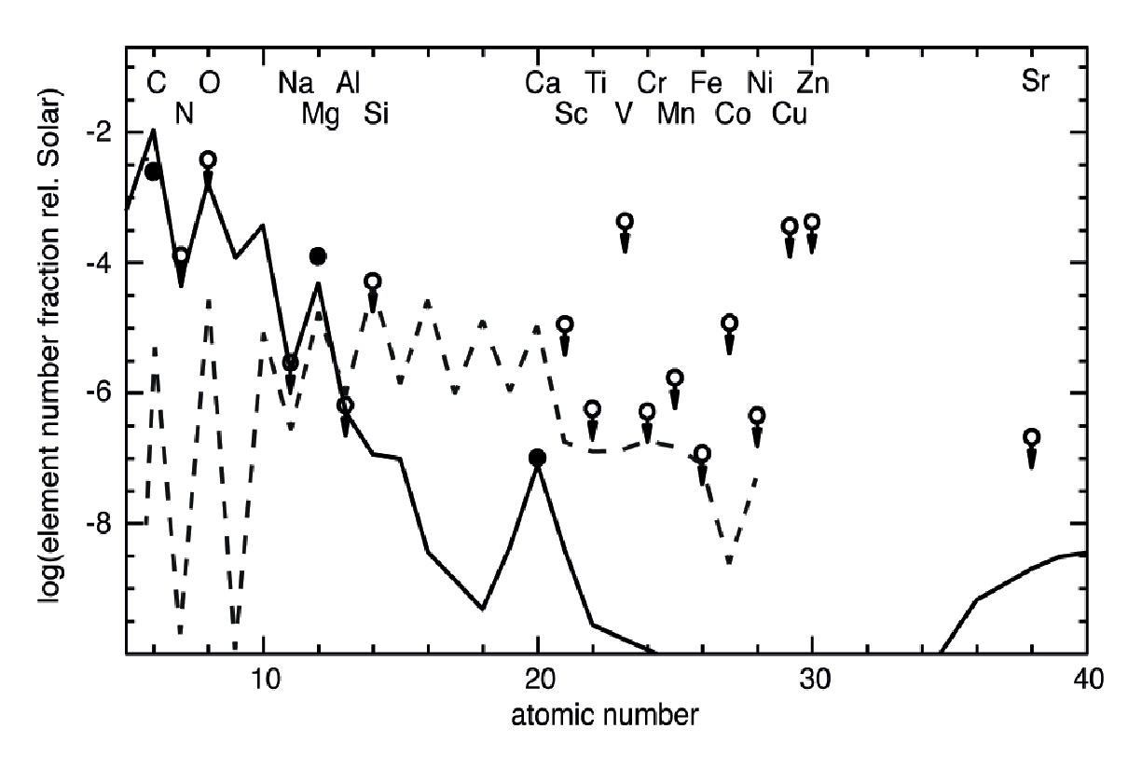

Observational Evidence
SMSS J031300.36−670839.3 or
Keller Star
proton or neutron induced processes
SC Keller et al. Nature 000, 1-4 (2014) doi:10.1038/nature12990

Slide 35
⁹Be production
¹⁰B production
¹¹B production
⁴He(αn,γ)⁹Be
⁷Li(³He,p)⁹Be
⁷Li(²H,γ)⁹Be
⁷Li(³H,n)⁹Be
⁹Be(α,n)¹²C
⁶Li(α,γ)¹⁰B
⁹Be(p,γ)¹⁰B
¹⁰B(α,n)¹³N
¹³C(α,n)¹⁶O
⁷Li(α,γ)¹¹B
⁹Be(p,γ)¹¹B
¹¹C(β⁺ν) ¹¹B
¹¹B(α,n)¹⁴N
Most of the reaction rates go back to FCZ 75 and CF88, very limited amount on new data! Extremely limited amount on low energy data.
Most of the systems, e.g. ⁹Be, ¹⁰B, ¹¹B are characterized by alpha –cluster structures, 2α⊗n, 2α⊗d, and 2α⊗t, respectively. These structures typically emerge as resonances near the alpha thresholds. Broad resonance in ⁶Li(α,γ)¹⁰B at 730 keV and at 945 keV in ⁷Li(α,γ)¹¹B.

