Slide 1
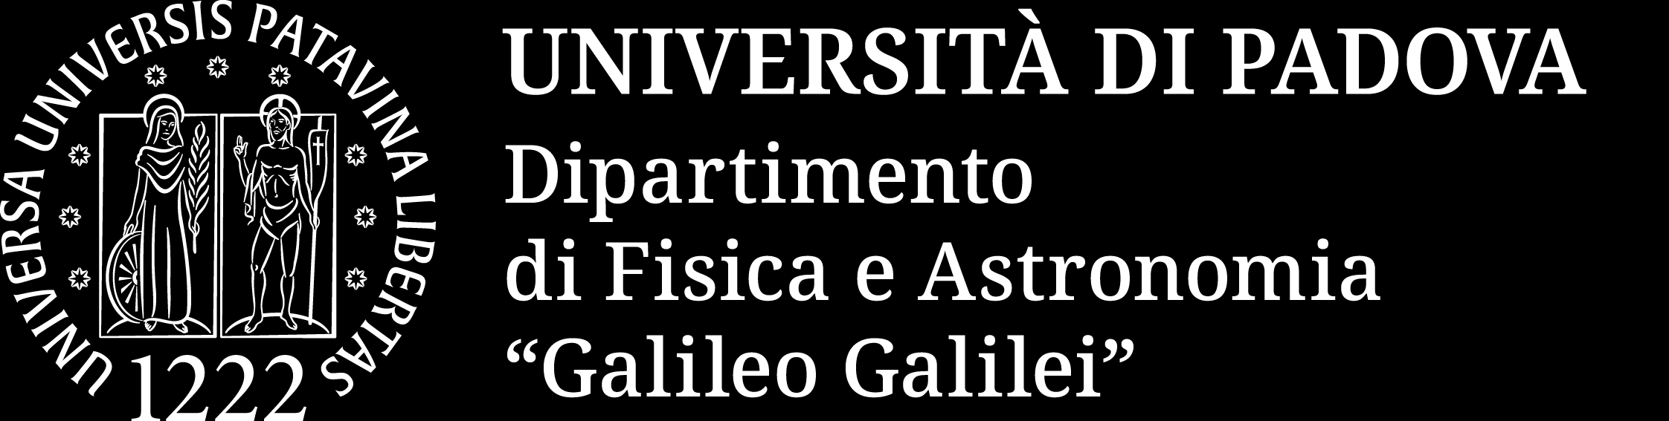
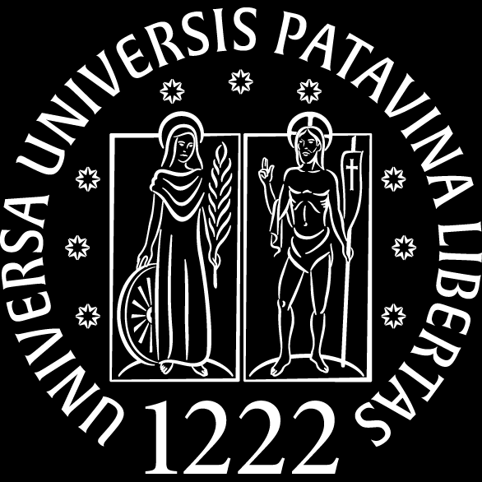

Direct and indirect approaches for Nuclear Astrophysics:
recent highlights from LUNA and the AGATA campaigns
The ¹⁴N(p,γ)¹⁵O reaction: from the underground data to the lifetime of the 6.79 MeV state
Jakub Skowronski (https://jskowron.eu)
Università degli Studi di Padova & INFN Sezione di Padova – for the LUNA and AGATA collaborations
Nuclear Physics in Astrophysics 2026
10/09/2025, Cluj-Napoca
Notes:
Fill in date and venue. 25 min: ~9 min motivation + LUNA, ~14 min AGATA + impact, ~2 min summary.

Slide 2

¹⁴N(p,γ)¹⁵O: the bottleneck of the CNO cycle
J. Skowronski | Università di Padova & INFN Padova | NPA 2026
2
Notes:
1.5 min. Stars above ~1.2 Msun burn hydrogen through the CNO cycle; in the Sun it is ~1 % of the luminosity but produces a distinctive neutrino flux. The slowest step, 14N(p,g)15O, sets the speed of the whole cycle: it controls the CNO neutrino flux, the lifetime of massive stars and the turn-off of globular clusters. Figure: Nature draft Fig. 1.

Slide 3
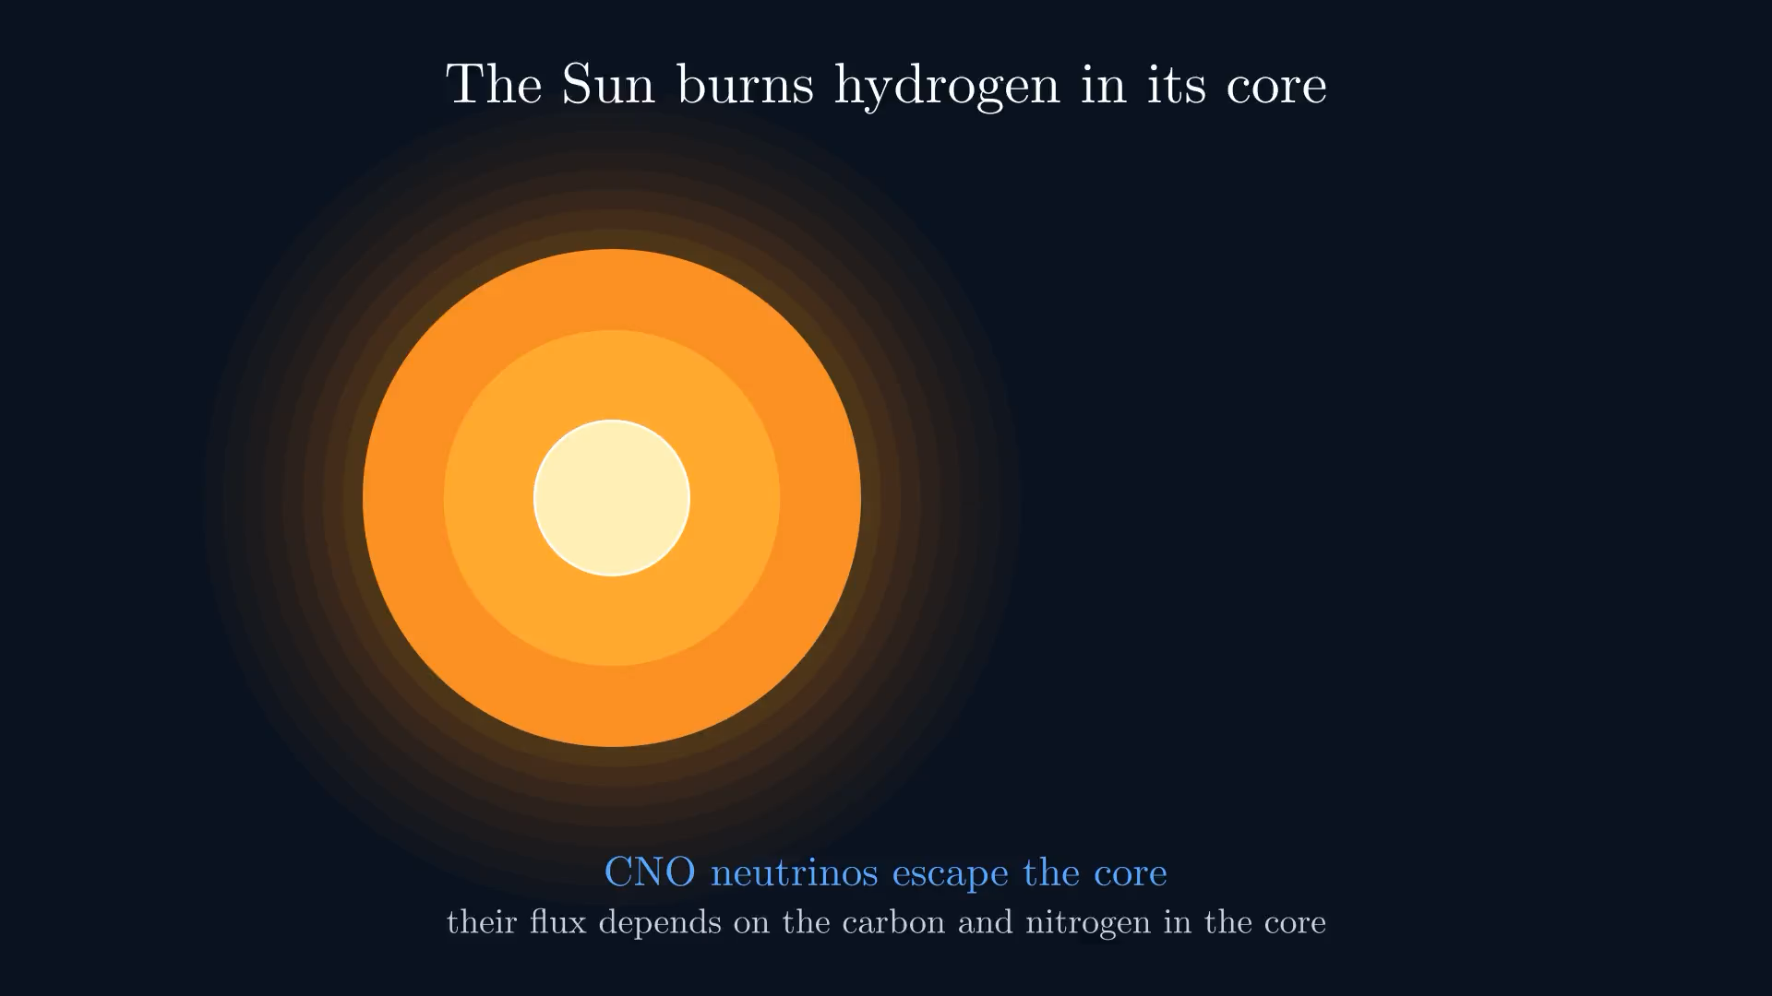
¹⁴N(p,γ)¹⁵O: the bottleneck of the CNO cycle
J. Skowronski | Università di Padova & INFN Padova | NPA 2026
2
Notes:
1.5 min. Stars above ~1.2 Msun burn hydrogen through the CNO cycle; in the Sun it is ~1 % of the luminosity but produces a distinctive neutrino flux. The slowest step, 14N(p,g)15O, sets the speed of the whole cycle: it controls the CNO neutrino flux, the lifetime of massive stars and the turn-off of globular clusters. Figure: Nature draft Fig. 1.

Slide 4
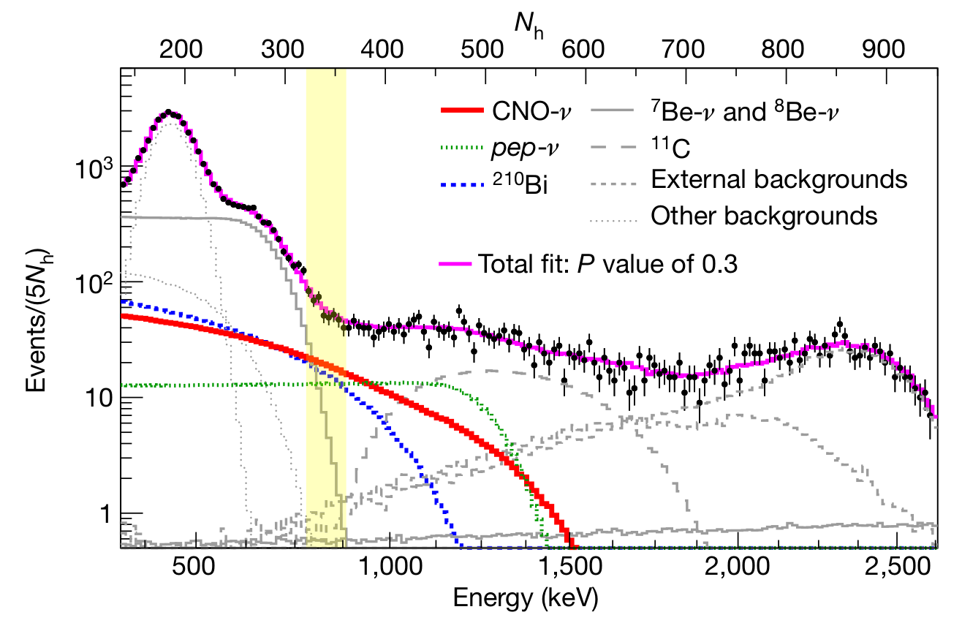
CNO neutrinos: a probe limited by nuclear physics
Flux ∝ C+N abundance in the core → the solar abundance problem
Borexino error budget (Appel et al. 2022): S₁₁₄ is the 2nd largest term after statistics
JUNO and SNO+ will remove the statistics and nuclear physics becomes the limit
Borexino, Nature 587 (2020): first detection of CNO neutrinos
J. Skowronski | Università di Padova & INFN Padova | NPA 2026
3
Notes:
1.5 min. Borexino 2020: first detection of CNO neutrinos; flux ∝ core C+N abundance → direct handle on the solar abundance problem (spectroscopy vs helioseismology). In the Borexino CN-abundance budget, S114 is the second largest contribution after statistics. JUNO and SNO+ will bring the statistics down: then nuclear physics is the limit. SF III assigns 8.4 % to S114(0).

Slide 5
CNO neutrinos: a probe limited by nuclear physics
Flux ∝ C+N abundance in the core → the solar abundance problem
Borexino error budget (Appel et al. 2022): S₁₁₄ is the 2nd largest term after statistics
JUNO and SNO+ will remove the statistics and nuclear physics becomes the limit
Borexino, Nature 587 (2020): first detection of CNO neutrinos
8.4 %
uncertainty on S₁₁₄(0)
Solar Fusion III (2025)
The largest nuclear-physics contribution to the predicted CNO neutrino flux
Goal of this talk: how LUNA and AGATA bring it to the few-% level
J. Skowronski | Università di Padova & INFN Padova | NPA 2026
3
Notes:
1.5 min. Borexino 2020: first detection of CNO neutrinos; flux ∝ core C+N abundance → direct handle on the solar abundance problem (spectroscopy vs helioseismology). In the Borexino CN-abundance budget, S114 is the second largest contribution after statistics. JUNO and SNO+ will bring the statistics down: then nuclear physics is the limit. SF III assigns 8.4 % to S114(0).

Slide 6
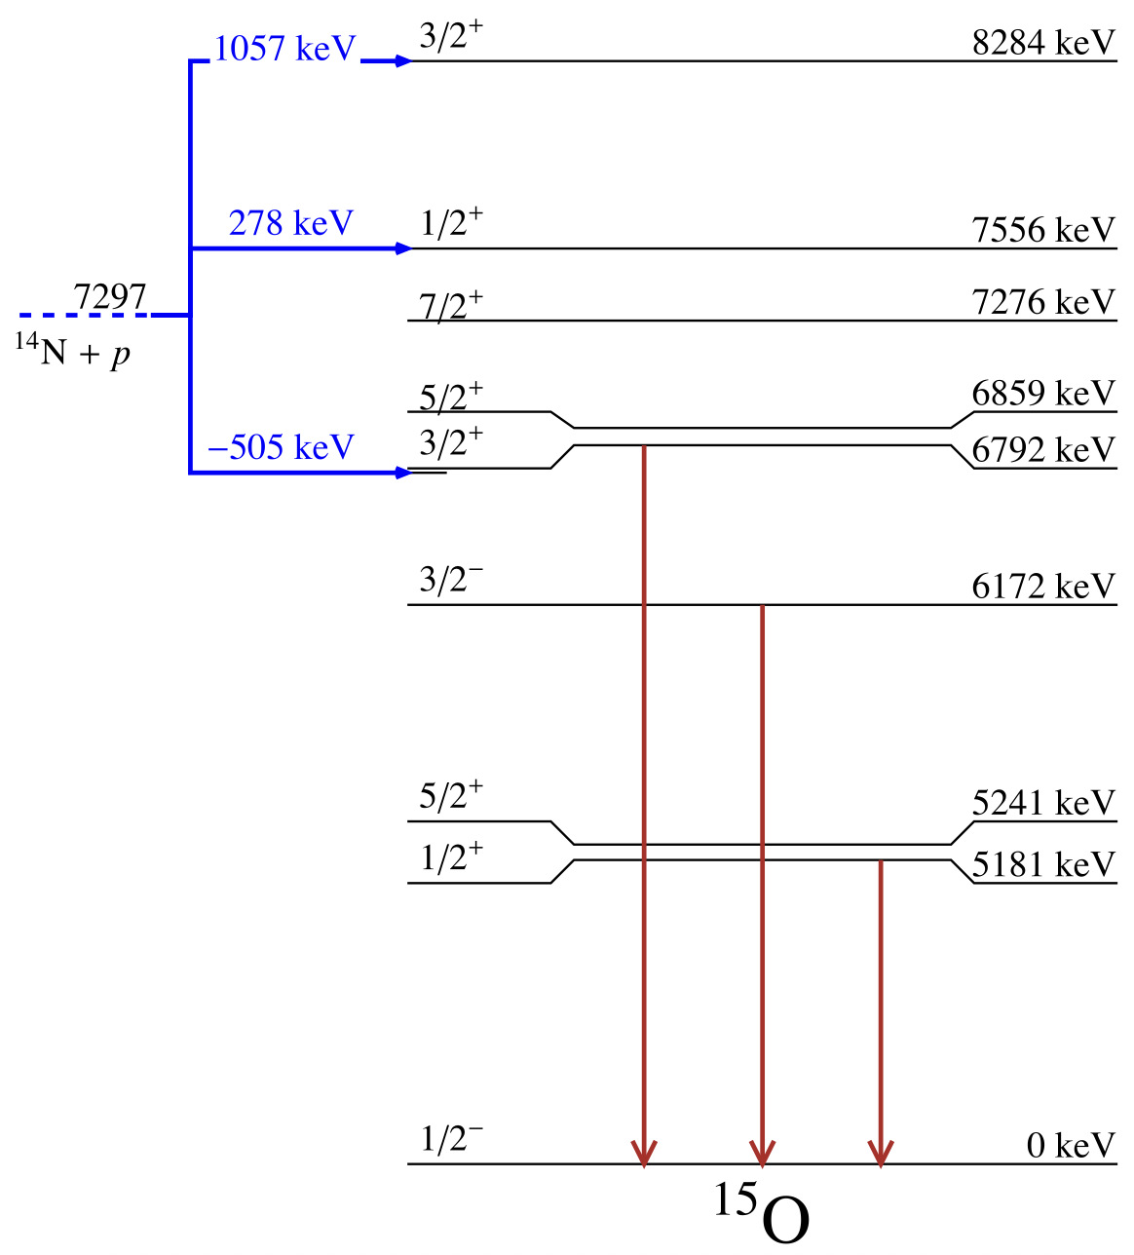
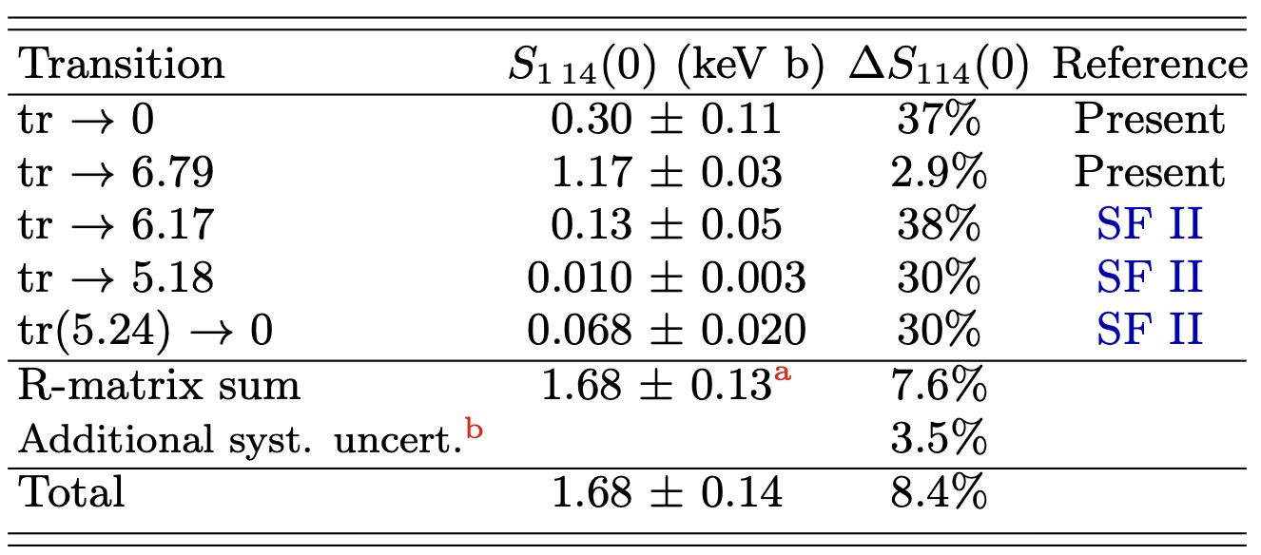
One state controls the extrapolation: ¹⁵O at 6.79 MeV
J. Skowronski | Università di Padova & INFN Padova | NPA 2026
4
Notes:
1.5 min. Q = 7.297 MeV, solar Gamow peak 20–35 keV. Capture to the 6.79 MeV state: 71–78 %, external capture, robust (3 %). Capture to the ground state: 16–17 %, but here the 6.79 MeV state acts as a sub-threshold resonance (505 keV below threshold) interfering with the 259 keV resonance, external capture and the broad 2.2 MeV 3/2+ resonance → 37 % uncertainty. Its width Γ = ħ/τ is the key parameter and was never measured.

Slide 7
One state controls the extrapolation: ¹⁵O at 6.79 MeV
The 6.79 MeV state is both the strongest transition and the sub-threshold resonance of the ground-state transition.
J. Skowronski | Università di Padova & INFN Padova | NPA 2026
4
Notes:
1.5 min. Q = 7.297 MeV, solar Gamow peak 20–35 keV. Capture to the 6.79 MeV state: 71–78 %, external capture, robust (3 %). Capture to the ground state: 16–17 %, but here the 6.79 MeV state acts as a sub-threshold resonance (505 keV below threshold) interfering with the 259 keV resonance, external capture and the broad 2.2 MeV 3/2+ resonance → 37 % uncertainty. Its width Γ = ħ/τ is the key parameter and was never measured.

Slide 8
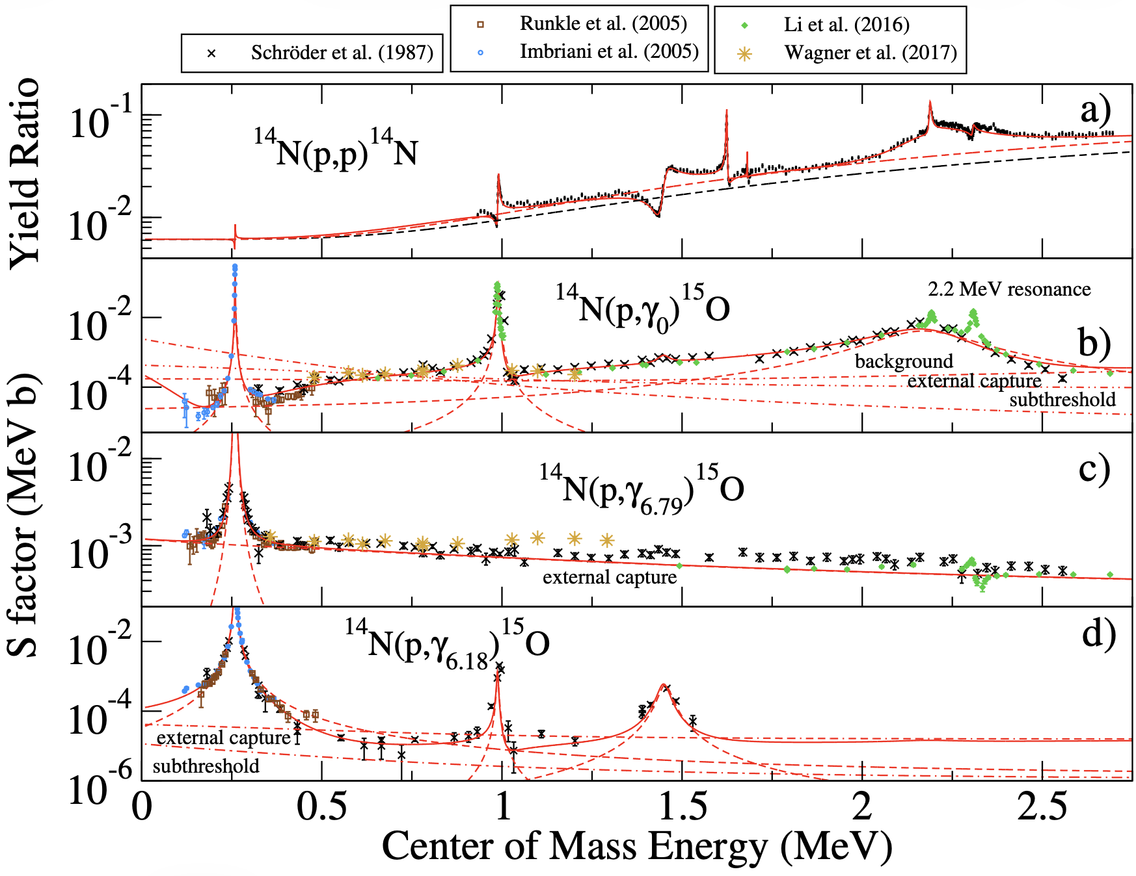
One state controls the extrapolation: ¹⁵O at 6.79 MeV
→ 6.79 MeV: 70% external capture, robust (3%)
→ ground state: 18% sub-threshold 6.79 MeV pole + other resonances resonance interfering (uncertainty 37%)
J. Skowronski | Università di Padova & INFN Padova | NPA 2026
4
Notes:
1.5 min. Q = 7.297 MeV, solar Gamow peak 20–35 keV. Capture to the 6.79 MeV state: 71–78 %, external capture, robust (3 %). Capture to the ground state: 16–17 %, but here the 6.79 MeV state acts as a sub-threshold resonance (505 keV below threshold) interfering with the 259 keV resonance, external capture and the broad 2.2 MeV 3/2+ resonance → 37 % uncertainty. Its width Γ = ħ/τ is the key parameter and was never measured.

Slide 9


Direct Measurements: LUNA
Notes:
~8 min for the LUNA part.

Slide 10
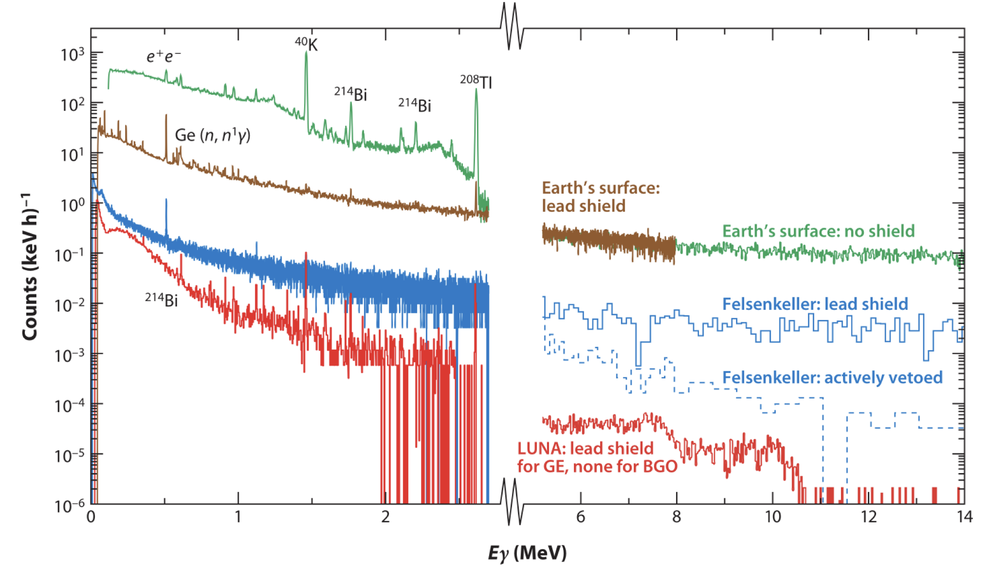
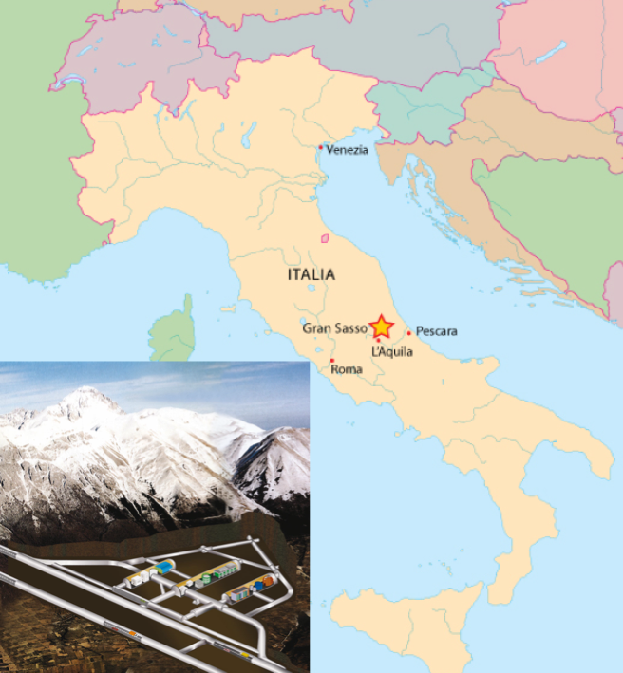
LUNA
1400 meters of rock: muons ×10⁻⁶, neutrons ×10⁻³ → the 6 – 8 MeV region is nearly background free
LUNA-400 (2000–) for the low-energy CNO program; Bellotti IBF, 3.5 MV (2023–) up to the MeV range
J. Skowronski | Università di Padova & INFN Padova | NPA 2026
6
Notes:
1 min. Muon flux ×10⁻⁶, neutrons ×10⁻³: the 6–8 MeV γ region relevant here becomes almost background free. Three accelerators: 50 kV, 400 kV (2000–), and the 3.5 MV Bellotti IBF (2023–).

Slide 11
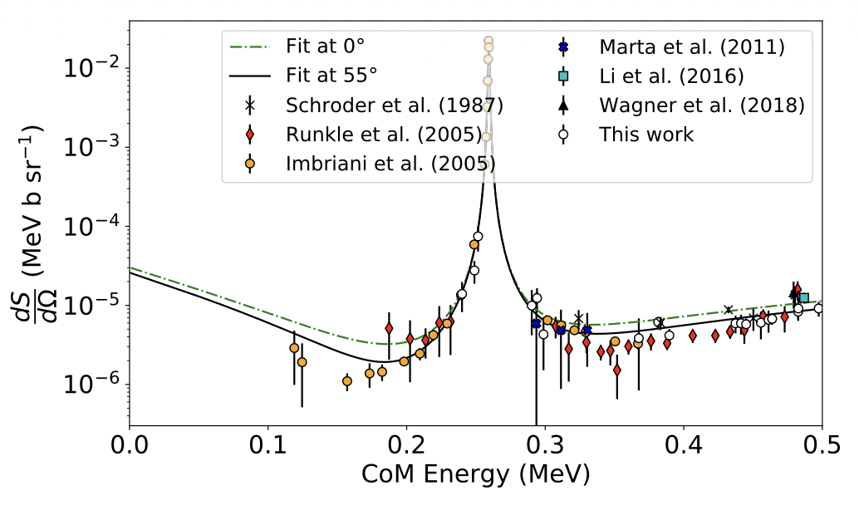
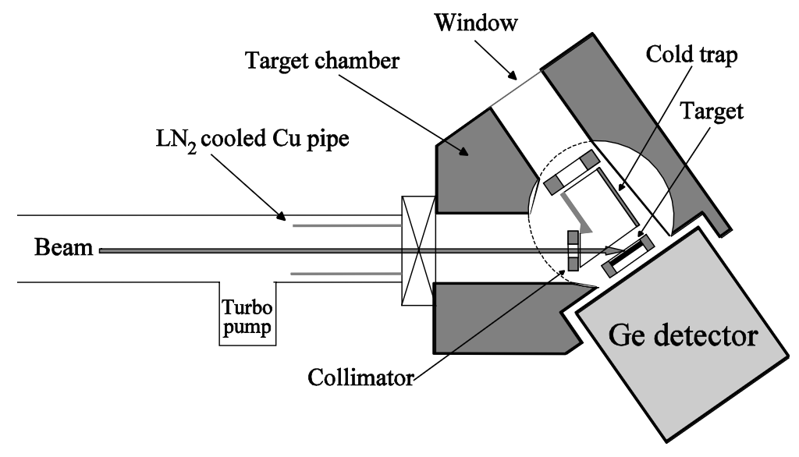
Generation 1 — Imbriani et al. (2005)
LUNA-400, TiN targets, HPGe detector, E_{cm} = 120–370 keV, all transitions
Close geometry → large summing-in corrections on the ground-state line
The only data below 200 keV up to 2025
J. Skowronski | Università di Padova & INFN Padova | NPA 2026
7
Notes:
1.5 min. LUNA-400, TiN solid targets, HPGe detectors; E_eff = 119–367 keV; all transitions. Sgs(0) = 0.25 ± 0.06 keV b, Stot(0) = 1.61 ± 0.08 keV b. Close geometry → summing-in corrections for the gs line. Together with LENA (Runkle 2005, 0.49 ± 0.08) still the only gs data below 200 keV, and the two differ by a factor 2. The paper itself: "the extrapolated S(0) is model dependent".

Slide 12
Generations 2 and Generation 3
See Rosanna Depalo talk!
Bellotti IBF — HPGe at several angles
SOCIAL (LUNA 400kV) — Segmented 4π BGO
E_{p} = 250 keV – 1.2 MeV, far geometry
Ground-state angular distributions, negligible summing
Replaces the uncorrected Schröder (1987) yields
Fixes the interference in the 0.4 - 1.2 MeV region
E_{p} = 120 – 280 keV, below the 278 keV resonance
Summing efficiency ≈ 70 % → statistics where HPGe cannot reach
Segmentation isolates the ground-state transition
Independent underground check of Chen et al. (2025)
J. Skowronski | Università di Padova & INFN Padova | NPA 2026
8
Notes:
1 min. Map the SF III recommendations onto the two campaigns: far-geometry angular distributions over the Schröder/Li range with LUNA-MV; the ground-state transition at the lowest energies with a segmented summing detector (SOCIAL).

Slide 13
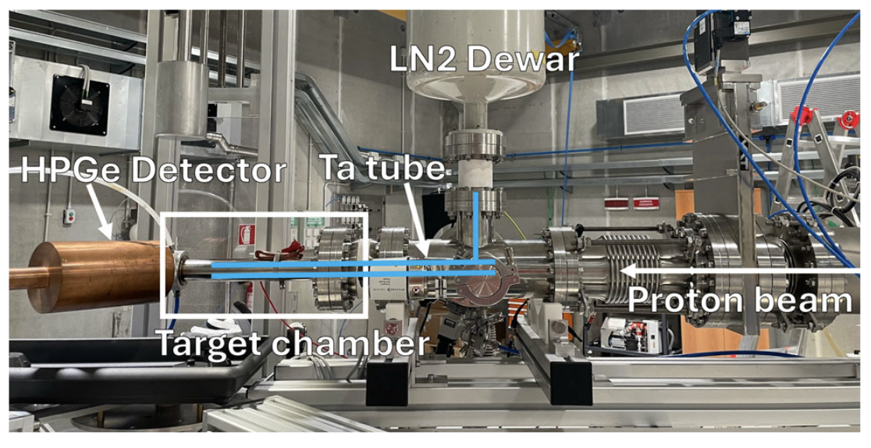
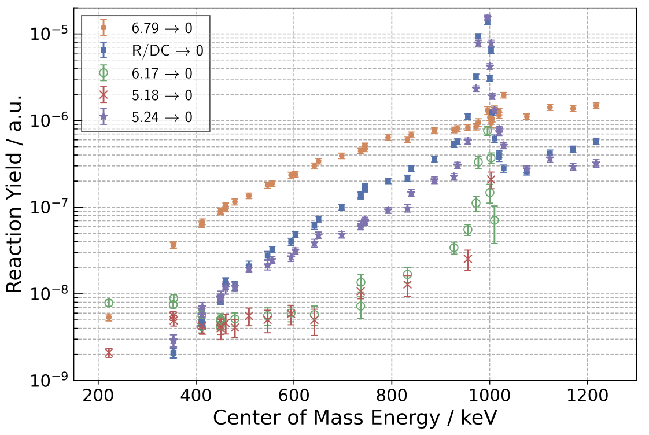

Generation 2 — Bellotti IBF Measurement
TiN/TaN targets, several angles (0°, 55°, 90°, 120°, 135°), first IBF measurement
Far geometry for angular distribution for every transition → Schröder superseded
Status: technical manuscript out (Eur. Phys. J. A (2025) 61:191), physics paper in the making
Alessandro Compagnucci’s PhD
J. Skowronski | Università di Padova & INFN Padova | NPA 2026
9
Notes:
1.5 min. [edit] setup (angles, distances, targets, beam current), status. Show one spectrum and one angular distribution / S-factor comparison with Li et al. 2016 and Schröder.

Slide 14
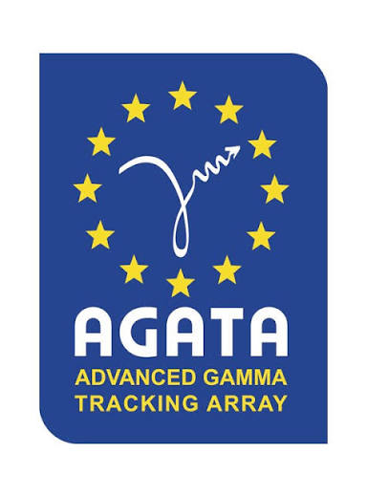
Indirect Measurement: AGATA
Notes:
~14 min for the second half.

Slide 15
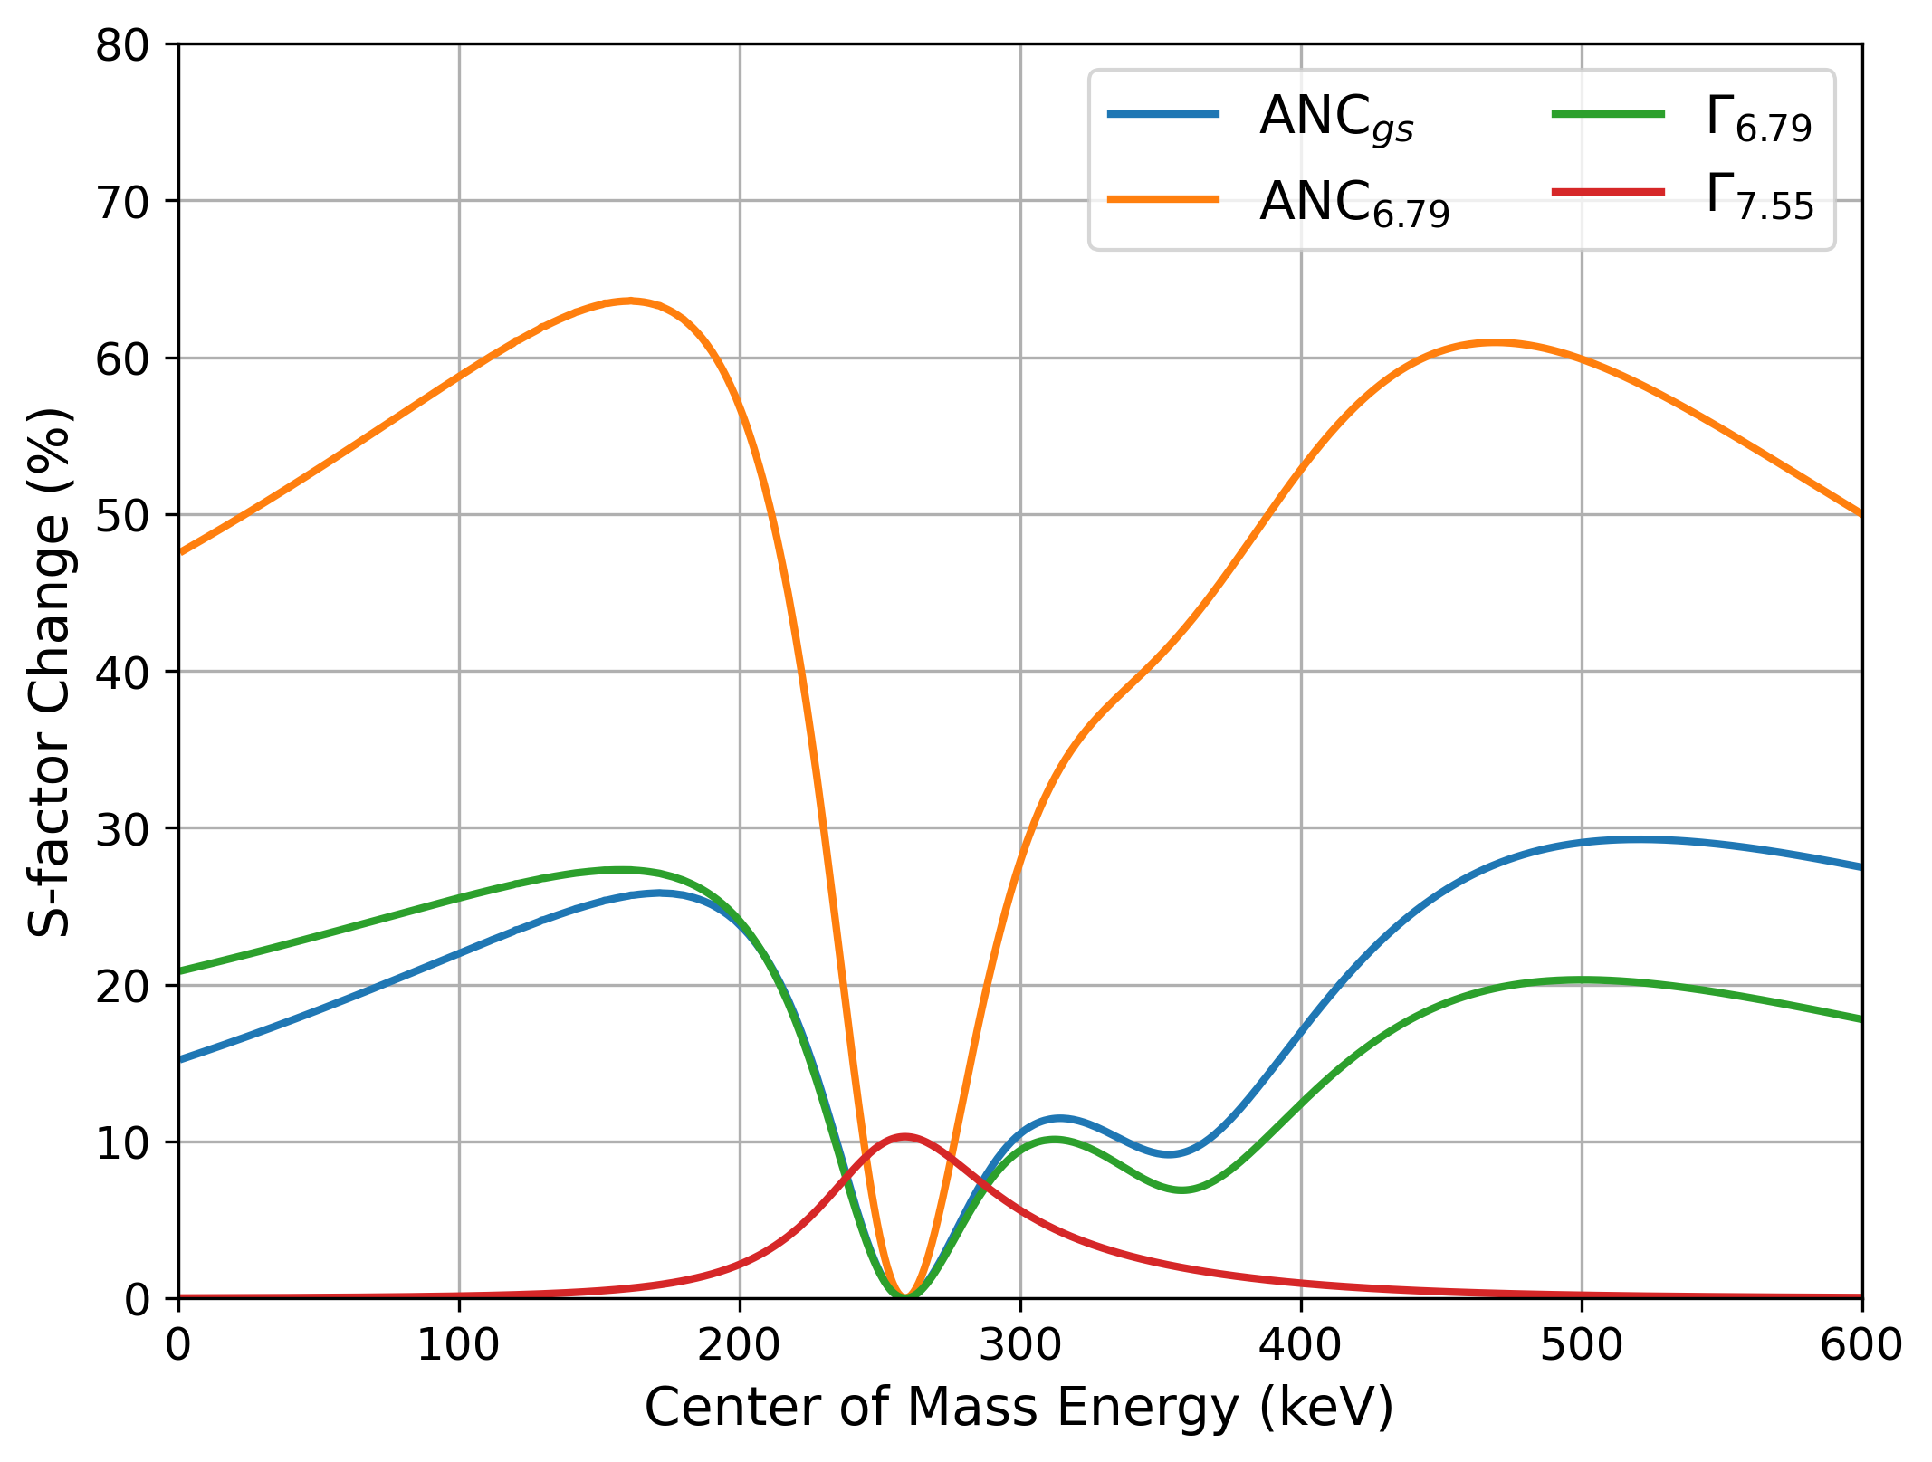
What matters below 200 keV
ANCs of g.s. and 6.79 MeV
Transfer reactions (Mukhamedzhanov et al. 2003): C_{gs} = 7.4 ± 0.4, C_{6.79} = 4.9 ± 0.5 fm^{-1/2}
Γ_{6.79} = ħ / τ_{6.79}
This is what AGATA measurement brings
J. Skowronski | Università di Padova & INFN Padova | NPA 2026
13
Notes:
1.5 min. Vary each R-matrix parameter by 10 %: below 200 keV only the two ANCs and Γ_6.79 move the S-factor (plus the 259 keV strength as normalisation). The 2.2 MeV 3/2+ resonance is pinned by the elastic scattering (deBoer 2015). ANCs from transfer (Mukhamedzhanov 2003). The missing piece is Γ_6.79 = ħ/τ: this is what AGATA delivers.

Slide 16
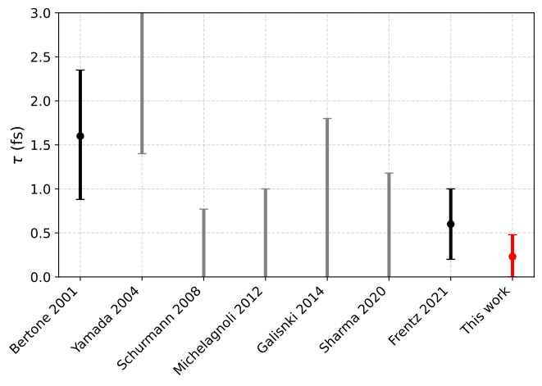
The 6.79 MeV lifetime
Γ_{6.79} = ħ / τ_{6.79}
Values from 1.6 fs down to upper limits < 0.8 fs; latest 0.6 ± 0.4 fs
Sub-fs: the nucleus decays at full velocity → line-shape DSAM loses sensitivity
Solar Fusion III: "still remains unmeasured … a high priority"
J. Skowronski | Università di Padova & INFN Padova | NPA 2026
14
Notes:
1 min. From Bertone 2001 (1.6 fs) to Schürmann (< 0.8), Galinski, Frentz 2021 (0.6 ± 0.4): all DSAM line-shape analyses; sub-fs means the state decays at full velocity and the information is a tiny centroid shift entangled with stopping powers, feeding and calibrations. An AGATA demonstrator attempt via 14N(d,n) was inconclusive. SF III: "still remains unmeasured … a high priority".

Slide 17
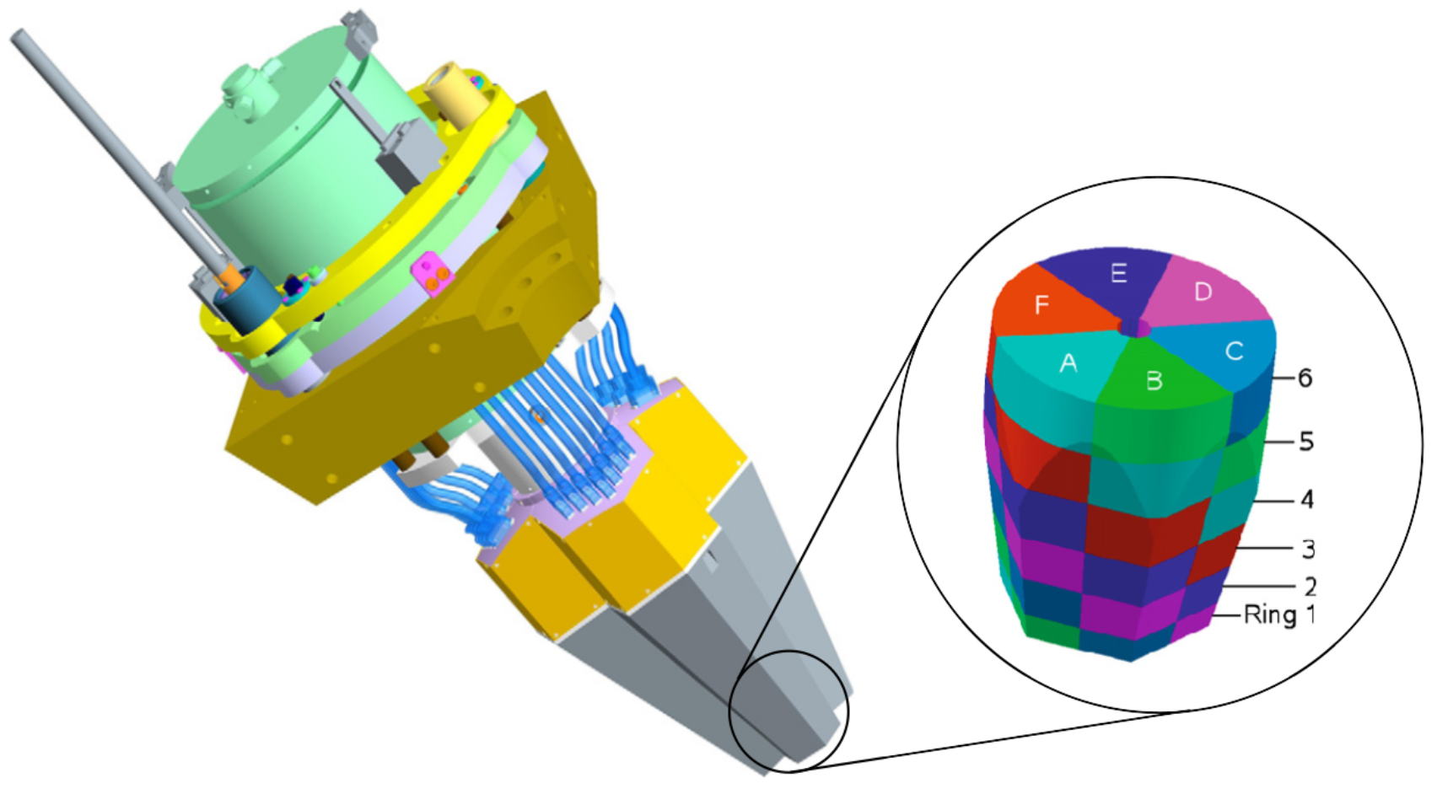
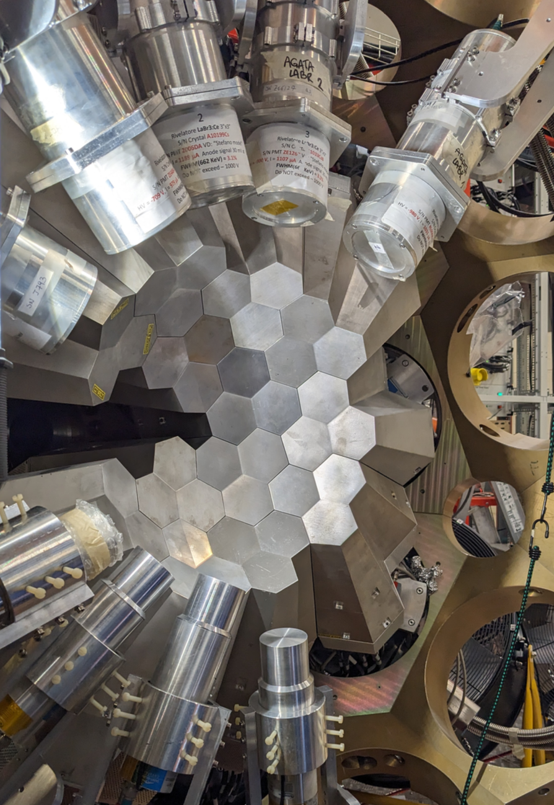
AGATA Array
AGATA @ Legnaro Laboratories, Padova, Italy
J. Skowronski | Università di Padova & INFN Padova | NPA 2026
14
Notes:
1 min. From Bertone 2001 (1.6 fs) to Schürmann (< 0.8), Galinski, Frentz 2021 (0.6 ± 0.4): all DSAM line-shape analyses; sub-fs means the state decays at full velocity and the information is a tiny centroid shift entangled with stopping powers, feeding and calibrations. An AGATA demonstrator attempt via 14N(d,n) was inconclusive. SF III: "still remains unmeasured … a high priority".

Slide 18
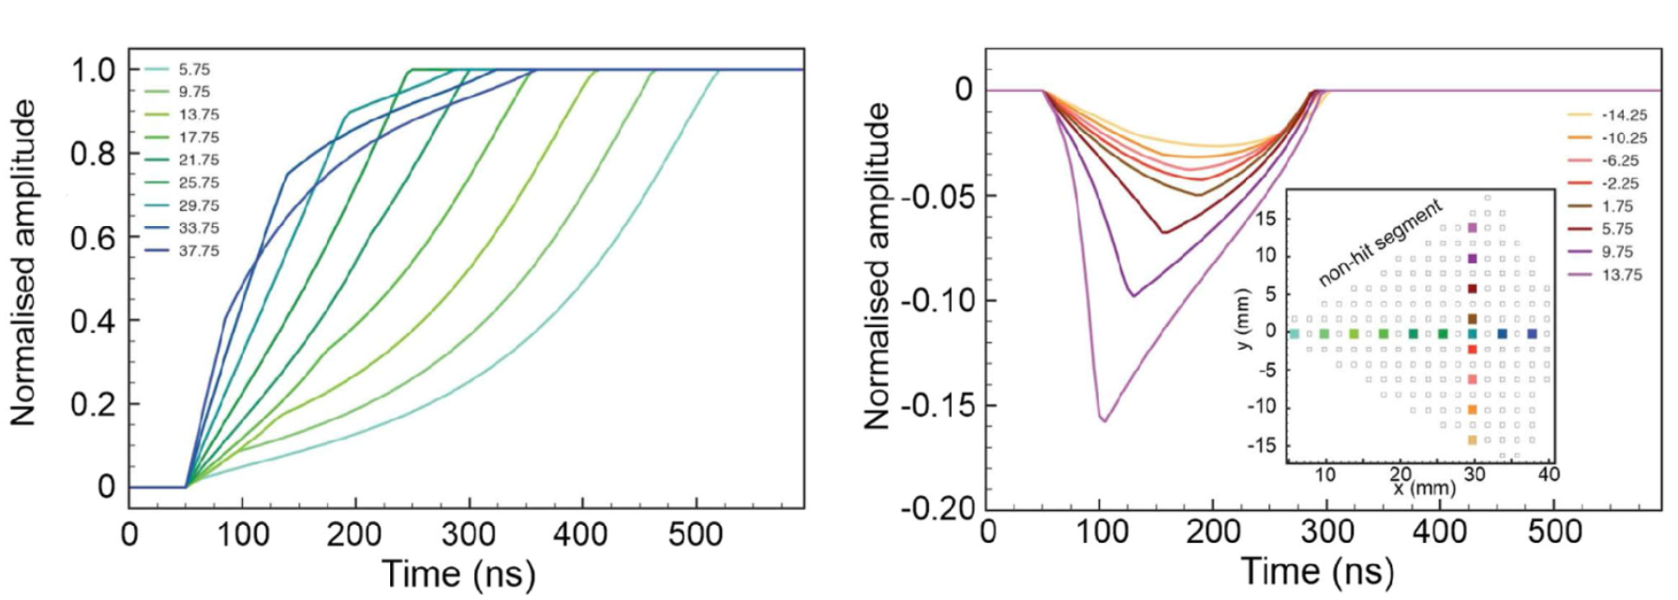
AGATA Array
AGATA @ Legnaro Laboratories, Padova, Italy
J. Skowronski | Università di Padova & INFN Padova | NPA 2026
14
Notes:
1 min. From Bertone 2001 (1.6 fs) to Schürmann (< 0.8), Galinski, Frentz 2021 (0.6 ± 0.4): all DSAM line-shape analyses; sub-fs means the state decays at full velocity and the information is a tiny centroid shift entangled with stopping powers, feeding and calibrations. An AGATA demonstrator attempt via 14N(d,n) was inconclusive. SF III: "still remains unmeasured … a high priority".

Slide 19
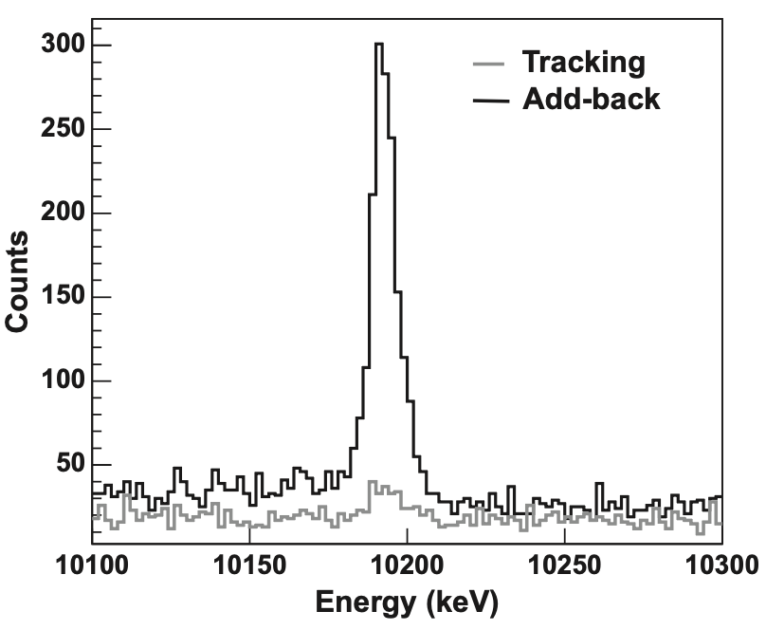
AGATA Array
AGATA @ Legnaro Laboratories, Padova, Italy
J. Skowronski | Università di Padova & INFN Padova | NPA 2026
14
Notes:
1 min. From Bertone 2001 (1.6 fs) to Schürmann (< 0.8), Galinski, Frentz 2021 (0.6 ± 0.4): all DSAM line-shape analyses; sub-fs means the state decays at full velocity and the information is a tiny centroid shift entangled with stopping powers, feeding and calibrations. An AGATA demonstrator attempt via 14N(d,n) was inconclusive. SF III: "still remains unmeasured … a high priority".

Slide 20
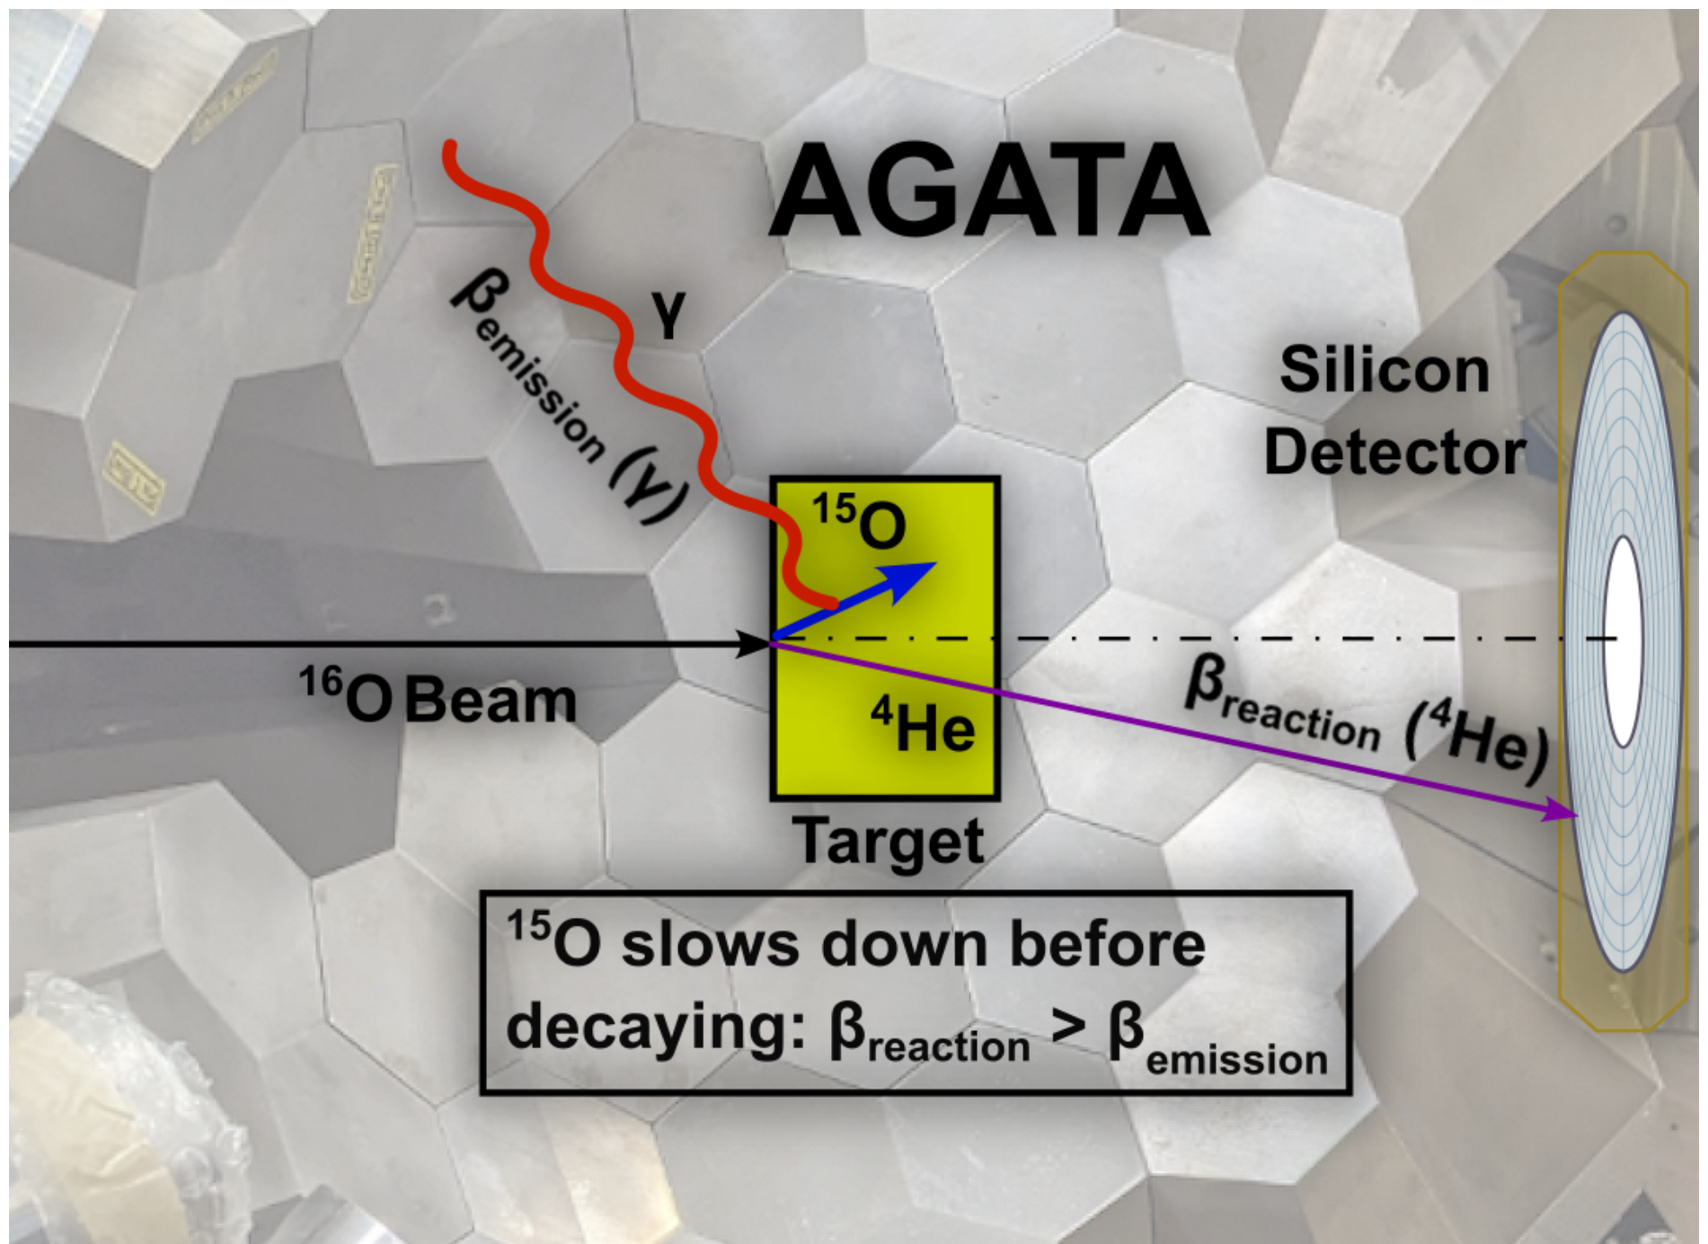

AGATA Campaign at LNL
¹⁶O(³He,⁴He)¹⁵O @ 50 MeV
¹⁶O beam, 50 MeV on ³He implanted in gold (HZDR)
⁴He in the silicon detector tags the ¹⁵O state and gives its velocity at the reaction
AGATA @ LNL: 12 triple clusters, 40°–160°,
¹⁸F states from ¹⁶O(³He,p)¹⁸F in the same run → in-situ calibration
Elia Pilotto’s PhD
J. Skowronski | Università di Padova & INFN Padova | NPA 2026
16
Notes:
1.5 min. 16O beam at 50 MeV (~20 nA) on 3He implanted in gold (HZDR, 4.7e17 at/cm2). 3He(16O,15O)4He: the alpha detected in the DSSSD tags the state and, via two-body kinematics, gives the 15O velocity at the reaction. AGATA: 12 triple clusters, 40–160°, PSA 3–5 mm. Inverse kinematics → β ≈ 0.07: the recoil slows in the gold and decays in flight. 18F states from 3He(16O,18F)p in the same run are the calibration. Figure: Nature Fig 2.

Slide 21
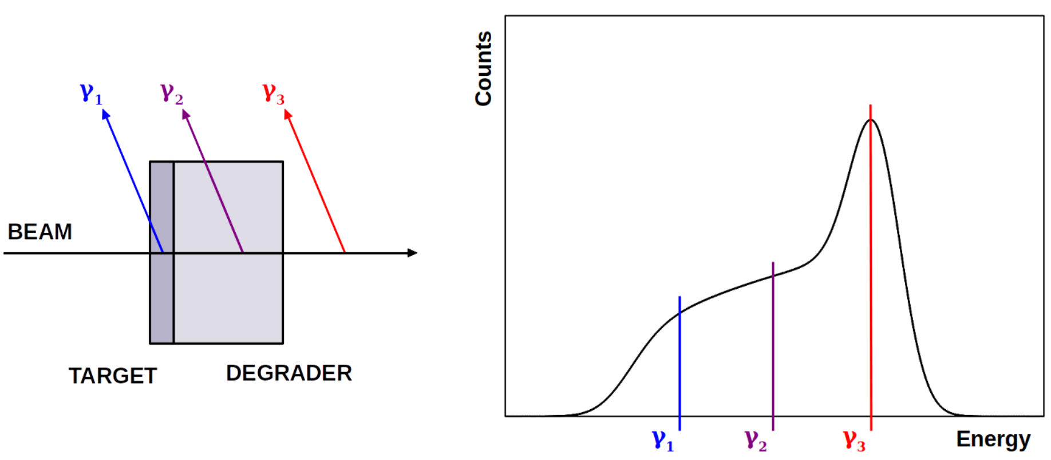
Doppler Shift Attenuation Method
J. Skowronski | Università di Padova & INFN Padova | NPA 2026
17
Notes:
2 min. Core slide. Classic DSAM fits a line shape. Here, for every event: β_reac from the alpha (kinematics + energy loss in the target) and β_emis from AGATA by inverting the Doppler formula with the known E0. Δβ = β_reac − β_emis is the velocity lost during the lifetime: Δβ ≈ (dβ/dt) τ, linear in τ (slope from the stopping power). The centroid of the Δβ distribution carries τ; the width is only resolution. Δβ ≈ 10⁻⁴ for 1 fs. Fougères et al. 2023 introduced the idea with limited angular coverage.

Slide 22
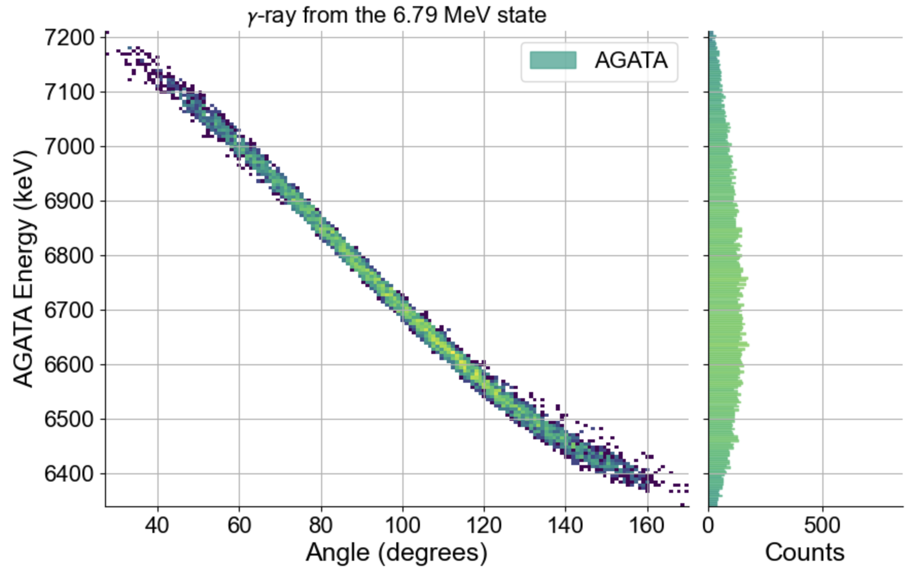
AGATA Lineshape of the 6.79 MeV γ-ray
J. Skowronski | Università di Padova & INFN Padova | NPA 2026
18
Notes:
1 min. Left: observed energy vs emission angle, from 7.2 MeV at 40° to 6.4 MeV at 160°. Right: the raw AGATA spectrum vs the Doppler-corrected one using the silicon kinematics: the 6791 keV line comes back at the literature energy with ~10 keV FWHM. Neutron-damage and gain-drift corrections applied (backup). Figure: Nature Fig 4.

Slide 23
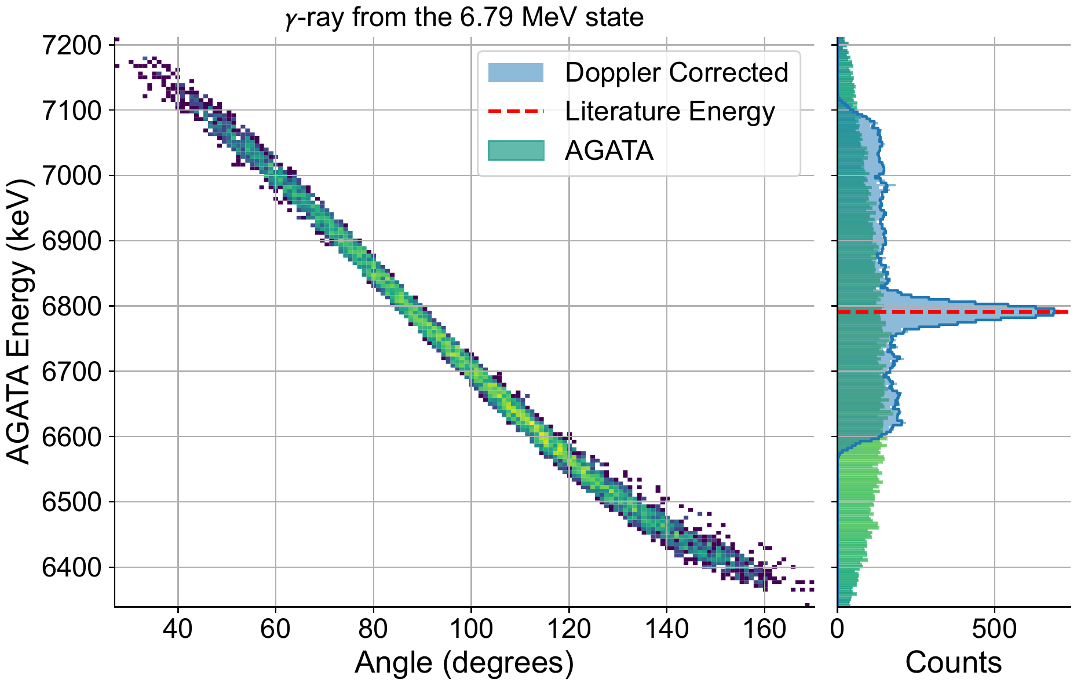
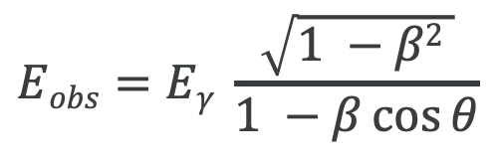
AGATA Lineshape of the 6.79 MeV γ-ray
Doppler correction with β_{reac} from the silicon detector brings the 6791 keV line to the literature energy
$$Eobs=Eγ \frac{\sqrt{1 −β2 }}{1 −β\cos{θ}}$$
SAURON
Mostly AGATA
SAURON
J. Skowronski | Università di Padova & INFN Padova | NPA 2026
18
Notes:
1 min. Left: observed energy vs emission angle, from 7.2 MeV at 40° to 6.4 MeV at 160°. Right: the raw AGATA spectrum vs the Doppler-corrected one using the silicon kinematics: the 6791 keV line comes back at the literature energy with ~10 keV FWHM. Neutron-damage and gain-drift corrections applied (backup). Figure: Nature Fig 4.

Slide 24
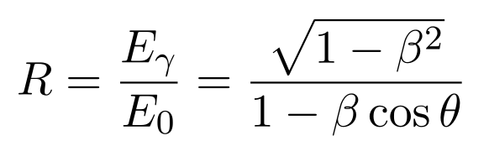
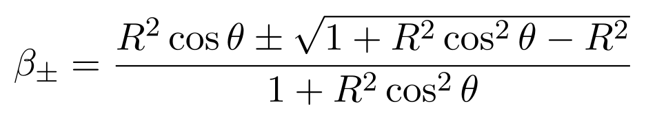
AGATA Lineshape of the 6.79 MeV γ-ray
Doppler correction with β_{reac} from the silicon detector brings the 6791 keV line to the literature energy
$$Eobs=Eγ \frac{\sqrt{1 −β2 }}{1 −β\cos{θ}}$$
SAURON
Mostly AGATA
SAURON
New Approach
J. Skowronski | Università di Padova & INFN Padova | NPA 2026
18
Notes:
1 min. Left: observed energy vs emission angle, from 7.2 MeV at 40° to 6.4 MeV at 160°. Right: the raw AGATA spectrum vs the Doppler-corrected one using the silicon kinematics: the 6791 keV line comes back at the literature energy with ~10 keV FWHM. Neutron-damage and gain-drift corrections applied (backup). Figure: Nature Fig 4.

Slide 25
NEW Doppler Shift Attenuation Method
J. Skowronski | Università di Padova & INFN Padova | NPA 2026
17
Notes:
2 min. Core slide. Classic DSAM fits a line shape. Here, for every event: β_reac from the alpha (kinematics + energy loss in the target) and β_emis from AGATA by inverting the Doppler formula with the known E0. Δβ = β_reac − β_emis is the velocity lost during the lifetime: Δβ ≈ (dβ/dt) τ, linear in τ (slope from the stopping power). The centroid of the Δβ distribution carries τ; the width is only resolution. Δβ ≈ 10⁻⁴ for 1 fs. Fougères et al. 2023 introduced the idea with limited angular coverage.

Slide 26
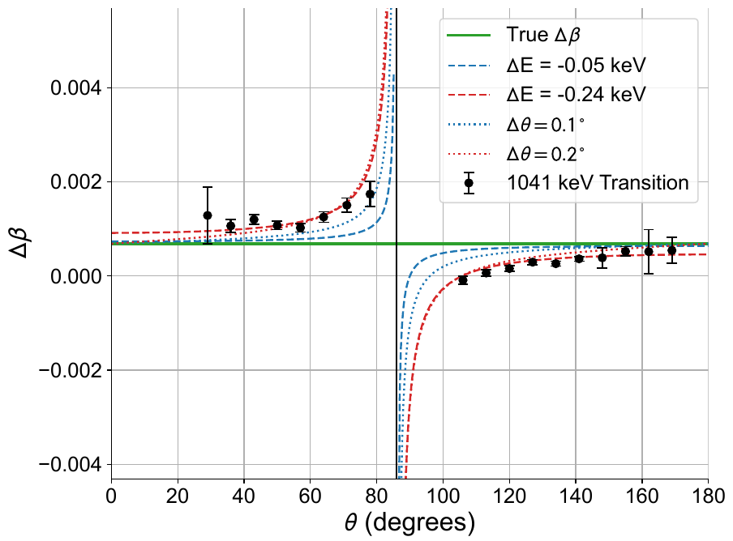
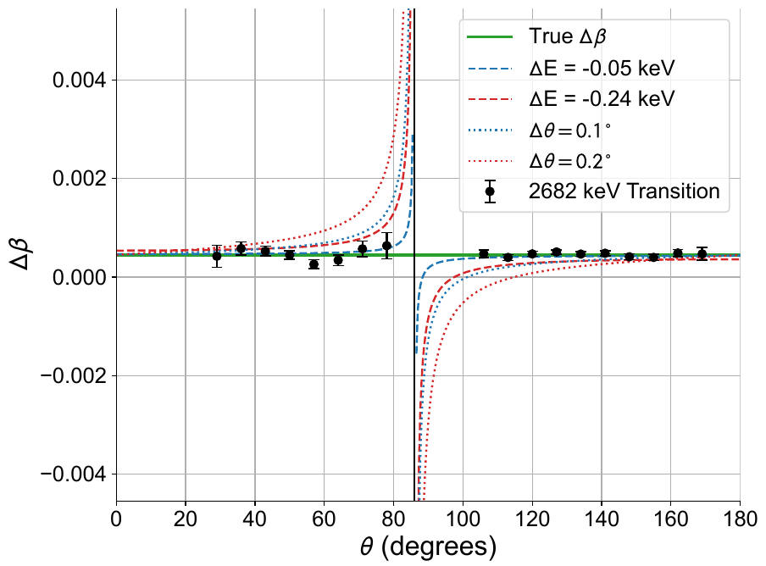
Why the wide angular coverage matters
J. Skowronski | Università di Padova & INFN Padova | NPA 2026
19
Notes:
1.5 min. An energy offset ΔE or an angle offset Δθ distorts Δβ(θ) in a characteristic angle-dependent way: antisymmetric around 90° where the Doppler shift vanishes. A true Δβ is a flat offset. With 40–160° coverage the nuisance parameters are fitted simultaneously (Bayesian, emcee) and decorrelate from Δβ. Two 18F examples: the 1041 keV line shows a systematic, the 2682 keV one does not. The earlier application (Fougères) had only backward angles. Figure: Nature Fig 5.

Slide 27
Why the wide angular coverage matters
Systematics distort Δβ(θ) antisymmetrically around 90°; a true Δβ is a flat offset
AGATA 40°–160° → ΔE and Δθ fitted simultaneously with Δβ, and they decorrelate
J. Skowronski | Università di Padova & INFN Padova | NPA 2026
19
Notes:
1.5 min. An energy offset ΔE or an angle offset Δθ distorts Δβ(θ) in a characteristic angle-dependent way: antisymmetric around 90° where the Doppler shift vanishes. A true Δβ is a flat offset. With 40–160° coverage the nuisance parameters are fitted simultaneously (Bayesian, emcee) and decorrelate from Δβ. Two 18F examples: the 1041 keV line shows a systematic, the 2682 keV one does not. The earlier application (Fougères) had only backward angles. Figure: Nature Fig 5.

Slide 28
Why the wide angular coverage matters
Systematics distort Δβ(θ) antisymmetrically around 90°; a true Δβ is a flat offset
AGATA 40°–160° → ΔE and Δθ fitted simultaneously with Δβ, and they decorrelate
Bonus: in-beam γ-ray energies to ~ 10 eV
J. Skowronski | Università di Padova & INFN Padova | NPA 2026
19
Notes:
1.5 min. An energy offset ΔE or an angle offset Δθ distorts Δβ(θ) in a characteristic angle-dependent way: antisymmetric around 90° where the Doppler shift vanishes. A true Δβ is a flat offset. With 40–160° coverage the nuisance parameters are fitted simultaneously (Bayesian, emcee) and decorrelate from Δβ. Two 18F examples: the 1041 keV line shows a systematic, the 2682 keV one does not. The earlier application (Fougères) had only backward angles. Figure: Nature Fig 5.

Slide 29
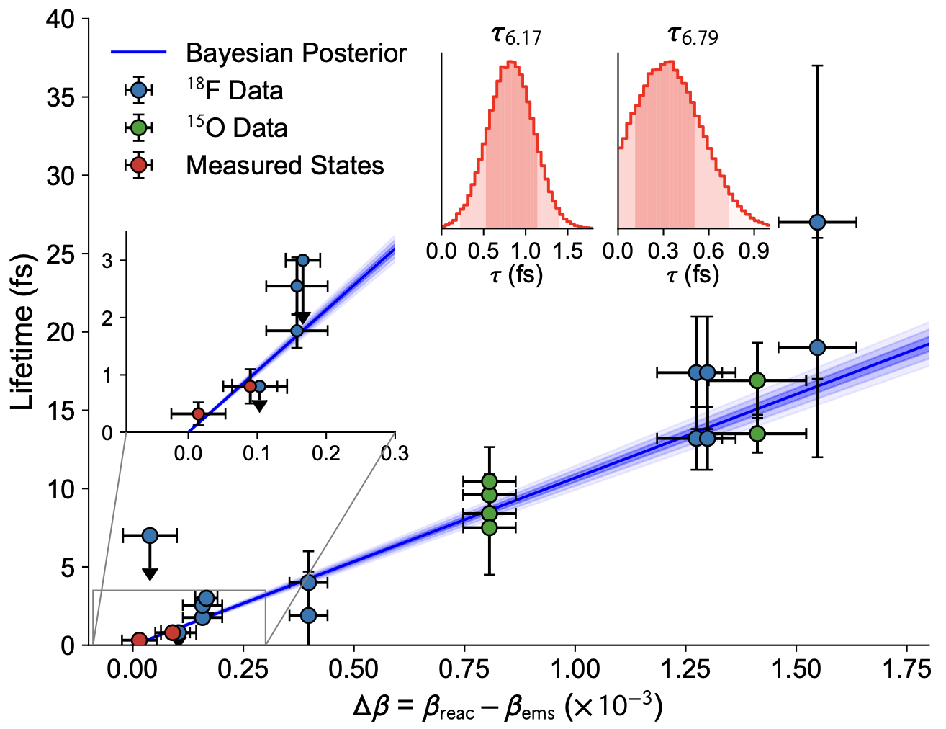
The lifetime fit
Δβ vs literature τ for 8 ¹⁸F and 4 ¹⁵O states
Bayesian linear fit: slope (9.4 ± 0.2)·10⁻³ fs⁻¹ vs SRIM (9.7 ± 0.3)·10⁻³
τ_{6.17} and τ_{6.79} are free parameters (insets)
Checks: two γ-rays from one ¹⁸F level give the same Δβ; feeding cascades reproduce the intermediate lifetime
PRELIMINARY
J. Skowronski | Università di Padova & INFN Padova | NPA 2026
20
Notes:
1.5 min. Nature Fig 3a. Δβ vs literature τ for all observed transitions; 18F scaled by the stopping-power ratio 1.19. Bayesian linear fit: slope prior 3 % (stopping power), intercept 2 % (silicon kinematics); best-fit slope (9.4 ± 0.2)e-3 fs, SRIM predicts (9.7 ± 0.3)e-3. The 15O 6.17 and 6.79 MeV lifetimes are free parameters (insets). Consistency checks: two γ from the same 18F 3.839 MeV level give the same Δβ; the 3.724 → 1.041 cascade reproduces the intermediate lifetime. Flat prior: 0.2 ± 0.3 fs, so the data drive the result.

Slide 30
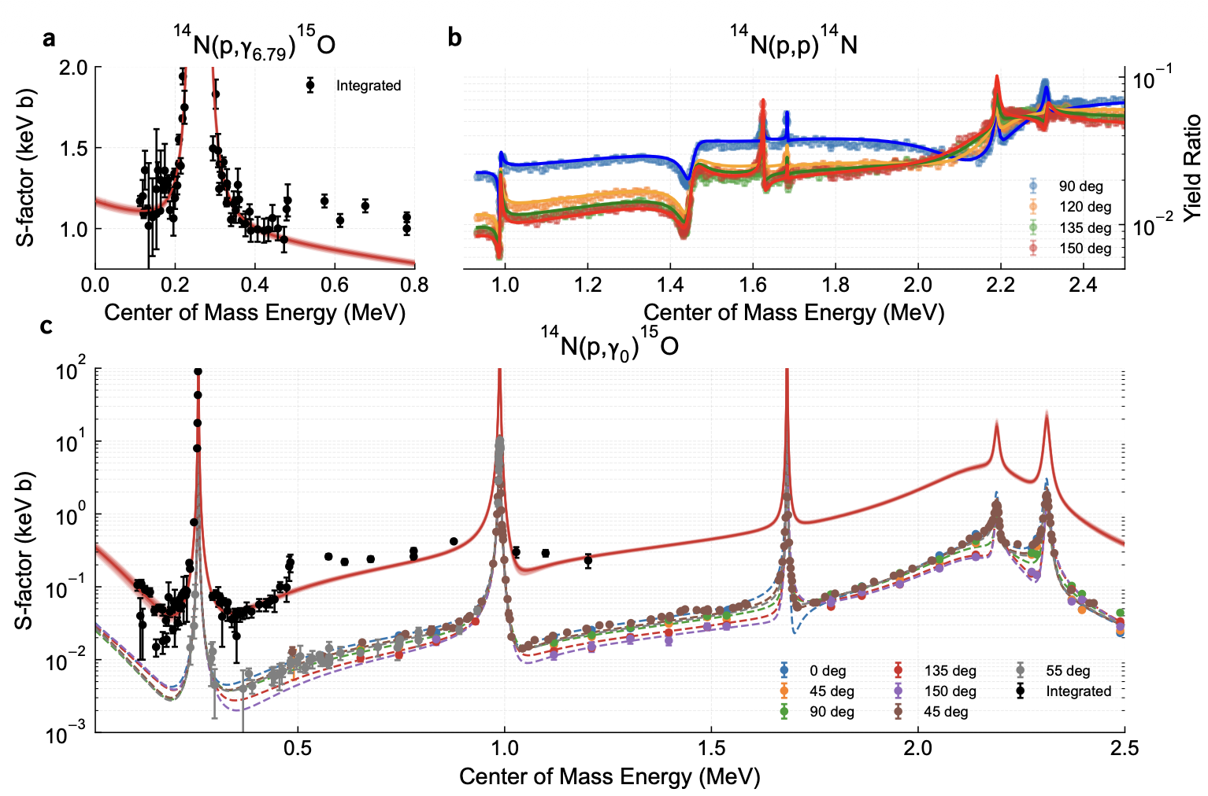
Bayesian R-matrix: from the 6.79 MeV width to S₁₁₄(0)
Seven capture data sets + elastic scattering
Priors: ANCs (transfer), ωγ₂₅₉ (SF III), our Γ_{6.79}
PRELIMINARY
J. Skowronski | Università di Padova & INFN Padova | NPA 2026
22
Notes:
1.5 min. AZURE2 + emcee. Fitted simultaneously: 14N(p,γ6.79), 14N(p,γ0) (seven data sets) and the 14N(p,p) elastic scattering (deBoer 2015) that pins the 2.2 MeV resonance. Priors: ANCs from transfer, ωγ from SF III, our Γ directly as prior. Result: Sgs(0) = 0.38 ± 0.03, S6.79(0) = 1.17 ± 0.02, total S114(0) = 1.76 ± 0.06 keV b, i.e. 3.4 % instead of 8.4 %. Figure: Nature Fig 6.

Slide 31
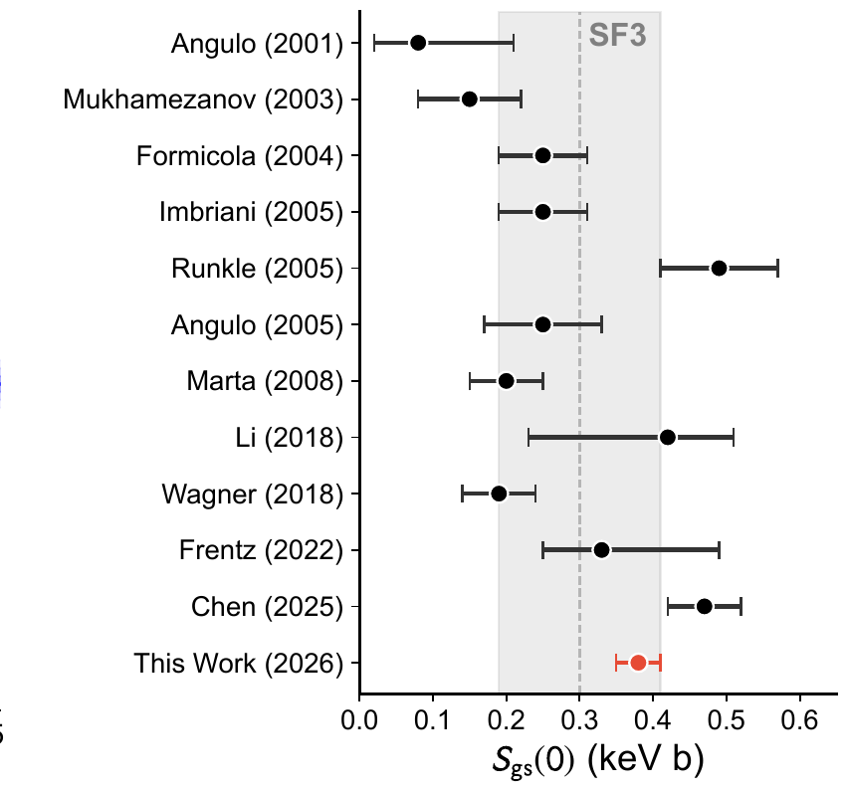
Impact
8.4 %
Solar Fusion III
3.4 %
This work
PRELIMINARY
The ¹⁴N(p,γ)¹⁵O rate below every other nuclear input of the standard solar model
Central value of Solar Fusion III confirmed; Chen et al. enhancement not supported once Γ and the scattering data are included
JUNO and SNO+ can extract the core metallicity limited only by their own precision
J. Skowronski | Università di Padova & INFN Padova | NPA 2026
23
Notes:
1 min. Nature Fig 3b for the ground state. The nuclear-physics contribution to the predicted CNO flux now falls below every other input of the standard solar model. JUNO and SNO+ can extract the core metallicity limited only by their own precision.

Slide 32
Impact
8.4 %
Solar Fusion III
3.4 %
This work
PRELIMINARY
The ¹⁴N(p,γ)¹⁵O rate below every other nuclear input of the standard solar model
Central value of Solar Fusion III confirmed; Chen et al. enhancement not supported once Γ and the scattering data are included
JUNO and SNO+ can extract the core metallicity limited only by their own precision
Next: Bellotti IBF and SOCIAL data in the same Bayesian framework (work in progress)
J. Skowronski | Università di Padova & INFN Padova | NPA 2026
23
Notes:
1 min. Nature Fig 3b for the ground state. The nuclear-physics contribution to the predicted CNO flux now falls below every other input of the standard solar model. JUNO and SNO+ can extract the core metallicity limited only by their own precision.

Slide 33
Summary
LUNA — Direct
AGATA — Indirect
Impact
Bellotti IBF: angular distributions for all transitions
SOCIAL: ground state down to 120 keV
Event-by-event Δβ = β_{reac} − β_{emis} ∝ τ
τ_{6.79} = 0.3 ± 0.2 fs: shortest nuclear lifetime measured
S₁₁₄(0) = 1.76 ± 0.06 keV b
Uncertainty 8.4 % → 3.4 %
CNO neutrinos: nuclear physics no longer the limit
Direct underground data and indirect structure information are not alternatives: the few-percent S₁₁₄(0) needs both
J. Skowronski | Università di Padova & INFN Padova | NPA 2026
24
Notes:
1 min. Close the loop: direct + indirect. The technique is general: near- and sub-threshold states in other key reactions; future AGATA campaigns.

Slide 34
Thank you
LUNA Collaboration • AGATA Collaboration

Slide 35
Backup

Slide 36
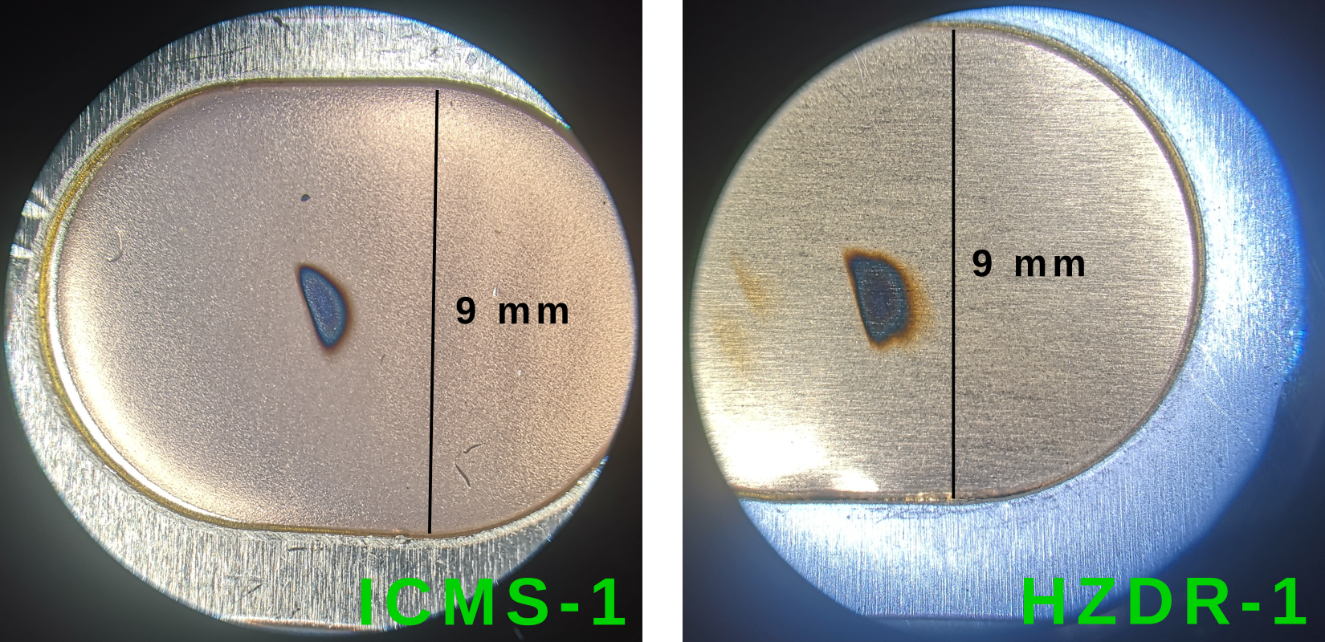
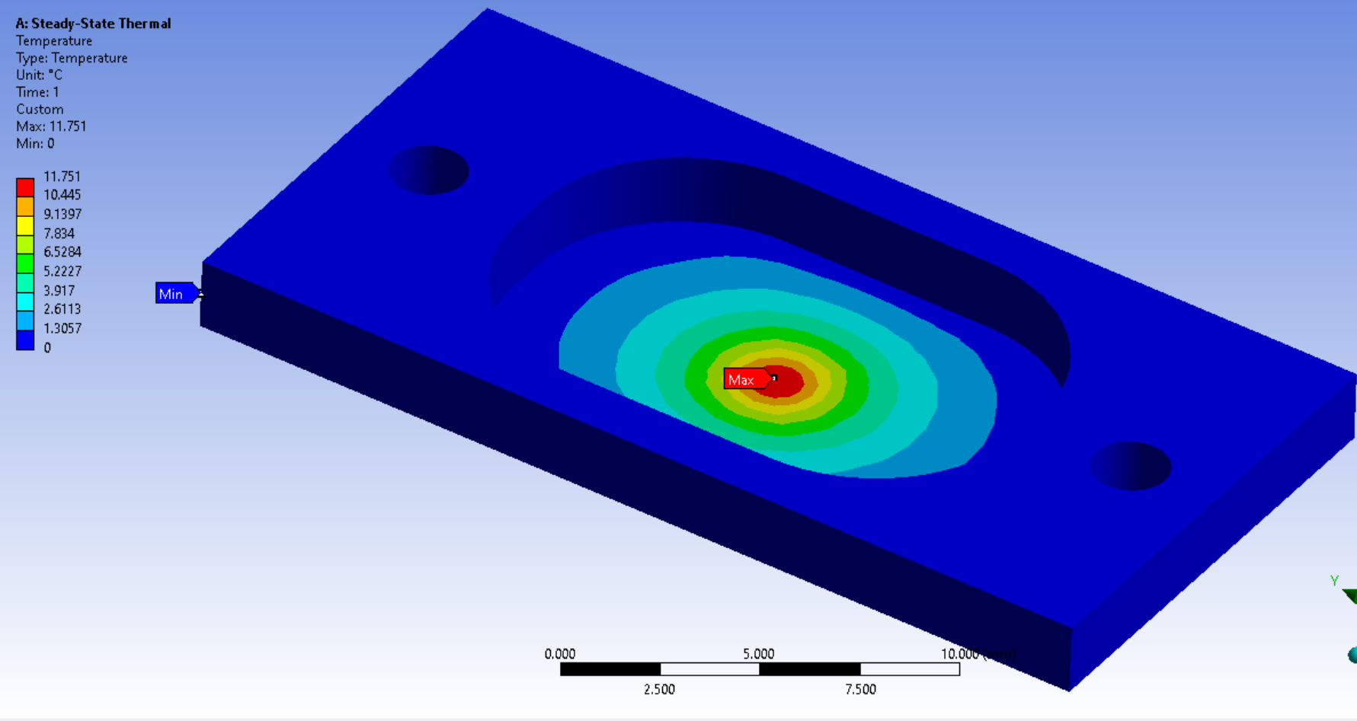
Backup — ³He targets in gold
Implanted (HZDR Dresden, ≈4.7·10¹⁷ at/cm²) and sputtered (CNA Seville, ≈2.2·10¹⁸ at/cm²) ³He in Au
Characterised by NRA and ERDA; depth profiles enter the recoil-velocity reconstruction
Au stopping power (SRIM, 3 % prior) enters only as the slope of the Δβ–τ relation
J. Skowronski | Università di Padova & INFN Padova | NPA 2026
27
Notes:
Pilotto et al. EPJA 61:117 (2025).

Slide 37
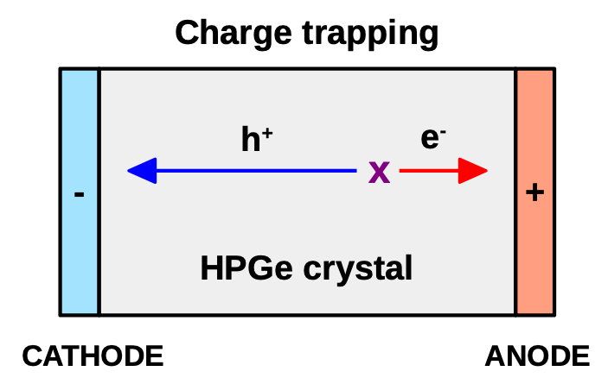
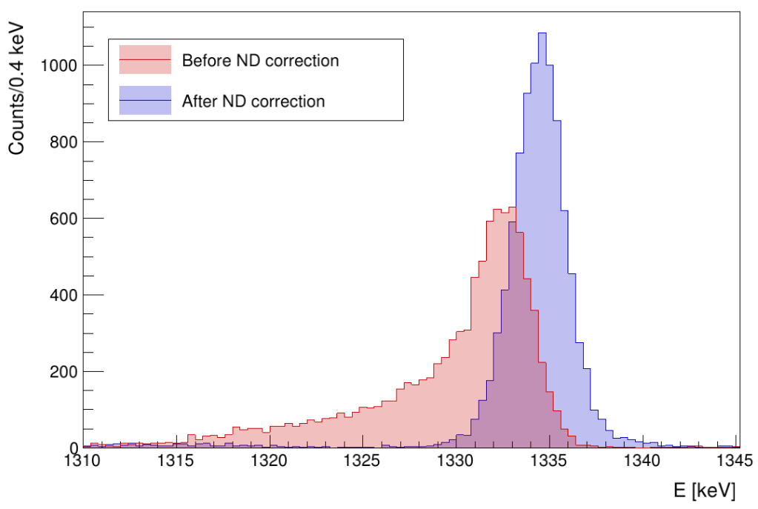
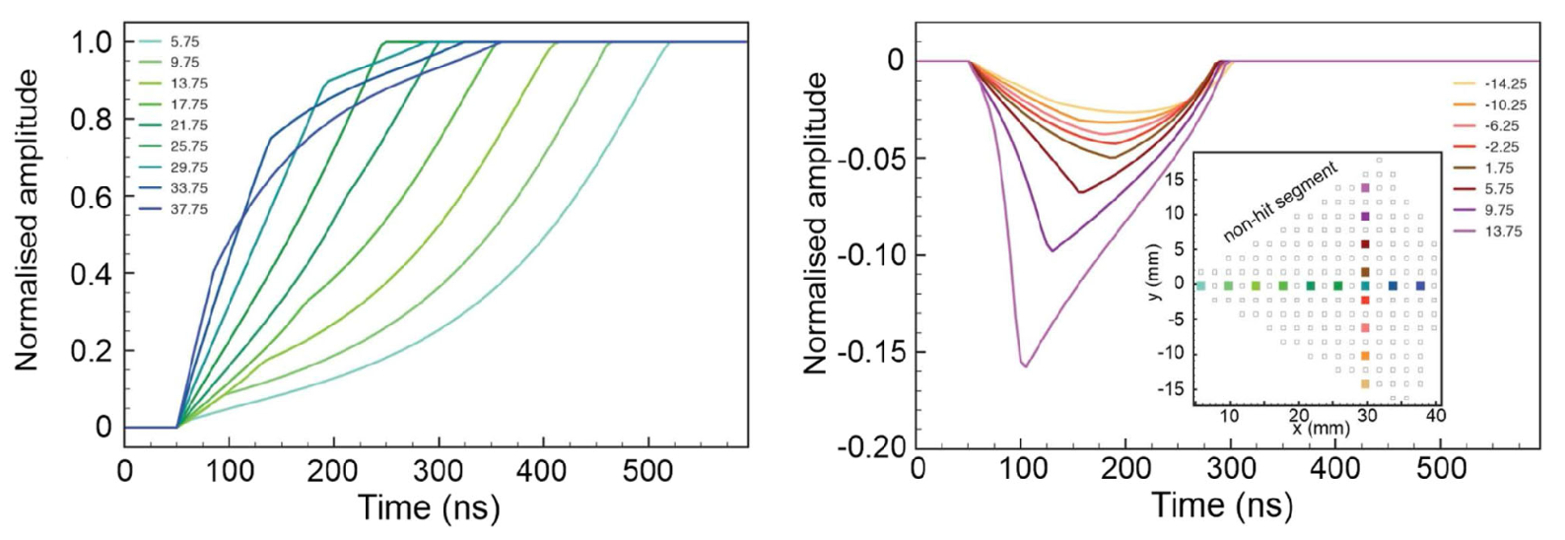
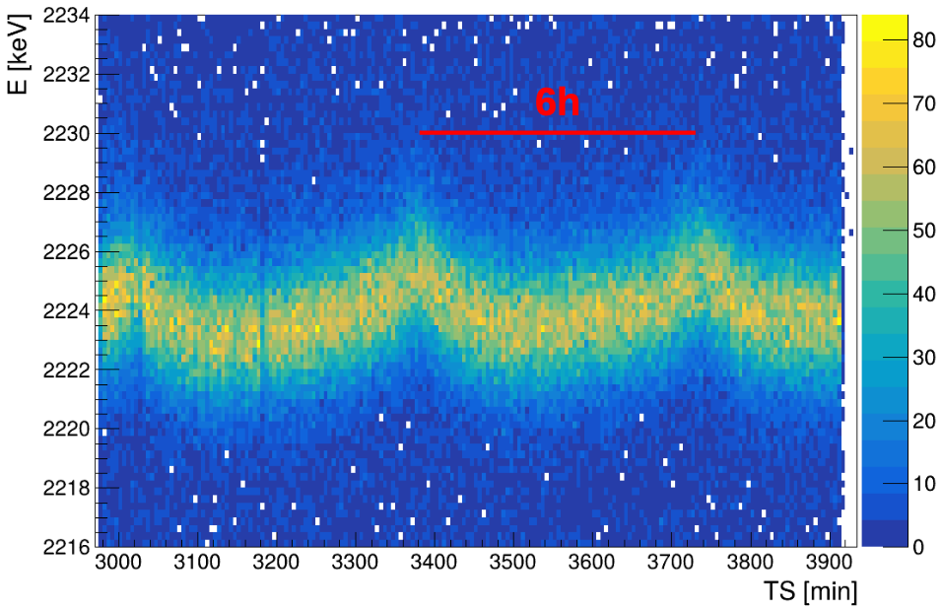
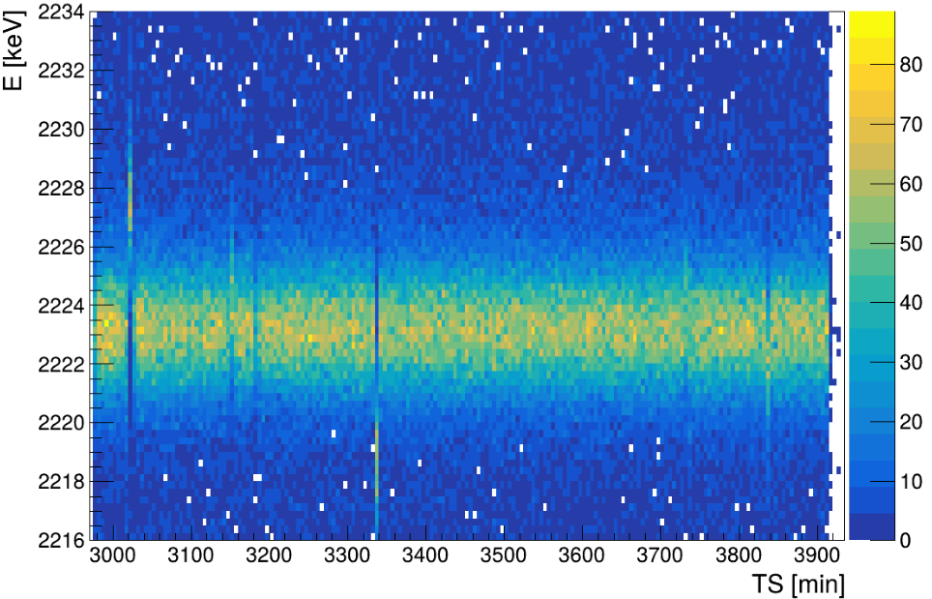
Backup — AGATA corrections
Charge trapping corrected event by event with the PSA position (adaptive grid search)
Temperature-driven gain oscillations corrected with the cross-correlation method
FWHM 3.5 keV at 2.2 MeV over 7 days
J. Skowronski | Università di Padova & INFN Padova | NPA 2026
28

Slide 38
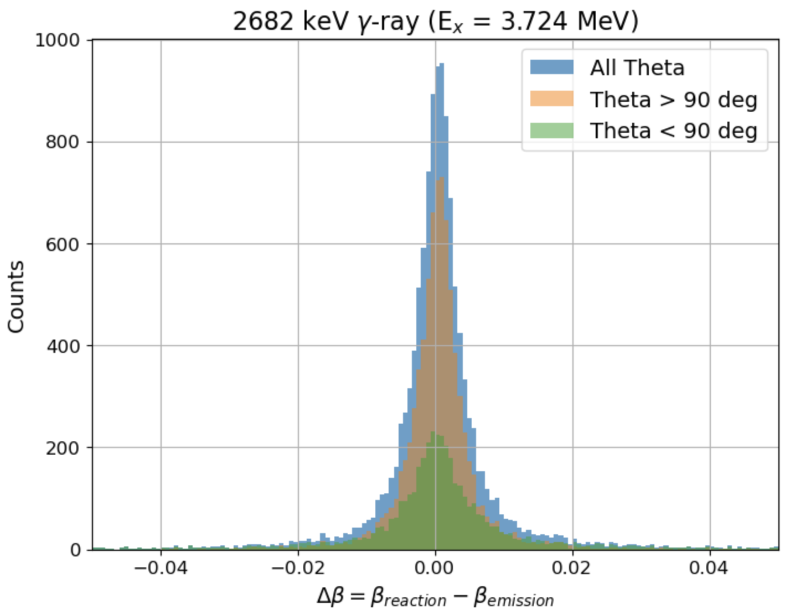
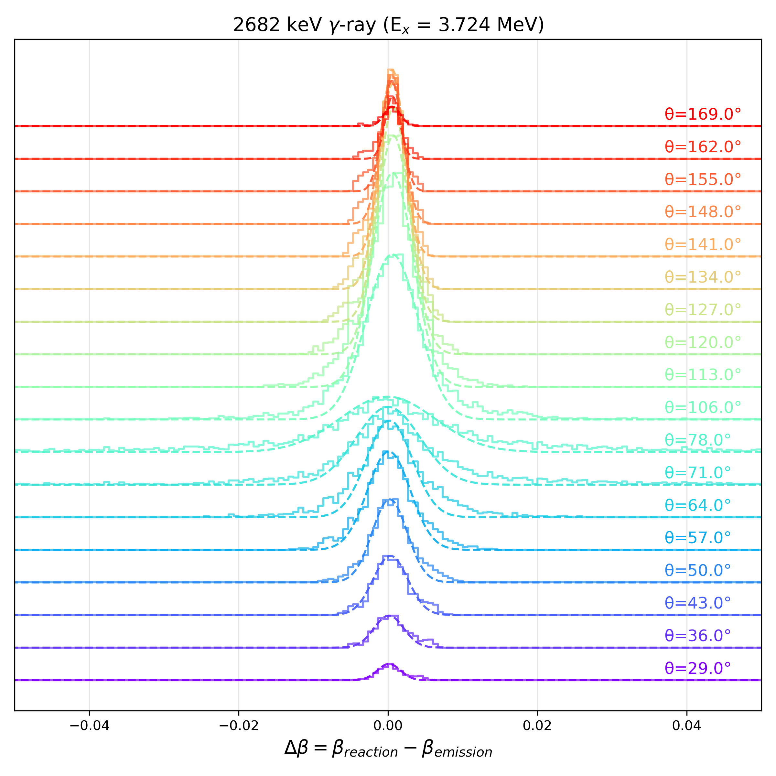
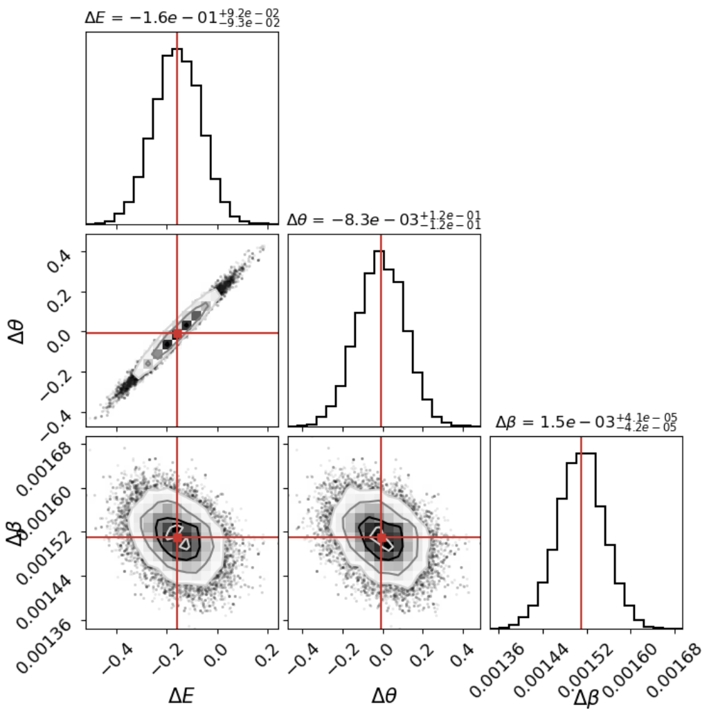
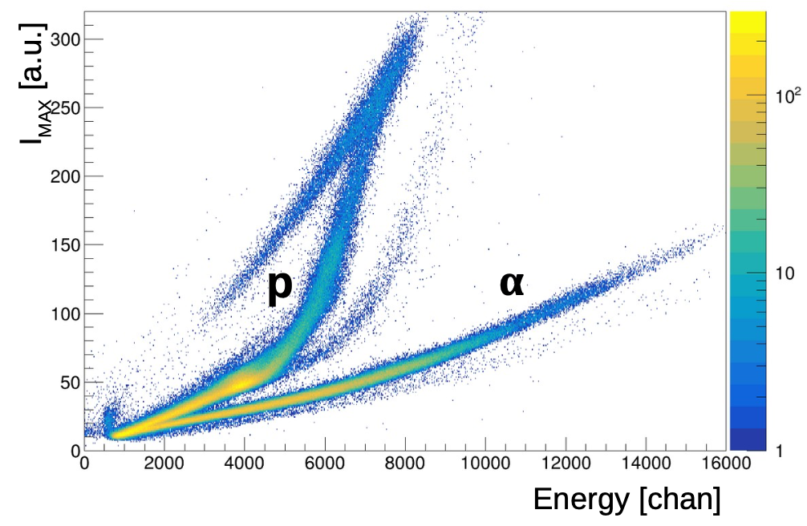
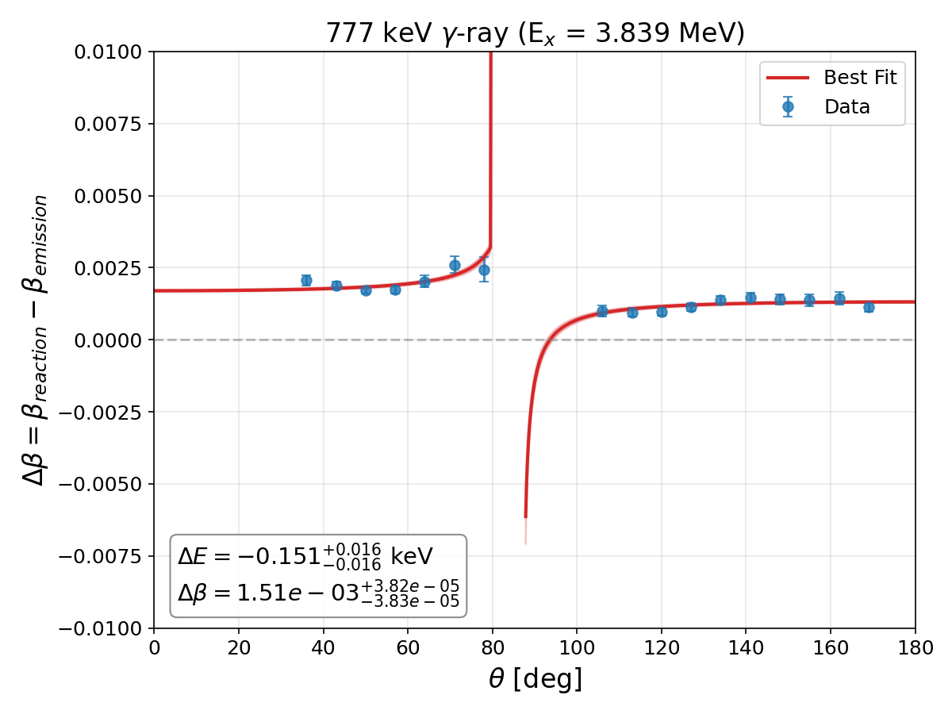
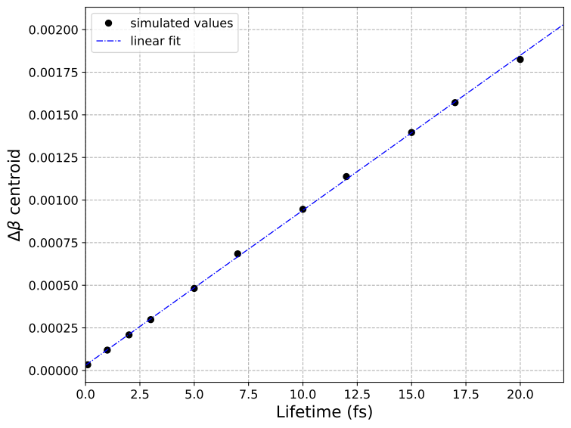
Backup — Δβ extraction step by step
J. Skowronski | Università di Padova & INFN Padova | NPA 2026
29

Slide 39
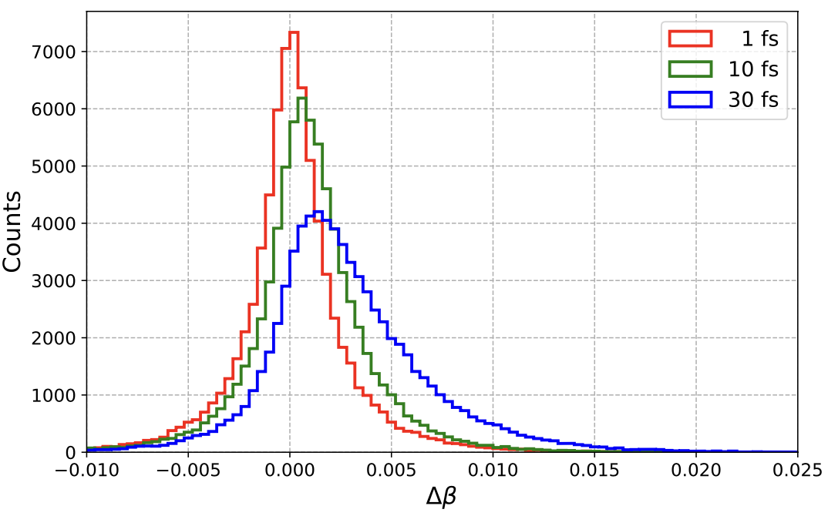
NEW Doppler Shift Attenuation Method
1. β_{reac} — start
from the α energy and angle: two-body kinematics + energy loss in the target
2. β_{emis} — stop
from E_{γ} and θ_{γ} in AGATA, inverting the Doppler formula for the known E₀
3. Δβ = β_{reac} − β_{emis} ∝ τ
velocity lost during the lifetime; slope from the stopping power (SRIM)
The centroid of the Δβ distribution carries τ; its width is only resolution → no line-shape or feeding model
Δβ ≈ 10⁻⁴ for τ = 1 fs → ~ 0.1° angle resolution needed: only a tracking array can do it
J. Skowronski | Università di Padova & INFN Padova | NPA 2026
17
Notes:
2 min. Core slide. Classic DSAM fits a line shape. Here, for every event: β_reac from the alpha (kinematics + energy loss in the target) and β_emis from AGATA by inverting the Doppler formula with the known E0. Δβ = β_reac − β_emis is the velocity lost during the lifetime: Δβ ≈ (dβ/dt) τ, linear in τ (slope from the stopping power). The centroid of the Δβ distribution carries τ; the width is only resolution. Δβ ≈ 10⁻⁴ for 1 fs. Fougères et al. 2023 introduced the idea with limited angular coverage.

Slide 40
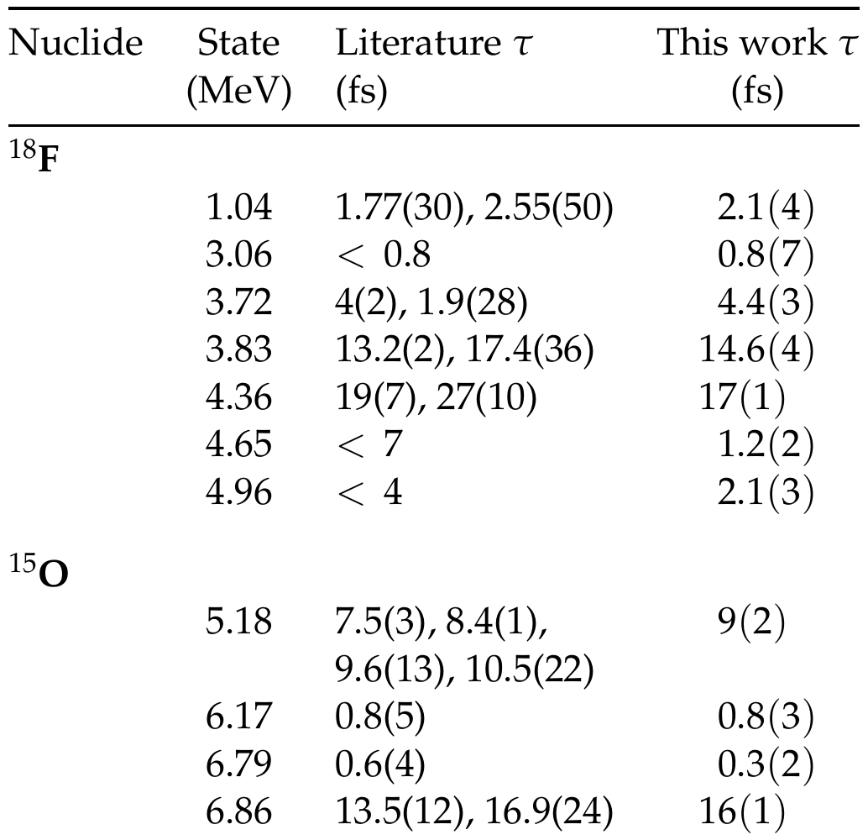
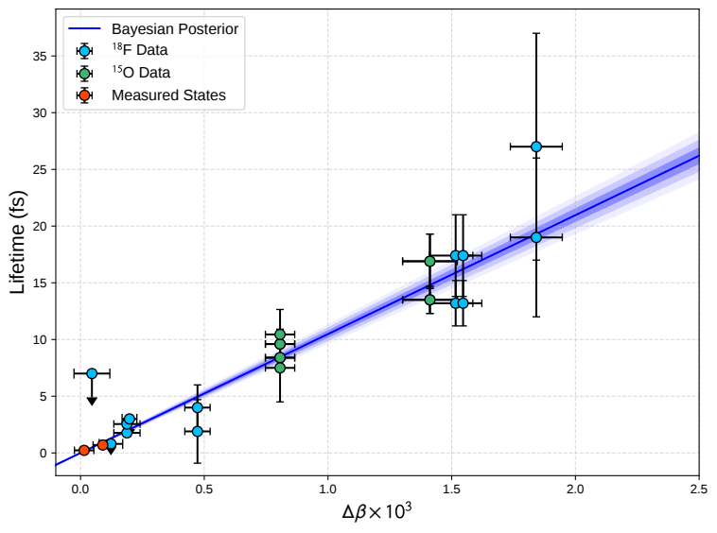
Backup — All lifetimes
J. Skowronski | Università di Padova & INFN Padova | NPA 2026
30

Slide 41
The shortest nuclear lifetime ever measured
τ_{6.79} = 0.3 ± 0.2 fs
The most stringent constraint to date
PRELIMINARY
τ_{6.17} = 0.8 ± 0.3 fs
Consistent with the literature
Excludes the long lifetimes and provide strongest constraint on the subthreshold width
Seven ¹⁸F and two more ¹⁵O lifetimes improved on the way
Sub-femtosecond regime reached with a γ-ray tracking array
J. Skowronski | Università di Padova & INFN Padova | NPA 2026
21
Notes:
1 min. τ(6.79) = 0.3 ± 0.2 fs → Γ = 2.2 (+4.4 −0.9) eV. τ(6.17) = 0.8 ± 0.3 fs. Excludes the long lifetimes (Bertone) and collapses the two-decade spread to the lower end. Other 18F/15O lifetimes improved over the literature (Table 1, backup).

Slide 42
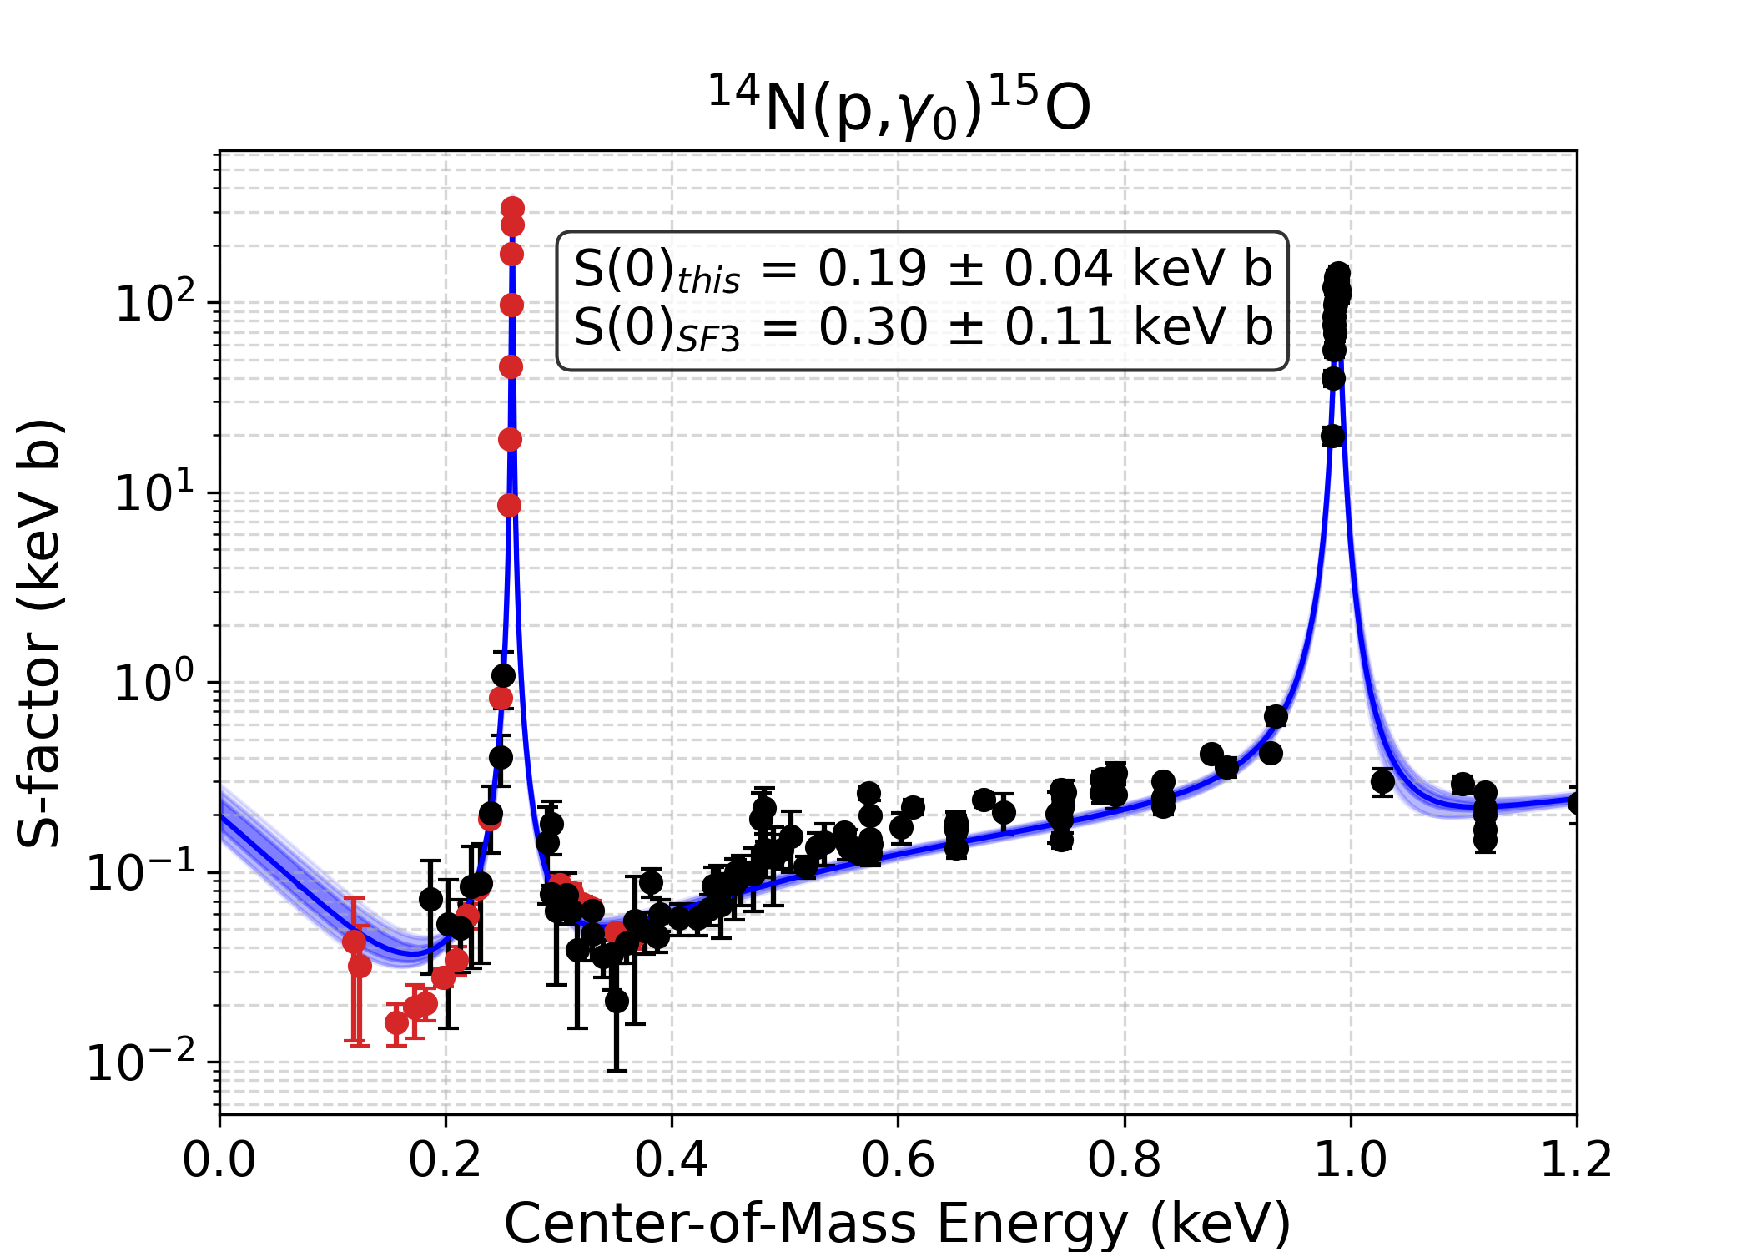
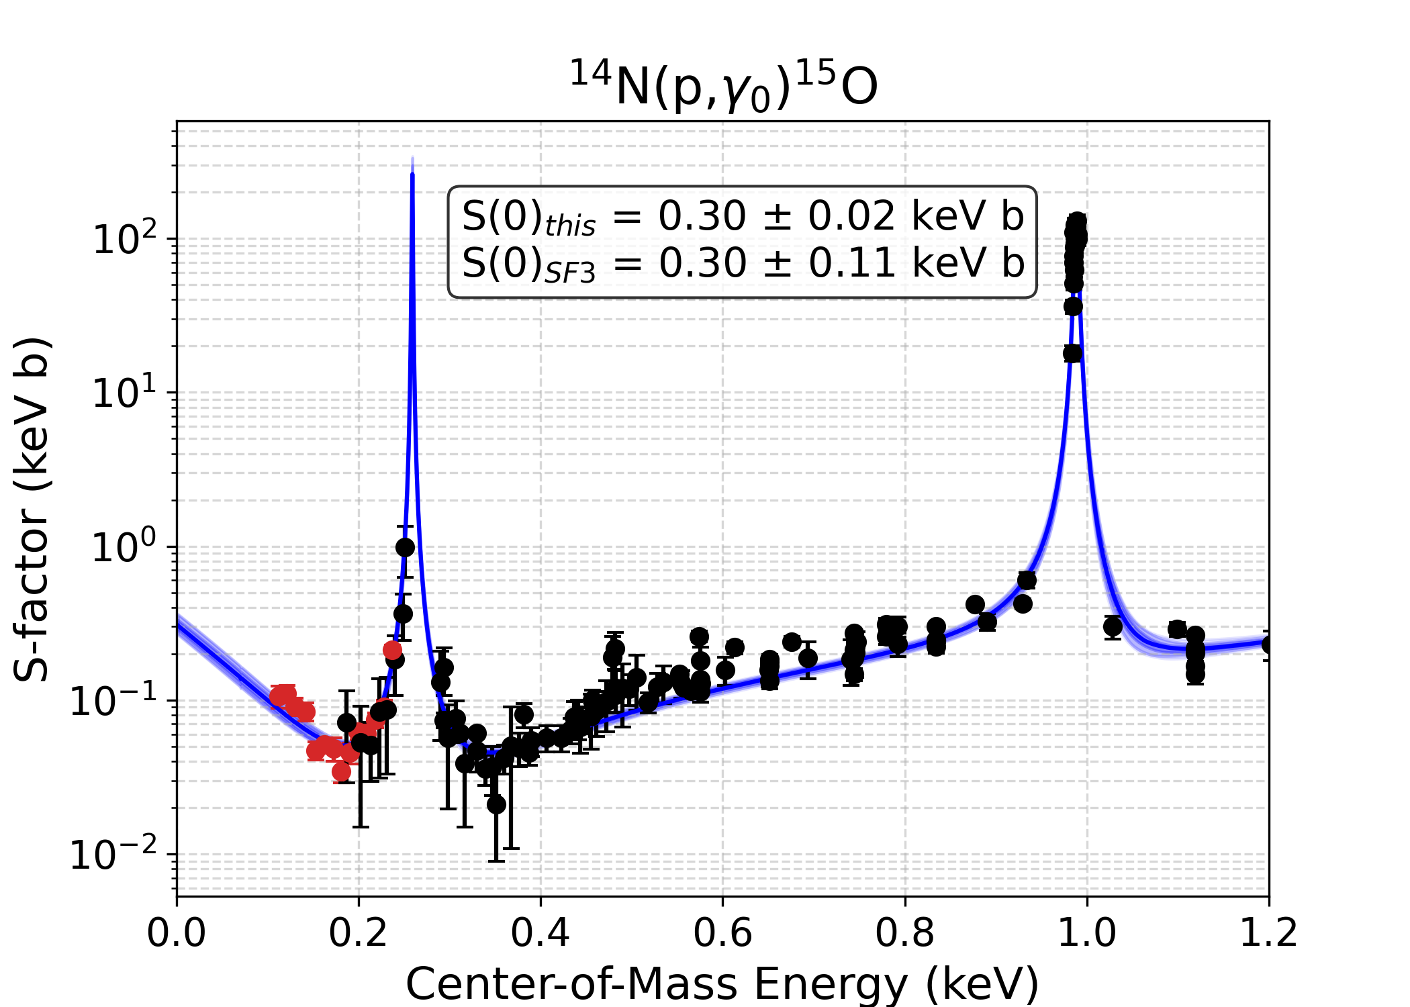



Backup — Alternative R-matrix fits
Chen et al. parameters do not reproduce the 2.2 MeV region of the elastic scattering (left); fit including scattering (right)
J. Skowronski | Università di Padova & INFN Padova | NPA 2026
31

