Slide 1
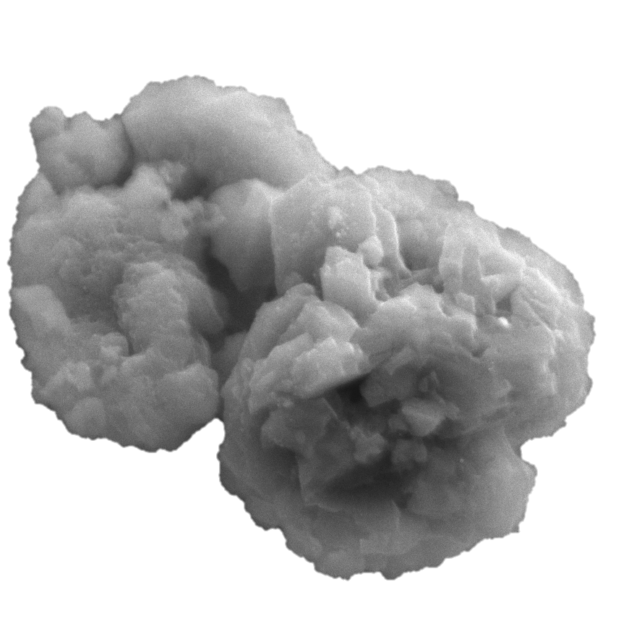
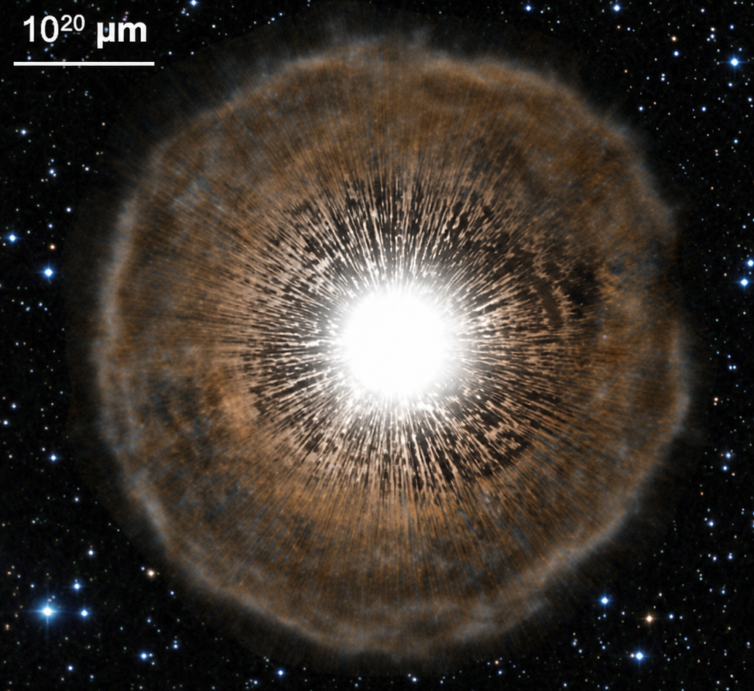
Nuclear Physics in Astrophysics XII 2026
Cluj-Napoca, Romania · 07–11 SEP 2026
Meteoritic isotopic anomalies as precision tests of stellar nucleosynthesis
1 μm
Nan Liu
Boston University
01 / 23
Notes:
Thank you to the organizers for the invitation. It is a pleasure to be here. Today I will discuss how isotopic anomalies in presolar grains can be used to test stellar nucleosynthesis. Presolar grains are microscopic samples, but they preserve information that is difficult to obtain in any other way. I will focus on three examples from AGB stars, and then briefly show two additional applications. The main message is that grain measurements, stellar models, and nuclear data must all work together.

Slide 2
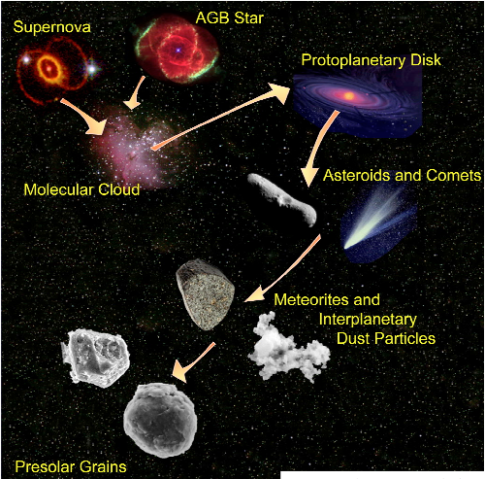
Presolar grains — ancient stardust in meteorites
Microscopic stardust we can hold
Grains that condensed in stars and supernova ejecta before the Solar System formed — preserved intact in primitive meteorites
Their isotope ratios reach orders of magnitude variations, in contrast to subtle changes for bulk solar material
Sizes range from <100 nm to ~10 µm, enabling single-grain analysis
Presolar Grains
Schematic by L. Nittler — SN/AGB ejecta → ISM → meteorites → laboratory
Background · presolar grains
02 / 23
Notes:
Presolar grains are exactly what the name says. They formed before the Solar System. They condensed in stellar winds or supernova ejecta, traveled through the interstellar medium, and were later incorporated into meteorites. A small fraction survived all of this processing. We can now extract these grains and analyze them one by one in the laboratory. The grain shown here is only about one micron across. Their isotope ratios can differ from solar composition by orders of magnitude. This is very different from most bulk Solar System materials, where isotope variations are small. Because we measure one grain at a time, the large signatures are not averaged together. So each grain gives us a direct sample of material from an individual star or stellar explosion.

Slide 3
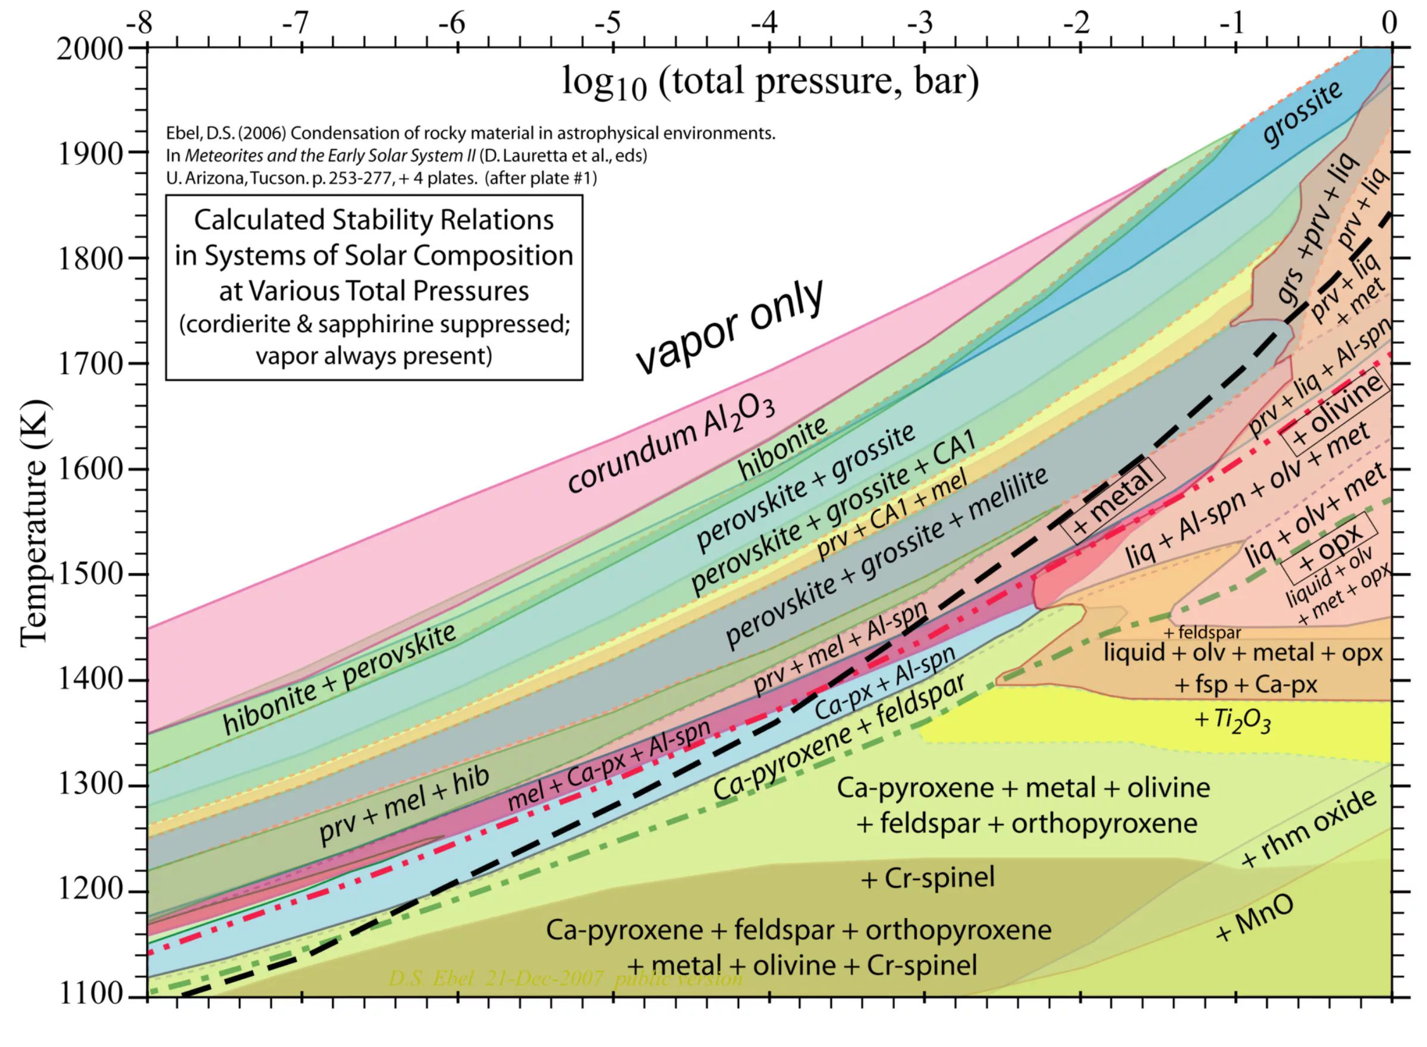
Dust formation in stellar winds and explosions
Chemical versus isotopic compositions
Elemental composition set by stellar gas + condensation P / T
Isotopic composition set by stellar only, precisely recording stellar nucleosynthesis signatures
Background · dust formation
03 / 23
Notes:
Before showing the isotope data, I want to make one useful distinction. The chemical composition of a grain determines which mineral forms. It depends on the gas composition, pressure, and temperature during condensation. The isotopic composition is different. It precisely records the stellar material from which the grain condensed. So mineralogy tells us about dust formation, while isotopes let us test stellar nucleosynthesis. This is why we will rely on isotope ratios to compare the grains with stellar models to provide accurate constraints.

Slide 4
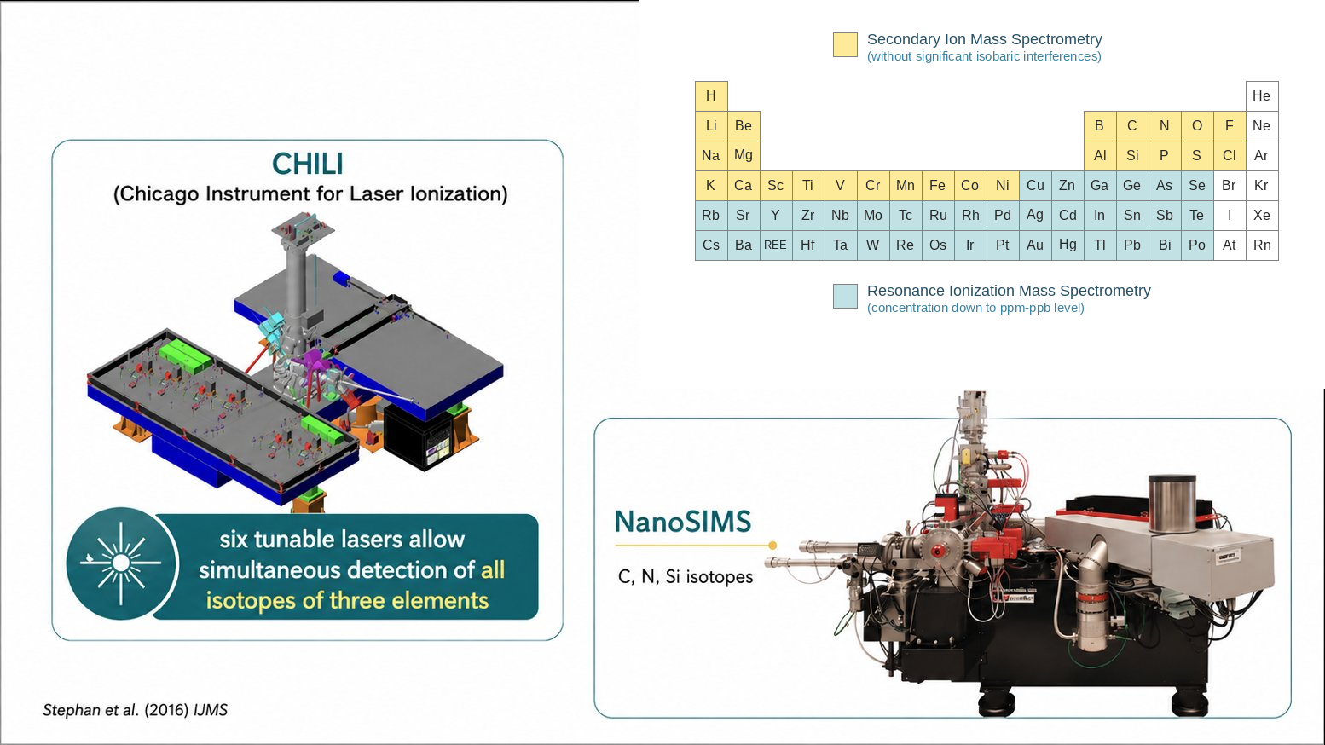
Laboratory isotope analyses
Stephan+2016 IJMS
Background · methods
04 / 23
Notes:
We obtain isotope data with two complementary types of instruments. NanoSIMS provides isotope images at 100 nm spatial resolution. This is important because imaging allows us to exclude surface contamination during data reduction, and this is essential to extract the real stellar signature. We’ll see such an example later. For heavy elements such as Mo, we use resonance ionization mass spectrometry, such as the CHILI instrument at Chicago. In this case, resonant lasers ionize the element of interest selectively. The high ionization efficiency makes trace-element measurements possible in single grains. Together, the two techniques give us multielement isotope records from single presolar grains.

Slide 5
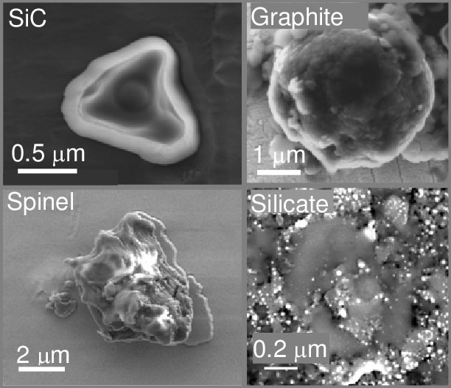
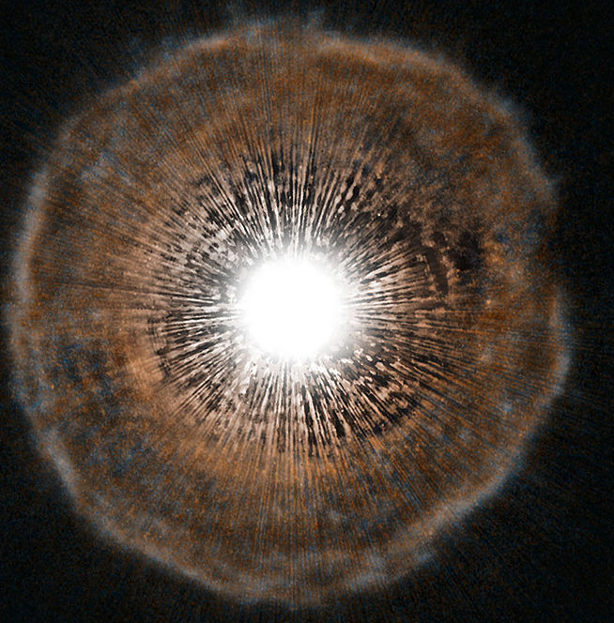
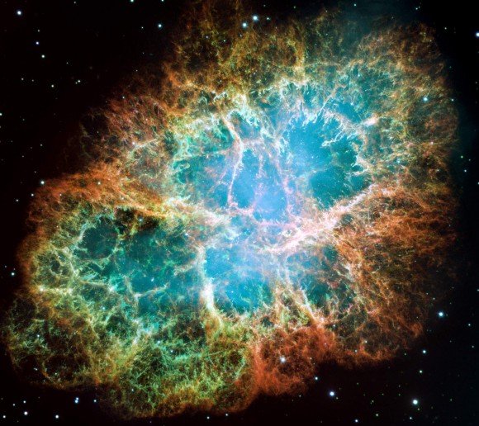
Stellar origins of presolar grains
Many minerals· two sources dominate
Carbon-rich grains: formed in C-rich stellar gas (C/O>1)
Oxide/silicate grains: formed in O-rich stellar gas (C/O<1)
Main sources: Core collapse supernovae and RGB/AGB stars
RGB/AGB Stars
Supernovae
Background · origins
05 / 23
Notes:
Presolar grains include many minerals, but two stellar sources dominate. Carbon-rich grains, especially silicon carbide, mainly formed around AGB stars. Oxides and silicates formed in oxygen-rich gas and came from both evolved stars and supernovae. The carbon-to-oxygen ratio therefore controls which minerals can condense. Today I will focus mainly on SiC grains from AGB stars. SiC can be chemically separated from meteorites and enriched in the laboratory. It has also been studied for a very wide range of isotopes.

Slide 6
What limits our interpretation of the s-process?
Measurements
Contamination control
KEY ISOTOPES
Recover intrinsic stellar signal from single grains
⁶⁴Ni
Modeling
T-dependent Decay
KEY ISOTOPES
Accurate treatment of decay rate throughout AGB evolution
⁹⁴Nb
Nuclear Data
Neutron-capture rates
KEY ISOTOPES
Data–model discrepancies point to inaccurate (n,γ) inputs
^{95,96,98}Mo
Overview
06 / 23
Notes:
Let me first be clear about the main scope. The next three topics are all about AGB SiC grains and the s-process. They are not three unrelated case studies. They all rely on AGB grains and the same nucleosynthesis process, but they reveal three different limitations on our previous interpretation. I will show data-model discrepancies using nickel-64, niobium-94, and the s-process Mo isotopes. Together, these examples show how measurements, modeling, and nuclear physics can play different roles in resolving a data-model disagreement. This is why cosmochemists, astrophysicists, and nuclear physicists need to work together.

Slide 7
PART 1 · MEASUREMENTS
Recovering
intrinsic Nickel
SLIDES 7 – 11
⁶⁴Ni
07 / 23
Notes:
I will begin with the measurement problem. Nickel is only a trace element in SiC. Therefore, even a small amount of solar nickel can strongly change the measured isotope ratios. The question is whether the measured nickel is truly inside the grain.

Slide 8
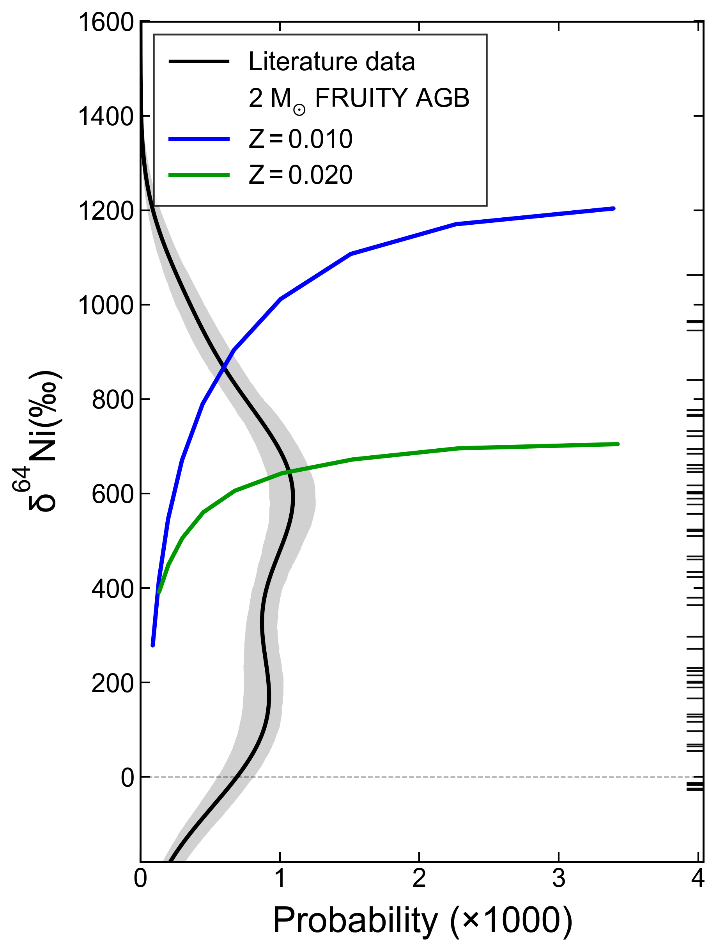
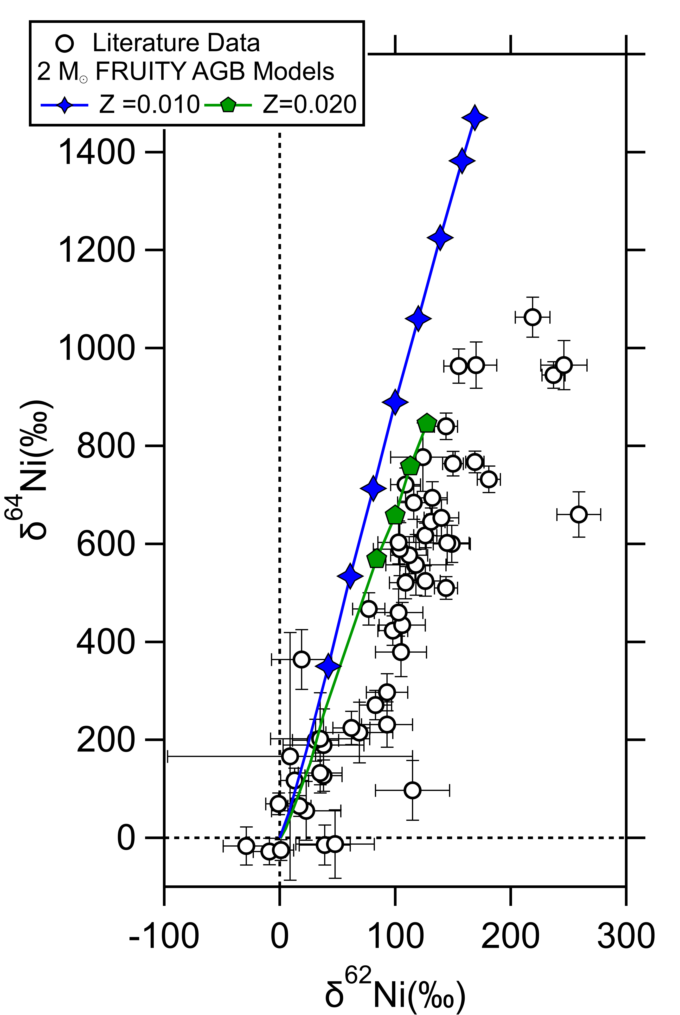
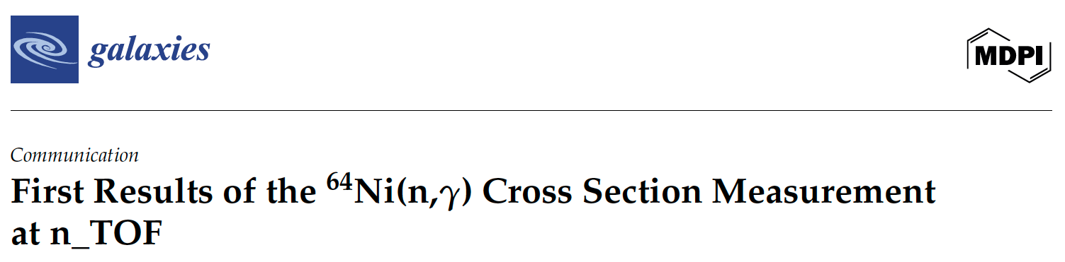
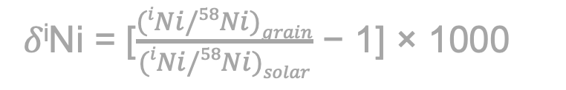
Data-model Discrepancy
AGB models: Vescovi et al. (2020) ApJL
Mass loss increases over time
dust formation speeds up
1𝜎 errors
Forbidden
𝛿^{i}Ni = [$\frac{(iNi/58Ni)grain}{(iNi/58Ni)solar}$ − 1] × 1000
1𝜎 errors
Literature data: Trappitsch+(2018) GCA
Measurements · discrepancy
08 / 23
Notes:
Here is the previously reported data-model discrepancy. Before discussing the plot, let me explain how to read the models, because we’ll see many similar plots throughout the talk. The axes show isotope deviations from solar composition at zero. Each model begins with the solar isotopic composition. As the AGB star evolves, material produced by the s-process is repeatedly dredged up from the interior into the envelope. The envelope therefore becomes more enriched in s-process products and also in carbon. Along each colored model track, the symbols show C-rich envelope compositions after different dredge-up episodes. As the symbols represent the carbon-rich phase, when carbon exceeds oxygen and SiC dust is expected to condense. These symbols are the model predictions that should be compared with the grains. The literature grain data are shown as open circles. And many of the data points overlap with the O-rich phase during which SiC formation is forbidden.
[Click] The late C-rich phase is also important because the mass-loss rate increases with time. So at the last several thermal pulses, the star loses most of its envelope material, and SiC dust formation becomes most efficient near the end of AGB evolution.
[Click] We can use the mass loss rate to produce the probability distribution on the right. It predicts that most grains should have values between 600 and 1200 per mil, but a high fraction of the literature grains lies below this range. The data-model discrepancy motivated this n_TOF measurement of 64Ni(n,g) rate. But the new rate did not remove the discrepancy. This led us to ask whether the grain data were affected by contamination.

Slide 9
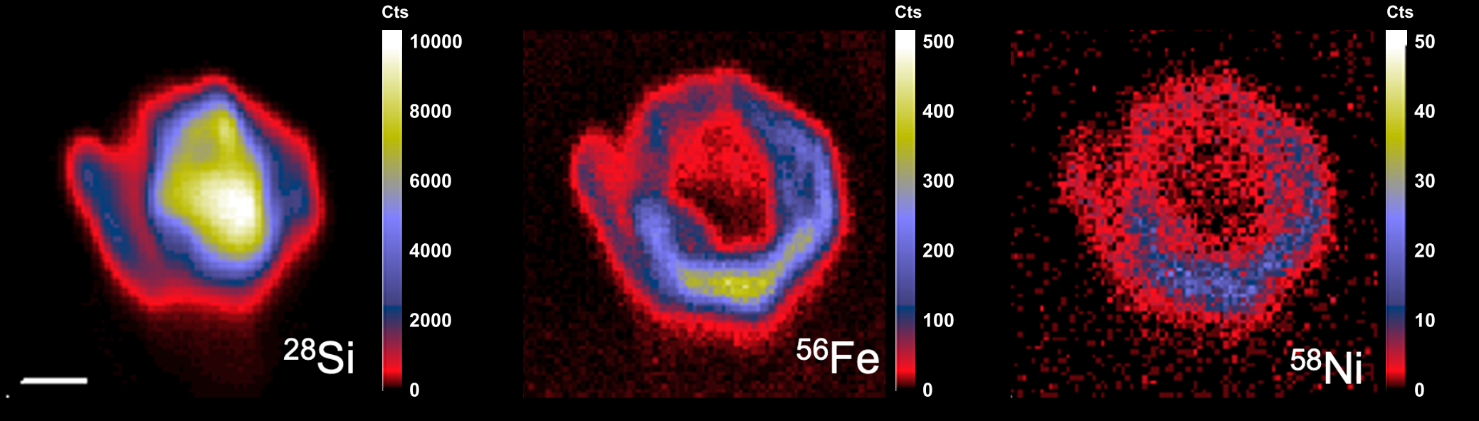

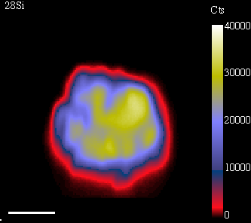
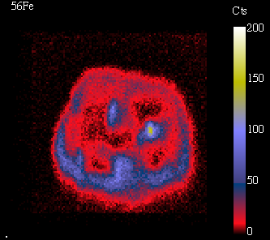
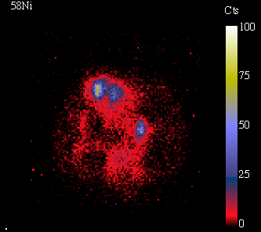
Isotope Imaging Reveals Contamination
1 um
Liu et al. (2026) Nat. Astron., submitted; José et al. (2026) EPJA
Dominated by intrinsic Ni
Contamination minimized during data reduction
Measurements · imaging
09 / 23
Notes:
The previous Ni isotope data were collected using the CHILI instrument that is resonance ionization mass spectrometer and has no imaging capability. The high-resolution NanoSIMS isotope images shown here let us test contamination directly. The silicon image defines the SiC grain. We then compare it with the iron and nickel images as Fe and Ni share similar chemical behavior. In this case, most of the Fe and nickel signals sit at the grain edge. A simple analogy is a mud bath. Obviously, we know this person is coated with mud, both because she is sitting in a mud bath and because humans are intrinsically mud-free. Most of the mud stays on the skin, but some dissolved elements can enter the outermost layers. The same thing happened to this grain. It was bathed in solar material in its host meteorite for almost 4.5 billion years. As the grain’s nickel signal is dominated by external contamination with little intrinsic signals, demonstrated by its close to solar Ni isotopic composition, this is a case when we need to discard the data.
[Click] The lower panel shows another SiC grain. In this case, although the grain surface is still coated with Ni contamination, the grain interior also contains substantial Ni signals. We can define the grain region carefully by maximizing the Ni isotopic anomaly and thus suppressing contamination. The two examples tell us that this spatial information is essential. A single bulk number would not tell us whether the nickel is intrinsic.

Slide 10
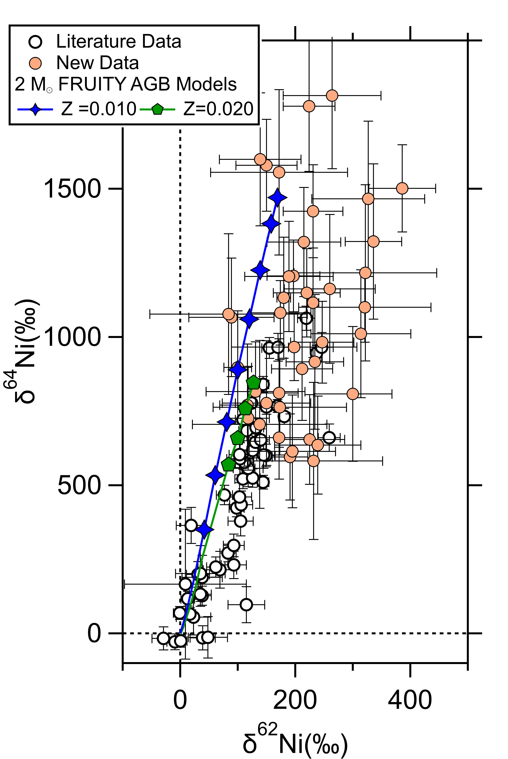
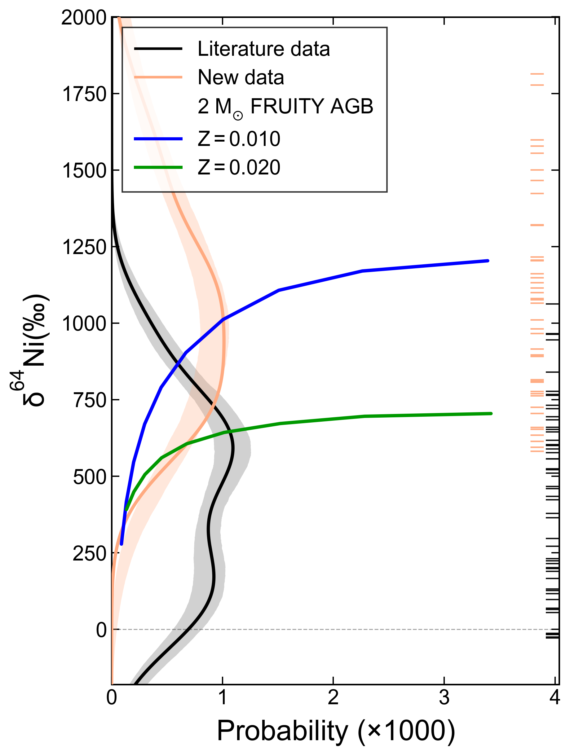
Discrepancy is Resolved
Predicted
New data peak where SiC formation is most probable!
Measurements · agreement
10 / 23
Notes:
The new NanoSIMS imaging results change the picture completely. The new data, shown in orange, extend to much larger nickel-64 enrichments and follow the AGB model tracks. These high values are exactly what we expect from the later, carbon-rich part of the AGB evolution.
[Click] The probability distribution illustrates this point more clearly. The new grain distribution in orange now peaks in the same region where the model predicts that SiC formation is most likely. So neither the stellar models nor the nuclear input was the problem. The previous RIMS measurements were shifted toward solar composition by contamination. This is a good example of how a small analytical effect can look like a major problem in stellar or nuclear physics.

Slide 11
TAKEAWAY
The discrepancy came from Ni contamination
WHAT THIS MEANS
When a grain-model discrepancy is revealed, the possibility of solar contamination always needs to be taken into consideration and tested
Measurements · takeaway
11 / 23
Notes:
The first takeaway is simple. The discrepancy came from nickel contamination, not from the nuclear inputs or stellar modeling. Before using a grain-model mismatch to question the physics, we must first make sure that we have recovered the intrinsic grain composition.

Slide 12
PART 2 · MODELING
Temperature-dependent β⁻ Decay
SLIDES 12 – 16
⁹⁴Nb
12 / 23
Notes:
The second example involves niobium-94. Here the analytical data are not the main issue. The key uncertainty is how the stellar model treats a beta-decay rate that changes strongly with temperature.

Slide 13

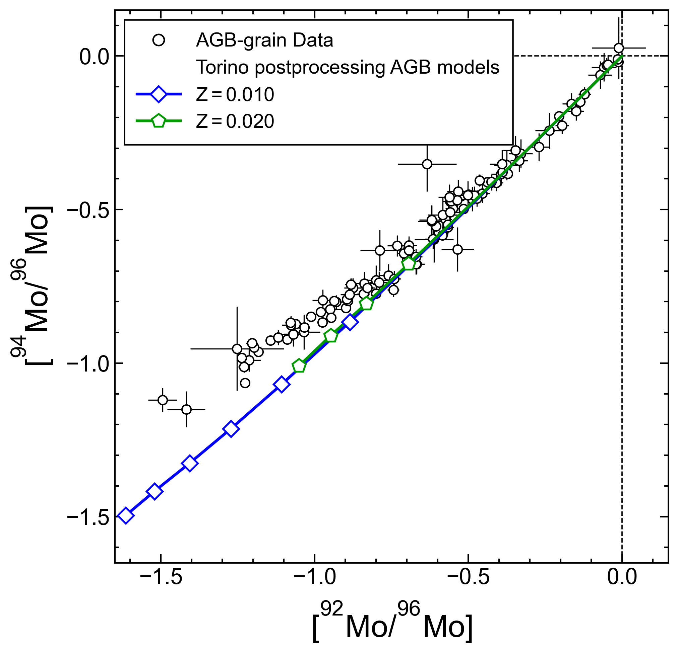
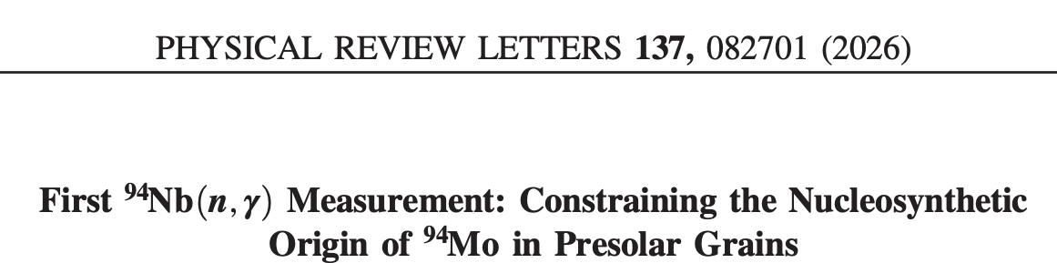
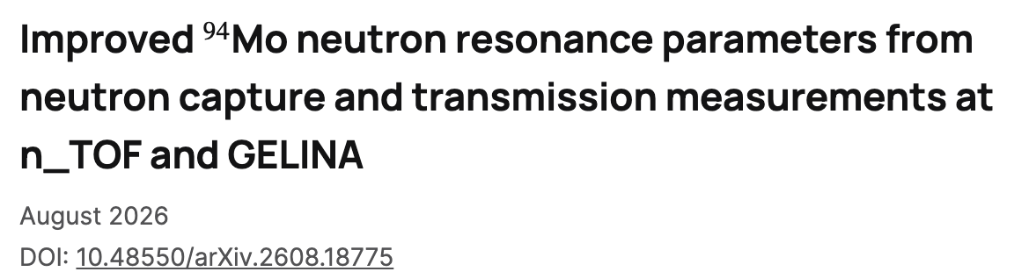
Branch point along s-process path at ⁹⁴Nb
Likely contamination
s-process production
Liu+(2019) ApJ
Modeling · branch points
13 / 23
Notes:
Niobium-94 lies at a branch point along the s-process path. It can capture a neutron and move to niobium-95, or it can beta decay and produce molybdenum-94. So although 94Mo is traditionally considered as a pure p-process isotope, it can indeed be produced by the s-process. The competition between these two channels controls how much molybdenum-94 is produced. This makes the grain data sensitive to both nuclear inputs and stellar conditions.
[Click] The plot compares AGB grain data with two postprocessing AGB models. Postprocessing is a common way to reduce the computational cost of stellar nucleosynthesis calculations. The stellar evolution is first calculated using only the reactions needed to model energy generation. The resulting temperature, density, and mixing histories are then used in a separate calculation with the full nuclear network. This approach is efficient, but strongly temperature-dependent rates must be handled carefully. The model curves fall below most of the grains. These grains close to the solar composition are probably affected by contamination, but this cannot explain the main disagreement at the more anomalous compositions, pointing to uncertainties in the predicted s-process production.
[Click] This motivated investigation of the relevant neutron capture rates. And these two measurements suggest that the (n,g) cross sections are not the main cause of the underprediction. With the relevant neutron-capture rates excluded, the remaining question is how the beta decay of niobium-94 was treated over the changing temperature history of the star.

Slide 14
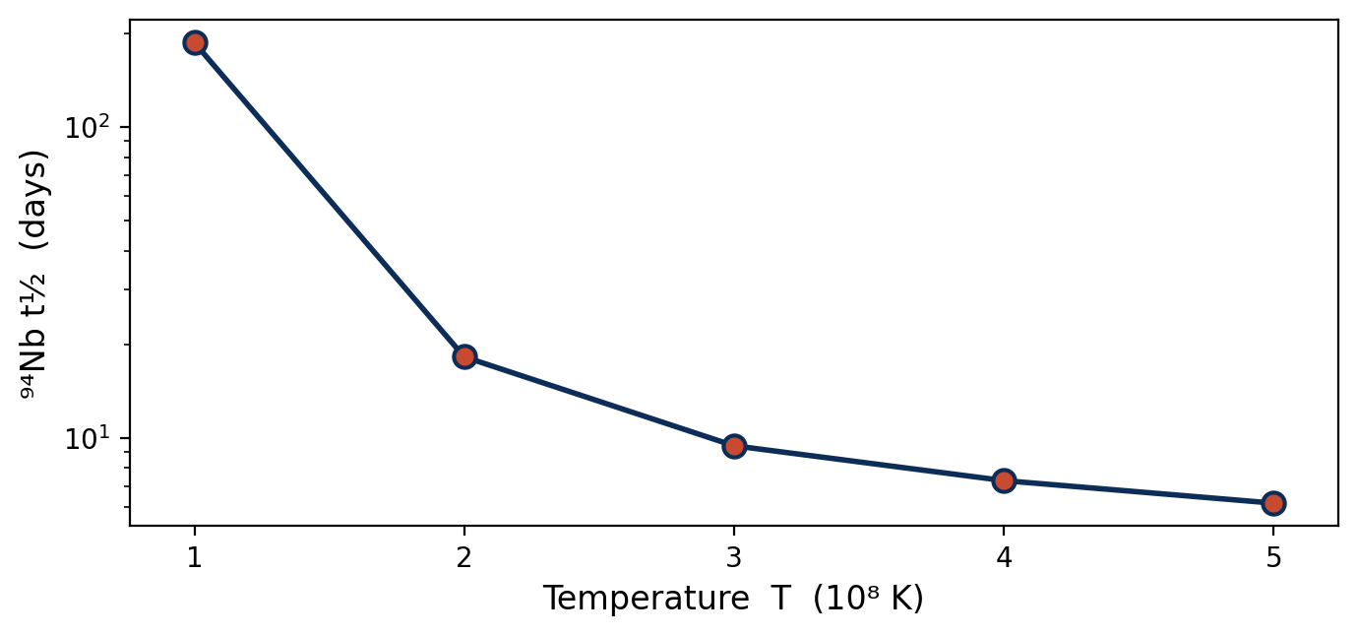
⁹⁴Nb β⁻ half-life − temperature-dependent
Interpulses
Yokoi & Takahashi 1987
During TPs, β⁻ decay dominates over neutron capture, producing ⁹⁴Mo
thermal pulses
Modeling · ⁹⁴Nb β⁻ rate
14 / 23
Notes:
On Earth, niobium-94 has a half-life of about twenty thousand years. In a hot stellar plasma, however, excited nuclear states become populated, and the effective half-life becomes much shorter. The rate therefore changes during the AGB evolution. During the cooler interpulse periods, the decay remains slow. During a thermal pulse, the temperature rises sharply and beta decay can dominate over neutron capture to produce 94Mo. The important point is that one terrestrial decay rate, or even one rate at a representative temperature, cannot be applied throughout the AGB evolution. The model must accurately follow the changing temperature with sufficiently fine temporal resolution.

Slide 15
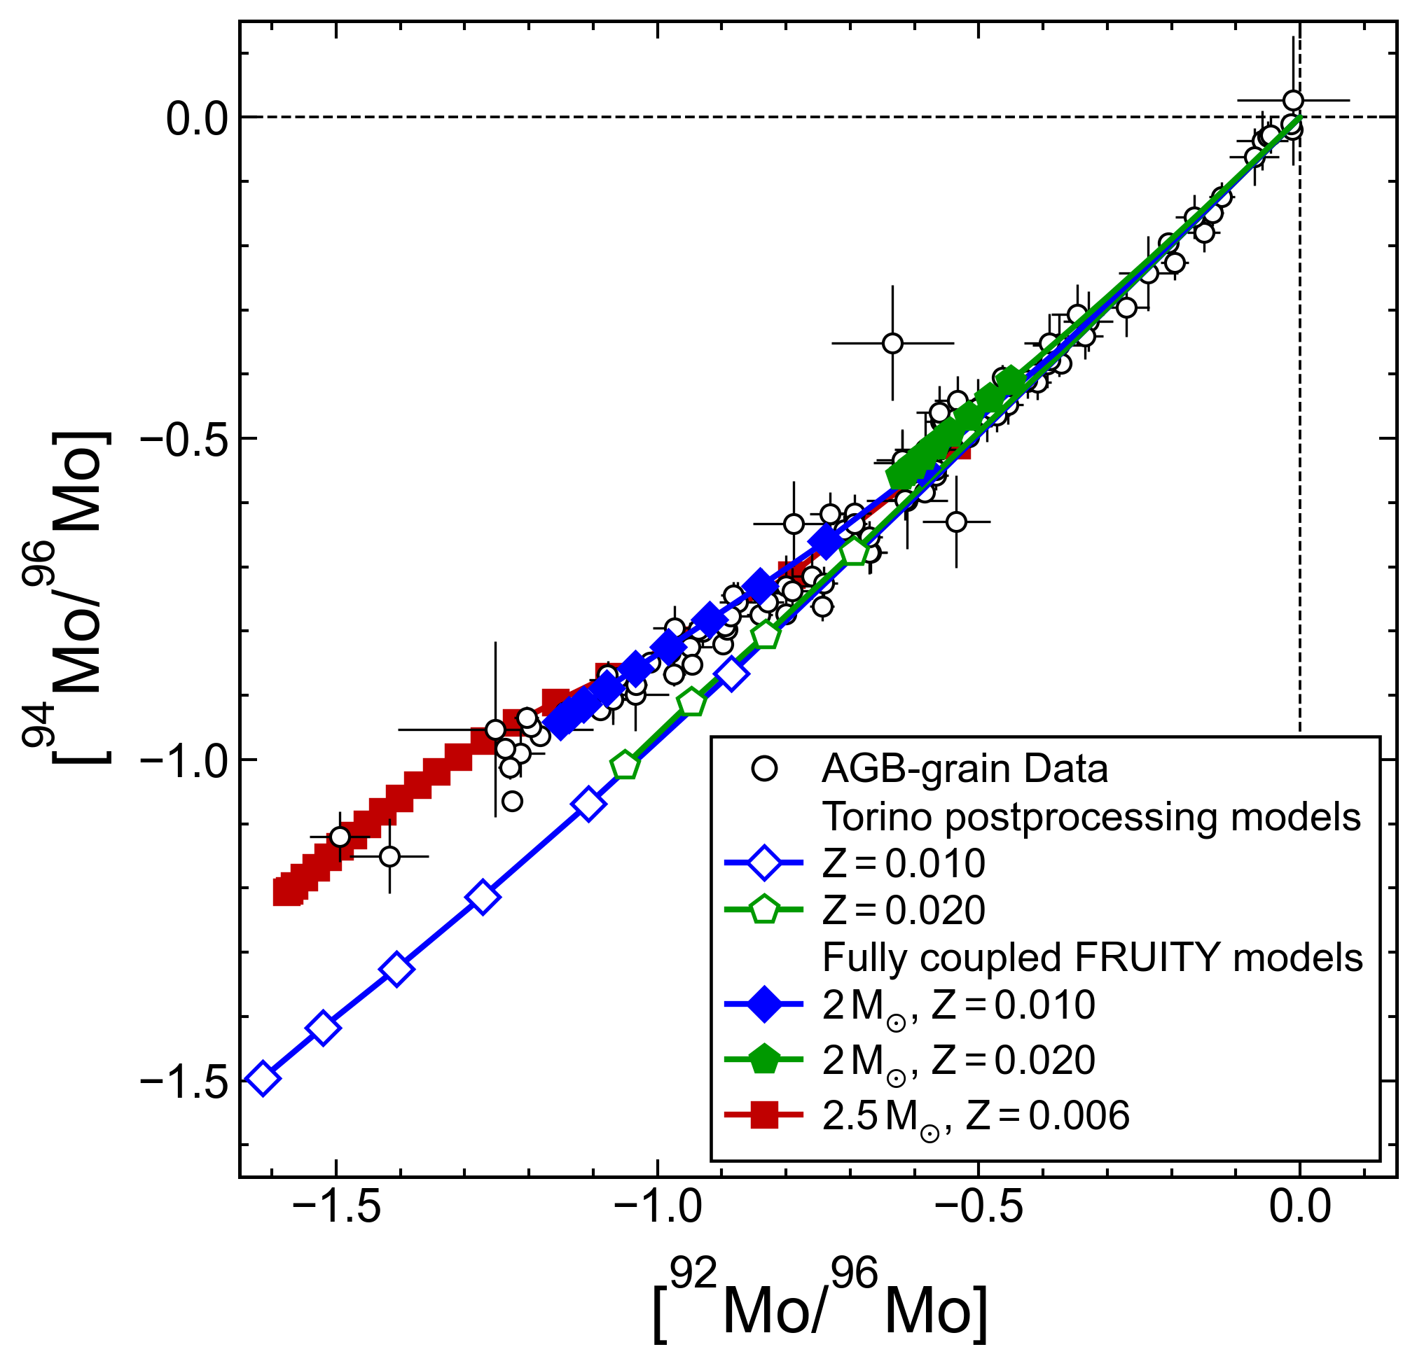
Accurate Treatment of ⁹⁴Nb 𝛽⁻ Decay
Vescovi+(2020) ApJL
Balibrea-Correa+(2026) PRL
Previous postprocessing AGB models failed to explain the grain data
Fully Coupled FRUITY AGB models are in line with grain data
The problem was caused by the inaccurate treatment of the ⁹⁴Nb β⁻ rate in previous models
Modeling · data-model comparison
15 / 23
Notes:
This explains the difference between the models. The fully coupled FRUITY models shown as filled symbols treat the nuclear network together with the changing stellar conditions. Once this rate is handled consistently, the model predictions agree with all AGB grains. So the molybdenum-94 discrepancy was caused by the stellar beta-decay treatment, rather than by the neutron-capture cross sections. This time the measurements and nuclear inputs were both reliable, but the model implementation was not.

Slide 16
TAKEAWAY
The discrepancy came from the stellar β⁻ treatment
WHAT THIS MEANS
Better understanding of the s-process production of ⁹⁴Mo depends on experimentally determined β⁻ rate for ⁹⁴Nb — a target of the PANDORA project
Modeling · takeaway
16 / 23
Notes:
This is the second takeaway. Here the problem was in the stellar modeling. A direct measurement of the niobium-94 beta-decay rate under stellar conditions would provide an important test. This is one of the targets of the PANDORA project.

Slide 17
PART 3 · NUCLEAR DATA
The Mo Mismatch
SLIDES 17 – 20
^{95,96,98}Mo
17 / 23
Notes:
The final AGB example is the Mo mismatch. These are stable, s-process-produced Mo isotopes. In this case, the correlation among several isotopes allows the grains to test neutron-capture rates very precisely.

Slide 18
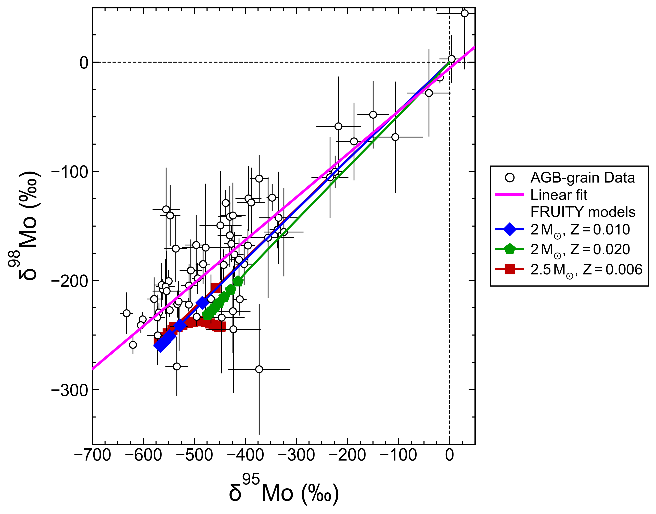
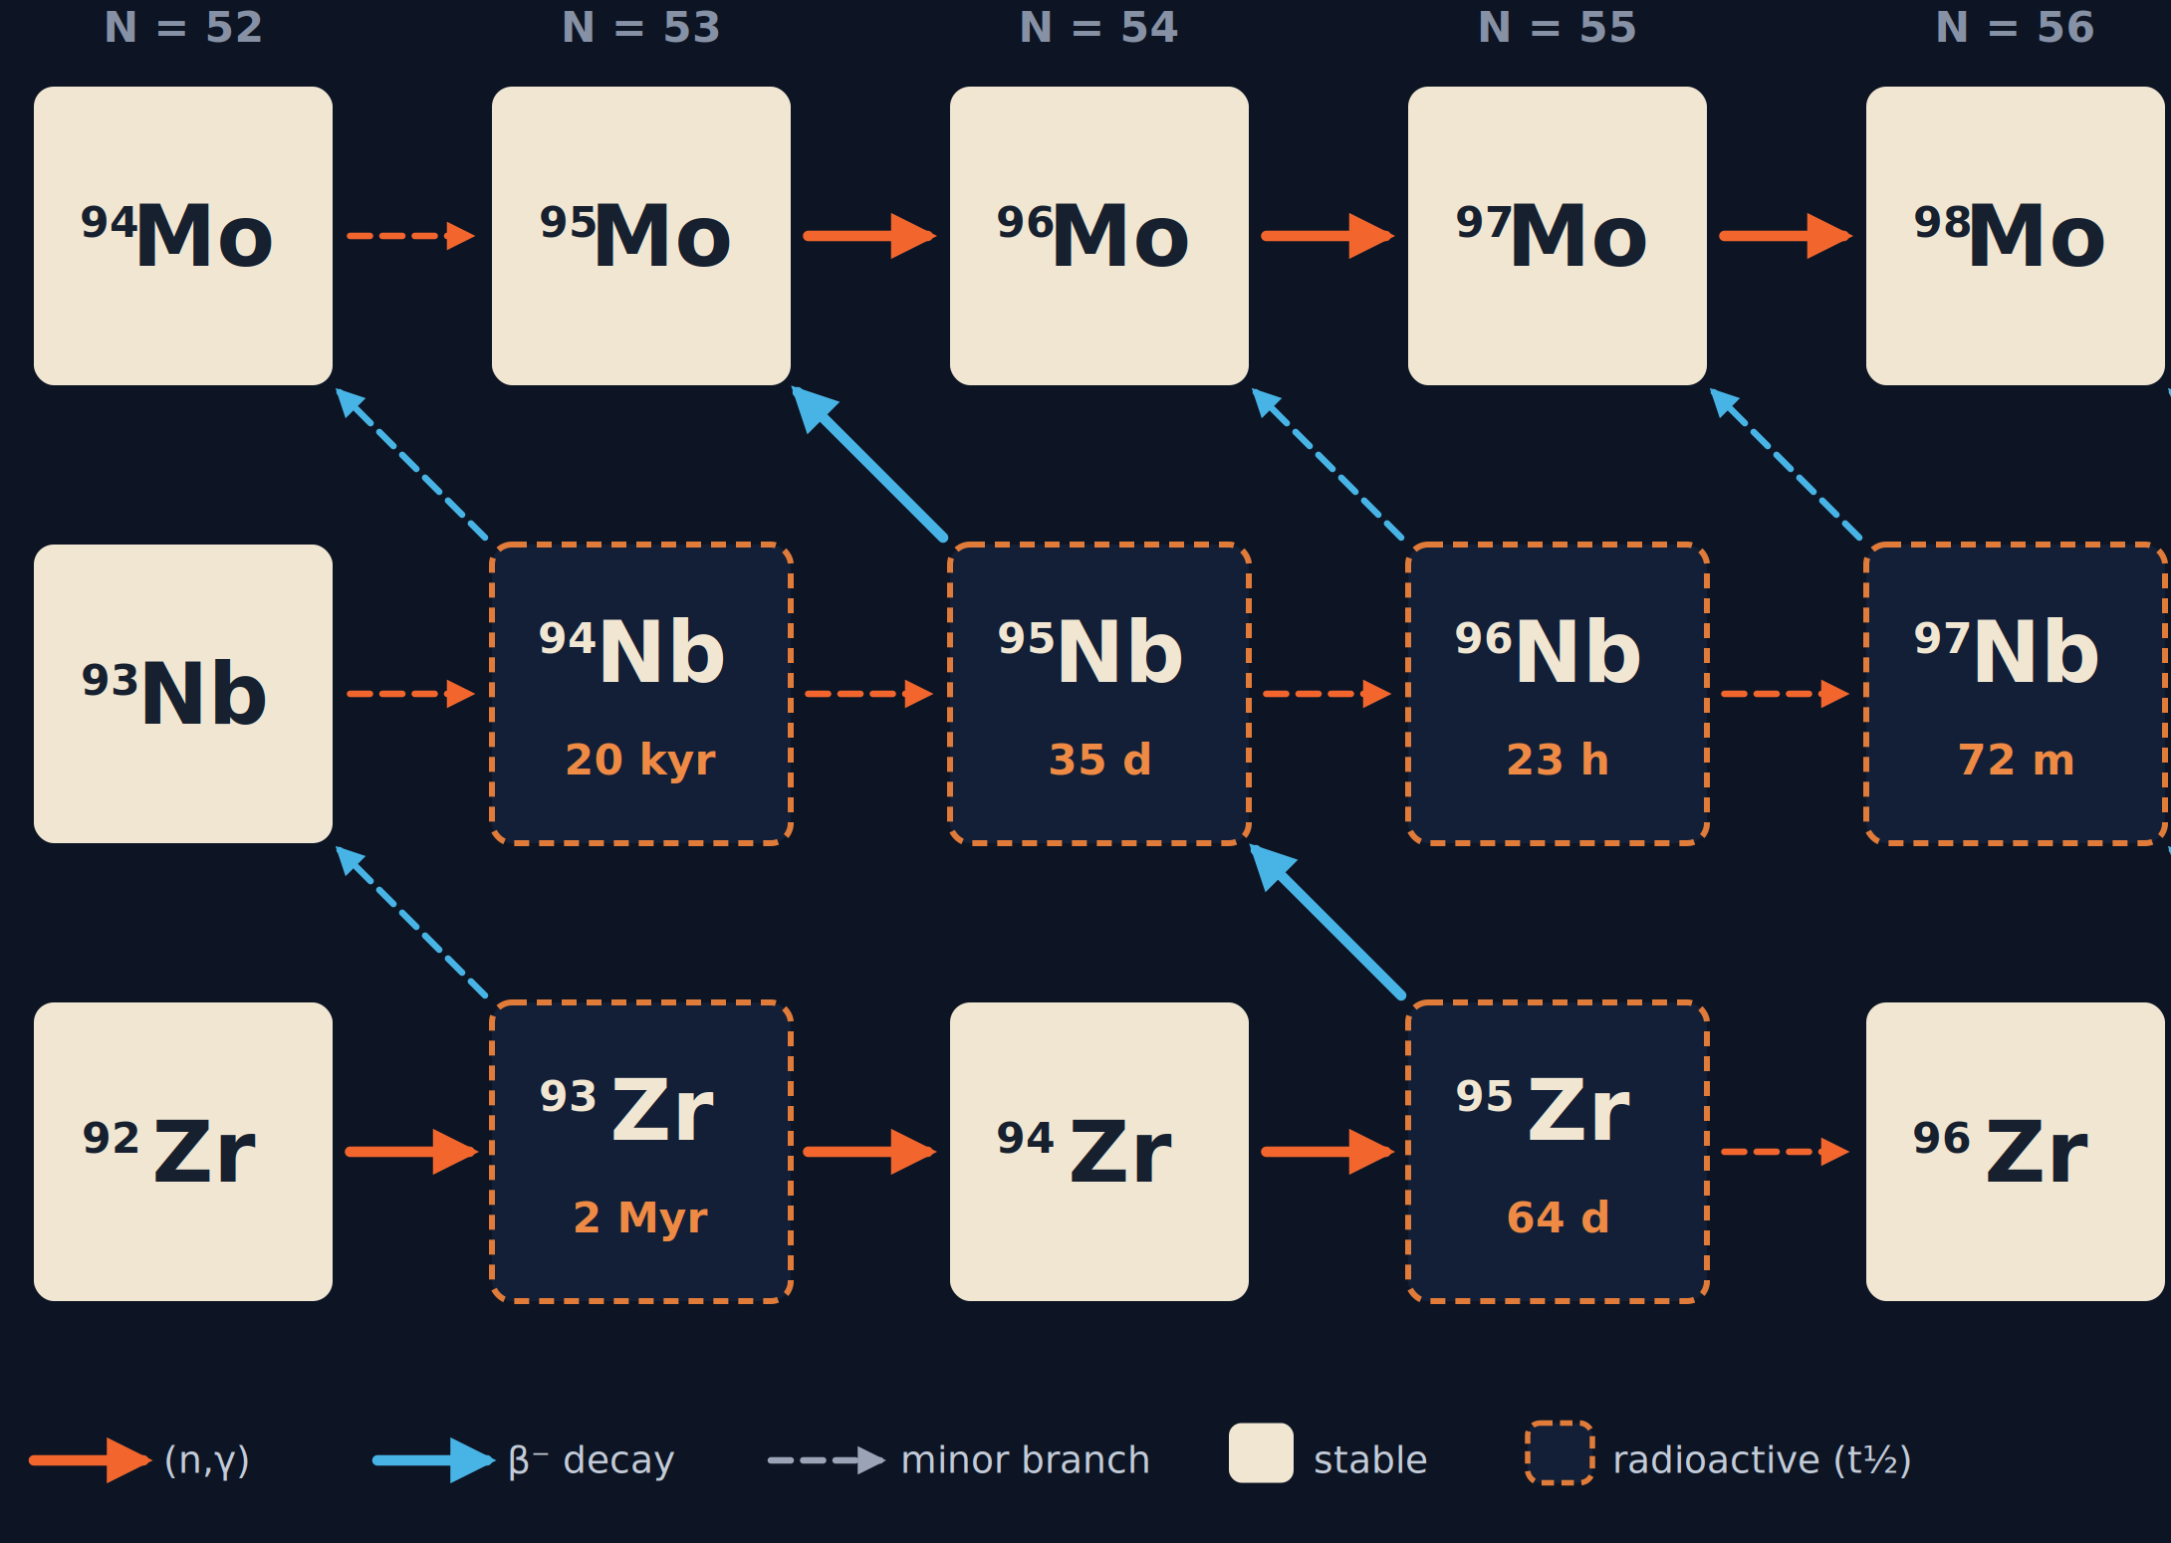


Data-model Discrepancy
KADoNIS v0.3 MACS values
Slope $∝ \frac{σ(95Mo)}{σ(98Mo)}$
$σiMo ∗NiMo$ ≈ constant
Liu+(2019) ApJ
Nuclear data · Mo isotopes
18 / 23
Notes:
In typical low-mass AGB stars near solar metallicity, the production of ^95Mo through ^98Mo is dominated by the main s-process path, with negligible contributions from the branches. Therefore, the local approximation for the s-process works well: isotope abundances are inversely related to their MACS values.
This is why the two two-solar-mass models shown on the right, despite their different metallicities, lie along essentially the same straight line. They represent mixing between the initial composition and one s-process endmember. Contamination and repeated dredge-up move the envelope along this line without changing its slope. Thus, the grain-correlation slope is proportional to the relevant MACS ratio.
The 2.5-solar-mass model is different. Its higher temperature activates the zirconium-95 branch, allowing part of the s-process flow to bypass molybdenum-96 and changing the Mo isotope pattern. Still, none of the models reproduces the grain slope.

Slide 19
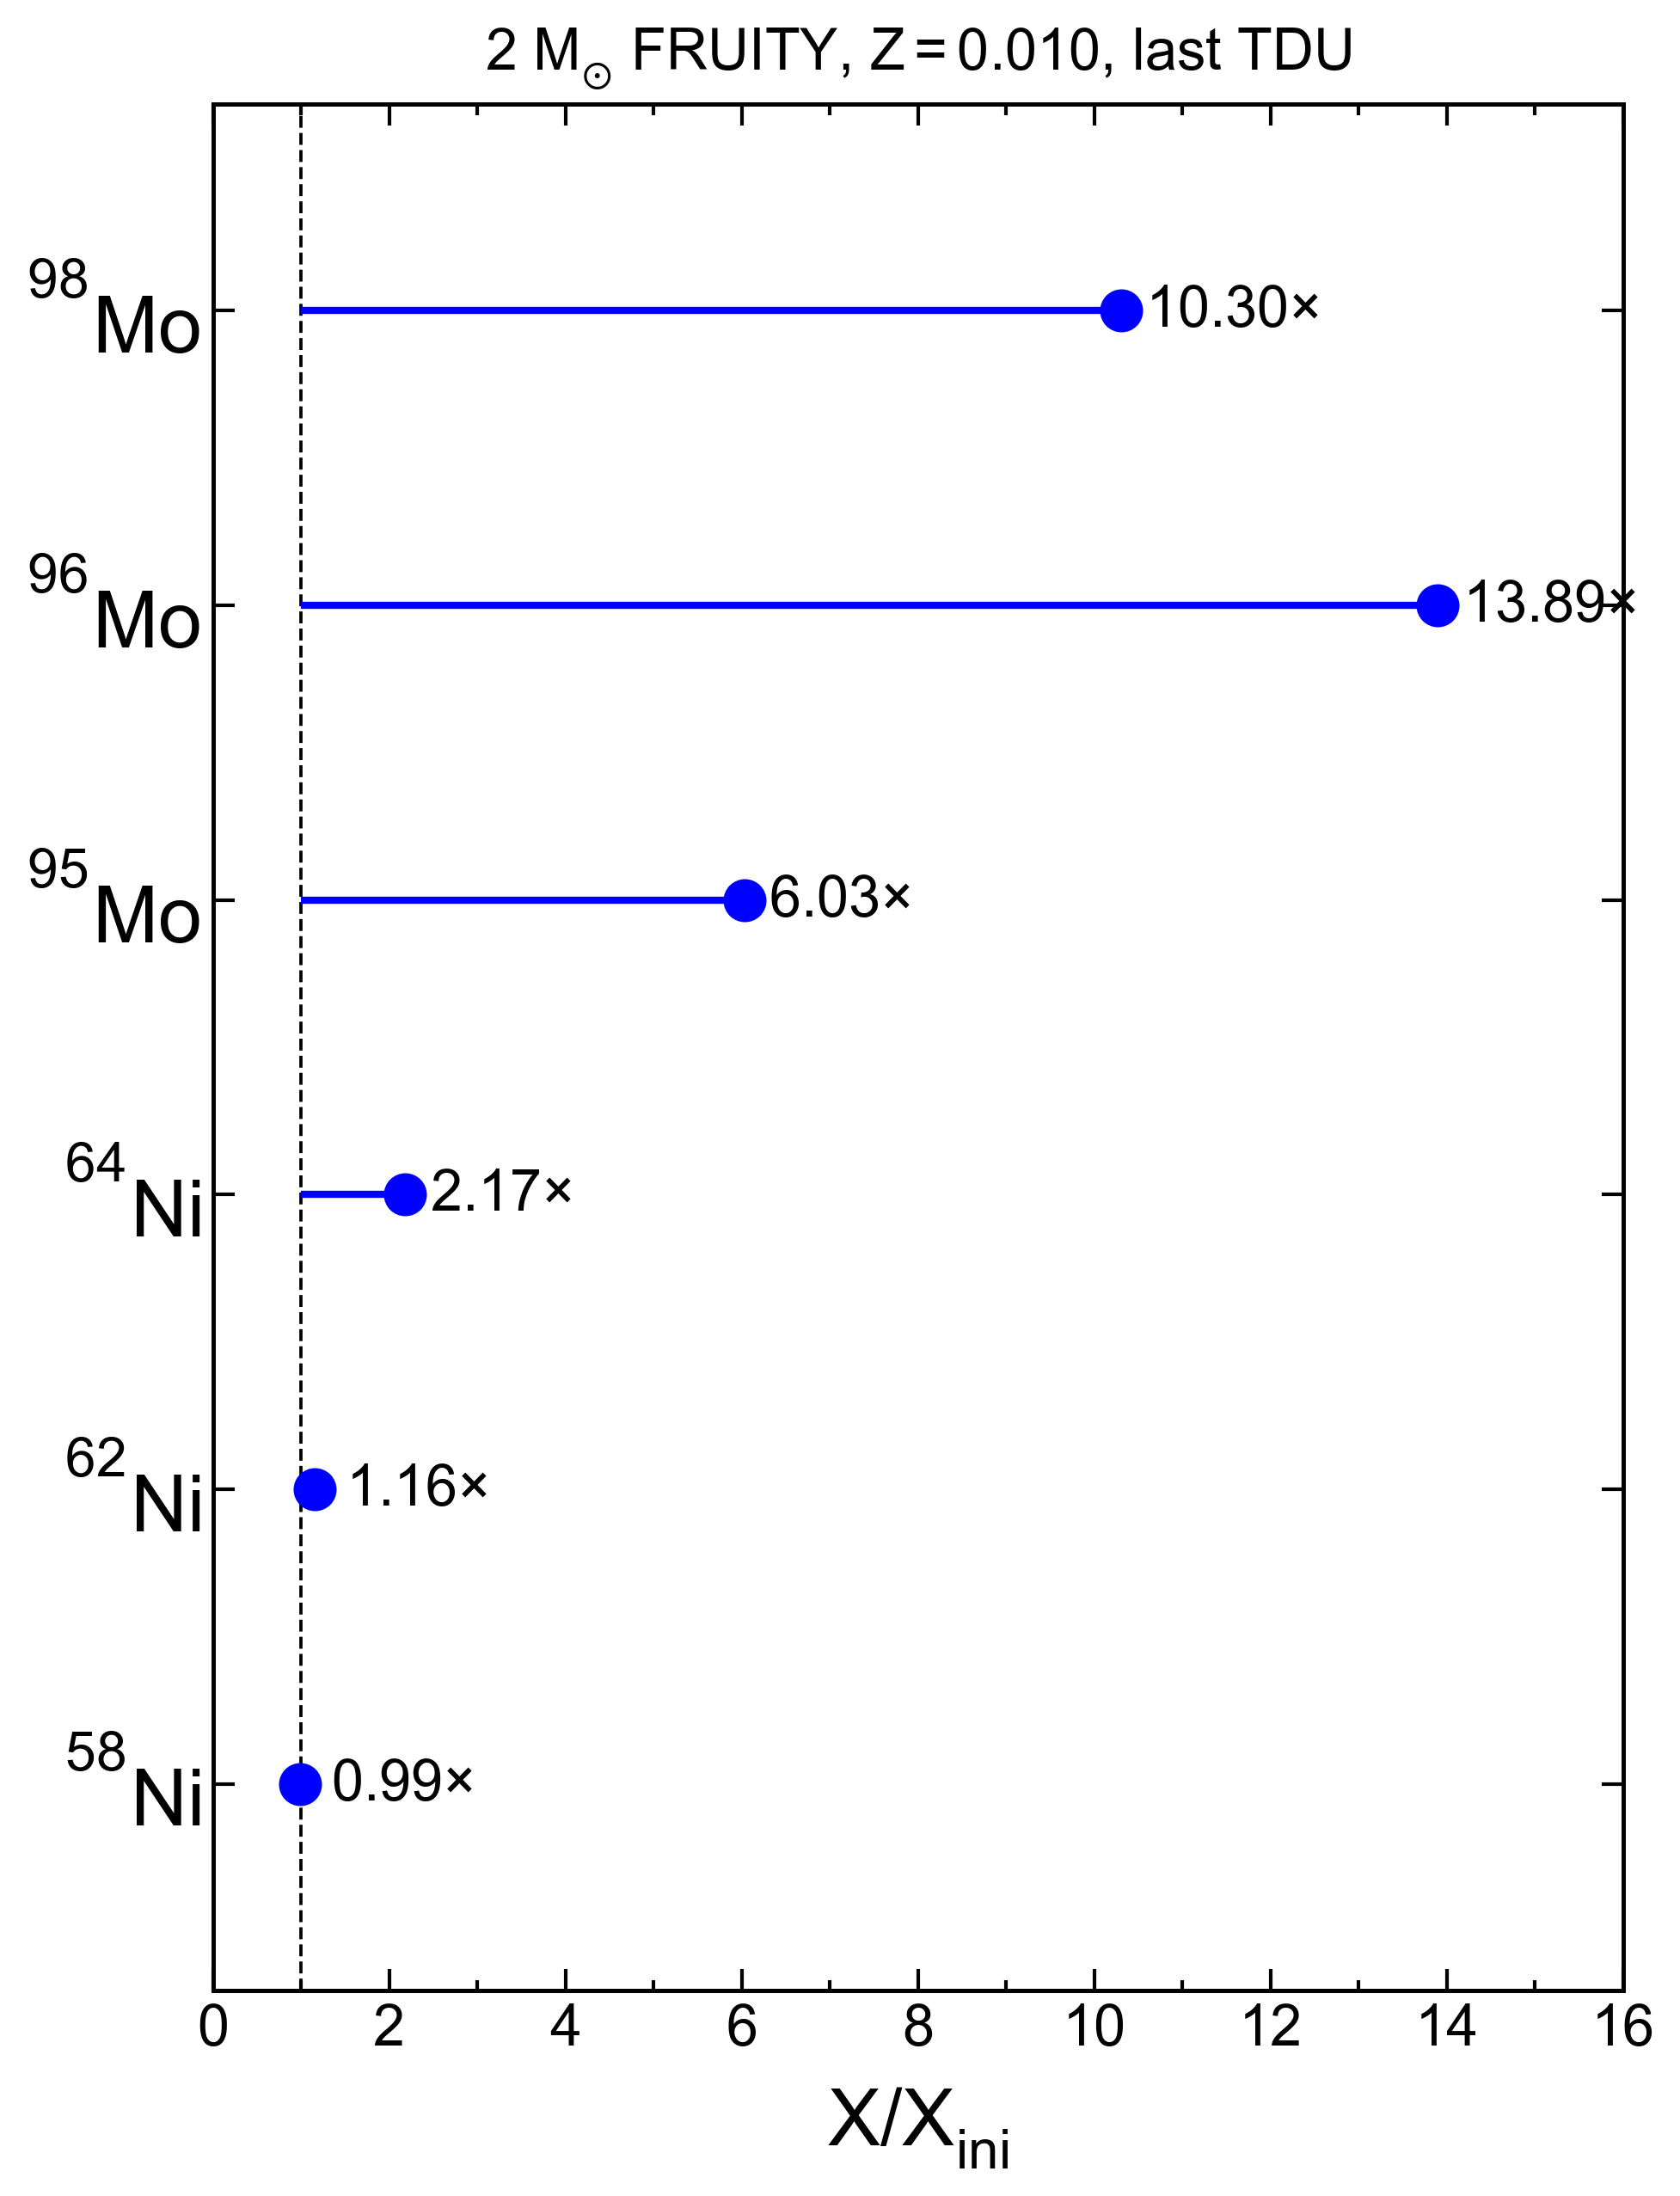
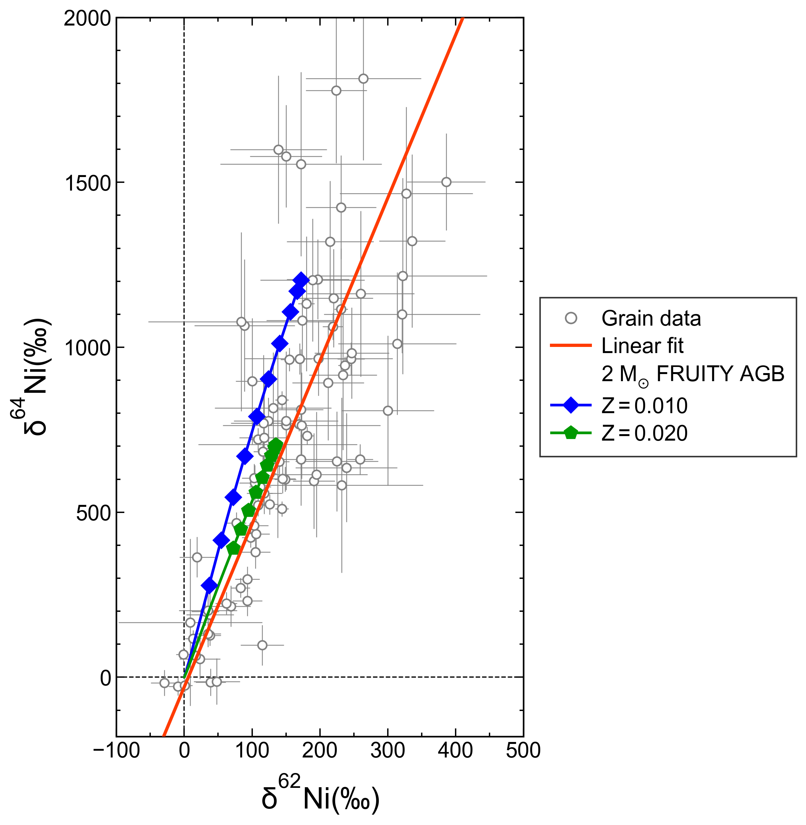
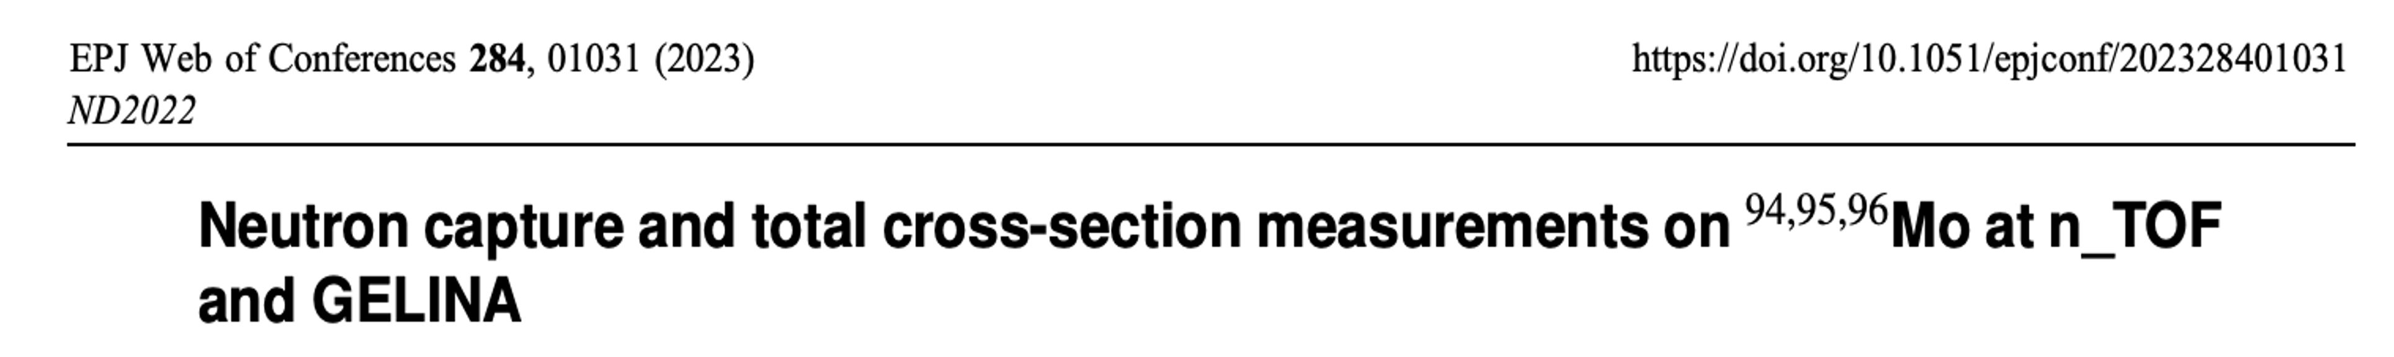

Initial Composition Matters—But Not for Mo
Slope $∝ \frac{σ(62Ni)}{σ(64Ni)}$
Ni isotopes: barely produced, largely affected by initial stellar composition
The data-model mismatch: Nuclear data or initial ⁶²Ni enrichments
Mo isotopes: significantly produced, barely affected by initial stellar composition
Limited s-process production
Nuclear data · initial composition
19 / 23
Notes:
Before we attribute the mismatch to the MACS values, let’s take a look at the effect of the Initial composition. The initial stellar composition can differ from solar and affect the envelope composition, but its importance depends on the element. Nickel is only weakly modified by the s-process in an AGB star, especially 62Ni compared to 64Ni. The 62Ni’s final envelope composition therefore retains much of the initial stellar signature. This is why an initial nickel-62 enrichment can pull the model predictions toward right and explain the data-model disagreement here. In this case, we have to consider both the starting composition and the nuclear data.
Molybdenum is different. During the AGB phase, the star produces large amounts of the s-process Mo isotopes. By the last dredge-up, we see the three Mo isotopes are enhanced by roughly an order of magnitude. The newly produced Mo therefore dominates the envelope inventory and largely erases the initial Mo isotope signature. Even if the star did not begin with an exactly solar Mo composition, that difference becomes small compared with its own production. This means that changing the initial stellar composition cannot explain the Mo slope, especially at large s-process enrichments. For Mo, the most likely explanation is the neutron-capture input. New measurements at n_TOF and GELINA will directly test this conclusion.

Slide 20
TAKEAWAY
The discrepancy points to the neutron-capture rates
WHAT THIS MEANS
The Mo isotope correlation slopes directly test neutron-capture cross-section ratios
Nuclear data · takeaway
20 / 23
Notes:
So the third takeaway is that the Mo discrepancy points to the neutron-capture rates. Because the grain correlation slopes depend directly on cross-section ratios, improved measurements can be tested immediately against the grain data.

Slide 21

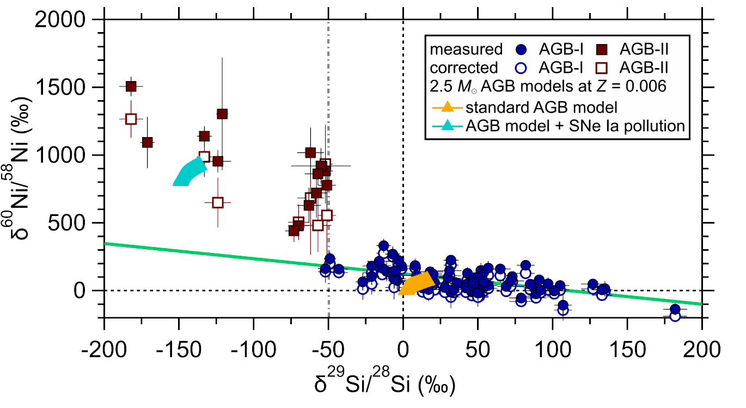
⁶⁰Ni Reveals Stochastic GCE
~97%: well-mixed GCE
~3%: extreme ⁶⁰Ni excesses −subChandra Type Ia
Takeaway: Rare AGB grains preserve local Type Ia supernova pollution.
Liu et al. (2026) Nat. Astron., submitted
Spotlight · Galactic chemical evolution
21 / 23
Notes:
Before I finish, I want to show two short spotlights on what else these grains can tell us. The first returns to nickel, but now the question is Galactic chemical evolution. Most of the AGB grains define the smooth trend expected from many generations of stellar contributions. About ninety-seven percent of the AGB grains follow this well-mixed Galactic trend. A small group, shown in red, has extreme nickel-60 excesses. These compositions cannot be explained by the smooth trend or by AGB nucleosynthesis. Instead, they record local pollution by sub-Chandrasekhar Type Ia supernovae before the parent stars formed. These events contributed iron-group material to a small ISM region before it was fully mixed. So these rare AGB grains preserve the stochastic, local part of Galactic chemical evolution that is for the first time revealed by grain measurements.

Slide 22
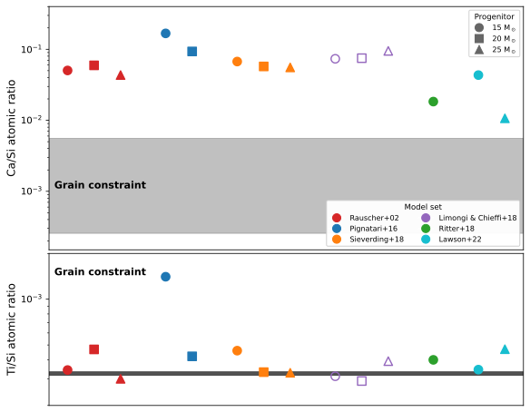
Ca–Si Challenges 1D CCSN Models
Ca-Si isotope data: All 1D models overpredict Ca/Si
→ neutron-rich ejecta during incomplete Si-burning.
Takeaway: The new Ca-Si isotope data provide a multielement isotope benchmark for 3D ejecta predictions.
Liu et al. (2026) in prep.
Spotlight · core-collapse supernovae
22 / 23
Notes:
The second spotlight moves from AGB stars to core-collapse supernovae. Here we combine calcium and silicon isotope data from supernova grains. The gray band shows the calcium-to-silicon ratio produced by incomplete Si-burning required by the grains. All available one-dimensional models overpredict this ratio. No single model set solves the problem. The grain data point to neutron-rich ejecta produced during incomplete silicon burning. The mismatch suggests that the thermodynamic histories in real explosions are not fully captured by 1D models. These grains therefore provide a multielement isotope benchmark for 3D calculations. This moves the grain record from identifying the supernova origin to testing the detailed physics of the explosion.

Slide 23
Summary — five insights
⁶⁴Ni: contamination matters
MEASUREMENTS
High-resolution imaging separates intrinsic grain signals from surface contamination
⁹⁴Nb: stellar decay rates matter
MODELING
T-dependent β⁻ decay rate in fully coupled AGB models resolves the apparent ⁹⁴Mo discrepancy
s-process Mo: nuclear inputs matter
NUCLEAR DATA
Grain-model slopes expose remaining uncertainties in neutron-capture inputs
⁶⁰Ni + Ca-Si: GCE and CCSNe
SPOTLIGHTS
⁶⁰Ni records localized SNe Ia pollution; Ca-Si exposes gaps in 1D CCSN models
Closing · summary
23 / 23
Notes:
Here is a summary of what we’ve discussed. First, high-resolution imaging shows that the nickel-64 discrepancy was caused by contamination. Second, the niobium-94 example shows that temperature-dependent stellar decay rates must be followed throughout AGB evolution. Third, the Mo correlation slopes provide a direct test of neutron-capture inputs. These three examples all came from AGB SiC grains and the s-process, but each disagreement had a different cause. The two spotlights extend the same approach beyond the s-process. Nickel-60 reveals local Type Ia supernova pollution during Galactic chemical evolution, while calcium and silicon expose missing physics in one-dimensional core-collapse supernova models. The broader lesson is that presolar grains connect laboratory analysis, stellar modeling, and nuclear experiments across very different astrophysical scales. A convincing interpretation requires all three. And when they agree, a one-micron grain can provide a remarkably precise test of stellar nucleosynthesis. Thank you.

