Slide 1


Primary ¹⁴N production in zero metallicity massive stars
Agnese Falla
in collaboration with
Marco Limongi, INAF – Osservatorio Astronomico di Roma, Italy
Alessandro Chieffi, IAPS – Istituto di Astrofisica e Planetologia Spaziali, Italy
Lorenzo Roberti, INFN/LNS – Istituto Nazionale di Fisica Nucleare, Italy

Slide 2
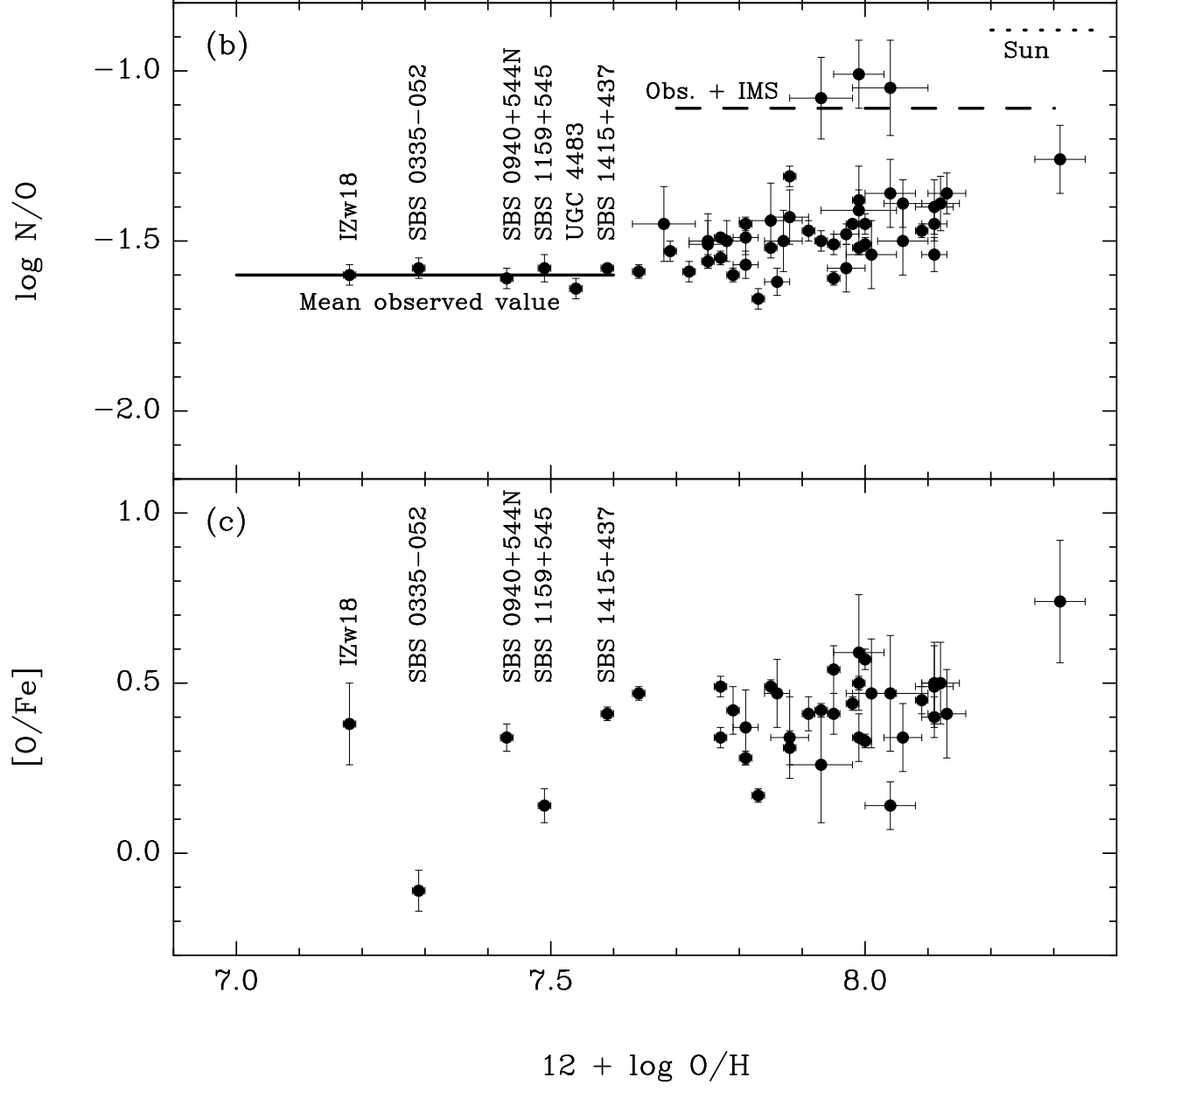
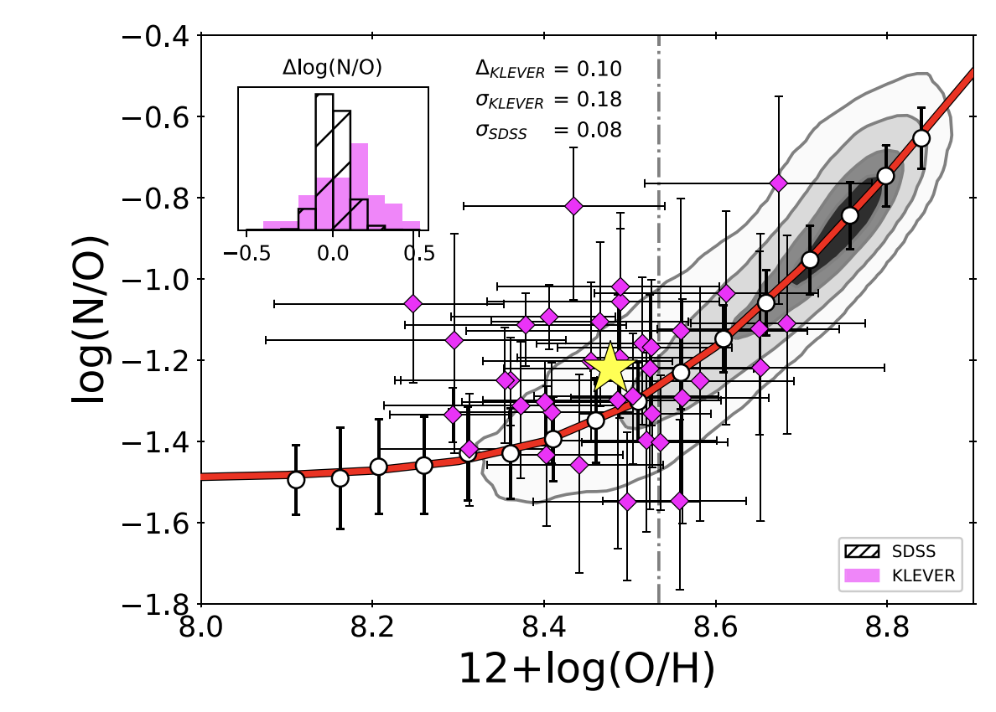
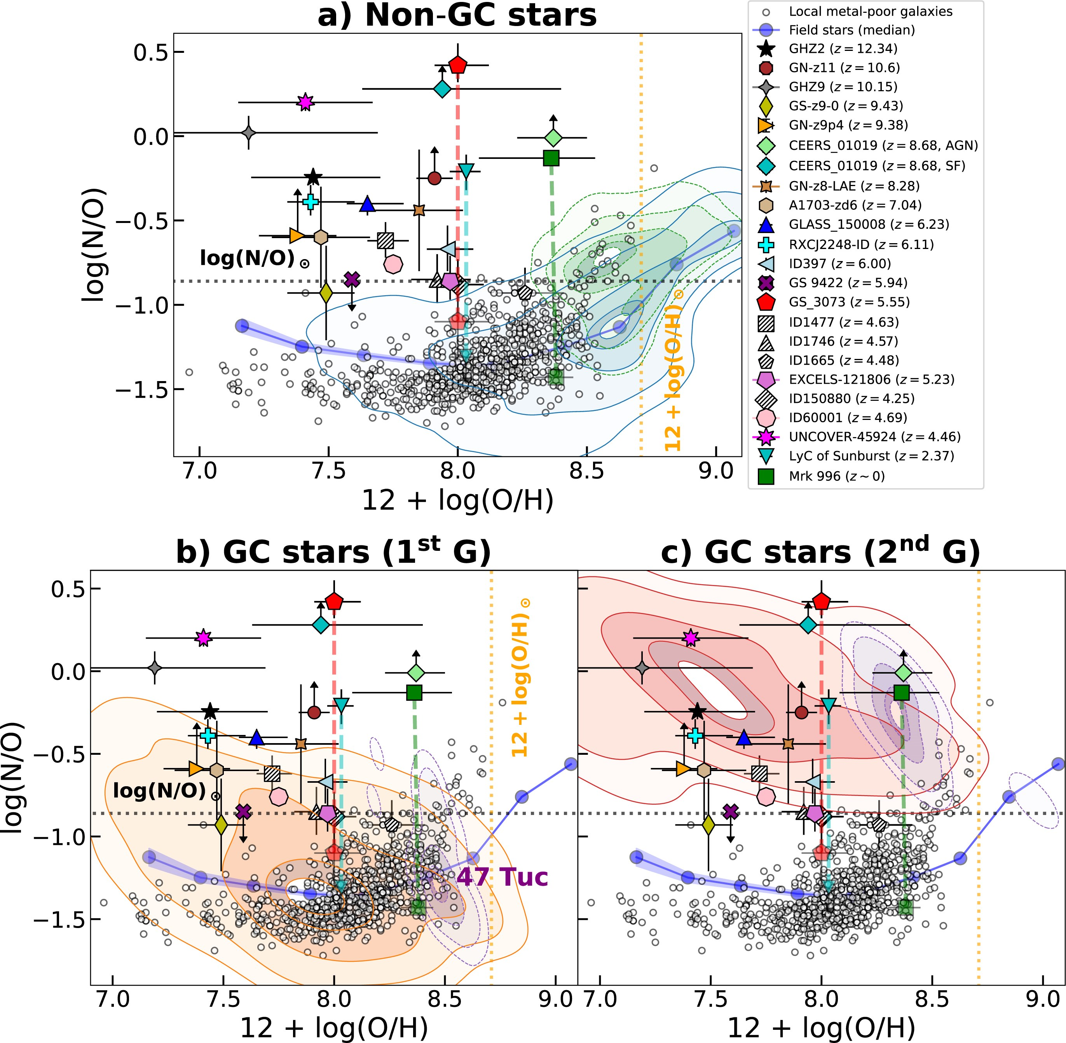




Classic scenario…
plateau:
primary ¹⁴N
¹⁴N: secondary element
$$^{12}C(p,γ) ^{13}N(β^{+},ν) ^{13}C(p,γ) ^{14}N$$
CNO cycle
(H burning)
$$^{16}O(p,γ) ^{17}F(β^{+},ν) ^{17}O(p,α) ^{14}N$$
Izotov&Thuan 1999
(~ metallicity)
initial CNO abundance ($∝$initial metallicity)
…and the JWST revolution
Hayden-Pawson+2022
Theoretical models struggle to reproduce the
Nitrogen-Overabundant Galaxies (NOEGs)
Possible source: primordial stars (PopIII stars)
→ METAL FREE structures (Z = 0)
→ Likely massive, top-heavy Initial Mass Function
Mean observed value
→ Inefficient winds (mass loss $\sim$ 0)
1
Notes:
C’è un intervallo di mass cut con cui l’N/O puà variare in questo intervallo, riproducendo le osservazioni di galassie ad alto redshift

Slide 3
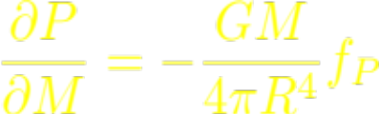

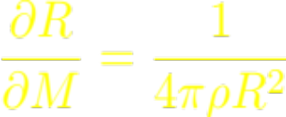
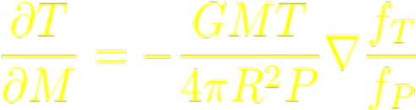
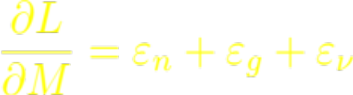
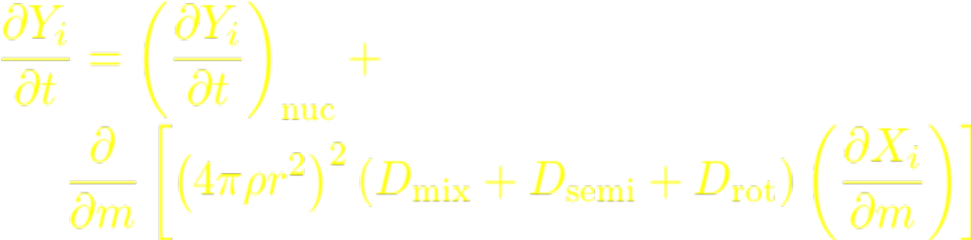

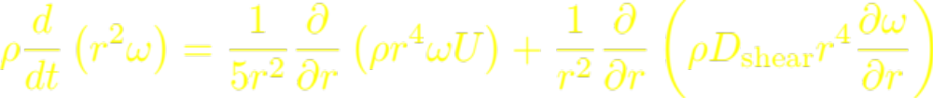
Stellar modelling of PopIII stars
with
FRANE. C (Frascati RAphson Newton Evolutionary Code)
FULL COUPLING of:
Physical Structure
Nuclear Burning
Chemical Mixing (convection, semiconvection, rotation)
INCLUSION OF ROTATION:
Shellular Rotation (Meynet & Maeder 1997)
Transport of Angular Momentum due to shear instabilities and meridional circulation (Advection/Diffusion equation, Meynet & Maeder 2000)
Coupling of Rotation and Mass Loss
EXTENDED NETWORK
→ arbitrary choice: 237 isotopes from n to ⁷⁸Se
+ supernova evolution and explosive nucleosynthesis with
(Hydrodynamic Ppm Explosion with Radiation diffusION)
meridional circulation
shear instabilities
(Chieffi & Limongi 2013, ApJ, 764, 21)
2

Slide 4
Stellar modelling of PopIII stars
with
FRANE. C (Frascati RAphson Newton Evolutionary Code)
FULL COUPLING of:
Physical Structure
Nuclear Burning
Chemical Mixing (convection, semiconvection, rotation)
INCLUSION OF ROTATION:
Shellular Rotation (Meynet & Maeder 1997)
Transport of Angular Momentum due to shear instabilities and meridional circulation (Advection/Diffusion equation, Meynet & Maeder 2000)
Coupling of Rotation and Mass Loss
mass range: 13, 15, 20, 25, 30, 40, 60, 80 and 120 M⊙
velocities: 0, 300 km/s
EXTENDED NETWORK
→ arbitrary choice: 237 isotopes from n to ⁷⁸Se
+ supernova evolution and explosive nucleosynthesis with
(Hydrodynamic Ppm Explosion with Radiation diffusION)
meridional circulation
shear instabilities
(Chieffi & Limongi 2013, ApJ, 764, 21)
2

Slide 5
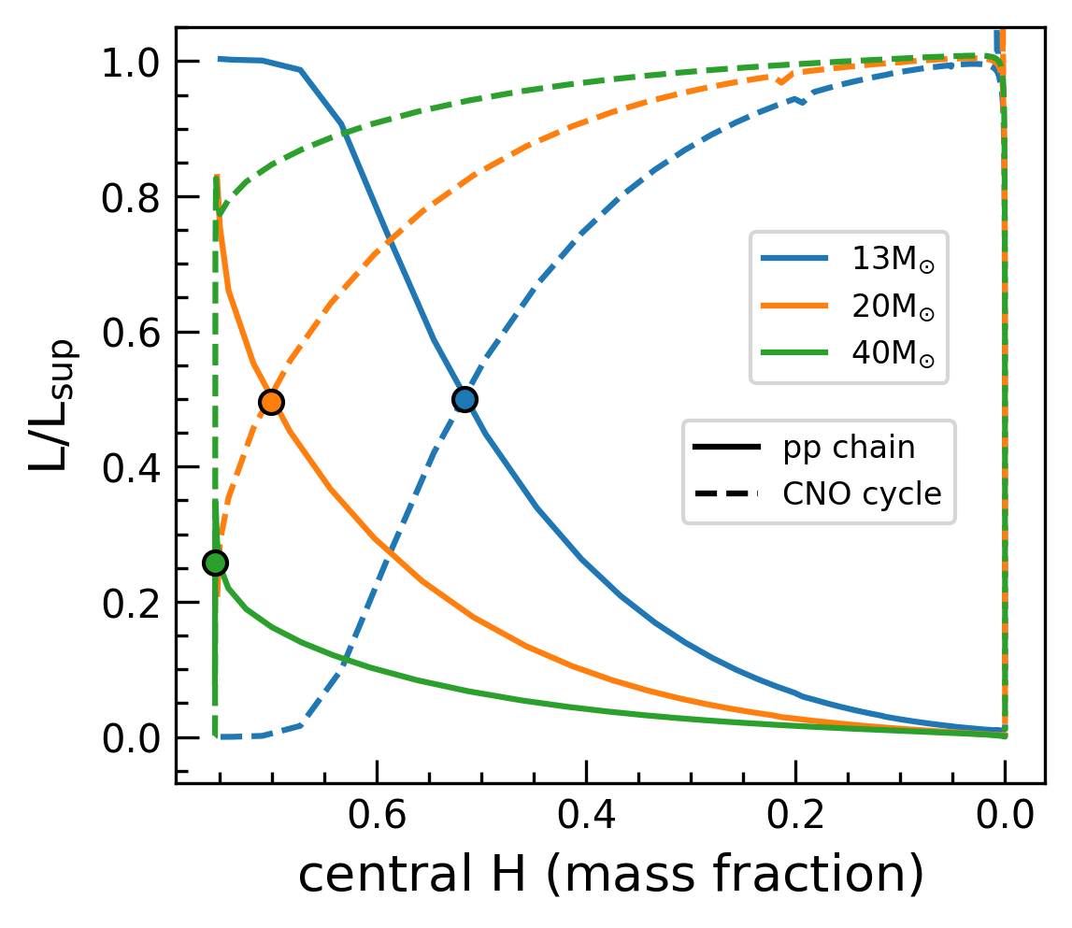
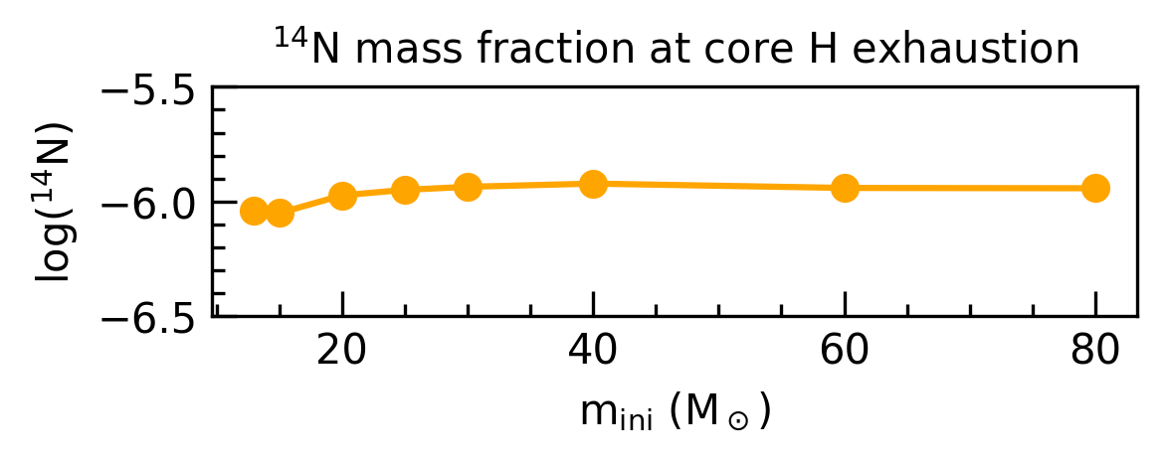


Signature feature of PopIII stars
Lack of metals → no CNO nuclei to trigger CNO cycle
→ stars are forced to start H burning through the
pp-chain
the energy produced by pp-chain is not enough to sustain the star
CONTRACTION
central temperature rise enough to trigger 3$α$ reactions (T $\sim$ 100MK)
C produced by 3$α$ reactions triggers CNO cycle
→ H and He burning are coupled in temperature
Z ≳ 10⁻⁶: normal evolution driven by CNO cycle
3
Notes:
La fase pp è più o meno veloce a seconda della massa iniziale.
Inoltre, come osservato da roberti et al nel 2025, l’n14 prodotto durante l’H burning raggiunge un valore critico indipendentemente dalla massa. Ciò è caratteristico delle stelle con abbondanza iniziale di CNO < 10^-6, che necessitano quindi di una fase in cui l’H è bruciato dalla pp.

Slide 6
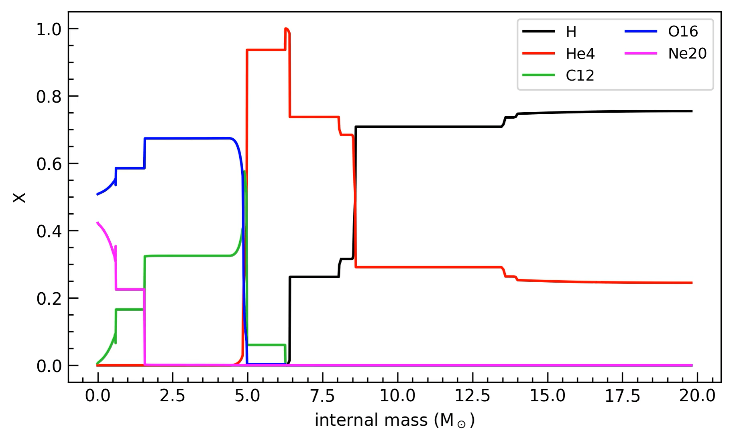
Signature feature of PopIII stars
After core H exhaustion, evolution is driven by the mass of He core, therefore is not dependent anymore on the metallicity
The differences
persist in the envelope!
25M⊙, 0km/s
20, 25, 30, 40M⊙:
H-He shell merging
(Roberti+24)
This merging has important consequences on the nucleosynthesis
nucleosynthesis of ¹⁴N
4
Notes:
Such a merging is not unusual in zero metallicity stars because the entropy barrier at the interface between the He core and the H rich envelope is considerably lower than in higher metallicity stars; this is mainly due to the fact that H and He burning operate at almost the same temperatur.

Slide 7
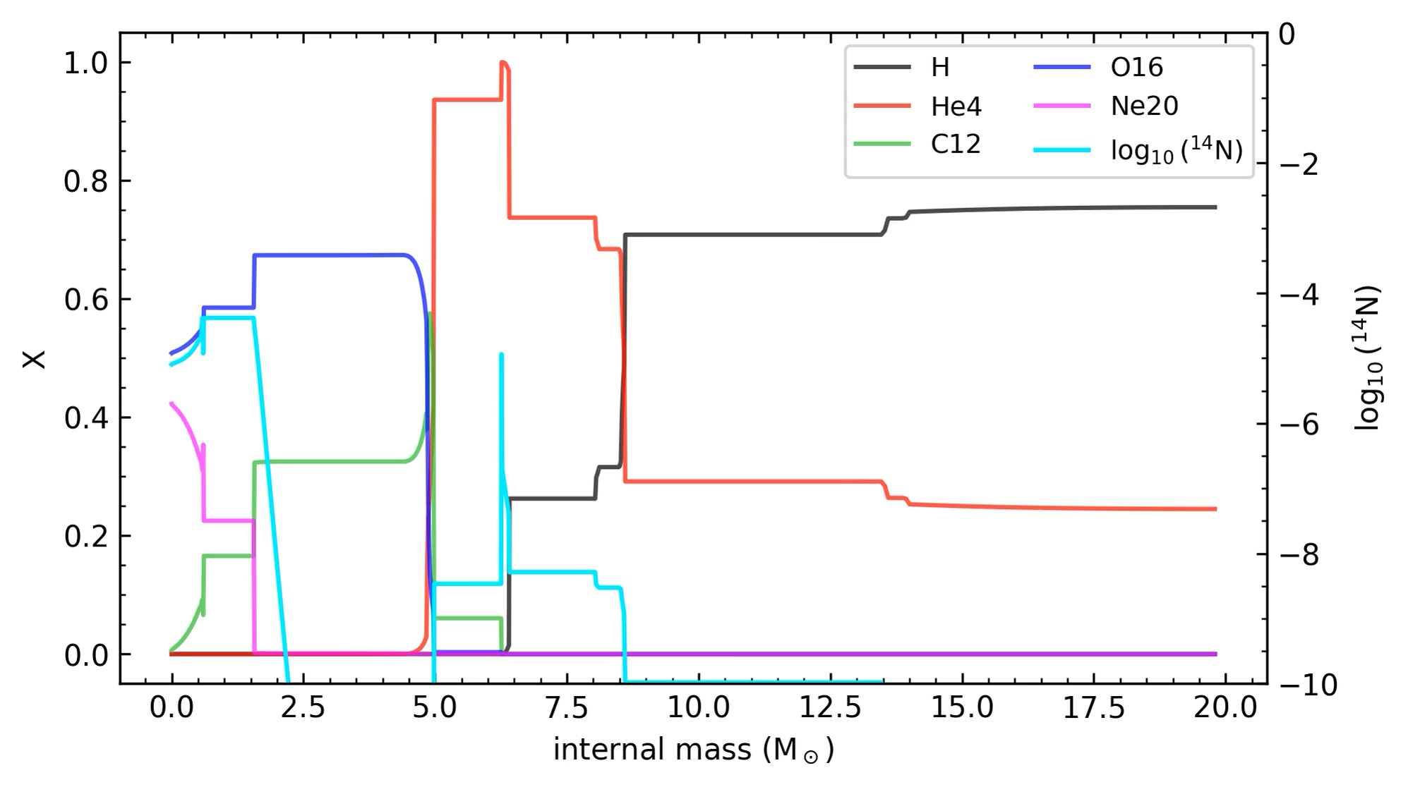
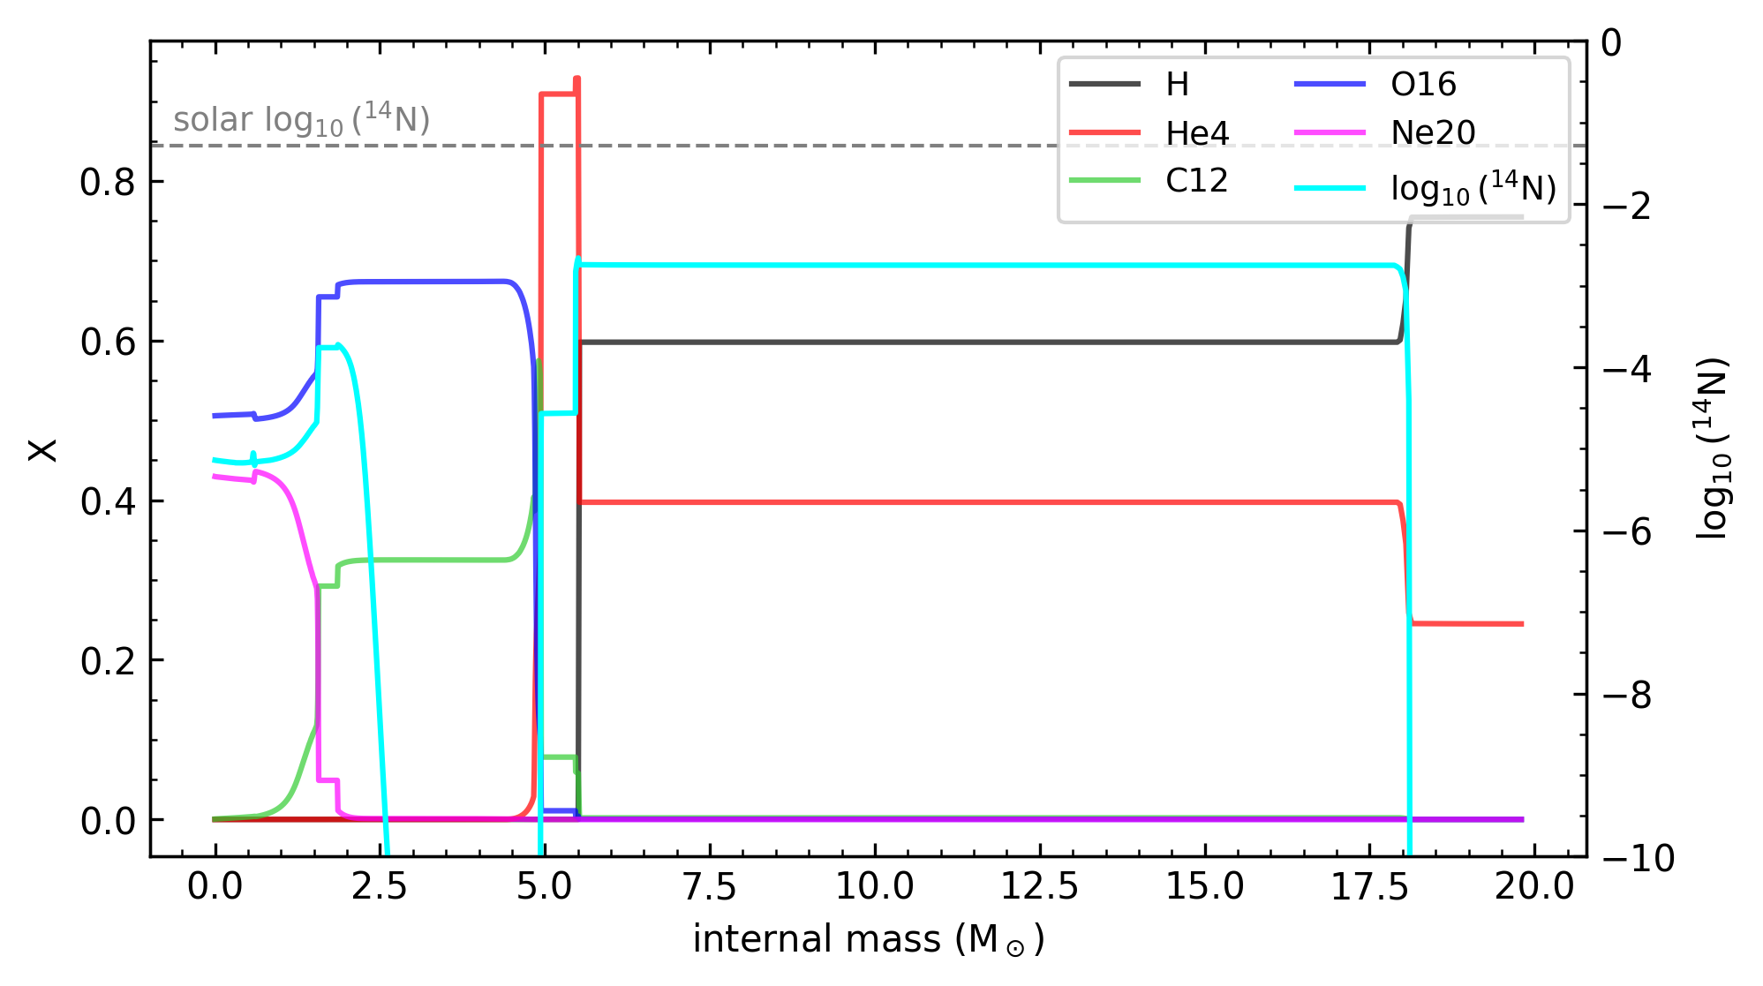
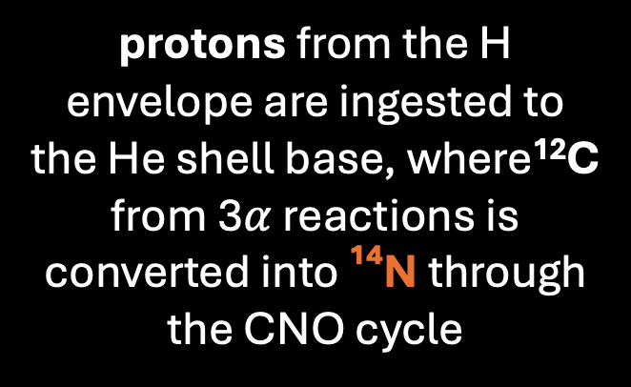

H-He shell merging
:
nucleosynthesis of ¹⁴N
protons from the H envelope are ingested to the He shell base, where¹²C from 3$α$ reactions is converted into ¹⁴N through the CNO cycle
25M⊙, 0km /s
$$^{12}C(p,γ) ^{13}N(β^{+},ν) ^{13}C(p,γ) ^{14}N$$
primary ¹⁴N
5
Notes:
C’è un intervallo di mass cut con cui l’N/O puà variare in questo intervallo, riproducendo le osservazioni di galassie ad alto redshift

Slide 8
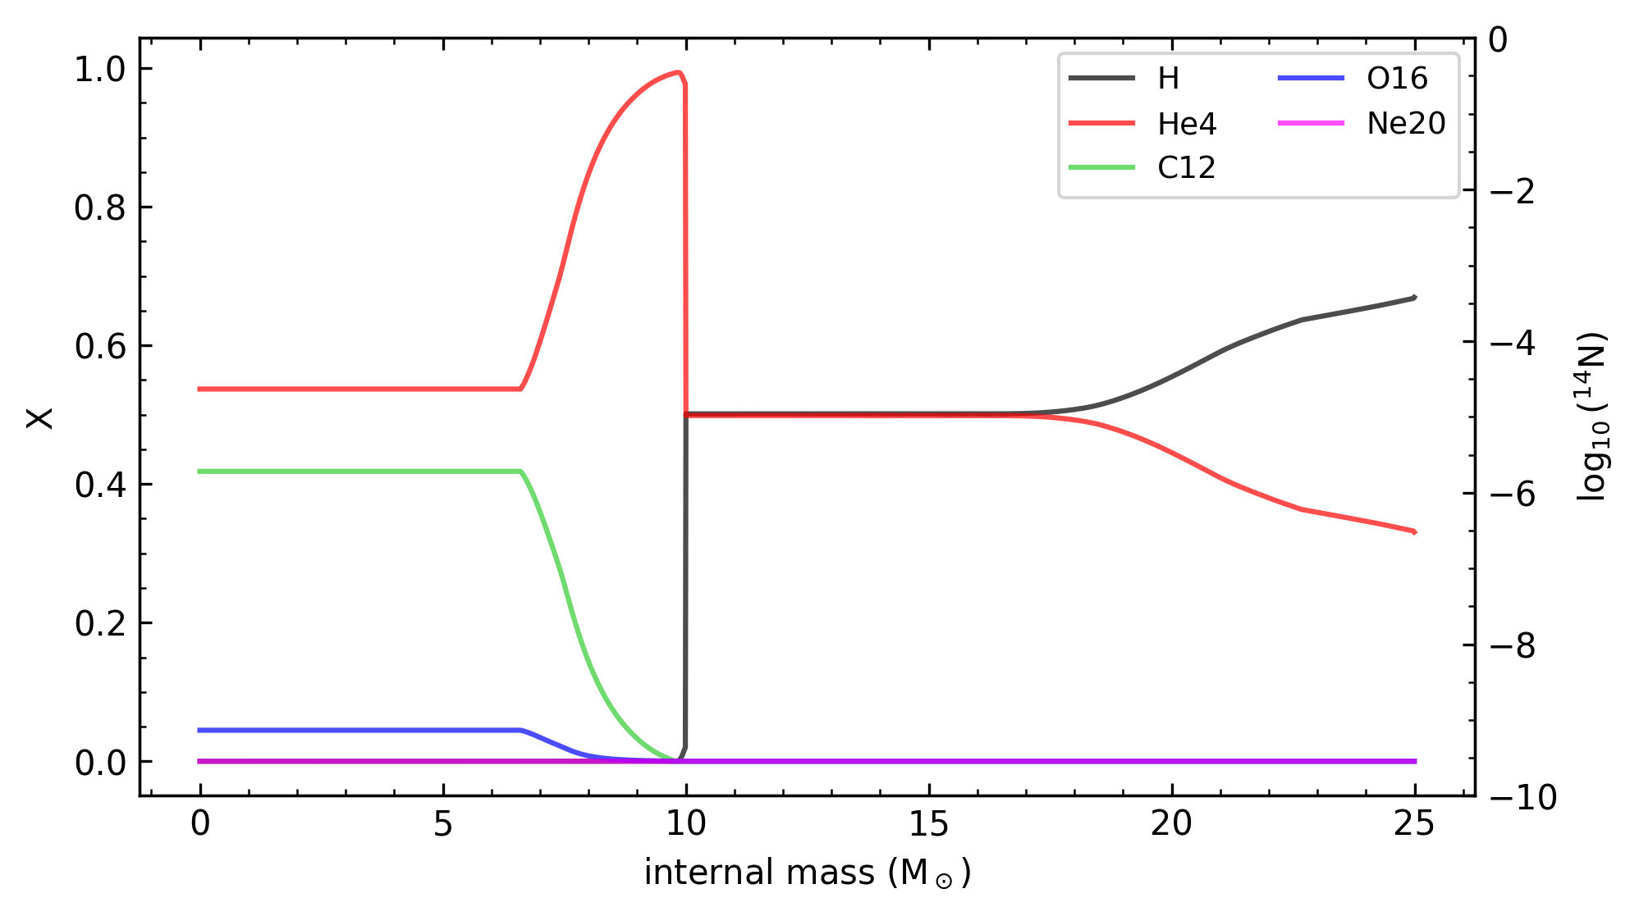
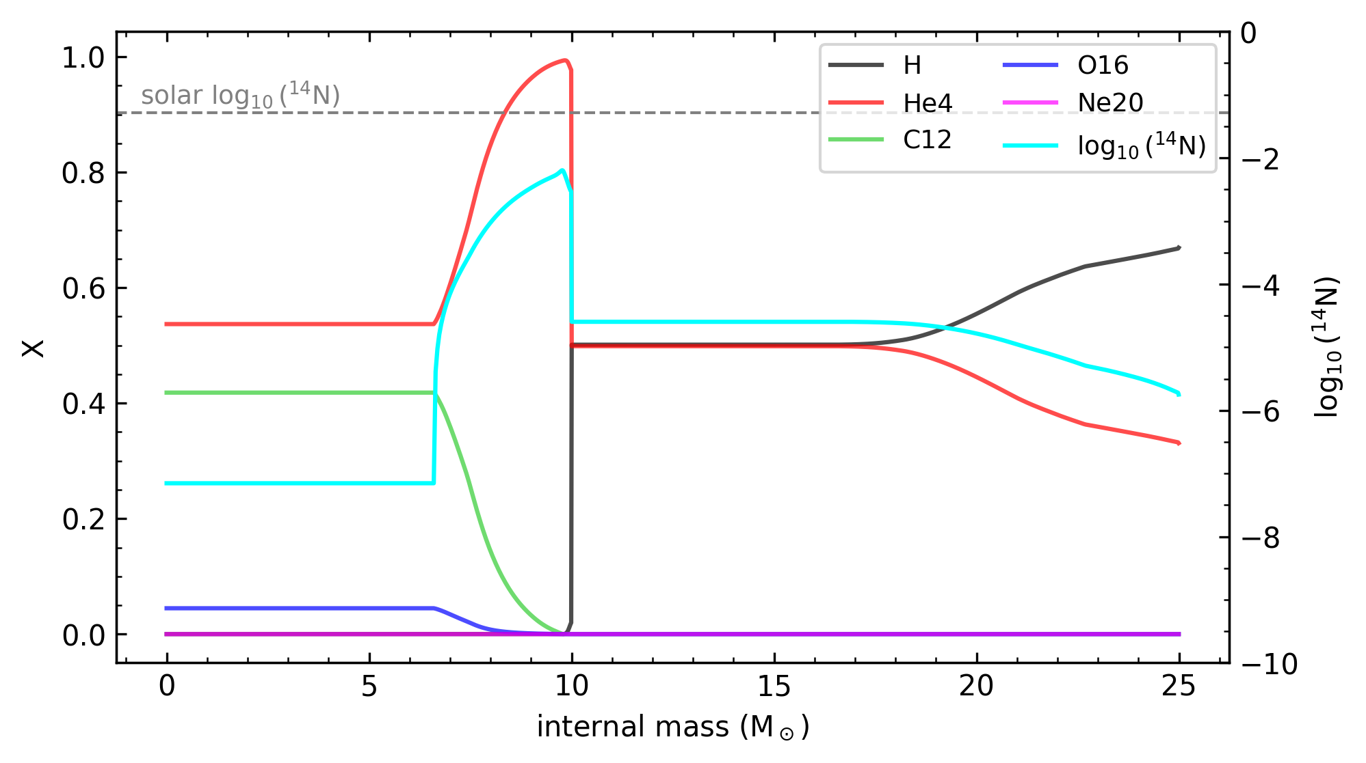

Effect of rotation
transport of angular momentum and mixing of the chemical composition in radiative zones
Rotation makes the star oblated: meridional circulation
Differential rotation: shear instabilities between layers
Rotation induced mixing disfavour
H-He shell merging
25M⊙, 300km/s
but allows ¹⁴N production at the base of the H shell
$$^{12}C(p,γ) ^{13}N(β^{+},ν) ^{13}C(p,γ) ^{14}N$$
primary ¹⁴N
6
Notes:
12C and16O produced during core He burning into the H burning layer, creating via the CNO cycle a 14N pocket, which is brought up to the external layers of the stars
L 14N poi è portato verso gli strati esterni sempre dal mixing rotazionale

Slide 9
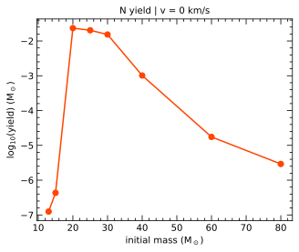
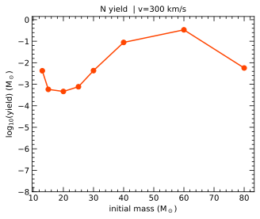
The yields (→ ejected masses!)
H-He shell merging
Rotation driven
mixing
Falla+2026 in prep.
Can these yields actually explain what we observe in high-redshift galaxies?
7
Notes:
Non rot : fenomeno dinamico (convezione); la 40anche un po’ lo ha ma tardi e non ha troppo tempo né di produrre né di omogenizzare la chimica
Rot: fenomeno secolare (diffusione)

Slide 10
Extragalactic context
Both non rotating and rotating models lead to log(N/O) compatible with the abundances observed in high redshift galaxies!
8
Notes:
Ccombinando gli yields di N con quelli di O possiamo effettivamente predirre teoricamente l’N/O.
C’è un intervallo di mass cut con cui l’N/O puà variare in questo intervallo, riproducendo le osservazioni di galassie ad alto redshift

Slide 11
Conclusions
Primary nitrogen can be produced in zero-metallicity massive stars;
Rotation strongly enhance the N production;
Our N yields reach nitrogen abundances consistent with the values observed in high-redshift galaxies;
Nitrogen-Overabundant Galaxies (NOEGs) chemical abundances could be the result of an early enrichment dominated by the first stars
Ongoing work!
9

