Slide 1


Horia Hulubei National Institute for R&D in Physics and Nuclear Engineering (Bucharest, Romania)
Finite-Temperature Equations of State for Core-Collapse Supernovae and Binary Neutron Star Mergers
A. R. Raduta, M. V. Beznogov,
Nuclear Physics in Astrophysics XII,
10th September, 2026

Slide 2
Finite-Temperature Equations of State for CCSNe and BNS Mergers
Introduction. What neutron stars are.
Main part
Conclusions
Effective masses & Finite-T effects
Bayesian setup
Properties of NS matter at $T=0$
Properties of NS matter at 𝑇=0
Properties of Finite-T matter

Slide 3
Introduction 03 (20)
What is a neutron star (NS)?
It is a stellar remnant, a final stage of evolution of ordinary stars of certain mass range.
M < 8 M_{ʘ}
White dwarf
White dwarf
R_{WD} ~ R_{E}
M_{WD} = 0.1 – 1.4 M_{ʘ}
ρ_{c,WD} = 10⁵ – 10⁹ g/cm³
g_{WD} ~ 10⁸ cm/c²
Neutron star
Ordinary
star
M > 8 M_{ʘ}
M < 30 M_{ʘ}
Neutron star
R_{NS} ≈ 12 km
M_{NS} ≈ 1.4 M_{ʘ}
ρ_{c,NS} ~ 10¹⁵ g/cm³
g_{NS} ~ 10¹⁴ cm/c²
Black hole
M > 30 M_{ʘ}

Slide 4
Introduction
04 (20)
Why neutron stars?
Because neutron stars are “superstars” (the Pines “theorem” by David Pines, 1990)
“Proof”. Neutron stars are:
Superdense objects
Superfast rotators
Superfluid and superconducting inside at high temperature
Superaccelerators of high energy particles
Sources of superstrong magnetic fields
Superprecise timers
Enormous variety of observational manifestations, etc.

Slide 5
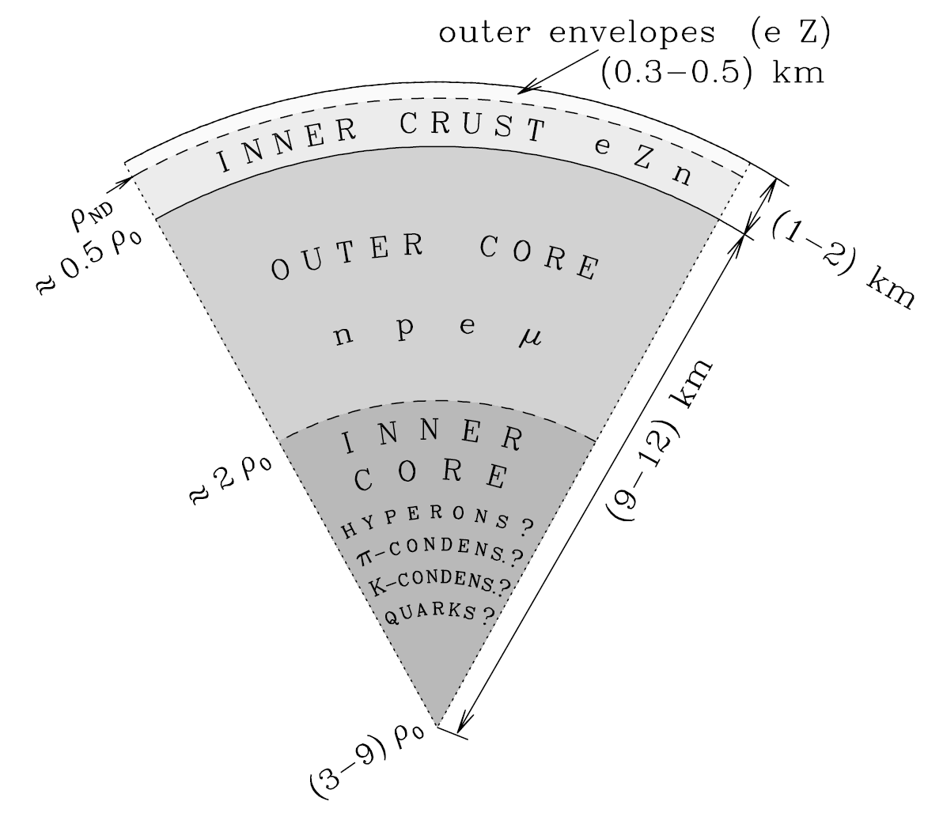
Introduction
05 (20)

Slide 6
Introduction
06 (20)
Rotational frequency:
The fastest known millisecond pulsar rotates at a frequency of 716 Hz (PSR J1748-2446ad).
Just for fun: with this rotational frequency of the wheels (17 inch) a motorcycle will make almost 1 km/s. And typical washing machine can make no more than 27 Hz (≈ 1600 rpm).
Magnetic fields:
Magnetic fields in magnetars can reach ~ 10¹⁶ G.
For comparison: the strongest impulse magnetic field ever obtained in the laboratory is ~ 2.8∙10⁷ G (obtained in magnetic explosion generator).

Slide 7
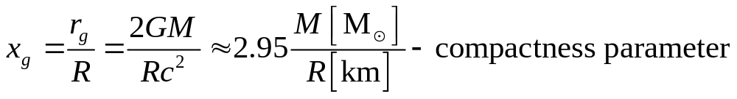
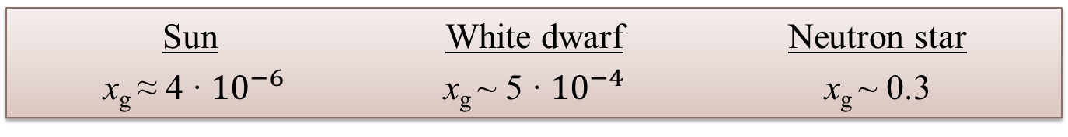
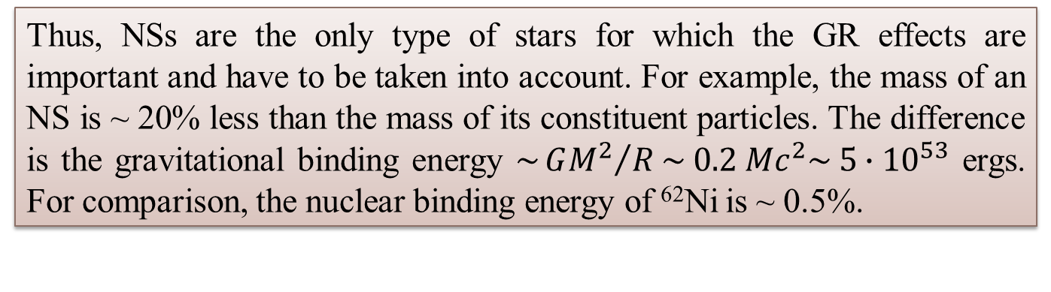
Introduction
07 (20)
Neutron stars are (general) relativistic (GR) objects.
The extent of GR effects on a star can be described in terms of the compactness parameter:
Sun
x_{g} ≈ 4 ∙ ${10}^{−6}$
White dwarf
x_{g} ~ 5 ∙ ${10}^{−4}$
Neutron star
x_{g} ~ 0.3
Thus, NSs are the only type of stars for which the GR effects are important and have to be taken into account. For example, the mass of an NS is ~ 20% less than the mass of its constituent particles. The difference is the gravitational binding energy $\sim {GM^{2}}/R\sim 0.2 Mc^{2}\sim 5∙{10}^{53}$ ergs. For comparison, the nuclear binding energy of ⁶²Ni is ~ 0.5%.

Slide 8
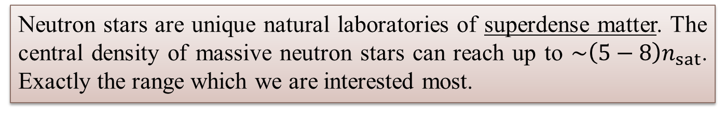
Introduction
08 (20)
Thus, neutron stars are interesting to study as they are.
But there is another important reason.
Neutron stars are unique natural laboratories of superdense matter. The central density of massive neutron stars can reach up to $\sim \left(5−8\right)n_{sat}$. Exactly the range which we are interested most.
The equation of state (EOS) is one of the most sought-after properties of dense matter that scientists are trying to determine by studying neutron stars.
For ordinary NSs, zero-temperature EOSs are sufficient. However, with advances in multi-messenger astronomy, there is a growing demand for finite-temperature EOSs.

Slide 9
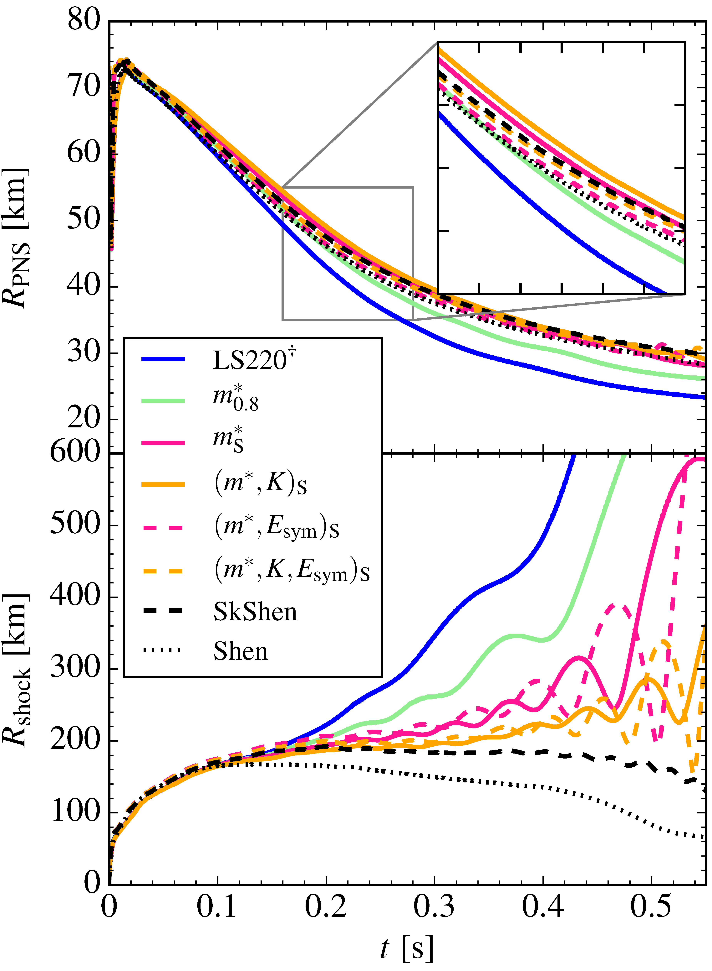
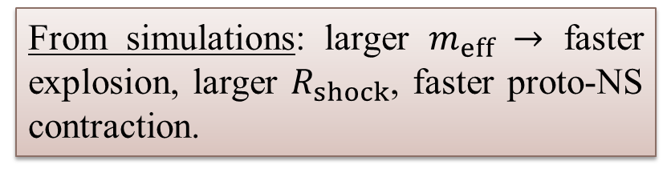
Main 09 (20)
It is well-known (e.g., [1, 2]) that cataclysmic astrophysical phenomena, such as core-collapse supernovae (CCSNe) and binary neutron star (BNS) mergers, strongly depend on the equation of state (EOS) of dense matter and, in particular, on the effective masses.
From simulations: larger $m_{eff} →$ faster explosion, larger $R_{shock}$, faster proto-NS contraction.
[1,Fig] Yasin et al., PRL 124, 092701 (2020);
[2] Schneider et al., PRC 100, 055802 (2019).

Slide 10
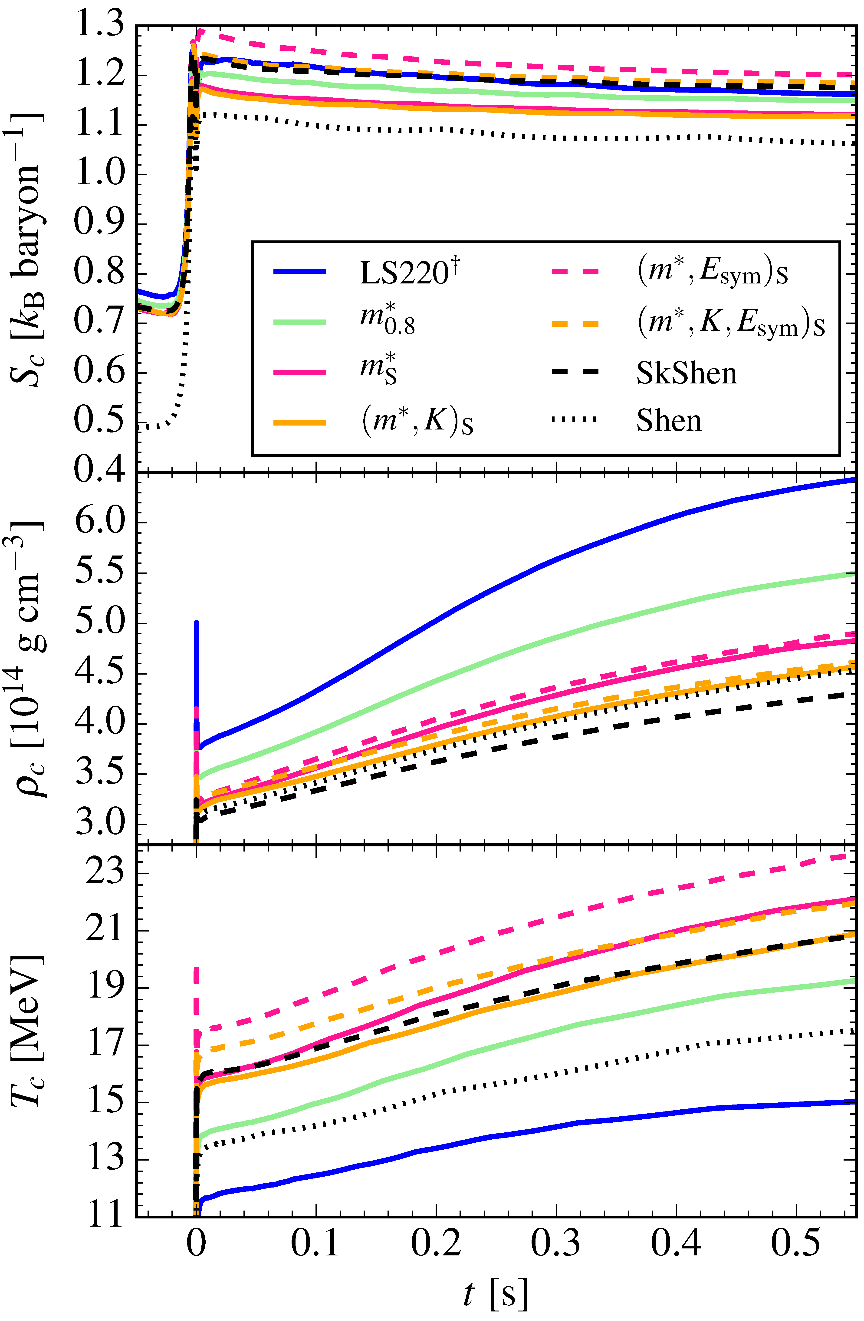
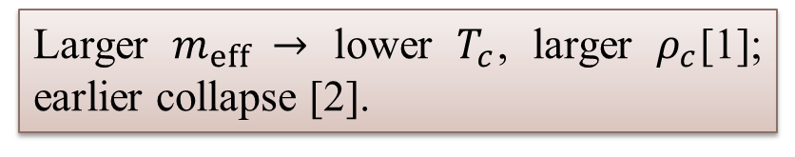
Effective mass & finite-T effects 10 (20)
Larger $m_{eff} →$ lower $T_{c}$, larger $ρ_{c}$[1]; earlier collapse [2].
[1, right] Yasin et al., PRL 124, 092701 (2020);
[2, top] Schneider et al., ApJ 894, 4 (2020);

Slide 11
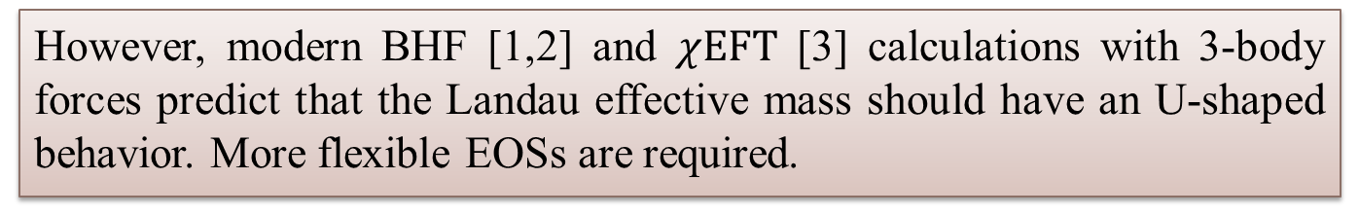
Effective mass & finite-T effects 11 (20)
The numerical simulations in the literature employ Skyrme EOSs that have a very simple monotonic dependence of the effective mass on density (or non at all).
However, modern BHF [1,2] and $χEFT$ [3] calculations with 3-body forces predict that the Landau effective mass should have an U-shaped behavior. More flexible EOSs are required.
Consequently, we performed a massive Bayesian investigation of EOSs built upon Brussels-Skyrme interactions, investigated finite-temperature properties of such EOSs, computed and uploaded on CompOSE general purpose EOSs suitable for simulations.
[1] Baldo et al., PRC 89, 048801 (2014); [2] Shang et al., PRC 101, 065801 (2020);
[3] Somasundaram et al., PRC 103, 045803 (2021).

Slide 12
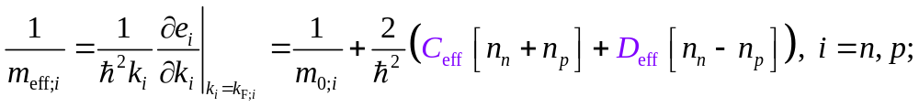
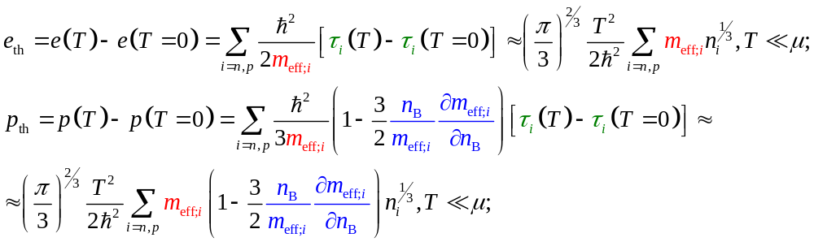
Effective mass & finite-T effects 12 (20)
Analytic expressions & low temperature approximation
Constantinou et al., PRC 89, 065802 (2014); PRC 92, 025801 (2015)

Slide 13
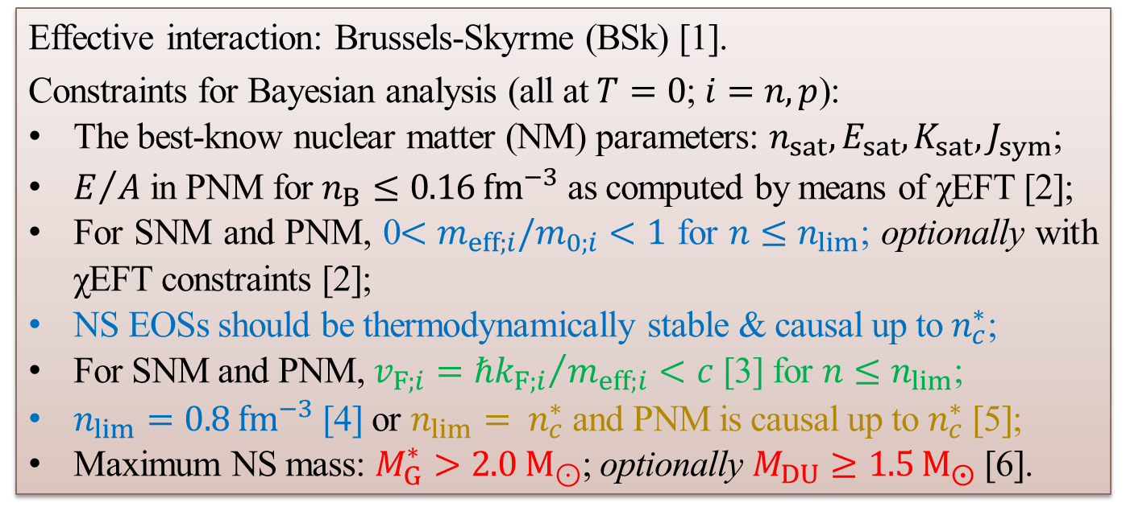
Bayesian setup
13 (20)
Bayesian setup
Effective interaction: Brussels-Skyrme (BSk) [1].
Constraints for Bayesian analysis (all at $T=0$; $i=n,p$):
The best-know nuclear matter (NM) parameters: $n_{sat}, E_{sat}, K_{sat},J_{sym}$;
$E/A$ in PNM for $n_{B}≤0.16 {fm}^{−3}$ as computed by means of χEFT [2];
For SNM and PNM, 0${<m}_{eff;i}/m_{0;i}<1$ for $n≤n_{lim}$; optionally with χEFT constraints [2];
NS EOSs should be thermodynamically stable & causal up to $n_{c}^{∗}$;
For SNM and PNM, $v_{F;i}={ℏk_{F;i}}/{m_{eff;i}}<c$ [3] for $n≤n_{lim}$;
$n_{lim}=0.8 {fm}^{−3}$ [4] or $n_{lim}= n_{c}^{∗}$ and PNM is causal up to $n_{c}^{∗}$ [5];
Maximum NS mass: $M_{G}^{∗}>2.0 M_{⊙}$; optionally $M_{DU}≥1.5 M_{⨀}$ [6].
[1] Chamel et al., PRC 80, 065804 (2009); [2] Somasundaram et al., PRC 103, 045803 (2021); [3] Duan & Urban, PRC 108, 025813 (2023); [4] MB & AR, PRC 110, 035805 (2024); [5] AR & MB, A&A 705, A151 (2026); [6] MB & AR, ArXiv: 2607.09369

Slide 14
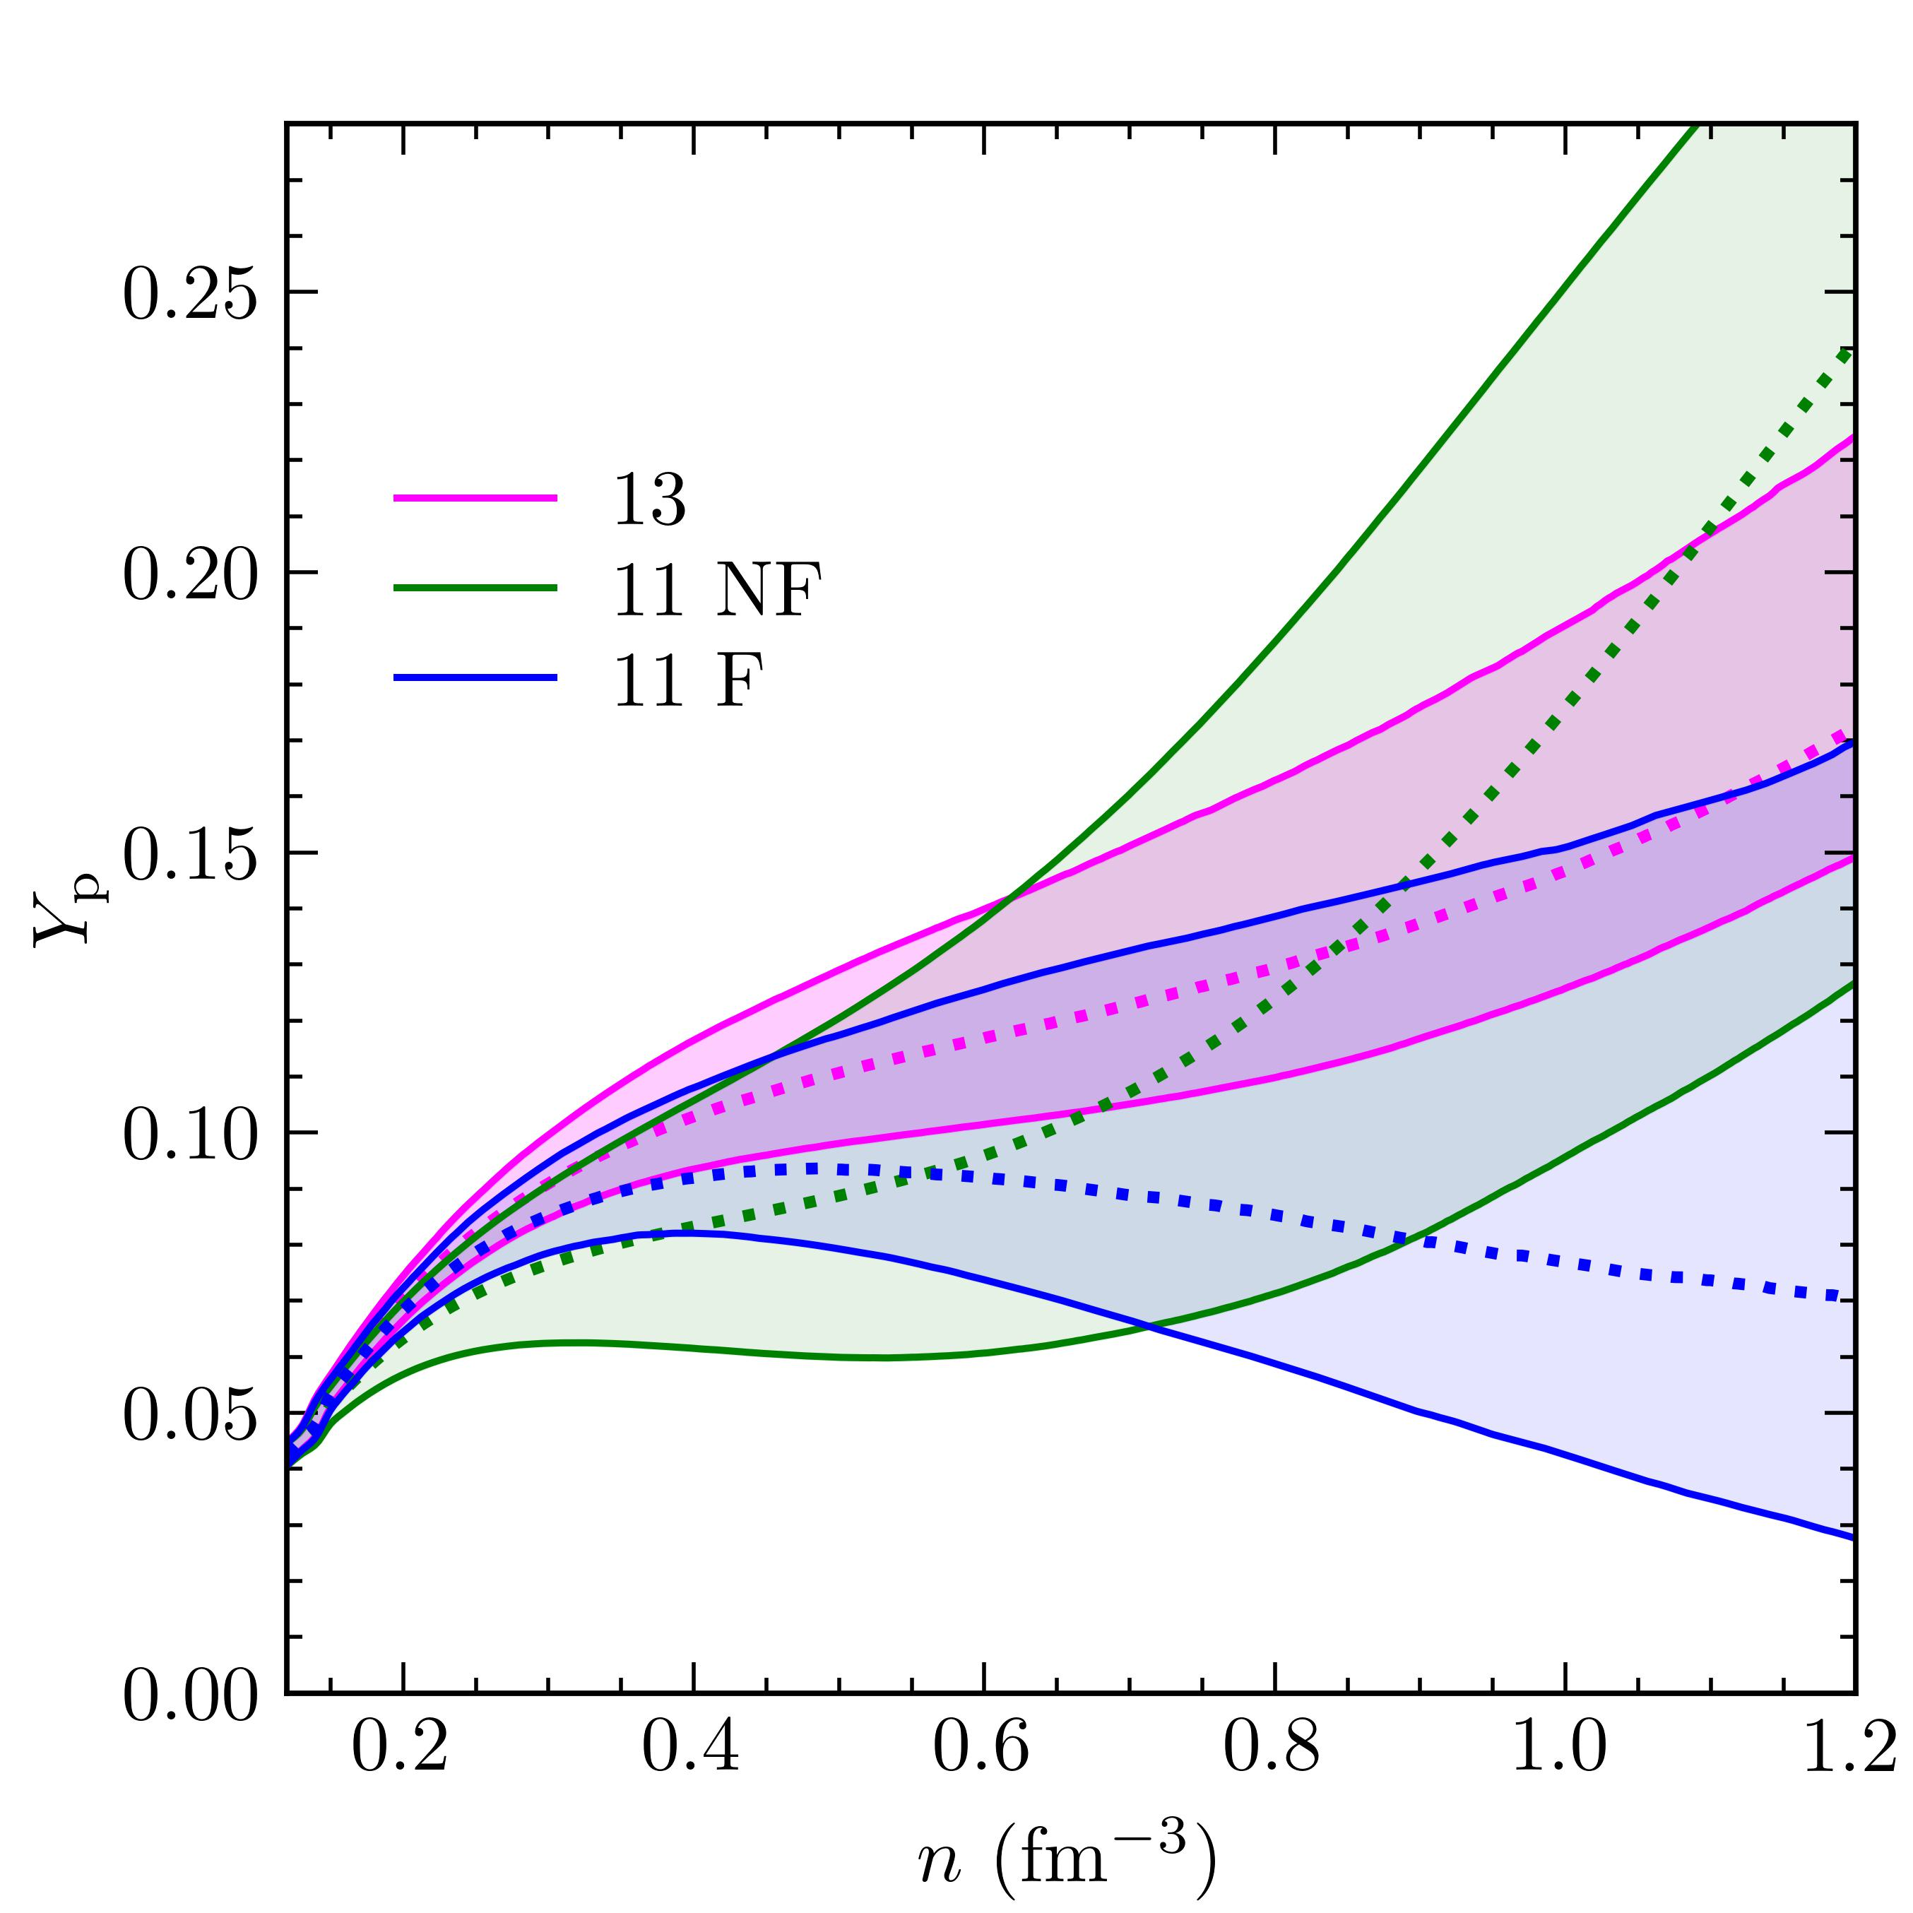
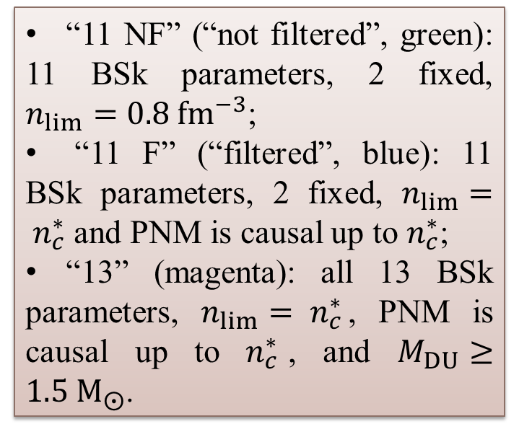
T = 0
14 (20)
Beta-equilibrium proton fraction at $T=0$ & direct Urca constraint
“11 NF” (“not filtered”, green): 11 BSk parameters, 2 fixed, $n_{lim}=0.8 {fm}^{−3}$;
“11 F” (“filtered”, blue): 11 BSk parameters, 2 fixed, $n_{lim}= n_{c}^{∗}$ and PNM is causal up to $n_{c}^{∗}$;
“13” (magenta): all 13 BSk parameters, $n_{lim}= n_{c}^{∗}$, PNM is causal up to $n_{c}^{∗}$, and $M_{DU}≥1.5 M_{⨀}$.
[Fig] MB & AR, ArXiv: 2607.09369

Slide 15
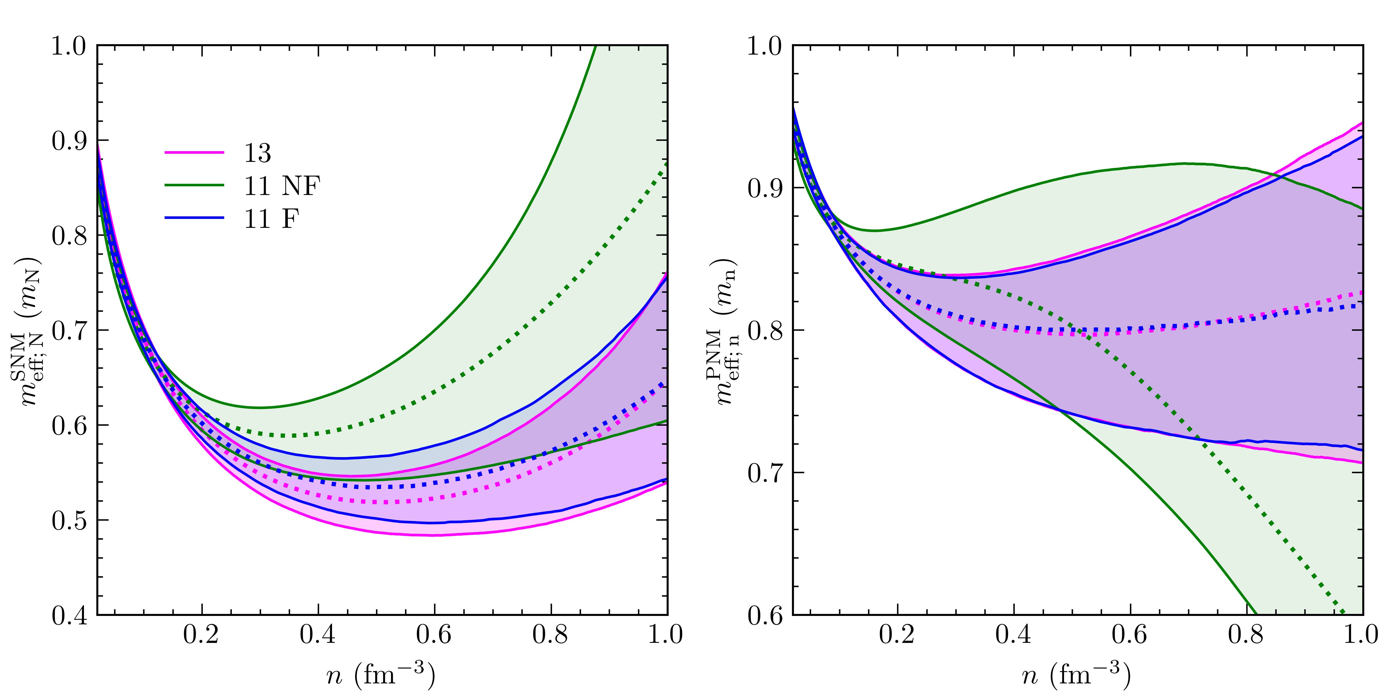
T = 0
15 (20)
Effective masses
[Fig] MB & AR, ArXiv: 2607.09369

Slide 16
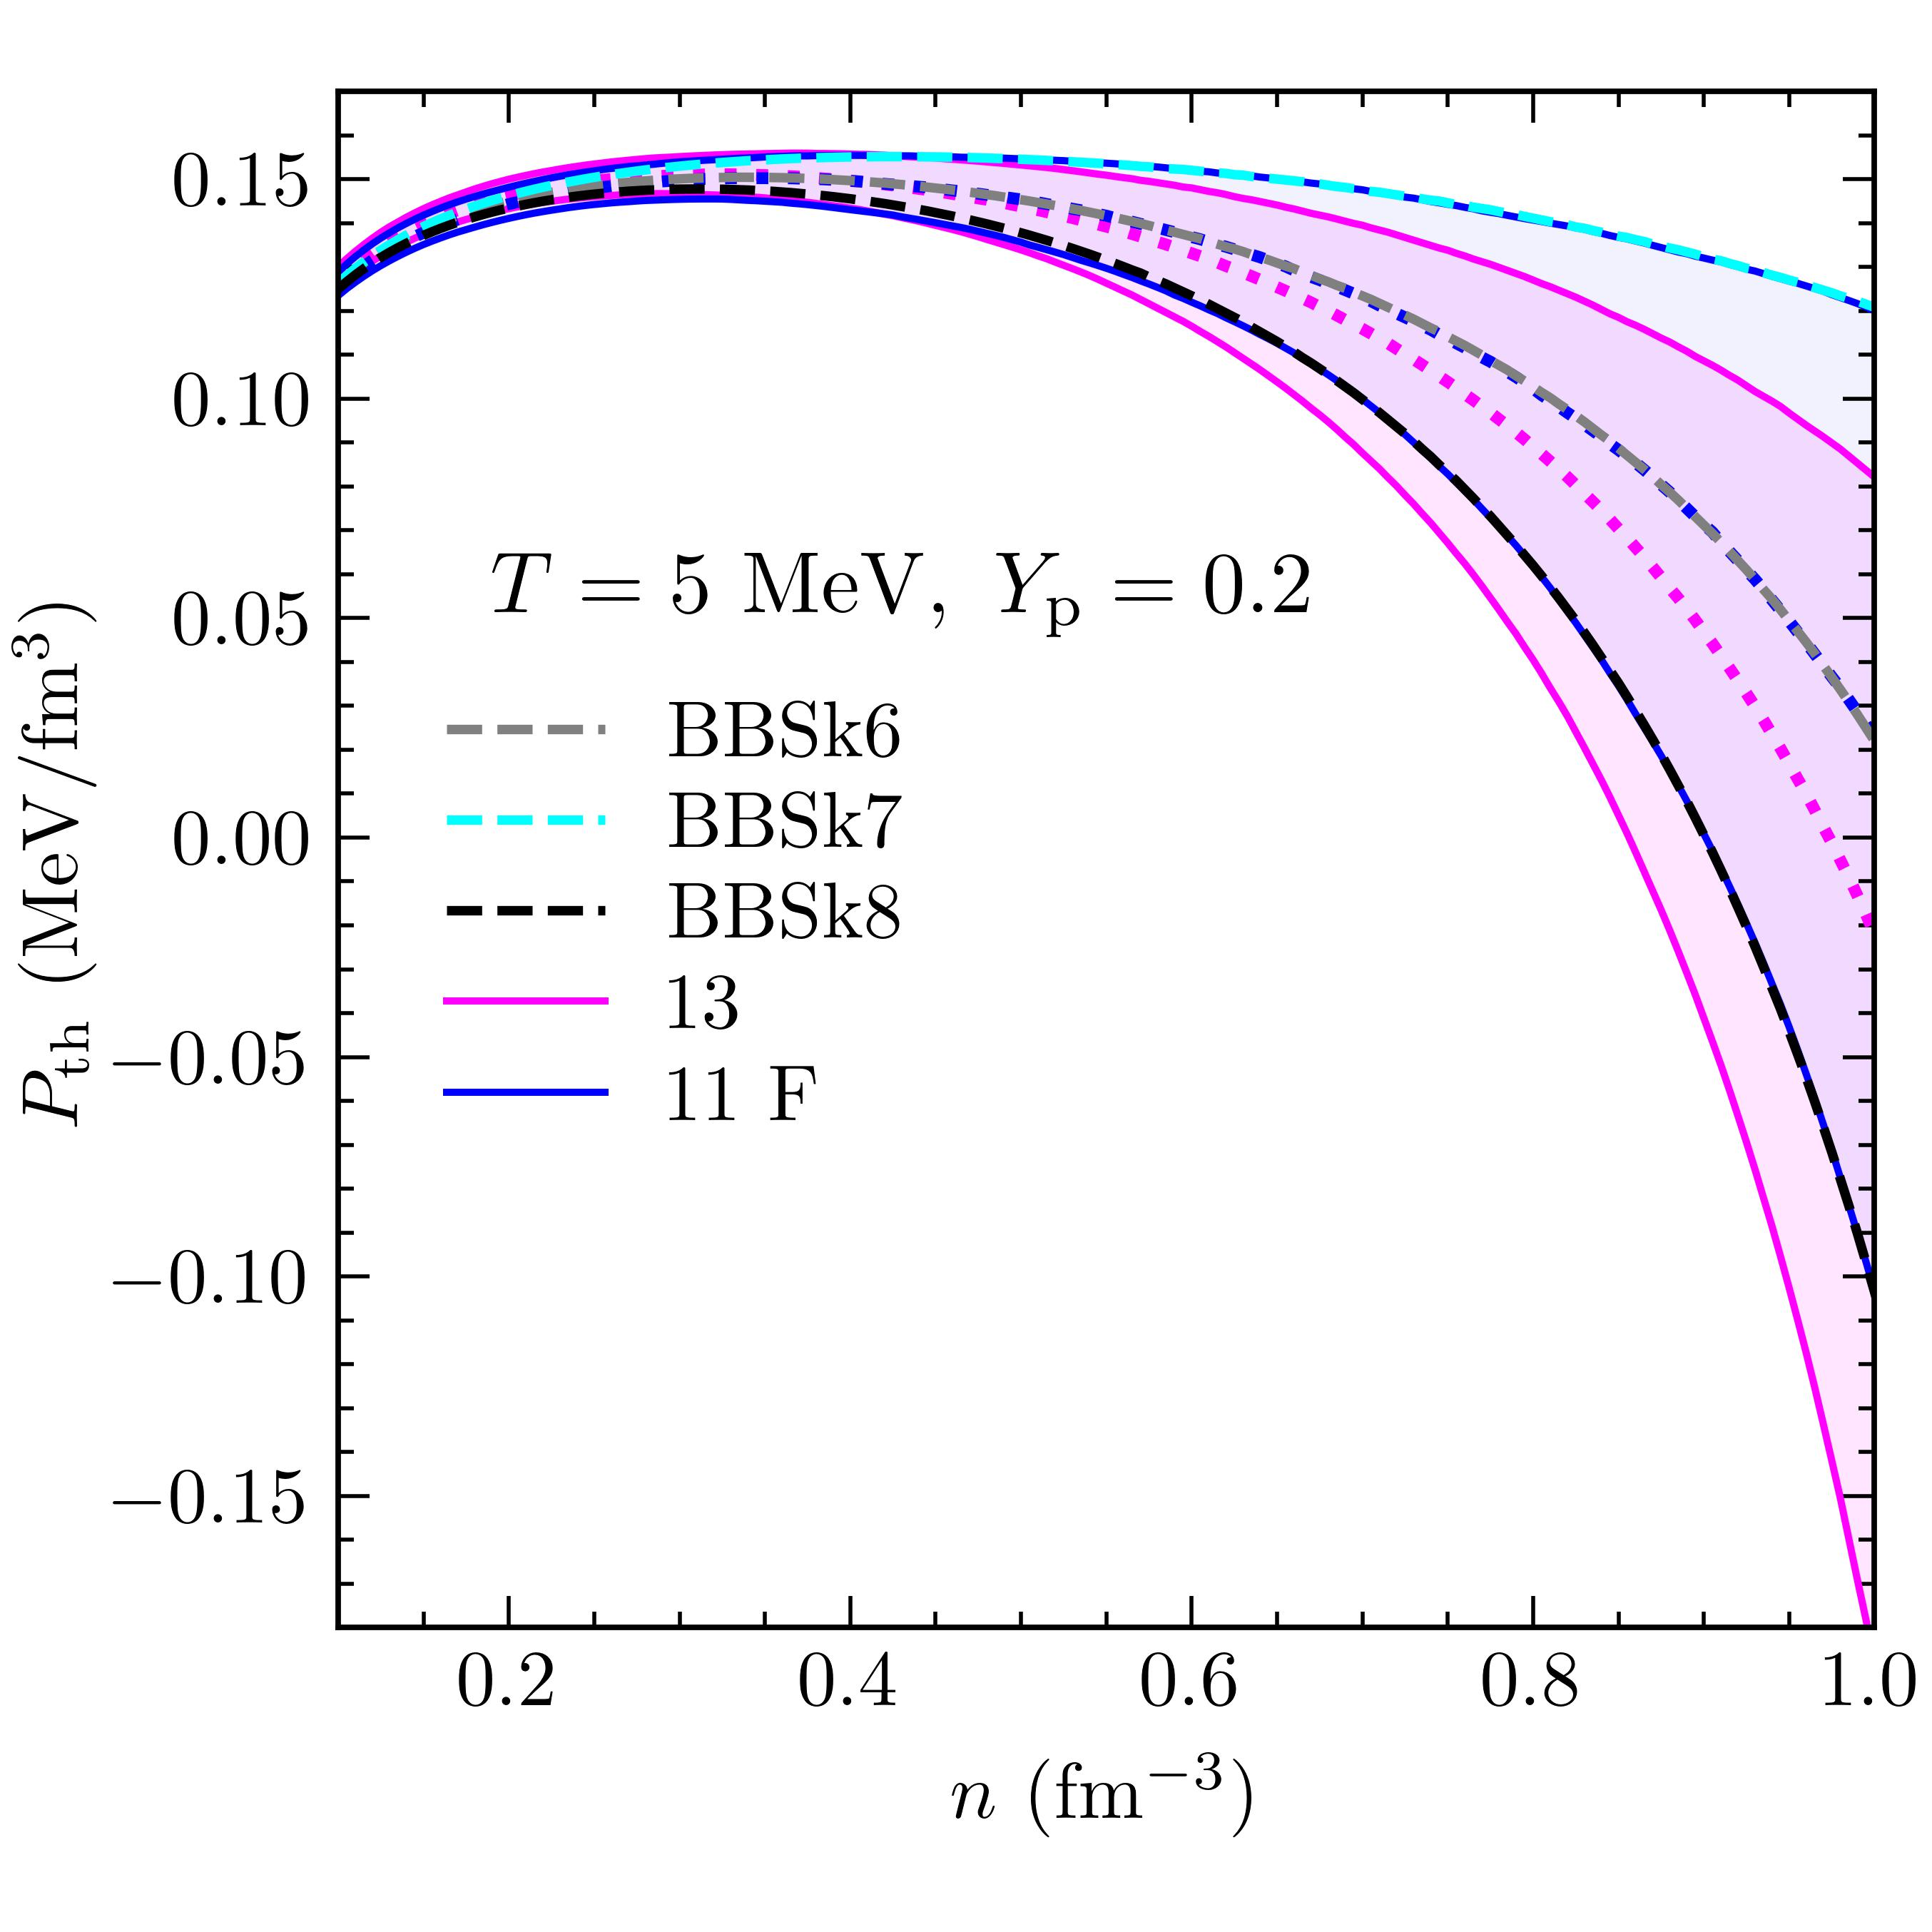
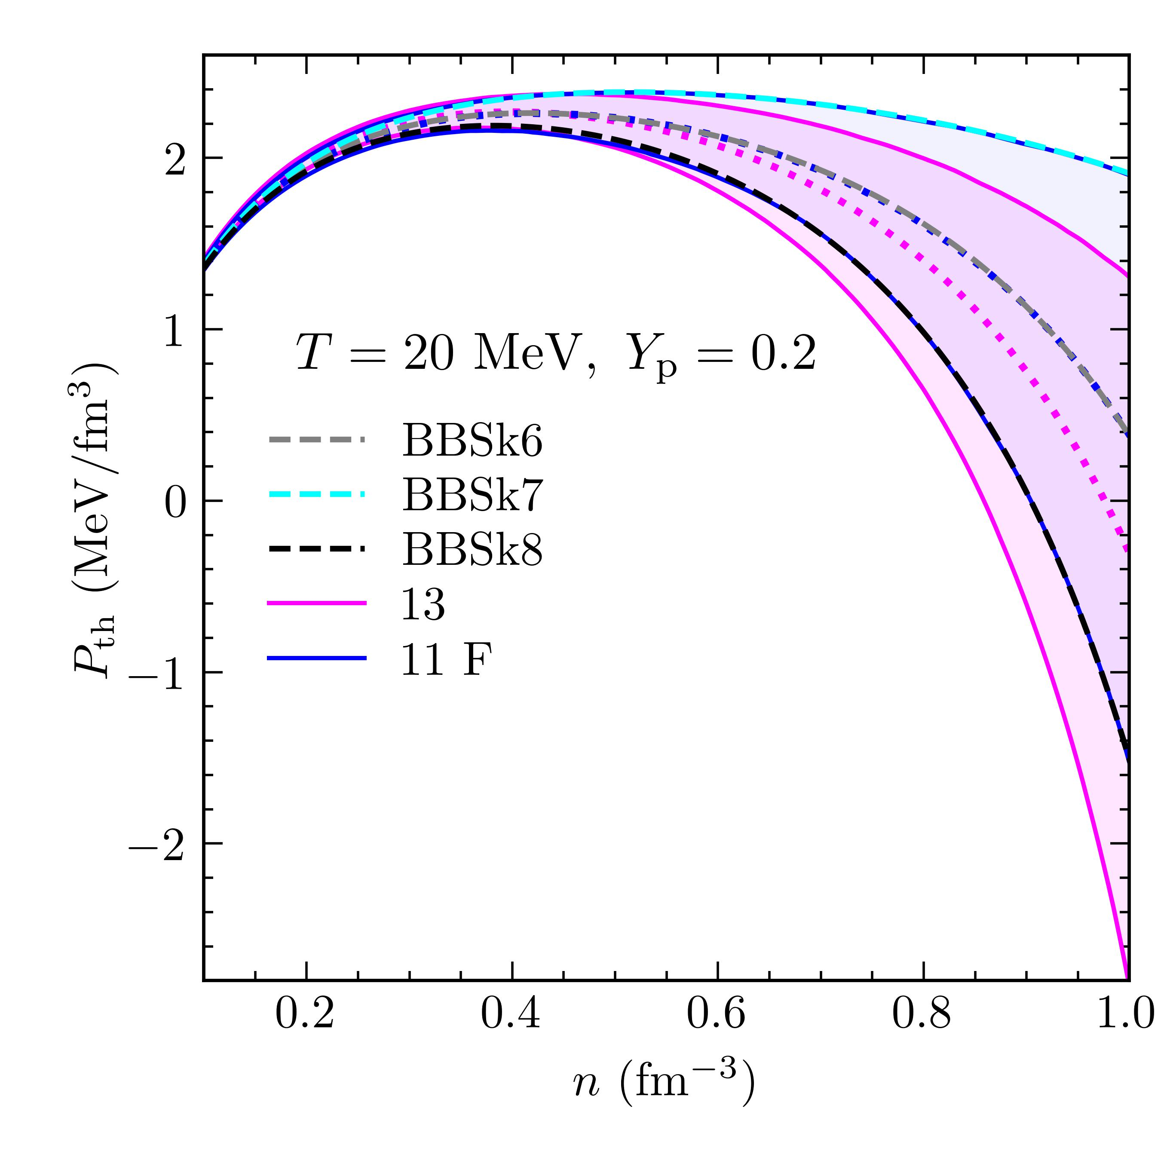
Finite-T
16 (20)
Thermal pressure

Slide 17
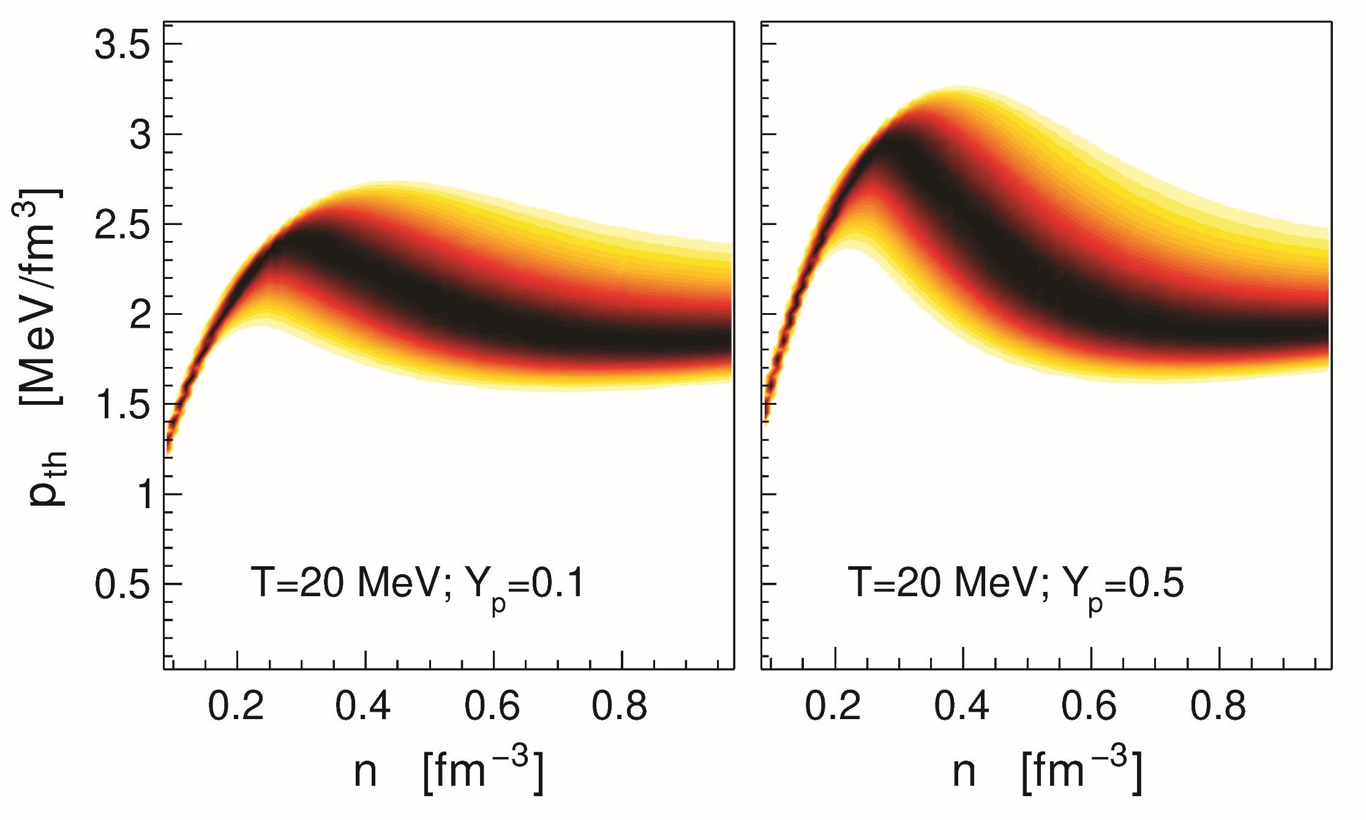
Finite-T
17 (20)
A quick comparison.
Thermal pressure for a DD-RMF model [1, 2, 3].
[1] Malik et al., ApJ 930, 17 (2022); [2] MB & AR, PRC 107, 045803 (2023);
[3] AR et al., PLB 853, 138696 (2024).

Slide 18
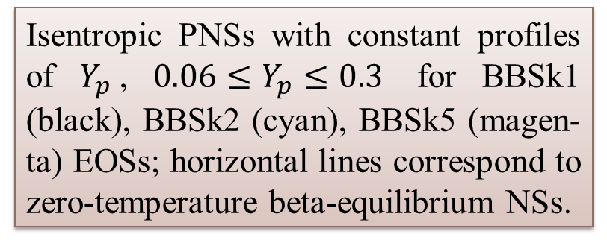
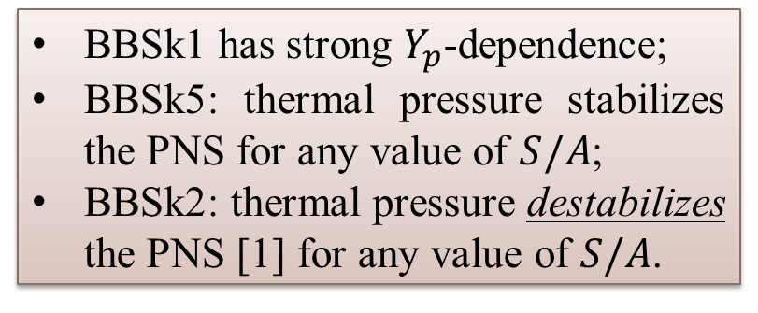
Finite-T
18 (20)
Stability of finite-T (proto-)NSs
Isentropic PNSs with constant profiles of $Y_{p}$, ${0.06≤Y}_{p}≤0.3$ for BBSk1 (black), BBSk2 (cyan), BBSk5 (magen-ta) EOSs; horizontal lines correspond to zero-temperature beta-equilibrium NSs.
BBSk1 has strong $Y_{p}$-dependence;
BBSk5: thermal pressure stabilizes the PNS for any value of $S/A$;
BBSk2: thermal pressure destabilizes the PNS [1] for any value of $S/A$.
[Fig] AR & MB, A&A 705, A151 (2026);
[1] Lu et al., PRC 100, 054335 (2019).

Slide 19
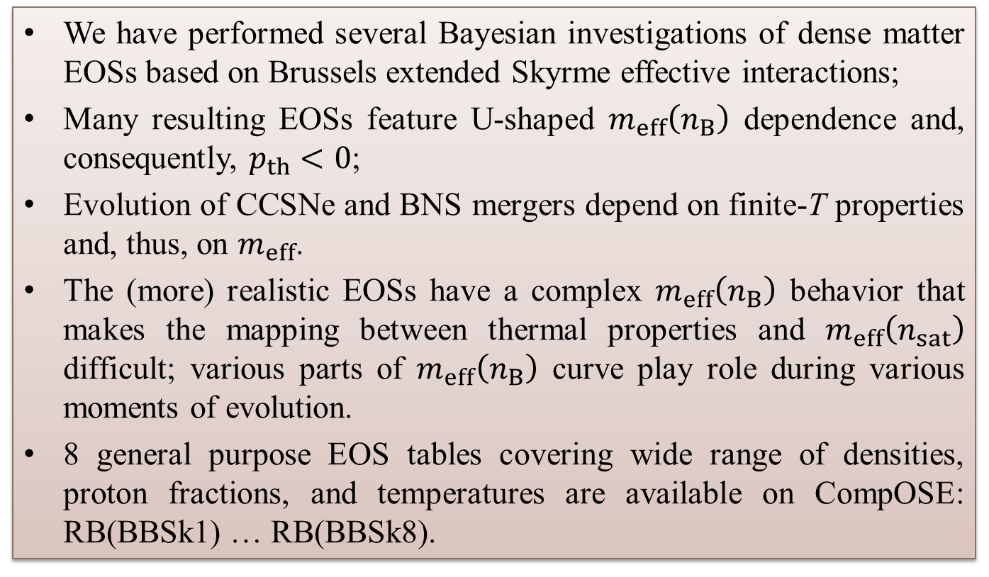
Conclusions 19 (20)
We have performed several Bayesian investigations of dense matter EOSs based on Brussels extended Skyrme effective interactions;
Many resulting EOSs feature U-shaped $m_{eff}\left(n_{B}\right)$ dependence and, consequently, $p_{th}<0$;
Evolution of CCSNe and BNS mergers depend on finite-T properties and, thus, on $m_{eff}$.
The (more) realistic EOSs have a complex $m_{eff}\left(n_{B}\right)$ behavior that makes the mapping between thermal properties and $m_{eff}\left(n_{sat}\right)$ difficult; various parts of $m_{eff}\left(n_{B}\right)$ curve play role during various moments of evolution.
8 general purpose EOS tables covering wide range of densities, proton fractions, and temperatures are available on CompOSE: RB(BBSk1) … RB(BBSk8).

Slide 20
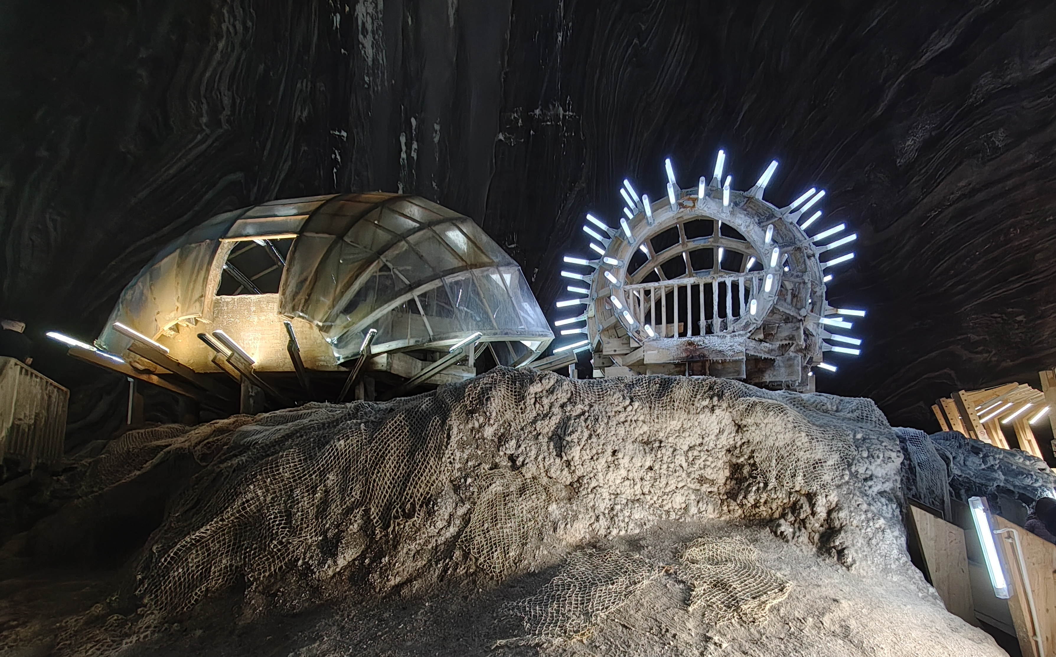
Thank you!
Acknowledgments: CNCS/CCCDI–UEFISCDI, Project No. PN-IV-P1-PCE-2023-0324

