Slide 1



Study of the Stellar Neutron Source Reaction ¹³C(α ,n)¹⁶O
Taoyu Jiao
HUN-REN CSFK, Konkoly Observatory
Nuclear Physics in Astrophysics 08.09.2026 Cluj-Napoca, Romania

Slide 2
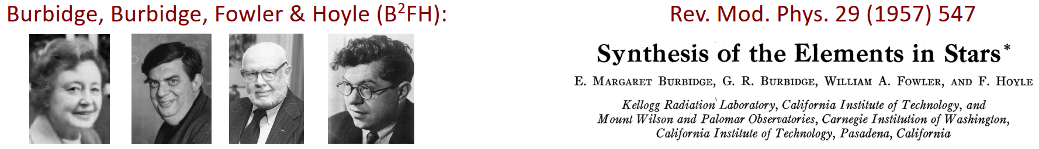
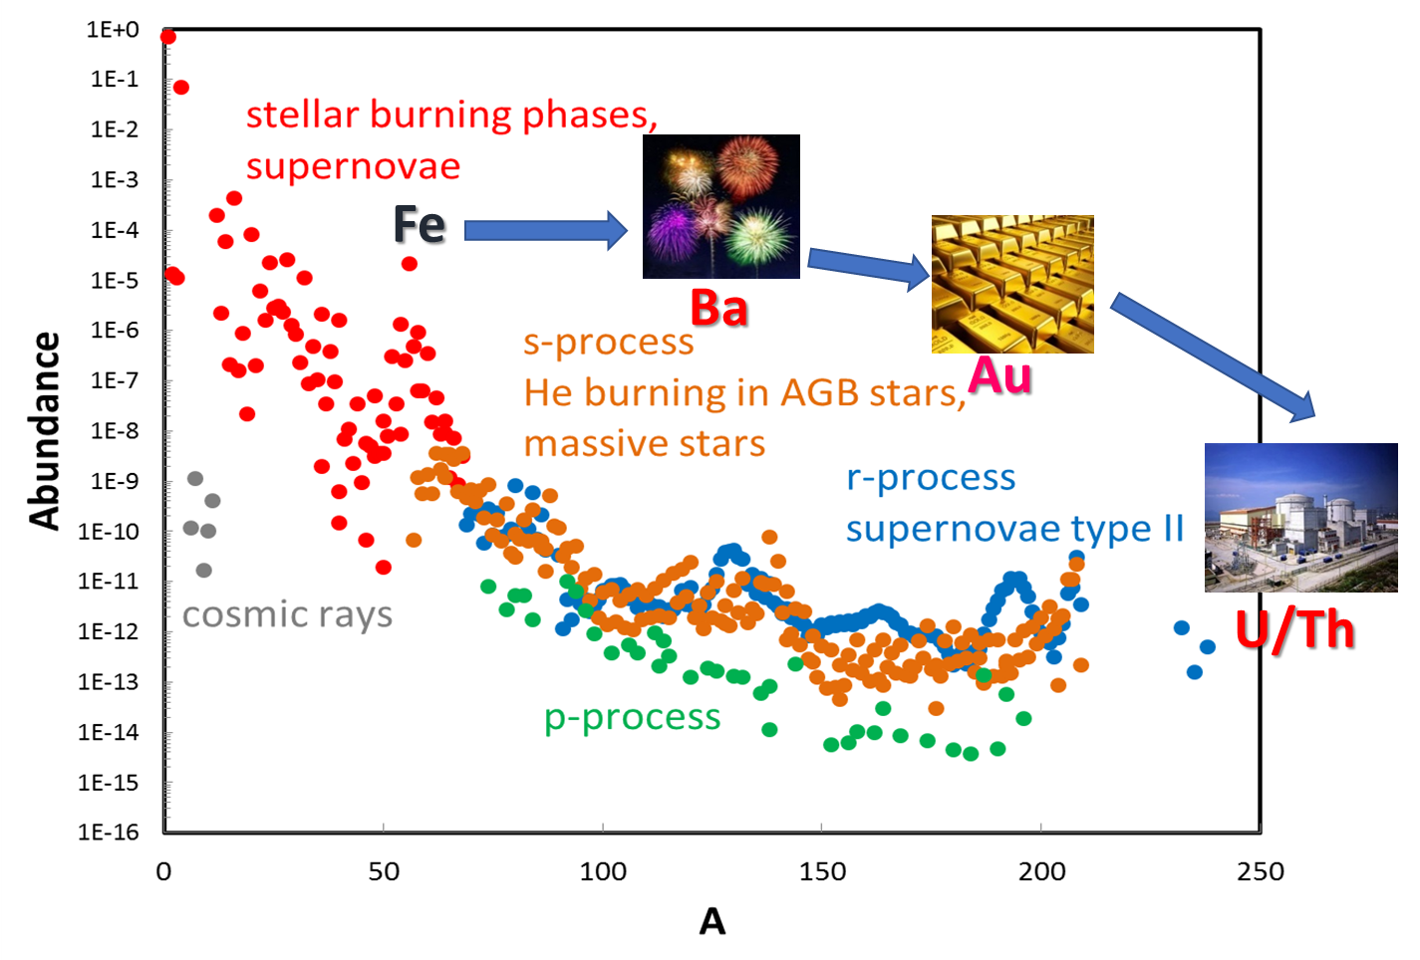
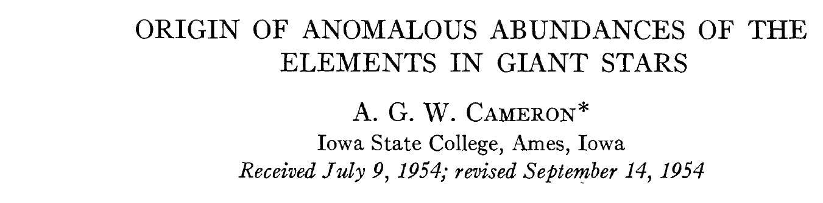
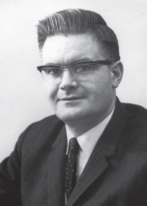
Origin of Elements
n-star merger
唐晓东，李阔昂。宇宙中元素的起源。物理，2019, 48(10):633.
S factor =3.9x10³ MeV*barn
~1/1000 of the present value
Notes:
We already knew the importance of s-process from the previous speakers. So I'll just skip it. And it's also mentioned that 13C(a,n)16O is one of the dominant neutron-source reactions.
I want to introduce some pioneer work. The importance of 13C(a,n)16O was first recognized by Cameron in 1954, although the estimated astrophysical S-factor at that time was about three orders of magnitude smaller than what we know today. The reaction was also highlighted in the famous B2FH paper

Slide 3
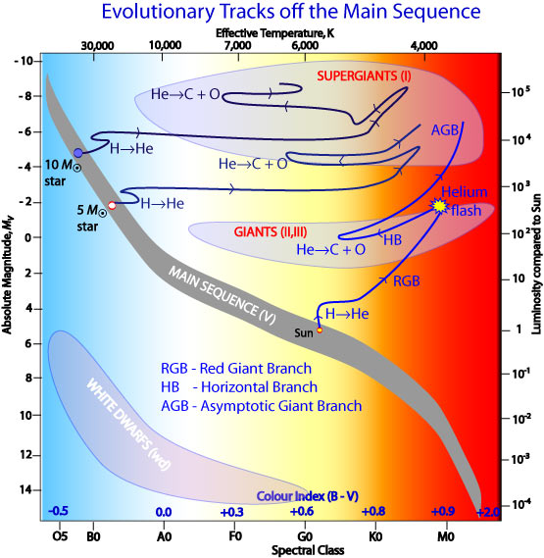
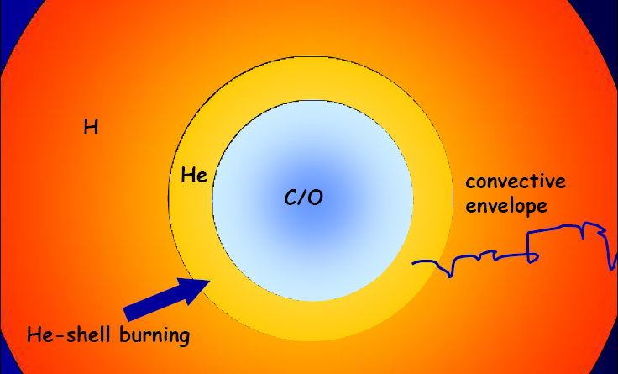
Slow Neutron Capture Process
¹²C(p,γ)¹³N(β⁺)¹³C (α,n)
¹³C (p,γ)¹⁴N(α,γ)¹⁸F(β⁺ν)¹⁸O(α,γ)²²Ne(α,n)
p
He-shell burning of M<4M⊙ AGB stars
N_{n}<10⁹ cm⁻³
(¹²C,¹⁶O,Fe,..)
Stars smaller than 8 M⊙ become white dwarfs via the Asymptotic Giant Branch (AGB star)
¹³C(α,n)¹⁶O is the main neutron source reaction of the s-process and i-process
Typical s-process have a neutron density of ρ = 10^{7~11} cm⁻³
Notes:
The main site of the s-process is low- and intermediate-mass AGB stars. At this stage, the star contains a degenerate carbon-oxygen core surrounded by helium- and hydrogen-rich layers, with recurrent thermal pulses occurring in the helium shell.
After a thermal pulse, a small amount of protons can mix into the helium shell. These protons are captured by 12C, eventually producing 13C pocket on the top of He-shell.
The 13C then reacts with alpha particles through 13C(a,n), providing the neutrons that drive the s-process and produce heavy elements up to bismuth.

Slide 4
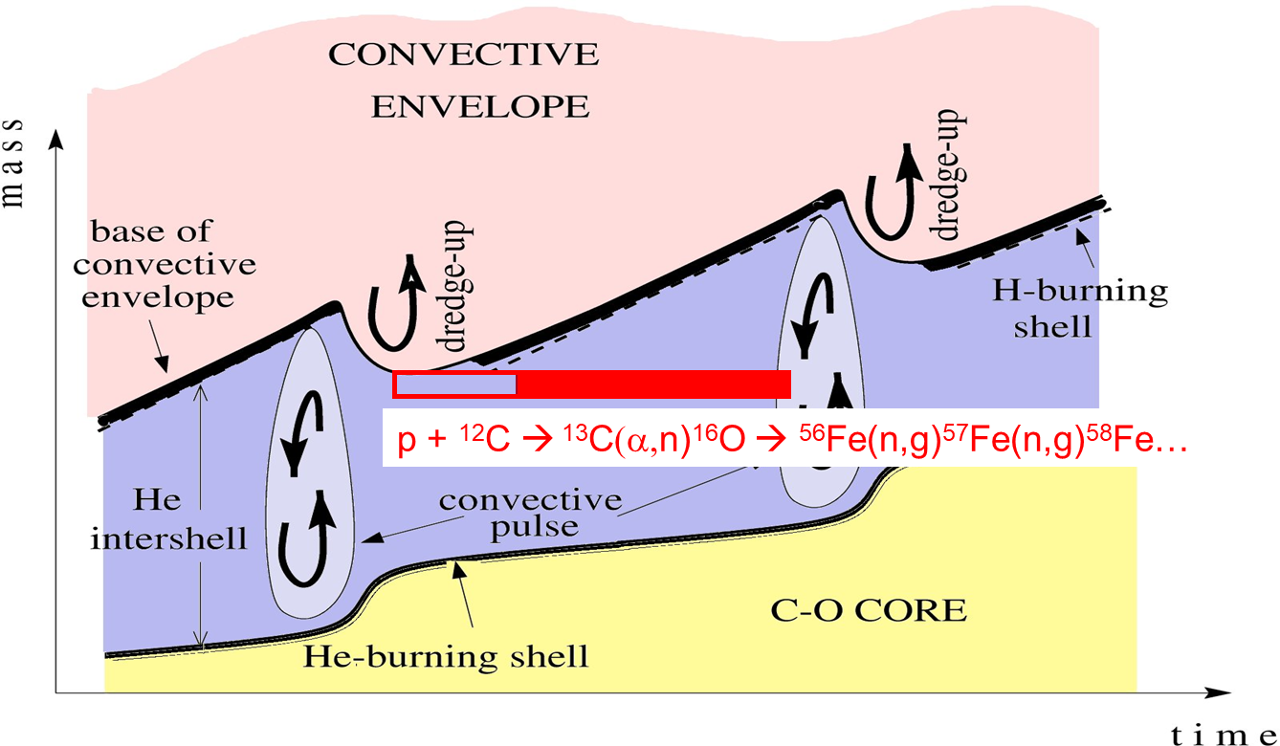
Slow Neutron Capture Process
Token from A. Karakas, NIC 2023
Stars smaller than 10 M⊙ become white dwarfs via the Asymptotic Giant Branch (AGB star)
¹³C(α,n)¹⁶O is the main neutron source reaction of the s-process and i-process
Typical s-process have a neutron density of ρ = 10^{7~11} cm⁻³
Notes:
This figure shows how the internal structure of an AGB star evolves with time. The red region indicates the 13C pocket.
The lifetime of this pocket mainly depends on the temperature and the 13C(a,n) reaction rate. In most cases, the 13C is consumed before the next thermal pulse.
However, when the burning is less efficient, part of the 13C can survive until the next thermal pulse. It is then burned at a higher temperature, producing a different neutron flux and therefore changing the final s-process abundance pattern.

Slide 5
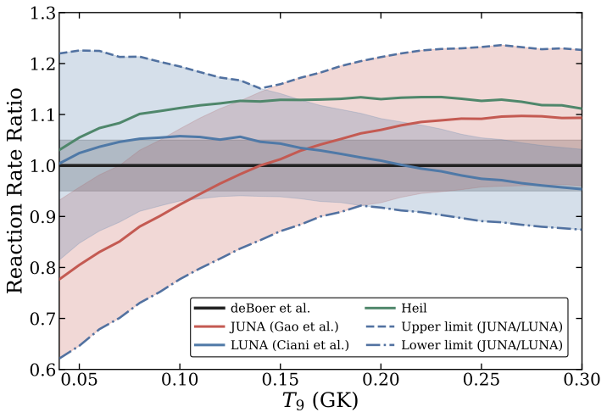
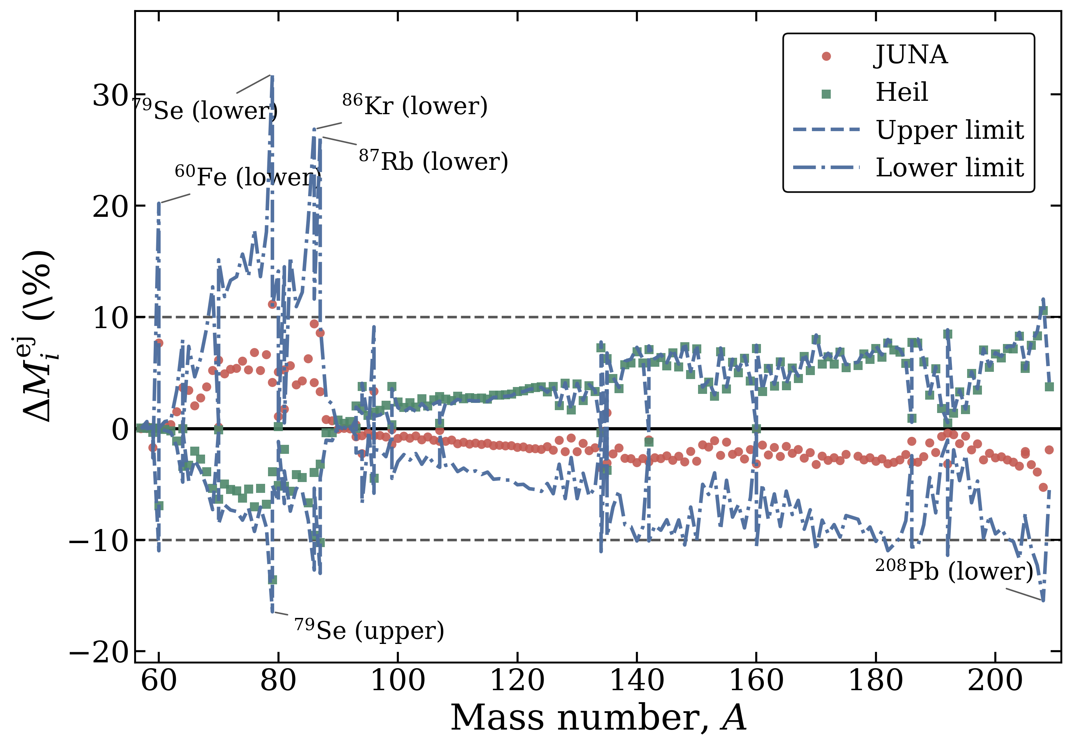

Effect of 13C(a,n) reaction rate
$$\text{M} \text{=} \text{1.7} \text{M}⊙ , Z=0.014, std pmz$$
Preliminary
Recent measurements improved the uncertainty at Gamow Window for s- and i-processes
The extrapolations show different trends; ND uncertainty seem to underestimated
Different rates shows ~ 10% difference in s-process stellar yield (Calculated with Monash code)
Notes:
The left figure shows the reaction rate of 13C(a,n). The typical burning temperature is around 0.1 GK.
Thanks to recent underground and angular-distribution measurements, the uncertainty of the reaction rate has been significantly reduced. However, different measurements show different trends.
The right figure shows the stellar yields from a 1.7-solar-mass star with solar metallicity. The differences in reaction rates can lead to about a 10% variation in the heavy-element yields. If we include the upper and lower limits of the reaction rate, the total uncertainty can reach nearly 20%.
Since stars in this mass range are relatively common in the Galaxy, a better constraint on this reaction rate is still important.
I want to mention the Notre Dame rate reports an uncertainty of 5%, but we believe this analysis may underestimate the total uncertainty.

Slide 6
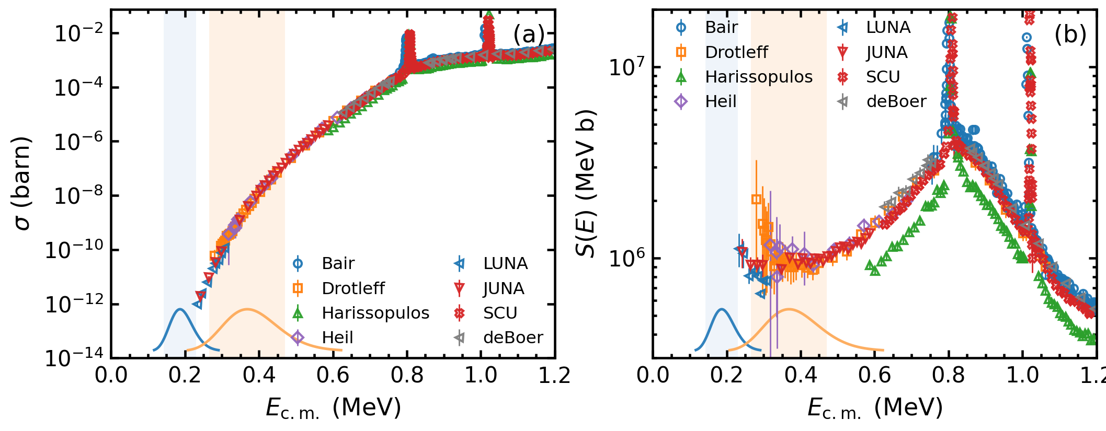
Q1: Extremely Small Cross Section
s-process
i-process
s-process
i-process
The s-process region is almost impossible to access though direct measurements
Notes:
So the next question is: what makes this reaction rate so difficult to constrain?
The left figure shows the cross section of the 13C(a,n) reaction as a function of energy. The Gamow window lies below the Coulomb barrier, so the cross section drops exponentially toward lower energies.
As a result, even with underground experiments, it is still very difficult to measure directly inside the Gamow window.
The right figure shows the corresponding astrophysical S-factor. We can see that there are still some discrepancies among the different measurements, which makes the low-energy extrapolation very important.

Slide 7
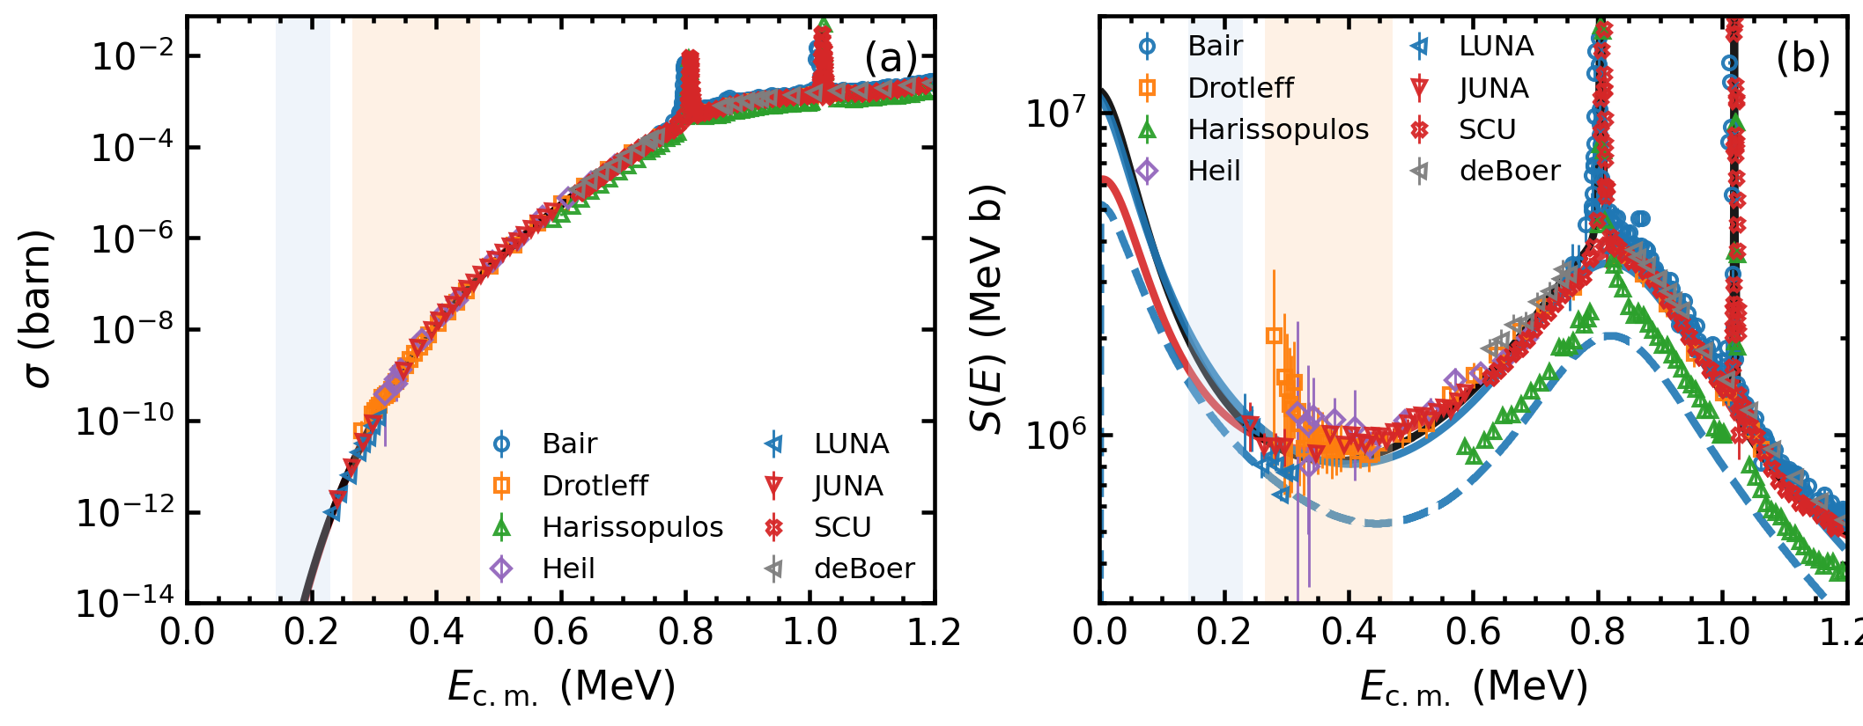
Q1: Extremely Small Cross Section
s-process
i-process
s-process
i-process
The s-process region is almost impossible to access though direct measurements
Discrepancies among data sets lead to divergent extrapolations
Notes:
Most of the previous analysis used R-matrix, but different groups adopted different fitting strategies, datasets, and level parameters. As a result the low-energy extrapolations have significant difference, which then propagate into the reaction rates.

Slide 8

Q1: Extremely Small Cross Section
s-process
i-process
Generated by ChatGPT
The s-process region is almost impossible to access though direct measurements
Discrepancies among data sets lead to divergent extrapolations

Slide 9
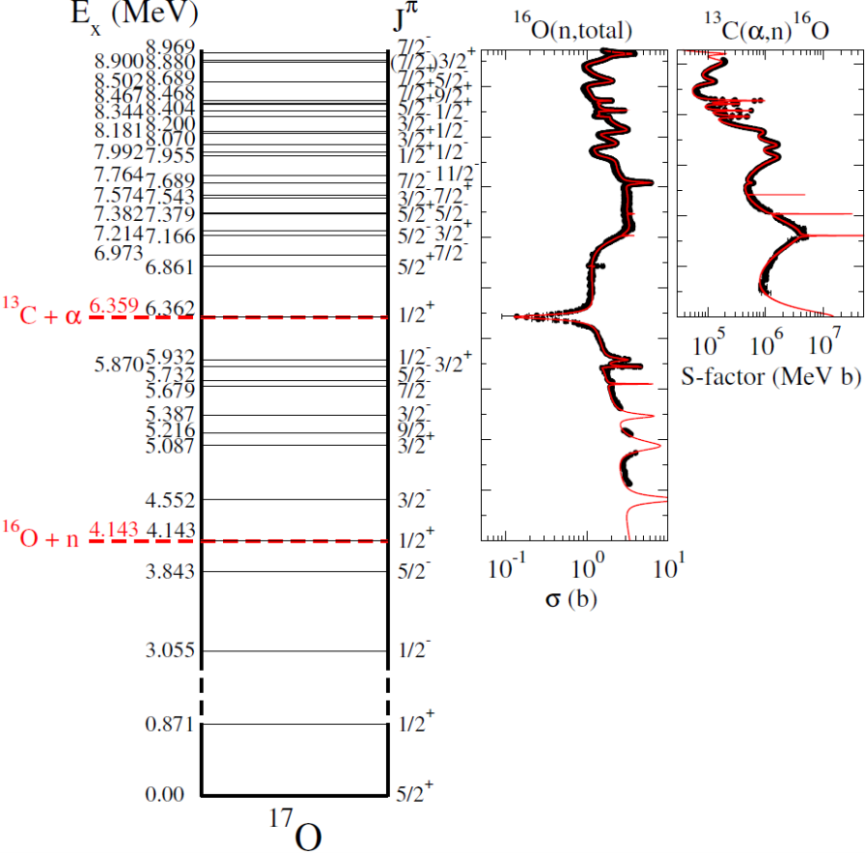
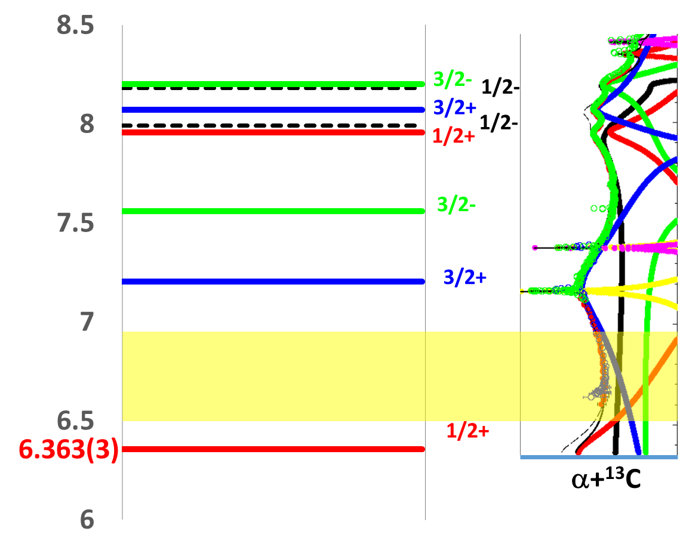
Q2: Complicated Resonances
Interference pattern affects the s-factor at GW
Taken form R.J. deBoer’s slide
Notes:
Another difficulty comes from the nuclear structure.
The compound nucleus, 17O, has a complicated level structure. In particular, the threshold resonance have a strong impact on the cross section inside the Gamow window.

Slide 10
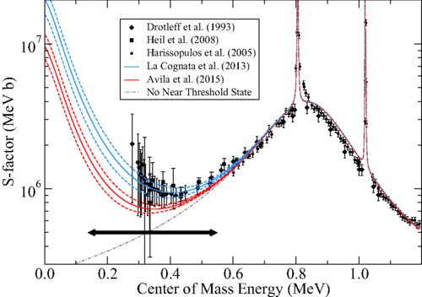
Q2: Complicated Resonances
deBoer et al., (2020)
Interference pattern affects the s-factor at GW
Large uncertainty also appears in indirect measurements
Notes:
The strength of the threshold state can also be constrained through indirect measurements.
For example, Transfer reactions and the Trojan Horse Method have been used to determine the ANC of this state.
However, the results from these indirect measurements are not fully consistent with each other, and the uncertainties are still relatively large.
So, although they provide very useful parameters, it is difficult to only rely on the indirect measurements for the low-energy extrapolation.
In addition, interference pattern between different resonances can also change the low-energy cross section.

Slide 11
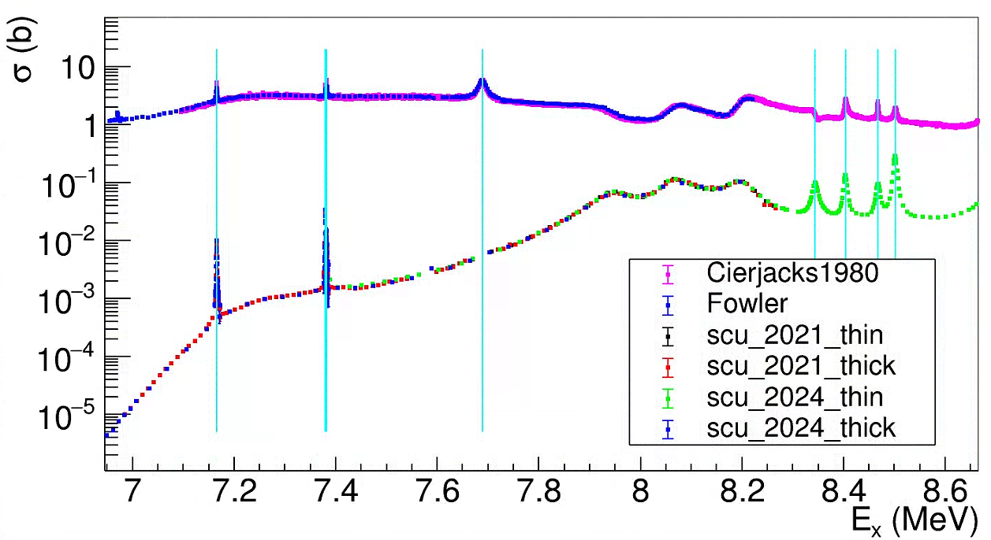
Energy Calibration
¹⁶O(n,tot)
8.46763MeV
8.5024MeV
7.37923MeV
7.38237MeV
8.34394MeV
8.4039MeV
7.68921MeV
7.16586MeV
¹³C(α,n)¹⁶O
Extended measurement makes it possible to calibrate the energy using narrow resonances via NNDC recommendation
The energy is calibrated for both ¹⁶O(n,tot) and ¹³C(α,n)¹⁶O data
Notes:
To address these issues, we performed a new R-matrix analysis.
The first step was to make the energy calibration of all datasets as consistent as possible. Although most experiments reported their own accelerator energy calibration, but some of these measurements are quite old, so small energy offsets may still remain.
We therefore recalibrated all the datasets using the resonance energies recommended by NNDC.
In this way, we can reduce possible systematic differences in the energy scale and improve the consistency between different datasets.

Slide 12
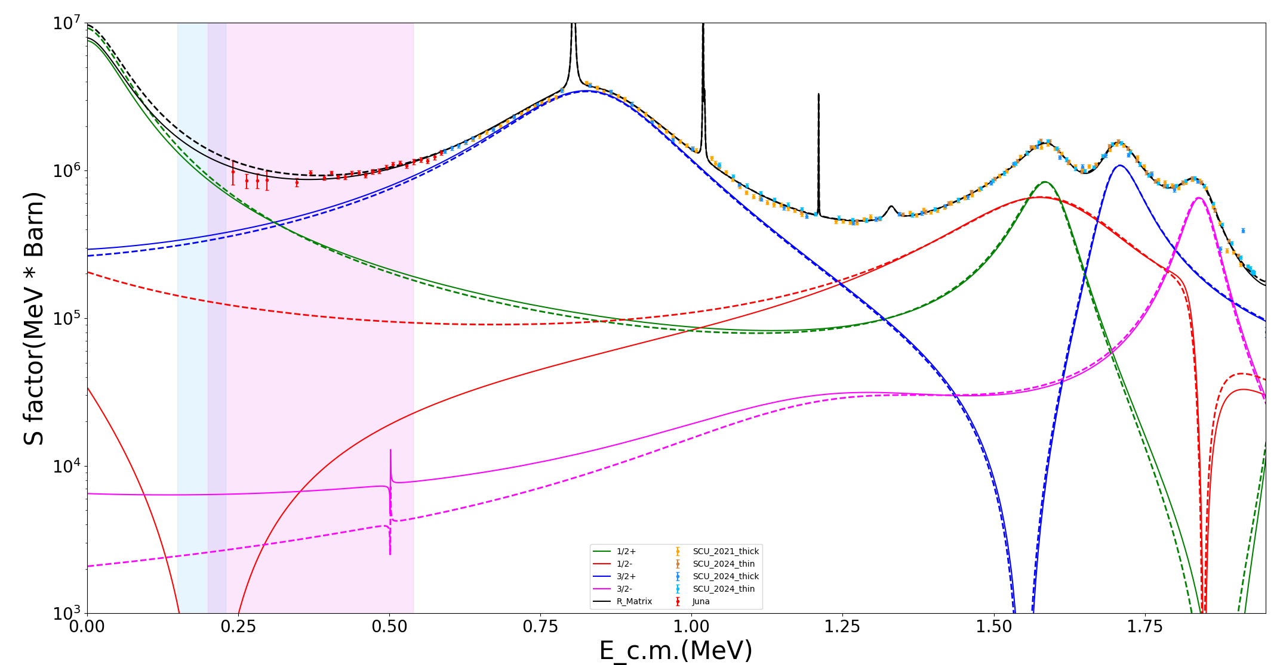
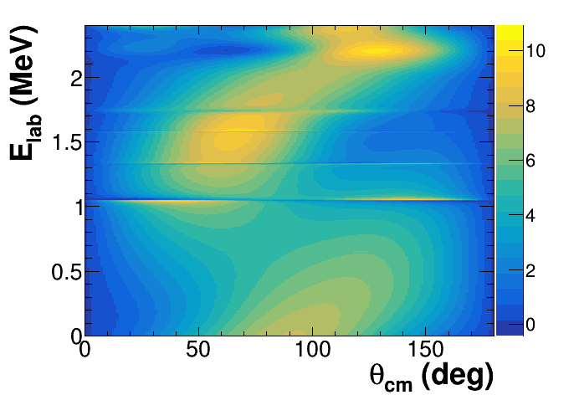
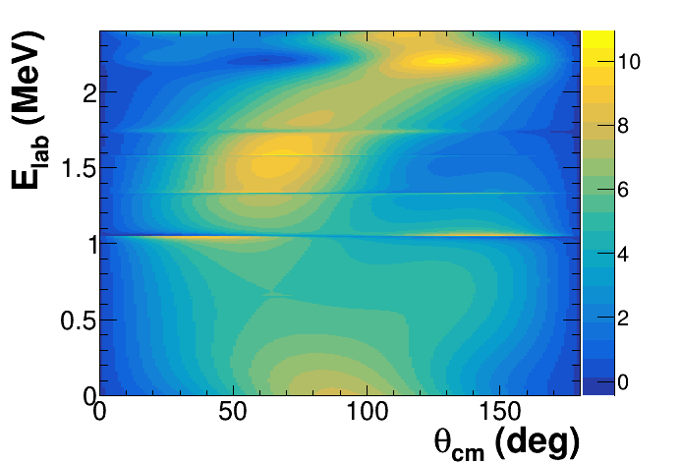
R-matrix fitting using MINUIT
E_{x} ~ 5.93 MeV: ANC = -4e4 fm^{-1/2}
Preliminary
E_{x} ~ 5.93 MeV: ANC = 2e4 fm^{-1/2}
Notes:
In this analysis, we unfixed the parameters of subthreshold states and allowed their level parameters to vary freely.
This figure shows the contributions of the main 13C(a,n) resonances in the MINUIT fit. The black curve is the total cross section, different color shows different Spin-parities.
For the 5.93 MeV 1/2- state, we found two local solutions for the ANC, corresponding to constructive and destructive interference.
The two solutions differ by about 10% inside the s-process Gamow window. However, both can reproduce the total cross-section data quite well, which means the total cross section alone is not sufficient to constrain the extrapolation.

Slide 13
R-matrix fitting using MINUIT
E_{x} ~ 5.93 MeV: G = -4e4 fm^{-1/2}
Preliminary
E_{x} ~ 5.93 MeV: G = 2e4 fm^{-1/2}
Notes:
We then project the differential cross sections from the two solutions into a two-dimensional angular-distribution spectrum as a function of both energy and angle.
At higher energies, the angular distributions from the two solutions are quite similar.
But at lower energies, the different interference patterns lead to clearly different angular distributions. One solution becomes more forward-peaked, while the other becomes more backward-peaked.

Slide 14
R-matrix fitting using MINUIT
Preliminary
ANC = 2e4 fm^{-1/2}
ANC = -4e4 fm^{-1/2}
Differential cross section measurement at lower energies are still needed to determine interference! Especially for Ea<0.6 MeV
Notes:
Looking more closely at the low-energy differential cross sections, we can see that the sensitivity increases very quickly as the energy decreases.
At 0.7 MeV, the difference between the differential cross sections at 0 and 180 degrees is only about 10%. But at 0.4 MeV, this difference increases to around 50%.
This shows that angular-distribution measurements at relatively high energies are not sufficient to constrain the behavior at low energies, where the interference effect becomes much stronger.

Slide 15
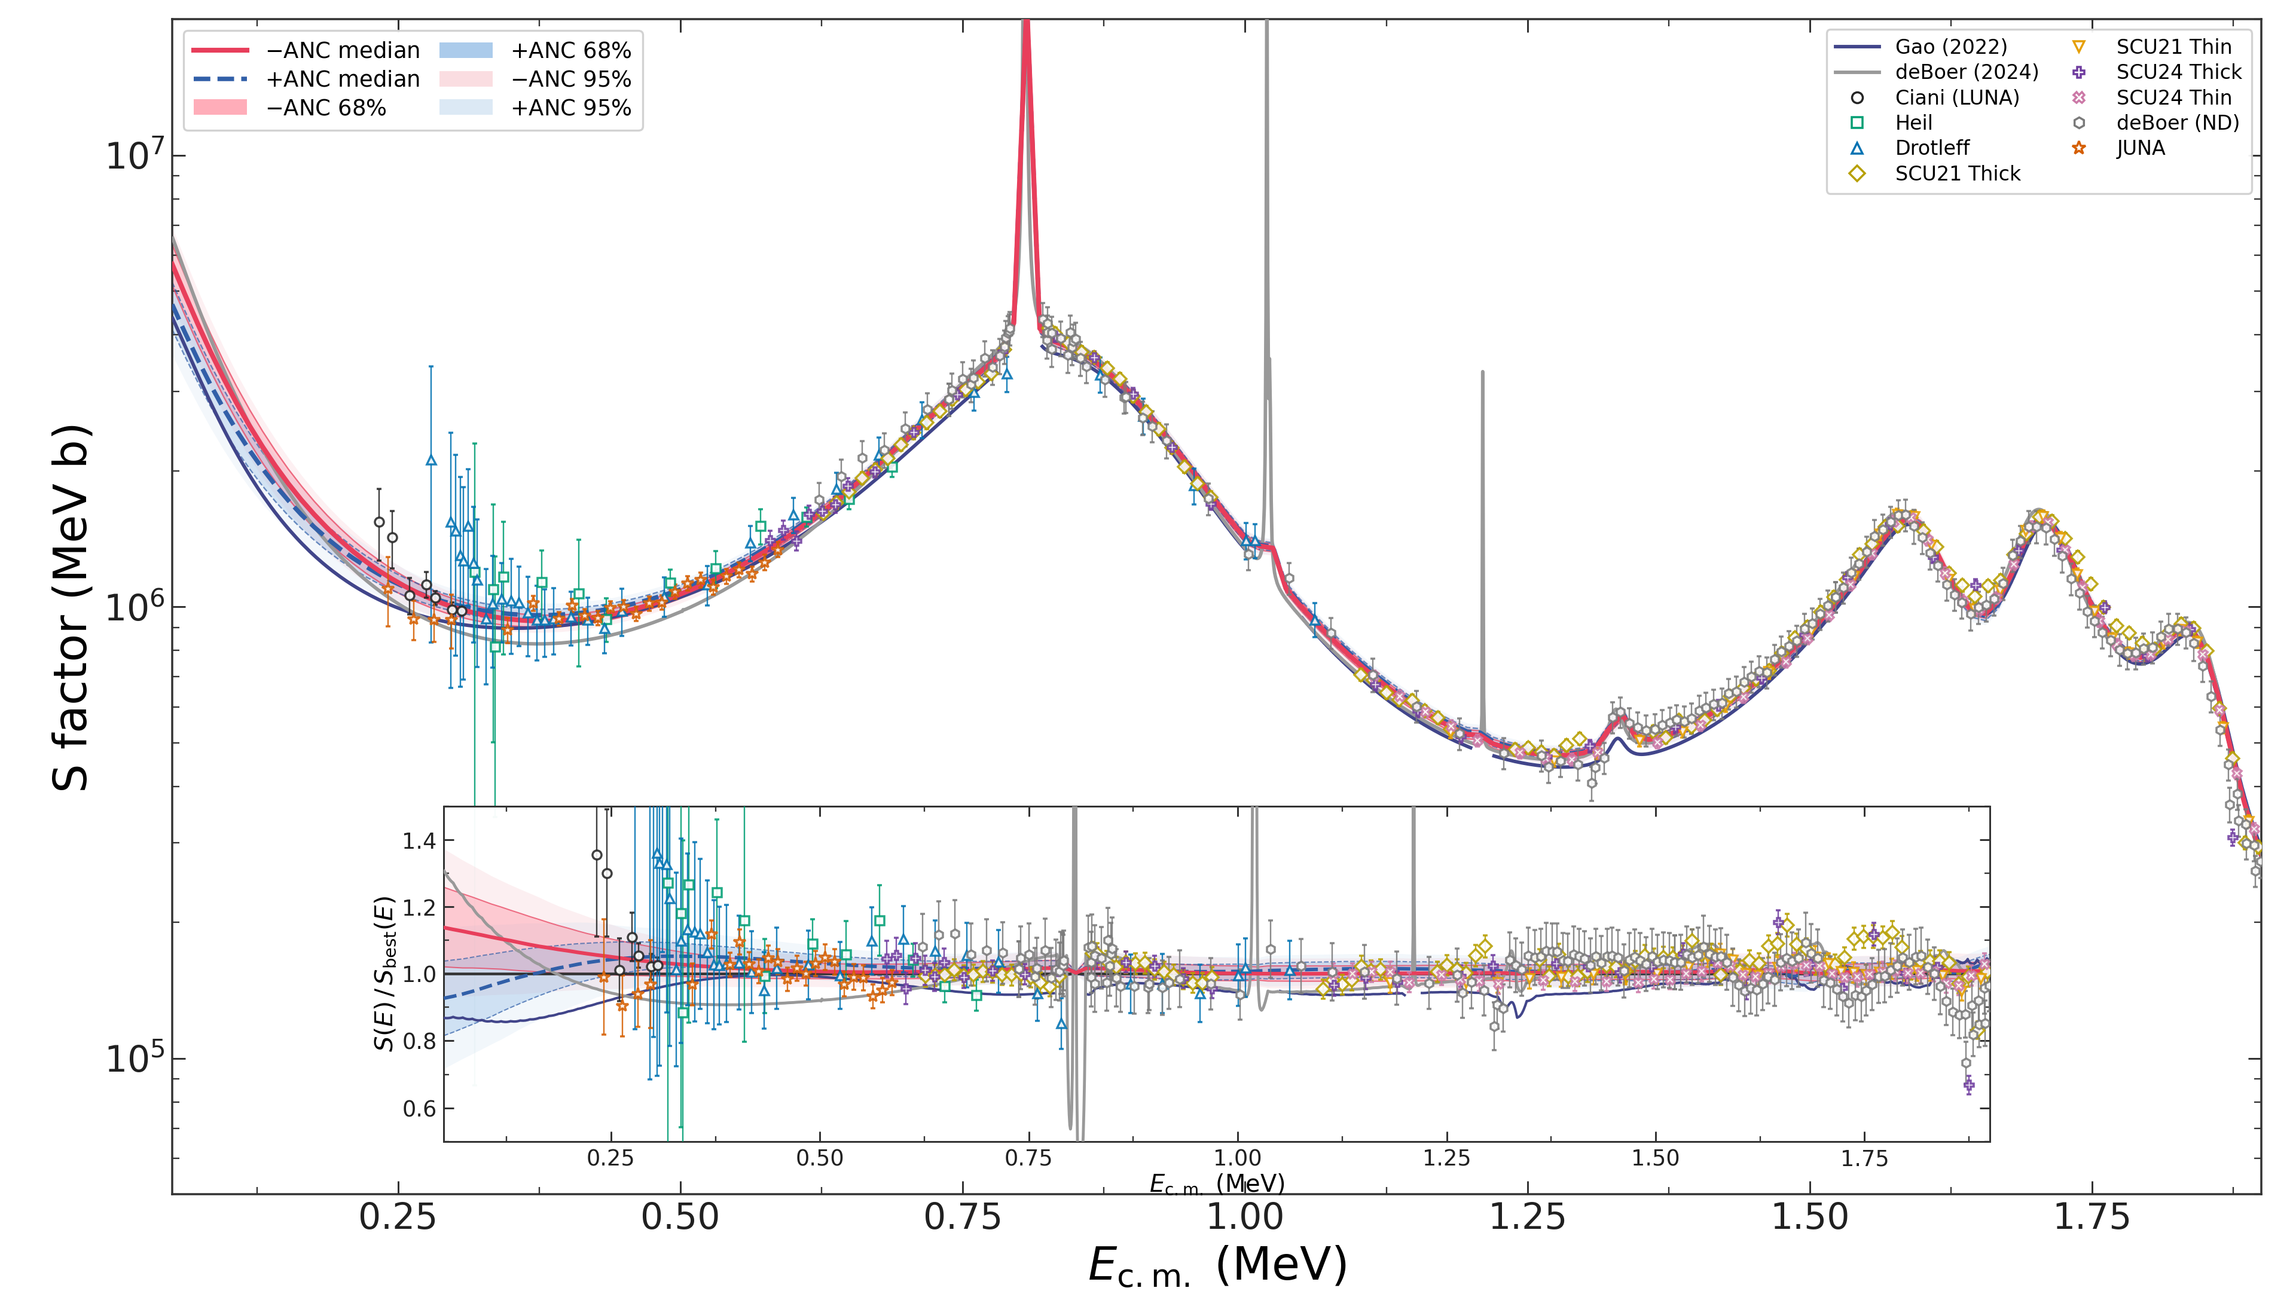
R-matrix fitting using MCMC
 | Ciani | Gao | deBoer | -ANC | +ANC
γ_{th} (MeV^{1/2}) | 0.72(11) | 0.46(12) | 0.54(2) | 0.51(3) | 0.43(4)
Preliminary
Notes:
Since we still cannot determine the interference pattern, we performed separate MCMC analyses for both interference solutions.
The fit includes 78 free parameters in total, so it was actually quite surprising that the chains could converge reasonably well.

Slide 16
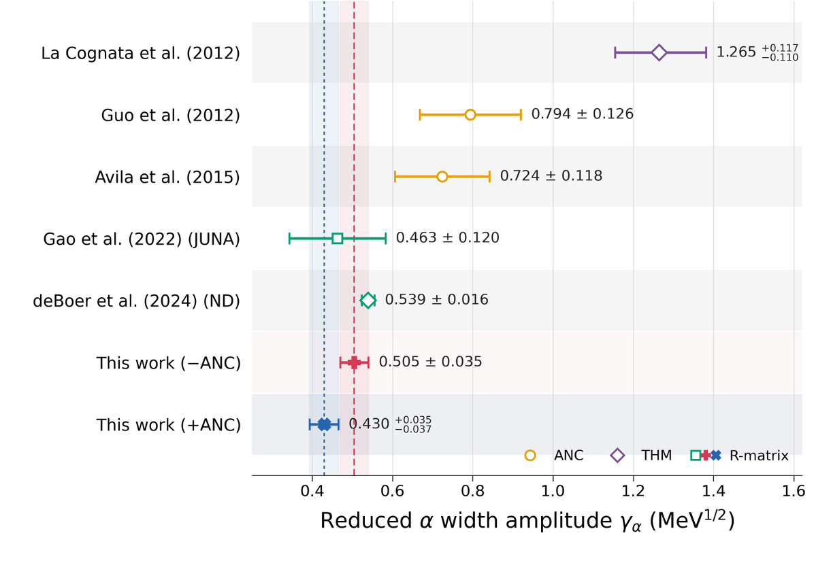
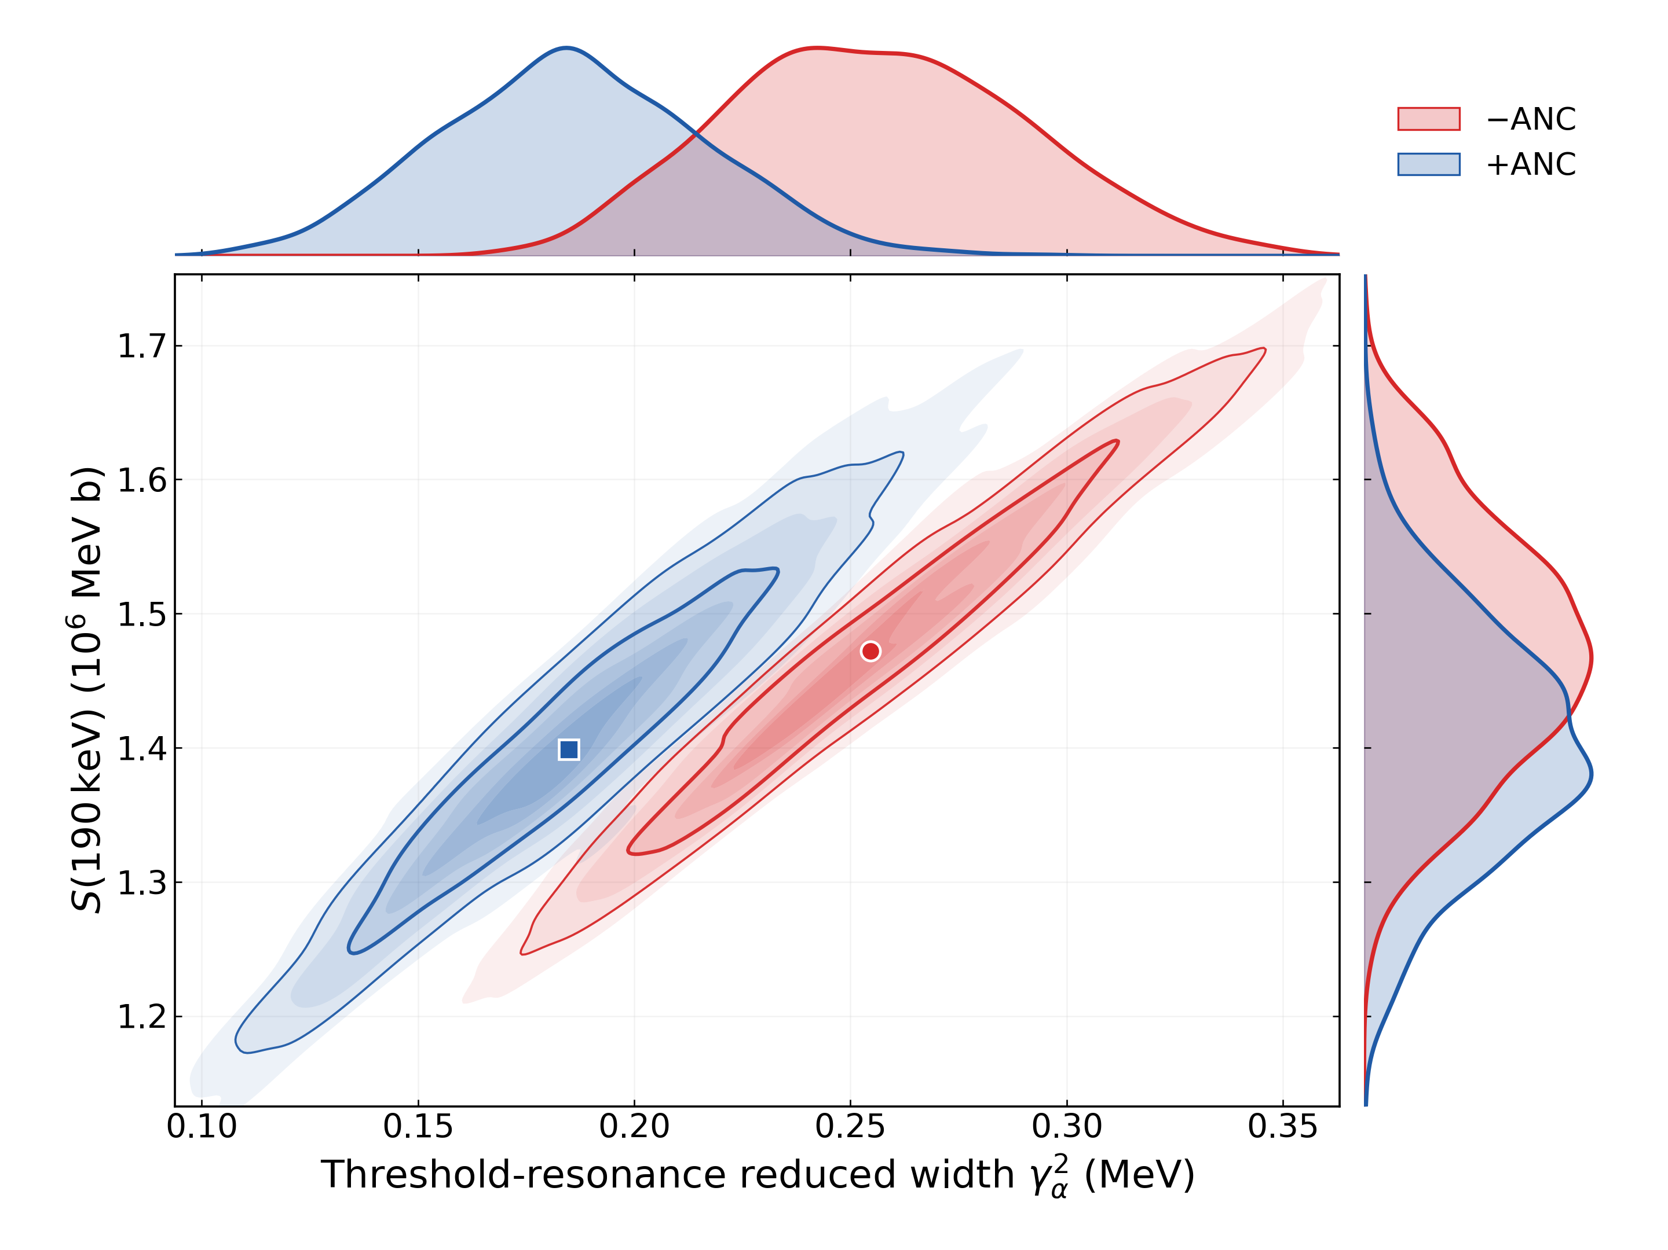
R-matrix fitting using MCMC
Preliminary
-ANC agrees better with the previous results, but +ANC still can’t be rolled out
S-factor at the center of GW is highly corresponded with Gamma width of threshold state
Also need to consider electron screening effect!
Notes:
Here we compare the reduced width of the threshold state from our fit with previous results.
At first glance, the indirect measurements seem to give significantly larger values than the R-matrix analyses based on direct measurements.
But actually, this comparison is a little misleading.

Slide 17
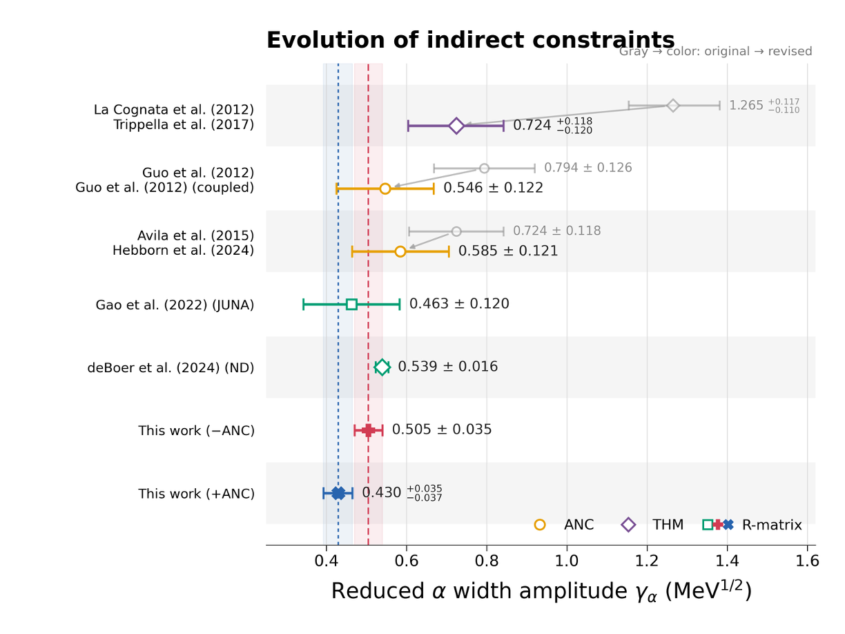
R-matrix fitting using MCMC
Preliminary
-ANC agrees better with the previous results, but +ANC still can’t be rolled out
S-factor at the center of GW is highly corresponded with Gamma width of threshold state
Also need to consider electron screening effect!
Notes:
The previous indirect measurements have been revised to account for effects such as channel coupling and improved ab initio calculations. After these corrections, their results are generally consistent with our fit within the uncertainties.
It is worth noting that the indirect measurements tend to favor the negative-ANC solution, although the positive-ANC solution still cannot be completely excluded.
We also extracted the correlation between the S-factor at the center of the Gamow window and the strength of the threshold state. As we can see, they are strongly correlated, which again shows how important this state is for the low-energy extrapolation.
Electron screening is another important effect at low energies. However, with the current dataset, we are not able to constrain the screening contribution very well.

Slide 18
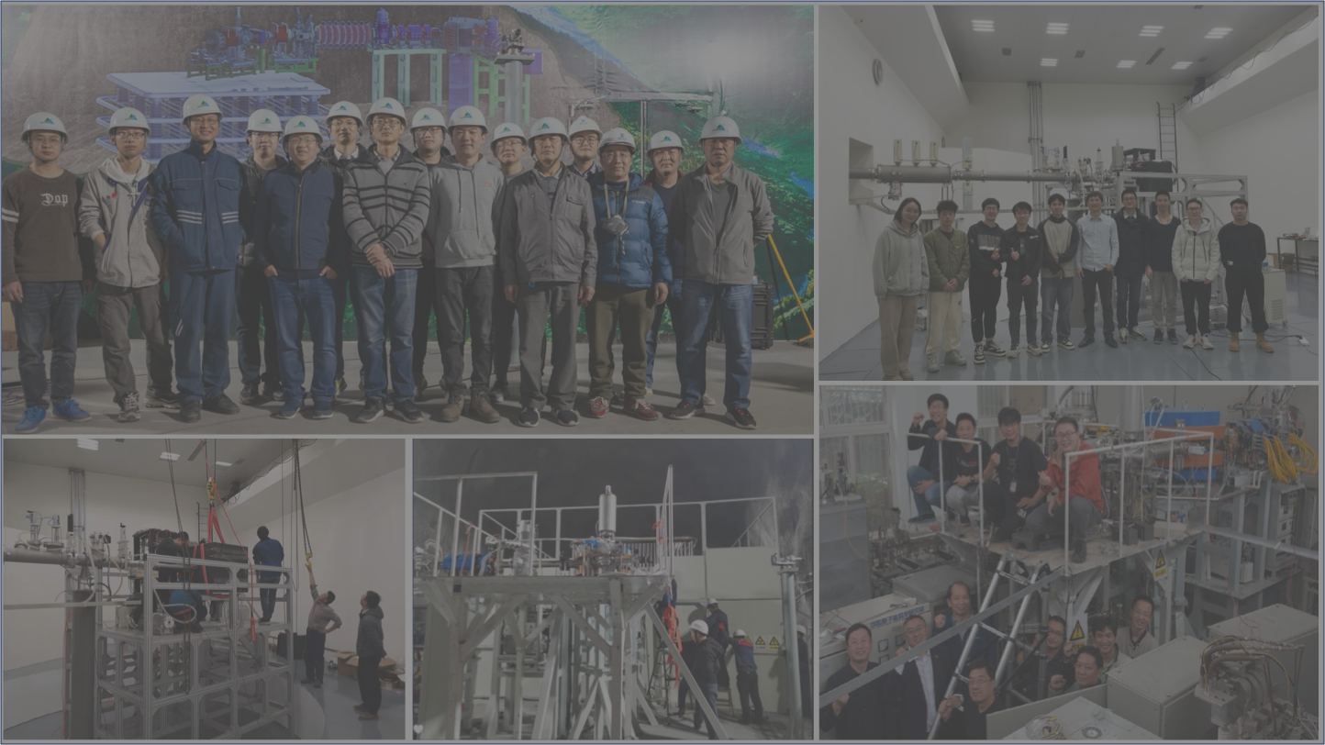
Summary & Outlook
¹³C(α,n)¹⁶O is a significant reaction for s-process and i-process nucleosynthesis
With recent R-matrix analysis, we provided new s-factor for ¹³C(α,n)¹⁶O
We will apply the updated rates in post-processing codes to check the influence in AGB nucleosynthesis
Differential cross section measurement towards lower energy is needed
Electron screening effect should be considered
THANK YOU!

Slide 19
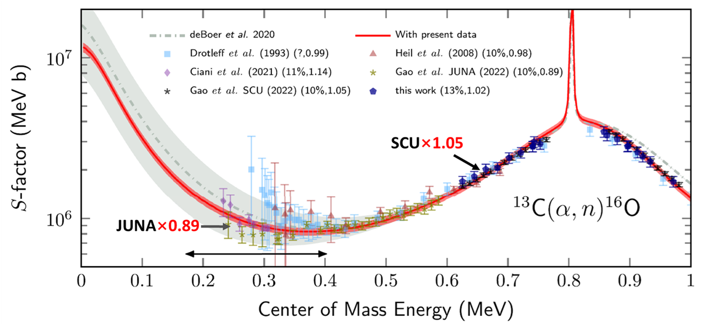
Current Status
R. J. deBoer et al., PRL 132, 062702 (2024)
Angular distributions measured in wide energy range of E_{cm} = 0.61 – 4.97 MeV
5% extrapolation uncertainty, reduced width γ = 0.539(16) MeV^{1/2}
Inconsistencies JUNA and SCU data, caused by different scaling factors; missed serval levels below threshold; ignored the effect of electron screening

Slide 20
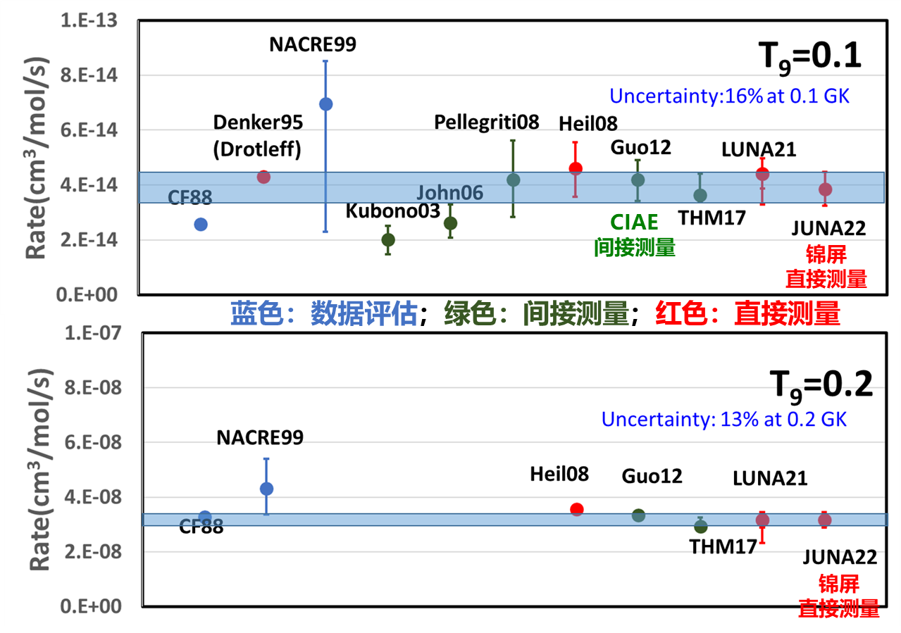
天体物理反应率
为天体物理研究提供最可靠的反应率

