Slide 1



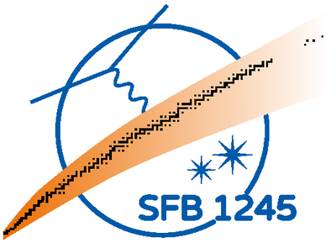




Probing heavy element nucleosynthesis through electromagnetic observations
Gabriel Martínez-Pinedo
Nuclear Physics in Astrophysics XII
Cluj-Napoca, September 7-11, 2026
ERC AdG KILONOVA

Slide 2
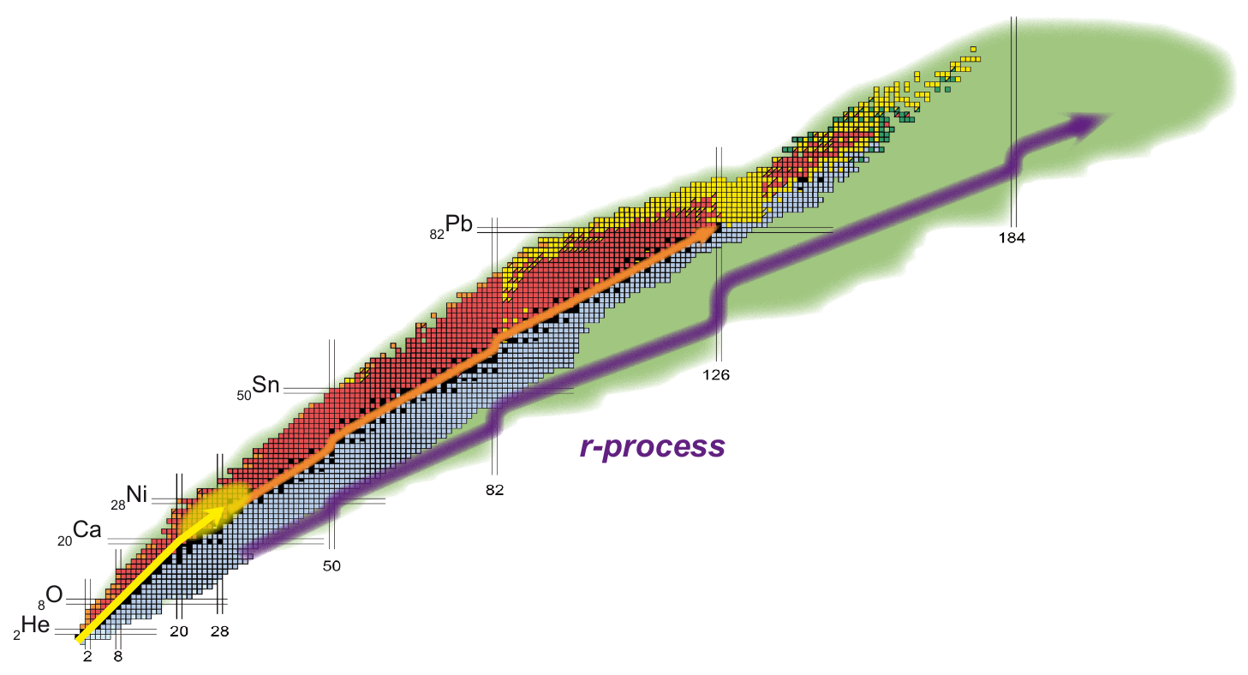
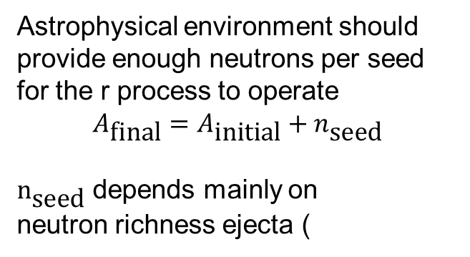
R process needs
Astrophysical environment should provide enough neutrons per seed for the r process to operate
$$A_{\text{final}}=A_{\text{initial}}+n_{\text{seed}}$$
$n_{\text{seed}}$ depends mainly on
neutron richness ejecta (
requires properties of exotic neutron-rich nuclei:
Beta-decay rates
Neutron capture rates
Fission rates and yields
Benchmark against observations:
Indirect: Solar and stellar abundances (contribution many events, chemical evol.)
Direct: Kilonova electromagnetic emission (single event, sensitive Atomic and Nuclear Physics)

Slide 3
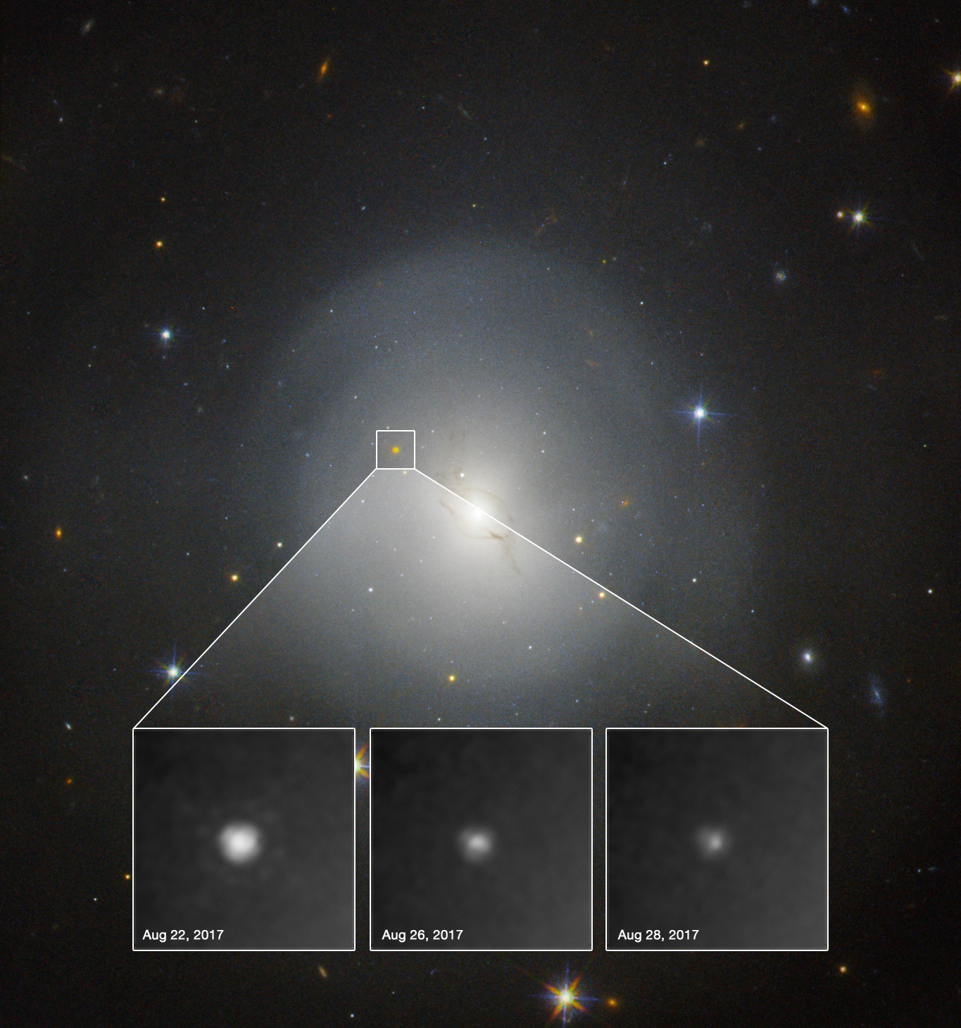
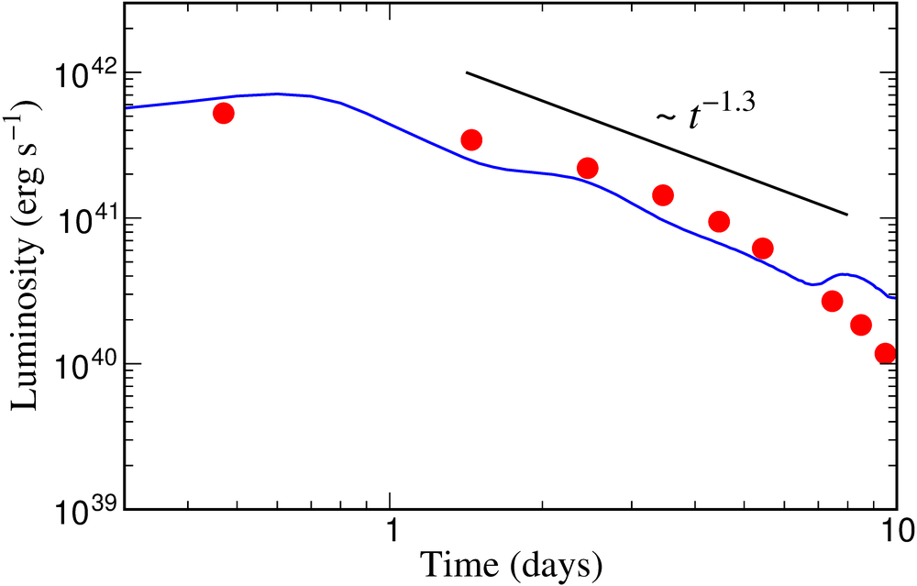
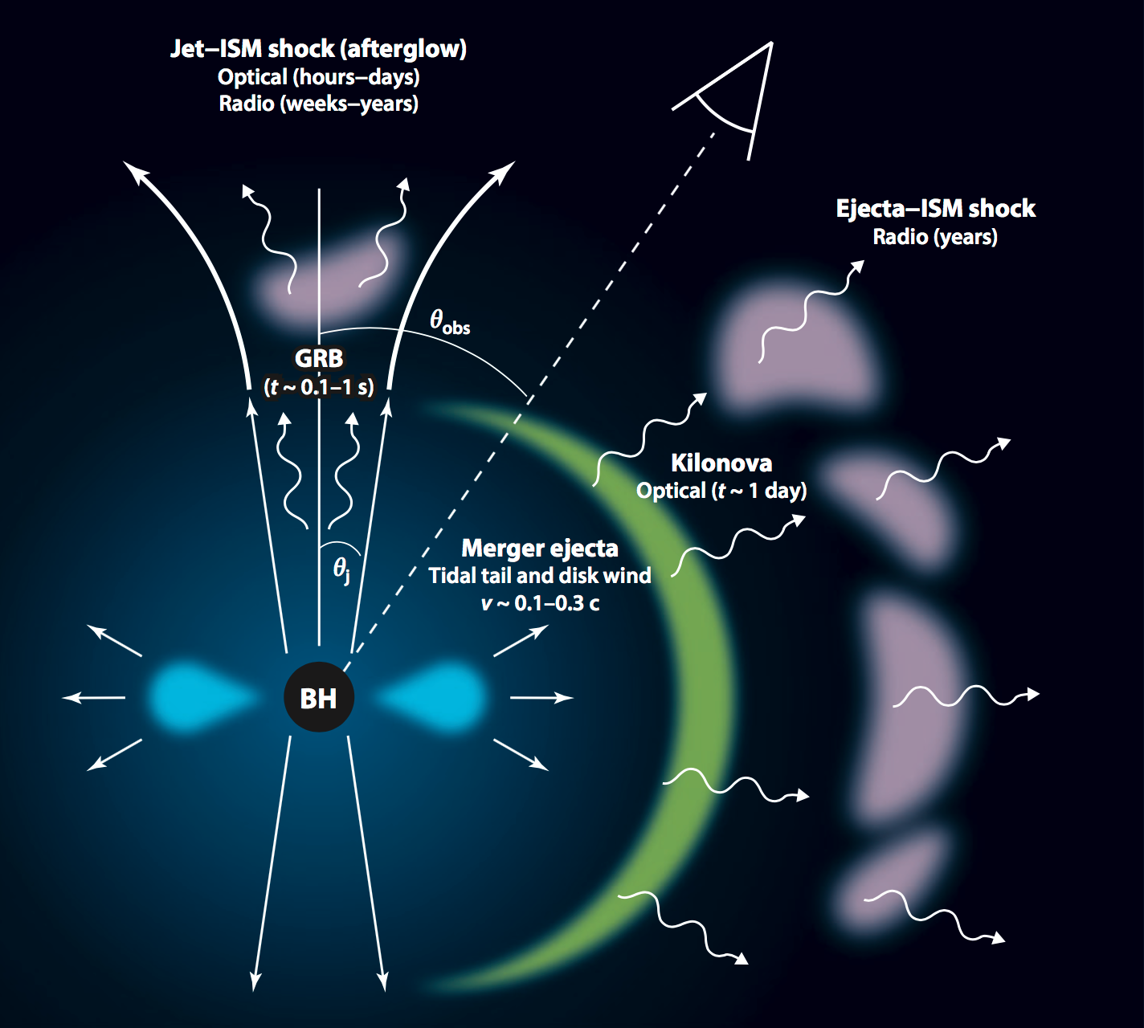
Kilonova: signature of the r-process
Kilonova: An electromagnetic transient due to long term radioactive decay of
r-process nuclei
Metzger, et al, 2010
predictions
Cowperthwaite, et al 2017
Kilonova observations
Electromagnetic counterpart to Gravitational Waves
Diagnostics physical processes at work during merger
Direct probe of the formation r-process nuclei
Information elements produced single event
Metzger & Berger 2012

Slide 4
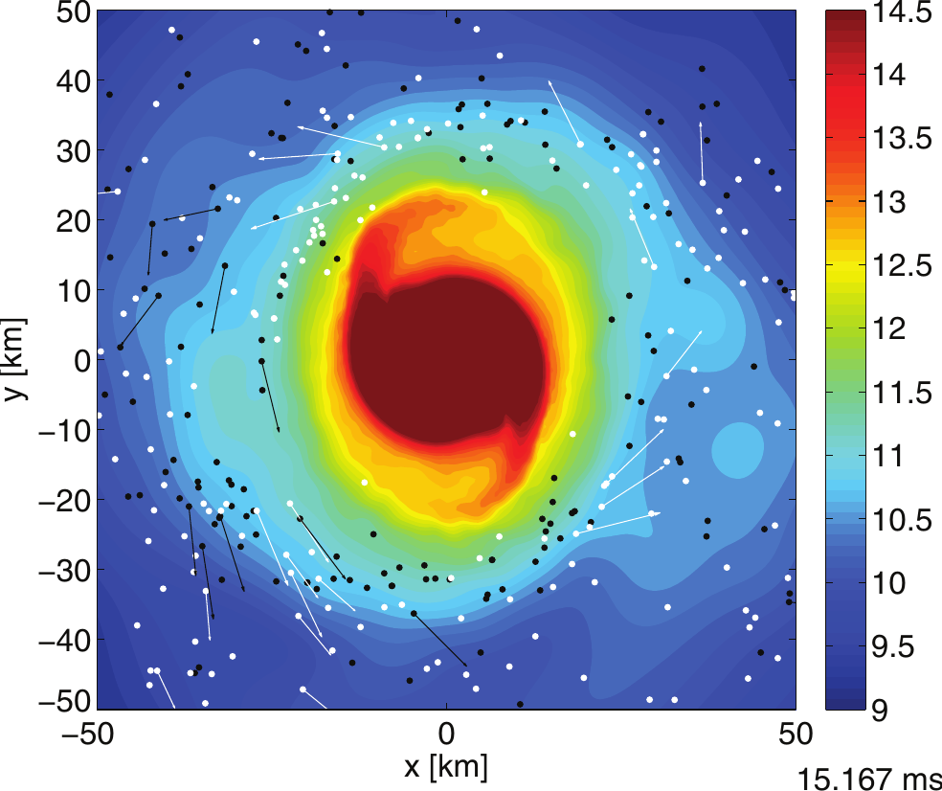
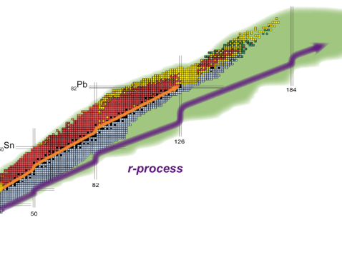
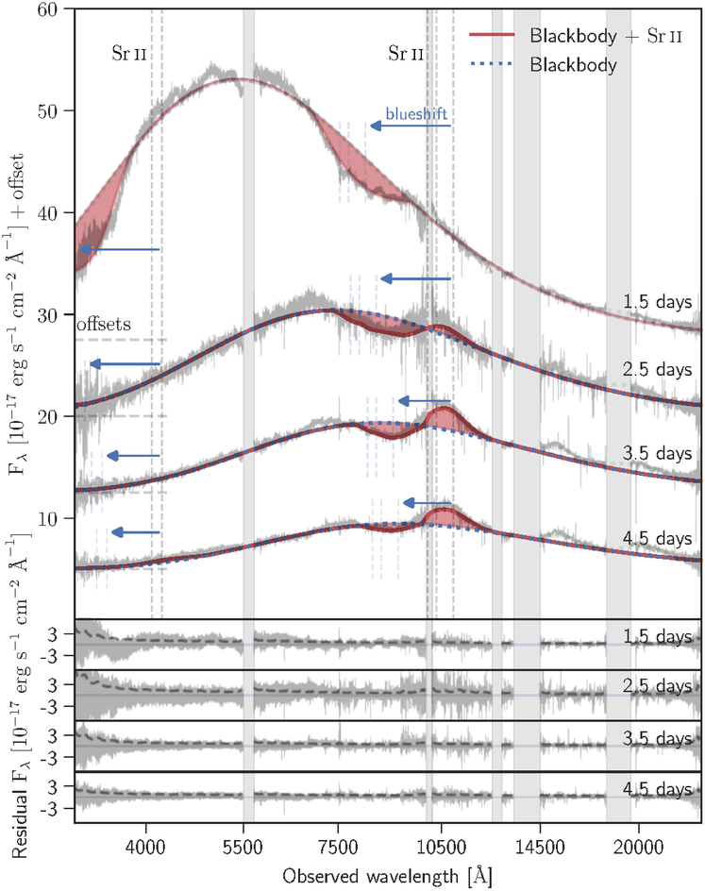
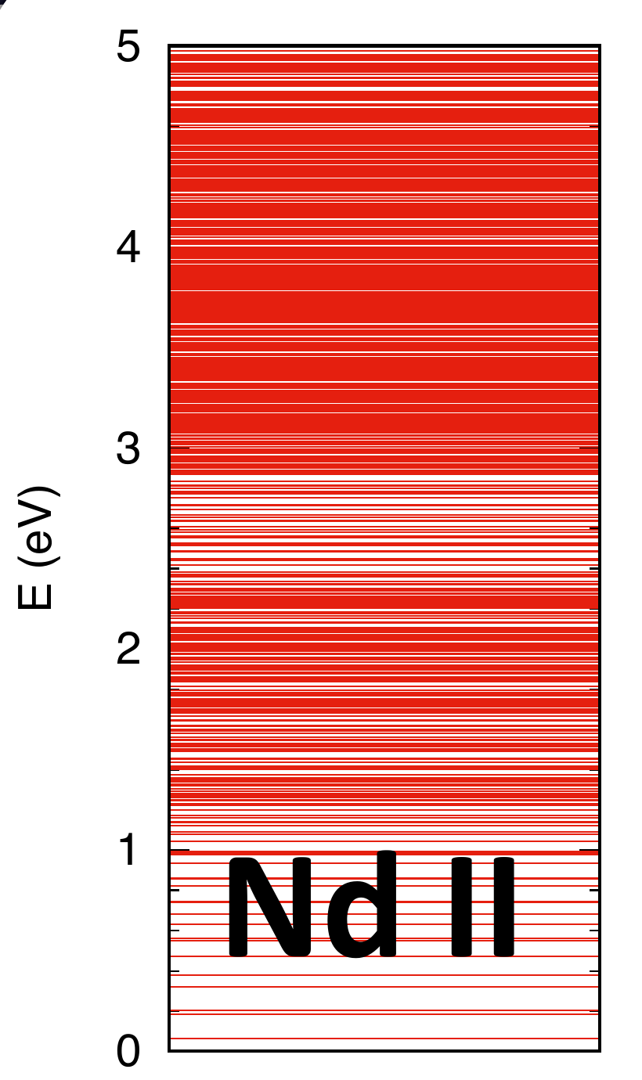
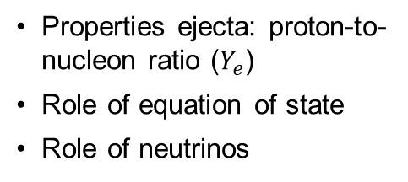
Pipeline for r-process in mergers
Radioactive transfer modelling
Thermalization decay products (Barnes+ 2016, Kasen+ 2019)
Spectra formation: atomic data depends on ejecta evolution (LTE vs NLTE)
Properties ejecta: proton-to-nucleon ratio ($Y_{e}$)
Role of equation of state
Role of neutrinos
Physics of neutron-rich and heavy nuclei
Atomic data
forward modelling
Nuclear data
Atomic data
Bauswein et al, ApJ 773, 78 (2013)
backward modelling
Which r-process elements are produced in mergers?
Are mergers the (main) r-process site?
Watson et al, Nature 574, 497 (2019)
Molecules?
(Xiao Zhang, P36)

Slide 5
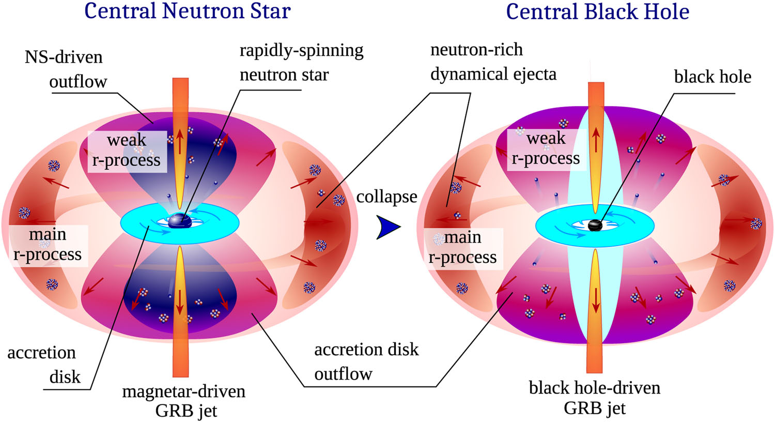

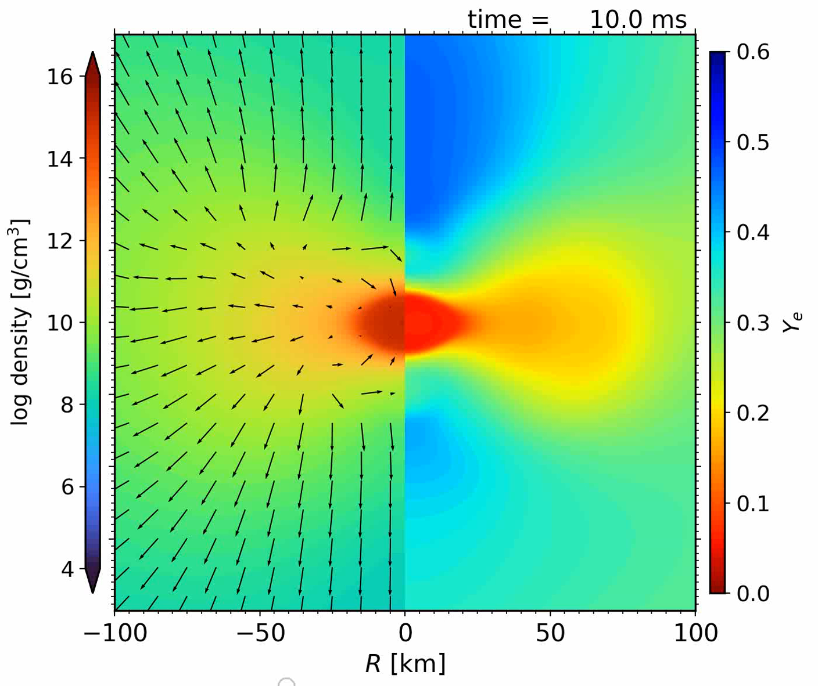
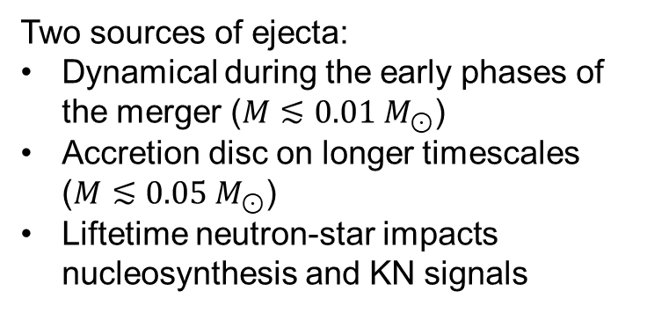
Neutron star mergers:
Different ejection mechanisms
S. Rosswog and O. Korobkin, Annalen Der Physik 2022, 2200306 (2022)
Long-term simulations with neutron star lifetimes 0.1-1 s, all components of the ejecta: dynamical, NS-torus ejecta, and final viscous ejecta from BH torus.
Just et al,
ApJL 951, L12 (2023)
Two sources of ejecta:
Dynamical during the early phases of the merger ($M≲0.01 M_{⊙}$)
Accretion disc on longer timescales ($M≲0.05 M_{⊙}$)
Liftetime neutron-star impacts nucleosynthesis and KN signals

Slide 6


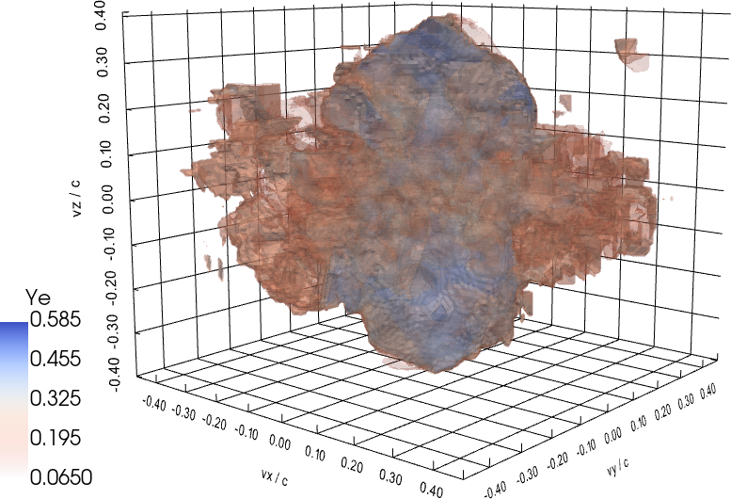
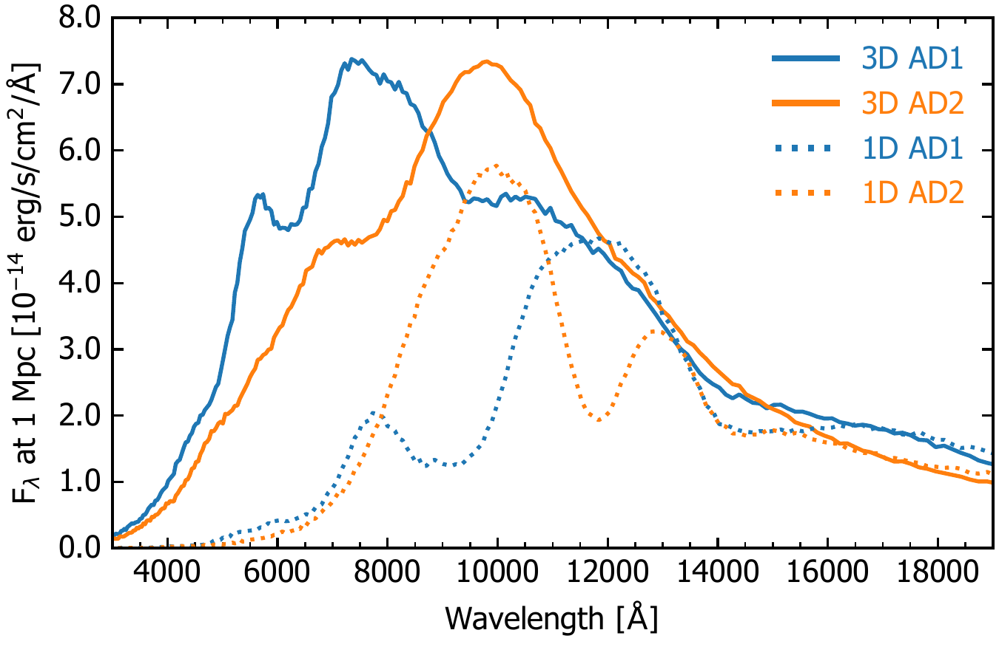
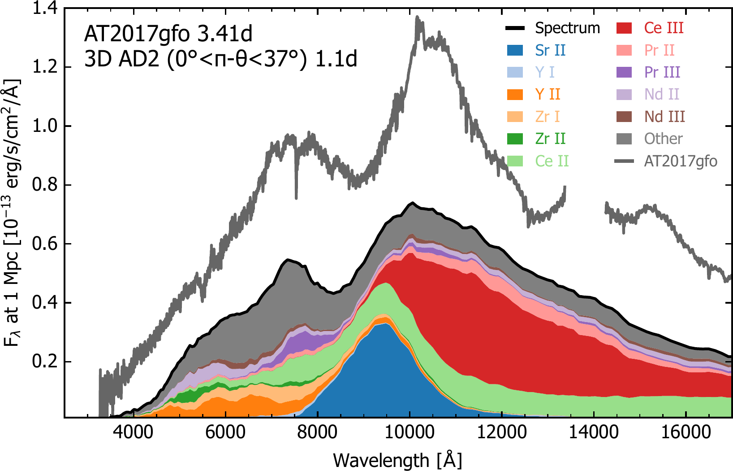
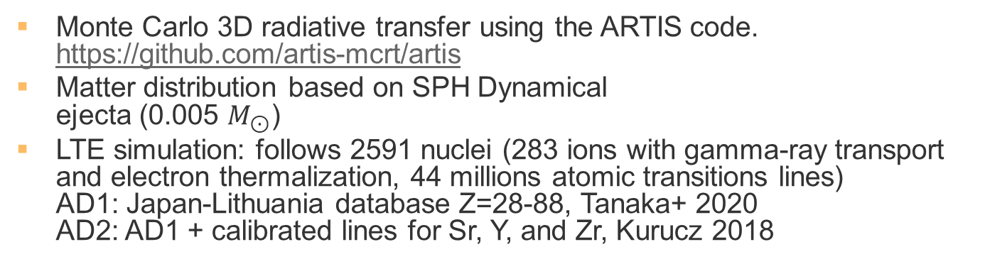
Self-consistent 3D radiative transfer
C. Collins
Monte Carlo 3D radiative transfer using the ARTIS code.
https://github.com/artis-mcrt/artis
Matter distribution based on SPH Dynamical
ejecta (0.005 $M_{⊙}$)
LTE simulation: follows 2591 nuclei (283 ions with gamma-ray transport and electron thermalization, 44 millions atomic transitions lines)
AD1: Japan-Lithuania database Z=28-88, Tanaka+ 2020
AD2: AD1 + calibrated lines for Sr, Y, and Zr, Kurucz 2018
L. Shingles
Shingles et al, ApJ 954, L41 (2023); Collins et al, A&A 712, A229 (2026)
Key role :
Calibrated atomic opacities
Multidimensional effects

Slide 7
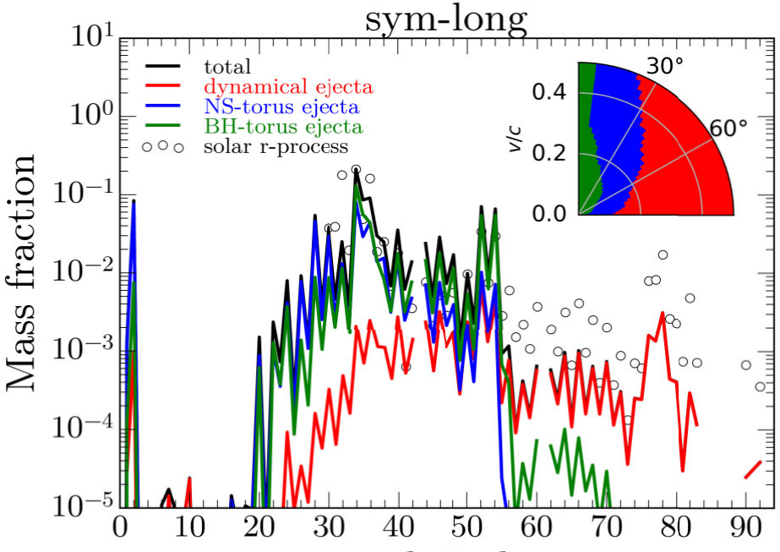
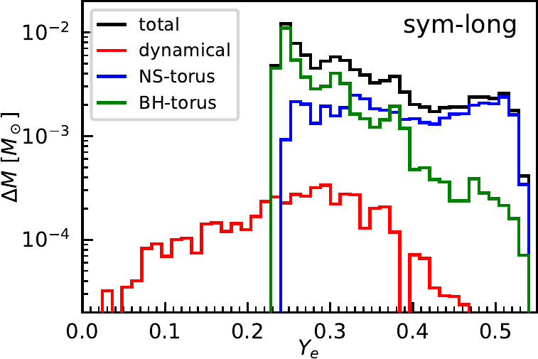
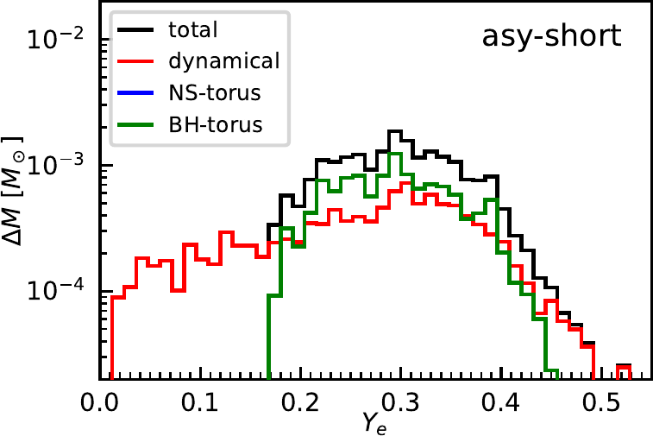
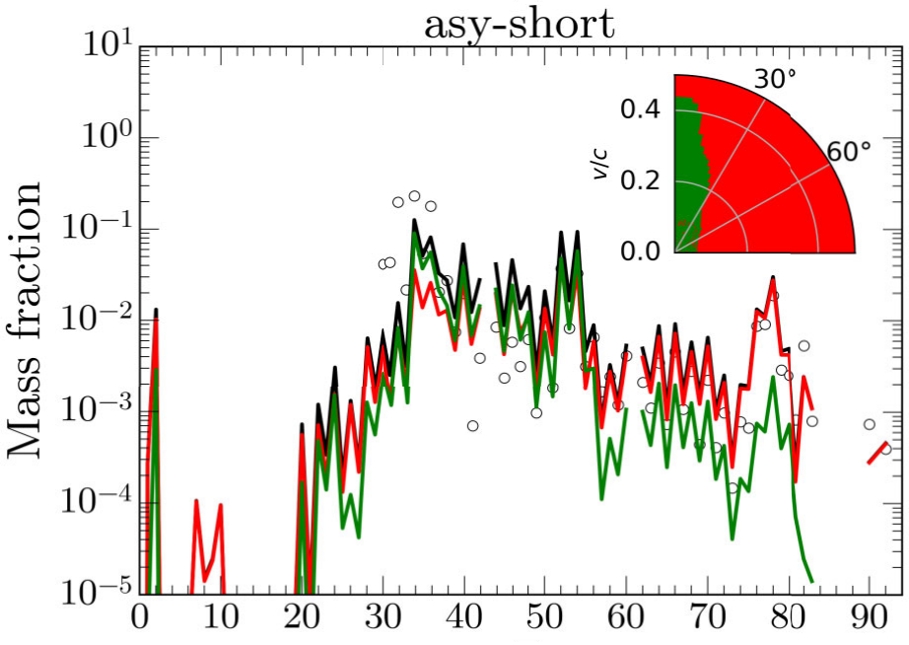




Ejecta model variability
Sim, et al, MNRAS 551, stag1384 (2026)
$$1.375+1.375 M_{⊙}$$
$$M_{ej}=0.095 M_{⊙}$$
$$1.2+1.6 M_{⊙}$$
Z
$$M_{ej}=0.025 M_{⊙}$$
Z

Slide 8

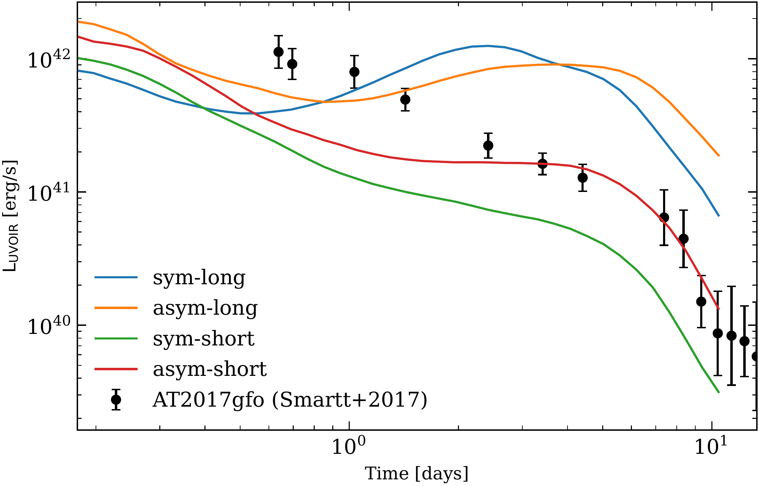
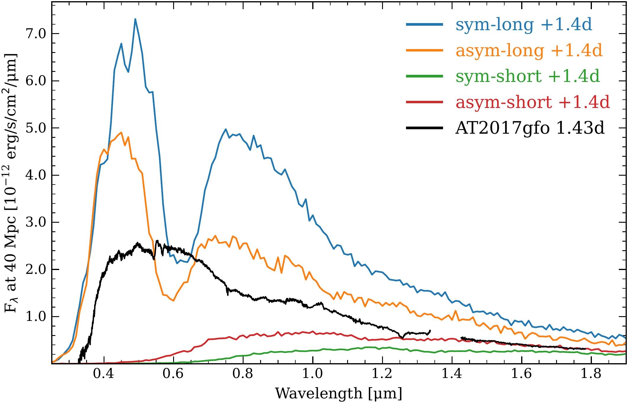
KN light curves and spectra
Gerrit Leck
Light curves mainly sensitive to ejected mass
Spectra provides information about progenitor system, composition and ejecta distribution
Signatures of neutron lifetime: constraints on equation of state

Slide 9




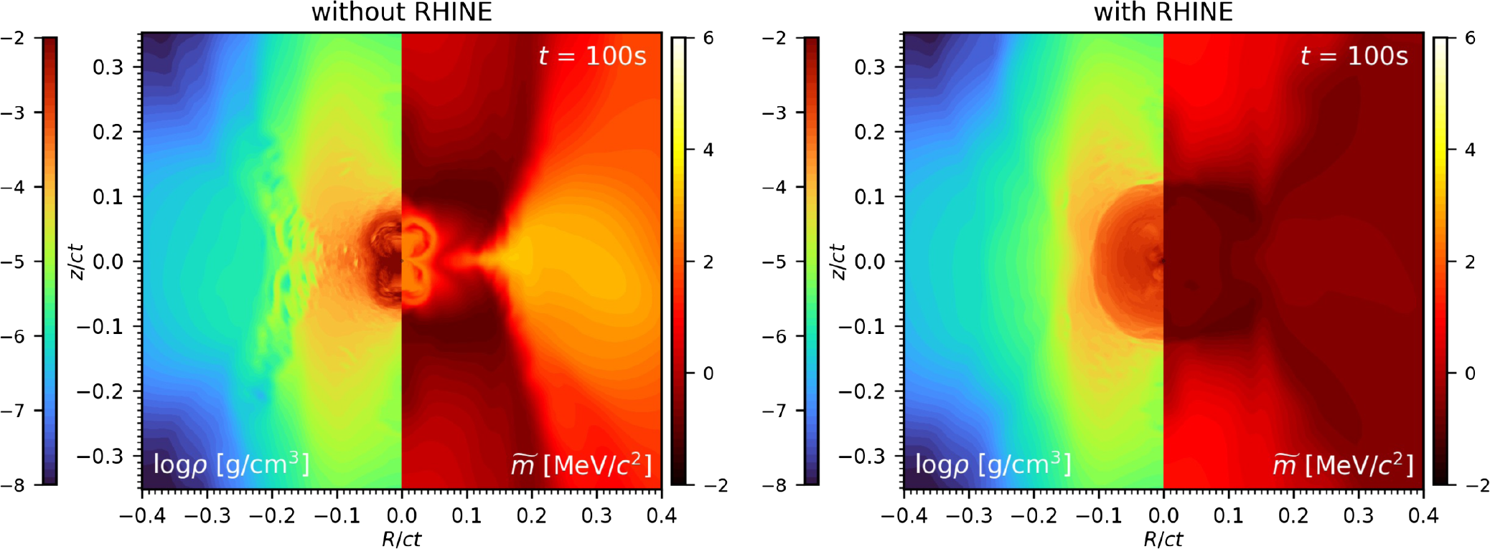
Effect Nuclear Heating Ejecta
Zewei Xiong
Oliver Just
Phys. Rev. D 113, 063041 (2026)
Nuclear heating increases the amount of low velocity ejecta affecting mainly black-hole-torus ejecta (20% increase ejected mass)

Slide 10
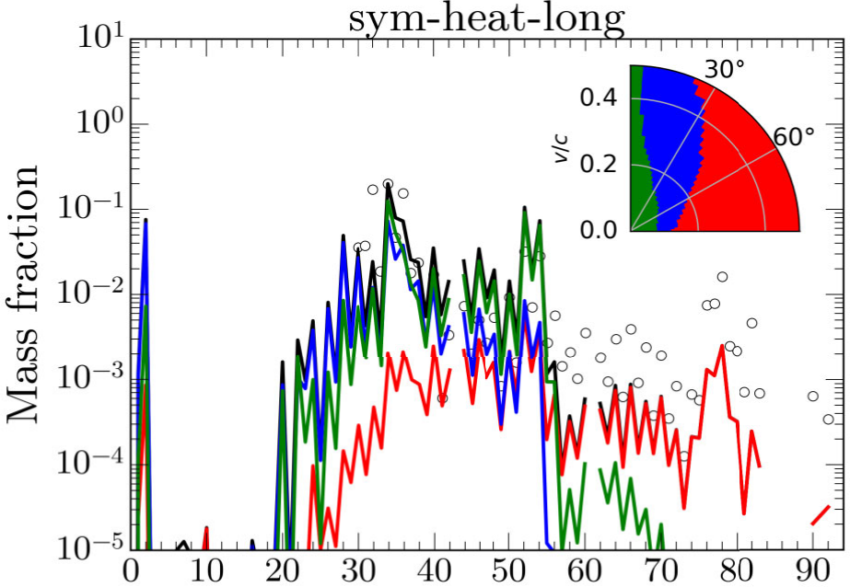
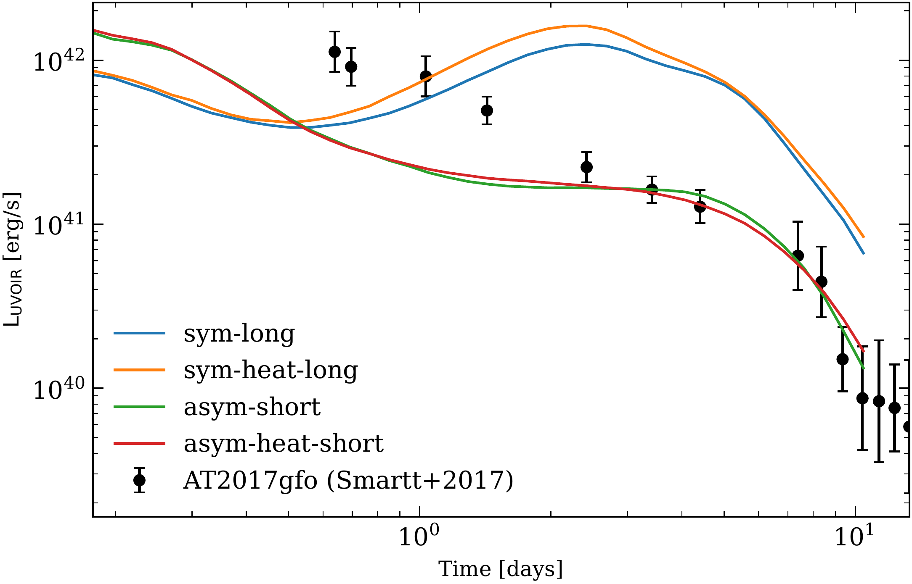
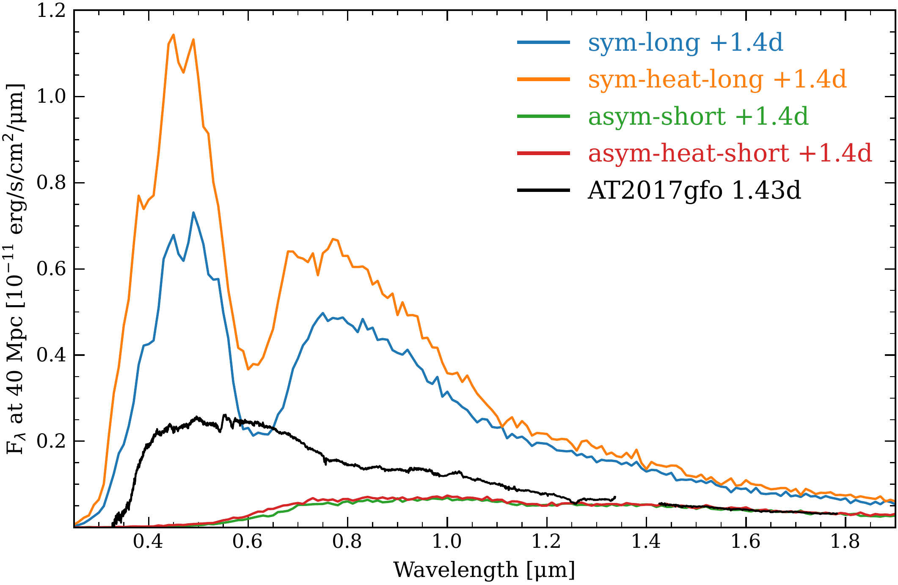


Impact abundances and KN signal
$$M_{ej}=0.095 M_{⊙}, M_{BH}=0.048 M_{⊙}$$
$$M_{ej}=0.107 M_{⊙}, M_{BH}=0.060 M_{⊙}$$

Slide 11

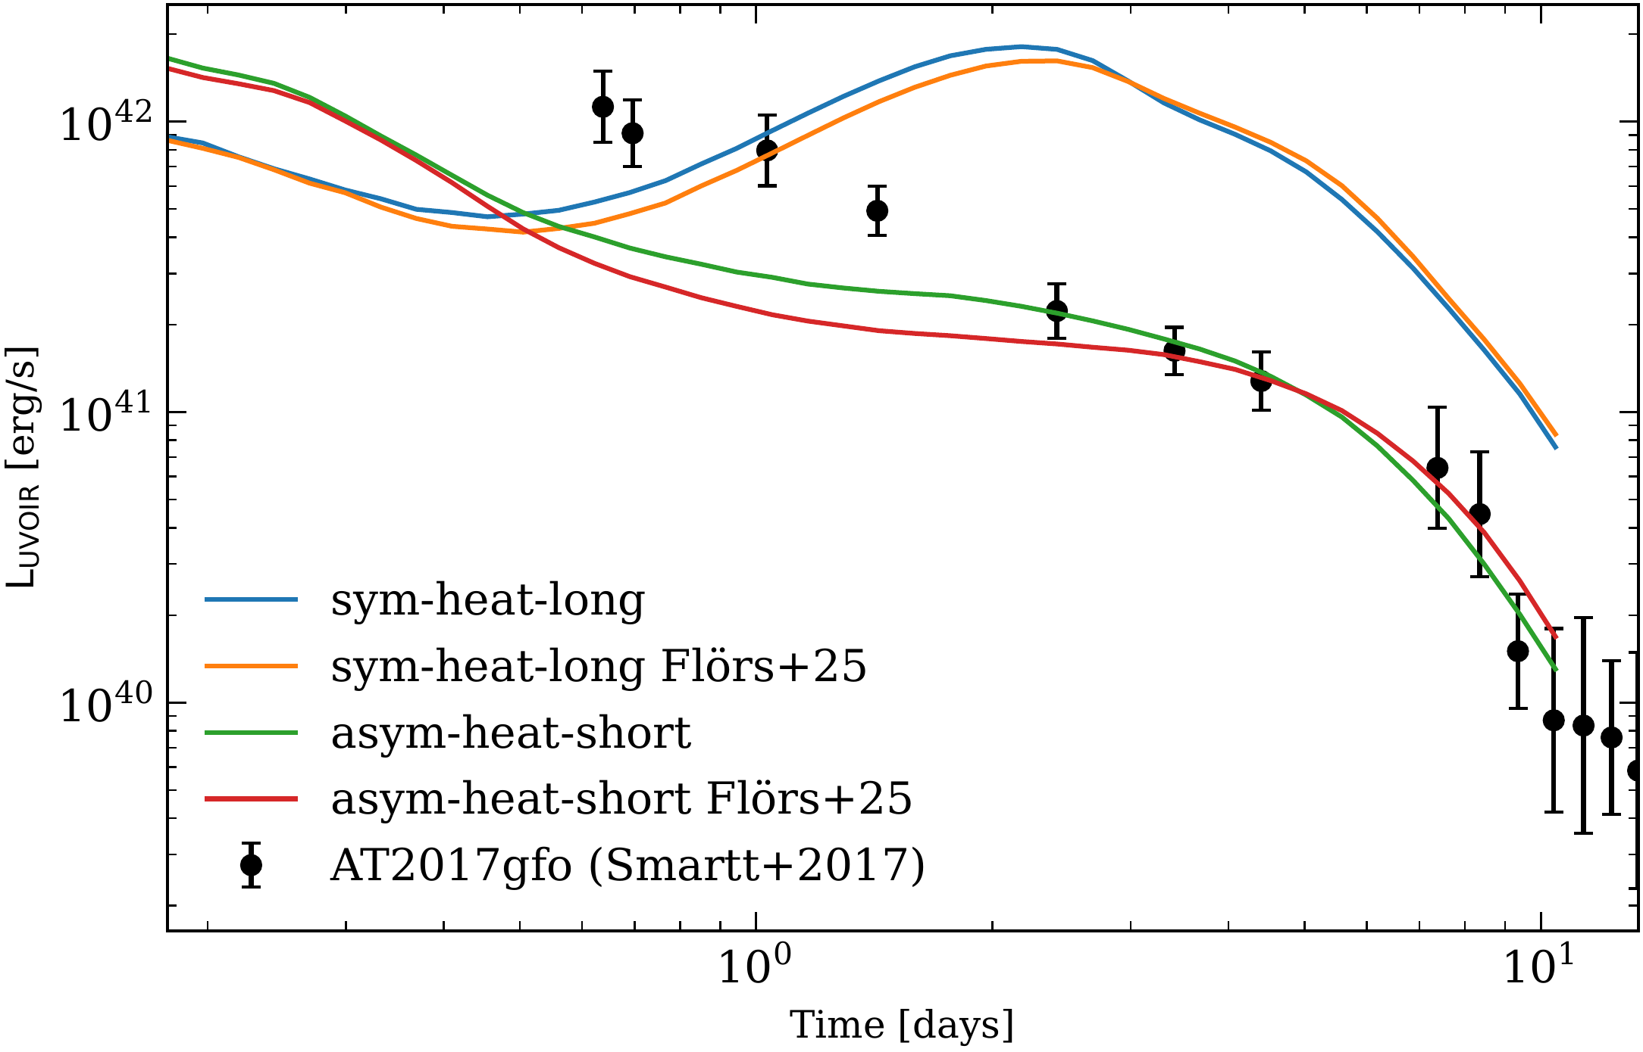
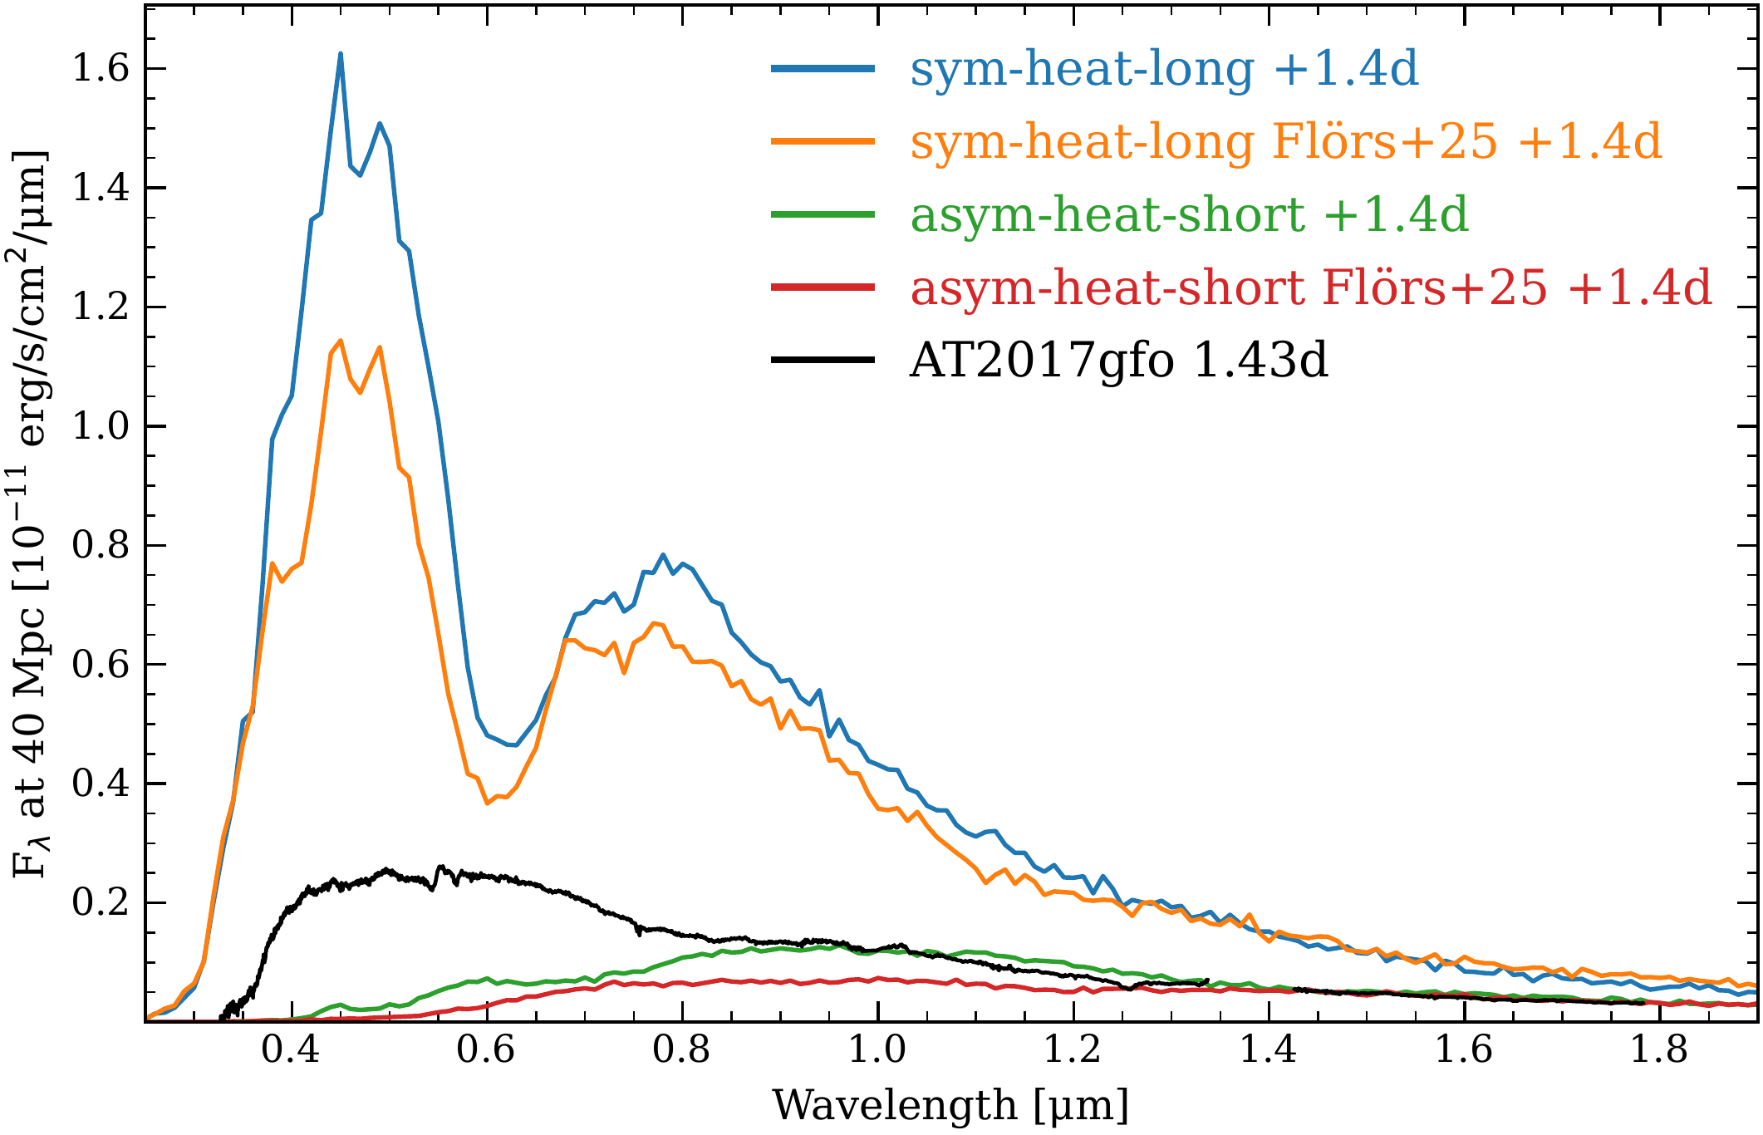
Calibrated atomic data for kilonova modeling
A. Flörs
Calibrated lanthanide (Z=67-70) atomic data
66 722 transitions with experimentally calibrated wavelengths
Phys. Rev. D 113, 063041 (2026)

Slide 12
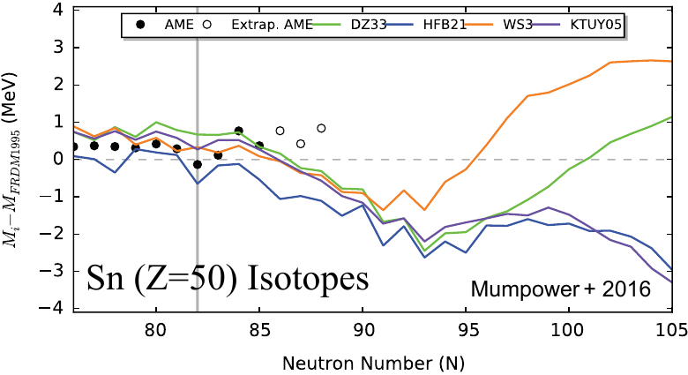
Theoretical masses far from stability
Horowitz et al, JPG 46 083001 (2019)
Theoretical models do rather well far from stability!
Spread due to small differences in bulk properties (e.g. symmetry energy difference ~ 0.5 MeV).
Limited impact on r-process nucleosynthesis!

Slide 13
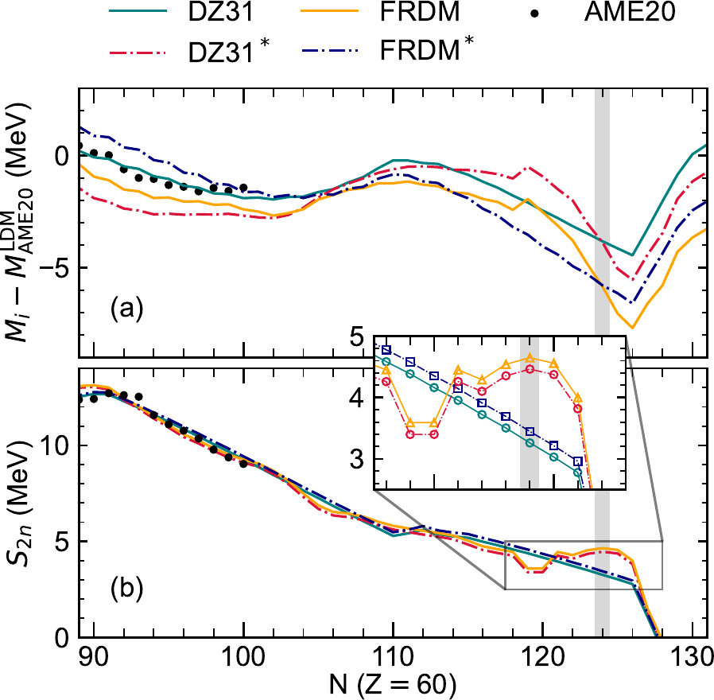
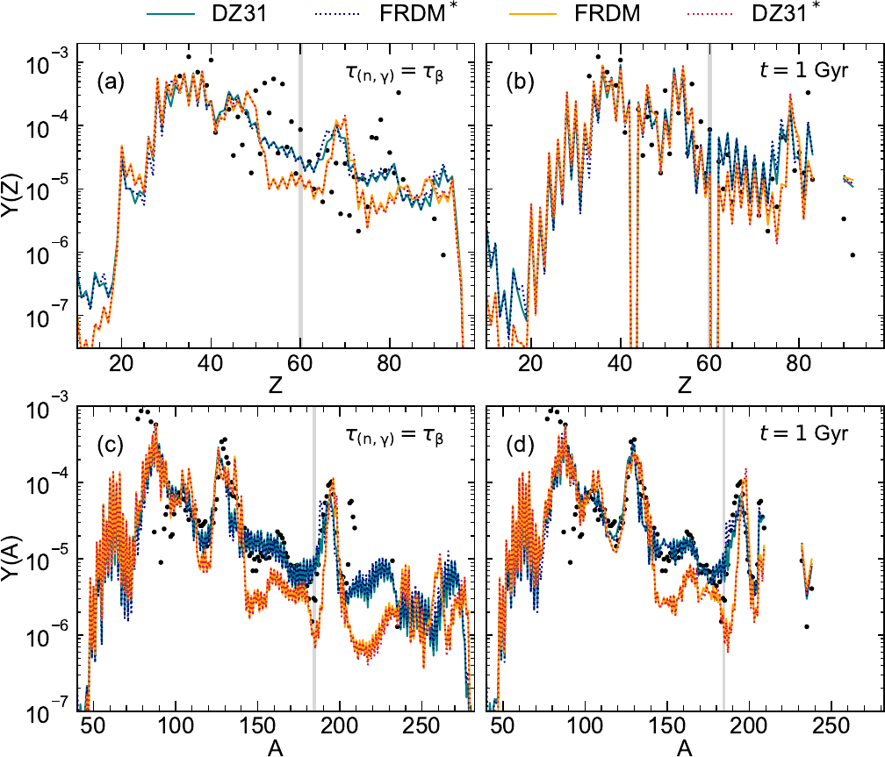
Nuclear masses for r-process nuclei
Mass models give very different predictions beyond experimentally known regions.
How do the large differences impact r-process abundances?
Decompose masses in smooth (bulk properties like symmetry energy) and local parts (shell effects).
Giuliani, et al, Phys. Rev. C 113, 045806 (2026)
Nd Isotopes

Slide 14
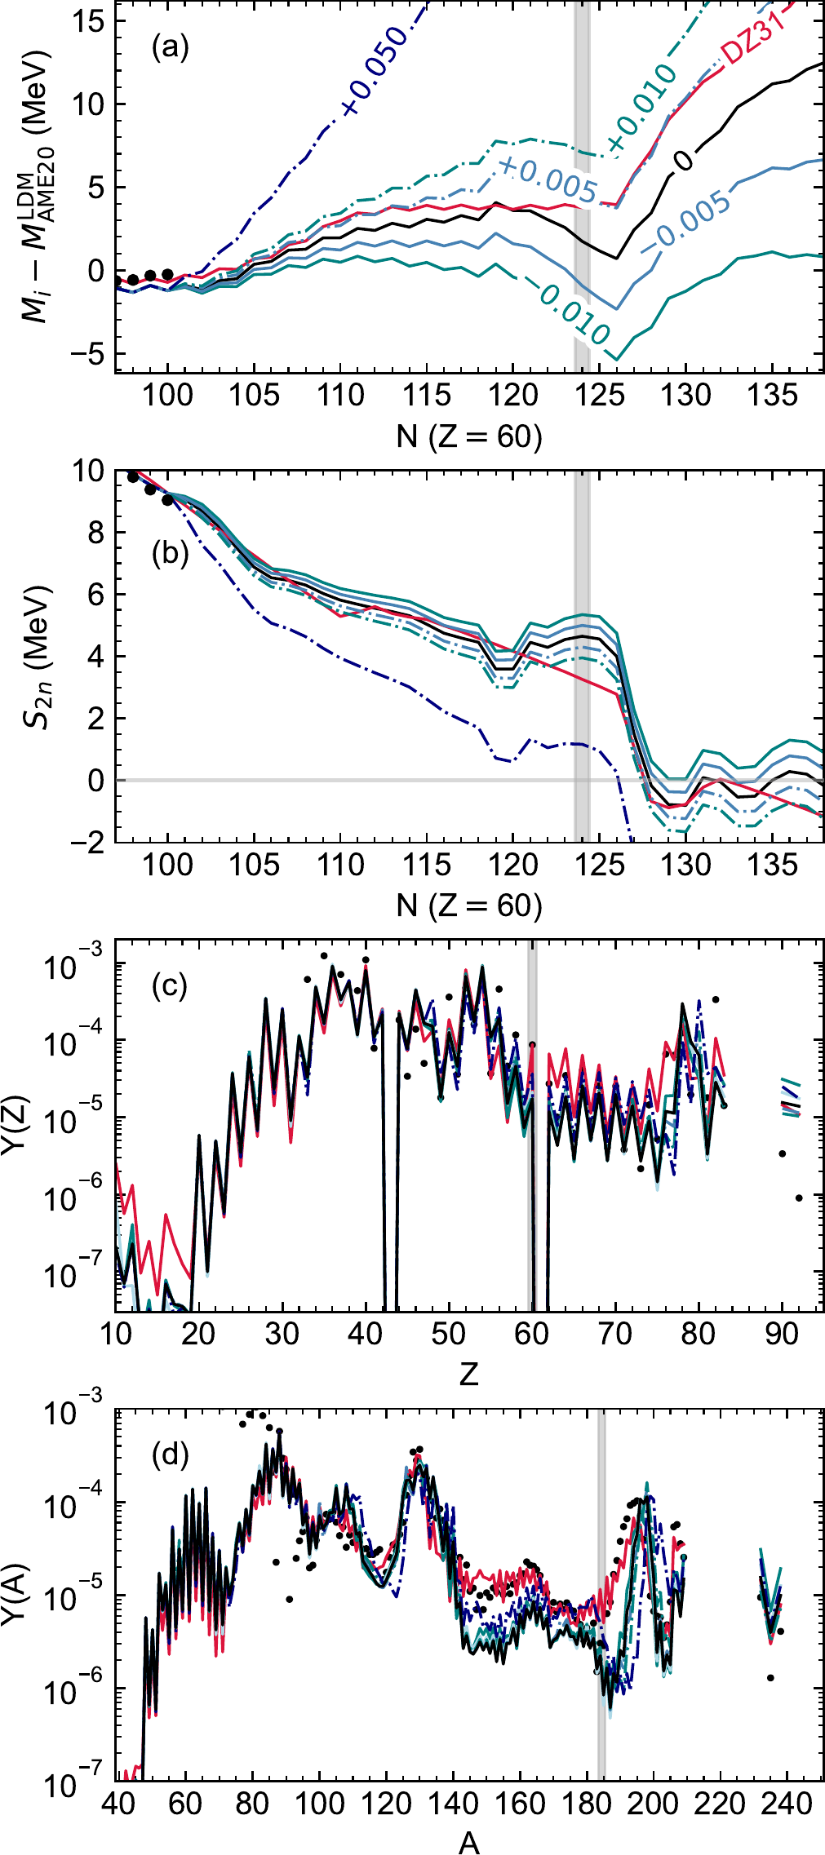
Masses (main conclusions)
Large changes in the smooth (liquid drop) behavior of masses barely impact the
r-process abundances.
Abundances are rather sensitive to local irregularities (shell effects) in the mass surfaces.
Approaches aiming to determine nuclear masses should aim to confirm the presence of local irregularities in mass surfaces.
Giuliani, et al, Phys. Rev. C 113, 045806 (2026)

Slide 15
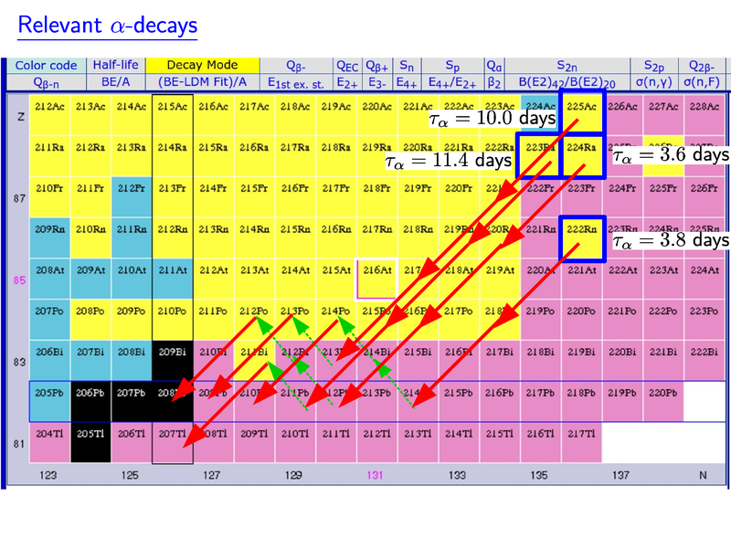
Can we find a signature of actinides?
Wu, Barnes, GMP, Metzger, PRL 122, 062701 (2019)
If actinides are present alpha-decay chains may dominate the energy generation on timescales of days.
Fission plays a secondary role except perhaps the presence of ²⁵⁴Cf

Slide 16
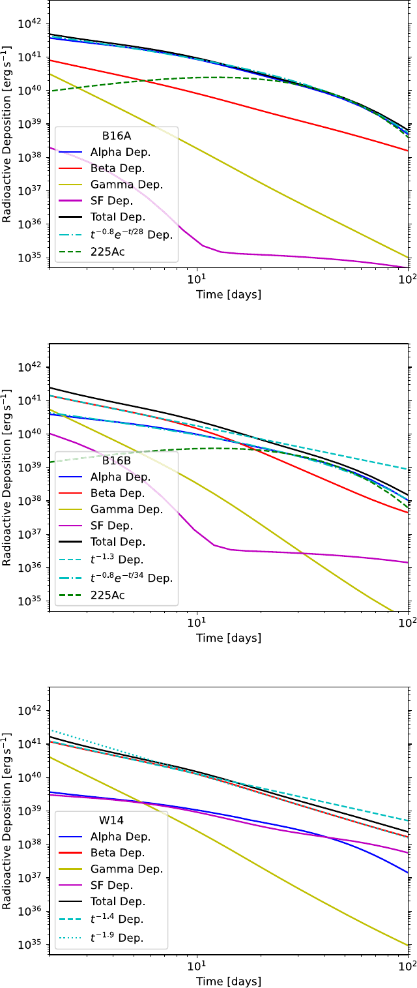
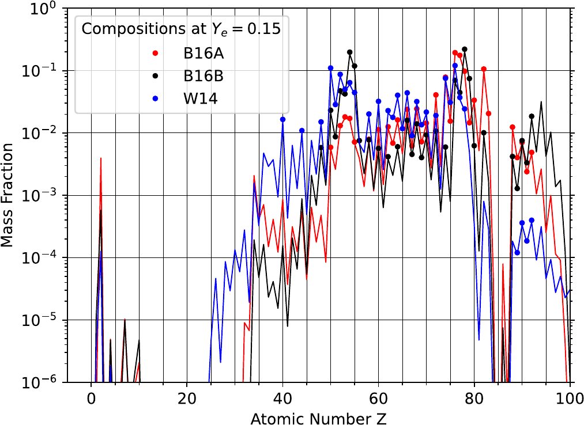
Impact of actinides
Different nuclear inputs (masses) predict substantial differences in the production of Actinides
Their alpha decay, mainly ²²⁵Ac, contributes substantially to the energy production
Pognan, et al, MNRAS 536, 2973 (2025).

Slide 17
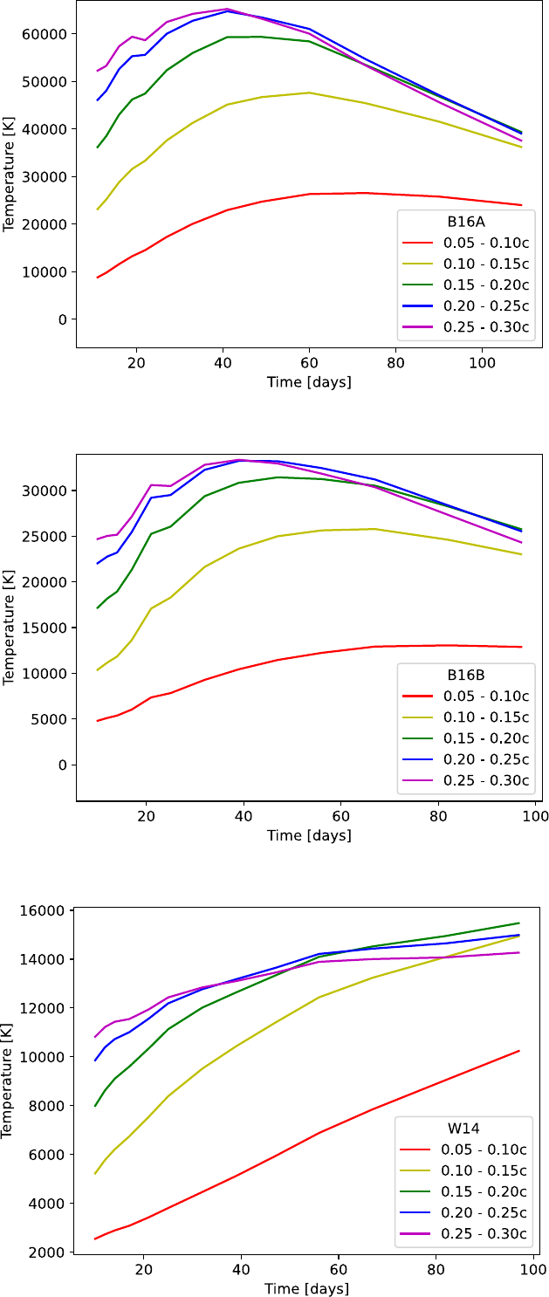
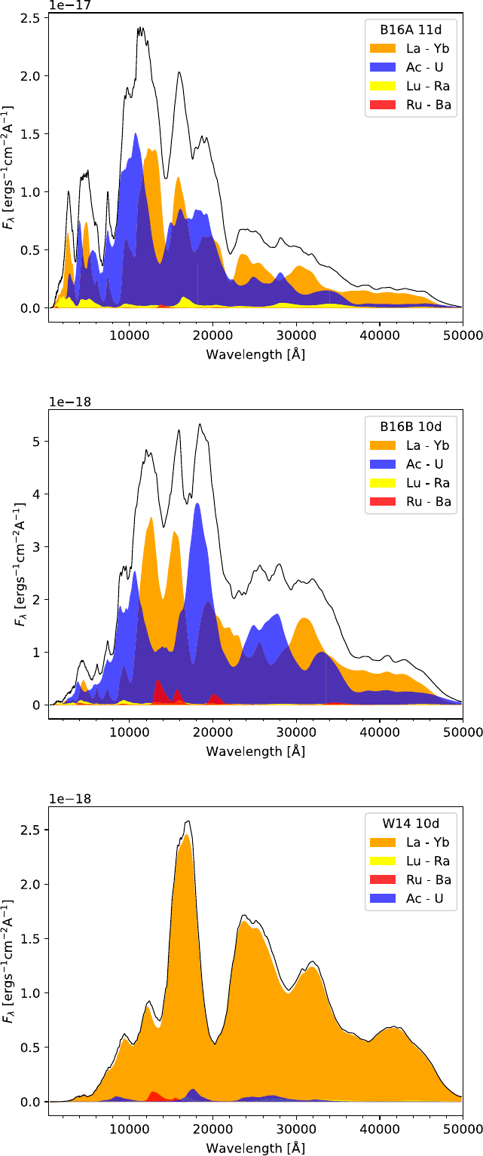
Impact Temperature and Spectra
Higher energy deposition leads larger temperatures
Leads to larger emitted fluxes
Spectra dominated by shorter wavelengths (hotter material)
Actinides dominate the spectra.
Pognan, et al, MNRAS 536, 2973 (2025).

Slide 18







Summary
Connecting neutron-star merger simulations to kilonova spectra predictions via radiative transfer modeling is key to understand variations in r-process sites.
Collaborators
A. Bauswein, A. Flörs, O. Just, N. Kumar, G. Leck, Z. Xiong
P. Amaro, J. P. Marques, J. M. Sampaio, R. Silva
S. Sim, L. Shingles | C. Collins
S. Giuliani | L. Robledo

