Slide 1
OAP Alignment Training Group B Report
Cană Alexandra
Naum Diana
Iancu Andrei

Slide 2
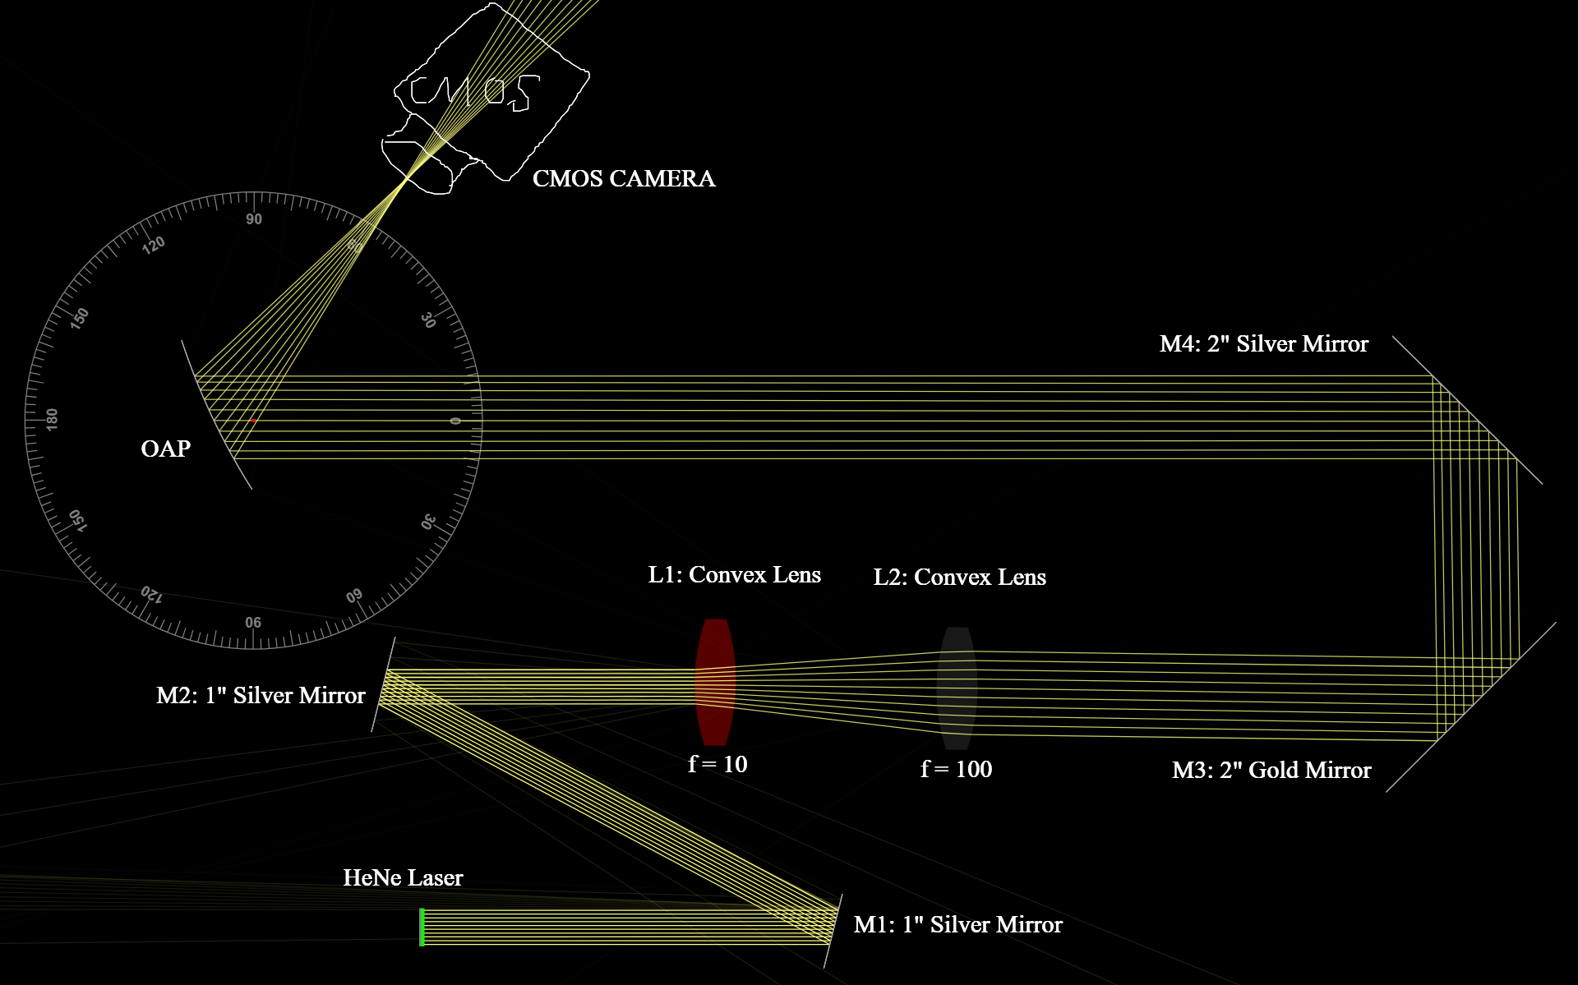
Optical Setup
Our experimental setup consisted of the following components arranged in linear and reflective stages
The beam path was carefully designed to ensure proper collimation, alignment, and focusing through each component.

Slide 3
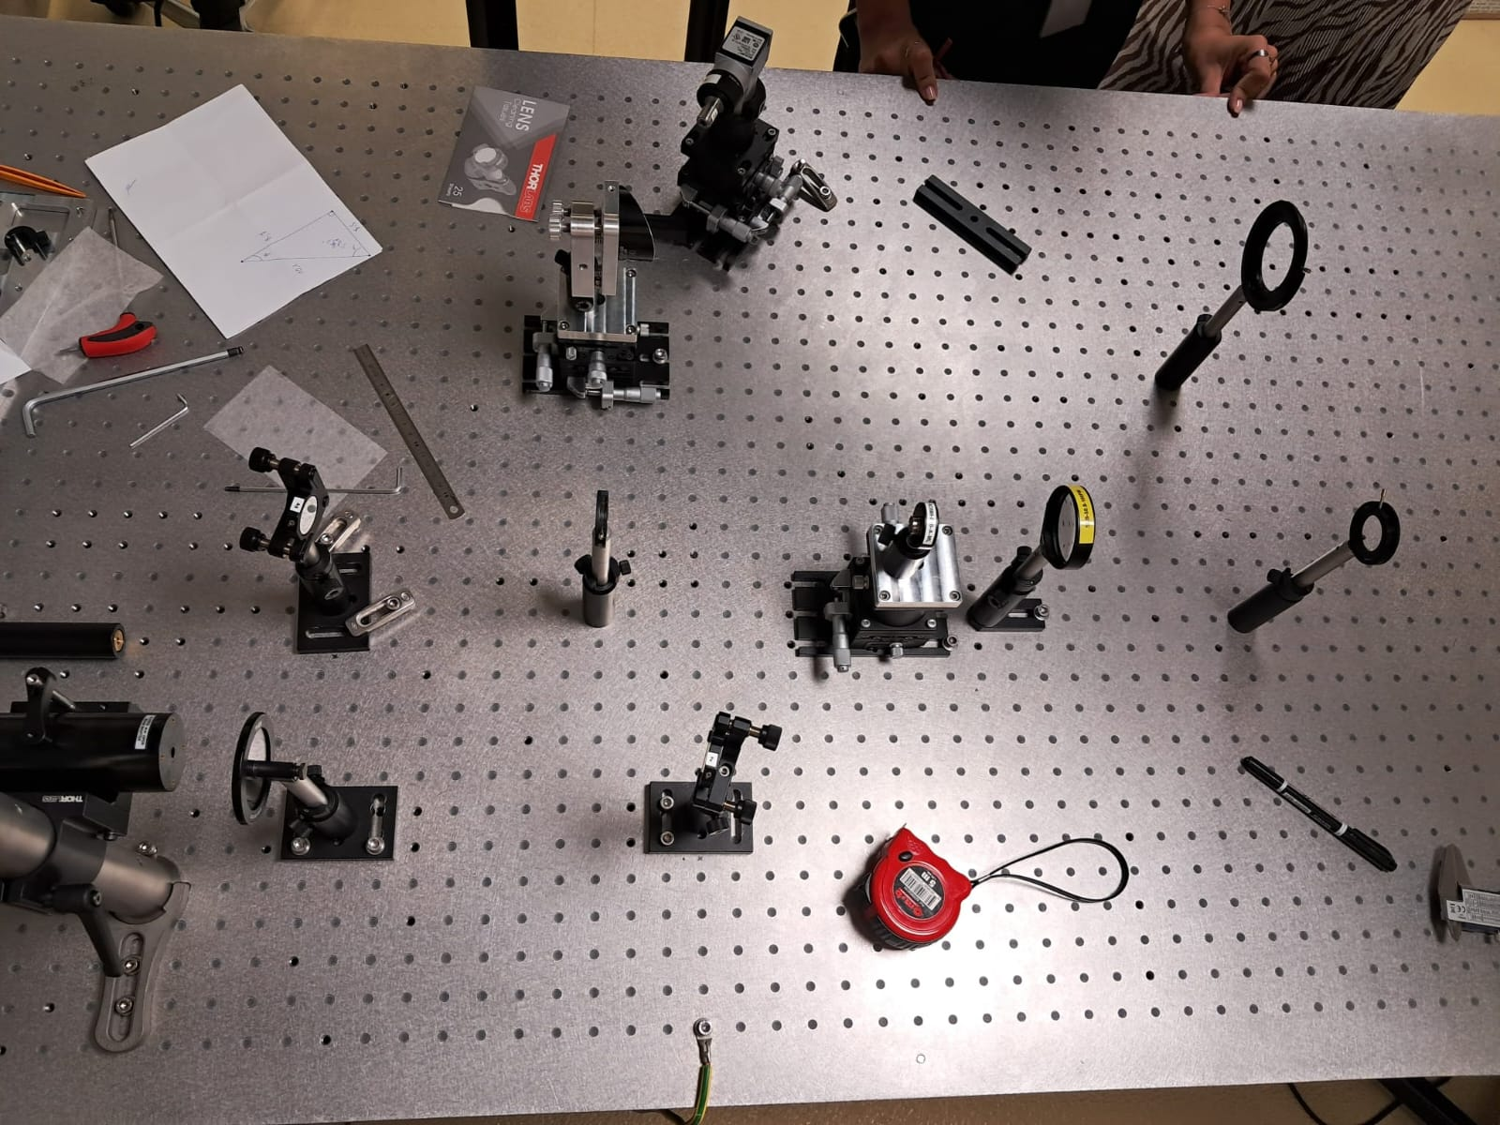
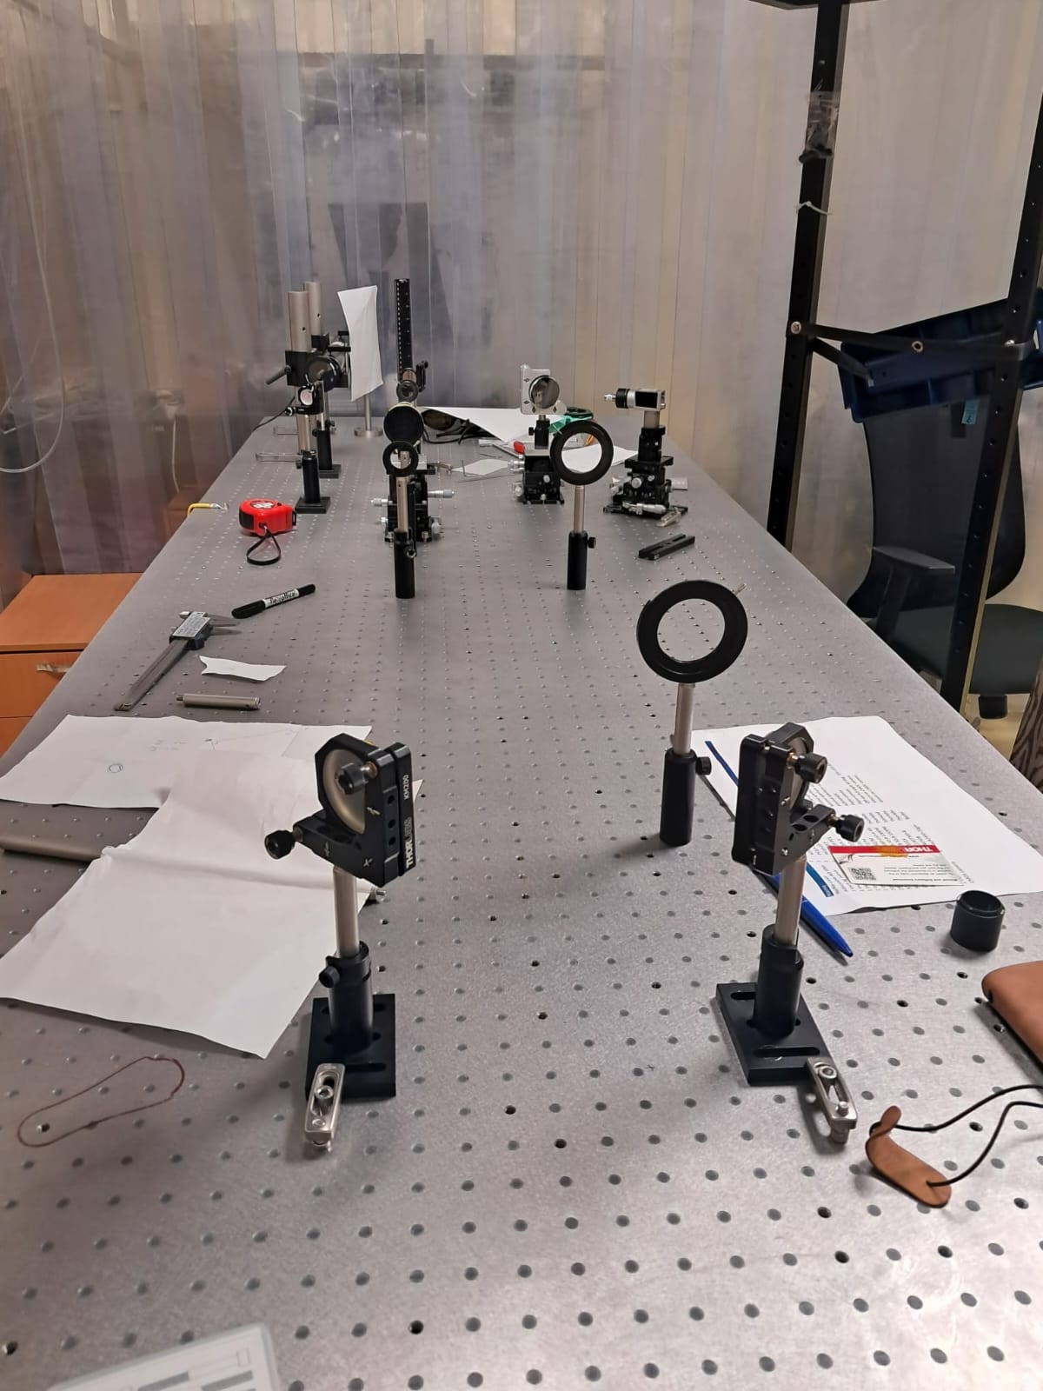

Slide 4
List of the optical components used
HeNe Laser
Adjustable ND Filter
M1 (1” Silver mirror)
M2 (1” Silver mirror)
Iris 1
L1: Convex lens (f = 10 mm)
L2: Convex lens (f = 100 mm)
Iris 2
M3 (2” Gold mirror)
M4 (2” Silver mirror)
Iris 3
Iris 4
OAP Mirror
(Off Axis, full angle 60°, EFL = 101.6 mm)
Aspheric lens (f = 4.5 mm)
CMOS Camera

Slide 5
Alignment Procedure - Beam Expander
The beam expander used two convex lenses (f = 10 mm and f = 100 mm) in a Keplerian configuration.
We adjusted the distance between the lenses to the sum of their focal lengths.
Collimation was verified using Iris 2 and by observing beam diameter consistency.

Slide 6
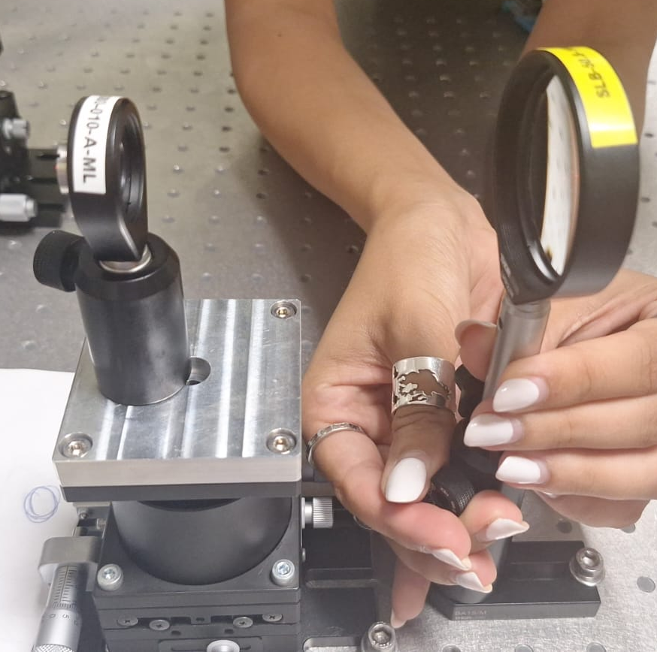
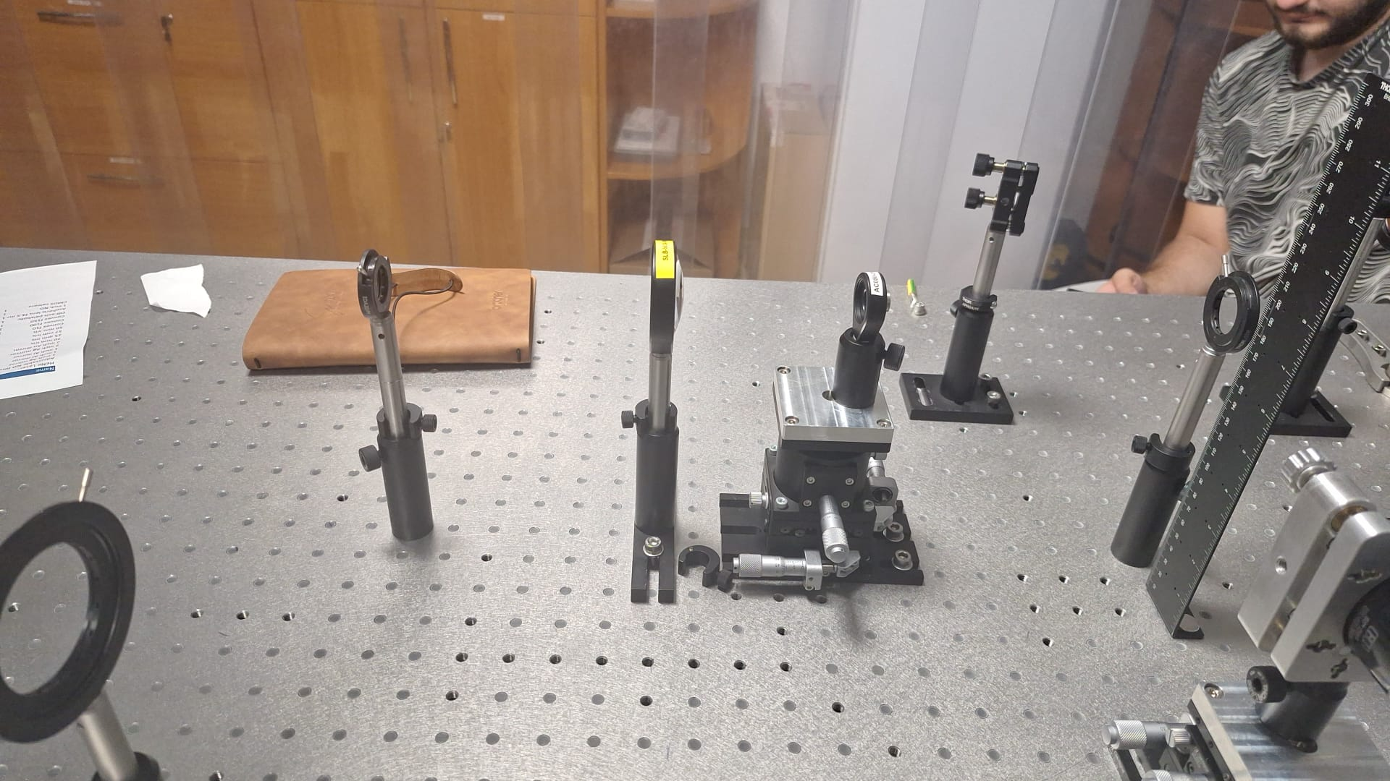
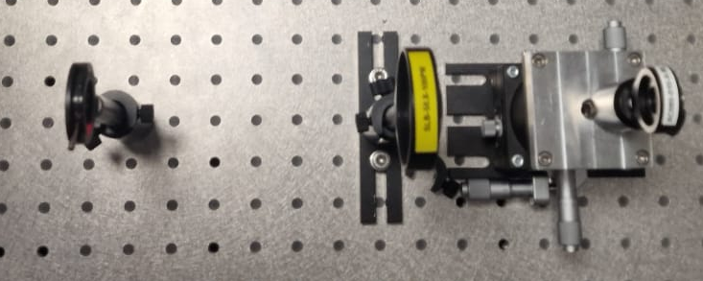

Slide 7
Optimization of Angle of Incidence to OAP
Beam was guided through M3 and M4 toward the OAP.
Pitch and yaw adjustments were made to ensure the beam entered the OAP at the correct off-axis angle.
Astigmatic distortion in the focal spot was used as a cue to refine angular alignment.

Slide 8
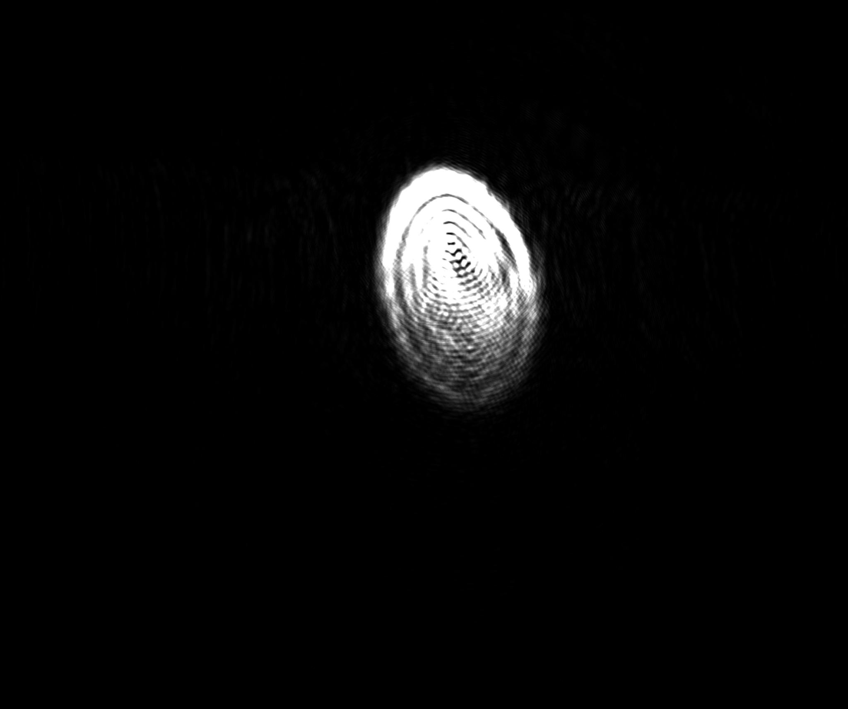
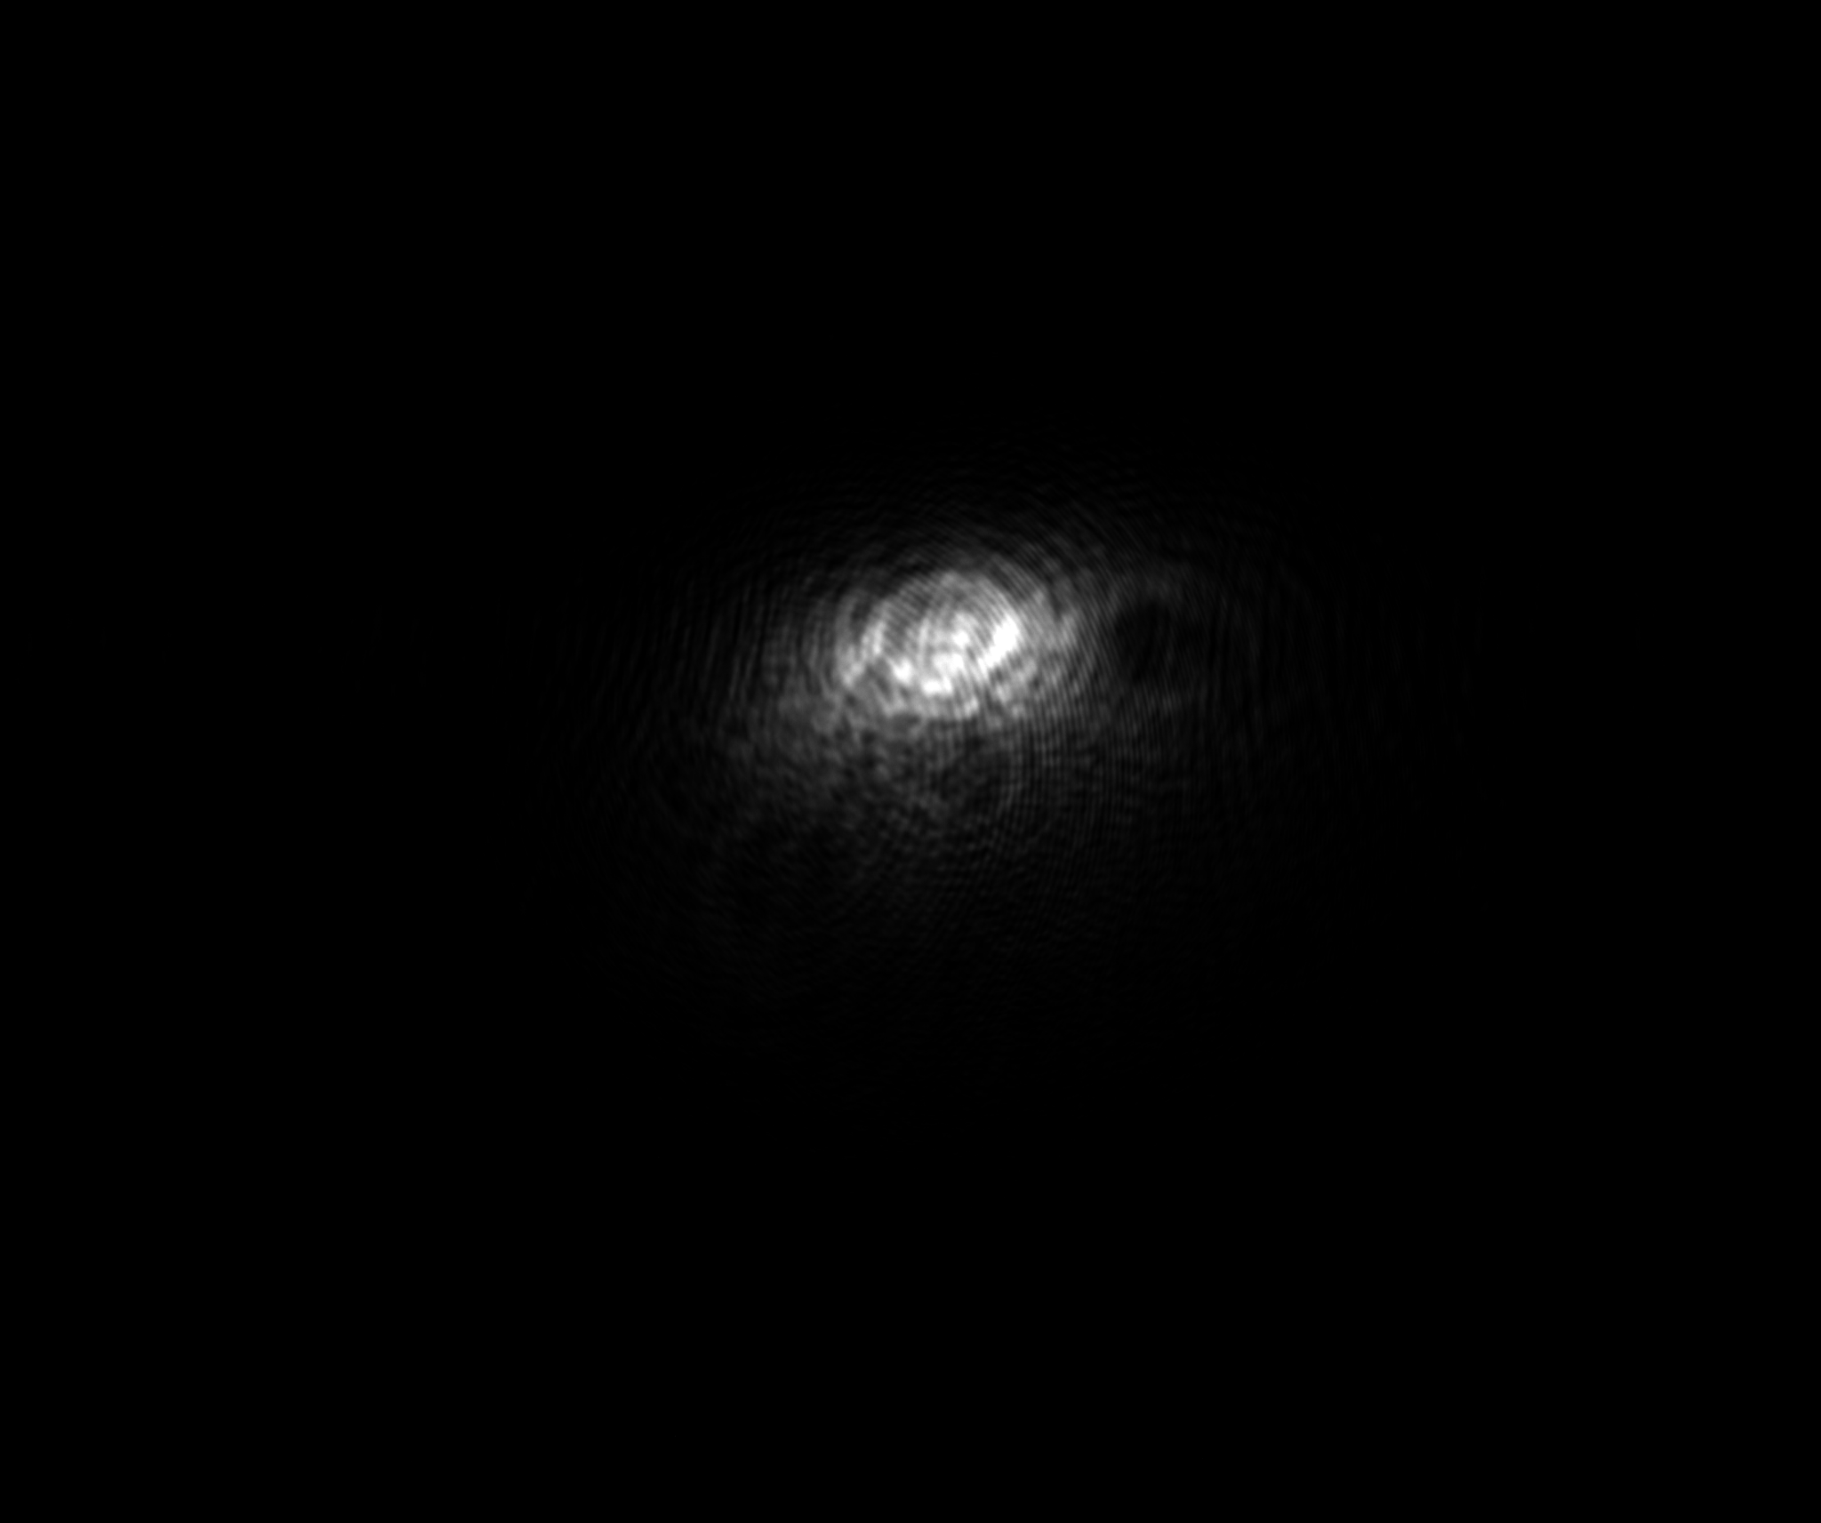
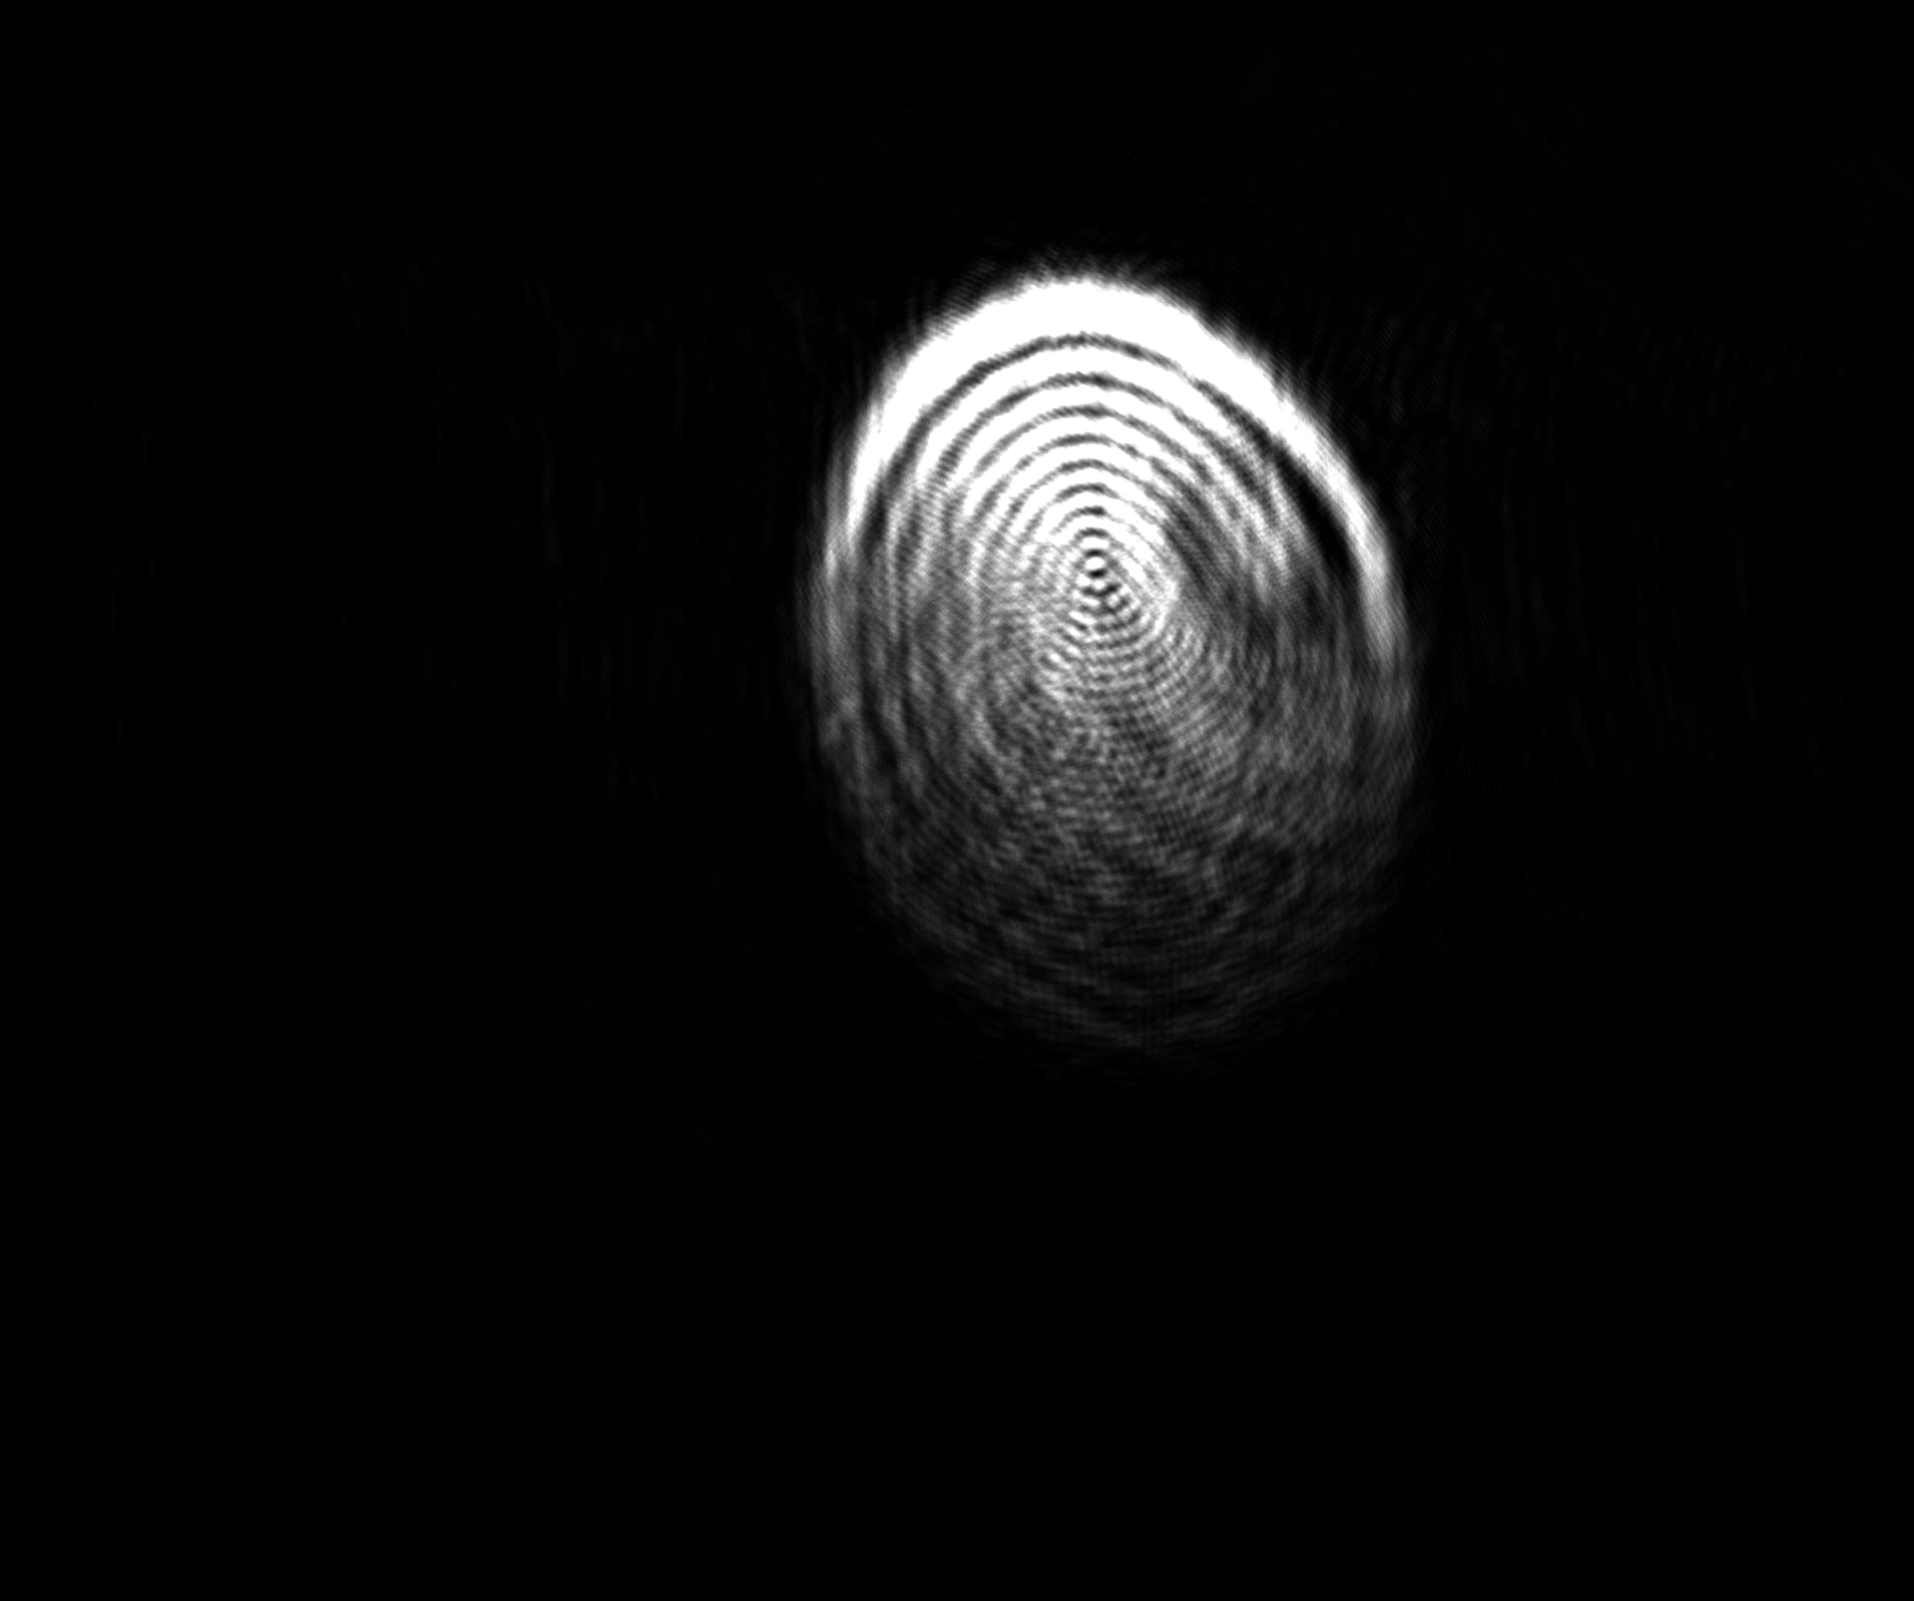

Slide 9
Optimization of Angle of Outgoing Beam from OAP
The beam's reflection from the OAP was directed into the CMOS camera via the aspheric lens.
Fine tuning of camera height and lateral position ensured the beam focus landed on center.
Iterative adjustments of the OAP orientation helped improve symmetry and minimize spot size.

Slide 10
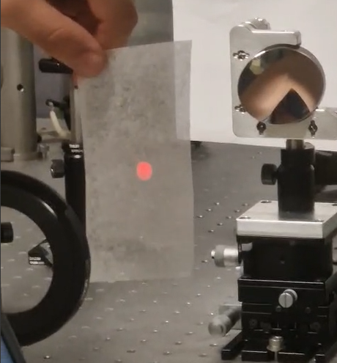

Slide 11
Measurement, Analysis, and Results
Images of the beam spot before and after alignment were recorded using the CMOS camera.
Beam shape data was collected at various camera positions (z-scan).
Spot size was measured using pixel dimensions converted into microns.
Circularity and intensity distribution were analyzed visually and with centroid tools.
Compared experimental spot to theoretical Gaussian shape.

Slide 12
Analysis Results
Initial beam showed strong astigmatism and elongation.
Final spot after optimization was nearly circular and well-focused.
Estimated spot radius was consistent with Gaussian predictions.
One pixel from the camera we used corresponds to 3.45 x 3.45 μm.
After calibration, the size of the beam spot has 17 pixels which results to 58.65 x 58.65 μm.
To verify the stability and accuracy of the alignment, we performed two additional z-scan measurements by adjusting the CMOS camera position: once by +10 μm (20 pixels, ~69 × 69 μm) and once by -10 μm (18 pixels, ~62.1 × 62.1 μm).

Slide 13
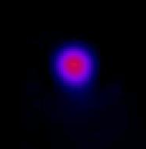
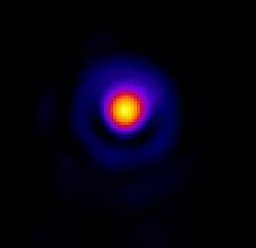
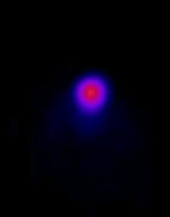
Calibration on z-axis
z = -10 μm
z = 0 μm
z = +10μm

Slide 14
Opinions and Insights - What we learned?
Most Difficult/Critical Part:
The fine angular alignment of the OAP was the most sensitive and challenging part.
Minor changes in yaw/pitch led to significant deviations in focal spot shape.
How we tackled these difficulties:
Used real-time CMOS feedback to iteratively tune angles.
Applied gradual, controlled adjustments while observing spot symmetry.
Re-checked lens spacing and beam collimation after each major change.
In order to fully understand how to use the parabolic mirror in an OAP configuration, we calibrated the mirror three times.

Slide 15
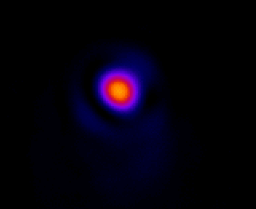
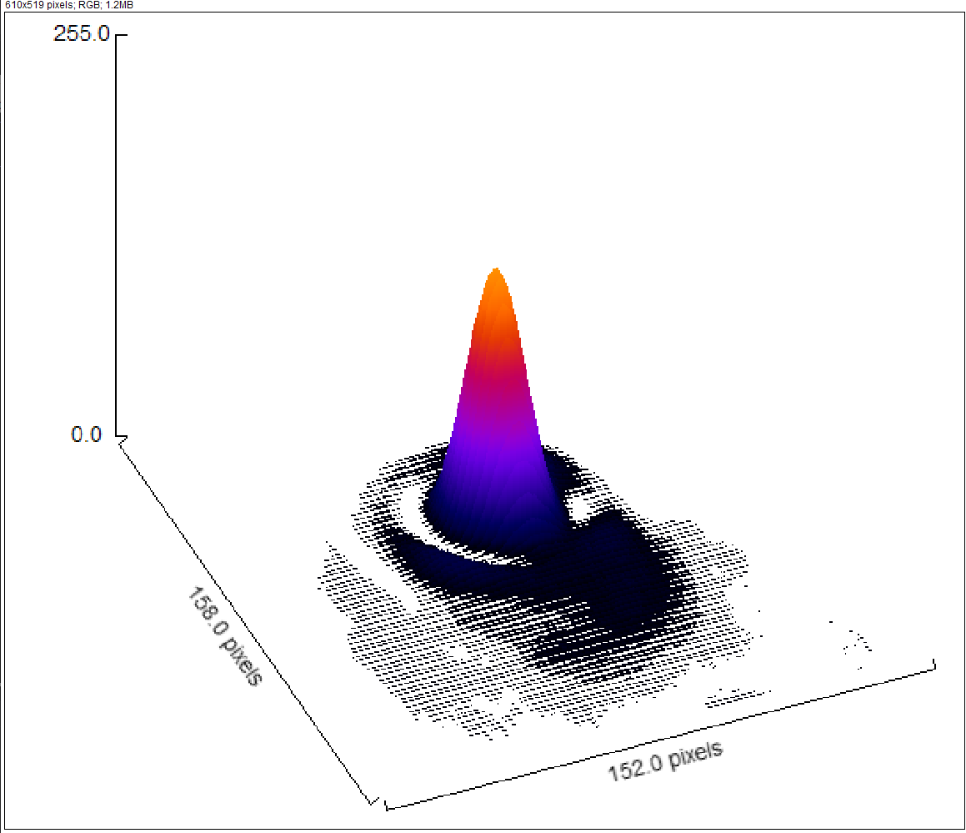
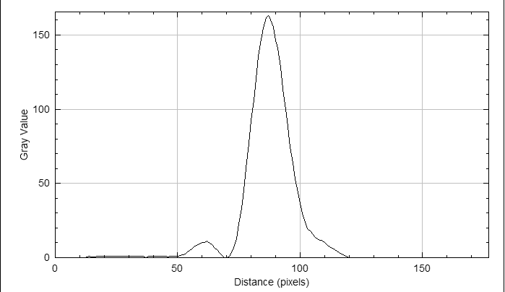

Slide 16
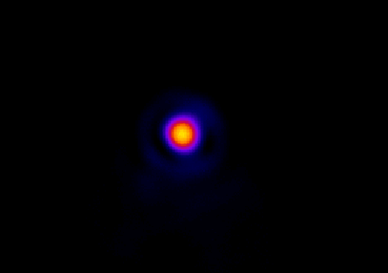
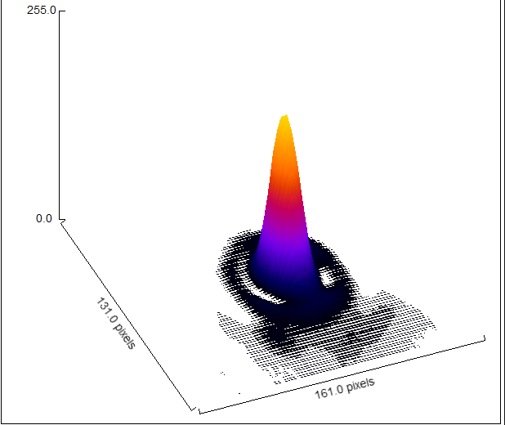
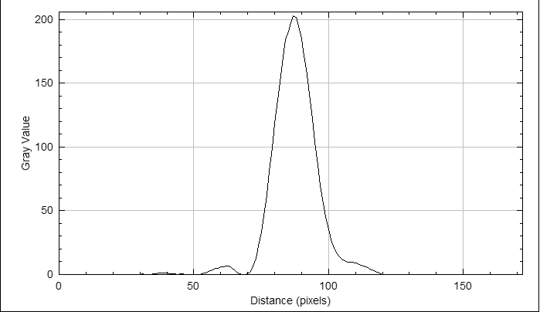

Slide 17
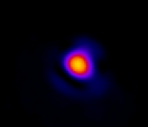
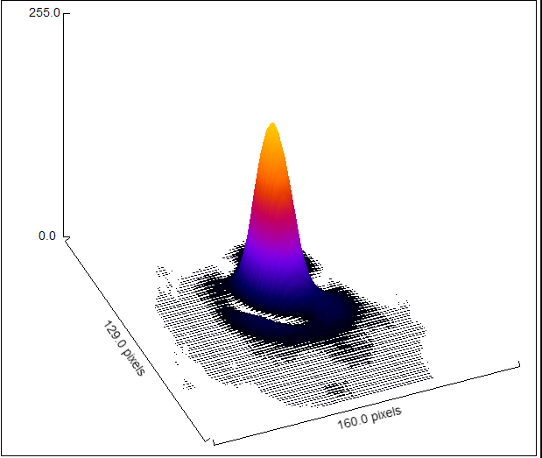
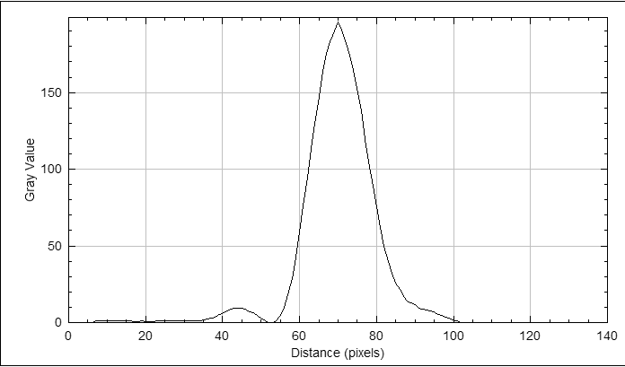

Slide 18
Summary
Achievements:
Successfully aligned a complex optical setup from scratch.
Captured and analyzed a focused beam spot.
Learned the importance of each optical element's precision.
Remaining Issues & Improvements:
CMOS camera alignment could benefit from micrometer adjustments.
Spot size estimation would improve with more image analysis.
This training deepened our hands-on understanding of precision optics.

Slide 19
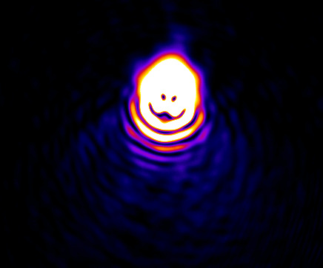
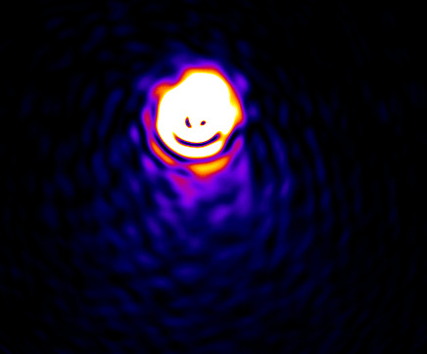
THANK YOU!

